Slide 1
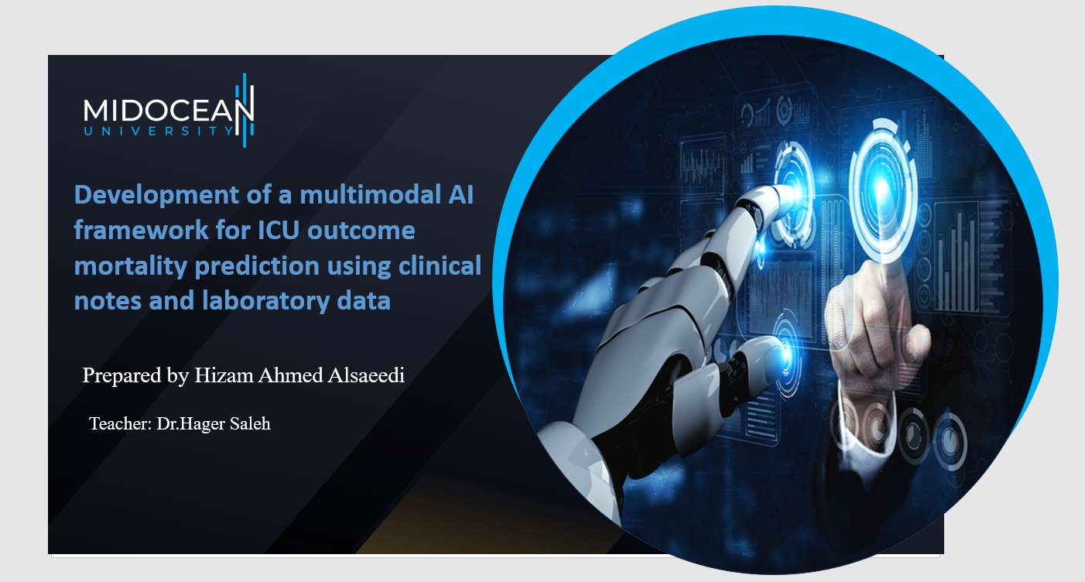

Slide 2


Introduction
ICU mortality prediction is critical for timely interventions and better patient outcomes.
Traditional models rely mostly on structured clinical data (e.g., vitals, lab tests).
Clinical notes contain valuable unstructured information often overlooked.
Multimodal AI integrates structured (labs) + unstructured (notes) for richer prediction.
Our work: Develop a transformer-based multimodal framework for improved predictive accuracy.
Prepared by Dr. Hizam Alsaeedi Teacher: Dr.Hager Saleh
2
www.midocean.ae

Slide 3
Problem statement
ICU patients generate large-scale heterogeneous data (labs, notes, vitals).
Existing models:
    Struggle with data fusion (structured + unstructured).
    Limited ability to capture temporal dynamics of ICU data.
    Lack generalizability across hospitals and datasets.
Need: A robust multimodal deep learning framework to improve mortality prediction
Prepared by Dr. Hizam Alsaeedi Teacher: Dr.Hager Saleh
3
www.midocean.ae

Slide 4
Objective
Primary Objective:
  Develop a multimodal deep learning framework combining clinical notes + laboratory data for ICU mortality prediction.
Sub-Objectives:
  Extract semantic meaning from clinical notes using NLP (transformer-based models).
  Encode lab test values and temporal trends using time-aware architectures.
Fuse clinical notes and lab data via transformer-based fusion networks.
Implement belief theory & ensemble learning to handle uncertainty.
Achieve robust prediction measured by:
AUROC (discrimination ability)
AUPRC (precision-recall performance)
Predictive stability across ICU datasets
Prepared by Dr. Hizam Alsaeedi Teacher: Dr.Hager Saleh
4
www.midocean.ae

Slide 5
Related work
Multimodal Transformer Frameworks:
  Saleh et al. [1] → Proposed TransformerFusionNet for real-time ICU heart failure mortality prediction using streaming big data.
Clinical Notes Integration:
  Caicedo-Torres & Gutierrez [2] → Developed ISeeU2, an interpretable mortality prediction model leveraging free-text ICU notes.
Fusion of Notes + Structured EHR:
  Lyu et al. [3] → Introduced a Multimodal Transformer combining clinical notes with structured EHR for interpretable in-hospital mortality prediction.
Physiological Time Series + Notes:
  Shukla & Marlin [4] → Integrated physiological time series and clinical notes using deep learning to improve ICU mortality prediction.
Multimodal Pretraining:
  King et al. [5] → Proposed multimodal pretraining of medical time series and notes to enhance downstream ICU predictive tasks.
Prepared by Dr. Hizam Alsaeedi Teacher: Dr.Hager Saleh
5
www.midocean.ae

Slide 6
Research Plan
Dataset & Link
  Use MIMIC-III/MIMIC-IV ICU dataset (freely available, >60k ICU stays).
Data Preprocessing
  Clinical Notes: Tokenization, stop-word removal, embeddings (BERT/ClinicalBERT).
  Lab Data: Normalization, missing-value imputation, temporal alignment.
Deep Learning Model
  Clinical notes → Transformer (e.g., ClinicalBERT).
  Lab data → Temporal encoder (e.g., GRU/Transformer).
  Fusion via Transformer-FusionNet.
Evaluation
  Metrics: AUROC, AUPRC, Accuracy, F1-score.
  Cross-validation & external validation for robustness.
Prepared by Dr. Hizam Alsaeedi Teacher: Dr.Hager Saleh
6
www.midocean.ae

Slide 7
Refrences
[1] Saleh, H., Mccann, M., El-Sappagh, S., & Breslin, J. G. (n.d.). TransformerFusionNet: A Real-Time Multimodal Framework for ICU Heart Failure Mortality Prediction Using Big Data Streaming.
[2] Caicedo-Torres, W., & Gutierrez, J. (2022). ISeeU2: Visually interpretable mortality prediction inside the ICU using deep learning and free-text medical notes. Expert Systems with Applications, 202, 117190.
[3] Lyu W, Dong X, Wong R, Zheng S, Abell-Hart K, Wang F, Chen C. A Multimodal Transformer: Fusing Clinical Notes with Structured EHR Data for Interpretable In-Hospital Mortality Prediction. AMIA Annu Symp Proc. 2023 Apr 29;2022:719-728. PMID: 37128451; PMCID: PMC10148371.
[4] Shukla, S. N., & Marlin, B. M. (2020). Integrating physiological time series and clinical notes with deep learning for improved ICU mortality prediction. arXiv preprint arXiv:2003.11059.
[5] King, R., Yang, T., & Mortazavi, B. J. (2023, December). Multimodal pretraining of medical time series and notes. In Machine Learning for Health (ML4H) (pp. 244-255). PMLR.
Prepared by Dr. Hizam Alsaeedi Teacher: Dr.Hager Saleh
7
www.midocean.ae

Slide 8


