Slide 1


Final Project-2
Orientation Day
PMG497
Introduction
Prepared by
Dr. Mona Moustafa Elashry
www.midocean.ae

Slide 2

Lecture Outline
About The Instructor
Academic Agenda
Course Description
Course Objectives
Learning Outcomes
Assessment Method
Project Delivery
Delivery Schedule
Project Delivery Rules
Attendance
Student Guide. Pdf.
Interactive Technology
www.midocean.ae

Slide 3

About The Instructor
www.midocean.ae
www.midocean.ae

Slide 4
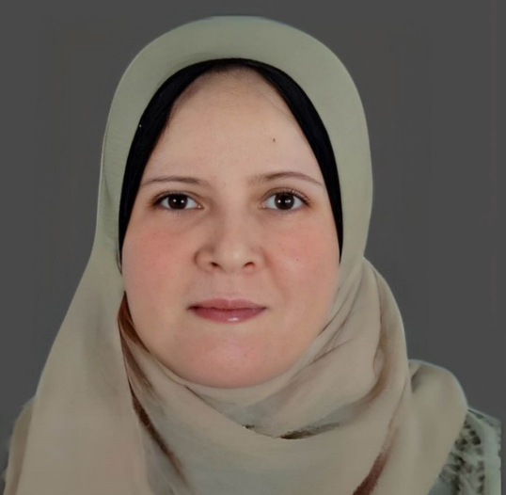
Education:
Doctorate of Business Administration2021
Master of Business Administration 2016
Postgraduate Diploma in Business Administration 2011
Bachelor degree in Economics 1999
Experiences:
Teaching different courses in management
Teaching research methodology & Statistical Analysis
Name: Dr. Mona Mostafa Elashry
Nationality: Egyptian
www.midocean.ae
www.midocean.ae

Slide 5
Academic Agenda
www.midocean.ae
www.midocean.ae

Slide 6
Course Description
www.midocean.ae
www.midocean.ae

Slide 7
This course is designed for senior-level students pursuing a Bachelor's degree in faculty of Management.
The course focuses on developing the skills necessary to complete the final graduation project in their chosen area of study.
The final project 2 course focuses on developing advanced research skills through practical application. Students will complete a research project.
www.midocean.ae

Slide 8
Course Objectives
www.midocean.ae
www.midocean.ae

Slide 9
By the end of this course, students will be able to:
Complete final graduation project.
Create a research methodology and timeline.
Analyze data using statistical methods and present findings effectively.
Critically evaluate research limitations and make recommendations for future studies.
www.midocean.ae

Slide 10
Course Outcome
www.midocean.ae
www.midocean.ae

Slide 11
Upon completion of this course, students will have the skills and knowledge necessary to write a comprehensive and well-structured research proposal.
They will understand the importance of conducting research in their field of study and demonstrate proficiency in choosing relevant research topics, conducting literature reviews, formulating research objectives and questions, developing a research methodology, analyzing data, and writing effectively.
www.midocean.ae

Slide 12
Assessment Method
www.midocean.ae
www.midocean.ae

Slide 13
Students will be assessed through a certain number of assignments that they will be given during the semester.
The student must submit 4 required assignments during the semester, starting from the 3rd week until the 11th week.
Important: It is important to ensure that the student succeeds in the course by submitting at least 3rd & 4th assignments, as the third & fourths assignments are mandatory assignments to succeed.
www.midocean.ae

Slide 14
Individual Work:
Every student will be required to write and deliver all assignments individually; there will not be group assignments.
www.midocean.ae

Slide 15
Project Delivery
www.midocean.ae
www.midocean.ae

Slide 16
Starting from week 3 student will be asked to submit the required assignments
Students will be asked to deliver 4 submissions for the project.
www.midocean.ae

Slide 17
Delivery Schedule
www.midocean.ae

Slide 19
التكليف الرابع | أرسل النسخة النهائية لمشروعك النهائي كاملا، بعد إضافة: تعديل جدول المحتويات مستخلص الدراسة الفصل الخامس: حدود البحث والتوصيات والاستنتاجات | الأسبوع الحادي عشر

Slide 20
Assignment 1
Delivered in week 3
Assignment 2
Delivered in week 5
Assignment 3
Delivered in week 10
Assignment 4
NP-Pass
  Delivered in week 11

Slide 21
Assignment 1
Delivered in week 3
Assignment 2
Delivered in week 5
Assignment 3
Delivered in week 10
Assignment 4
NP-Pass
  Delivered in week 11

Slide 22
Assignment 1
Delivered in week 3
Assignment 2
Delivered in week 5
Assignment 3
Delivered in week 10
Assignment 4
NP-Pass
  Delivered in week 11

Slide 23
Assignment 1
Delivered in week 3
Assignment 2
Delivered in week 5
Assignment 3
Delivered in week 10
Assignment 4
NP-Pass
  Delivered in week 11

Slide 24
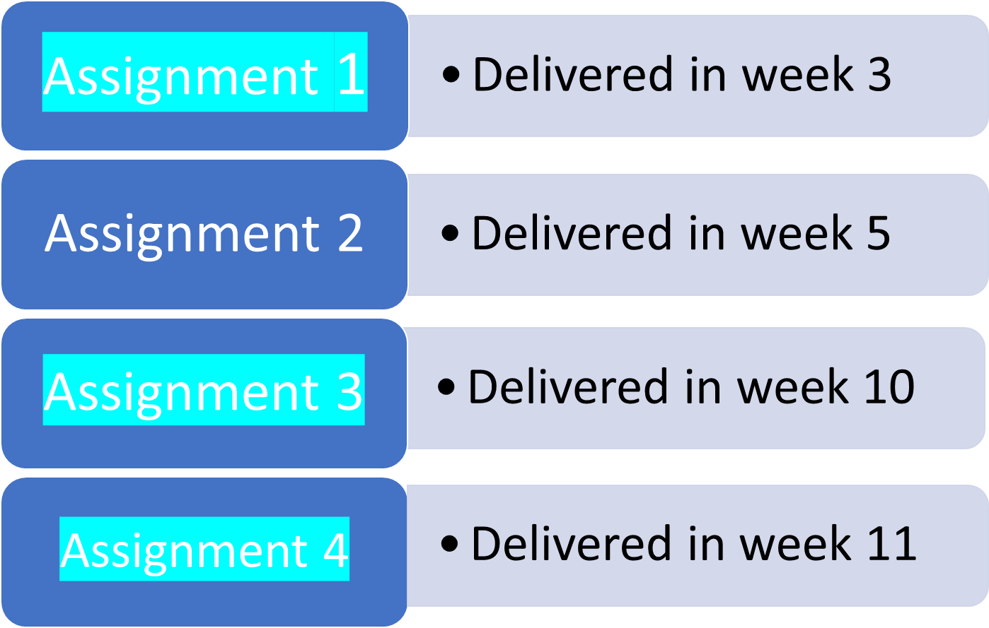
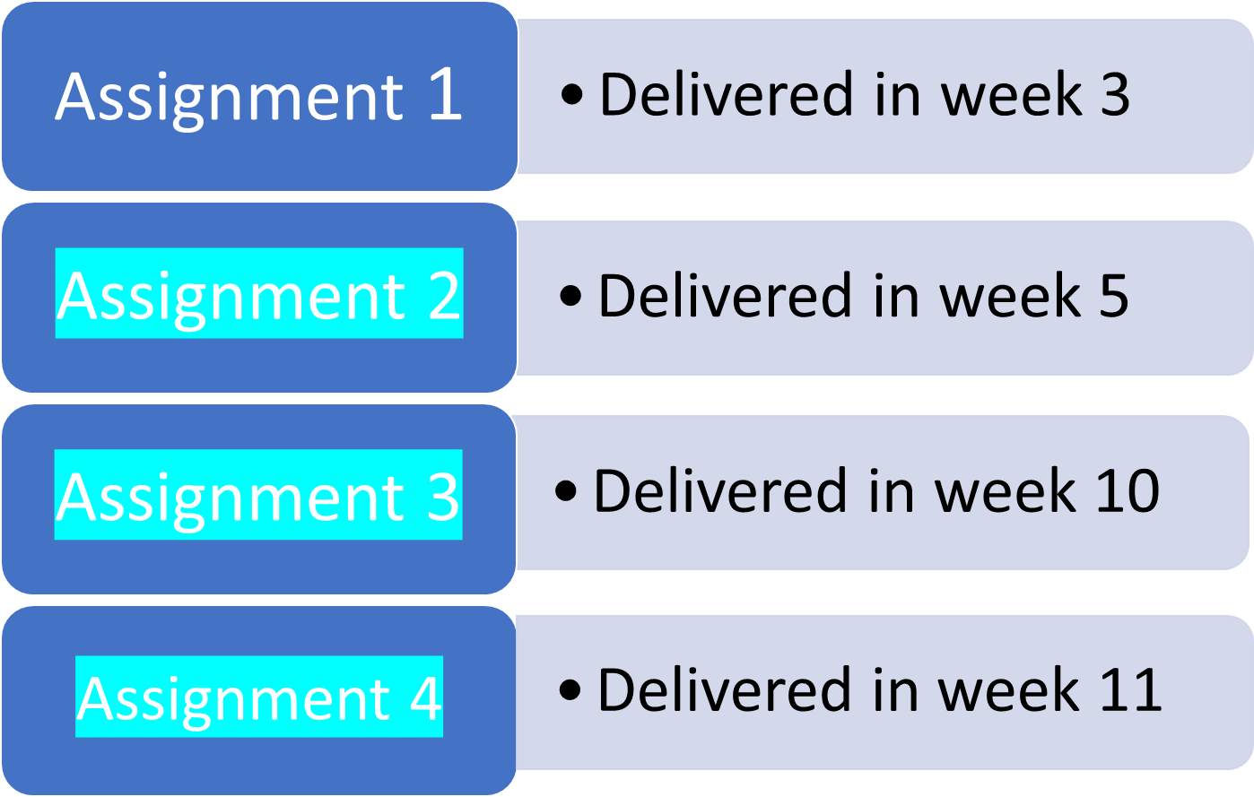
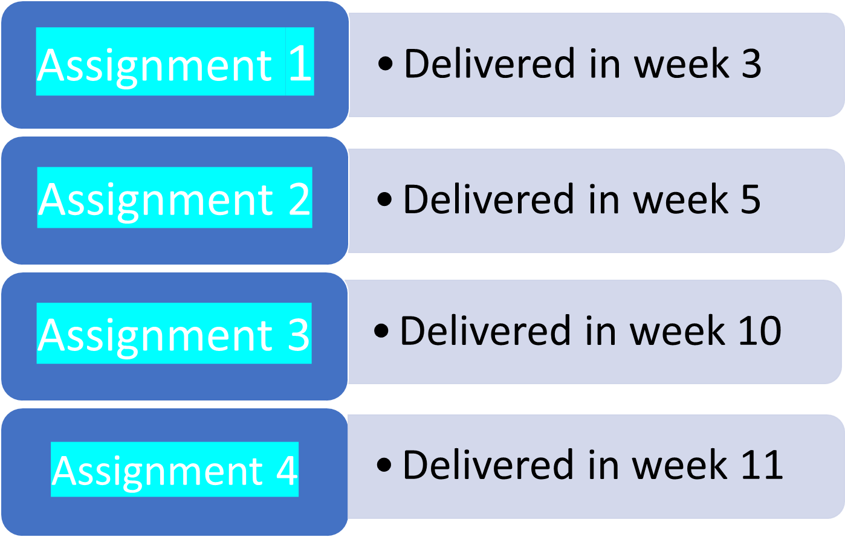
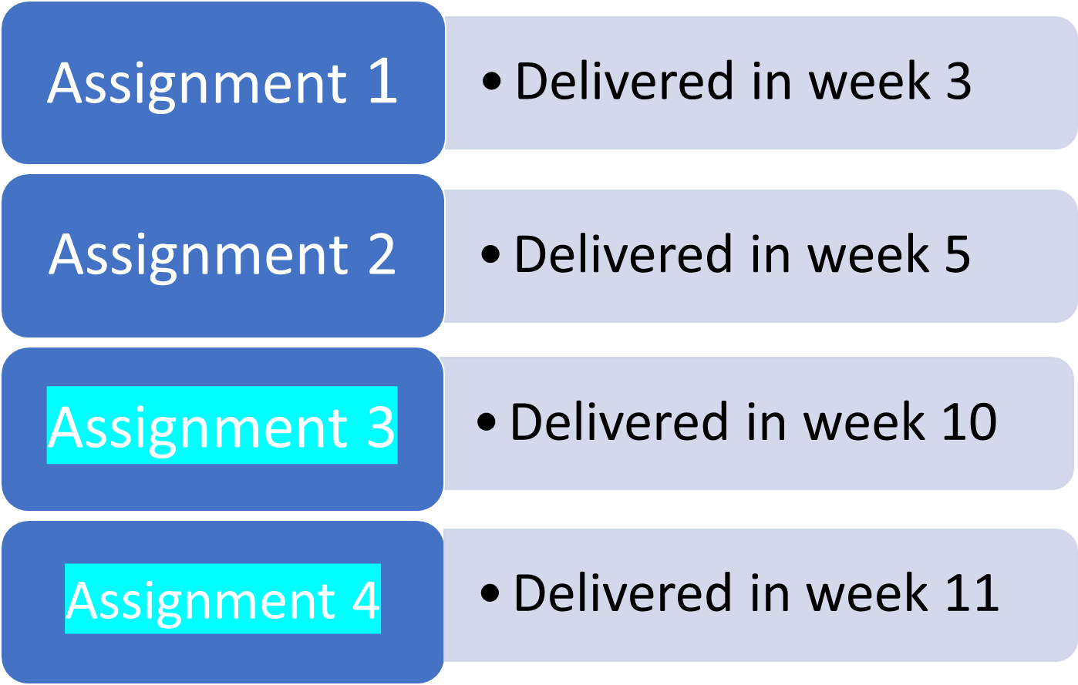
Pass

Slide 25
To ensure the student's success, they should do one of the following:
1.Submit all the four assignments (NP- Pass)
2.Submit the first, third & fourth assignments, (NP- Pass)
3.Submit the second, third & fourth assignments. (NP- Pass)
4.Submit the third & fourth assignments (NP- Pass)
It is highly recommended to submit all four assignments.
www.midocean.ae

Slide 26
Attendance
www.midocean.ae
www.midocean.ae

Slide 27
Students are required to watch all the recorded lectures.
While it may not be mandatory for students to attend online lectures, it is still extremely important for them to do so in order to gain a complete understanding of the course material and to engage with the learning process.
Attending lectures can help students grasp important concepts, participate in discussions, and receive valuable clarification from the instructors
www.midocean.ae

Slide 28
Project Delivery Rules
www.midocean.ae
www.midocean.ae

Slide 29
All projects should follow the academic writing characteristics which are:
Planned and focused: Delivering research according to the guidance of the scientific research methodologies.
Structured: is coherent, written in scientific research methodologies, and brings together related points and material.
Evidenced: demonstrates knowledge of the scientific research steps, supports opinions and arguments with evidence, and is referenced accurately.
Formal in tone and style: uses appropriate scientific language and tenses and is clear, concise, and balanced.
www.midocean.ae

Slide 30
Interactive Technology
www.midocean.ae

Slide 31

Online Lecture
https://padlet.com/
www.midocean.ae

Slide 32

Online Lecture
https://www.mentimeter.com/
https://www.menti.com/
www.midocean.ae

Slide 33
Student Guide & Syllabus. Pdf.
www.midocean.ae

Slide 34



Thank You

