Slide 1


Decision making
&
Leadership
Prepared by Dr. Injy Nashaat
Lecture 6

Slide 2
What Is Leadership?
Leadership: The ability to influence a group toward the achievement of goals.
Management: Use of authority inherent in designated formal rank to obtain compliance from organizational members.
  Both are necessary for organizational success.

Slide 3
Trait Theories of Leadership
Theories that consider personality, social, physical, or intellectual traits to differentiate leaders from non-leaders.
Not very useful until matched with the Big Five Personality Framework.
Leadership Traits
    Sociability
    Conscientiousness
    Openness
    Emotional Intelligence (Qualified)
Traits can predict leadership, but they are better at predicting leader emergence than effectiveness.

Slide 4
Behavioral Theories of Leadership
Theories proposing that specific behaviors differentiate leaders from non-leaders.
Differences between theories of leadership:
    Trait theory: leadership is inherent, so we must identify the leader based on his or her traits.
    Behavioral theory: leadership is a skill set and can be taught to anyone, so we must identify the proper behaviors to teach potential leaders.

Slide 5
Contingency Theories
While trait and behavior theories do help us understand leadership, an important component is missing: the environment in which the leader exists.
Contingency Theory deals with this additional aspect of leadership effectiveness studies.
Three key contingency theories:
    Fielder’s Model
    Hersey and Blanchard’s Situational Leadership Theory
    Path-Goal Theory

Slide 6
Fiedler’s Model
Effective group performance depends on the proper match between leadership style and the situation.
    Assumes that leadership style (based on orientation revealed in LPC questionnaire) is fixed.
    Least-Preferred Coworker :is a management heuristic that assigns an individual's leadership style as either task-oriented or relationship-oriented. The scale utilizes a subjective evaluation of an individual's attitudes toward their least favorable co-worker.
Considers three situational factors:
    Leader-member relations: degree of confidence and trust in the leader.
    Task structure: degree of structure in the jobs.
    Position power: leader’s ability to hire, fire, and reward.
For effective leadership: must change to a leader who fits the situation or change the situational variables to fit the current leader.

Slide 7
Fiedler’s Model (cont’d) Assessment
Positives
  Considerable evidence supports the model, especially if the original eight situations are grouped into three.
Problems
  The logic behind the LPC scale is not well understood.
  LPC scores are not stable.
  Contingency variables are complex and
  hard to determine.

Slide 8
Fiedler’s Model (cont’d) Cognitive Resource Theory
A refinement of Fiedler’s original model:
  Focuses on stress as the enemy of rationality and creator of unfavorable conditions.
  A leader’s intelligence and experience influence his or her reaction to that stress.
Research is supporting the theory.
Stress Level
Low
High
Intellectual Abilities
Effective
Ineffective
Leader’s Experience
Ineffective
Effective

Slide 9
Hersey & Blanchard’s Situational Leadership
A model that focuses on follower ‘readiness’
  Followers can accept or reject the leader.
  Effectiveness depends on the followers’ response to the leader’s actions.
  Readiness is the extent to which people have the ability and willingness to accomplish a specific task.

Slide 10
Hersey & Blanchard’s Situational Leadership (cont’d)
A paternal model
  As the child matures, the adult releases more and more control over the situation.
  As the workers become more ready, the leader becomes more laissez-faire.
An intuitive model that does not get much support from the research findings.

Slide 11
House’s Path–Goal Theory
Builds from the Ohio State studies and the expectancy theory of motivation.
The theory
  Leaders provide followers with information, support, and resources to help them achieve their goals.
  Leaders help clarify the ‘path’ to the worker’s goals.
  Leaders can display multiple leadership types.

Slide 12
House’s Path–Goal Theory (cont’d)
Four types of leaders
  Directive: focuses on the work to be done.
  Supportive: focuses on the well-being of the worker.
  Participative: consults with employees in decision-making.
  Achievement-Oriented: sets challenging goals.

Slide 13
House’s Path–Goal Theory (cont’d)
Path-Goal Model
Two classes of contingency variables:
  Environmental are outside of employee control.
  Subordinate factors are internal to employee.
There is mixed support in the research findings.

Slide 14
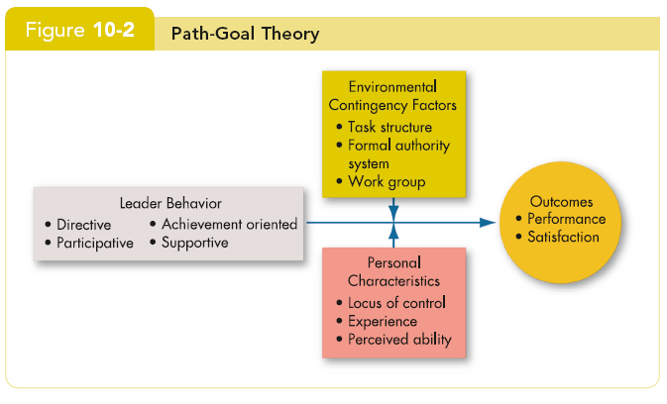
House’s Path–Goal Theory (cont’d)
Path-Goal Model

Slide 15
Vroom and Yetton’s Leader-Participation Model
How a leader makes decisions is as important as what is decided.
Premise:
  Leader behaviors must adjust to reflect task structure.
  ‘Normative’ model tells leaders how participative to be in their decision making of a decision tree.
    Five leadership styles
    Twelve contingency variables
Research testing for both original and modified models has not been encouraging.
  Model is overly complex.

Slide 16
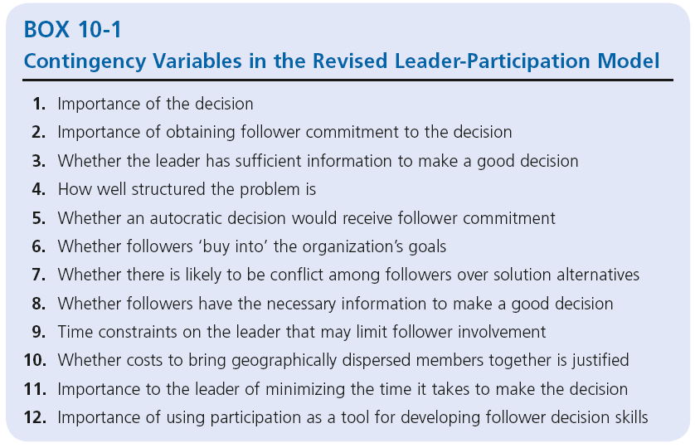
Vroom and Yetton’s Leader-Participation Model

Slide 17
Inspirational Approaches to Leadership
The focus is leader as communicator.
Framing
  A way of communicating that shapes meaning.
  Selective highlighting of facts and events.
  Ignored in traditional leadership studies.
Two contemporary leadership theories
  Charismatic Leadership.
  Transformational Leadership.

Slide 18
Charismatic Leadership
House’s charismatic leadership theory:
  Followers make attributions of heroic or extraordinary leadership abilities when they observe certain behaviors.
Four characteristics of charismatic leaders:
  Have a vision.
  Are willing to take personal risks to achieve the vision.
  Are sensitive to follower needs.
  Exhibit behaviors that are out of the ordinary.

Slide 19
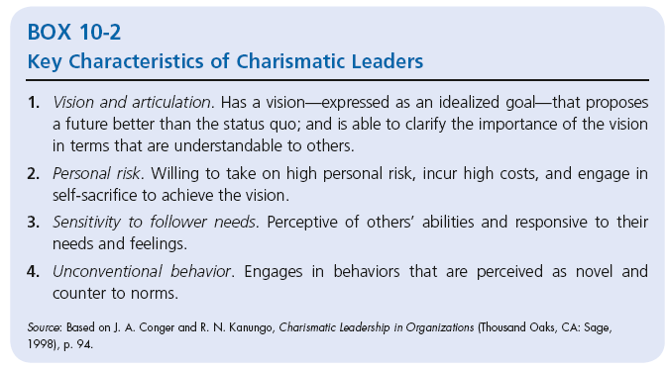
Charismatic Leadership
Traits and personality are related to charisma.
People can be trained to exhibit charismatic behaviors.

Slide 20
How Charismatic Leaders Influence Followers
A four-step process:
  Leader articulates an attractive vision.
    Vision Statement: A formal, long-term strategy to attain goals.
    Links past, present, and future.
  Leader communicates high performance expectations and confidence in follower ability.
  Leader conveys a new set of values by setting an example
  Leader engages in emotion-inducing and often unconventional behavior to demonstrate convictions about the vision.

Slide 21
Charismatic Leadership Issues
Charismatic effectiveness and situation
  Charisma works best when:
    the follower’s task has an ideological component;
    there is a lot of stress and uncertainty in the environment;
    the leader is at the upper level of the organization;
    followers have low self-esteem and self-worth.

Slide 22
Charismatic Leadership Issues (cont’d)
Importance of vision
  Must be inspirational, value-centered, realizable, and given with superior imagery and articulation.
Dark side of charisma
  Ego-driven charismatics allow their self-interest and personal goals to override the organization’s goals.

Slide 23
Beyond Charisma: Level-5 Leaders
Very effective leaders who possess the four typical leadership traits
  Individual competency
  Team skills
  Managerial competence
  Ability to stimulate others to high performance

Slide 24
Beyond Charisma: Level-5 Leaders
Plus one critical new trait…
  A blend of personal humility and professional will.
  Personal ego needs are focused toward building a great company.
  Take responsibility for failures and give credit to others for successes.

Slide 25
Transactional & Transformational Leadership
Transactional leaders
  Leaders who guide or motivate their followers in the direction of established goals by clarifying role and task requirements.
Transformational leaders
  Inspire followers to transcend their own self-interests for the good of the organization; they can have a profound and extraordinary effect on followers.

Slide 26
Characteristics of the Two Types of Leaders
Transactional Leaders
Contingent reward
  Contracts exchange of rewards for effort, promises rewards for good performance, recognizes accomplishments.
Management by exception
  Active: watches and searches for deviations from rules and standards, takes corrective action.
  Passive: intervenes only if standards are not met.

Slide 27
Characteristics of the Two Types of Leaders
Transformational Leaders
Idealized influence
  Provides vision and sense of mission, instills pride, gains respect and trust.
Inspiration
  Communicates high expectations, uses symbols to focus efforts, expresses important issues simply.
Intellectual stimulation
  Promotes intelligence, rationality, and problem solving.
Individualized consideration
  Gives personal attention, coaches, advises.

Slide 28
Authentic Leadership: Ethics and Trust
Authentic leaders
  Ethical people who know who they are, know what they believe in and value, and act on those values and beliefs openly and candidly.
  Primary quality is trust.
Build trust by:
  sharing information;
  encouraging open communication;
  sticking to their ideals.
Still a new topic; needs more research.

Slide 29
Ethics, Trust, and Leadership
Ethics touch on many leadership styles
  As the moral leaders of organizations, CEOs must demonstrate high ethical standards.
  Socialized charismatic leadership: leaders who model ethical behaviors.
Trust
  The positive expectation that another person will not act opportunistically.
  Composed of a blend of familiarity and willingness to take a risk.
  Five key dimensions: integrity, competence, consistency, loyalty, and openness.

Slide 30
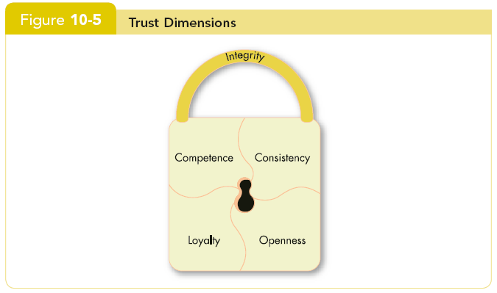
Ethics, Trust, and Leadership (cont’d)

Slide 31
Five Key Dimensions of Trust
Integrity
  Honesty and truthfulness.
Competence
  An individual’s technical and interpersonal knowledge and skills.
Consistency
  An individual’s reliability, predictability, and good judgment in handling situations.

Slide 32
Five Key Dimensions of Trust (cont’d)
Loyalty
  The willingness to protect and save face for another person.
Openness
  Reliance on the person to give you the full truth.

Slide 33
Three Types of Trust
Deterrence-based trust
  Trust based on fear of reprisal if the trust is violated.
Knowledge-based trust
  Trust based on behavioral predictability that comes from a history of interaction.
Identification-based trust
  Trust based on a mutual understanding of one another’s intentions and appreciation of the other’s wants and desires.

Slide 34
Contemporary Leadership Roles
Mentoring
A mentor is a senior employee who sponsors and supports a less-experienced employee.
  Good teachers present ideas clearly, listen, and empathize
  Two functions:
    – Career
      Coaching, assisting, sponsoring.
    – Psychosocial
        Counseling, sharing, acting as a role model.
        Can be formal or informal.
  Mentors tend to select protégés who are like them in background: may restrict minorities and women.

Slide 35
Contemporary Leadership Roles
Self-Leadership
  A set of processes through which individuals
  control their own behavior.
  Effective leaders (super-leaders) help
  followers to lead themselves.
  Important in self-managed teams.
To engage in self-leadership:
  Make a mental chart of your peers and colleagues.
  Focus on influence and not on control.
  Create opportunities; do not wait for them.

Slide 36
Challenges to the Leadership Construct
Attribution theory of leadership
  The idea that leadership is merely an attribution that people make about other individuals.
  Qualities attributed to leaders:
    Leaders are intelligent, outgoing, have strong verbal skills, are aggressive, understanding, and industrious.
    Effective leaders are perceived as consistent and unwavering in their decisions.
    Effective leaders project the appearance of being leaders.

Slide 37
Finding and Creating Effective Leaders
Selection
  Review specific requirements for the job.
  Use tests that identify personal traits associated with leadership, measure self-monitoring, and assess emotional intelligence.
  Conduct personal interviews to determine candidate’s fit with the job.
  Keep a list of potential candidates.

Slide 38
Finding and Creating Effective Leaders
Training
  Recognize that all people are not equally trainable.
  Teach skills that are necessary for employees to become effective leaders.
  Provide behavioral training to increase the development potential of nascent charismatic employees.

Slide 39
Summary and Managerial Implications
Companies are looking for transformational leaders—even if they only ‘look the part’.
Transformational style crosses borders reasonably well.
Effective managers must build trust with those they lead.
Leadership selection and training are important to long-term success.

Slide 40



Thank You

