Slide 1


College of Management
Project Communications
Lecturer: Dr. Raef Baraka
PMG 112
Lecture 10

Slide 2

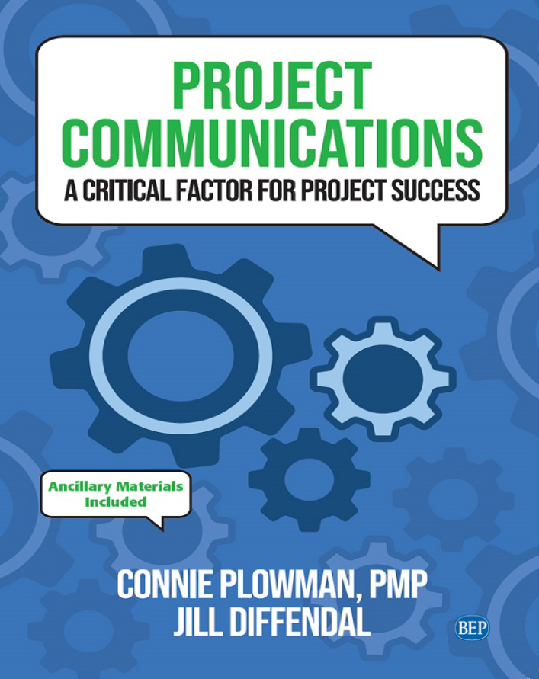
Reference Book:
Ch1: Introduction.
Ch2: Exploring Communication Theories.
Ch3: Knowing Your Audience.
Ch4: Starting with the Basics.
Ch5: Planning Project Communications.
Ch6: Managing and Monitoring Project Communications.
Ch7: Using Project Communication Tools.
Ch8: Communicating Change.
Ch9: Managing Conflict through Communication.
Ch10: Closing.

Slide 3

Chapter 10: Closing
The purpose of this chapter is to help you:
See where we have been and where we are going from here.
Know how to put this information into a personalized action plan.
Explore different ways to communicate the value of project management.

Slide 4
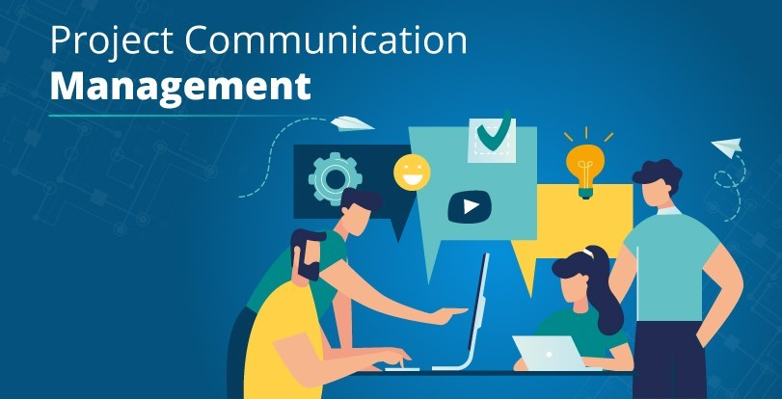
Chapter 10: Closing
Ends are not bad things; they just mean that something else is about to begin. And there
are many things that don’t really end, anyway, they just begin again in a new way. Ends are
not bad, and many ends aren’t really an ending; some things are never-ending

Slide 5

Chapter 1: Introduction to project communication
The purpose of this chapter is to help you:
Understand why project communication is so important.
Know what to expect from this course: what it will cover, who the audience is, how the course is structured, and key definitions.
Trace the evolution of project communications

Slide 6
Chapter 1: Introduction to project communication
A Time to Reflect
In the beginning, we traveled through time and looked at the evolution of project communications through the lens of the PMBOK® Guide.
Why is this important? Because the PMBOK® Guide is written by project management practitioners from around the world and shows us how project communications (and project management knowledge) have progressed, not just from an individual perspective but from a global view.
Refer to the evolution of project communications as you continue to evolve your own project communications (see Chapter 1).
Dr. Raef Baraka

Slide 7
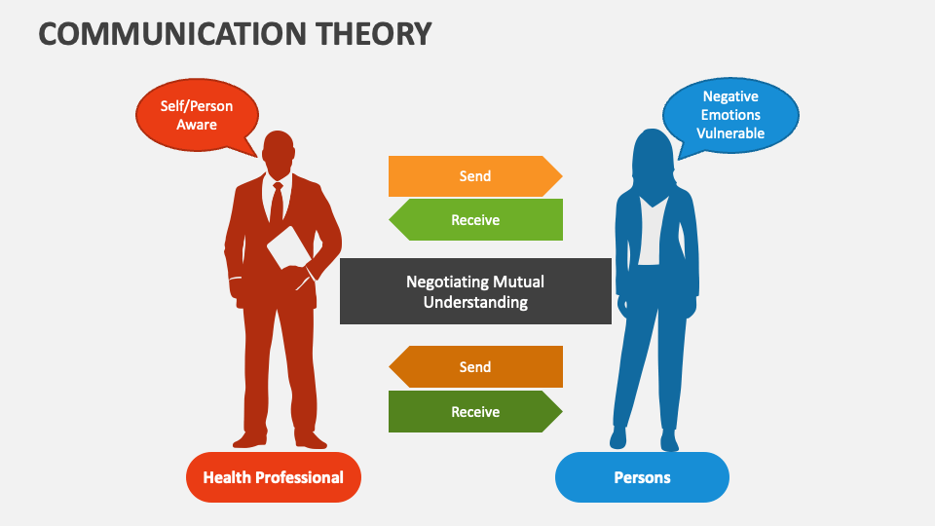
Chapter 2: Exploring Communication Theories
The purpose of this chapter is to help you:
Understand why people communicate by looking at two different communication theories that focus on communication as a way people handle uncertainty
Evaluate the impact of the quality as well as the quantity of communication in a project.
See the connection between effective communication and stakeholder trust.

Slide 8
Ch2: Exploring Communication Theories.
A Time to Reflect
To build a solid foundation for project communications and have a better appreciation of uncertainty, we explored two communication theories: uncertainty reduction theory and uncertainty management theory. Why is this important? Understanding uncertainty as a motivator can help project managers and stakeholders appreciate the value of communication as a way to manage uncertainty.
There are two ways to reduce uncertainty: to ensure sufficient quantity and high-quality communications. Focus on building trust among the project team and other stakeholders—a key factor in project success (see Chapter 2).
Dr. Raef Baraka

Slide 9
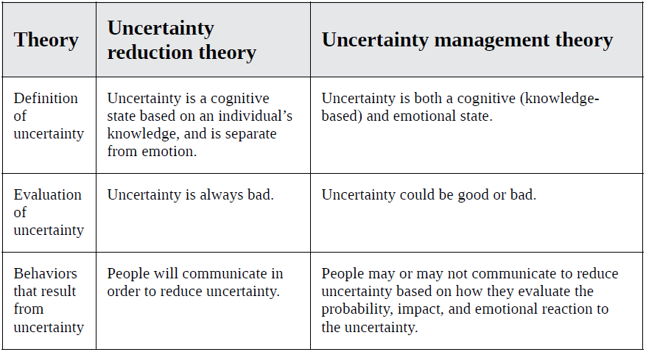
Exploring Communication Theories
Comparison of uncertainty reduction and uncertainty management theories
Dr. Raef Baraka

Slide 10

Chapter 3: Knowing Your Audience
The purpose of this chapter is to help you:
Explore various recommendations for identifying the audience in your project, including their role, their level of power and influence over the project, and their level of support for the project•
See the value of understanding what is important to the members of your audience—the WIIFM (what’s in it for me).

Slide 11
Chapter 3: Knowing Your Audience
The purpose of this chapter is to help you:
Become familiar with stakeholder personas as a communication approach.
Put it into practice: Know your audience in traditional, agile, and virtual project teams.

Slide 12
Ch3: Knowing Your Audience.
A Time to Reflect
We examined the importance of knowing your audience and how different factors can affect stakeholders’ engagement with your communications.
Start with the WIIFM—what’s in it for me?
Developing stakeholder personas can help capture stakeholders’ characteristics and concerns as a group. Why is this important?
By knowing your audience, you can tailor your communications for them, leading to decreased uncertainty, increased trust, and a greater possibility of project support and success (see Chapter 3).
Dr. Raef Baraka

Slide 13
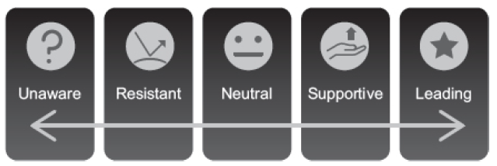
Knowing Your Audience
Identifying Stakeholders
Dr. Raef Baraka

Slide 14
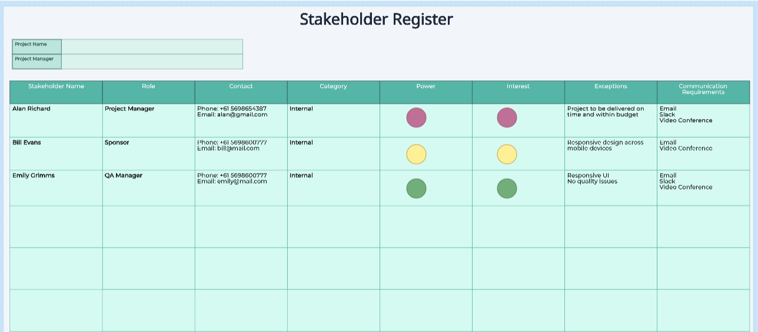
Knowing Your Audience
Identifying Stakeholders
Dr. Raef Baraka

Slide 15
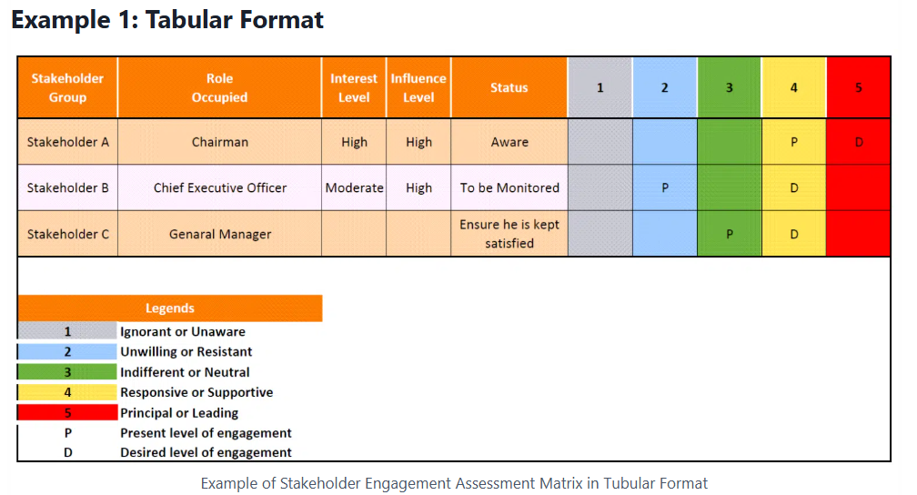
Knowing Your Audience
Stakeholder Engagement Assessment Matrix
Dr. Raef Baraka

Slide 16

Chapter 4: Starting with the Basics
The purpose of this chapter is to help you:
Look at how high-performing organizations and project teams communicate.
Identify things to consider when communicating on projects, including the need for inclusive language.
Distinguish between formal and informal communications.

Slide 17
Chapter 4: Starting with the Basics
The purpose of this chapter is to help you:
Examine the scalability of project communications
Put it into practice: Project communication basics in traditional, agile, and virtual project teams.

Slide 18
Ch4: Starting with the Basics.
A Time to Reflect
It is important to start with the basics in project communications. We looked at how high-performing organizations and project teams are more effective at project communications than others.
We explored some practical and sensible approaches for effectively delivering your message when communicating on projects.
Why is this important? Because it may stimulate new ideas for you to explore or reconfirm effective approaches that may already be working well for you. Make every word and interaction meaningful (see Chapter 4).
Dr. Raef Baraka

Slide 19
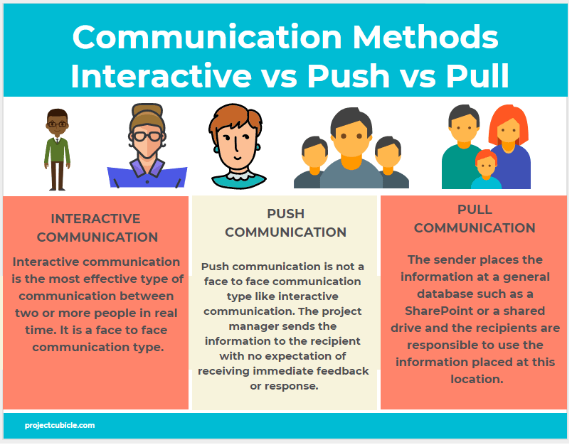
Starting with the Basics
Dr. Raef Baraka

Slide 20
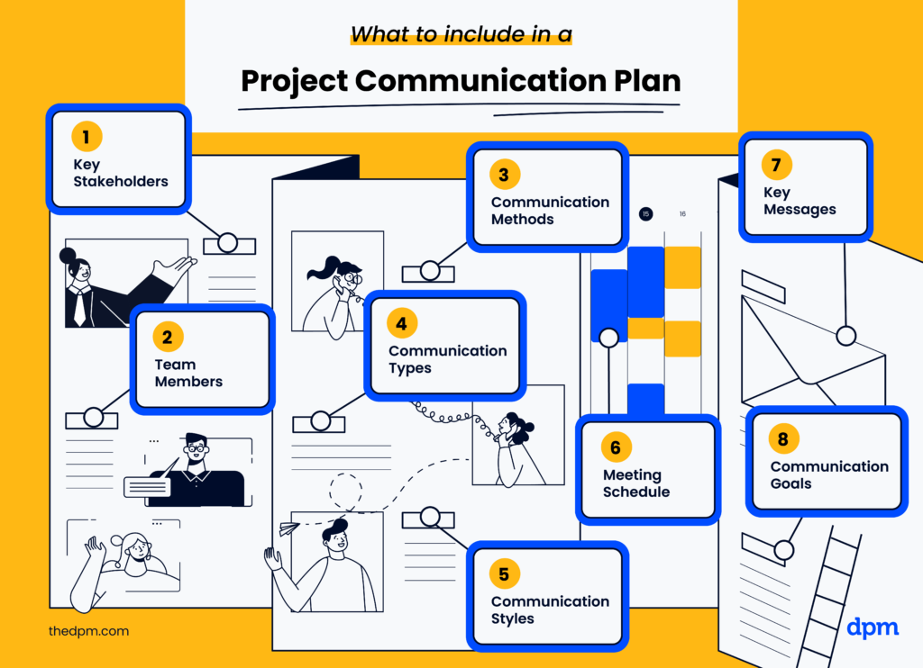
Chapter 5: Planning Project Communications
The purpose of this chapter is to help you:
Understand the purpose, content, and development of a project communications management plan.
Demonstrate how to effectively use a project communications management plan.

Slide 21
Chapter 5: Planning Project Communications
The purpose of this chapter is to help you:
Examine a communications matrix.
Put it into practice: Planning communications in traditional, agile, and virtual project teams.

Slide 22
Ch5: Planning Project Communications.
A Time to Reflect
In any project, it is important to have a plan; so is having a project communications management plan—and using it.
A project communications management plan and its various elements provide a roadmap for the project team to keep others informed. Make sure your plan is being used effectively. As the project team implements their project communications management plan, the team may find that adjustments are needed.
Why is this important? Because a project communications management plan and its evolution help us to stay on track by delivering the right message, at the right time, to the right stakeholders, for the right reasons, using the right communication methods and frequency (see Chapter 5).
Dr. Raef Baraka

Slide 23
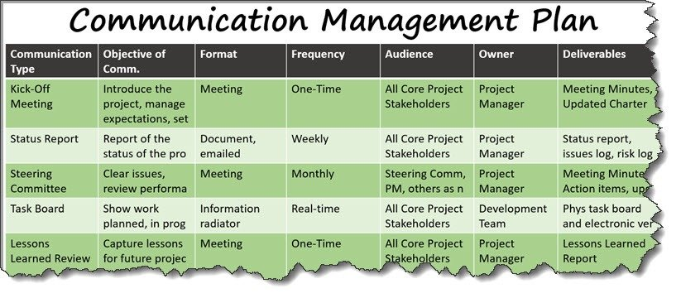
Planning Project Communications

Slide 24

Chapter 6: Managing and Monitoring Project Communications
The purpose of this chapter is to help you:
Build key skills needed to address stakeholders’ practical needs and personal needs when communicating on projects—including a five-step approach.
Measure the effectiveness of your project communications.

Slide 25
Chapter 6: Managing and Monitoring Project Communications
The purpose of this chapter is to help you:
Understand the importance of incorporating feedback loops.
Examine lessons learned and retrospectives.
Put it into practice: Managing and monitoring communications in traditional, agile, and virtual project teams.

Slide 26
Ch6: Managing and Monitoring Project Communications.
A Time to Reflect
Once you have planned your project communications, you are now ready to start using your project communications management plan through managing and monitoring project communications.
Don’t forget to measure the effectiveness of your project communications. Ask questions like, “What do you think?” or “What did you just hear?”
Why is this important? Getting and giving feedback, having structured conversations, and addressing the personal and practical needs of the project team and stakeholders are all essential in managing and monitoring project communications (see Chapter 6).
Dr. Raef Baraka

Slide 27
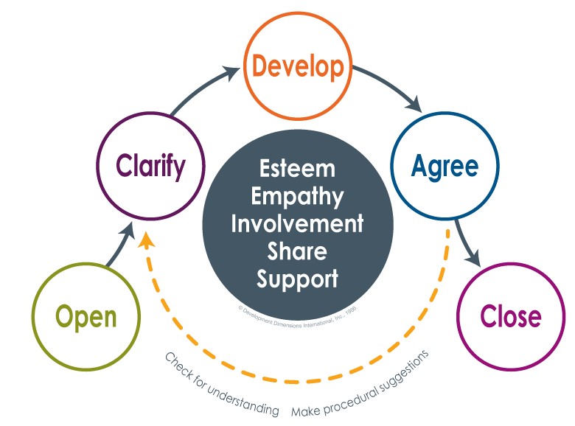
Managing Project Communications

Slide 28
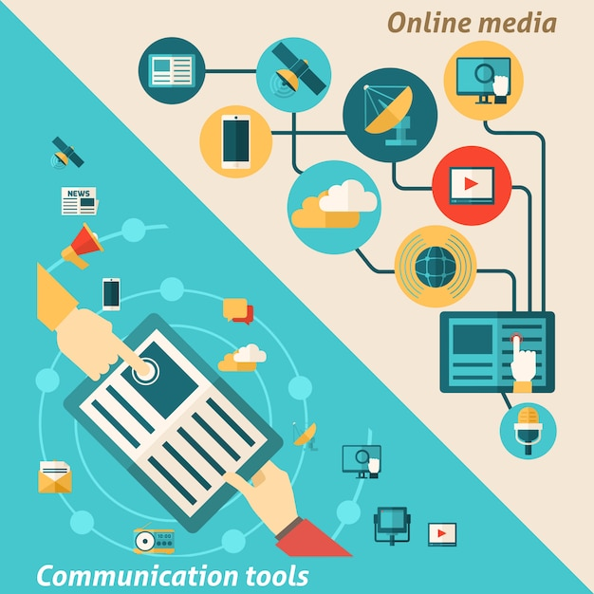
Chapter 7: Using Project Communication Tools
The purpose of this chapter is to help you:
Consider what goes into choosing the right communication tools for your project
Examine the purpose and benefits of different project communication tools
Understand the importance of being knowledgeable about whatever communication tools you use for your project.

Slide 29
Chapter 7: Using Project Communication Tools
The purpose of this chapter is to help you:
Put it into practice: Using communication tools in traditional, agile, and virtual project teams.

Slide 30
Ch7: Using Project Communication Tools.
A Time to Reflect
We explored different communication tools and how to select the best tools that fit your project needs and organization by starting with why, then how, then what. Establishing the priorities of your selection criteria can help you focus on what matters most.
Selecting the right tool is as important as knowing how to use the tool. If you need education in how to use a tool, get it. If you need to change the tool because it is not working, do it. Why is this important? Because tools are vital in communicating. In projects, we use a collection of tools when communicating. Even our talents and strengths are a tool. However, remember that our primary focus is on the message and the communication. Consider the communication tool as the vehicle for delivering the message (see Chapter 7).
Dr. Raef Baraka

Slide 31
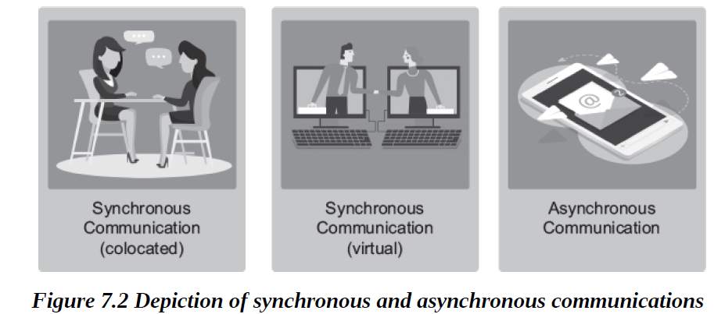
Using Project Communication Tools

Slide 32

Chapter 8: Communicating Change
The purpose of this chapter is to help you:
Understand change management, including three common models of managing change.
Describe how change management and project management work together.
Integrate change management into a project through communications.

Slide 33
Chapter 8: Communicating Change
The purpose of this chapter is to help you:
Put it into practice: Communicating change in traditional, agile, and virtual project teams.

Slide 34
Ch8: Communicating Change.
A Time to Reflect
Projects are the connectors between where we are now (current state) and where we want to be (future state). In the middle, there is change and uncertainty.
There are a number of change management models to consider for integrating change management concepts into your project communications. Be cautious, however, that too much change can create change fatigue, which can put projects and teams at risk.
Why is this important? Because effective project communications that incorporate change management principles can help projects succeed and help organizations realize the benefits of the project (see Chapter 8).
Dr. Raef Baraka

Slide 35
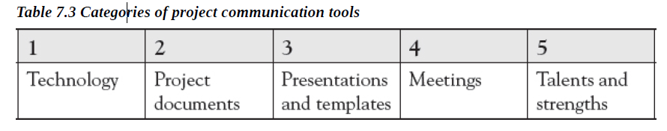
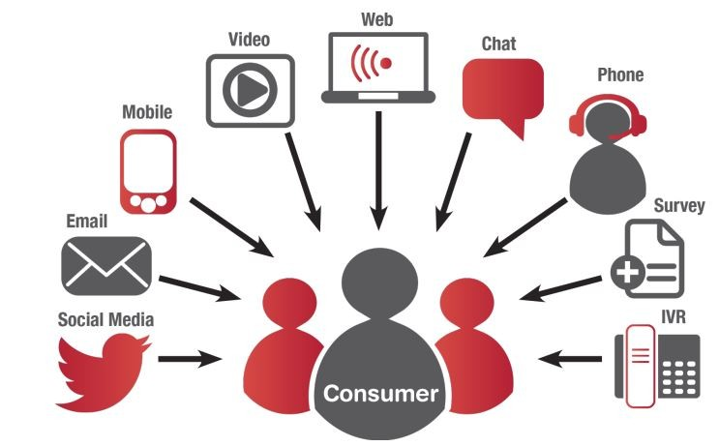
Communication Tools for Projects

Slide 36
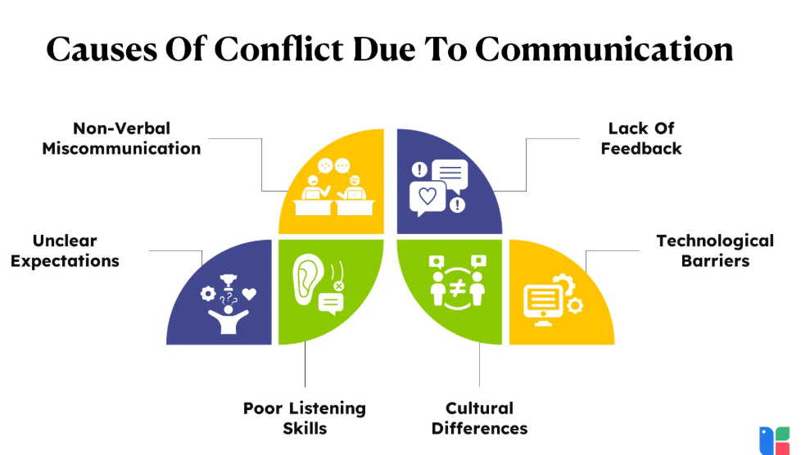
Chapter 9: Managing Conflict through Communication
The purpose of this chapter is to help you:
Examine two different types of conflict and how they can affect the project and the team•
Explore strategies for understanding and resolving conflict within the project team.

Slide 37
Chapter 9: Managing Conflict through Communication
The purpose of this chapter is to help you:
Consider ways to communicate with stakeholders when they do not support the project, when their expectations conflict with one another, or when the project deviates from the plan
Put it into practice: Managing conflict through communication in traditional, agile, and virtual project teams.

Slide 38
Ch9: Managing Conflict through Communication.
A Time to Reflect
And finally, things happen. We looked at how to effectively communicate when conflict occurs on the project. There are two sources of conflict: interpersonal conflict (relational conflict) and task conflict (disagreements). A moderate amount of conflict can have a positive outcome by building stronger relationships and generating better project results. Too much conflict can have a negative outcome, causing dysfunctional project teams, unhappy stakeholders, and poor project results. Why is this important? Because like other problem-solving situations, we must address conflict with different strategies—using what works and/or adjusting when the approach does not work. Bottom line: Don’t take it personally (see Chapter 9).
Dr. Raef Baraka

Slide 39
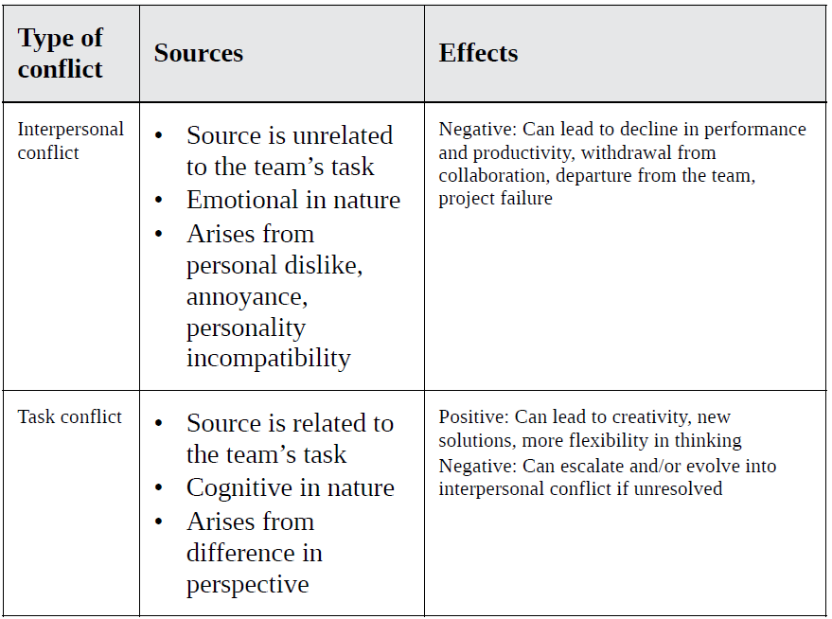
Managing Conflict through Communication
Dr. Raef Baraka

Slide 40
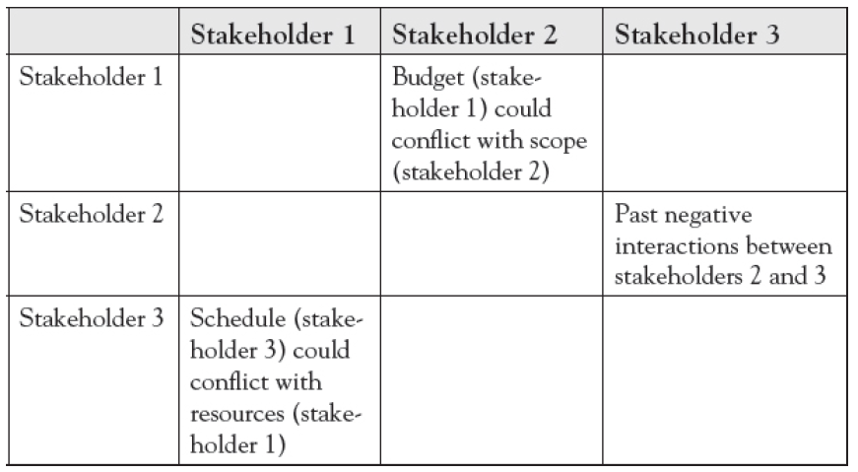
Managing Conflict through Communication
Managing Conflict with Stakeholders Outside the Project
Dr. Raef Baraka

Slide 41
Chapter 10: Closing
The purpose of this chapter is to help you:
See where we have been and where we are going from here.
Know how to put this information into a personalized action plan.
Explore different ways to communicate the value of project management.

Slide 42



Thank You

