Slide 1



Agile Project
Management
Prepared by Eng. Ahmed Hussein, MBA, PfMP©, PMP©, CMP APMG
PMG 622
Master of Project Management
Orientation Lecture

Slide 2

Orientation
Learning Objectives
Lecture
Introduction
Learn about Course Objectives and Schedule
Brief Introduction to Agile Project Management
www.midocean.ae

Slide 3
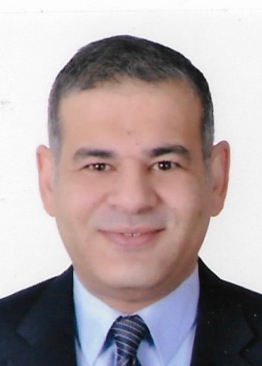
Eng. Ahmed Hussein, MBA, PfMP©, PMP© and APMG-Change Management Practitioner
Lecturer and management consultant with >30 years of executive management experience
Lecturing experience over 15 years on:
  Portfolio/ Program / Project Management,
  Strategic Management and Organizational Change Management and Business Transformation,
Led programs and projects worth over 1 B USD
Established and led several PMOs, and developed hybrid PM methodologies to deployed at various organizations and government entities
Contributed to development and review of several standards and certifications with Project Management Institute (PMI)
Held voluntary leadership roles in Project Management Institute (PMI) as a founding board member and Vice President of PMI Egypt Chapter
Broad international exposure spanning across diverse cultural groups within MENA, Europe & USA and different industries
Member of Project Management Institute and The Association of Change Management Professionals (ACMP)

Slide 4
Orientation
Course Objectives and Learning Outcomes
Lecture
1
2
3
4
5
Provide students with a comprehensive overview of the history, principles, processes, practices of agile approaches to project management, and Knowledge of agile development frameworks and agile tools and techniques.
Students understand similarities and differences between Traditional and Agile Project Management Lifecycles (PMLC) and strengths and weaknesses of each.
Learn techniques for managing projects using agile practices and work with a framework such as Scrum, to manage agile projects,
Gain knowledge of Hybrid life cycles, and how to design and customize agile and traditional life cycles,
Define Key performance metrics and resources to monitor and control agile project management.
www.midocean.ae

Slide 5


Course Schedule and Topics
Week | Lecture | Lecture Topic | Discussion Panel | Quiz
Week 1 | Orientation Lecture | Orientation Lecture
Week 2 | Lecture 1 | History, principles, and values of agile approaches and the Agile Manifesto
Week 3 | Lecture 2 | Understanding agile approaches: general practices and terminology
Week 4 | Lecture 3 | How agile is similar and how it is different from traditional PM life cycles
Week 5 | Lecture 4 | Strengths and weaknesses of the agile approach
Week 6 | Lecture 5 | Different Agile frameworks and methodologies
Week 7 | Lecture 6 | Working with a framework such as Scrum
Week 8 | Lecture 7 | Hybrid life cycles: designing and customizing agile and traditional life cycles
Week 9 | Lecture 8 | Key metrics and resources to monitor and control agile projects
Week 10 | Lecture 9 | Role of the Project Manager in agile Projects
Week 11 | Lecture 10 | Key challenges faced in agile projects’ environment
Week 12 | - | - | -
Week 13 | - | Beginning of Final Exams | -

Slide 6
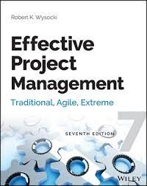
Required Textbook:
“Effective Project Management: Traditional, Agile, Extreme, Hybrid”, by Robert K. Wysocki
The main material and reference for the course will be the textbook, lecture notes and slides. are additional resources that are prepared by the professor.

Slide 7
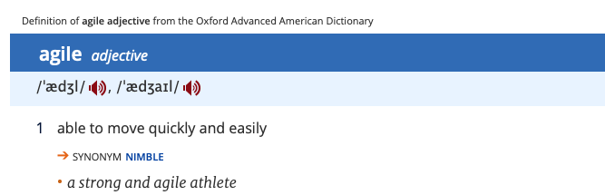


Orientation
Definition of Agile
02
Lecture
(Agile Adjective - Definition, Pictures, Pronunciation and Usage Notes | Oxford Advanced American Dictionary at OxfordLearnersDictionaries.com, n.d.)
www.midocean.ae

Slide 8
Orientation
Today’s business environment is continuously changing
Lecture
Continuous Change in
Markets, competition
Customers
Technology
Regulations
Environment
Social
www.midocean.ae

Slide 9
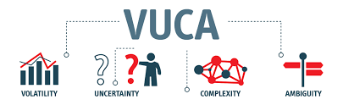
Orientation
We live in a VUCA World
Lecture
Rapid and Unexpected Challenges
Many Risks
Multiple Decision Factors
Many Unknown Risks
This requires organizations to continuously adapt and change to stay competitive
www.midocean.ae

Slide 10
Orientation
Business Agility
Lecture
The ability of an organization to rapidly adapt to market and/or other environmental changes.
Focuses on value realization through thoughtful strategic alignment, prioritization, and sequencing of projects.
Sometimes referred to as enterprise agility.
www.midocean.ae

Slide 11



Orientation
Chapter
Agile Project Management
02
Lecture
iterative and incremental approach
Mindset Based on values and principles
Emphasizes collaboration, change, and flexibility
Agile project management is an iterative and incremental approach to project management that emphasizes collaboration, flexibility, change, and continuous improvement.
Agile project management is a Mindset based on Values and Principles.
Started and gained popularity in software development projects but can be used to manage any type of project.
www.midocean.ae

Slide 12


Agile vs Traditional Approaches
Plan
Develop
Test
Final Outcome
Deploy
Classic/Traditional/Predictive/Waterfall Approach
Project Timeline
Agile/Incremental/Adaptive Approach
Iteration 1
Iteration 2
Iteration 3
………….
Iteration N
Develop
Test
Develop
Test
Develop
Test
Develop
Test
Plan
Deploy
Plan
Deploy
Plan
Deploy
Plan
Deploy
Intermediate Outcome
Intermediate Outcome
Intermediate Outcome
Final Outcome

Slide 13
Orientation
Agile vs Traditional Approach
Lecture
Traditional Approach
Agile Approach
Scope
Time
Quality
Cost
Time
Cost
Fixed
Quality
Scope
Variable
www.midocean.ae

Slide 14
Orientation
Benefits of Agile
Lecture
Enhances ability to manage changing priorities
Improves project visibility
Improves business/IT alignment
Increases speed of delivery/time to market
Improves team morale
Increases team productivity
Reduces project risk
Enhances delivery predictability
Source: 14th Annual State of Agile Report, 2020
www.midocean.ae

Slide 15
Orientation
Key Points
Lecture
Organizations need to continuously adapt and change in response to changing business environment
Agile is an iterative and incremental approach to project management that adapts to uncertain, complex and changing needs
Being Agile is a mindset based on Values and principles
In Agile project management approach, the project is delivered in a series of “Iterations”
Agile approaches embrace change, Scope can vary within the project
www.midocean.ae

Slide 16

Preparation for discussion panel:
Think of projects can follow Traditional Project Management approach and which projects suit Agile Project Management.
Give an example for each.
Orientation
Lecture
For Discussion Panel
www.midocean.ae

Slide 17
Before next lecture:
Reading:
”The Key Values and Principles of the Agile Manifesto”
Orientation
Lecture
For Next Lecture
www.midocean.ae

Slide 18



Thank You

