Slide 1


Risk Management
Prepared by Dr. Majid Saad
MGM510
Lec.4 : Enterprise Risk Management and Related Topics

Slide 2

Risk Management
“The field of risk management is constantly changing. Risk
managers must understand the implications of the changes,
analyze how such changes affect their risk management
program, look for ways to incorporate new techniques and
tools into their analysis and design, and continue to broaden
their knowledge of emerging trends and the financial aspects of risk management.”
Millicent Workman,
CPCU Director of Training and Education,
International Risk Management Institute (IRMI),
and Editor, Practical Risk Management…

Slide 3

Lecture objectives
After studying this chapter, you should be able to
Explain the meaning of financial risk management and enterprise risk management.
Describe how the risks of terrorism, climate change, and cyber-liability impact risk management.
Describe the impact of the underwriting cycle and consolidation in the insurance industry on the practice of risk management.
Explain capital market risk-financing alternatives, including risk securitization through catastrophe bonds and weather options.
Explain the methods that a risk manager employs to forecast losses.
Show how financial analysis can be applied to risk management decision making.
Describe other tools that may be of assistance to risk managers.
www.midocean.ae

Slide 4

Financial Risk Management
Business firms face a number of speculative financial risks. Financial risk management refers to the identification, analysis, and treatment of speculative financial risks. These risks include the following:
Commodity price risk
Interest rate risk
Currency exchange rate risk
www.midocean.ae

Slide 5

Commodity Price Risk
Commodity price risk is the risk of losing money if the price of a commodity changes. Producers and users of commodities face commodity price risks.
www.midocean.ae

Slide 6
Interest Rate Risk
Financial institutions are especially susceptible to interest rate risk. Interest rate risk is the risk of loss caused by adverse interest rate movements.
www.midocean.ae

Slide 7

Currency Exchange Rate Risk
The currency exchange rate is the value for which one nation’s currency may be converted to another nation’s currency.
Currency exchange rate risk is the risk of loss of value caused by changes in the rate at which one nation’s currency may be converted to another nation’s currency .
www.midocean.ae

Slide 8
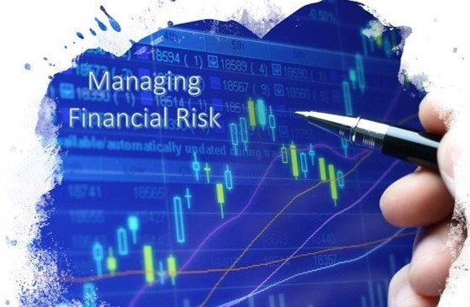
Managing Financial Risks
The traditional separation of pure and speculative risks meant that different business departments addressed these risks.
Pure risks were handled by the risk manager through risk retention, risk transfer, and risk control. Speculative risks
were handled by the finance division through contractual provisions and capital market instruments.
www.midocean.ae

Slide 9
Managing Financial Risks
An integrated risk program is a risk treatment technique that combines coverage for pure and speculative risks in the same contract.
The Chief Risk Officer (CRO) was responsible for the treatment of pure and speculative risks faced by the organization..
www.midocean.ae

Slide 10
Enterprise risk management (ERM)
Enterprise risk management (ERM) is a comprehensive risk management program that addresses all risks faced by organization—pure risks, speculative financial risks, strategic risks, operational risks, and other risks .
Pure and speculative risks were defined previously. Strategic risk refers to uncertainty regarding an organization’s goals and objectives, and the organization’s strengths, weaknesses, opportunities, and threats.
www.midocean.ae

Slide 11
Enterprise risk management (ERM)
ERM program does the following:
Prioritizes and manages those exposures as an interrelated risk portfolio rather than as individual risks
Evaluates the risk portfolio in the context of all significant internal and external environments, systems, circumstances, and stakeholders
Recognizes that individual risks across the organization are interrelated and can create a combined exposure that differs from the sum of the individual risks
Provides a structured process for the management of all risks, whether those risks are primarily quantitative or qualitative in nature
Views the effective management of risk as a competitive advantage
Seeks to embed risk management as a component in all critical decisions through the organization
www.midocean.ae

Slide 12
Enterprise risk management (ERM)
The ERM Process The enterprise risk management process is similar to the risk management process discussed in the previous chapter: risk identification, risk analysis, selection and implementation of risk treatment measures, and monitoring the program and taking corrective actions. As with traditional risk
management programs, enterprise risk management is a continuous process.
www.midocean.ae

Slide 13
Risk Identification
The risk identification process is, obviously, broader under an ERM program. In addition to the property, liability, personnel-related, and financial risks that an organization faces, additional risks are considered.
These risks include operational risks, strategic risks, and other risks. Some of the other risks that may be considered are the organization’s reputation, political risks, supply-chain risks, cybersecurity, regulatory risk and compliance with legal and reporting requirements, and other organizational- specific exposures.
www.midocean.ae

Slide 14
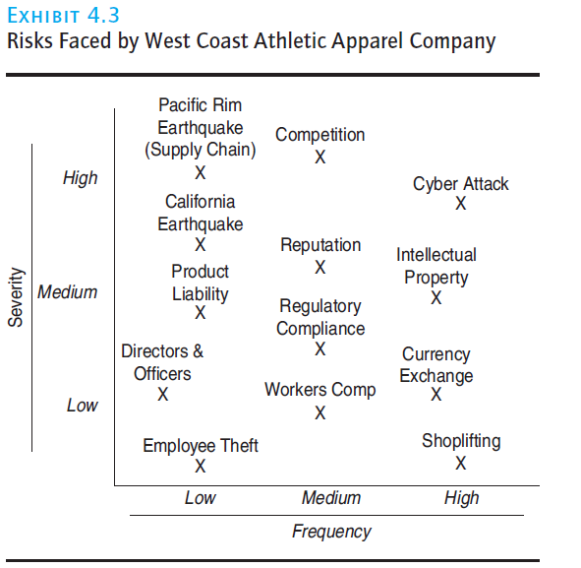
Risk Analysis
Once identified, the risks must be analyzed. As with traditional risk management, frequency and severity analysis can be used. Given the broader scope of the risks being analyzed, additional analysis tools may be employed. Some of these tools (e.g., risk mapping and catastrophe modeling) are discussed at the end of this chapter. Financial analysis tools (e.g., value at risk analysis) and predictive modeling may also be needed.
www.midocean.ae

Slide 15
Selection of Risk Treatment Measures
A wider range of treatment measures are needed. The risk -control measures discussed in the previous chapters (avoidance, loss prevention, loss reduction, separation, duplication and diversification) may be employed, as well as the risk-financing options (retention, noninsurance transfer, and insurance). The measures used to treat speculative financial risks were discussed in the previous section.
www.midocean.ae

Slide 16

Implement and Monitor the Program
The implementation stage of a “new” ERM program may be difficult. Implementation requires a commitment to the program and a fundamental change in how many employees in the organization view risk.
New operational and strategic risks may develop, insurance
markets may fluctuate, financial markets may become
more or less stable, the organization’s risk tolerance may
increase or decrease, a risk management technique applied
may not adequately address the exposure, and other changes
may occur
www.midocean.ae

Slide 17
Emerging Risks
ERM programs are designed to address all the risks faced by an organization. Several important emerging risks that merit additional discussion are terrorism-related losses, losses attributable to climate change, and cyber-liability exposures.
www.midocean.ae

Slide 18
Terrorism Risk
The risk of terrorism can be addressed through risk control and insurance. Numerous risk-control measures can be deployed. For example, physical barriers may be erected to prevent suicide bombers from using a vehicle to reach a building.
Terrorism insurance coverage is available through standard insurance policies or through separate, stand-alone coverage.
www.midocean.ae

Slide 19
Climate Change Risk
Losses attributable to natural catastrophes have increased significantly in recent years.
Governments, insurers, and businesses have all responded to this increased risk.
Cyber-Liability Risk An organization’s data are valuable assets that are often stored electronically. Unauthorized parties (hackers) may attempt to access the data for a variety of reasons. The hackers may attempt to learn trade secrets that can be exploited.
www.midocean.ae

Slide 20
Insurance Market Dynamics
Three important and interrelated factors influencing the insurance market are:
The underwriting cycle
Consolidation in the insurance industry
Capital market risk-financing alternatives
www.midocean.ae

Slide 21
The underwriting cycle
This cyclical pattern in underwriting stringency, premium levels, and profitability is referred to as the underwriting cycle. Property and liability insurance markets fluctuate between periods of tight underwriting standards and high premiums, called a “hard” insurance market, and periods of loose underwriting standards and low premiums, called a “soft” insurance market.
The combined ratio is the ratio of paid losses and loss adjustment expenses plus underwriting expenses to premiums.
www.midocean.ae

Slide 22
The underwriting cycle
When the market is “soft ” insurance can be purchased at favorable terms (for example, lower premiums, broader coverage, and removal of exclusions). In a “hard” market, more retention is used because some insurance coverages are limited in availability or may not be affordable.
two obvious factors affect property and liability insurance pricing and underwriting decisions:
Insurance industry capacity
Investment returns
www.midocean.ae

Slide 23
Consolidation in the Insurance Industry
In the financial services industry, the consolidation trend is continuing.
Consolidation means the combining of business organizations through mergers and acquisitions. A
number of consolidation trends have changed the insurance marketplace for risk managers:
■ Insurance company mergers and acquisitions
■ Insurance brokerage mergers and acquisitions
■ Cross-industry consolidations
www.midocean.ae

Slide 24

Insurance Company Mergers and Acquisitions
The number of large, independent, property and liability insurance companies is declining because of mergers and acquisitions.
Although the market remains competitive, insurer mergers and acquisition may have consequences for risk managers.
www.midocean.ae

Slide 25
Insurance Brokerage Mergers and Acquisitions
Consolidation in the insurance brokerage sector also may have consequences for risk managers. Insurance brokers are intermediaries who represent insurance purchasers.
Insurance brokers offer an array of services to their clients, including attempting to place their clients’ business with insurers. A risk manager wants to obtain insurance coverages and related services under the most favorable financial terms available.
Periodically, risk managers contact several insurance intermediaries to obtain competitive insurance coverage bids. The number of large, national insurance brokerages has declined because of consolidation.
www.midocean.ae

Slide 26
Cross-Industry Consolidation
Consolidation in the financial services arena is not limited to mergers between insurance companies or between insurance brokerages. Boundaries separating institutions with depository functions, institutions that underwrite risk, and securities businesses were enacted in Depression era legislation.
This consolidation has fostered the convergence of financial services trend as financial institutions are offering an increasing range of financial services products.
www.midocean.ae

Slide 27
Loss Forecasting
A risk manager must also identify the risks the organization faces, and then analyze the potential frequency and severity of these loss exposures. Although loss history provides valuable information, there is no guarantee that future losses will follow past loss trends.
Risk managers can employ a number of techniques to assist in predicting loss levels, including the following:
■ Probability analysis
■ Regression analysis
■ Forecasting based on loss distributions.
www.midocean.ae

Slide 28
Loss Forecasting
Probability Analysis: Chance of loss is the possibility that an adverse event will occur. The probability (P) of such an event is equal to the number of events likely to occur (X) divided by the number of exposure units (N).
The risk manager must also be concerned with the characteristics of the event being analyzed. Some
events are independent events —the occurrence does not affect the occurrence of another event.
www.midocean.ae

Slide 29
Regression Analysis
Regression analysis is another method for forecasting losses. Regression analysis characterizes the relationship between two or more variables and then uses this characterization to predict values of a variable..
www.midocean.ae

Slide 30
Forecasting Based on Loss Distributions
Another useful tool for the risk manager is loss forecasting based on loss distributions. A loss distribution is a probability distribution of losses that could occur.
Forecasting by using loss distributions works well if losses tend to follow a specified distribution and the sample size is large.
www.midocean.ae

Slide 31
Financial Analysis in Risk Management Decision Making
Financial analysis can be applied to assist in risk management decision making. To make decisions involving cash flows in different time periods, the risk manager must employ time value of money analysis..
The Time Value of Money
The time value of money means that when valuing cash flows in different time periods, the interest-earning capacity of money must be taken into consideration. A dollar received today is worth more than a dollar received one year from today because the dollar received today can be invested immediately
to earn interest
www.midocean.ae

Slide 32
Other Risk Management Tools
Our discussion of advanced risk management topics would not be complete without a brief discussion of
some other risk management tools. These tools include:
■ Risk management information systems (RMIS)
■ Risk management intranets
■ Predictive analytics
■ Risk maps
■ Value at risk (VAR) analysis
■ Catastrophe modeling
www.midocean.ae

Slide 33
Risk management information systems
A risk management information system (RMIS): is a computerized database that permits the risk manager to store, update, and analyze risk management data and to use such data to predict and attempt to control future loss levels. Risk management information systems may be of great assistance to risk managers in decision making. Such systems are marketed by a number of vendors, or they may be developed in-house.
www.midocean.ae

Slide 34
Risk Management Intranets
An intranet is a private network with search capabilities designed for a limited, internal audience. For example, a software company that sponsors trade shows at numerous venues each year might use a risk management intranet to make information available to interested parties within the company. Through the intranet, employees can obtain a list of procedures to follow (formulated by the risk management department) along with a set of forms that must be signed and filed before the event can be held, such as hold-harmless agreements.
www.midocean.ae

Slide 35

Predictive Analytics
Predictive analytics is the analysis of data to generate information that will help make more informed decisions.
Risk managers can also employ predictive analytics. A risk manager may want to reduce the return-to-work period for injured workers or to reduce the number of accidents caused by its fleet drivers.
www.midocean.ae

Slide 36
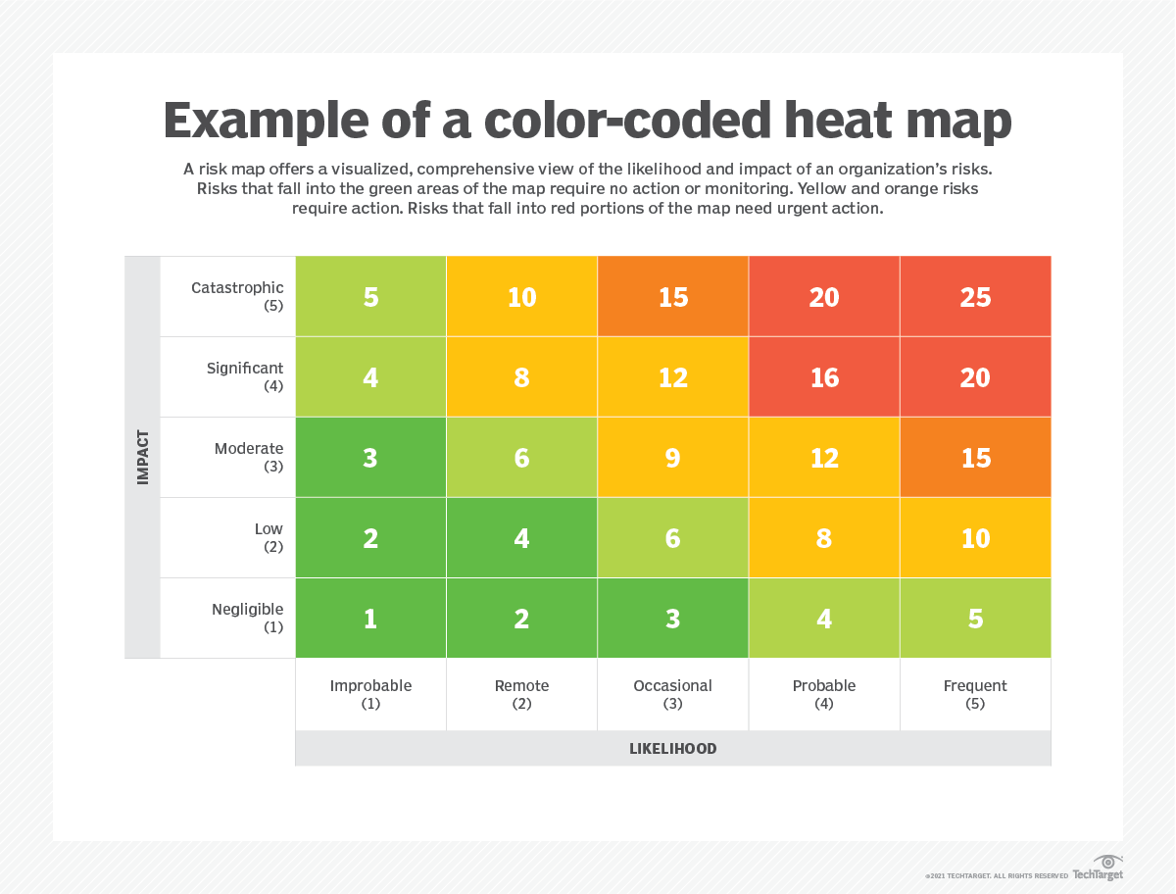
Risk Maps
Risk maps are grids detailing the potential frequency and severity of risks faced by the organization. Construction of these maps requires risk managers to analyze each risk that the organization faces before plotting it on the map. Use of risk maps varies from simply graphing the exposure to employing simulation analysis to estimate likely loss scenarios.
www.midocean.ae

Slide 37
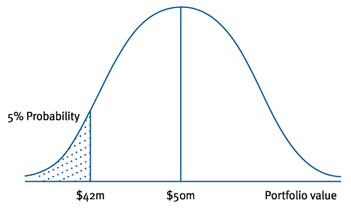
Value at Risk (VAR) Analysis
Value at risk (VAR) is the worst probable loss likely to occur in a given time period under regular market conditions at some level of confidence. Value at risk analysis is often applied to a portfolio of assets, such as a mutual fund or a pension fund. It is similar to the concept of “maximum probable loss” in traditional property and liability risk management discussed in the previous chapter
www.midocean.ae

Slide 38
Catastrophe modeling
Catastrophe modeling is a computer-assisted method of estimating losses that could occur as a result of a catastrophic event. Input variables include such factors as seismic data, meteorological data, historical
losses, and values exposed to loss (e.g., structures, population, business income).
www.midocean.ae

Slide 39



Thank You

