Slide 1
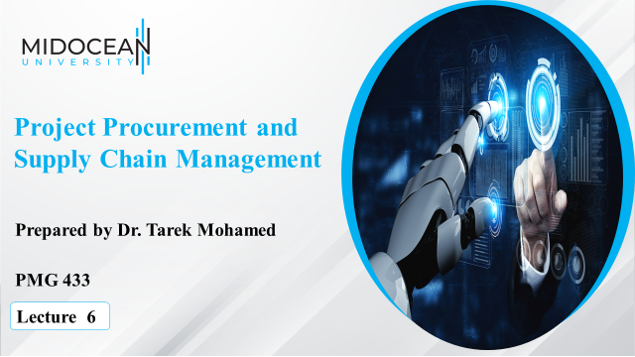

Slide 2
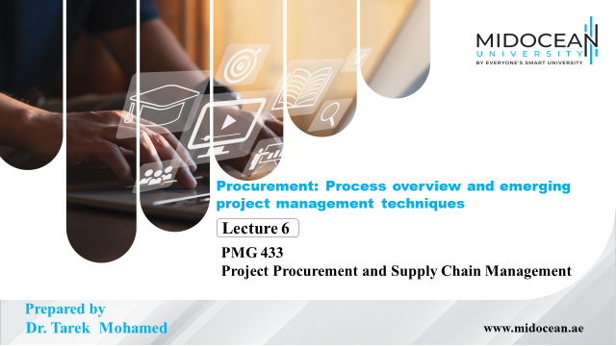

Slide 3


Learning Objectives
To explain more about the scope of procurement.
To overview the project procurement management processes.
To explain the procurement planning steps.
To differentiate between the RFP and RFQ and RFI
www.midocean.ae

Slide 4
PROCUREMENT
Procurement – The process of acquiring and evaluating goods and services beginning with determining needs through product utilization, conclusion of contracted service, or until the end of the useful life of a capital equipment item.
Procurement means acquiring goods and/or services from an outside source.
Purchasing – The process of “buying:” placing an order, receiving a product or service, and paying the supplier.
www.midocean.ae

Slide 5
Why Outsource?
Outsourcing is a growing practice within the IT industry, and it is
important to appreciate the reasons it is adopted:
  To reduce both fixed and recurrent costs.
  To allow the client organization to focus on its core business.
  To access skills and technologies.
  To provide flexibility.
  To increase accountability.
www.midocean.ae

Slide 6
Procurement Management Processes
Project procurement management includes the following
processes for acquiring goods and services from outside the project
organisation:
  Procurement planning: determining what to procure and when.
  Solicitation planning: documenting product requirements and identifying potential sources.
  Solicitation: obtaining quotations, bids, offers, or proposals as appropriate.
  Source selection: choosing from among potential vendors.
  Contract administration: managing the relationship with the vendor.
  Contract close-out: completion and settlement of the contract.
www.midocean.ae

Slide 7
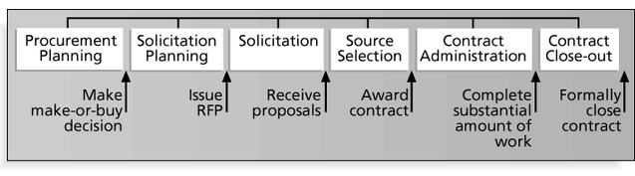
Procurement Management Processes & Key Outputs
The figure below summarises the major processes involved in procurement management, and identifies important milestones associated with each stage.
For example, after procurement planning the key milestone is the “make or buy decision”. This will determine if further procurement management processes are required.
www.midocean.ae

Slide 8
Procurement Planning
Procurement planning involves identifying which project needs
can be best met by using products or services outside the organization.
It includes deciding:
  Whether to procure.
  How to procure.
  What to procure.
  How much to procure.
  When to procure.
It is essential to be thorough and creative when planning procurement.
Even though a company may be viewed as a competitor, it will often be
advantageous to collaborate on some projects.
www.midocean.ae

Slide 9
Inputs to Procurement Planning
The inputs needed for procurement planning include:
The project scope statement.
Product description.
Market conditions.
Constraints and assumptions.
It is important to define the scope of the project, the products,
market conditions, and constraints and assumptions.
However, it is also essential to know exactly why you want
to procure goods or services.
www.midocean.ae

Slide 10
Tools and Techniques
Procurement management will often incorporate the following:
  Make-or-buy analysis: determining whether a particular product or service should be made or performed inside the organization or purchased from someone else. Often involves financial analysis.
  Experts, both internal and external, are valuable assets in procurement decisions.
    Internal experts are particularly useful in providing knowledge of organisational and personnel issues.
    External experts can provide expert judgement, especially with regard to vendors and technology issues.
www.midocean.ae

Slide 11
Procurement Plan
www.midocean.ae

Slide 12
Procurement Planning (cont.)
Procurement plan linked to project implementation schedule:
Consulting services
Goods and / or works
Major contracts
Phasing of contracts
Critical path
www.midocean.ae

Slide 13
Procurement Planning Packaging
Decide contract packages
WHAT
(like items, large, small, values slice and packages)
HOW
(ICB, NCB, other, co-financing)
WHEN
(each step, each package)
WHO
(to do, to review)
www.midocean.ae

Slide 14
Procurement Planning: Timing
TIMING
(Preparation, approvals, delays)
CONSTRAINTS
(Technical, PIU staffing, legal, training, other)
DETERMINE LEAD TIME
  Administrative
  Manufacture
  Delivery
  Construction period
www.midocean.ae

Slide 15
Procurement Planning: Schedule
Critical dates for each package
Tabulate / prepare bar chart
Periodically update
Use of monitoring system
www.midocean.ae

Slide 16
Procurement Process Definition
The Procurement Process consists of the full cycle of activities (steps) to undertake to fulfill a specified need, starting from identification of the said need
www.midocean.ae

Slide 17
Procurement Steps
Identification of needs
  List of goods (e.g. equipment, materials, plant, IT systems)
  Types of works (large, small, very small)
  Associated services: transport, distribution, training, maintenance
www.midocean.ae

Slide 18
Procurement Steps (cont.)
Project implementation plan
  Design and specification
  Packaging: organizational implementation
  Schedule: time frame of implementation
Bidding methods and documents
  Competitive methods
  Shopping methods
  Direct contracting
www.midocean.ae

Slide 19
Procurement Steps (cont.)
Advertising
Bidding process
  Issuance of bidding documents or request for quotations
  Bid or quotations submission and opening
  Bid or quotation evaluation
www.midocean.ae

Slide 20
Procurement Steps (cont.)
Contract and purchase order award
  Notification
  Signature
  Effectiveness
Contract management
  Contract execution
  Delivery, commissioning, acceptance
  Warranty
  Maintenance period
Need fulfilled
www.midocean.ae

Slide 21
Competence Requirements in Procurement Process
DETERMINING NEEDS
1. Forecasting Requirements
2. Acquisition (procurement), Planning and Packaging
3. Initiating Procurement (requisition, budget approval)
ANALYSIS OF REQUIREMENTS
4. Preparation of Technical Specifications (goods / equipment)
5. Detailed Design and Drawings (Civil Works)
6. Terms of Reference (TOR) - (Services)
www.midocean.ae

Slide 22
Competence Requirements in Procurement Process (cont.)
EXTENT OF COMPETITION
7. Sources of Supply (market research)
8. Lease vs. Purchase
9. Evaluation Factors (technical and commercial)
10. Method of Procurement (with or without pre-qualification)
www.midocean.ae

Slide 23
Competence Requirements in Procurement Process - Bidding
TERMS AND CONDITIONS
11. Contract Types
Need for Securities (Bid and Performance)
Selection of INCOTERM
Preparation of Tender Documents
Prescribing insurance requirements
14. Publicizing Proposed Procurements
15. Pre-bid / Pre-proposal Conferences
16. Amending Bidding Documents
17. Cancelling Tenders
www.midocean.ae

Slide 24
Competence Requirements in Procurement Process - Bidding
BID EVALUATION
Receiving Bids / Rejecting Late Bids
Bid Opening
Preliminary Examination / Determination of Responsiveness
Technical Evaluation
Cost Analysis
Evaluation: Other Terms and Conditions
Clarification of Issues before Contract Signing
www.midocean.ae

Slide 25
Competence Requirements in Procurement Process - Bidding
SELECTION FOR AWARD
Subcontracting Requirements
Post-Qualification
EXECUTING AWARD
Preparing Awards
Debriefing
Protests by Bidders
Dealing with Fraud & Corruption
www.midocean.ae

Slide 26
Competence Requirements in
Procurement Process – Contract Execution
ORGANIZATION
Contract Administration Planning
Consent to sub-contracts
MONITORING AND RESOLUTION OF PERFORMANCE PROBLEMS
Monitoring, Inspection and Acceptance
Delays
Stop Works (Suspension of Works)
Remedies
Reporting Performance Problems / Contemporary record
www.midocean.ae

Slide 27
Competence Requirements in Procurement Process – Contract Execution
PROCEDURES - PAYMENT
Variation Orders
Progress Payment / Retention
Price Adjustment
PROCEDURES - ACCOUNTING
41. Cost Accounting Systems
PROCEDURES - MODIFICATION / OPTIONS
42. Contract Amendments
www.midocean.ae

Slide 28
Competence Requirements in Procurement Process – Contract Execution
PROCEDURES - TERMINATION
Termination for Default / Convenience
Warranty / Maintenance / Defects Notification Period
Contract close-out
PROCEDURES - CLAIMS / DISPUTES
49. Claims
50. Dispute Settlement Procedures
www.midocean.ae

Slide 29
RFP/RFQ Process
Difference of RFP and RFQ and RFI
www.midocean.ae

Slide 30
Difference of RFP and RFQ and RFI
Request for Proposal (RFP)
Request for Quote (RFQ)
Request for information (RFI)
www.midocean.ae

Slide 31
Difference of RFP and RFQ and RFI
DEFINITION of RFP:
Request for Proposal (RFP) - A solicitation to prospective suppliers where the supplies and/or services described are highly complex, undeveloped products and/or services, requiring a response detailing technical and management expertise and a proposed design/development approach.
www.midocean.ae

Slide 32
Difference of RFP and RFQ and RFI
DEFINITION of RFQ:
Request for Quotation (RFQ) - A solicitation to prospective suppliers wherein the requirements described are existing, “off-the-shelf” equipment, build-to-print parts with known specifications, common services, or otherwise sufficiently defined so that the award can be made on the basis of price and past performance from the responsive bidders.
www.midocean.ae

Slide 33
Difference of RFP and RFQ and RFI
DEFINITION of RFI:
Request for information (RFI) - is a standard business process whose purpose is to collect written information about the capabilities of various suppliers. Normally it follows a format that can be used for comparative purposes.
An (RFI) is primarily used to gather information to help make a decision on what steps to take next. RFIs are therefore seldom the final stage and are instead often used in combination with the following: request for proposal (RFP), and request for quotation (RFQ).
www.midocean.ae

Slide 34
Types of solicitations
A solicitation is a document, sent to prospective contractors by a Government agency, requesting the submission of offers or information. This is a generic term that includes the following types of solicitations:
Invitations for Bids (IFBs)
Requests for Proposals (RFPs)
Requests for Quotations (RFQs)
www.midocean.ae

Slide 35
Invitation for Bids (IFB)
The Invitation for Bid (IFB) is the solicitation document used in Sealed Bidding procurements.
IFBs must describe the Government’s requirements clearly, accurately, and completely.
It includes all documents needed by prospective bidders for the purpose of bidding plus all terms and conditions of the prospective contract (except price) so that all bidders will submit bids on the same basis and award can be made solely on the basis of price and price-related factors.
www.midocean.ae

Slide 36
Buyer’s Role in the RFQ/RFP Process
Upon receipt of a requirement the Buyer reviews and determines if the originating organization(s) has furnished complete specifications, blueprints, statements of work (SOW), description of item(s) to be purchased, etc., so that requirements can be adequately defined in the RFQ/RFP and any resulting Purchase Order (PO).
The Buyer will contact originating organization(s) or Integrated Product Teams (IPTs) if additional data is required.
www.midocean.ae

Slide 37
RFQ Structure
The Buyer is responsible for the entire content of the RFQ. The RFQ should be structured in such a manner to assure that all requirements are clearly delineated on the RFQ, and that the supplier clearly understands the requirements.
In some cases, the Buyer may need to provide additional clarification of the requirements to assure complete understanding by the supplier. In such cases, the Buyer is responsible for providing consistent information to all solicited suppliers.
www.midocean.ae

Slide 38
Supplier Steps To Providing A Responsive Proposal
  Do’s
    Read the RFP Instructions
    Contact the Buyer regarding RFP questions
    Meet the RFP deadline and provide a Proposal which meets the RFP instructions
    Protect PWR proprietary data
    Protect Export controlled data
  Don’ts
    Contact technical personnel for questions during the proposal process unless Buyer instructed
    Wait to the last minute to ask for an extension
    Continually ask for extensions
www.midocean.ae

Slide 39
Request for proposal
Key objectives
Obtain correct information to enable sound business decisions.
Ensure that all suppliers have an equal understanding of the requirements.
Enable a broader and creative range of solutions to be considered.
Responsive Bids allow PWR purchasing to evaluate proposals to obtain a favorable deal.
www.midocean.ae

Slide 40
Evaluation Criteria
Responsive Bid
Price
Delivery
Technical Solution
Past Performance (SPI)
Financial Stability
Agreed Upon Terms & Conditions
www.midocean.ae

Slide 41
Steps In The RFP Evaluation Process
Step One: Review All Proposals
Step Two: Determine Status. Determine if proposal is “responsive” or “non-responsive”
Step Three: Score Proposals based on criteria established in the RFP
Step Four: Discuss Proposals. The evaluation committee reaches a “unified understanding” of the criteria and corresponding responses. Individual scores may be adjusted at this point based on discussion. Tally results.
Step Five: Interview. This step is optional. This is an opportunity for both sides to explain their viewpoints
www.midocean.ae

Slide 42
Steps In The RFP Evaluation Process
Step Six: Discussion/Negotiation. This step can be optional, but may be required.
Step Seven: Best and Final Offer. This is optional. Once a BAFO is received the committee will evaluate it in the same manner as the original proposal.
Step Eight: Recommendation. Written recommendation includes scores, justification and rationale for the decision.
Step Nine: Management Review of committee scoring and justification. If accepted, the winning proposal will be used to roll up in PWR proposal or award PO to supplier if using company funds or after PWR is awarded a contract.
www.midocean.ae

Slide 43
Summary of Learning Objectives
To explain more about the Scope of Procurement.
To overview the Project procurement management processes.
To explain the procurement planning steps.
To differentiate between the RFP and RFQ and RFI
www.midocean.ae

Slide 44
Essential Reference
Morris, P. W., & Pinto, J. K. (Eds.). (2007). The Wiley guide to project technology, supply chain, and procurement management (Vol. 4). John Wiley & Sons.
www.midocean.ae

Slide 45



Thank You

