Slide 1


Project Leadership
Prepared by Dr. Ehab Mahmoud

Slide 2



Project Leadership
Lecture 1
Introduction to Project Leadership
PMG 511
Master in Project Management
Prepared by
Dr. Ehab Mahmoud

Slide 3

Chapter
Learning Outcomes
01
What is a project?
Leadership vs Management.
Leader vs Manager.
Impact of leadership on project.
Major project leadership skills.

Slide 4
Chapter
What is a project?
01
Projects are used as a means to achieve an organization’s strategic goals.
Projects are a great opportunity for organizations and individuals to achieve their business and non-business objectives more efficiently through implementing change.
Projects help us make desired changes in an organized manner and with reduced probability of failure.

Slide 5
Chapter
What is a project?
01
A Project is made to produce some kind of a tangible or intangible result (a unique product, service, benefit, competitive advantage, etc.). It usually includes a series of interrelated tasks that are planned for execution over a fixed period of time and within certain requirements and limitations such as cost, quality, performance, others.
Projects often are associated with unknowns, complexity, and uncertainty.

Slide 6
Characteristics of the Project
Chapter
Temporary
Defined beginning and end
Unique
Specific set of operations designed to accomplish a singular goal
Product or service
The output is to create a product or perform a service
Project Charter
Defined scope and resources
Not a routine operation
Established with a project charter or a contract
01

Slide 7

Chapter
Project management or project Leadership?
01

Slide 8
Chapter
What is management?
01
The process of getting things done effectively and efficiently with and through people.
Effectiveness: doing the right things.
Efficiency: doing things right.

Slide 9
Chapter
What is management?
01
“Is the Process of Getting Things Done through the Efforts of Other People”. Harold Koontz.
“Is the processes that are based in a simple rule: the POLC rule – Planning, Organizing, Leading and Control. It also involves overseeing projects, resources and business enterprises”. Mary Cushing Nile.

Slide 10
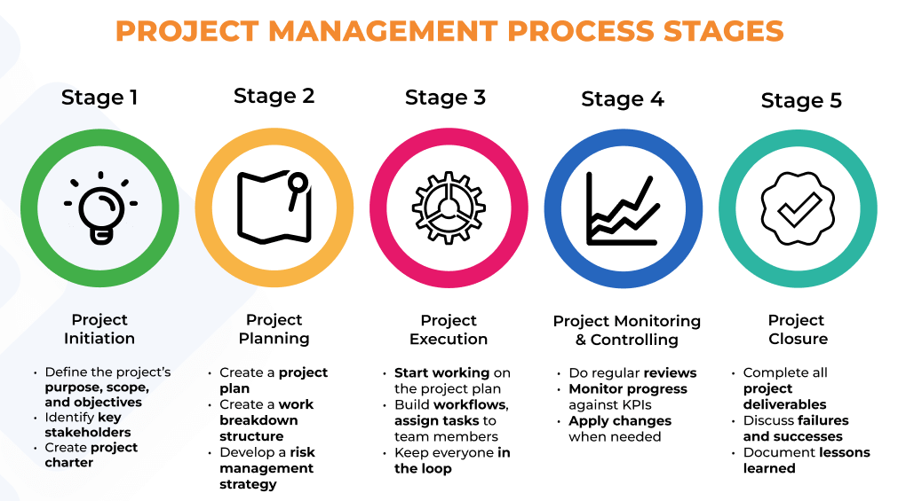
Chapter
Project Management
01

Slide 11
Chapter
Project Management
01
Project management occurs in a team setting; it is concerned with making decisions about processes and functions.
Successful projects depend on both the effectiveness of the project team, the leadership and management of that team.

Slide 12
Chapter
Project Management
01
Who is the Project Manager?
The person assigned to lead the team that is responsible for completing the project objectives.
Variations of this title could be: Project Director, Project Planner, Project Coordinator or Project Leader
Project Managers must pay attention to many different aspects of a project simultaneously including time, resources, team members, results and reports.

Slide 13

Chapter
What is Leadership?
01
Leadership is a soft ability; often more art than science.
Leadership is the process of leading a group and influencing that group to achieve its goals.

Slide 14
Chapter
What is Leadership?
01
Leadership requires the development of specific and unique soft skills along with the more typical hard skills that were listed in your job description.
Soft skills are key traits that often apply to communication, decision-making, leadership abilities, attitude, instincts, and work ethics.

Slide 15




Chapter
What is Leadership?
01
LEADERSHIP

Slide 16
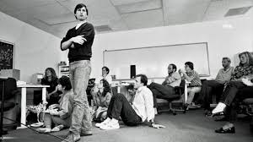
Chapter
Components of Leadership
01
The word leadership evokes:
  Responsibility.
  Burden.
  Honor.
  Duty.
  Calling.
  Ability.

Slide 17
Chapter
Importance of Leadership
01
Create a Vision:
Creating an inspiring vision of the future.
Motivation:
Motivating and inspiring people to engage with that vision.
Managing:
Managing delivery of the vision with providing guidance .
Coaching:
Coaching and building a team, so that it is more effective at achieving the vision with an effective planning.

Slide 18
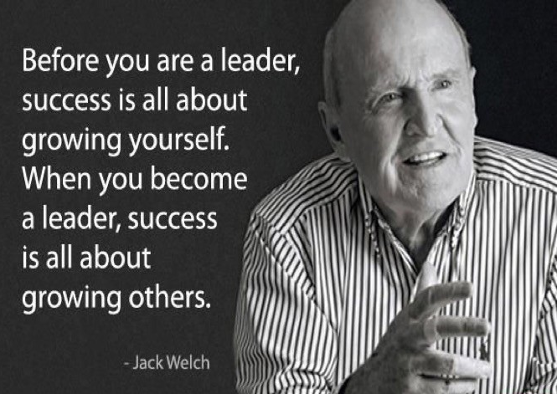
Chapter
Importance of Leadership
01
Being a leader isn’t simply about hitting targets and delivering goods, it’s also about projecting the right attitude and inspiring others to do their best work

Slide 19

Chapter
Project Manager or Project Leader?
01

Slide 20

Chapter
A project MANAGER is responsible for…
01
Implementing product strategy, including product improvement, feature prioritization, and costing.
Setting deadlines and ensuring that projects remain on schedule.
Tracking the deliverables sprint and providing updates to relevant stakeholders.

Slide 21

Chapter
A project MANAGER is responsible for…
01
Ensuring the project is sticking to the agreed-upon budget.
Managing every moving part in relation to milestones, including schedules, documentation, staffing and, sometimes, HR concerns.
Establishment of quality assurance unit to control quality.

Slide 22
Chapter
A project LEADER is responsible for…
01
Communicating with team members, including relaying briefs, connecting daily tasks to larger goals, and providing context and support.
Ensuring the team remains focused and on track, including addressing any conflicts or bottlenecks.

Slide 23


Chapter
A project LEADER is responsible for…
01
Creating a vision around the project to provide team members with a sense of purpose and motivation.
Offering less tangible and more emotional support to help a team stay focused on the ultimate goal.
Fostering a workplace atmosphere that helps bring out the best in his or her team.

Slide 24
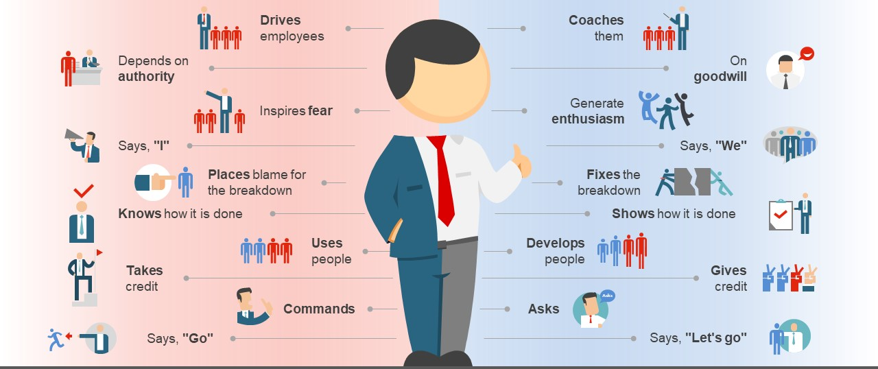
Chapter
Project Manager or Project Leader?
01
MANAGER VS LEADER

Slide 25
Chapter
Manager vs Leader
01
MANAGER | LEADER
Goals and objectives Telling how and when Shorter range System, resources and structure Autocracy Restraining Maintaining Conforming Imitating Administrating Controlling Procedures Consistency Thinks in the box | Vision Telling what and why Longer range People and human nature Democracy Enabling Developing Challenging Originating Innovating Directing Flexibility Thinks outside the box

Slide 26
Chapter
Manager vs Leader
01
Not every manager is a leader, and not every leader is a manager.
Leader
Project
Manager

Slide 27
Chapter
A Project Without Positive Leadership
01
May well under-perform.
May miss strategic opportunities.
Stifle innovation.
Underutilize team members.
Fall short of its project goals, quality performance and productivity.

Slide 28

Chapter
A Project Without Positive Leadership
01

Slide 29
Chapter
Leadership Traits and Soft Skills
01
L - Listener, Lovable.
E - Energetic, Effective.
A - Alert, Assertive.
D - Determination, Diligence.
E - Empathy, Eagerness.
R - Responsible, Realistic.
S - Self respect, Self control.
H - Honesty, High hopes.
I - Interest, Impartial.
P- Patience.

Slide 30
Chapter
Major Project Leadership Skills
01
Decision-making and Conflict Resolution
Team Management
Visioning
Effective Project Leadership
Communicating
Motivation
Influencing

Slide 31
Chapter
Team Management
01
Successful project leaders are responsible for the daily mechanisms of team harmony.
Successful project leaders make sure the whole team stays focused and works smoothly together towards a shared vision.
Successful project leaders discuss, decide and do real work.
Successful project leaders recognize that their team has been putting in extra hours on a project, might come up with a special reward—like a special team dinner together, or a day off post-project—to both demonstrate appreciation and encourage continued hard work.

Slide 32
Chapter
Decision-making
01
Successful project leaders are successful decision-makers.
Successful project leaders often have to make challenging decisions, such as what direction to move their project in.
Successful project leaders understand how to balance emotion with reason and make decisions that positively impact themselves, their employees, their customers and stakeholders, and the project.
Successful project leaders also know when to move quickly and proceed with the available information, versus when to take more time and gather additional information.

Slide 33
Chapter
Conflict Resolution
01
Conflict resolution is at the core of being a successful a project leader, it is an ongoing job duty of a leader.
A successful project leader is patient listener and assess the problem realistically without getting emotional or biased.
The impact of conflict in the workplace can result in a disruption of the effectiveness of the project and slow the achievement of its goals.
A successful project leader believes that facing conflict head is the best thing for both sides.

Slide 34
Chapter
Communication
01
A successful project leader is an effective listeners.
Communication can include persuading team members to collaborate in a way they’re not accustomed to, negotiating with project stakeholders on timelines and expectations.
A successful project leader can be adept at transfer ideas, align expectations, inspire and motivate any action, and he can also spread their vision. They can build the values and trust that enable effective working relationships and goal accomplishment.
A successful project leader is an effective listener.
Communication can include persuading team members to collaborate in a way they’re not accustomed to, negotiating with project stakeholders on timelines and expectations.
A successful project leader can be adept at transferring ideas, aligning expectations, inspiring and motivating any action, and he can also spread his vision. Leaders can build the values and trust that enable effective working relationships and goal accomplishment.

Slide 35
Chapter
Motivation
01
A successful project leader must be a self-motivated.
A successful project leader must have a way of motivational factors for others. they must understand the basic needs of employees, peers and his superiors.
Leadership is used as a means of motivating others.

Slide 36
Chapter
Influencing
01
A successful project leader must have these 4 keys of influencing skills:
Organizational Intelligence: leaders understand how to get things done and embrace the reality of working within organizational politics to move teams and initiatives forward.
Team Promotion: leaders cut through the noise to promote themselves — while also promoting what’s good for the entire organization.
Trust-building: because leadership often involves guiding people through risk and change, trust is essential.
Expanding Networks: no leader is an island. They are empowered by their connections with others.

Slide 37
Chapter
Conclusion
01
There is a common belief that leadership is vital for any successful project.
Leader is expected to have an honest understanding of who is in his team, what they know, and what they can do? And what is his duty?
An important thing about leaders is that the followers and the results will decide whether the leader is successful or not.
This chapter developed a picture of the special purpose of leadership for projects, with adapting and spotting the difference between project leader and project manager. And what skills needed by the leader in the project toward his team to keep the project on course.

Slide 38
Chapter
Conclusion
01
A leaders is:
Role model.
Visionary.
Technically competent.
Decisive.
A good communicator.
A good motivator.
Stands up to top management when necessary.
Supports team members.
Encourages new ideas.

Slide 39

Chapter
Leaders in our Lives
01

Slide 40



Thank You

