Slide 1

Strategic and Operational Management
(part 1 Analysis)
Prepared by Dr. Adam Yagoub
Lecture 5
MGM 630
Competitive Advantage, Firm Performance, and Business Models

Slide 2

Lecture 5
Lecture Outline
5.1 Competitive Advantage and Firm Performance
- Accounting Profitability
- Shareholder Value Creation
- Economic Value Creation
-The Balanced Scorecard
- The Triple Bottom Line
5.2 Business Models: Putting Strategy into Action
- Popular Business Models
- Dynamic Nature of Business Models

Slide 3
Lecture 5
Learning Objectives
1. Conduct a firm profitability analysis using accounting data to assess and evaluate competitive advantage.
2. Apply shareholder value creation to assess and evaluate competitive advantage.
3. Explain economic value creation and different sources of competitive advantage.
4. Apply a balanced scorecard to assess and evaluate competitive advantage.
5. Apply a triple bottom line to assess and evaluate competitive advantage.
6. Outline how business models put strategy into action.

Slide 4
Lecture 5
Competitive Advantage, Firm Performance, and Business Models
5.1 Competitive Advantage and Firm Performance
It is easy to compare two firms and identify the better performer as having competitive advantage. But simple comparisons have their limitations. How can we understand how and why a firm has competitive advantage? How can we measure it? How can we under-stand that advantage within the bigger picture of an entire industry and the ever-changing external environment? And what strategic implications for managerial actions do we derive from our assessments? These apparently simple questions do not have simple answers. Strategic management researchers have debated them intensely for at least 30 years.

Slide 5
Lecture 5
Competitive Advantage, Firm Performance, and Business Models
To address these key questions, we will develop a multidimensional perspective for assessing competitive advantage. Let’s begin by focusing on the three standard performance dimensions:
1. What is the firm’s accounting profitability?
2. How much shareholder value does the firm create?
3. How much economic value does the firm generate?

Slide 6
Lecture 5
Competitive Advantage, Firm Performance, and Business Models
- Accounting profitability
As we discussed in Chapter 1, strategy is a set of goal-directed actions a firm takes to gain and sustain competitive advantage. Using accounting data to assess competitive advantage and firm performance is standard managerial practice. When assessing competitive advantage by measuring accounting profitability, we use financial data and ratios derived from publicly available accounting data such as income statements and balance sheets.

Slide 7
Lecture 5
Competitive Advantage, Firm Performance, and Business Models
Since competitive advantage is defined as superior performance relative to other competitors in the same industry or the industry average, a firm’s managers must be able to accomplish two critical tasks:
1. Accurately assess the performance of their firm.
2. Compare and benchmark their firm’s performance to other competitors in the same industry or against the industry average.

Slide 8
Lecture 5
Competitive Advantage, Firm Performance, and Business Models
Accounting data enable us to conduct direct performance comparisons between different companies. Some of the profitability ratios most commonly used in strategic management are return on invested capital (ROIC), return on equity (ROE), return on assets (ROA),and return on revenue (ROR).

Slide 9
Lecture 5
Competitive Advantage, Firm Performance, and Business Models
Apple VS. Microsoft To demonstrate the usefulness of accounting data in assessing competitive advantage and to derive strategic implications, let’s revisit the Apple and Microsoft, and investigate the sources of performance differences in more detail. Exhibit 5.1 shows the ROIC for Apple and Microsoft (as of fiscal year 2014). It further breaks down ROIC into its constituent components. This provides important clues for managers on which areas to focus when attempting to improve firm performance relative to their competitors.

Slide 10
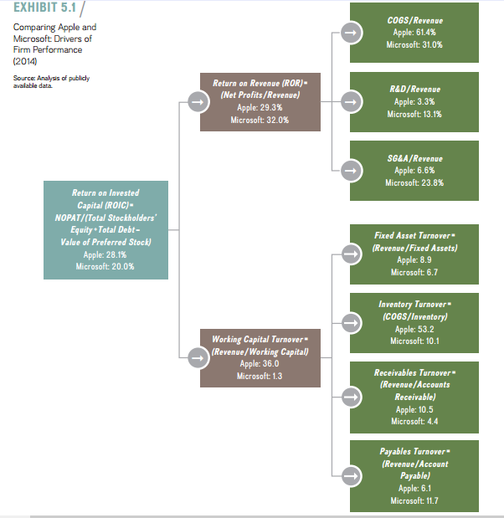
Lecture 5
Competitive Advantage, Firm Performance, and Business Models

Slide 11
Lecture 5
Competitive Advantage, Firm Performance, and Business Models
Limitations of accounting data: Although accounting data tend to be readily available and we can easily transform them into financial ratios to assess and evaluate competitive performance, they also exhibit some important limitations:
■ All accounting data are historical and thus backward-looking. Accounting profitability ratios show us only the outcomes from past decisions, and the past is no guarantee of future performance.

Slide 12
Lecture 5
Competitive Advantage, Firm Performance, and Business Models
■ Accounting data do not consider off–balance sheet items. Off–balance sheet items, such as pension obligations (quite large in some U.S. companies) or operating leases in the retail industry, can be significant factors.
■ Accounting data focus mainly on tangible assets, which are no longer the most important. This limitation of accounting data is nicely captured in the adage: Not everything that can be counted counts. Not everything that counts can be counted.

Slide 13
Lecture 5
Competitive Advantage, Firm Performance, and Business Models
Intangibles and The Value of Firms: Intangible assets that are not captured in accounting data have become much more important in firms’ stock market valuations over the last few decades. Exhibit 5.2 shows the firm’s book value (accounting data capturing the firm’s actual costs of assets minus depreciation) as part of a firm’s total stock market valuation (number of outstanding shares times share price). The firm’s book value captures the historical cost of a firm’s assets, whereas market valuation is based on future expectations for a firm’s growth potential and performance.

Slide 14
Lecture 5
Competitive Advantage, Firm Performance, and Business Models
For the firms in the S&P 500 (the 500 largest publicly traded companies by market capitalization in the U.S. stock market, as determined by Standard & Poor’s, a rating agency), the importance of a firm’s book value has declined dramatically over time. This decline mirrors a commensurate increase in the importance of intangibles that contribute to growth potential and yet are not captured in a firm’s accounting data.

Slide 15
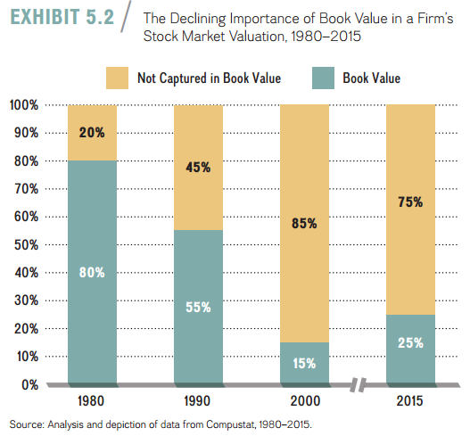
Lecture 5
Competitive Advantage, Firm Performance, and Business Models
In 1980, about 80 percent of a firm’s stock market valuation was based on its book value with 20 percent based on the market’s expectations concerning the firm’s future performance. This almost reversed by 2000 (at the height of the Internet bubble), when firm valuations were based only 15 percent on assets captured by accounting data. The important take-away is that intangibles not captured in firms’ accounting data have become much more important to a firm’s competitive advantage. By 2015, about 75 percent of a firm’s market valuation was determined by its intangibles.

Slide 16
Lecture 5
Competitive Advantage, Firm Performance, and Business Models
- Shareholder Value Creation
Shareholders—individuals or organizations that own one or more shares of stock in a public company—are the legal owners of public companies. From the shareholders’ perspective, the measure of competitive advantage that matters most is the return on their risk capital, which is the money they provide in return for an equity share, money that they cannot recover if the firm goes bankrupt.

Slide 17
Lecture 5
Competitive Advantage, Firm Performance, and Business Models
Limitations of Shareholder Value Creation: Although measuring firm performance through total return to shareholders and firm market capitalization has many advantages, just as with accounting profitability, it has its shortcomings:
■ Stock prices can be highly volatile, making it difficult to assess firm performance, particularly in the short term. This volatility implies that total return to shareholders is a better measure of firm performance and competitive advantage over the long term, because of the “noise” introduced by market volatility, external factors, and investor sentiment.

Slide 18
Lecture 5
Competitive Advantage, Firm Performance, and Business Models
■ Overall macroeconomic factors such as economic growth or contraction, the unemployment rate, and interest and exchange rates all have a direct bearing on stock prices. It can be difficult to ascertain the extent to which a stock price is influenced more by external macroeconomic factors (as discussed in Chapter 3) than by the firm’s strategy

Slide 19
Lecture 5
Competitive Advantage, Firm Performance, and Business Models
■ Stock prices frequently reflect the psychological mood of investors, which can at times be irrational. Stock prices can overshoot expectations based on economic fundamentals amid periods like the Internet boom, during which former Federal Reserve Chair-man Alan Greenspan famously described investors’ buoyant sentiments as “irrational exuberance.” Similarly, stock prices can undershoot expectations during busts like the 2008–2009 global financial crisis, during which investors’ sentiment was described as “irrational gloom.

Slide 20
Lecture 5
Competitive Advantage, Firm Performance, and Business Models
- Economic value Creation
The relationship between economic value creation and competitive advantage is fundamental in strategic management. It provides the foundation upon which to formulate a firm’s competitive strategy for cost leadership or differentiation (discussed in detail in the next chapter). For now, it is important to note that a firm has a competitive advantage when it creates more economic value than rival firms. What does that mean?

Slide 21
Lecture 5
Competitive Advantage, Firm Performance, and Business Models
Economic value created is the difference between a buyer’s willingness to pay for a product or service and the firm’s total cost to produce it. Let’s assume you consider buying a laptop computer and you have a budget of $1,200. You have narrowed your search to two models, one offered by Firm A, the other by Firm B. Your subjective assessment of the benefits derived from owning Firm A’s laptop is $1,000—this is the absolute maximum you’d be willing to pay for it, or the reservation price.

Slide 22
Lecture 5
Competitive Advantage, Firm Performance, and Business Models
Limitations of economic value Creation: As with any tool to assess competitive advantage, the economic value creation framework also has some limitations:
■ Determining the value of a good in the eyes of consumers is not a simple task. One way to tackle this problem is to look at consumers’ purchasing habits for their revealed preferences, which indicate how much each consumer is willing to pay for a product or service.

Slide 23
Lecture 5
Competitive Advantage, Firm Performance, and Business Models
■ The value of a good in the eyes of consumers changes based on income, preferences, time, and other factors. If your income is high, you are likely to place a higher value on some goods (e.g., business-class air travel) and a lower value on other goods (e.g., Greyhound bus travel).
■ To measure firm-level competitive advantage, we must estimate the economic value created for all products and services offered by the firm. This estimation may be a relatively easy task if the firm offers only a few products or services.

Slide 24
Lecture 5
Competitive Advantage, Firm Performance, and Business Models
- The Balanced Scorecard
Just as airplane pilots rely on a number of instruments to provide constant information about key variables—such as altitude, airspeed, fuel, position of other aircraft in the vicinity, and destination—to ensure a safe flight, so should managers rely on multiple yardsticks to more accurately assess company performance in an integrative way. The balanced scorecard is a framework to help managers achieve their strategic objectives more effectively. This approach harnesses multiple internal and external performance metrics in order to balance both financial and strategic goals.

Slide 25
Lecture 5
Competitive Advantage, Firm Performance, and Business Models
Exhibit 5.8 depicts the balanced-scorecard framework. Managers using the balanced scorecard develop appropriate metrics to assess strategic objectives by answering four key questions. Brainstorming answers to these questions ideally results in a set of measures that give managers a quick but also comprehensive view of the firm’s current state. The four key questions are:

Slide 26
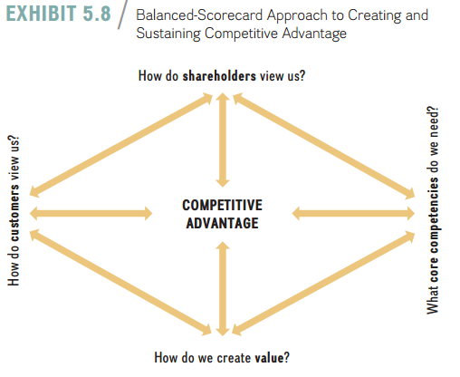
Lecture 5
Competitive Advantage, Firm Performance, and Business Models
1. How do customers view us? The customer’s perspective concerning the company’s products and services links directly to its revenues and profits. Consumers decide their reservation price for a product or service based on how they view it.
2. How do we create value? Answering this question challenges managers to develop strategic objectives that ensure future competitiveness, innovation, and organizational learning. The answer focuses on the business processes and structures that allow a firm to create economic value.
3. What core competencies do we need? This question focuses managers internally, to identify the core competencies needed to achieve their objectives and the accompanying business processes that support, hone, and leverage those competencies.
4. How do shareholders view us? The final perspective in the balanced scorecard is the shareholders’ view of financial performance (as discussed in the prior section).

Slide 27
Lecture 5
Competitive Advantage, Firm Performance, and Business Models
Advantages of The Balanced Scorecard: The balanced-scorecard approach is popular in managerial practice because it has several advantages. In particular, the balanced scorecard allows managers to:
■ Communicate and link the strategic vision to responsible parties within the organization.
■ Translate the vision into measurable operational goals.
■ Design and plan business processes.
■ Implement feedback and organizational learning to modify and adapt strategic goals when indicated.

Slide 28
Lecture 5
Competitive Advantage, Firm Performance, and Business Models
Disadvantages of The Balanced Scorecard: Though widely implemented by many businesses, the balanced scorecard is not without its critics. It is important to note that the balanced scorecard is a tool for strategy implementation, not for strategy formulation. It is up to a firm’s managers to formulate a strategy that will enhance the chances of gaining and sustaining a competitive advantage. In addition, the balanced-scorecard approach provides only limited guidance about which metrics to choose. Different situations call for different metrics. All of the three approaches to measuring competitive advantage—accounting profitability, shareholder value creation, and economic value creation—in addition to other quantitative and qualitative measures can be helpful when using a balanced-scorecard approach.

Slide 29
Lecture 5
Competitive Advantage, Firm Performance, and Business Models
- The Triple Bottom line
Today, managers are frequently asked to maintain and improve not only the firm’s economic performance but also its social and ecological performance. CEO Indra Nooyi responded by declaring PepsiCo’s vision to be Performance with Purpose defined by goals in the social dimension (human sustainability to combat obesity by making its products healthier, and the whole person at work to achieve work/life balance) and ecological dimension (environmental sustainability in regard to clean water, energy, recycling, and so on), in addition to firm financial performance.

Slide 30
Lecture 5
Competitive Advantage, Firm Performance, and Business Models
Three dimensions—economic, social, and ecological—make up the triple bottom line, which is fundamental to a sustainable strategy. These three dimensions are also called the three Ps: profits, people, and planet:
■ Profits. The economic dimension captures the necessity of businesses to be profitable to survive.
■ People. The social dimension emphasizes the people aspect, such as PepsiCo’s initiative of the whole person at work.
■ Planet. The ecological dimension emphasizes the relationship between business and the natural environment.

Slide 31

Lecture 5
Competitive Advantage, Firm Performance, and Business Models
As the intersection of the three ovals (profits, people, and planet) in Exhibit 5.9 suggests, achieving positive results in all three areas can lead to a sustainable strategy. Rather than emphasizing sustaining a competitive advantage over time, sustainable strategy means a strategy that can be pursued over time without detrimental effects on people or the planet.

Slide 32
Lecture 5
Competitive Advantage, Firm Performance, and Business Models
5.2 Business Models: Putting Strategy into Action
Strategy is a set of goal-directed actions a firm takes to gain and sustain superior performance relative to competitors or the industry average. The translation of strategy into action takes place in the firm’s business model, which details the firm’s competitive tactics and initiatives. Simply put, the firm’s business model explains how the firm intends to make money. The business model stipulates how the firm conducts its business with its buyers, suppliers, and partners.

Slide 33
Lecture 5
Competitive Advantage, Firm Performance, and Business Models
How companies do business can sometimes be as important to gaining and sustaining competitive advantage as what they do. This also implies that business model innovation might be as important as product or process innovation.

Slide 34
Lecture 5
Competitive Advantage, Firm Performance, and Business Models
- popular Business models
Given their critical importance to achieving competitive advantage, business models are constantly evolving. Below we will discuss the some of the more popular business models:
■ Razor-razorblades. The initial product is often sold at a loss or given away for free in order to drive demand for complementary goods.

Slide 35
Lecture 5
Competitive Advantage, Firm Performance, and Business Models
■ Subscription. The subscription model has been traditionally used for (print) magazines and newspapers. Users pay for access to a product or service whether they use the product or service during the payment term or not.
■ Pay as you go. In the pay-as-you-go business model, users pay for only the services they consume.
■ Freemium. The freemium (free + premium) business model provides the basic features of a product or service free of charge, but charges the user for premium services such as advanced features or add-ons.

Slide 36
Lecture 5
Competitive Advantage, Firm Performance, and Business Models
■ Wholesale. The traditional model in retail is called a wholesale model. Let’s look at the book publishing industry as an example. Under the wholesale model, book publishers would sell books to retailers at a fixed price (usually 50 percent below the recommended retail price).
■ Agency. In this model the producer relies on an agent or retailer to sell the product, at a predetermined percentage commission.
■ Bundling. The bundling business model sells products or services for which demand is negatively correlated at a discount.

Slide 37
Lecture 5
Competitive Advantage, Firm Performance, and Business Models
- Dynamic Nature Of business models
Business models evolve dynamically, and we can see many combinations and permutations. Sometimes business models are tweaked to respond to disruptions in the market, efforts that can conflict with fair trade practices and may even prompt government intervention.

Slide 38
Lecture 5
Competitive Advantage, Firm Performance, and Business Models
Combination. Telecommunications companies such as AT&T or Verizon, to take one industry, combine the razor-razorblade model with the subscription model.
Evolution. The freemium business model can be seen as an evolutionary variation on the razor-razorblade model. The base product is provided free, and the producer finds other ways to monetize the usage.
Disruption. When introducing the agency model, we mentioned Apple and book publishing, and you may already know how severely Amazon disrupted the traditional whole-sale model for publishers.

Slide 39
Lecture 5
Competitive Advantage, Firm Performance, and Business Models
response to Disruption. The market is dynamic.
legal conflicts. The rapid development of business models, especially in response to disruption, can lead producers to breach existing rules of commerce.

Slide 40
Lecture 5
Competitive Advantage, Firm Performance, and Business Models
References:
Strategic management, third edition, 2017
By; Frank t. Rothaermel
Georgia Institute of Technology
Chapter 5

