Slide 1



Business Data Analysis
MGM509
Lecture 8
Reasoning Under Uncertainty:
Bayesian Thinking and Evidence Models
Prepared by
Eng. Ahmed Hussein, MBA, PfMP©, PMP©, CMP APMG

Slide 2

Lecture
What we will cover
8
Probabilistic Thinking and Bayesian Reasoning
Probabilistic Classification and Decision Thresholds
Lift, Ranking, and Model Evaluation Tools
Decision Support Using Expected Value and Utility
8 – 2

Slide 3


Probabilistic Thinking and Bayesian Reasoning
Lecture
08
8 – 3

Slide 4
Lecture
Why Probabilities Matter in Data Science?
8
Business decisions are made under uncertainty.
Probabilities quantify belief based on data.
Help make informed, evidence-based predictions.
Provide a framework for learning from new data.
8 – 4

Slide 5
Lecture
From Data to Decision
8
Raw data lacks context until interpreted probabilistically.
Data science models help map evidence to likelihoods.
Supports risk assessment and resource allocation.
Foundation of automated decision-making systems.
8 – 5

Slide 6
Lecture
The Role of Evidence
8
Examples:
  Predicting churn in telecom and SaaS.
  Fraud detection using transaction patterns.
  Credit risk scoring in financial services.
  Spam filtering based on email features.
Evidence shifts or supports our belief in a hypothesis.
Probabilities enable belief updating over time.
Enables predictive modeling and scenario planning
8 – 6

Slide 7
Lecture
What is Bayes Rule?
8
Developed by Thomas Bayes (1701–1761).
A rule to revise existing beliefs with new evidence.
Core tool in reasoning from incomplete information.
Bridges data and decision-making.
8 – 7

Slide 8
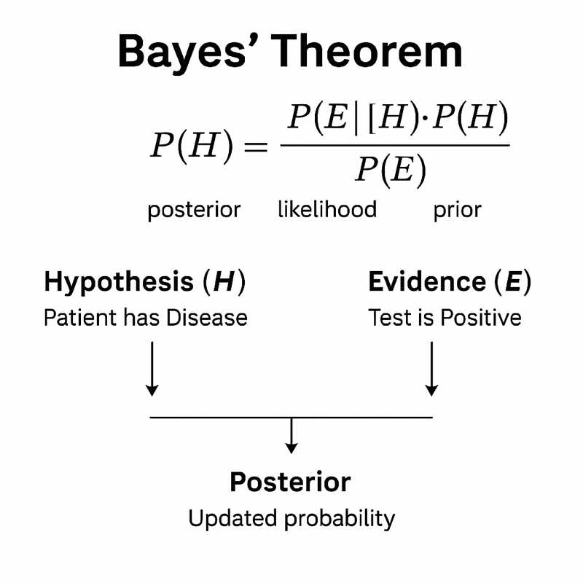
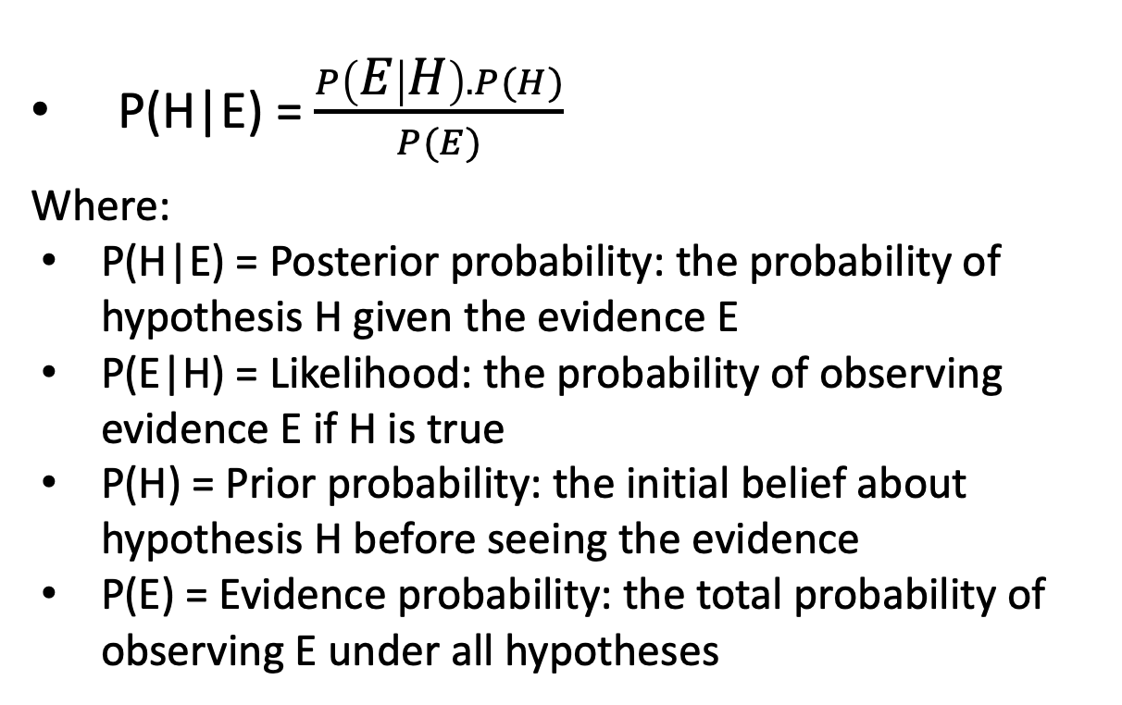
Lecture
What is Bayes Rule?
8
P(H|E) = $\frac{P\left(E | H\right).P(H)}{P(E)}$
Where:
  P(H|E) = Posterior probability: the probability of hypothesis H given the evidence E
  P(E|H) = Likelihood: the probability of observing evidence E if H is true
  P(H) = Prior probability: the initial belief about hypothesis H before seeing the evidence
  P(E) = Evidence probability: the total probability of observing E under all hypotheses
8 – 8

Slide 9
Lecture
Understanding Priors and Likelihood
8
Prior probability
Likelihood
Based on expert knowledge or historical data.
Can be subjective or empirical.
Strong priors influence conclusions, especially with limited data.
Priors reduce noise in sparse datasets.
Measures how expected the evidence is under a hypothesis.
Crucial for distinguishing between competing explanations.
Helps assess how data supports a belief.
Drives the strength of belief revision.
8 – 9

Slide 10
Lecture
Posterior Probability
8
Result of applying Bayes Rule.
Guides updated decisions and predictions.
Reflects new evidence combined with existing knowledge.
Used in classifiers, diagnostics, forecasting.
8 – 10

Slide 11
Lecture
Bayesian Example: Medical Diagnosis
8
Problem: A disease affects 1% of the population. A test for the disease is 99% accurate (true positive rate), but also has a 5% false positive rate.
If someone tests positive, What’s the probability they actually have the disease?
8 – 11

Slide 12
Lecture
Step-by-step using Bayes’ Theorem:
8
Let:
H = Patient has the disease
E = Test result is positive
Known:
P(H) = 0.01 (1% of population has the disease)
P(¬H) = 0.99 (99% don’t)
P(E|H) = 0.99 (true positive rate)
P(E|¬H) = 0.05 (false positive rate)
8 – 12

Slide 13
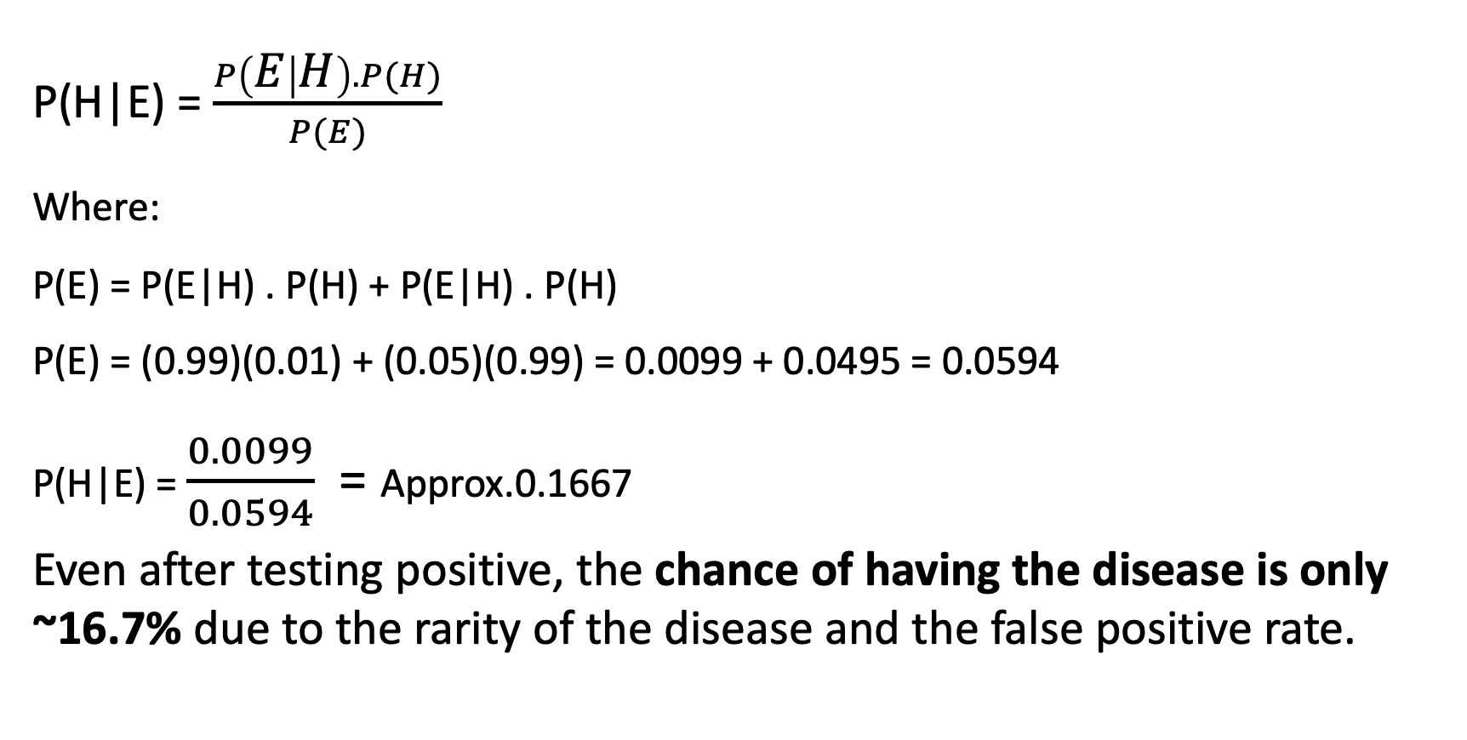
Lecture
Step-by-step using Bayes’ Theorem:
8
P(H|E) = $\frac{P\left(E | H\right).P(H)}{P(E)}$
Where:
P(E) = P(E|H) . P(H) + P(E|H) . P(H)
P(E) = (0.99)(0.01) + (0.05)(0.99) = 0.0099 + 0.0495 = 0.0594
P(H|E) = $\frac{0.0099}{0.0594}$ = Approx.0.1667
Even after testing positive, the chance of having the disease is only ~16.7% due to the rarity of the disease and the false positive rate.
8 – 13

Slide 14
Lecture
Bayesian vs Frequentist Thinking
8
Aspect | Bayesian Thinking | Frequentist Thinking
Definition of Probability | Degree of belief or certainty, subjective | Long-run frequency of events
Prior Knowledge | Explicitly includes prior beliefs (prior probability) | Assumes no prior beliefs; relies solely on sample data
Updates with New Data | Uses Bayes’ Theorem to revise beliefs as data accumulates | Data is fixed; probability only comes from long-term repeated trials
Typical Output | Posterior distribution (a probability distribution of outcomes) | Point estimates, confidence intervals, p-values
Interpretation of Parameters | Parameters are random variables (with distributions) | Parameters are fixed constants; data is random
Use Cases | Small datasets, dynamic models, decision-making under uncertainty | Large datasets, hypothesis testing, classical inference
Example | “There’s a 70% chance this customer will churn.” | “If we repeated this test 100 times, 95% of intervals would contain the true mean.”
8 – 14

Slide 15
Lecture
Common Misinterpretations of Probabilities
8
Base rate fallacy: ignoring prior probabilities.
Confusing P(A|B) with P(B|A).
Misreading conditional probabilities.
Avoid by explicitly modeling priors and evidence.
8 – 15

Slide 16
Lecture
Inverse Reasoning
8
Inverse reasoning is the process of reasoning from observed evidence back to the most probable cause or explanation.
It is central to Bayesian inference, where we want to compute:
P(Hypothesis|Evidence)
This is opposite of what most models directly give us (i.e., P(Evidence | Hypothesis)).
Using Bayes’ Rule, we “invert” the known probability to get the one we want.
8 – 16

Slide 17
Lecture
Example of Inverse Reasoning
8
You observe a customer who hasn’t logged in for 3 weeks and downgraded their subscription.
You want to know: → What is the probability that this customer will churn (leave)?
This is P(Churn | Observed Behavior) — inverse reasoning.
But your data model gives: P(Observed Behavior | Churn) — how likely a churned customer behaves this way.
Using Bayes’ Rule, you compute the inverted probability:
P(Churn | Behavior) = P(Behavior | Churn) . P(Churn)} / P(Behavior)
8 – 17

Slide 18
Lecture
Probabilistic Classification and Decision Thresholds
08
8 – 18

Slide 19
Lecture
Probabilities in Classification
8
Classification predicts category labels.
Probabilistic classifiers predict likelihood of each class.
Allows flexible decision thresholds.
Supports confidence-based predictions.
8 – 19

Slide 20
Email Spam Detection Using Probabilistic Classification
Lecture
8
The Problem: You receive a new email that contains the word “free”.
You want to calculate: → What is the probability this email is spam? → That is, P(Spam | “free”)
Given From historical data:
P(Spam) = 0.3 → 30% of all emails are spam
P(“free” | Spam) = 0.6 → 60% of spam emails contain “free”
P(“free” | Not Spam) = 0.1 → Only 10% of legitimate emails contain “free”
P(Not Spam) = 0.7
8 – 20

Slide 21
Email Spam Detection Using Probabilistic Classification
Lecture
8
P(Spam | free ) = P( free | Spam) . P(Spam) / P(free). (Bayes’ Rule)
First calculate P(“free”):
P(free) = P(free | Spam) . P(Spam) + P(free | Not Spam) . P(Not Spam)
P(free) = (0.6)(0.3) + (0.1)(0.7) = 0.18 + 0.07 = 0.25
Now apply Bayes:
P(Spam | free ) = 0.6 . 0.3 / 0.25 = 0.18/0.25 = 0.72
There is a 72% probability that the email is spam if it contains the word “free.”
8 – 21

Slide 22
Lecture
Naive Bayes Classifier
8
A Naive Bayes Classifier is a simple and effective probabilistic machine learning algorithm based on Bayes’ Theorem.
It is called “naive” because it assumes that all input features are independent of each other given the class label — an assumption that is rarely true in real-world data, but often works surprisingly well in practice.
Very efficient for high-dimensional data.
Popular in text classification.
8 – 22

Slide 23
Lecture
How it works (Simplified)?
8
Learn the probability of each class (e.g., spam vs. not spam).
Learn the probability of each feature value given a class.
Apply Bayes’ Theorem to calculate the probability of each class given a new observation.
Choose the class with the highest probability.
Example Use Case: In email spam detection, the classifier calculates:
P(Spam} | Free, “Offer”, “Buy”}) vs. P(Not Spam | Free, “Offer”, “Buy”)
It selects the label (spam or not) with the higher probability.
8 – 23

Slide 24
Lecture
Why Naive Bayes Works Well?
8
Feature | Benefit
Fast and scalable | Works well with large datasets, especially text
Simple and interpretable | Easy to understand and implement
Performs well on text data | Excellent for spam detection, sentiment analysis, etc.
Requires little training data | Can work with small datasets effectively
Robust to irrelevant features | Even if independence assumption is violated somewhat
8 – 24

Slide 25
Lecture
Applications in Business
8
Sentiment analysis in social media.
Loan default prediction.
Product recommendation systems.
Customer segmentation.
8 – 25

Slide 26
Lecture
Calibration vs. Sharpness
8
Concept | Measures | Goal
Calibration | How well predicted probabilities match reality | Match predicted confidence to actual outcomes
Sharpness | Concentration of predictions around 0 or 1 | Make confident, decisive predictions
8 – 26

Slide 27
Lecture
Thresholding & Decision Making
8
Thresholding is the process of converting a continuous probability score (output by a classifier) into a binary decision by setting a cutoff value called a threshold.
Lower threshold = fewer false negatives.
Higher threshold = fewer false positives.
Balance depends on cost of each error.
Probability | Threshold = 0.5 | Threshold = 0.7
0.82 | ✅ Positive | ✅ Positive
0.65 | ✅ Positive | ❌ Negative
0.45 | ❌ Negative | ❌ Negative
Use Cases:
Fraud detection: raise threshold to avoid false alarms
Medical diagnosis: lower threshold to catch all possible positives
Churn prediction: tune threshold based on customer lifetime value
8 – 27

Slide 28
Lecture
ROC Curves and Tradeoffs
8
ROC (Receiver Operating Characteristic) Plots:
  X-axis: False Positive Rate (FPR) = FP / (FP + TN)
  Y-axis: True Positive Rate (TPR) = TP / (TP + FN), also called Recall
TPR vs. FPR at various thresholds.
Helps visualize model trade-offs.
Used to compare classifier quality.
As you adjust the threshold, you affect both:
True Positives (TP): Catching real positives
False Positives (FP): Incorrectly flagging negatives as positives
8 – 28

Slide 29
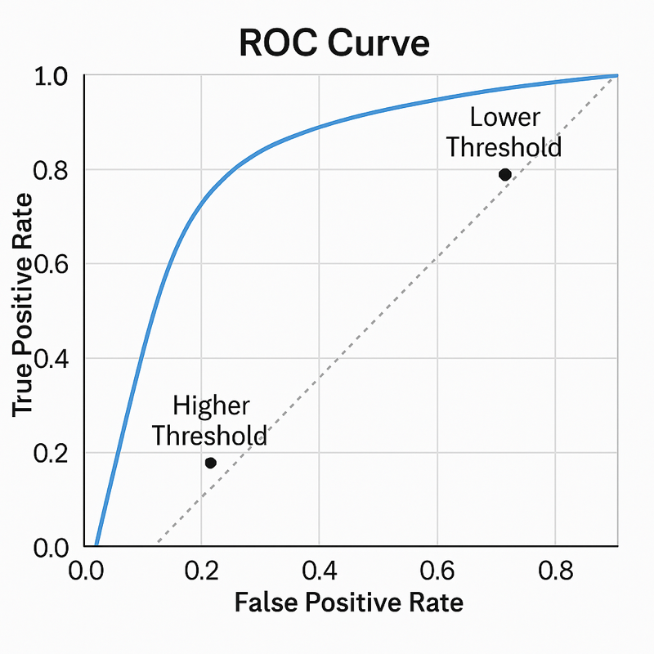
Lecture
Example: ROC Curve
8
Show true positive vs. false positive rate.
Point closest to top-left = best threshold.
8 – 29

Slide 30
Lecture
What Is Evidence Lifting?
8
Lift is a metric that measures how much better a predictive model is at identifying positives compared to random guessing. It’s widely used in classification, marketing, and risk modeling to evaluate the effectiveness of a model or targeting strategy.
Lift = P(target | evidence) / P(target)
Compares conditional vs. unconditional probabilities.
Used for feature evaluation & ranking.
Helps rank predictors in modeling.
  Lift > 1: positive evidence.
  Lift = 1: neutral.
  Lift < 1: negative evidence.
8 – 30

Slide 31
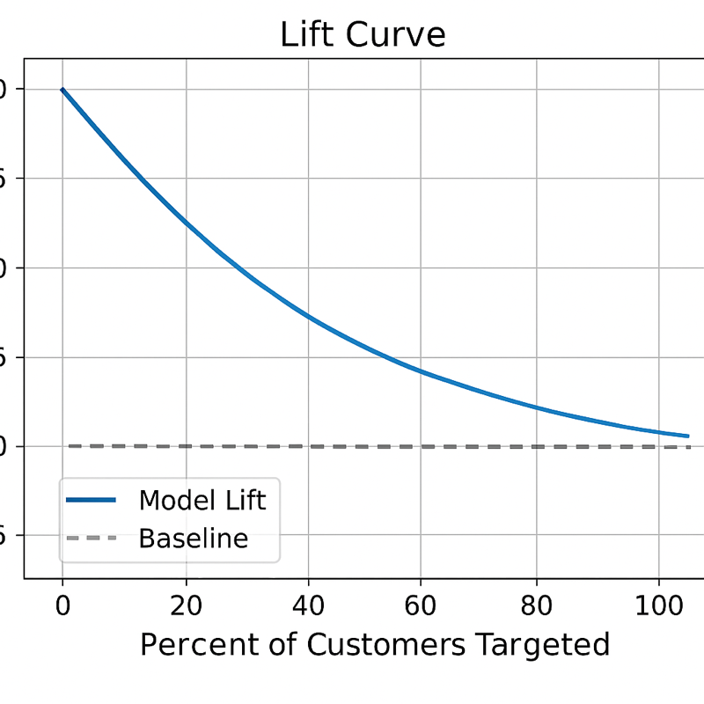
Lecture
Visualizing a Lift Curve
8
X-axis: % of population contacted.
Y-axis: % of total responders captured.
Steeper curve = better model.
Include sample chart..
8 – 31

Slide 32
Lecture
Common Applications of Lift
8
Marketing Campaigns & Targeting
Use Case: Identifying high-value customers likely to respond to a promotion.
How Lift Helps: Measures how much better the campaign performs by targeting the top decile vs. the general population.
Example: A lift of 4 in the top 10% means those customers are 4× more likely to respond than average.
Churn Prediction
Use Case: Prioritizing customers most likely to leave a service.
How Lift Helps: Helps allocate retention resources more effectively by targeting customers with the highest lift scores.
Fraud Detection
Use Case: Identifying transactions likely to be fraudulent.
How Lift Helps: Lift charts can show how concentrating on top-scoring transactions increases fraud detection efficiency.
8 – 32

Slide 33
Lecture
Common Applications of Lift
8
Credit Scoring and Risk Modeling
Use Case: Ranking applicants by likelihood of default.
How Lift Helps: Lift shows how much more likely default is among top-risk groups, aiding in cut-off score decisions.
5. Recommender Systems
• Use Case: Showing users content/products they’re most likely to engage with.
• How Lift Helps: Measures improvement in click-through or conversion vs. random recommendations.
8 – 33

Slide 34
Lecture
Lift vs. ROC Curve
8
Feature | Lift Curve | ROC Curve
Purpose | Measures model performance relative to random | Evaluates model’s ability to discriminate between classes
X-axis | % of population (or customers) sorted by score | False Positive Rate (FPR)
Y-axis | Lift = TPR / Baseline Rate (random targeting) | True Positive Rate (TPR)
Shows | How much better the model is than random guessing in top segments | The trade-off between sensitivity and false positives
Interprets | Model’s usefulness for targeting (e.g., top decile) | Model’s threshold-independent performance
Best Use Case | When you want to target a top % of ranked list | When you want to evaluate overall classifier quality
Business Focused? | ✅ Yes – actionable (target top X%) | ❌ Less direct; more technical/diagnostic
8 – 34

Slide 35
Lecture
Cautions in Using Lift
8
Lift can be unstable with rare events.
May overfit if not validated.
Validate on holdout or cross-validated sets.
Combine with other metrics for robustness...
8 – 35

Slide 36
Lecture
Decision-Making with Probabilities
08
8 – 36

Slide 37
Lecture
Decision Making with Probabilities
8
Use probabilities as inputs to decisions.
Estimate expected utility or value.
Incorporate risk tolerance and business goals.
Decision trees often use this framework.
8 – 37

Slide 38
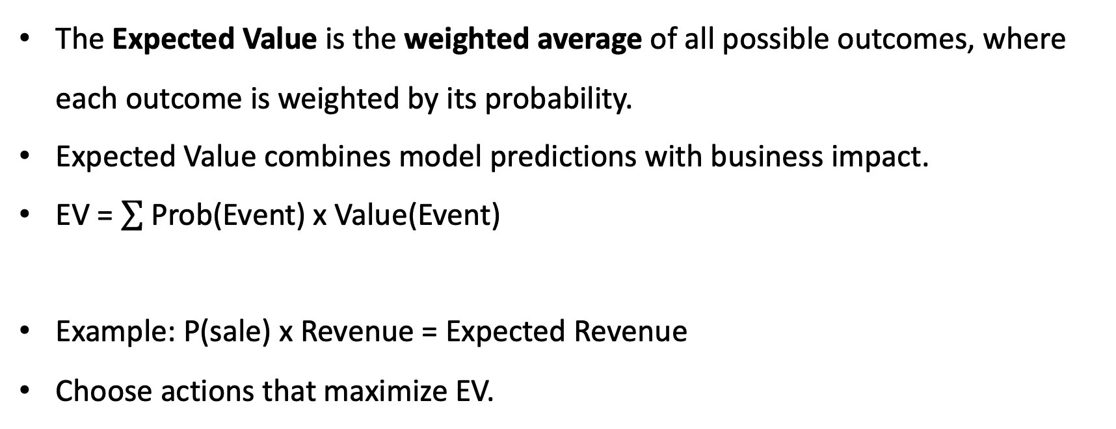
Lecture
Expected Value and Business Payoff
8
The Expected Value is the weighted average of all possible outcomes, where each outcome is weighted by its probability.
Expected Value combines model predictions with business impact.
EV = Prob(Event) x Value(Event)
Example: P(sale) x Revenue = Expected Revenue
Choose actions that maximize EV.
8 – 38

Slide 39
Lecture
Example: Customer Churn Intervention
8
Outcome | Probability | Payoff (Value) | Contribution to EV
Correctly saves a customer (TP) | 0.4 | +$500 | 0.4 × 500 = +$200
Offers discount to loyal customer (FP) | 0.2 | –$50 | 0.2 × –50 = –$10
Misses actual churner (FN) | 0.1 | –$400 | 0.1 × –400 = –$40
Correctly ignores non-churner (TN) | 0.3 | $0 | 0.3 × 0 = $0
Total Expected Value |  |  | $150
This means each customer decision yields $150 on average, justifying the use of the model
8 – 39

Slide 40
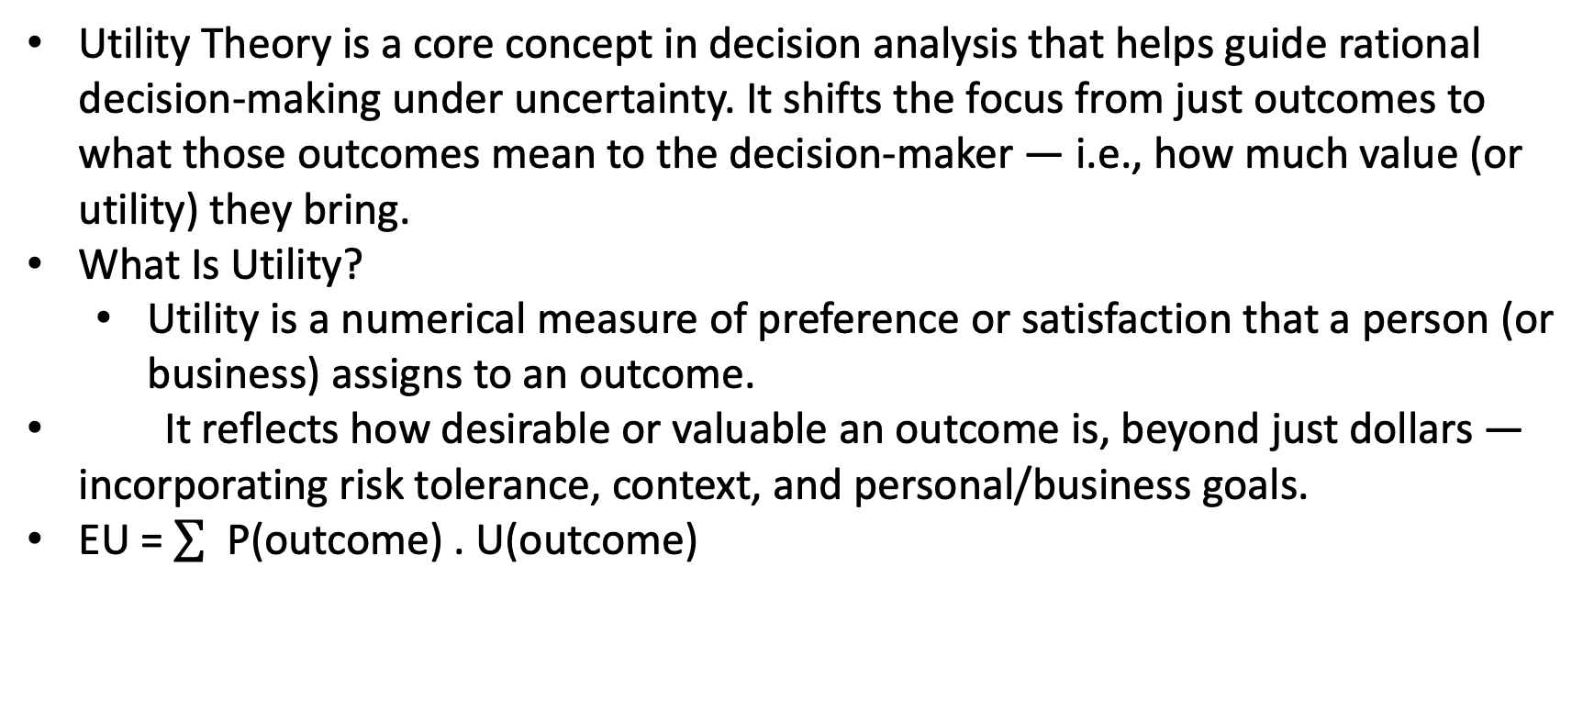
Lecture
Utility Theory in Decisions
8
Utility Theory is a core concept in decision analysis that helps guide rational decision-making under uncertainty. It shifts the focus from just outcomes to what those outcomes mean to the decision-maker — i.e., how much value (or utility) they bring.
What Is Utility?
  Utility is a numerical measure of preference or satisfaction that a person (or business) assigns to an outcome.
It reflects how desirable or valuable an outcome is, beyond just dollars — incorporating risk tolerance, context, and personal/business goals.
EU = P(outcome) . U(outcome)
8 – 40

Slide 41
Lecture
Utility vs. Monetary Value
8
Scenario | How Utility Helps
Marketing | Target customers based on expected utility, not just conversion
Credit Risk | Approve loans that align with risk-adjusted utility, not just profit
Medical AI | Recommend treatments considering patient preferences and risks
Customer Retention | Offer incentives where the utility of keeping a customer outweighs the cost
Fraud Detection | Balance false positives vs. false negatives based on utility of outcomes
Two decisions may have the same expected monetary value, but different utilities, especially when risk is involved.
Example:
  $1000 guaranteed = Utility = High
  50% chance of $2000 or $0 = Same expected value, but lower utility if you’re risk-averse
8 – 41

Slide 42
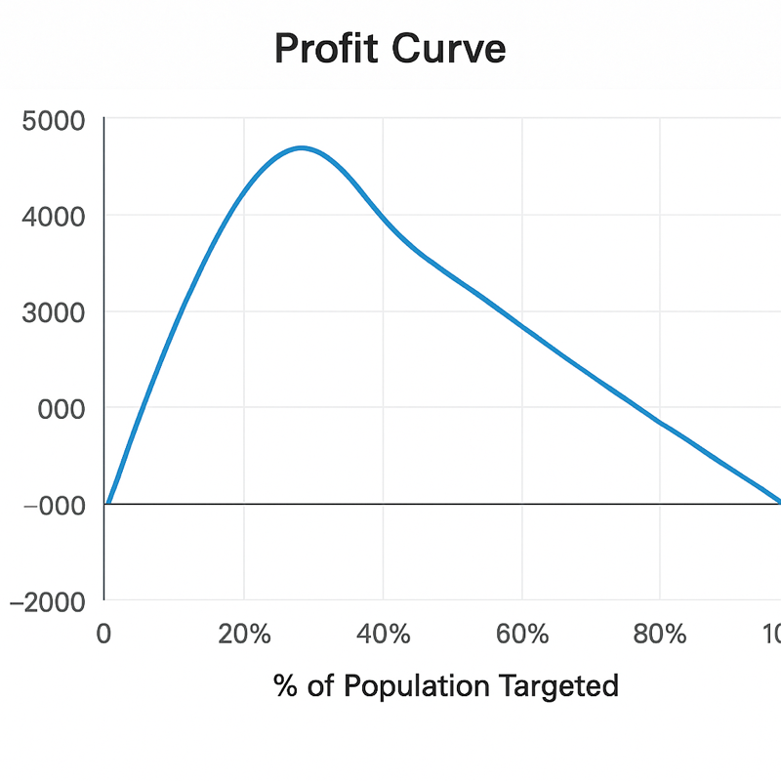
Lecture
Profit Curves
8
A profit curve shows how much profit a classification model generates as a function of how many top-ranked predictions (e.g., customers) you act upon.
X-axis: % of the population targeted (e.g., top 10%, 20%, …, 100%)
Y-axis: Profit or expected value (e.g., revenue gained – cost incurred)
Unlike ROC or precision-recall curves, profit curves:
  Integrate domain-specific cost-benefit values
  Answers: “How much money will this model help us make (or save)?”
  Help choose the optimal cutoff point
8 – 42

Slide 43
Lecture
Example: Churn Campaign Profit Curve
8
% Targeted
True Positives
False Positives
Profit
10%
80
20
$3,500
20%
140
60
$5,000
100%
200
300
–$2,000
% Targeted | True Positives | False Positives | Profit
10% | 80 | 20 | $3,500
20% | 140 | 60 | $5,000
100% | 200 | 300 | –$2,000
→ Best profit at 20% targeting level: Model helps maximize ROI by focusing only on top scores.
8 – 43

Slide 44
Lecture
Key Points
8
Probabilistic Models Provide Confidence, Not Certainty
Unlike simple classifications, probabilistic models output likelihoods, enabling nuanced decisions based on uncertainty and expected outcomes.
Bayes’ Theorem Enables Inverse Reasoning
Bayes’ Rule updates prior beliefs using observed evidence. It’s essential for reasoning from effect to cause — a common task in
Naive Bayes Classifier Assumes Feature Independence
Despite its “naive” assumption, Naive Bayes performs well in many real-world scenarios (like spam detection and sentiment analysis)
Calibration and Expected Value Connect to Business Decisions
A well-calibrated model aligns predicted probabilities with actual outcomes. Expected Value (EV) quantifies the payoff of acting on
Bayesian Thinking Enhances Decision Quality Under Uncertainty
By incorporating prior knowledge and evidence, Bayesian reasoning supports better choices — especially in low-data or high-risk
domains like medicine, finance, and cybersecurity.
predictions, guiding cost-benefit decision-making.
due to its simplicity and speed.
diagnostics, fraud, and risk modeling.
8 – 44

Slide 45

For Discussion Panel and Next Lecture:
Chapter 9 “Evidence and Probabilities”
Lecture
8
For Discussion Panel and Next Lecture
8 – 45

Slide 46



Thank You

