Slide 1

PRESENTATION AND WRITING SKILLS lecture No. 6
BY
Dr. Manal El-Sayed
MGM223

Slide 2


lecture No. 6
Categories of nonverbal messages and business Etiquette in the online communication

Slide 3
Test your knowledge for the previous lecture
how to improve your listening skills
Who are the effective listeners.
Know about the listening process.
Determine the listening process barriers.
Improving nonverbal communication
know nonverbal signals
Develop your presentation skills.

Slide 4

Lecture 6
Learning objectives
Categories of Nonverbal Communication
Identify nonverbal signals.
Gestures and postures
Misreading and Faking
Developing Your Business Etiquette.
How to communicate online.
Business Etiquette

Slide 5
Categories of Nonverbal Communication
Pay attention that:
Nonverbal signals are powerful, they aren’t infallible غير معصومة من الخطأ .
The range and variety of nonverbal signals is almost endless.
you can understand the basics by studying six general categories.

Slide 6
Lecture 6
Categories of Nonverbal Communication

Slide 7

Universal Gestures
the following gesture consists of pulling the sides of the mouth upwards and usually showing the teeth.
This gesture is universally known as Smiling and is recognized by just about anyone from any culture.

Slide 8

Universal Gestures
It is therefore easily recognized regardless of factors such as culture, language, education or nationality.
Recognition of universal gestures greatly increases the efficiency of
our communications.

Slide 9

Misreading and Faking
When reading body language, always beware of misinterpretations

Slide 10
Misreading and Faking
A person might feel tired and use certain signals that should not be interpreted as bored or disinterested.

Slide 11
Misreading and Faking
A person might be wearing tight clothing that limits his or her movements and the kind of gestures they can make.
Notes:
In any collaborative effort, recognize that team members coming from different backgrounds may have different work habits or priorities. To collaborate effectively, everyone involved must be flexible, open to other opinions, and focused on team objectives rather than on individual priorities. The following guidelines will help you work together more successfully:
Select collaborators carefully. Choose a combination of people who have the experience, information, and talent needed for each project.
Agree on project goals before you start. Starting without a clear idea of what you hope to accomplish will lead to frustration and wasted time.
Give your team time to bond before diving in. Make sure people can get to know each other before being asked to collaborate.
Clarify individual responsibilities. This is essential because team members will be depending on each other.

Slide 12

Facial Expressions
Your face is the primary site for expressing your emotions; it reveals both the type and the intensity of your feelings. However, facial signals can vary widely from culture to culture.

Slide 13
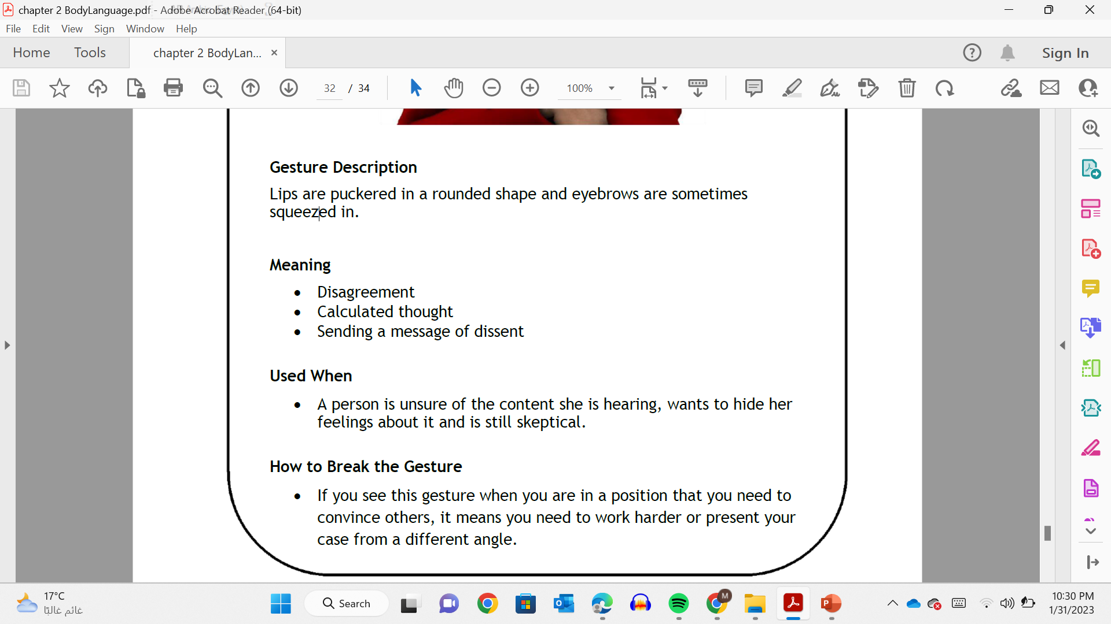

Slide 14

Gesture and postures.
المواقف والإيماءات
Many gestures—a wave of the hand, for example—have a specific and intentional meaning. Other types of body movement are unintentional and express a more general message.

Slide 15
Positive versus Negative Body
Language
Open gestures VS
Closed gestures
An important quality of gestures is whether they are open or closed.
Notes:
In any collaborative effort, recognize that team members coming from different backgrounds may have different work habits or priorities. To collaborate effectively, everyone involved must be flexible, open to other opinions, and focused on team objectives rather than on individual priorities. The following guidelines will help you work together more successfully:
Select collaborators carefully. Choose a combination of people who have the experience, information, and talent needed for each project.
Agree on project goals before you start. Starting without a clear idea of what you hope to accomplish will lead to frustration and wasted time.
Give your team time to bond before diving in. Make sure people can get to know each other before being asked to collaborate.
Clarify individual responsibilities. This is essential because team members will be depending on each other.

Slide 16
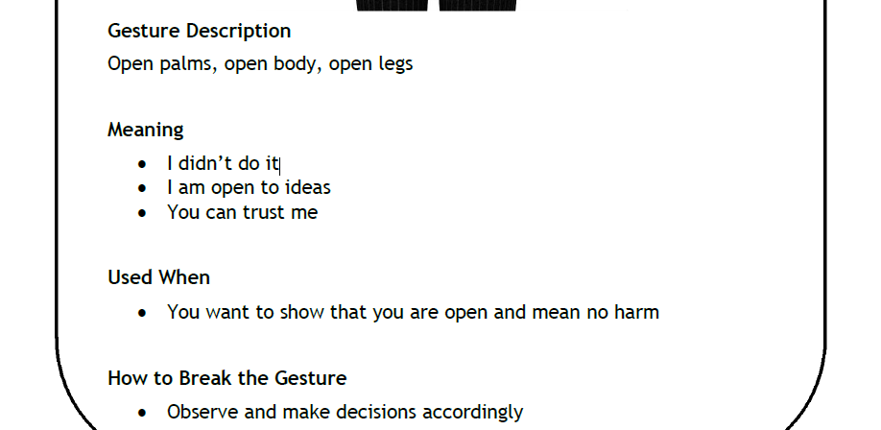
Open gestures
are encouraging, inviting and non-aggressive.

Slide 17
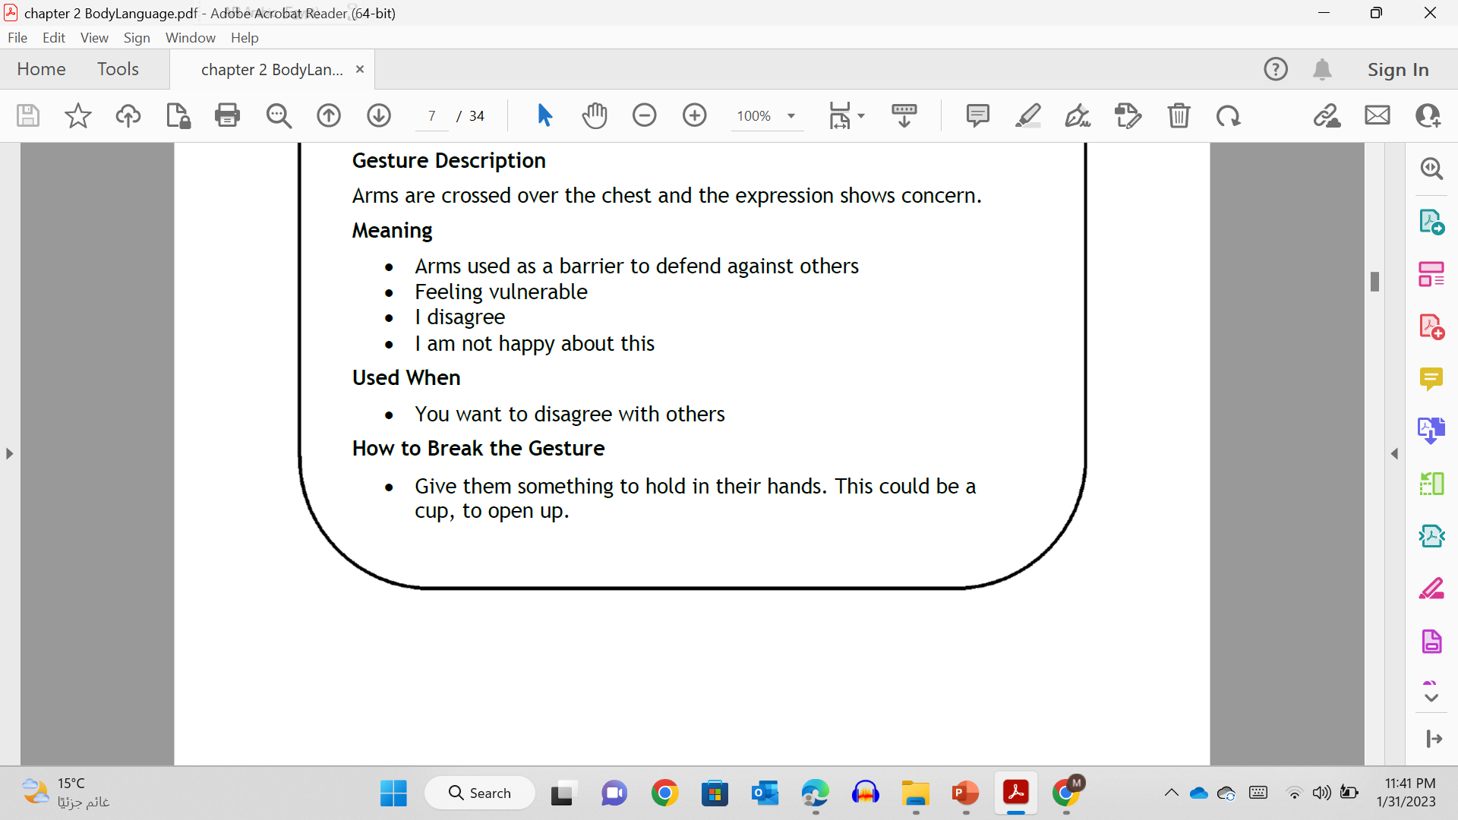
Closed gestures
are defensive and can easily be interpreted as aggressive. They may show that you feel you are under attack..

Slide 18
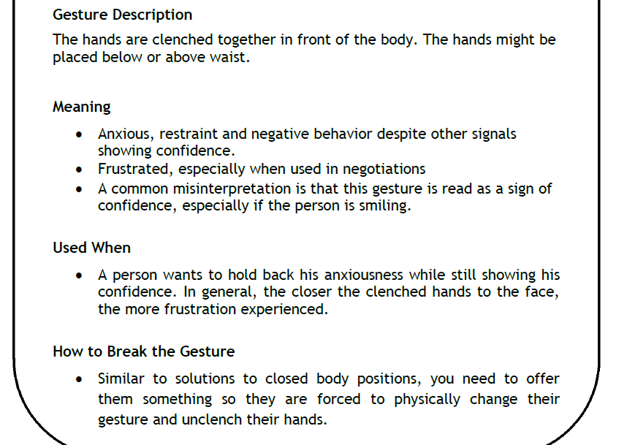
Hands Clenched
Notes:
تستخدم عندما
• يريد الشخص كبح قلقه بينما لا يزال يظهر
ثقة. بشكل عام ، كلما اقتربت الأيدي المشدودة من الوجه ،
كلما زاد الشعور بالإحباط.
كيفية كسر الإيماءة
• على غرار حلول أوضاع الجسم المغلقة ، تحتاج إلى تقديم
لهم شيء حتى يضطروا إلى تغيير جسديا
إيماءة وفك أيديهم.

Slide 20

Vocal characteristics.
Your voice also carries both intentional and unintentional messages.
Your tone and volume, as well as your accent and speaking pace say a lot about who you are, your relationship with the audience, and the emotions underlying your words.

Slide 21
Vocal characteristics.
People respond to others based on their physical appearance,
sometimes fairly and other times unfairly. Grooming, clothing, accessories, style—you can control all of these.
If your goal is to make a good impression, adopt the style of the people you want to impress.

Slide 22

Touch.
Touch is an important way to convey warmth, comfort, and reassurance. Touch is so powerful, in fact, that cultural customs govern touching behavior.

Slide 23

Time and space.
Time and space can be used to assert authority, imply intimacy العلاقة القوية, and send other nonverbal messages.
Keep in mind that expectations regarding both time and space vary by culture.

Slide 24

Developing Your Business Etiquette

Slide 25

Developing Your Business Etiquette
In Social Settings

Slide 26
Lecture 6
Developing Your Business Etiquette

Slide 27
In the Workplace
First Impressions
From business lunches to industry conferences, you represent your company when you are out in public.
Make sure that your appearance and actions are appropriate to the situation.
First impressions last a long time, so get to know the customs of the culture when you meet new people.

Slide 28
In the Workplace
Personal Appearance
Your personal appearance often has considerable impact on your career success.
Pay attention to the style of dress where you work and adjust your style to match.

Slide 29
In the Workplace
Personal Appearance
In addition to your clothing, grooming الهيئة affects the impression you give others in the workplace.
Pay close attention to cleanliness and avoid using products with powerful or perfumed scents.

Slide 30
In the Workplace
Personal Demeanor
السلوك الشخصي
is a vital element of workplace harmony.
No one expects you to be artificially upbeat يصطنع التفاؤل every second of the day, but a single negative personality can make an entire office miserable and unproductive.

Slide 31
In the Workplace
Personal Demeanor
السلوك الشخصي
Every person in the company has a responsibility to contribute to a positive, energetic work environment.

Slide 32
In the Workplace
Phone Skills or Habits
Phone skills will have a definite impact on your career success.
Like every other aspect of communication, your phone habits say a lot about how much respect you have for the people around you because phone calls lack the visual richness of face-to-face conversations,

Slide 33
In the Workplace
Phone Skills or Habits
you must rely on your attitude and tone of voice to convey confidence and professionalism.
Cell phones are a contentious point of etiquette in today’s workplace.
Don’t be surprised if you encounter policies restricting their use in offices or meeting rooms.

Slide 34
Developing Your Business Etiquette
In Social Settings

Slide 35
In Social settings
Personal Introductions
When introducing yourself, include a brief description of your role in the company.
When introducing two other people, speak both their first and last names clearly, and then try to offer some information (perhaps a shared professional interest) to help these two people ease into a conversation.

Slide 36
In Social settings
Business Meals
knowing the basics of dining etiquette will make you more effective in these situations.
Choose foods that are easy to eat while you are trying to carry on a conversation.
Leave business papers under your chair until entrée plates have been removed; the business aspect of the meal usually doesn’t begin until then.

Slide 37
In Social settings
Business Meals
Finally, remember that business meals are a forum for business, period.
Avoid topics that are likely to stir up emotions.
Do not complain about work, avoid profanityتجنب الألفاظ النابية , and be careful with humor.

Slide 38
In Social settings
Cellular Phones
Misuse of cell phones in restaurants and other public places is a common etiquette blunder خطأ .
When you use your cell phone in public, you send the message that people around you are not as important as your call and that you do not respect your caller’s privacy.

Slide 39
Communicating Online
Electronic media seem to be a fertile ground for poor etiquette.
Making mistakes in online behavior can hurt your company or your career.
Here are some guidelines to follow whenever you are representing your company while using electronic social media
Notes:
Electronic media seem to be a breeding ground for poor etiquette. Making mistakes in online behavior can hurt your company or your career. Here are some guidelines to follow whenever you are representing your company while using electronic media:
Avoid personal attacks on others.
Stay focused on the original topic.
Do not present opinions as facts, and support facts with evidence.
Follow the basic rules for spelling, punctuation, and capitalization.
Use anti-virus software and keep it up to date.
Ask if this is “a good time” for an IM chat before you start.

Slide 40
Communicating Online
Avoid personal attacks
Stay focused on the original topic
Do not present opinions as facts
Use good grammar and punctuation
Use updated virus protection
Ask permission before chatting
Notes:
Electronic media seem to be a breeding ground for poor etiquette. Making mistakes in online behavior can hurt your company or your career. Here are some guidelines to follow whenever you are representing your company while using electronic media:
Avoid personal attacks on others.
Stay focused on the original topic.
Do not present opinions as facts, and support facts with evidence.
Follow the basic rules for spelling, punctuation, and capitalization.
Use anti-virus software and keep it up to date.
Ask if this is “a good time” for an IM chat before you start.

Slide 41
Communicating Online
Control language and emotions
Avoid multitasking and IM
Never assume privacy
Avoid “reply all” in email
Do not waste other people’s time
Respect boundaries
Notes:
Electronic media seem to be a breeding ground for poor etiquette. Making mistakes in online behavior can hurt your company or your career. Here are some guidelines to follow whenever you are representing your company while using electronic media:
Avoid personal attacks on others.
Stay focused on the original topic.
Do not present opinions as facts, and support facts with evidence.
Follow the basic rules for spelling, punctuation, and capitalization.
Use anti-virus software and keep it up to date.
Ask if this is “a good time” for an IM chat before you start.

Slide 42
Lecture 6
Learning objectives
Categories of Nonverbal Communication
Identify nonverbal signals.
Gestures and postures
Misreading and Faking
Developing Your Business Etiquette.
How to communicate online.
Business Etiquette

Slide 43

لكم كل الشكر والتقدير والاحترام،

