Slide 1

Project Feasibility Study
Lecture 1
Everyone’s Smart
University
PMG201 Project Overview and Basic Data Analysis

Slide 2

Learning Outcomes
Project Overview
1. Background and Purpose of a Project
2. Project Selection Process and Implementation Agency
3. Contents of a Project
4. Guidelines for Writing Project Plans for Candidate Projects
Ⅱ. Basic Data Analysis
Analysis of the Natural and Living Environments
Analysis of the Social and Economic Environments
Ⅲ. Identification of Issues
Project Scope

Slide 3
Project Overview
A Preliminary Feasibility Study is based on a project plan submitted to the budget authority by the competent authority requesting execution of such study. The level of detail of a project plan depends on its nature. For standardized projects like a national highway network project, only basic information is included like the origin and destination, route length, and number of lanes. For some projects, the competent authority has a completed preliminary project plan as detailed as feasibility study.

Slide 4
1. Background and Purpose of a Project
Projects targeted for preliminary feasibility studies have different backgrounds and purposes. For example, in the case of road or railroad construction projects, the need can be raised in accordance with the Master Plan for Nationwide Transport Network or with the purpose of ensuring balanced regional development, balanced development between the nation’s eastern and western parts, or facilitating South-
North Korean exchange. The need for a project can be raised by a civil petition to improve local

Slide 5
Background and Purpose of a Project cont..
The purpose of a project is similar to its need in some respects, but it can still be defined as an objective. The purpose of a project should be explicitly defined in its plan. In the case of a project to build a highway, national highway network, or local road, the transportation problem to be solved by the project, its ripple effects, the spatial scope of the effects, etc. shall be roughly indicated.
The study team considers all the information from a project plan submitted by the competent authority, relevant literature, and field visits; identifies the background and purpose of the project; and states them in a report.

Slide 6
2. Project Selection Process and Implementation Agency
Even when a project subject to a preliminary feasibility study has a background and a purpose, the process by which the project has been chosen as the subject of a study should be clarified. Investigating the process of a project selected as the subject of a preliminary feasibility study and the party or agency that played a leading role in requesting a budget can hint at issues that should be dealt with in the analysis of the project.

Slide 7
Project Selection Process and Implementation Agency cont…
Interests can differ between projects led by the central government and those by local government organizations. Though it is not always the case,
1- projects by the central government often have ripple effects that spread to varying degrees throughout different regions, not only in a specific region.
2- Projects by local government organizations tend to have ripple effects that do not spread much beyond their jurisdictions, if at all.

Slide 8
3. Contents of a Project
Among the details that go into a project plan to be written by the competent authority, the most important is contents of the project other than its background and purpose, selection process, and the implementation agency. Knowing in advance the location of a project, its construction scale, and costs are important clues in roughly determining its economic feasibility. A project plan needs to state the spatial location, construction details, and total project costs based on data and past experience.

Slide 9
Contents of a Project cont …
Although the spatial location of a project is the element first considered when considering whether to pursue it, it requires extensive investigation to determine a specific location and detailed routes. Also, a bit of preliminary investigation is required to estimate construction details and total project costs. Arguably, a preliminary investigation should be conducted to select a specific location and route, and to estimate construction details and total project costs. Nevertheless, there should be no request for a preliminary feasibility study without an estimated spatial location, rough route, or total project costs. To this end, it should be mandatory to include a rough spatial location, construction details, and total project costs in a project plan submitted to the budget authorities.

Slide 10
4. Guidelines for Writing Project Plans for Candidate Projects
Based on the above discussion, the competent authorities of projects should write a project plan about candidate projects applying for preliminary feasibility studies as follows and submit it to the budget authorities:

Slide 11
First
First, the project plan (draft) of a candidate project should explicitly mention its background and purpose. A vague description of the background or purpose like ‘promotion of regional development’ or ‘resolution of regional transportation problems’ is inadequate and unacceptable. The industry or sector that stands to benefit from the project, the specific transportation problem, the region(s) affected, and the way in which the problem will be solved should all be clearly stated.

Slide 12
Second
Second, the project plan (draft) should state the specific location of the project, namely the region where it will be conducted or the route it will cover to the possible maximum extent. Merely mentioning the jurisdiction names of the origin and destination or listing candidate cities is inappropriate. For a building construction project, a site where the building will be built should be properly selected in the plan.

Slide 13
Third
Third, the implementation agency should be specified. Even for a project where it will likely be determined automatically according to standard procedures, the plan should explicitly state the implementation agency. In this regard, well-defined role sharing between the central government and local government organizations should be clarified as well.

Slide 14
Fourth
Fourth, the contents of a project should be rendered explicitly and the total project costs should be estimated and offered. As the project costs depend on the details of a project, only when the project plan can settle which facilities or structures will be included can total project costs be properly estimated. Estimation of total project costs can only be derived at first from the cost data of similar projects, but such estimation is critical to determining the need for investigation into the project.

Slide 15
Fifth
Fifth, the plan should also stipulate the expected effects of a project. Such effects as increased production, employment, added value, and the like once it is completed may not be definitely known at this step, but other expected effects need to be roughly presented like, in the case of a transport project, how much travel time can be reduced, how many commuters or travelers can be accommodated, and how much congestion costs can be reduced.

Slide 16
Ⅱ. Basic Data Analysis
1- Analysis of the Natural and Living Environments
2. Analysis of the Social and Economic Environments

Slide 17
Basic Data Analysis
The first thing to do when pursuing a public investment project or evaluating feasibility is to fully analyze basic data about the region subject to the project. For a preliminary feasibility study, therefore, the study team starts by visiting the target region and gathering basic data about it. The basic data of a region can be largely divided into data on the natural environment and that on the social and economic environment.

Slide 18
Basic Data Analysis cont. ….
Data on the natural environment refers to that about climate, geological features, altitudes, slopes, etc.
A more full-blown investigation like a geological survey and local due diligence is for regular feasibility studies rather than for preliminary feasibility studies.
Preliminary feasibility studies entail basic investigation through existing literature like the statistics and higher-level plans about the region in question. Data on the social and economic environment includes demographics, each industry’s employment structure, gross regional domestic product (GRDP), land use, and so on.
In the case of transport projects, particularly, the status of main roads in the target region should be delineated. For access roads into industrial complexes, and roads or railroads into ports, the status of traffic-generating facilities like industrial complexes, ports, and such in relation to the target project should be analyzed intensively.

Slide 19
Basic Data Analysis cont. ….
Rather than simply enumerating standardized data about the target region, basic data analysis should state the conditions of the region in relation to the project subject to a preliminary feasibility study. Analysis of the transportation situation should be done to ascertain what the project can do for the transportation system of the target region so that the need for the project can be determined before transportation analysis is conducted in full swing.

Slide 20
1. Analysis of the Natural and Living Environments
1. Analysis of the Natural and Living Environments
Depending on their characteristics, some projects are more strongly impacted by the natural environments than others. Projects to build expressways or railroads can be very different in nature and vary greatly in cost depending on topography.
On the other hand, projects to build industrial complexes are influenced more by the social and economic environment than the natural one. Their success or failure depends on the population, industrial structure, regional income level, and such.

Slide 21
Analysis of the Natural and Living Environments cont.…..
It is also important to look into living environment conditions like water and/or soil pollution, sanitation, and construction noise that have direct impact on daily life. Preliminary feasibility studies should conduct a rough investigation in any form about daily life pollution, etc. that can happen when the concerned project goes ahead.
For example, for water resource development and other such projects that greatly impact the environment, the environmental impact should be checked when the decision is made as to whether to push ahead with the projects.

Slide 22
2. Analysis of the Social and Economic Environments
Already pointed out was the need to check the population demographics and industrial structure, GRDP, use of land, transportation conditions, etc., namely the socio-economic environment of the target region.
The most basic data is that on demographics, industrial structure, and GRDP. This is true regardless of the type of project at issue, and these are important determinants of the project’s ripple effects.
Demand is higher in densely populated regions, so the project is likely to be more economically feasible. The industrial structure serves as a definite clue as to whether the project is appropriate for the region. GRDP data are important in determining economic feasibility and balanced regional development.

Slide 23
Analysis of the Social and Economic Environments cont. ….
To conduct more refined preliminary feasibility studies, the aforementioned data
and prospects should be developed in a way that they are readily accessible and
usable by both provincial and metropolitan city government, and lower-level local
government organizations.
In the case of transport projects like those for roads and railroads, the most important part of basic investigations for preliminary feasibility studies is to know the transportation conditions of the target region. For example, the number of roads of different types, their lengths, traffic volume, etc. in the target region are to be presented. Detailed description of transportation facilities closely related to the concerned project can shed light on its importance and/or necessity for the region.

Slide 24
Analysis of the Social and Economic Environments cont. ….
Preliminary feasibility studies on access roads into industrial complexes, access roads and railroads into ports, and such should include details on the facilities of industrial complexes and ports to ascertain not only the status of transportation facilities but also that of industrial complex and port facilities and generated traffic volume so that the importance of the concerned project can be understood.

Slide 25
Analysis of the Social and Economic Environments cont. ….
It is also important to review upper-level and relevant plans of the concerned project as a sort of socio-economic environment analysis. Few SOC projects are handled by a single implementation agency alone. Instead, a project is more likely to impact other plans by the central or local government, in turn involving more than one party. Review of higher-level plans can indicate whether the concerned project has been well coordinated and check the order of priority for investment determined in higher-level plans.

Slide 26
Analysis of the Social and Economic Environments cont. ….
Each type of project has higher-level sectoral plans that have to be first checked, and there are various relevant plans that need to be reviewed depending on the nature of the concerned project. Under Korea’s planning system, national land plans, plans under individual laws, plans by local governments, and such are often intertwined in a morass of complexity. Therefore, whether higher-level and relevant plans have actual impact on the concerned project and the project is in alignment with the overall direction of national development, etc. should be determined.

Slide 27
Ⅲ. Identification of Issues

Slide 28
Identification of Issues cont. ….
Once the outline and basic data on the natural, living, and social and economic environments of a project are analyzed in detail, the main issues to be dealt with in its preliminary feasibility study are identified. Such issues depend not only on the nature and background of the project but also on the natural and socio-economic environments of the concerned region.

Slide 29
Identification of Issues cont. ….
The most important issue in any preliminary feasibility study is the review of alternatives. Looking into alternatives is as important as estimating the costs and benefits of a suggested project plan. In the case of highway construction projects,
the question of whether alternatives like expanding other national and/or local roads or building a railroad instead of building the planned highway are more desirable should be addressed.
There is one restriction in reviewing alternatives: considerable time and effort are required to compare alternatives at a level playing field as doing so entails at the very least roughly calculating the costs and benefits of as many alternatives as possible. Consequently, a detailed and accurate cost-benefit analysis should be conducted for a project plan while the costs and benefits of alternatives are estimated using the existing data and such.

Slide 30
Identification of Issues cont. ….
One point to bear in mind is that ‘doing something’ is not the only alternative:
‘doing nothing’ is also in many cases an entirely legitimate alternative and should, therefore, be carefully considered. For example, in addition to considering expansion of a national highway network or laying a railroad instead of laying an expressway, ‘doing nothing’ should be seriously considered as well.
The opportunity costs should be considered in all cases to determine a project’s feasibility, and doing nothing may be found to be in fact the best alternative.

Slide 31
Identification of Issues cont. ….
Moreover, preliminary feasibility studies can identify other issues like technical feasibility, possibility of financing, inter-regional conflicts, national defense consideration, and possibility of attracting private investment. Whatever they are, the final report of a preliminary feasibility study must highlight important issues in analysis and suggest their solutions.

Slide 32
Project Scope
Scope refers to all the work involved in creating the products of the project and the processes used to create them.
  Product scope – the features and functions that characterize a product or service.
  Project Scope – the work must be done to deliver a result/product with the specified features and functions.

Slide 33
Scope Management
The processes required to ensure that the project includes all the work required, and only the work required, to complete the project successfully.
It is primarily concerned with defining and controlling what is or is not included in the project.

Slide 34
Scope Management
  Scope Planning – developing a written scope statement as the basis for future projects.
  Scope Definition – subdividing the major project deliverables into smaller, more manageable components.
  Create WBS – creating a structure for work division for a project to show elements.
  Scope Verification – formalizing acceptance of the project scope.
  Scope Change Control – controlling changes to project scope.

Slide 35
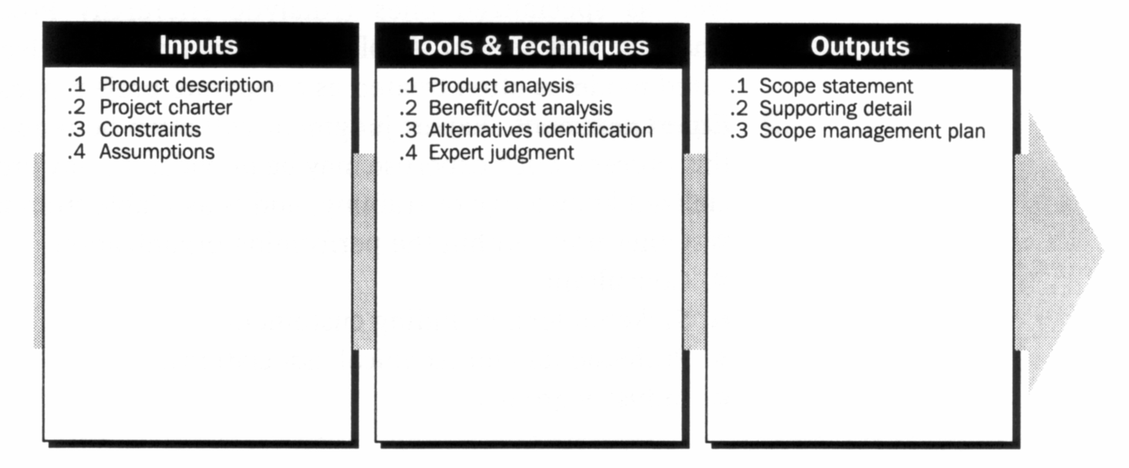
Scope Planning
Scope planning is the process of progressively elaborating
and documenting the project work (scope) that produces
the product.

Slide 36
Scope Statement
It provides a documented basis for making future project decisions and for confirming or developing common understanding of project scope among the stakeholders.
As the project progresses, the scope statement may need to be revised or refined to reflect approved changes to the scope of the project. The scope statement includes, either directly or by reference to other documents :
  Project justification (business need)
  Project’s product
  Requirements or specifications
  Project deliverables
  Project objectives
  Assumptions
  Cost and time estimates
  Constraints

Slide 37
Scope Definition
Scope definition involves subdividing the major project deliverables (as identified in scope statement) into smaller, more manageable components to:
  Improve the accuracy of cost, duration, and resource estimates.
  Define baseline for performance measurement/control.
  Facilitate clear responsibility assignment.
  Proper scope definition is critical to project success.
  When there is poor scope definition, final project costs will be higher

Slide 38
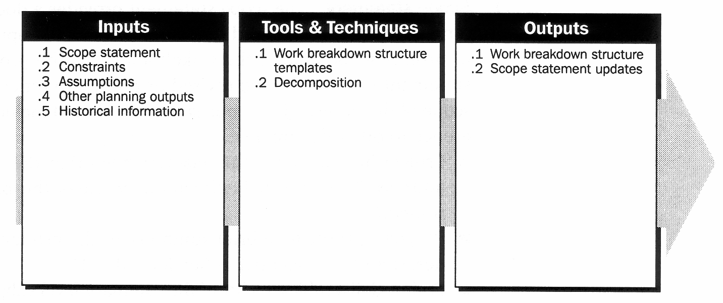
Scope Definition

Slide 39
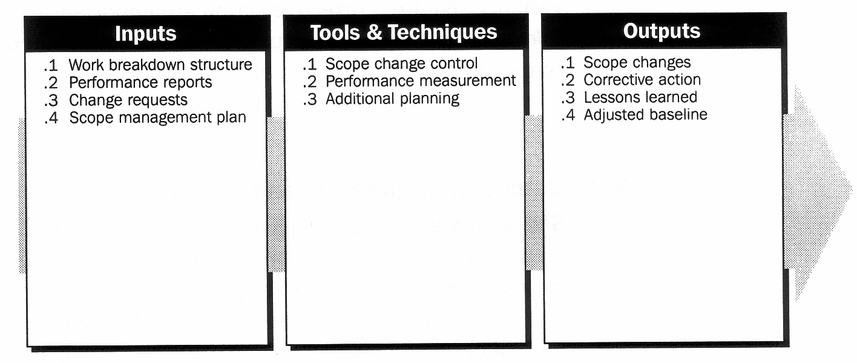
Scope Change Control
Scope change control involves controlling changes to the project scope. In order to minimize scope change control, it is crucial to do a good job of verifying project scope.

