Slide 1

Interaction Design (DGM 729)
Prepared by
Dr. Mohamed Owies
Lecture 2
Interaction Design(DGM 729)

Slide 2
Chapter 2
Getting Started
Interaction Design

Slide 3
Lecture 2
Content
lecture 2 includes the following points:
Get to Know the UX Toolkit
Establish a Point of View on the Work to Be Done
Get to Know Your Users
Start Designing

Slide 4
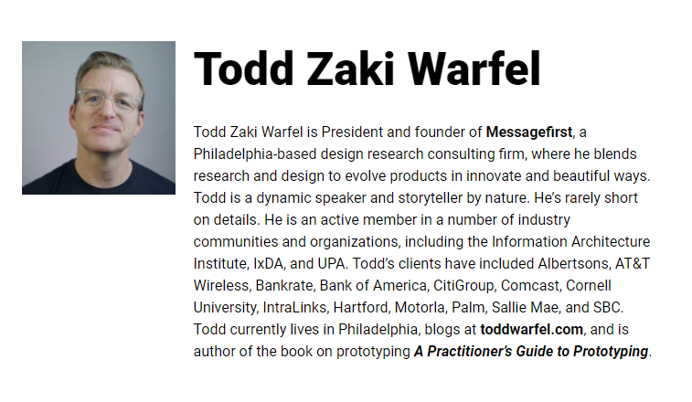
Lecture 2
Get to Know the UX Toolkit
Many models and diagrams have been created to illustrate the typical UX set of offerings, and they can be a great place to start in understanding the UX process, and how it fits in with other business processes. (see Figures 2-1).
Figure 1 shows a model that was created by Todd Zaki Warfel when he was at Message First. It gives a good sequential overview of the activities that are conducted in a typical user-centered design process, with helpful distinctions made between functional design, content analysis, interaction design and information architecture, and engineering.

Slide 5
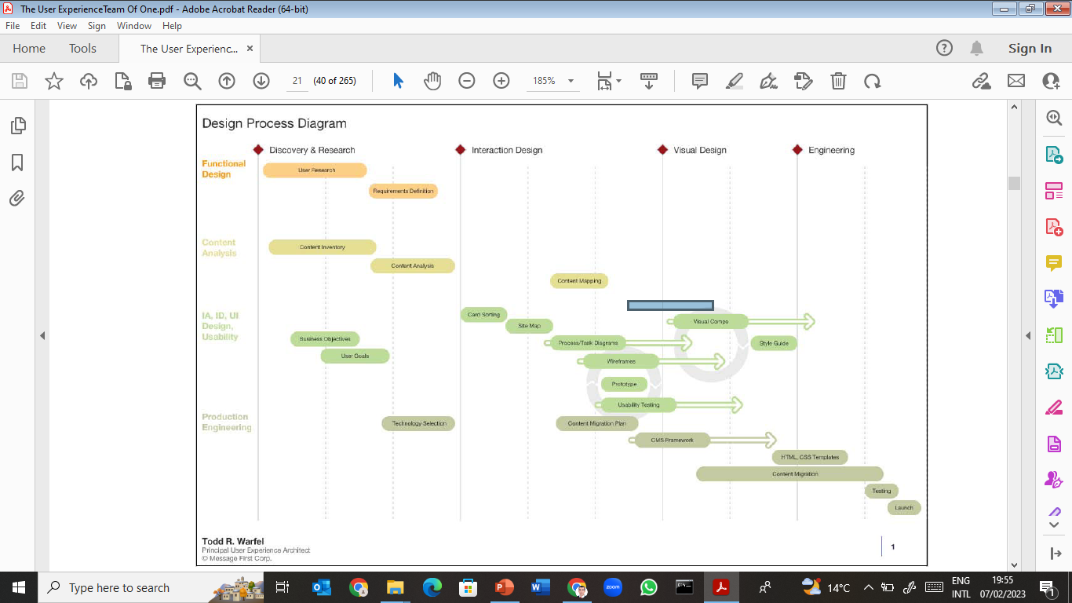
Lecture 2
Get to Know the UX Toolkit
Todd Zaki Warfel’s UX model

Slide 6
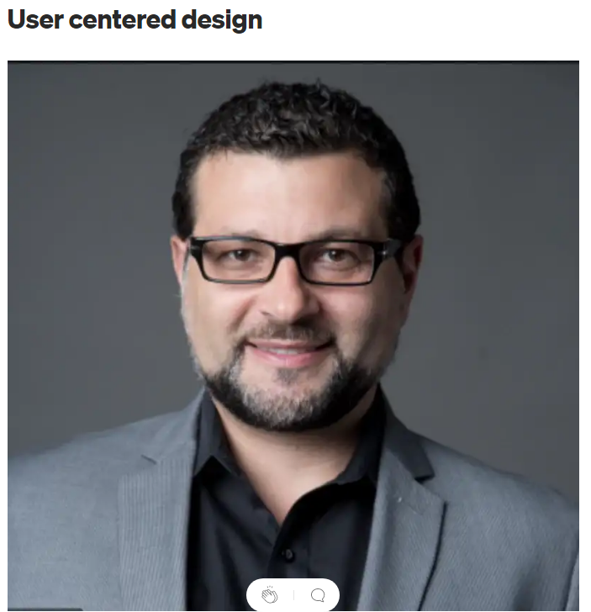
Lecture 2
Get to Know the UX Toolkit
By contrast, the model in Figure 2.2 from David Armano at Edelman Digital places more emphasis on the major conceptual phases of work that you go through in a user-centered design process. His Uncover > Define >Ideate > Build > Design framework is nice because it helps you think about the higher-level goals of each phase.

Slide 7
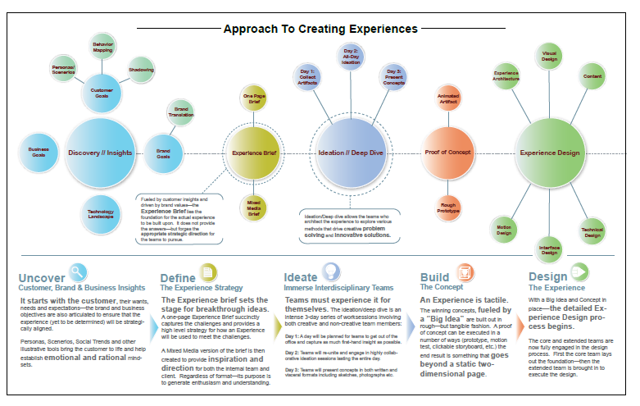
Lecture 2
Get to Know the UX Toolkit
David Armano’s UX model

Slide 8
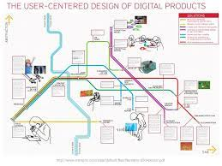
Lecture 2
Get to Know the UX Toolkit
Figure )2-3) shows a model from Namahn Design in Brussels. Styled like the London Underground map, it shows the relationship between specific methods and activities.

Slide 9
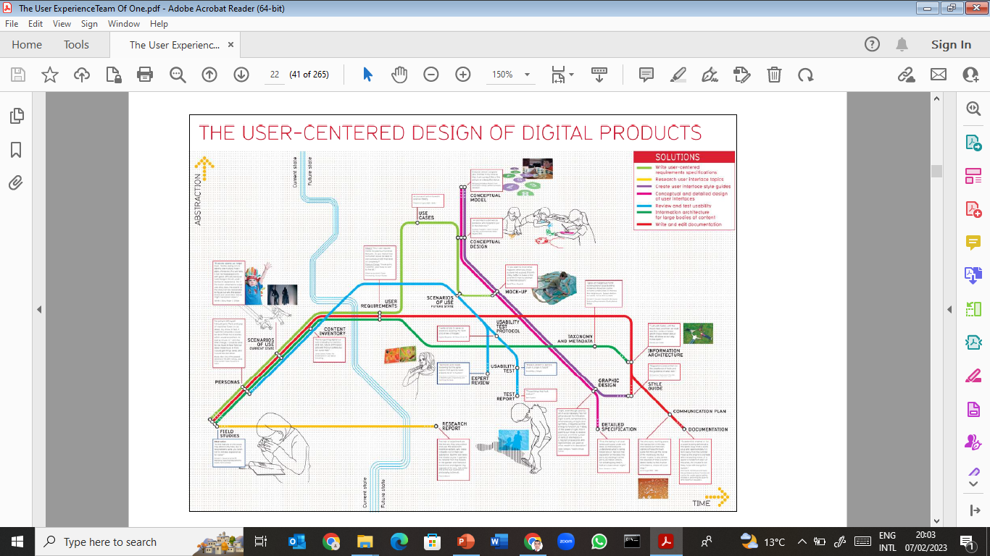
Lecture 2
Get to Know the UX Toolkit
Namahn Design UX model.

Slide 10

Lecture 2
Get to Know the UX Toolkit
For a different way to visualize the UX process, the model in Figure (2-4) from independent consultant Stephen P. Anderson focuses not so much on phases or deliverables, but rather on the primary considerations to take into account when designing user experiences.

Slide 11
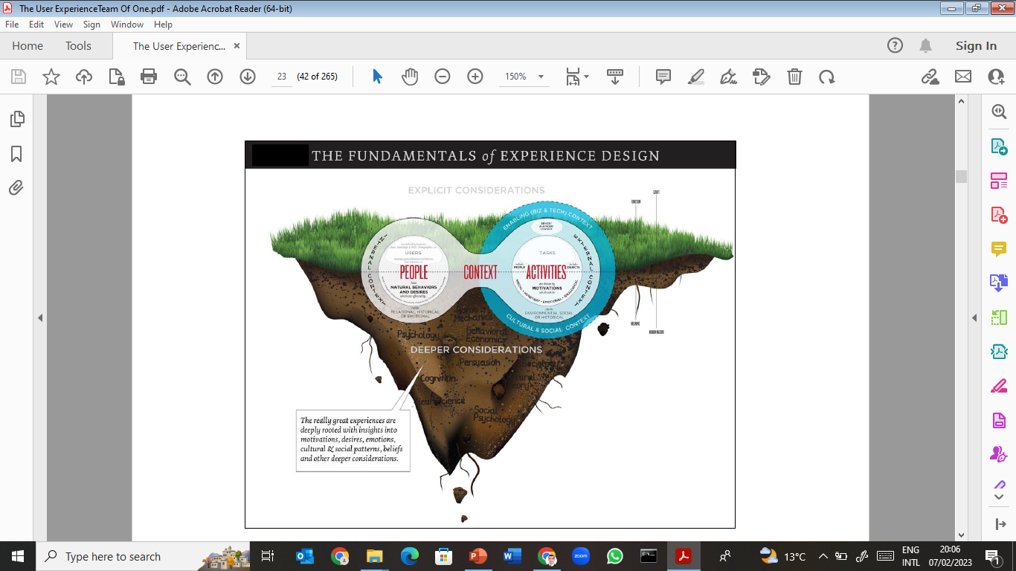
Lecture 2
Get to Know the UX Toolkit
Stephen P. Anderson’s UX model

Slide 12
Lecture 2
Get to Know the UX Toolkit
Like many of the previous models, the model in Figure (2-5) from James Kelway of the Danish design firm Hello Group shows the key phases and activities or deliverables within each—but in a sketchy, low-fidelity way.

Slide 13
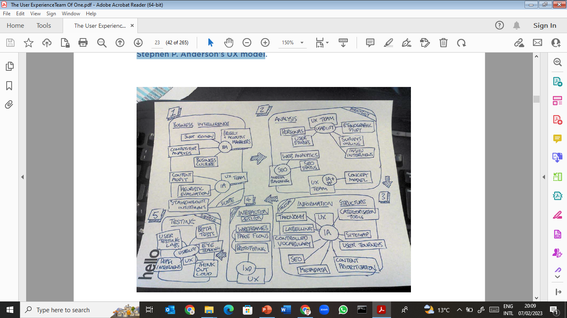
Lecture 2
Get to Know the UX Toolkit
James Kelway’s UX model

Slide 14
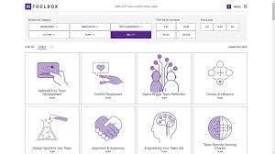
Lecture 2
Get to Know the UX Toolkit
As you can see from these examples, while there’s no certified process that all UX practitioners follow, you’ll find a relatively standard set of activities and deliverables that they all use. A large UX team may have the luxury of conducting most of these activities on a given engagement.

Slide 15
Lecture 2
Get to Know the UX Toolkit
Teams of one use many of these methods, too, just sometimes in less depth or without putting quite so many methods together into a full-fledged work plan. It’s helpful to start with an understanding of the full roster of options, though, and then think a bit about which ones seem most useful in the work that you’re doing.

Slide 16

Lecture 2
Get to Know the UX Toolkit
What follows is a fairly exhaustive list of the activities that may take place in a typical UX process.
1- Discovery. Figuring out where you stand and what you need to do so you can design products that meet the business’s needs.
- Stakeholder Interviews. Spending time with key decision-makers to understand their expectations for the product, plus any other important considerations that you should be aware of.

Slide 17
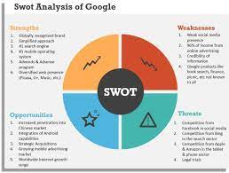
Lecture 2
Get to Know the UX Toolkit
- SWOT (Strengths, Weaknesses, Opportunities, Threats) Analysis. Various methods for assessing the strengths, weaknesses, opportunities and threats that impact the user experience of a product. First developed as a strategic planning tool, a number of UX techniques such as competitive review, content audits, and heuristic or expert reviews ultimately fall into this category.
- Requirements Gathering. The process of working with business decision makers and others on the team to determine what must go in the product and, in some cases, how it must be implemented.

Slide 18
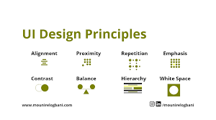
Lecture 2
Get to Know the UX Toolkit
2- Strategy. Establishing a vision for the target user experience so you can design products that are coherent and unified.
• Design Principles. A small handful of characteristics that collectively embody how the product design should be experienced by users.

Slide 19

Lecture 2
Get to Know the UX Toolkit
• Vision Artifacts. Diagrams, schematics, storyboards, or vision movies that convey the essence of the user experience and give a taste of how a person might experience a product that follows this strategy in the context of their normal lives.
• Roadmaps. An analysis of what needs to be built first, next, and last in order to deliver on the target experience.

Slide 20
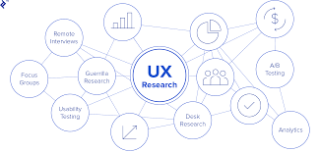
Lecture 2
Get to Know the UX Toolkit
3- User Research. Learning as much as you can about who your users are and what motivates them so that you can design products that meet their needs.
• Primary User Research. Various methods for learning from users firsthand. Could include field research, diary studies, surveys, and other forms of guerilla research.

Slide 21
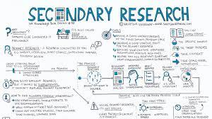
Lecture 2
Get to Know the UX Toolkit
• Secondary User Research. Reviewing an aggregation of third-party research that has been conducted into this user population. Could include publicly available research or research that’s been conducted by other parts of the organization.
• Personas, Mental Models, and User Stories. Documents that synthesize what you’ve learned about users through primary and secondary research and distill the key points into a handful of memorable profiles, with supporting diagrams and stories for how the product should fit into their lives.

Slide 22
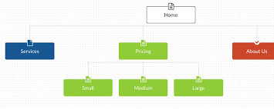
Lecture 2
Get to Know the UX Toolkit
4- Design. Envisioning and specifying how a user will encounter a product or service from moment to moment in the most fluid, intuitive, and enjoyable way possible.
• Information Architecture/Site Map. Documentation of how the
system is organized, including major groupings, categories, or sections, as well as other pertinent information structures such as search capabilities, taxonomies, tags, or other forms of metadata.
• Process and Task Diagrams. Models for how users will interact with the system step-by-step, and how the system will adapt or respond based on what the user does.

Slide 23
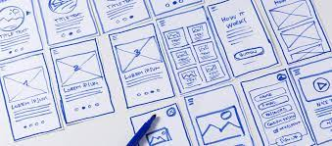
Lecture 2
Get to Know the UX Toolkit
• Wireframes. Schematic diagrams of each page or state in the system. Usually, this means each screen in the user interface.
• Design Comps. Detailed visual designs for each page or state in the system. If wireframes show a screen at a schematic level, design comps show a page exactly as it should look when implemented, including visuals such as color palettes, photography, typography, and other graphical elements.
• Detailed Specifications. Extremely detailed documentation of how the system should function. Detailed specifications include things like how the product adapts in response to user interactions like clicks, swipes, and keystrokes. It also includes how to handle error conditions, and how the system adapts and evolves in response to various system and user states.

Slide 24
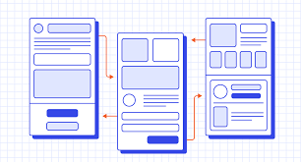
Lecture 2
Get to Know the UX Toolkit
• Style and Pattern Guides. Documentation of standard conventions for repeatable patterns. For style guides, this could be standard conventions for visual design or content. For pattern guides, this could be standard interaction conventions.
• Prototypes. Functioning or semi-functioning examples of how the design should behave and operate once implemented.

Slide 25
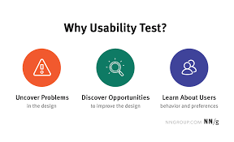
Lecture 2
Get to Know the UX Toolkit
5- Implementation. Ensuring that the design works for users and that it is implemented according to plan.
Usability Testing. Various methods for assessing whether and how easily people can use the design to accomplish anticipated tasks.

Slide 26
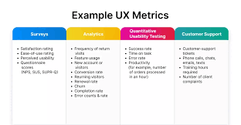
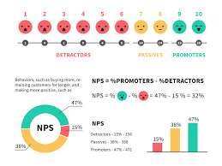
Lecture 2
Get to Know the UX Toolkit
Implementation Oversight. Sustained involvement between user experience designers and the engineering team to address additional UX questions as they come up and ensure that the design is implemented as planned.
Metrics/Analytics Tracking. Ongoing monitoring of key usage data to determine how people are using the product or service and to identify opportunities for future improvement or enhancement.

Slide 27
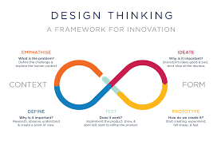
Lecture 2
Establish a Point of View on the Work to Be Done
Before you get started, it’s a good idea to have a clear picture of what work needs to be done and how you can best contribute to it. The good news is, you don’t really need permission to be a UX team of one. You can infuse the UX philosophy into work that you’re currently doing. You can also find small opportunities to get started. You might think that if you want to transition to UX, you should start by changing your title and your role.

Slide 28
Lecture 2
Establish a Point of View on the Work to Be Done
But asking for a wholesale role change before you’ve gotten people to understand and see the value in UX might be a long shot. It’s better to start doing UX-related activities in smaller, under-the-radar ways, and then build momentum from the positive support that your work causes.

Slide 29

Lecture 2
Establish a Point of View on the Work to Be Done
Here are a few recommendations as a foundation for any crossover. They’re not UX activities per se, but they pave the way for them:
• Find the low hanging fruit. Entice your colleagues with a vision of what might be. Find the parts of the product that everyone knows need improvement, and then plan your attack from there. However, it’s key to do it in a way that is positive and respectful. Use a “Black Hat Session” (Chapter 8) to get people thinking about where and how your product might be improved, or a quick “Heuristic Markup” (Chapter 6) to do the legwork on your own.

Slide 30
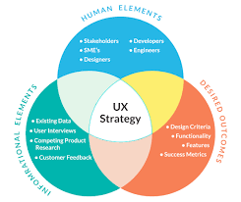
Lecture 2
Establish a Point of View on the Work to Be Done
• Make a plan. If you want to get people to buy into the concept of UX, you’ve got to be offering them something of value. How do you do it? Sit down and sketch out how you’d like to approach a UX project. Think about what activities you’d propose—when and why.
Think about what big questions you believe need to be answered, and work your way backward in thinking through how you’d answer them. Write a “UX Project Plan” (Chapter 5) to make it clear in your own mind. And then, ask yourself, “Do I need permission or support to do this, or is it possible that I might be able to do it now?” You may find that the answer is that you can just get started right away.

Slide 31
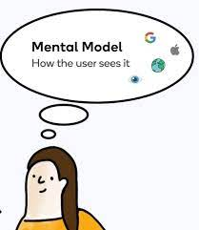
Lecture 2
Get to Know Your Users
Once you’ve identified some opportunities and developed a rough plan, your next priority should be to get firsthand experience with users, talking with them and learning about their needs. Users are at the core of user experience. Simply put, they are the people who use your products.
It’s important to keep these people in mind when designing products because they’re the ones who will endure firsthand the consequences of myriad design decisions.

Slide 32
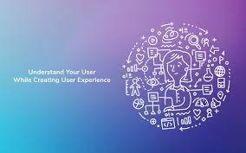
Lecture 2
Get to Know Your Users
Good products eventually become somewhat invisible, sinking into the background as users achieve a kind of flow where they’re actively and fluidly doing whatever the product is supposed to make possible. Not “posting to a wall,” but responding to a friend. Not “formatting a Word document,” but writing. If you’re a product maker, this is nirvana.

Slide 33
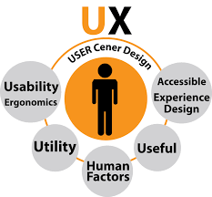
Lecture 2
Get to Know Your Users
It’s also darned hard to accomplish. In fact, you’re virtually guaranteed to get some of it wrong—especially at first—which is why the field of user experience places a big emphasis on understanding user needs and testing the design of products with users. This emphasis on connecting with users is so essential that it’s one of the core tenets of user experience:
design products for and with users.
Personally, I dislike the word user. I much prefer to call them, simply,
people. That helps me remember that it’s the people all around us that we’re designing for. But to design for people, you have to know something about them.

Slide 34
Lecture 2
Get to Know Your Users
That means you must resist the tendency to treat them as flat statistics derived from market segmentation and strive to understand them as the complex, erratic animals that they all are. Eric Ries of the Lean Startup movement has a great one liner that sums it up perfectly: “Data are people, too.”
This requires you to suspend what you know and adopt someone else’s perspective long enough to feel their pain and envision better alternatives. That’s harder than it sounds, which is why it’s essential that you take time to actually get to know real users.

Slide 35
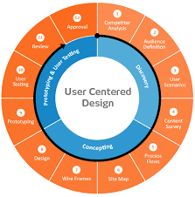
Lecture 2
Get to Know Your Users
It’s shocking how many people say they’re practicing user-centered design, but rarely talk to actual users. Don’t be one of them.
Real UX teams of one are committed to knowing not just “users” in the abstract, but the people who really use their products. It pays off. Jared Spool of User Interface Engineering has done research that shows that the amount of face-time a team has with end users directly impacts the quality of the product.

Slide 36
Lecture 2
Start Designing
In fact, for many of us, our first taste of design is through a software tool that makes laying out a page easy, but doesn’t necessarily teach us anything about how people encounter and make sense of features and information in an interactive medium.
While it’s tempting to throw yourself into the software and get lost in the satisfying process of laying out a page, that’s not necessarily the best way to ensure that designs are being developed that successfully balance user expectations, business expectations, and team expectations.

Slide 37
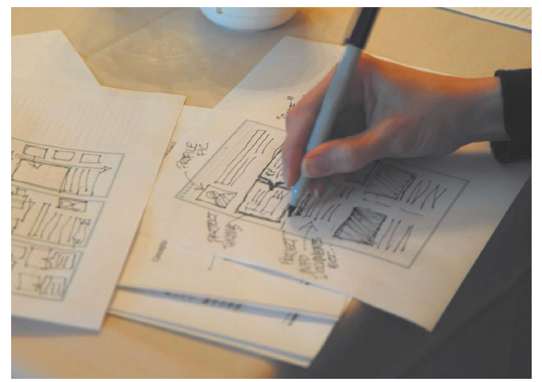
Lecture 2
Start Designing
This is where many of the tools of classically trained designers can come in handy for UX folks—in particular, sketching, critique, iterative improvement, and seeking inspiration from the world around you. Here’s how you can bring these techniques into your work as a team of one:
• Sketch your ideas. The simplest and most beautiful designs are seldom born that way (see Figure 2.12). It takes a lot of work to make something simple. That process often starts with sketches and back-of-the-napkin inspiration, and evolves over time as you iterate, refine, and mold your ideas into increasingly higher fidelity.
(see Figure 2.12).
Paradoxically, beautiful designs often start in an unattractive place, as mere sketches on paper or scribbles on a whiteboard.

Slide 38
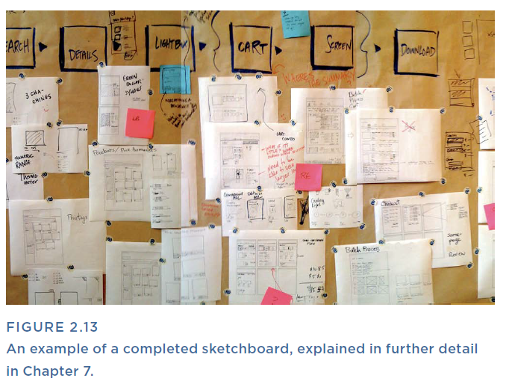
Lecture 2
Start Designing
Enlist colleagues to generate design ideas. Host activities that invite others to participate in the design process (see Figure 2.13).
Figure 2.13 shows what a successful cross-functional collaboration between a UX team of one and her team should look like: lots of sketches and visual artifacts, and lots of notes as a record of the conversation.

Slide 39
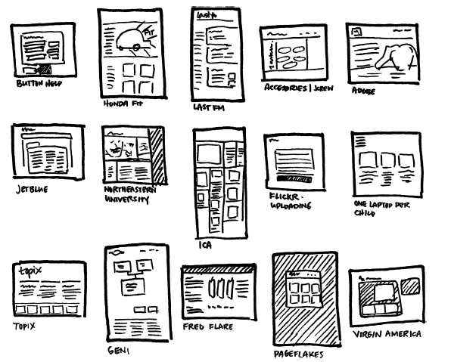
Lecture 2
Start Designing
Learn from other successful products. Create inspiration libraries to keep abreast of current standards and have a place to turn for multiple ideas when working on a new problem (see Figure 2.14).
But also question things. Spend time asking yourself “What makes a particular design work?” Equally importantly, when something doesn’t work, see if you can pinpoint why. You might even go so far as to practice verbalizing these thoughts (either to a friend or to your mirror, if you’d prefer).
Figu re 2 .14
An inspiration library can be as simple as a folder where you keep screenshots of designs you’ve encountered that are notable, either for being good or bad.

Slide 40
Lecture 2
Start Designing
Learn from other successful products. Create inspiration libraries to keep abreast of current standards and have a place to turn for multiple ideas when working on a new problem.
But also question things. Spend time asking yourself “What makes a particular design work?” Equally importantly, when something doesn’t work, see if you can pinpoint why. You might even go so far as to practice verbalizing these thoughts (either to a friend, or to your mirror, if you’d prefer).
Being confident in the language of critique is one hallmark of a strong designer, and it goes a long way in helping nondesigners understand objectively what works and what doesn’t in an otherwise subjective medium.

Slide 41
Lecture 2
Thank You

