Slide 1
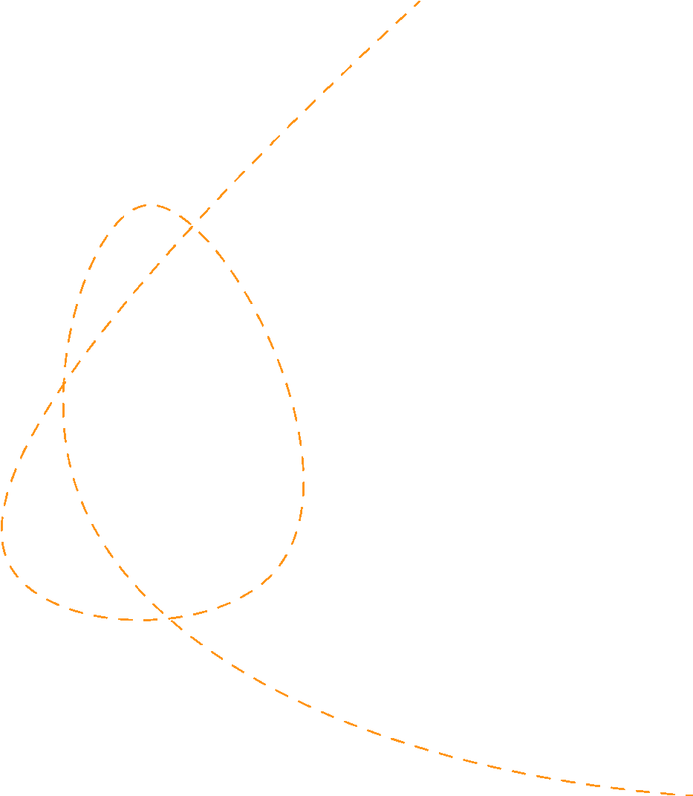





Differentiation and Applications
Prepared by Dr. Sahar ALBOSAILY
Lecture 11
MTH 112
Business Mathematics

Slide 2
Differentiation and Applications
Differentiation and Applications
Slope of a curve and Differentiation
Optimisation for functions of one variable
Economic applications of maximum and minimum
Curvature and other applications

Slide 3
Slope of a Curve and Differentiation
Slope of a Curve and Differentiation
At the end of this section, you should be able to:
Show how to measure the average slope of a curve between two points
Show how to calculate the slope of a curve at a point approximately
Use differentiation to determine the equation for slope from the equation of the curve
Differentiate functions containing $x^{n}$using the power rule
Use rules for differentiating sums and differences of several functions
Calculate higher derivatives
Use differentiation to determine whether a function is increasing or decreasing

Slide 4
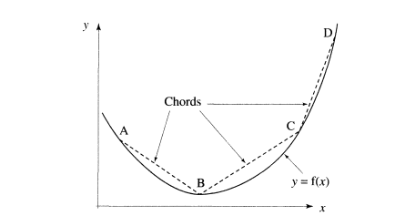
The slope of a curve is variable
The slope of a curve varies at every point on the curve

Slide 5

Slope of a curve and turning points
The slope of the chord BC is a reasonable approximation to the slope of the curve over this interval:

Slide 6
The derivative
The power rule for differentiation
Y=$x^{n}$ $\frac{dy}{dx}$ = n$x^{n−1}$ is called the power rule
If y = $x^{n}$ Then $\frac{dy}{dx}$ = n$x^{n−1}$
n drops down
$\frac{dy}{dx}$ = n$x^{\left(n−1\right)←←powerloses1}$ Slope = $\frac{dy}{dx}$ = 5 $x^{5−1}$ = 5 $x^{4}$
Worked Example 6.2 illustrates how this rule is used for various powers, and also for variables other than x and y

Slide 7
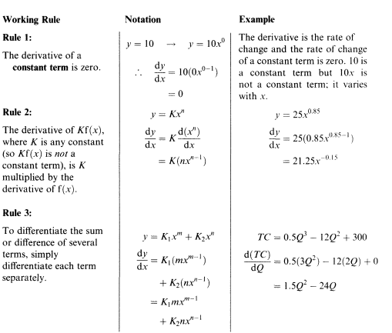
Working rules for differentiating sums and differences of several functions (1/3)
Working rules for differentiating sums and differences of several functions

Slide 8
Working rules for differentiating sums and differences of several functions (2/3)
Working rules for differentiating sums and differences of several functions

Slide 9
Working rules for differentiating sums and differences of several functions (3/3)
Working rules for differentiating sums and differences of several functions

Slide 10
Higher derivatives
Higher derivatives
$\frac{d}{dx}$ $\left(\frac{dy}{dx}\right)=\frac{d^{2}y}{dx^{2}}$ = $y^{′′}$

Slide 11
Optimisation for Functions of One Variable
Optimisation for Functions of One Variable
At the end of this section, you should be able to:
Use the slope of a curve to find turning points
Use the change in slope and second derivatives to determine whether a turning point is a maximum or minimum
Find the intervals along which a function is increasing or decreasing
Outline the key features of curve sketching.

Slide 12
Slope of a curve and turning points
Slope of a curve and turning points
We know that dy/dx gives the equation for slope at any point (x , y).
We know slope = 0 at turning points
So, dy/dx = 0 at turning points.

Slide 13
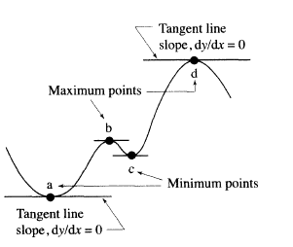
Slope of a curve and turning points
Therefore, to find the x-coordinates of the turning points for a curve y = f(x), the following method is used:
Step 1: Find dy/dx for the given curve y = f(x).
Step 2: Solve the equation dy/dx = 0.

Slide 14
Example
Find the turning points for the following functions
(a) (i) y = 3$x^{2}$ - 18x+ 34
(ii) AC = 3 $Q^{2}$ - 18Q + 34
(b ) y = 1/x

Slide 15
Solution (1/ 3)

Slide 16
Solution (2/ 3)

Slide 17
Solution (3/ 3)

Slide 18
Determining maximum and minimum turning points
Determining maximum and minimum turning points
The next step is to determine whether each turning point is a maximum or a minimum. We could of course plot the graphs, since we know the precise turning points as in Figure 6.13, but this is time-consuming and not practical in the long term. Before proceeding to a method that will enable us to determine whether a point is a maximum or a minimum, here are some points to note.

Slide 19
Determining maximum and minimum turning points
When y is increasing then y' is positive
When y' is increasing then y" is positive
$\frac{d}{dx}$ $\left(\frac{dy}{dx}\right)$ = $\frac{d^{2}y}{dx^{2}}$ is Positive

Slide 20
Determining maximum and minimum turning points
When y is decreasing then y' is negative
When y' is decreasing then v" is negative
$\frac{d}{dx}$ $\left(\frac{dy}{dx}\right)$ = $\frac{d^{2}y}{dx^{2}}$ is Negative

Slide 21
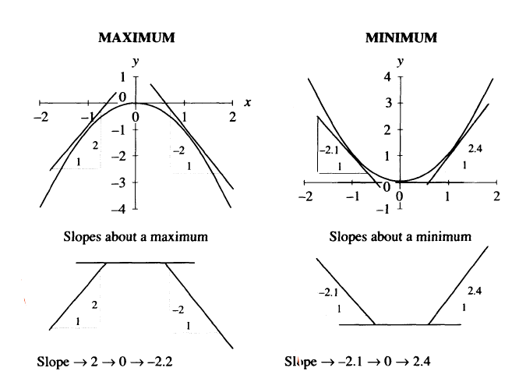
Testing for minimum and maximum points

Slide 22
Example
MAXIMUM AND MINIMUM TURNING POINTS
(a) Find the turning points for the curve, y = –$x^{3}$ + 9 $x^{2}$ – 24x + 26.
(b) Determine which point is a maximum and which is a minimum by using the second derivatives.

Slide 23
Solution (1/ 5)

Slide 24
Solution (2/ 5)

Slide 25
Solution (3/ 5)

Slide 26
Solution (4/ 5)

Slide 27
Solution (5/ 5)

Slide 28
Marginal Revenue -Marginal Cost
Testing for minimum and maximum points
Testing for minimum and maximum points

Slide 29
Example
MAXIMUM TR AND A SKETCH OF THE TR FUNCTION
The demand function for a good is given as P = 50 - 2Q.
Write down expressions for the TR and MR functions
Calculate the output at which TR is a maximum and confirm that marginal revenue is zero at this point.
Sketch the TR and MR functions.

Slide 30
Solution (1/5)

Slide 31
Solution (2/5)

Slide 32
Solution (3/5)

Slide 33
Solution (4/5)

Slide 34
Solution (5/5)

Slide 35
Example
PROFIT MAXIMISATION AND PRICE DISCRIMINATION
hotel charges different prices for the same meal in two different markets. The demand function in each market is given by the respective equations
P1 = 50 - ${4Q}_{1}$and P2 = 80 - ${3Q}_{2}$
The company's cost function is given by the equation
TC= 120 + 8Q
where Q = $Q_{1}$+ $Q_{2}$
(a) For each market, write down the marginal revenue and marginal cost.
(b) Determine the price and quantity at which profit is maximized. Calculate the overall profit from the two markets.

Slide 36
Solution (1/5)

Slide 37
Solution (2/5)

Slide 38
Solution (3/5)

Slide 39
Solution (4/5)

Slide 40
Solution (5/5 )

Slide 41
Thank you

