Slide 1

Operating Systems
Prepared by Dr. Alaa Mohamed
Module 6 – Part2
I/O Management and Disk Scheduling

Slide 2

Module
06-Part2
I/O Management and Disk Scheduling
Objectives:
  I/O Devices
  Organization of the I/O Function
  Operating System Design Issues
  Disk Scheduling

Slide 3
Categories of I/O Device
Module
06-Part2
Difficult area of OS design
  Difficult to develop a consistent solution due to a wide variety of devices and applications
Three Categories:
  Human readable
  Machine readable
  Communications

Slide 4
Human readable
Module
06-Part2
Devices used to communicate with the user
  Printers and terminals
  Video display
  Keyboard
  Mouse etc
Notes:
Suitable for communicating with the computer user.
Examples include printers and terminals, the latter consisting of video display, keyboard, and perhaps other devices such as a mouse.

Slide 5
Machine readable
Module
06-Part2
Used to communicate with electronic equipment
  Disk drives
    is a technology that enables the reading, writing, deleting and modifying of data on a computer storage disk. It is either a built-in or external component of a disk that manages the disk's input/output (I/O) operations.
  USB keys
  Sensors
  Controllers
Notes:
A

Slide 6
Communication
Module
06-Part2
Used to communicate with remote devices
  Digital line drivers
    are commonly used within digital systems, e.g. to communicate digital signals across circuit-board traces and cables, for example to connect a stereo music player to an amplified speaker system.
  Modems
    a device that converts signals produced by one type of device (such as a computer) to a form compatible with another (such as a telephone) and that is used specially to transmit and receive information between computers via landlines
Notes:
Suitable for communicating with remote devices.
Examples are digital line drivers and modems.
Line drivers are commonly used within digital systems, e.g. to communicate digital signals across circuit-board traces and cables. In analog audio, a line driver is typically used to drive line-level analog signal outputs, for example to connect a stereo music player to an amplified speaker system.

Slide 7
Differences in I/O Devices
Module
06-Part2
Devices differ in a number of areas
  Data Rate
  Application
  Complexity of Control
  Unit of Transfer
  Data Representation
  Error Conditions
Notes:
Each of these are covered in subsequent slides
This diversity makes a uniform and consistent approach to I/O, both from the point of view of the operating system and from the point of view of user processes, difficult to achieve.

Slide 8
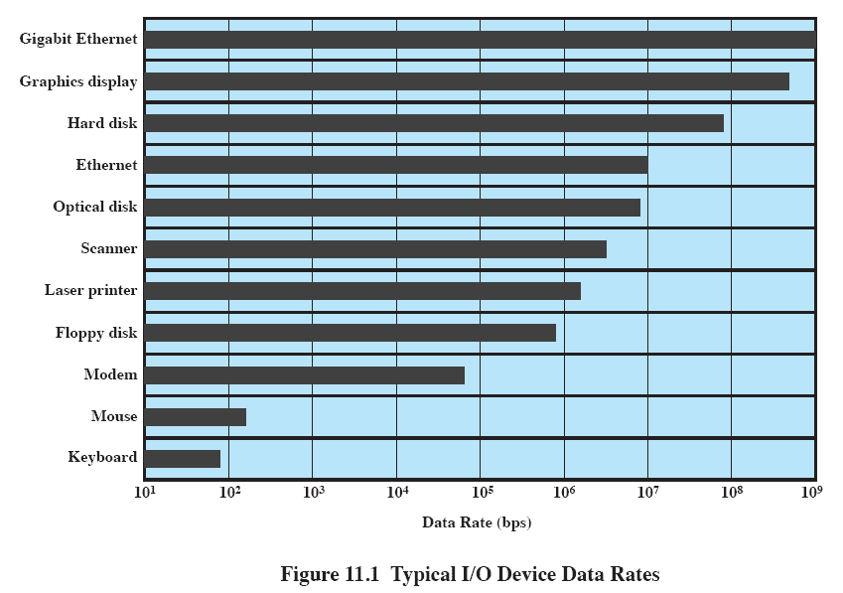
Data Rate
Module
06-Part2
May be massive difference between the data transfer rates of devices
Notes:
There may be differences of several orders of magnitude between the data transfer rates.
Gigabit Ethernet, a transmission technology based on the Ethernet frame format and protocol used in local area networks (LANs).

Slide 9
Application
Module
06-Part2
  The use to which a device is put has an influence on the software and policies in the operating system and supporting utilities.
  Disk used to store files requires file management software
  Disk used to store virtual memory pages needs special hardware and software to support it
  Terminal used by system administrator may have a higher priority
Notes:
The use to which a device is put has an influence on the software and policies in the operating system and supporting utilities.
Examples:
disk used for files requires the support of file management software.
disk used as a backing store for pages in a virtual memory scheme depends on the use of virtual memory hardware and software.
These applications have an impact on disk scheduling algorithms.
Another example, a terminal may be used by an ordinary user or a system administrator.
implying different privilege levels and perhaps different priorities in the operating system.

Slide 10
Complexity of control
Module
06-Part2
A printer requires a relatively simple control interface.
A disk is much more complex.
This complexity is filtered to some extent by the complexity of the I/O module that controls the device.
Notes:
A printer requires a relatively simple control interface while a disk is much more complex.
This complexity is filtered to some extent by the complexity of the I/O module that controls the device.

Slide 11
Unit of transfer
Module
06-Part2
Data may be transferred as
  a stream of bytes or characters (e.g., terminal I/O)
  or in larger blocks (e.g., disk I/O).
Notes:
Data may be transferred as a stream of bytes or characters (e.g., terminal I/O) or in larger blocks (e.g., disk I/O).

Slide 12
Data representation
Module
06-Part2
Different data encoding schemes are used by different devices,
  including differences in character code and parity conventions.
Notes:
Different data encoding schemes are used by different devices, including differences in character code and parity conventions.

Slide 13
Error Conditions
Module
06-Part2
The nature of errors differ widely from one device to another.
Aspects include:
  the way in which they are reported,
  their consequences,
  the available range of responses
Notes:
The nature of errors, the way in which they are reported, their consequences, and the available range of responses differ widely from one device to another.

Slide 14
Module
06-Part2
Roadmap
  I/O Devices
  Organization of the I/O Function
  Operating System Design Issues
  Disk Scheduling

Slide 15
Module
06-Part2
Techniques for performing I/O
Programmed I/O
Interrupt-driven I/O
Direct memory access (DMA)
Notes:
Table 11.1 indicates the relationship among these three techniques.

Slide 16
Module
06-Part2
Techniques for performing I/O
Programmed I/O:
  Processor issues an I/O command, on behalf of a process, to an I/O module;
  that process then busy waits for the operation to be completed before proceeding.

Slide 17
Module
06-Part2
Techniques for performing I/O
Interrupt-driven I/O:
  Processor issues an I/O command on behalf of a process.
  If the I/O instruction from the process is nonblocking, then the processor continues to execute instructions from the process that issued the I/O command.
  If the I/O instruction is blocking, then the next instruction that the processor executes is from the OS, which will put the current process in a blocked state and schedule another process.

Slide 18
Module
06-Part2
Techniques for performing I/O
Direct memory access (DMA):
  A DMA module controls the exchange of data between main memory and an I/O module.
  The processor sends a request for the transfer of a block of data to the DMA module and is interrupted only after the entire block has been transferred.

Slide 19
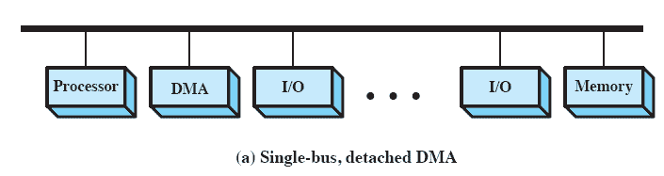
Module
06-Part2
DMA Configurations: Single Bus
The DMA mechanism can be configured in a variety of ways.
Some possibilities are shown here In the first example, all modules share the same system bus.
  The DMA module, acting as a surrogate processor, uses programmed I/O to exchange data between memory and an I/O module through the DMA module.

Slide 20
Module
06-Part2
DMA Configurations: Single Bus
In the example provided by the above diagram, there is a single bidirectional bus connecting the processor, the memory, the DMA module and all the I/O modules.
  When a particular I/O module needs to read or write large amounts contiguous data it requests the processor for direct memory access.
  If permission is granted by the processor, the I/O module sends the read or write address and the size of data needed to be read or written to the DMA module.

Slide 21
Module
06-Part2
DMA Configurations: Single Bus
Once the DMA module acknowledges the request, the I/O module is free to read or write its contiguous block of data from or onto main memory.
Even though in this situation the processor will not be able to execute while the transfer is going on (as there is a just a single bus to facilitate transfer of data),
DMA transfer is much faster then having each word of memory being read by the processor and then being written to its location.

Slide 22
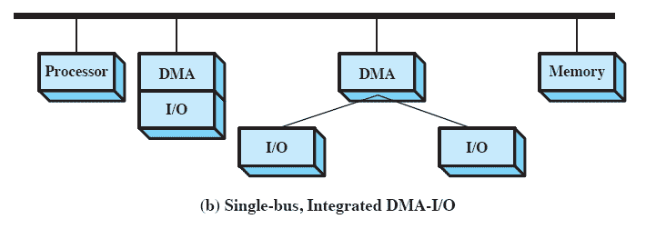
Module
06-Part2
DMA Configurations: Integrated DMA & I/O
Direct Path between DMA and I/O modules
The number of required bus cycles can be cut substantially by integrating the DMA and I/O functions.

Slide 23
Module
06-Part2
DMA Configurations: Integrated DMA & I/O
This means that there is a path between the DMA module and one or more I/O modules that does not include the system bus.
The DMA logic may actually be a part of an I/O module, or it may be a separate module that controls one or more I/O modules.
In this configuration the DMA and one or more I/O modules are integrated without the inclusion of system bus functioning as the part of I/O module or may be as a separate module controlling the I/O module.

Slide 24
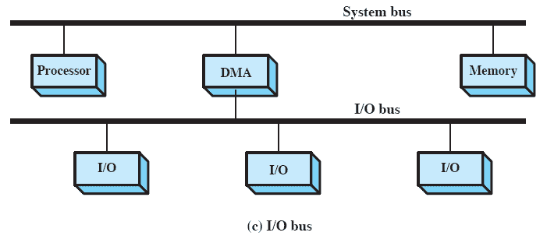
Module
06-Part2
DMA Configurations: I/O Bus
This concept can be taken one step further by connecting I/O modules to the DMA module using an I/O bus
This Reduces the number of I/O interfaces in the DMA module to one and provides for an easily expandable configuration.

Slide 25
Module
06-Part2
DMA Configurations: I/O Bus
The system bus that the DMA module shares with the processor and main memory is used by the DMA module only to exchange data with memory and to exchange control signals with the processor.
The exchange of data between the DMA and I/O modules takes place off the system bus.
Notes:
s.

Slide 26
Module
06-Part2
Roadmap
  I/O Devices
  Organization of the I/O Function
  Operating System Design Issues
  Disk Scheduling

Slide 27
Module
06-Part2
Goals: Efficiency
Most I/O devices extremely slow compared to main memory
One way to tackle this problem is multiprogramming which allows for some processes to be waiting on I/O while another process executes
I/O cannot keep up with processor speed
  Swapping used to bring in ready processes to keep processor busy
  But this is an I/O operation itself, , Thius a major effort in I/O design has been schemes for improving the efficiency of the I/O

Slide 28
Module
06-Part2
Generality
For simplicity and freedom from error it is desirable to handle all I/O devices in a uniform manner
Hide most of the details of device I/O in lower-level routines
Difficult to completely generalize, but can use a hierarchical modular design of I/O functions

Slide 29
Module
06-Part2
Hierarchical design
A hierarchical philosophy leads to organizing an OS into layers
Each layer relies on the next lower layer to perform more primitive functions
It provides services to the next higher layer.
Changes in one layer should not require changes in other layers

Slide 30
Module
06-Part2
Roadmap
  I/O Devices
  Organization of the I/O Function
  Operating System Design Issues
  Disk Scheduling
Notes:
Over the last 40 years, the increase in the speed of processors and main memory has far outstripped that for disk access, with processor and main memory speeds increasing by about two orders of magnitude compared to one order of magnitude for disk.
The result is that disks are currently at least four orders of magnitude slower than main memory.
Thus, the performance of disk storage subsystem is of vital concern.
In this section, we highlight some of the key issues and look at the most important approaches.

Slide 31
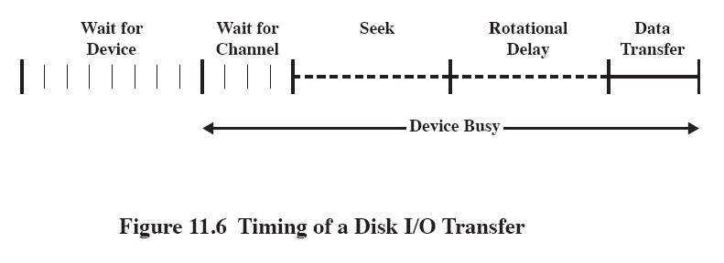
Module
06-Part2
Disk Performance Parameters
The actual details of disk I/O operation depend on many things such as, computer system, the operating system, and the nature of the I/O channel and disk controller hardware.
A general timing diagram of disk I/O transfer is shown here.

Slide 32
Module
06-Part2
Positioning the Read/Write Heads
When the disk drive is operating, the disk is rotating at constant speed.
Track selection involves moving the head in a movable-head system or electronically selecting one head on a fixed-head system.

Slide 33
Module
06-Part2
Disk Performance Parameters
Access Time is the sum of:
  Seek time: The time it takes to position the head at the desired track
  Rotational delay or rotational latency: The time its takes for the beginning of the sector to reach the head
Transfer Time is the time taken to transfer the data.

Slide 34
Module
06-Part2
Disk Scheduling Policies
To compare various schemes, consider a disk head is initially located at track 100.
  assume a disk with 200 tracks and that the disk request queue has random requests in it.
The requested tracks, in the order received by the disk scheduler, are
  55, 58, 39, 18, 90, 160, 150, 38, 184.

Slide 35
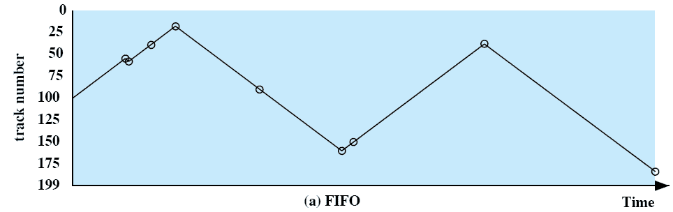
Module
06-Part2
First-in, first-out (FIFO)
Process request sequentially
Fair to all processes
this technique will often approaches random scheduling in performance if there are many processes
  55, 58, 39, 18, 90, 160, 150, 38, 184.

Slide 36
Module
06-Part2
Priority
Goal is not to optimize disk use but to meet other objectives
Short batch jobs may have higher priority
Provide good interactive response time
Longer jobs may have to wait an excessively long time
A poor policy for database systems

Slide 37
Module
06-Part2
Last-in, first-out
Good for transaction processing systems
  The device is given to the most recent user so there should be little arm movement
Possibility of starvation since a job may never regain the head of the line
Notes:
In transaction processing systems, giving the device to the most recent user should result in little or no arm movement for moving through a sequential file.

Slide 38
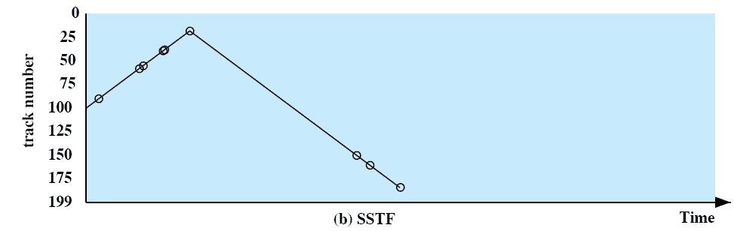
Module
06-Part2
Shortest Service Time First (SSTF)
Select the disk I/O request that requires the least movement of the disk arm from its current position
Always choose the minimum seek time
  55, 58, 39, 18, 90, 160, 150, 38, 184.
Notes:
Select the disk I/O request that requires the least movement of the disk arm from its current position.
Thus, we always choose to incur the minimum seek time.
Always choosing the minimum seek time does not guarantee that the average seek time over a number of arm movements will be minimum.
However, this should provide better performance than FIFO.
Because the arm can move in two directions, a random tie-breaking algorithm may be used to resolve cases of equal distances.

Slide 39
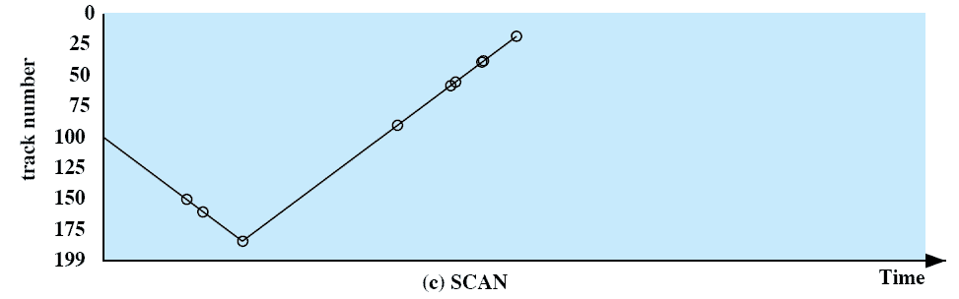
Module
06-Part2
SCAN
Arm moves in one direction only, satisfying all outstanding requests until it reaches the last track in that direction then the direction is reversed
  55, 58, 39, 18, 90, 160, 150, 38, 184.
Notes:
With SCAN, the arm is required to move in one direction only, satisfying all outstanding requests en route, until it reaches the last track in that direction or until there are no more requests in that direction.
The service direction is then reversed and the scan proceeds in the opposite direction, again picking up all requests in order.
This latter refinement is sometimes referred to as the LOOK policy.
The SCAN policy favors jobs whose requests are for tracks nearest to both innermost and outermost tracks and favors the latest-arriving jobs.

Slide 40
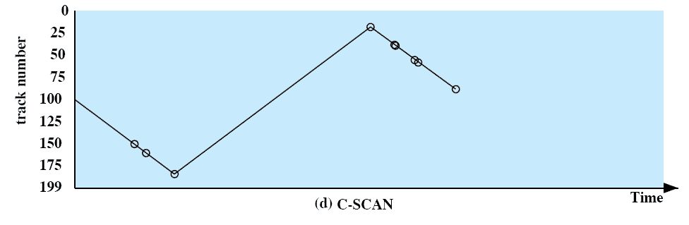
Module
06-Part2
C-SCAN
Restricts scanning to one direction only
When the last track has been visited in one direction, the arm is returned to the opposite end of the disk and the scan begins again
  55, 58, 39, 18, 90, 160, 150, 38, 184.
Notes:
The C-SCAN (circular SCAN) policy restricts scanning to one direction only.
Thus, when the last track has been visited in one direction, the arm is returned to the opposite end of the disk and the scan begins again.
This reduces the maximum delay experienced by new requests.

Slide 41
Module
06-Part2
N-step-SCAN
Segments the disk request queue into subqueues of length N
Subqueues are processed one at a time, using SCAN
New requests added to other queue when queue is processed
Notes:
The N-step-SCAN policy segments the disk request queue into subqueues of length N.
Subqueues are processed one at a time, using SCAN.
While a queue is being processed, new requests must be added to some other queue.
If fewer than N requests are available at the end of a scan, then all of them are processed with the next scan.

Slide 42
Module
06-Part2
FSCAN
Two subqueues
When a scan begins, all of the requests are in one of the queues, with the other empty.
All new requests are put into the other queue.
  Service of new requests is deferred until all of the old requests have been processed.
Notes:
FSCAN is a policy that uses two subqueues.
When a scan begins, all of the requests are in one of the queues, with the other empty.
During the scan, all new requests are put into the other queue.
Thus, service of new requests is deferred until all of the old requests have been processed.

Slide 43
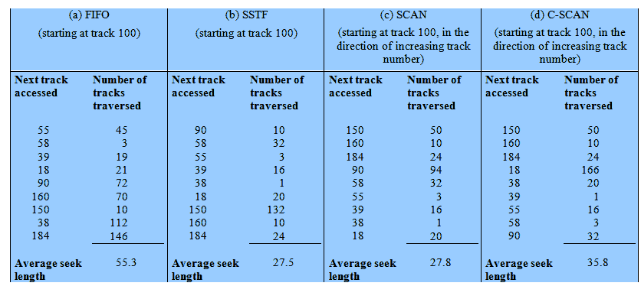
Module
06-Part2
Performance Compared
Comparison of Disk Scheduling Algorithms
Notes:
T

Slide 44
Module
06-part2
End of Module 6-Part2

