Slide 1


Software Engineering
Prepared by Dr. Yasser Abdelhamid
IT 382
Software Engineering
Lecture 0

Slide 2

Course Outline
Software engineering as an academic discipline that is responsible for educating the IT practitioners the skills required to develop, operate, and maintain software in a systematic, orderly and successful manner.
This course covers the fundamentals of software engineering, including understanding system requirements, finding appropriate engineering compromises, effective methods of design, coding, and testing, team software development, and the application of engineering tools.
midocean.edu.km

Slide 3
Learning Outcomes
Upon completion of this course, the student will be able to:
  Explain different software processes and how to choose between them.
  Design in the large, including principled choice of a software architecture, the use of modules and interfaces to enable separate development, and design patterns.
  Elicit requirements from a client and specify them.
  Demonstrate various quality assurance techniques, including unit testing, functional testing, and automated analysis tools.
  Apply good coding practices, including documentation, contracts, regression tests and daily builds.
midocean.edu.km

Slide 4
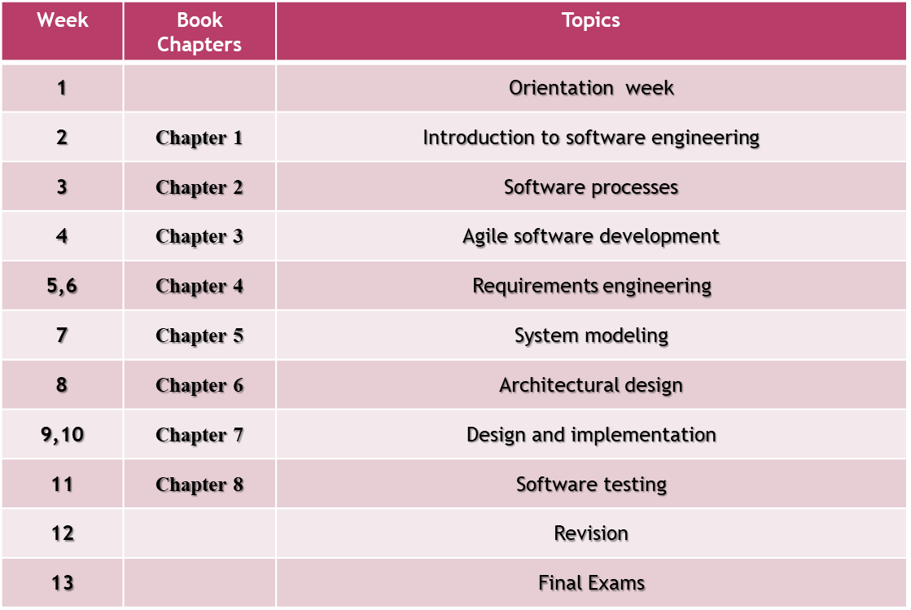

Course Plan
midocean.edu.km

Slide 5

Reference
  SOFTWARE ENGINEERING Ninth Edition, Ian Sommerville.
midocean.edu.km

Slide 6
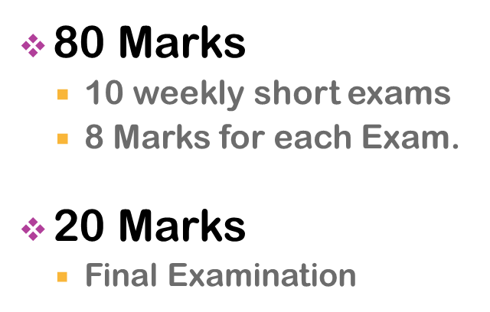

Assessment
midocean.edu.km

Slide 7


Thank You

