Slide 1


Slide 2
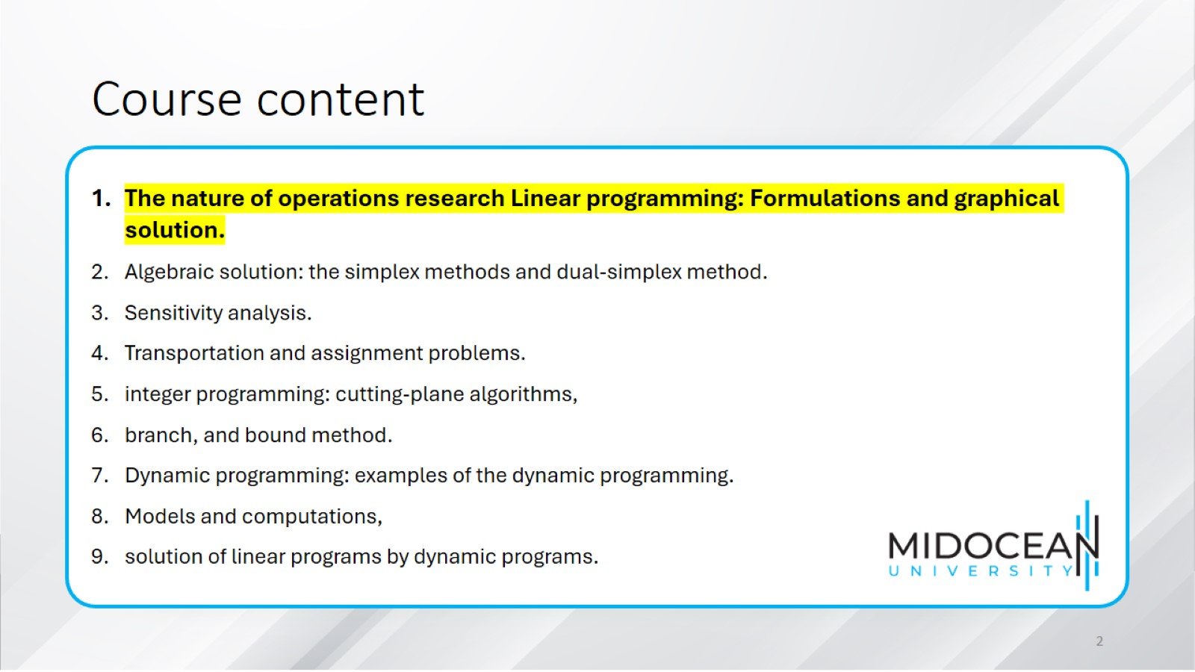
Course content

Slide 3
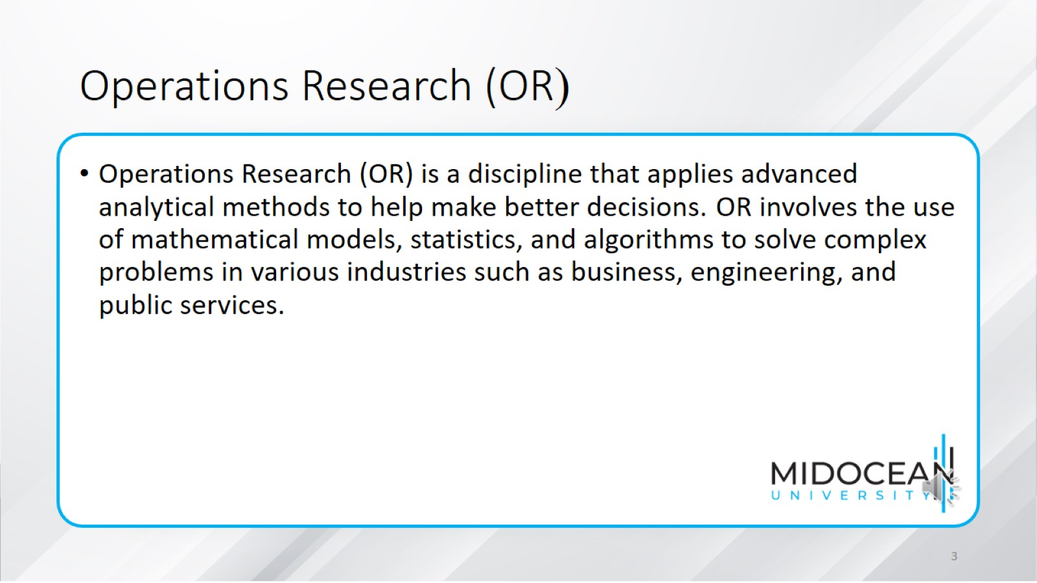
Operations Research (OR(

Slide 4
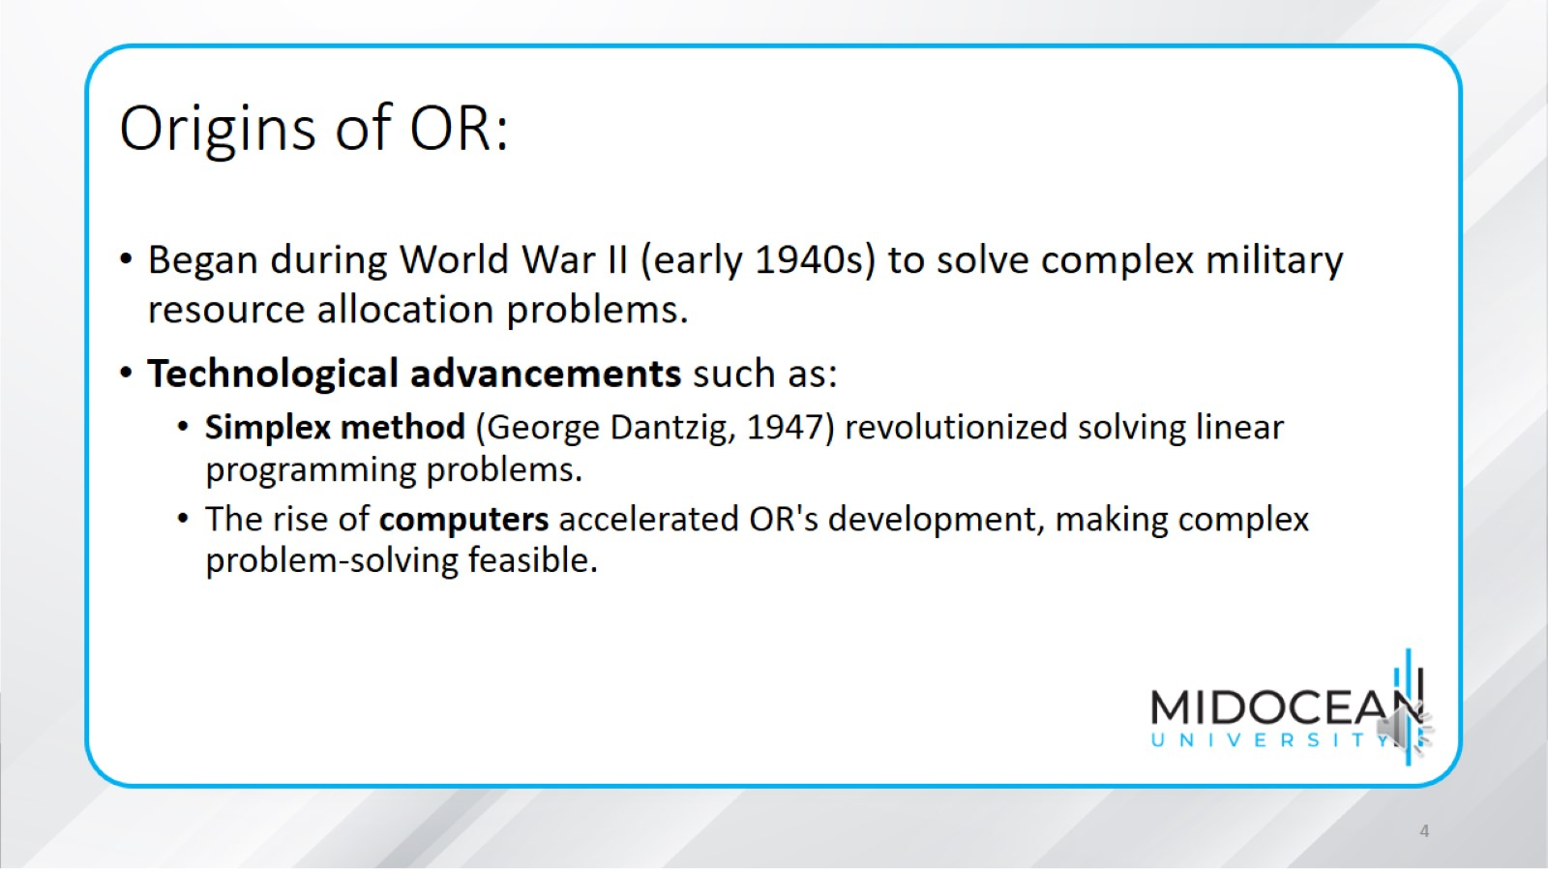
Origins of OR:

Slide 5
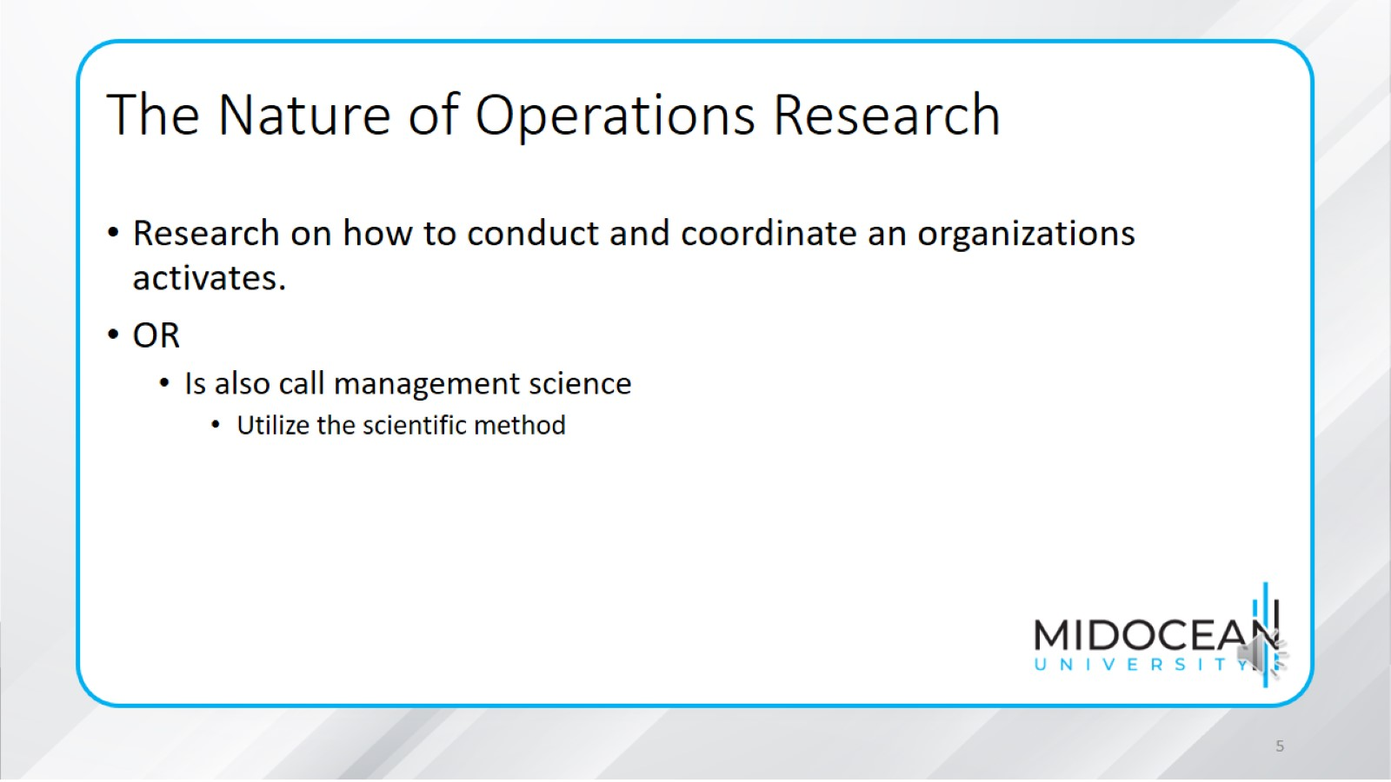
The Nature of Operations Research

Slide 6
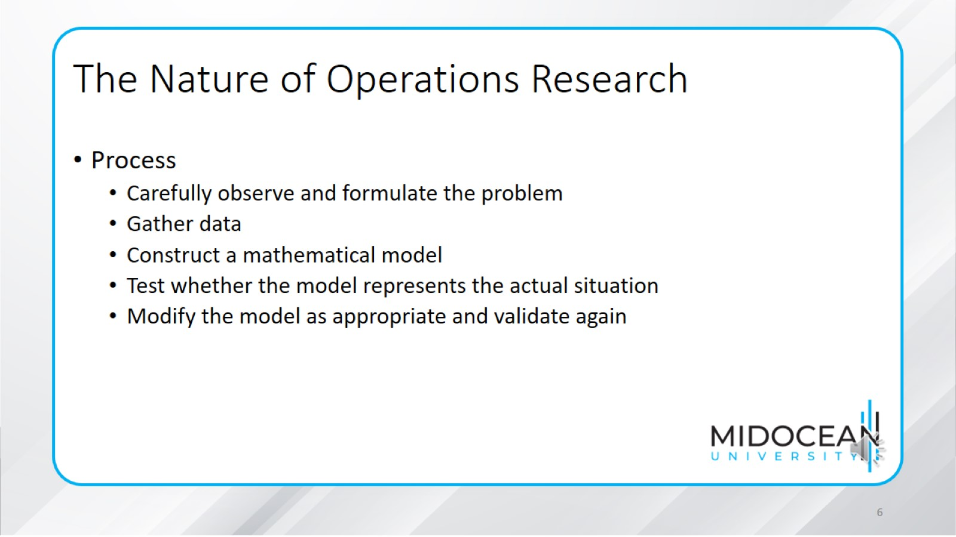
The Nature of Operations Research

Slide 7
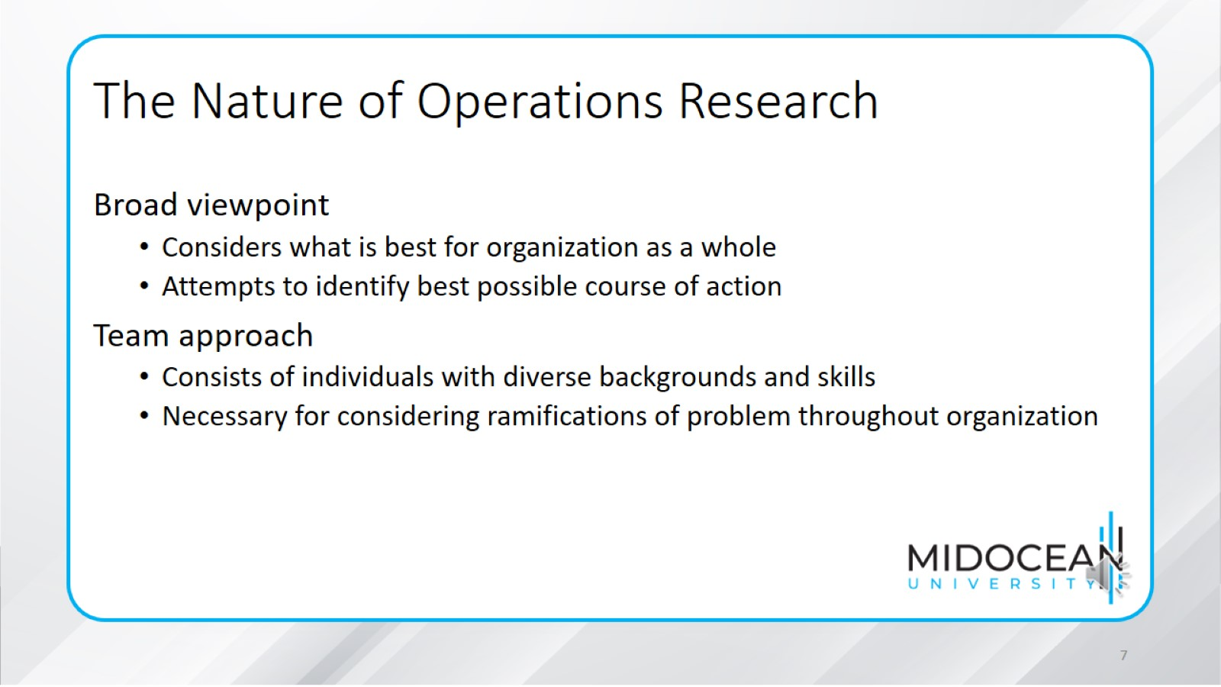
The Nature of Operations Research

Slide 8
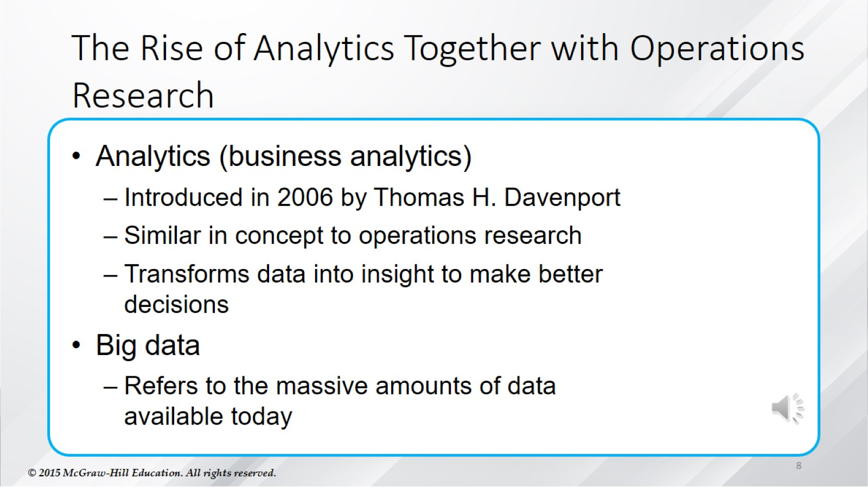
The Rise of Analytics Together with Operations Research

Slide 9
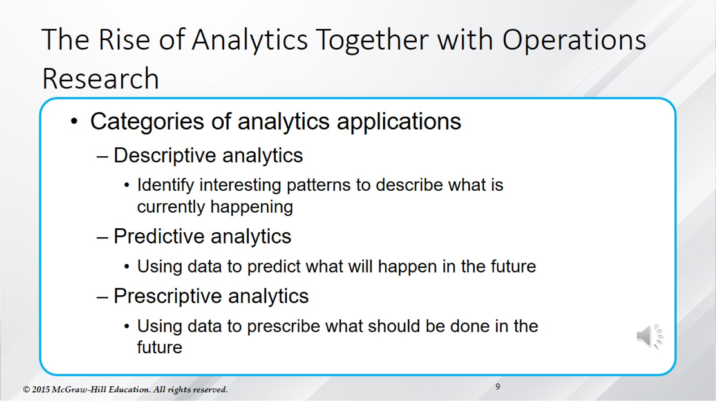
The Rise of Analytics Together with Operations Research

Slide 10
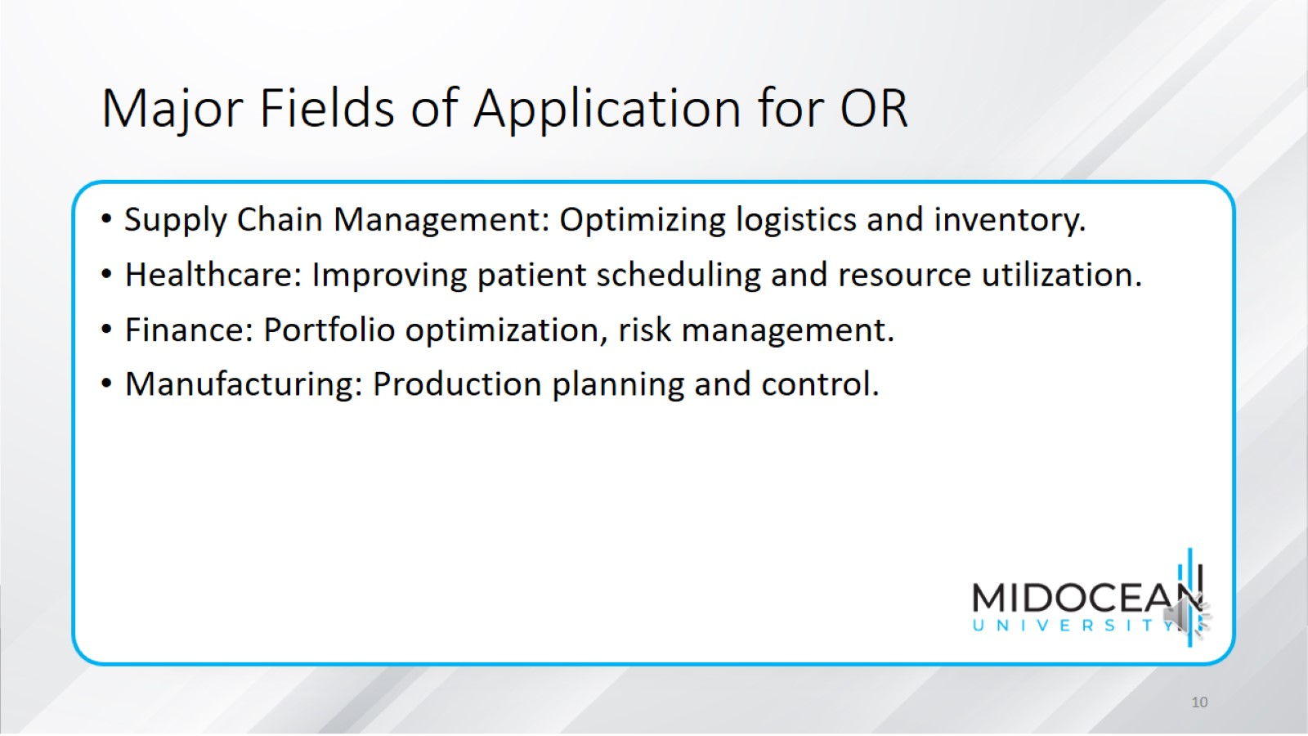
Major Fields of Application for OR

Slide 11
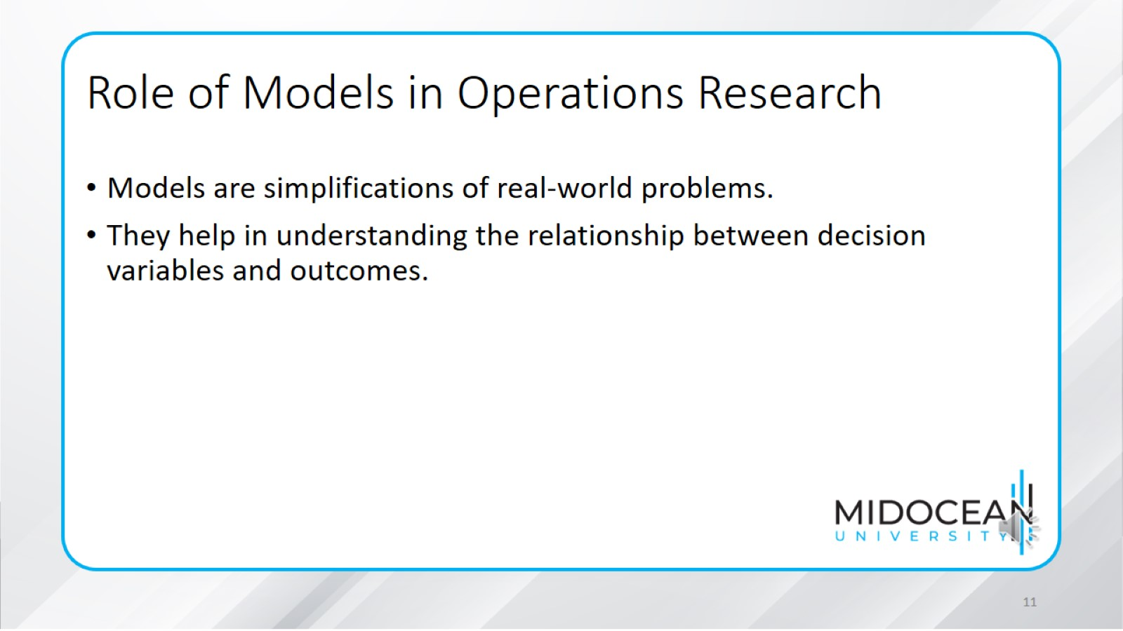
Role of Models in Operations Research

Slide 12
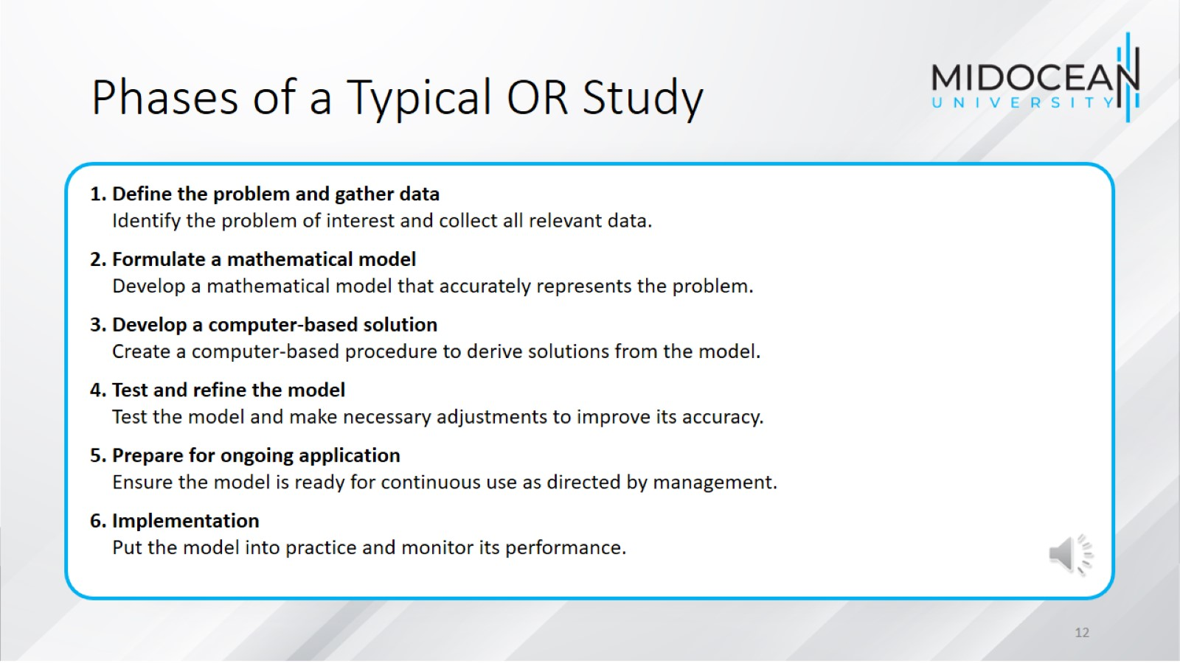
Phases of a Typical OR Study

Slide 13
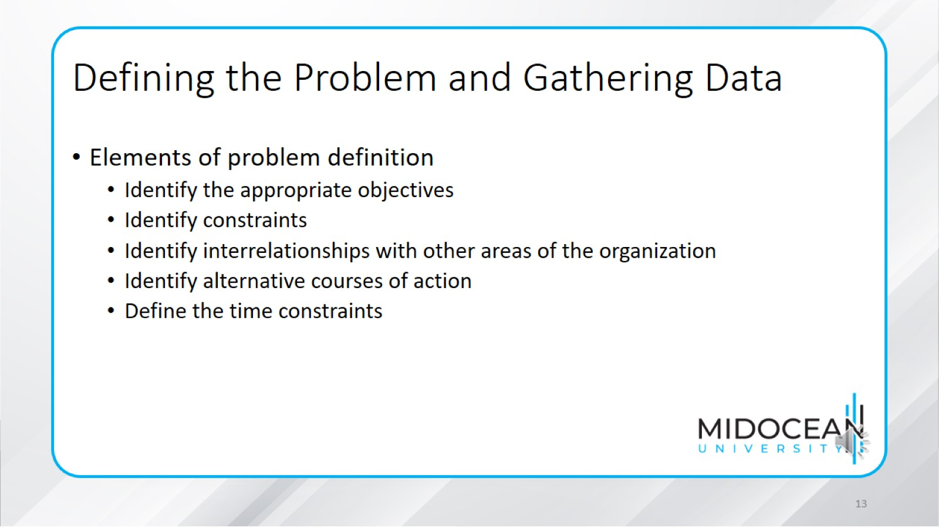
Defining the Problem and Gathering Data

Slide 14
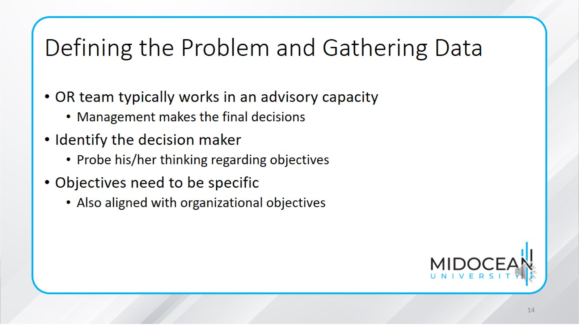
Defining the Problem and Gathering Data

Slide 15
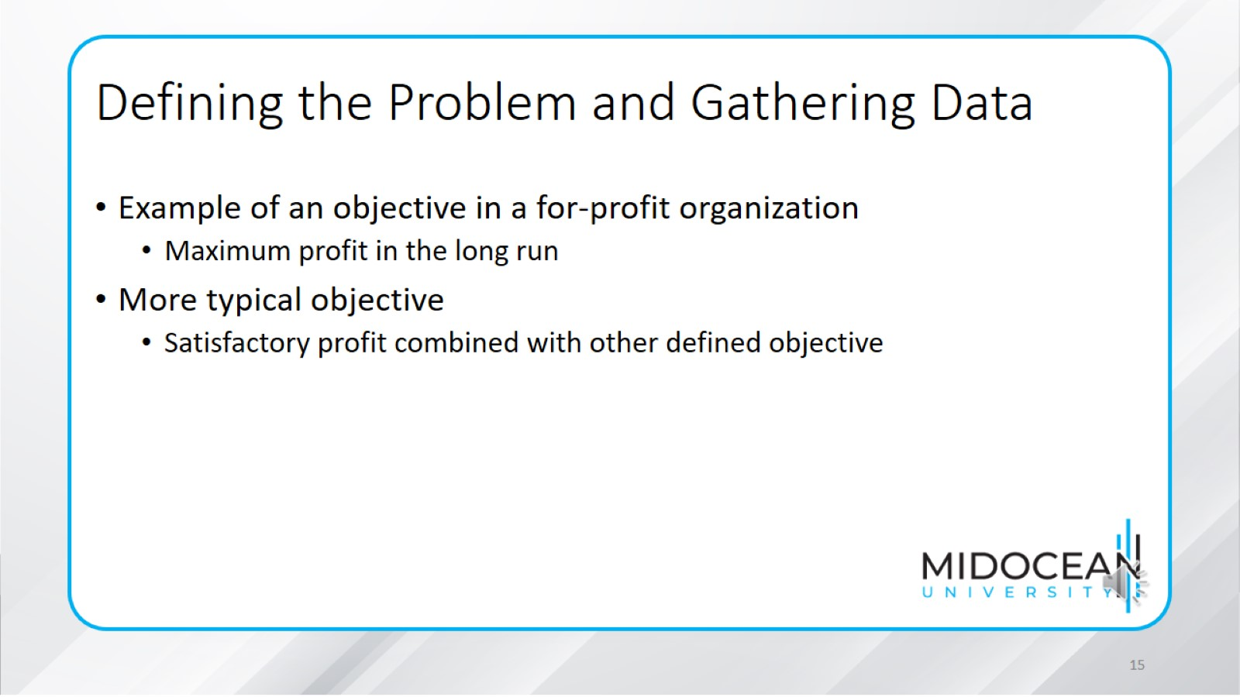
Defining the Problem and Gathering Data

Slide 16
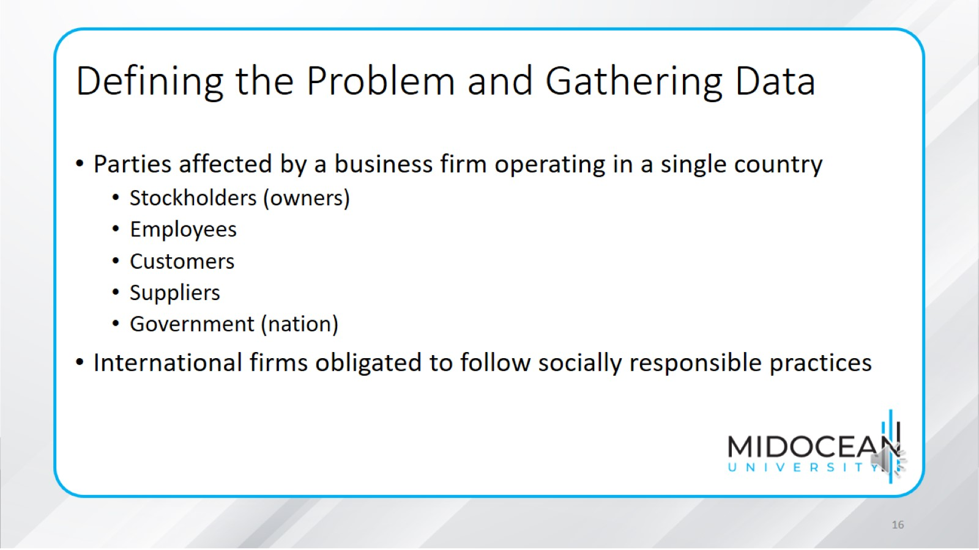
Defining the Problem and Gathering Data

Slide 17
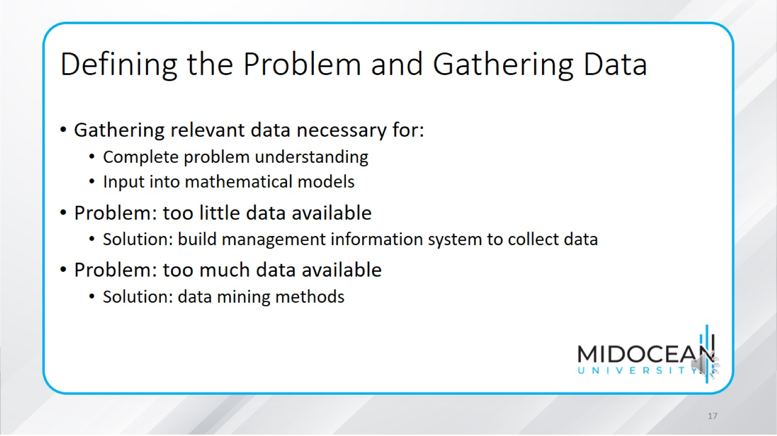
Defining the Problem and Gathering Data

Slide 18
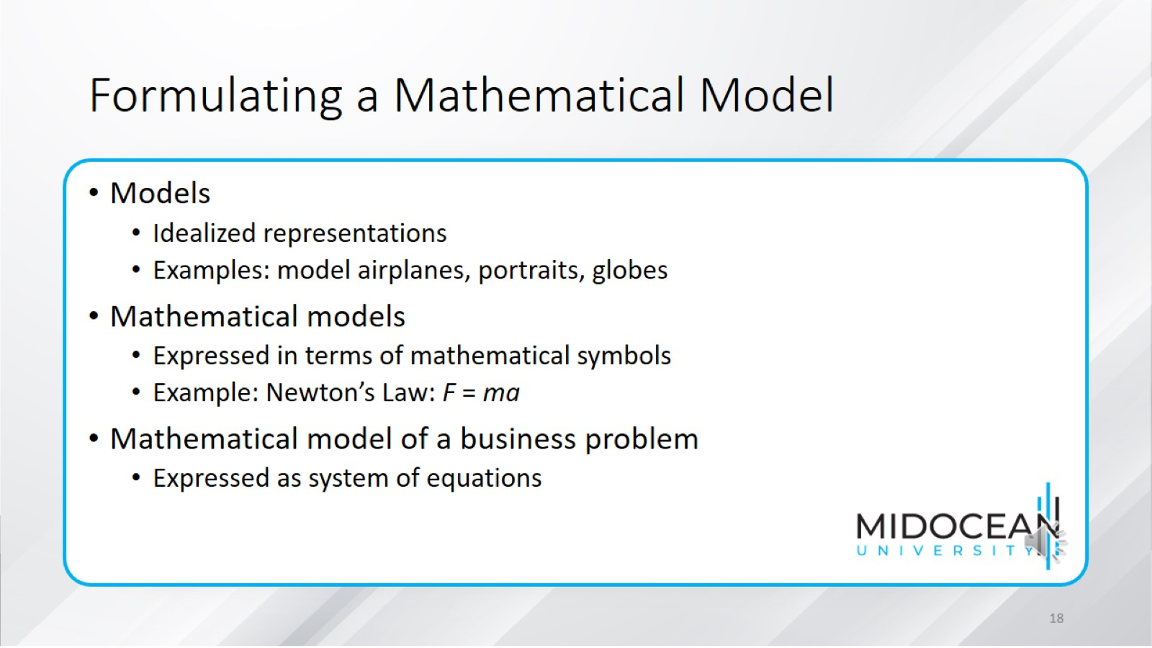
Formulating a Mathematical Model

Slide 19
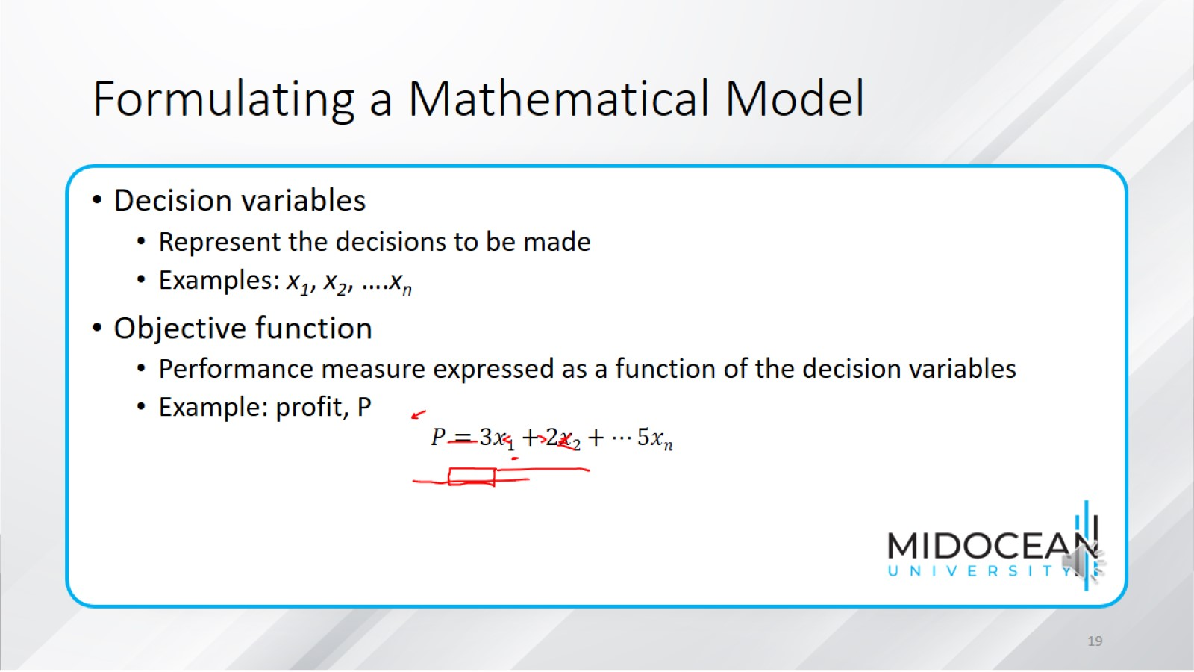
Formulating a Mathematical Model

Slide 20
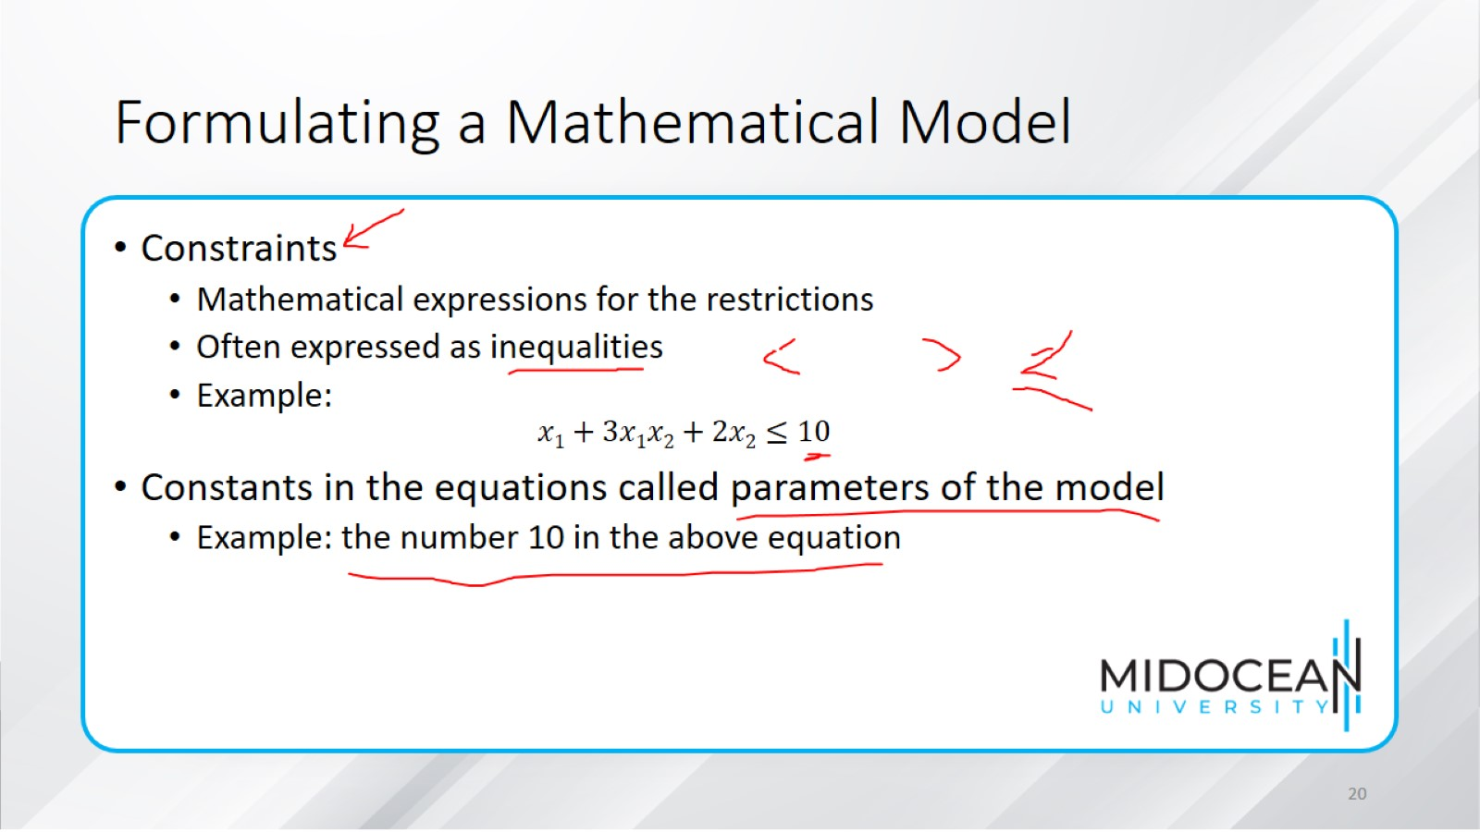
Formulating a Mathematical Model

Slide 21
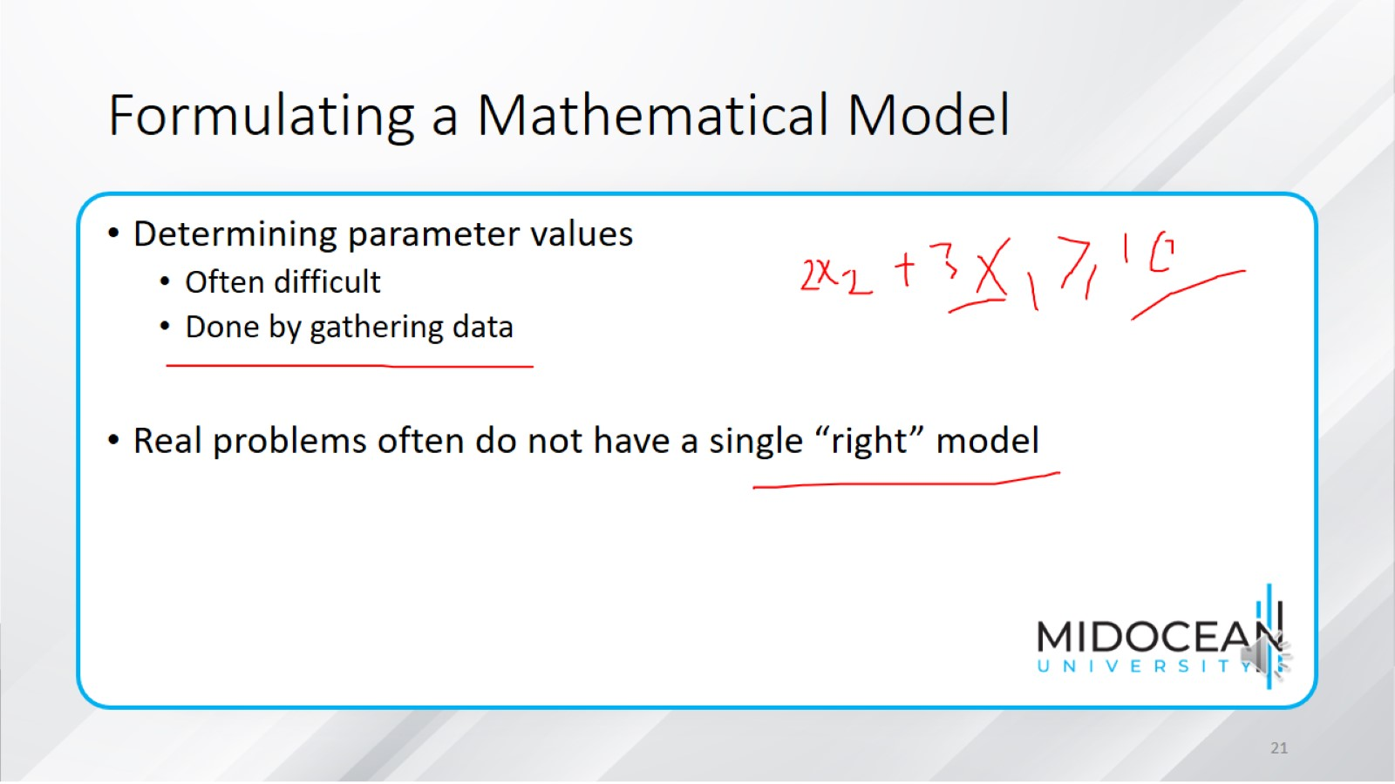
Formulating a Mathematical Model

Slide 22
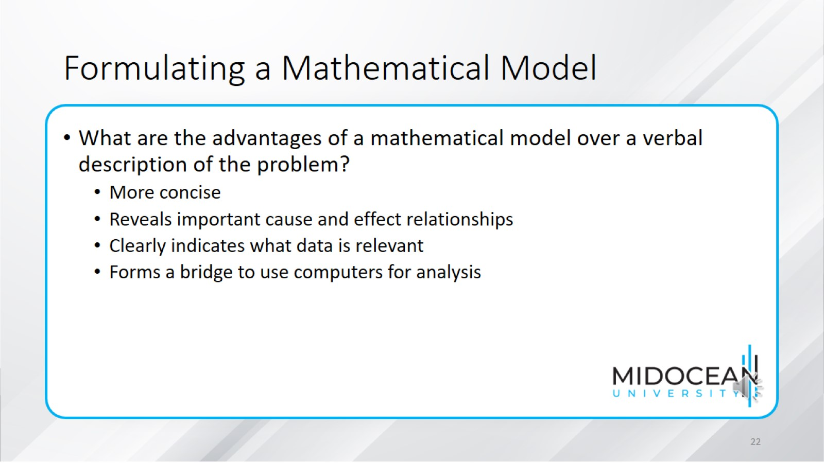
Formulating a Mathematical Model

Slide 23
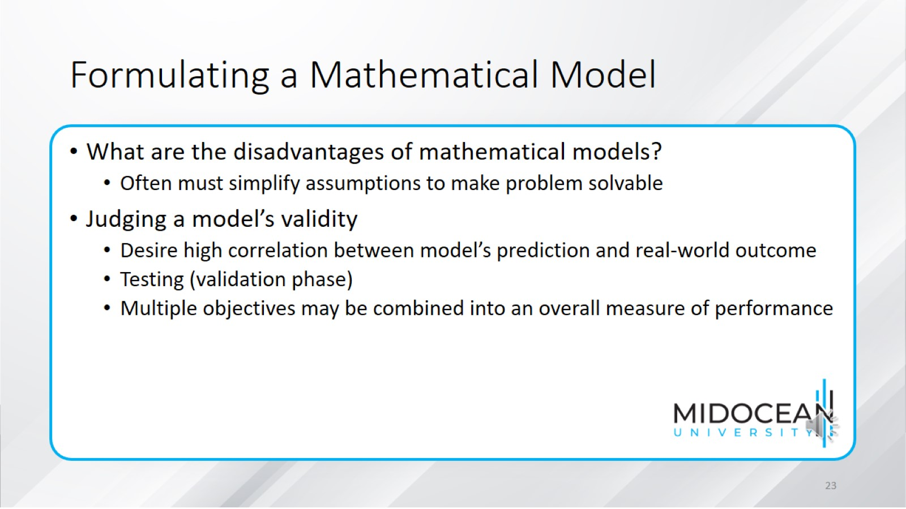
Formulating a Mathematical Model

Slide 24
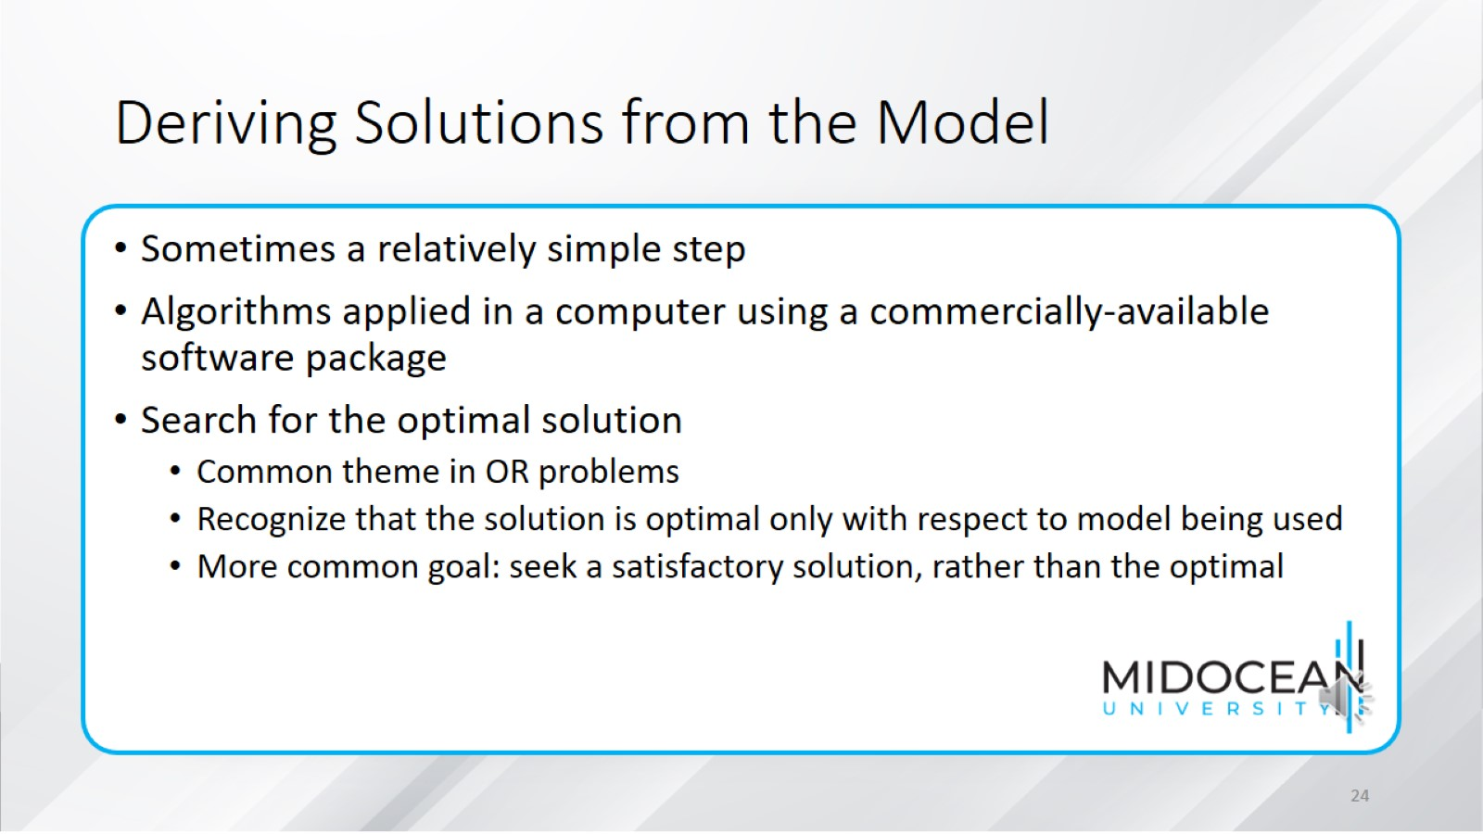
Deriving Solutions from the Model

Slide 25
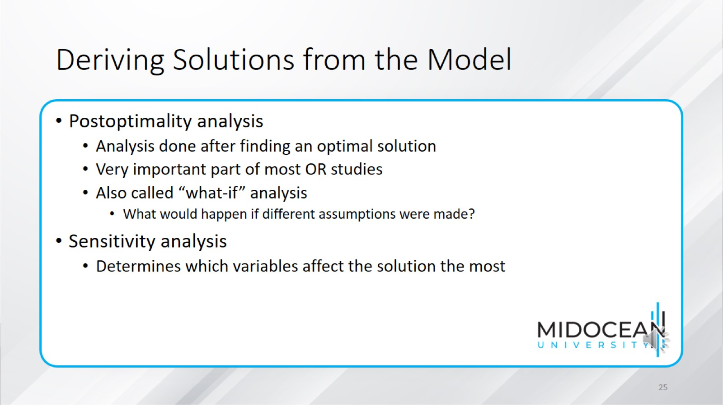
Deriving Solutions from the Model

Slide 26
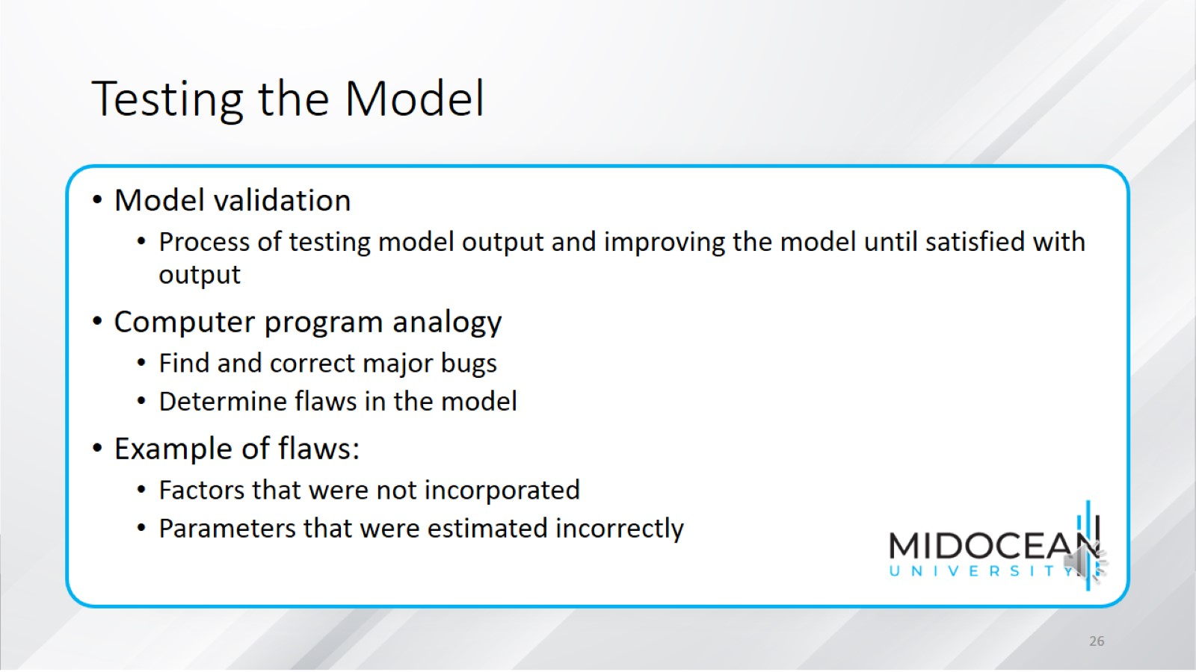
Testing the Model

Slide 27
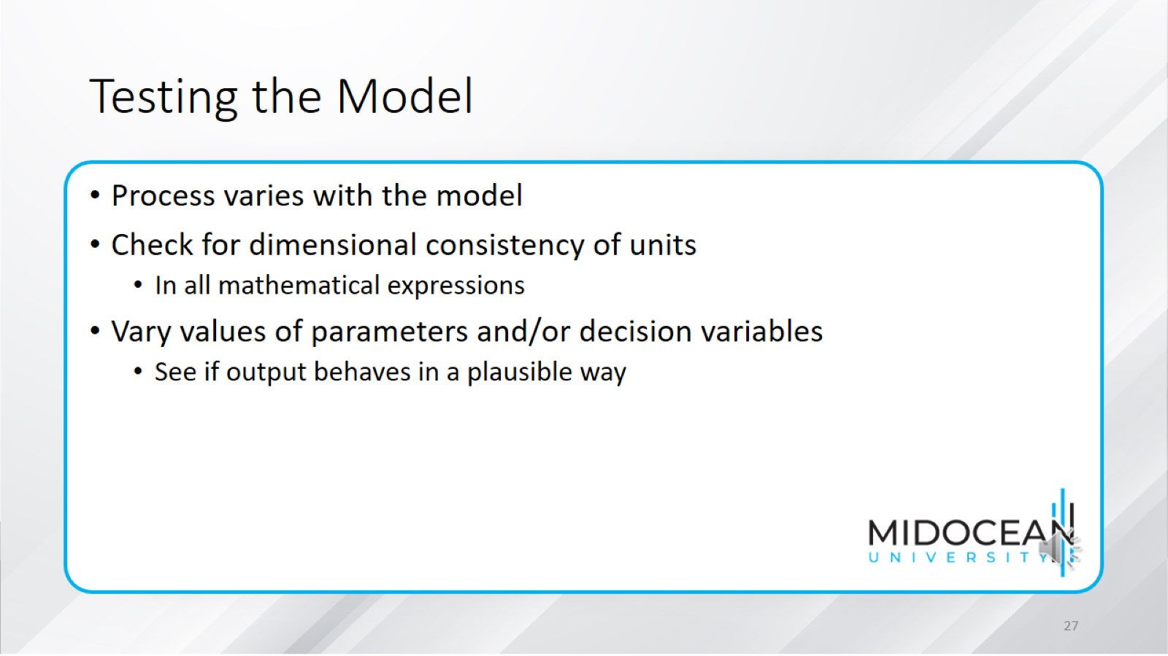
Testing the Model

Slide 28
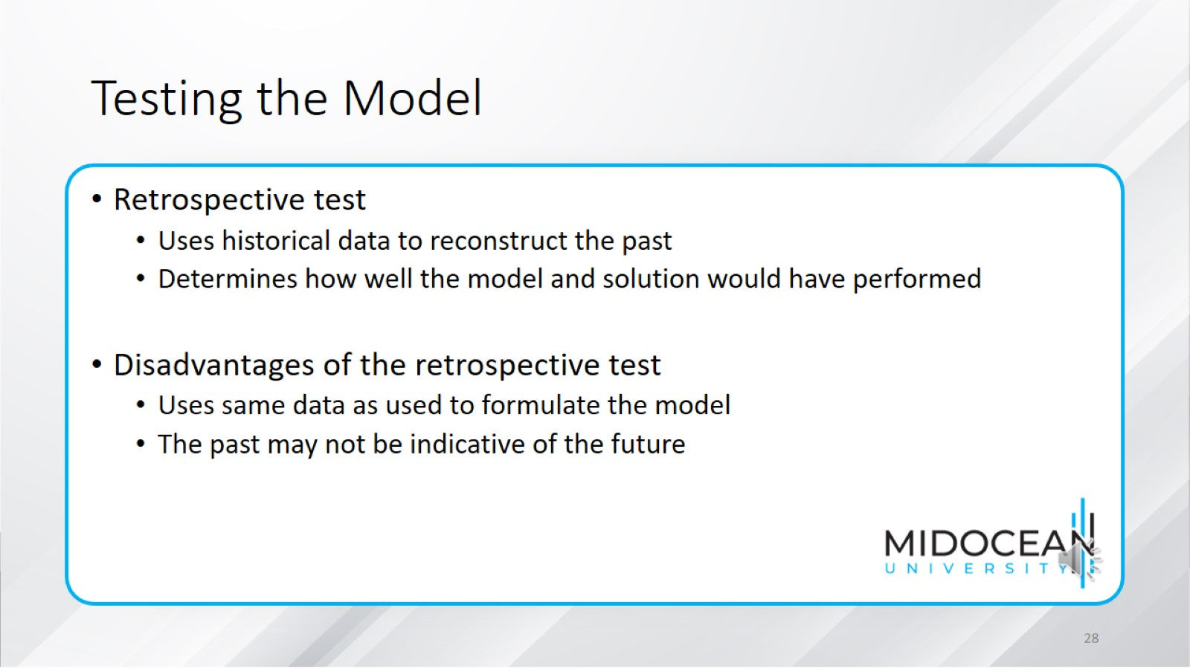
Testing the Model

Slide 29
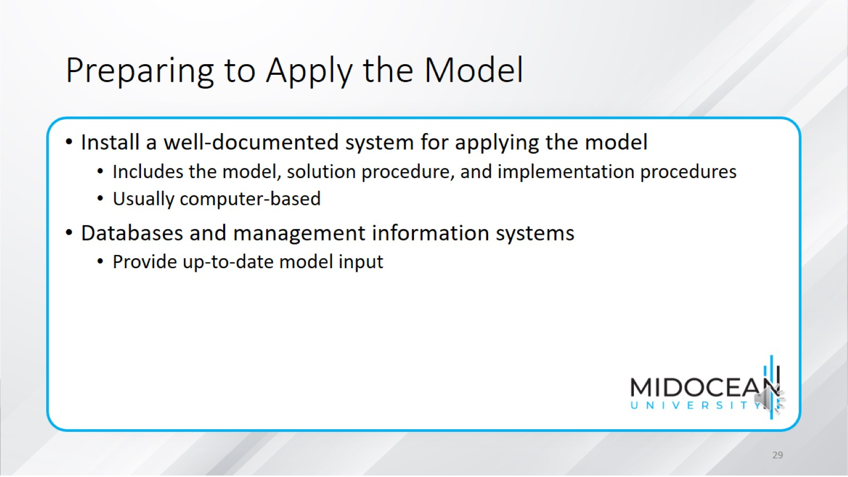
Preparing to Apply the Model

Slide 30
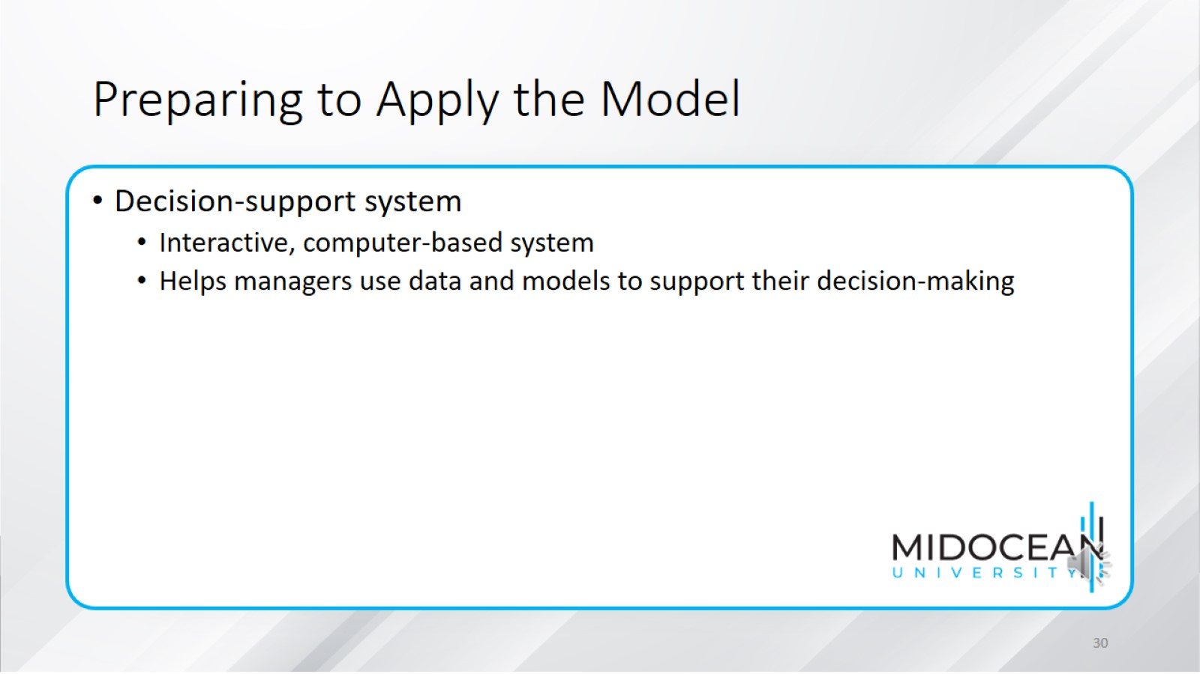
Preparing to Apply the Model

Slide 31
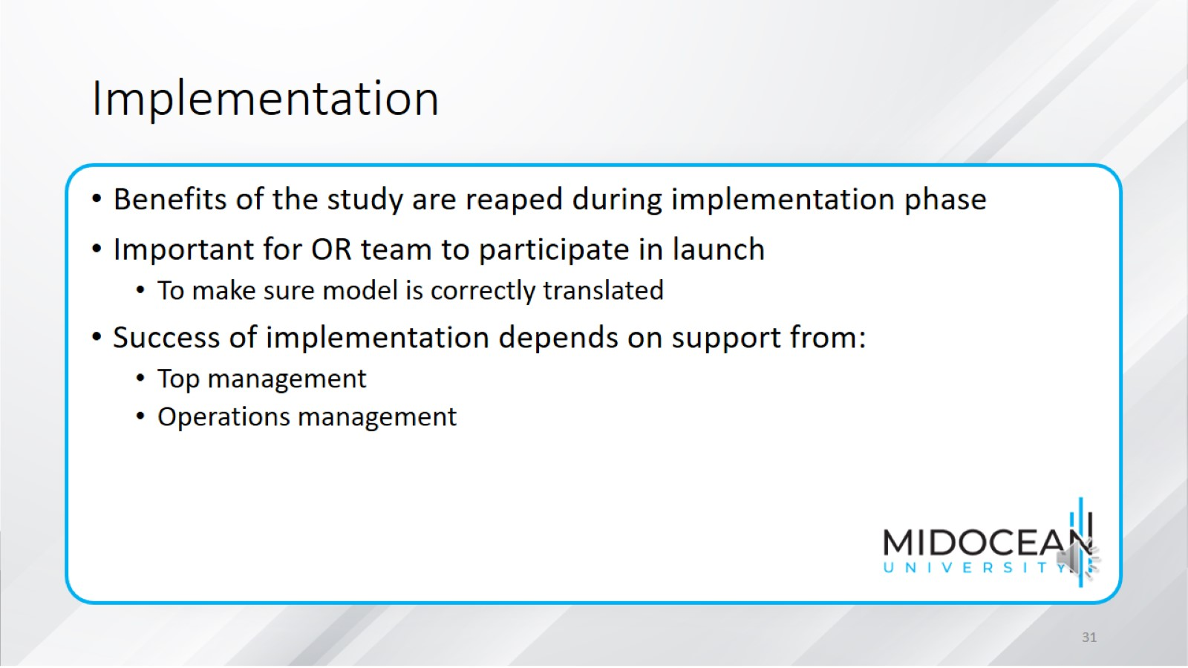
Implementation

Slide 32
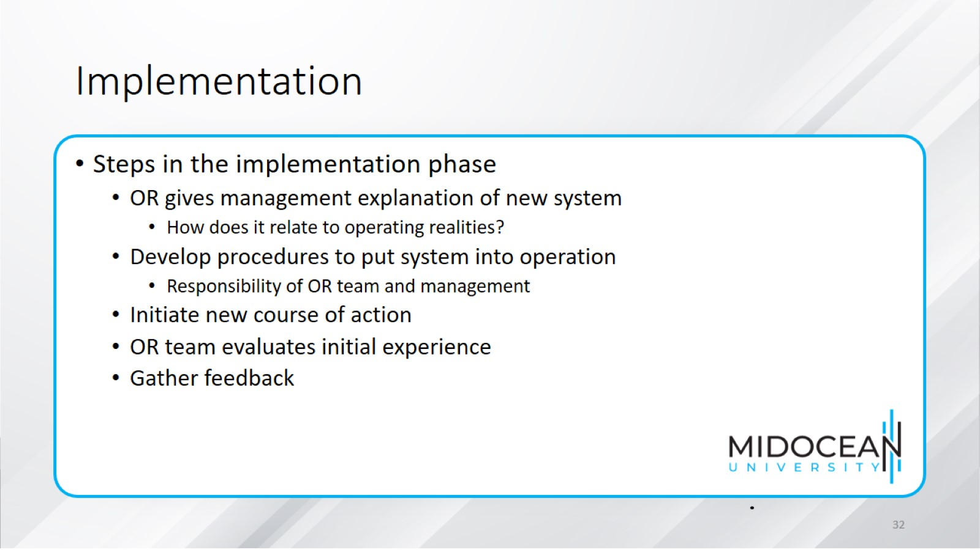
Implementation

Slide 33
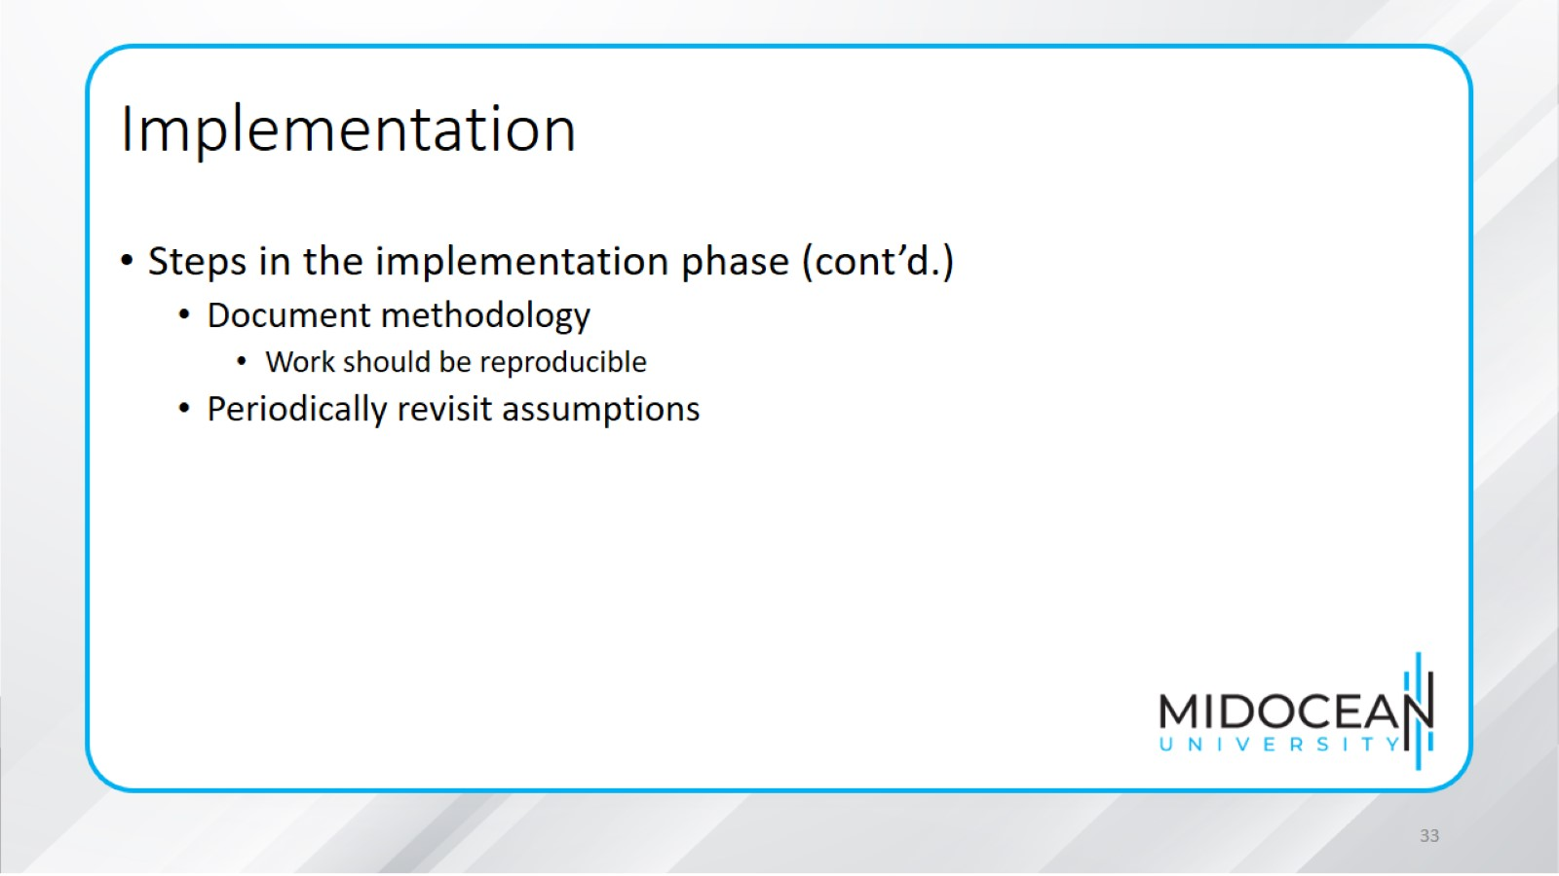
Implementation

Slide 34
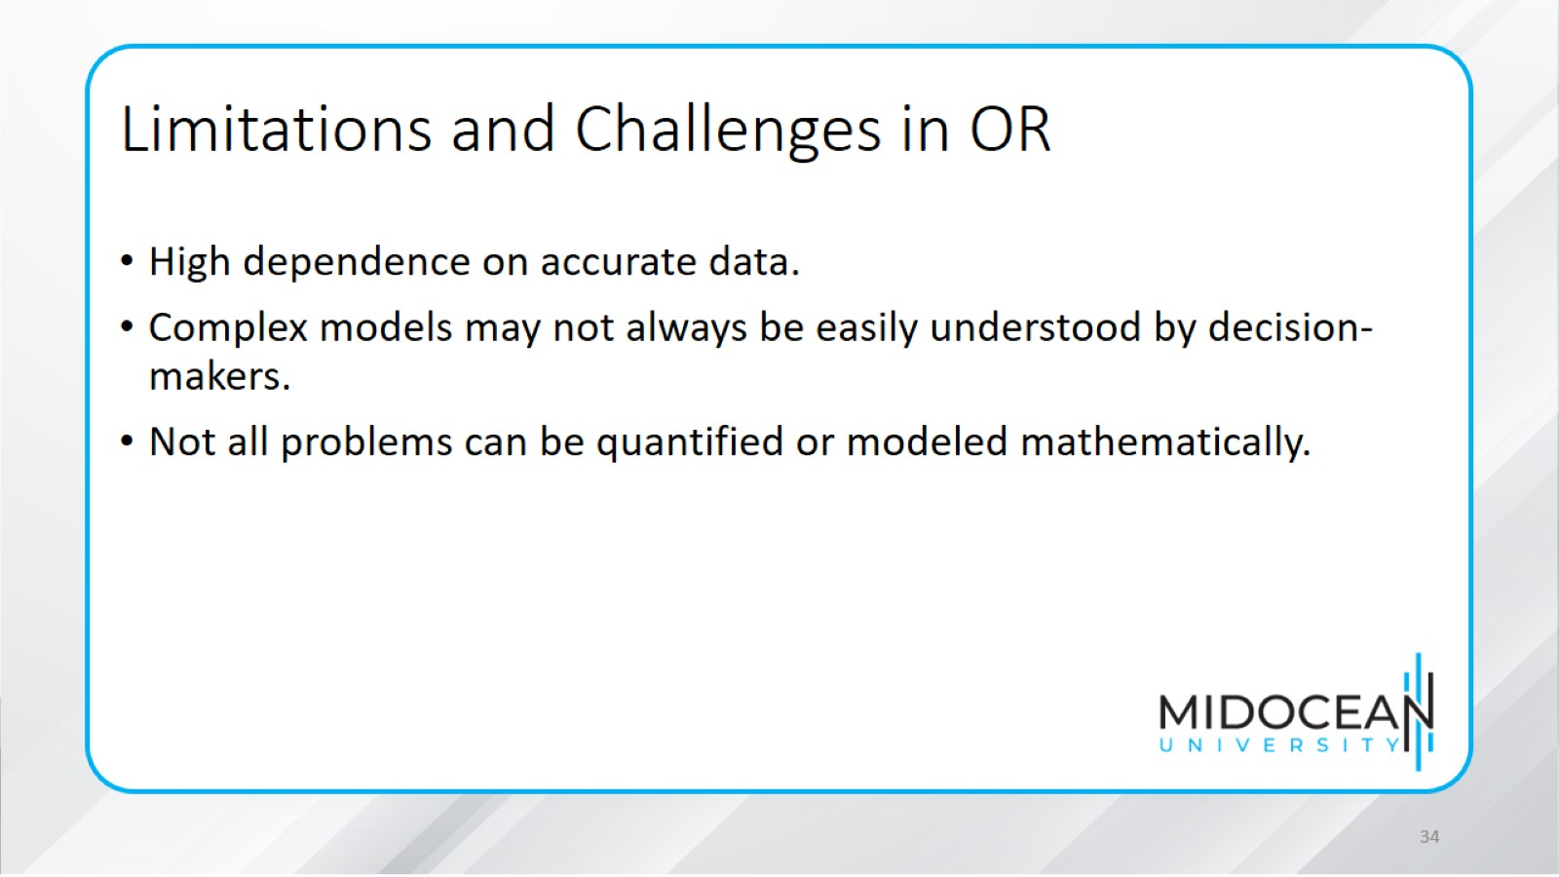
Limitations and Challenges in OR

Slide 35
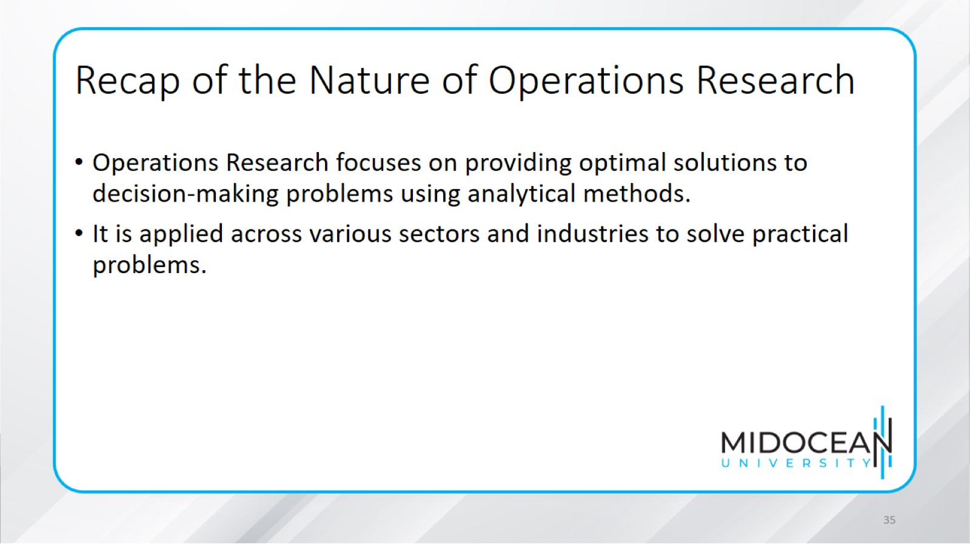
Recap of the Nature of Operations Research

Slide 36
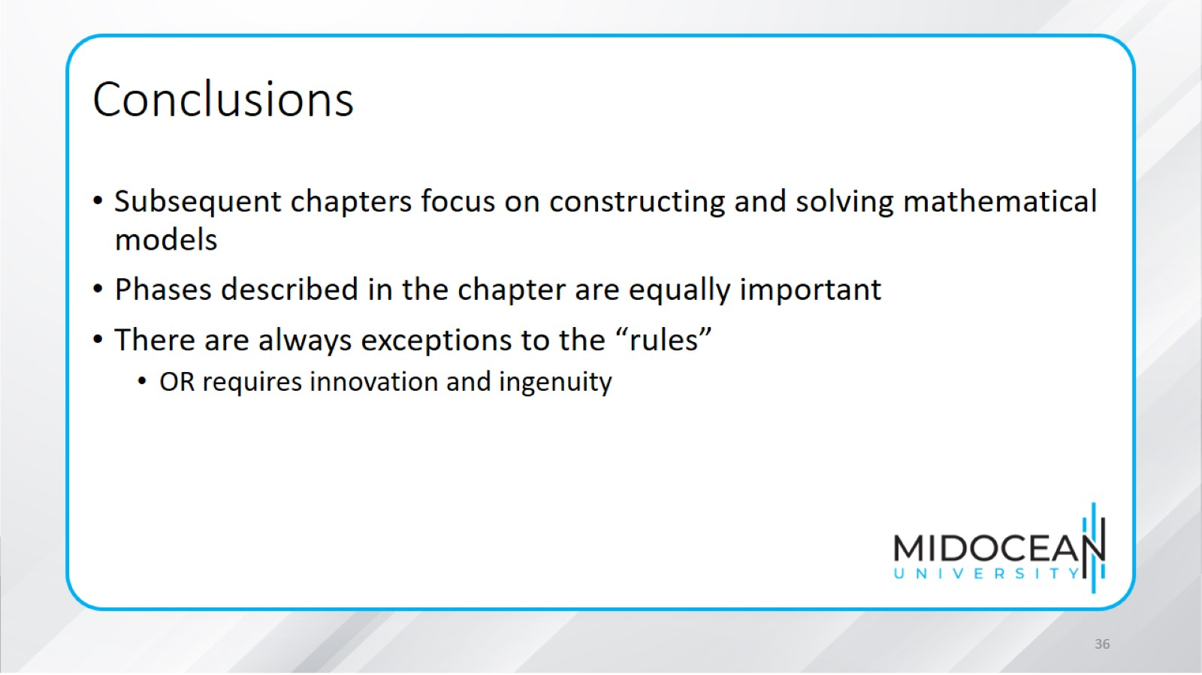
Conclusions

Slide 37


