Slide 1


IT111 - Introduction to Information Technology
Bachelor of Science in Information Technology
Lecture 2 Number
Systems
Prof. Lamiaa Fattouh Ibrahim
Everyone Smart University
Faculty of INFORMATICS
Spring 2023
1

Slide 2
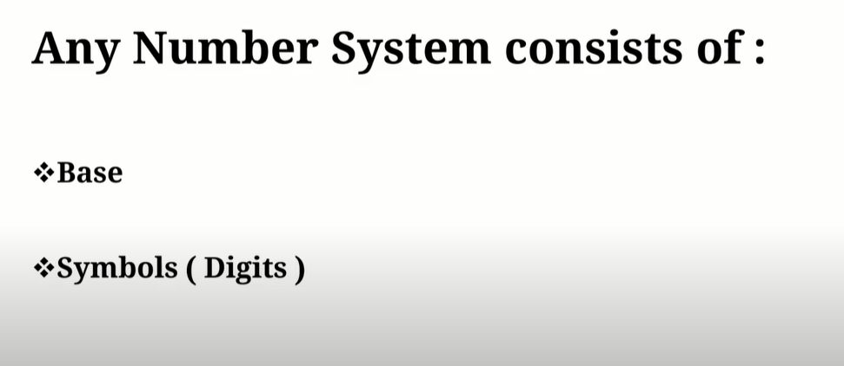

Slide 3
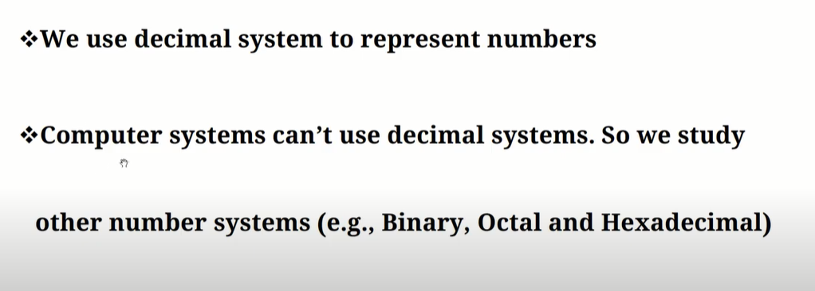

Slide 4
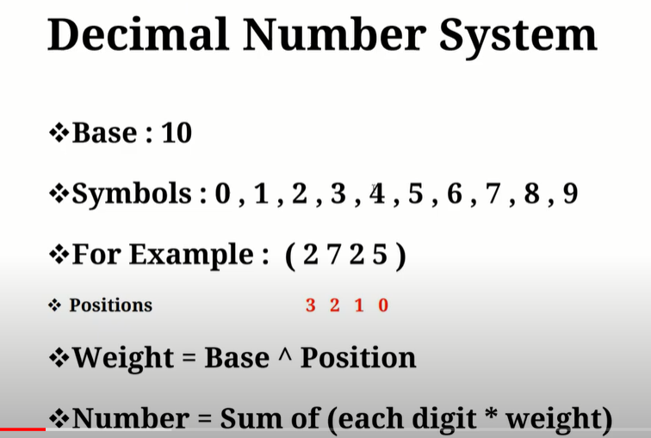

Slide 5
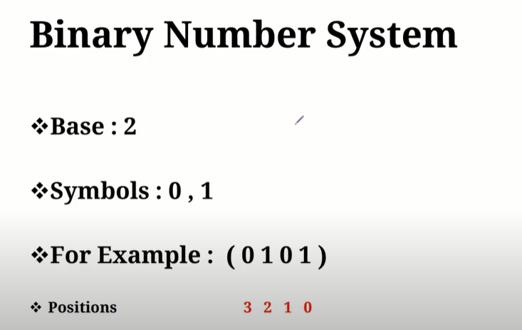
Number = 1*2⁰+ 0* 2¹+ 1*2²+ 0*2³=1+4=5

Slide 6
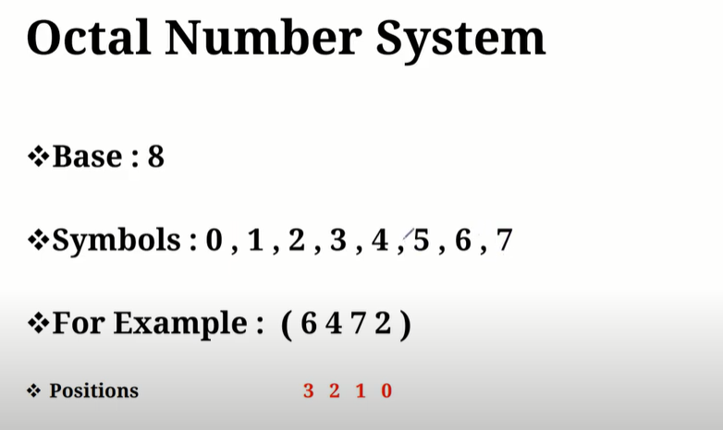
(1987)₈

Slide 7
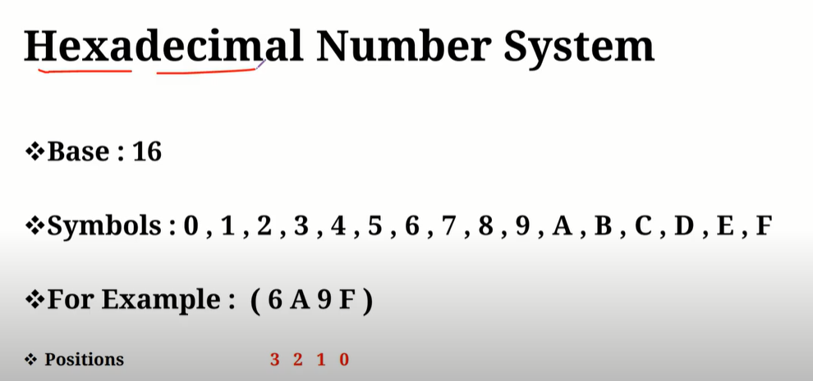

Slide 8
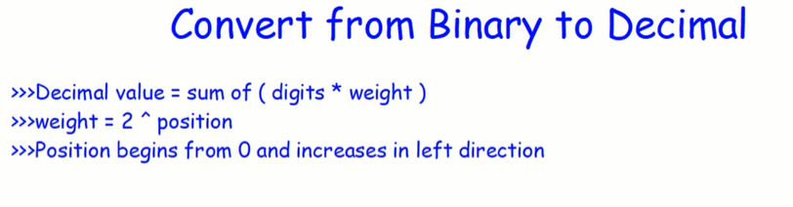
(1 0 1 1)₂=
Position = 3 2 1 0
Weight = 8 4 2 1
Decimal = 1* 8+1*2+1*1
= (11)₁₀
(1 0 1 0 1)₂
Position =4 3 2 1 0
Weight = 16 8 4 2 1
Decimal = 16+4+1
= (21)₁₀

Slide 9
(1 0 1 1 1 1)₂
Position =
Weight =
Decimal =1+2+4+8+32
= (47)₁₀
(1 0 1 1 . 0 1)₂
Position = 3 2 1 0 -1 -2
Weight = 8 4 2 1 .5 0.25
Decimal =8+2+1+.25
= (11.25)₁₀

Slide 10
(1 1 0 1 0 1 . 0 1 0 1)₂
Position = 5 4 3 2 1 0 .-1 -2 -3 -4
Weight = 32 16 8 4 2 1 . 1/2 1/4 1/8 1/16
Decimal = 32+16+4+1+(4/16+1/16)
= (53 5/16)₁₀= (53.3125)₁₀

Slide 11


Weight | 256 | 128 | 64 | 32 | 16 | 8 | 4 | 2 | 1
Position | 8 | 7 | 6 | 5 | 4 | 3 | 2 | 1 | 0
35/2= 17 R = 1
17/2= 8 R = 1
8/2= 4 R= 0
4/2= 2 R= 0
2/2= 1 R= 0
½= 0 R= 1
من تحت الى فوق من اليسار الى اليمن ( 100011)₂
(35)₁₀= ( 1 0 0 0 1 1 )₂
(17)₁₀= ( 10001 )₂

Slide 12
DEC | BINARY | OCTAL
 | 000 | 0
 | 001 | 1
 | 010 | 2
 | 011 | 3
 | 100 | 4
 | 101 | 5
 | 110 | 6
 | 111 | 7

Slide 13
BINARY | HEXADECIMAL
0000 | 0
0001 | 1
0010 | 2
0011 | 3
0100 | 4
0101 | 5
0110 | 6
0111 | 7
1000 | 8
1001 | 9
1010 | A
1011 | B
1100 | C
1101 | D
1110 | E
1111 | F

