Slide 1


Slide 2
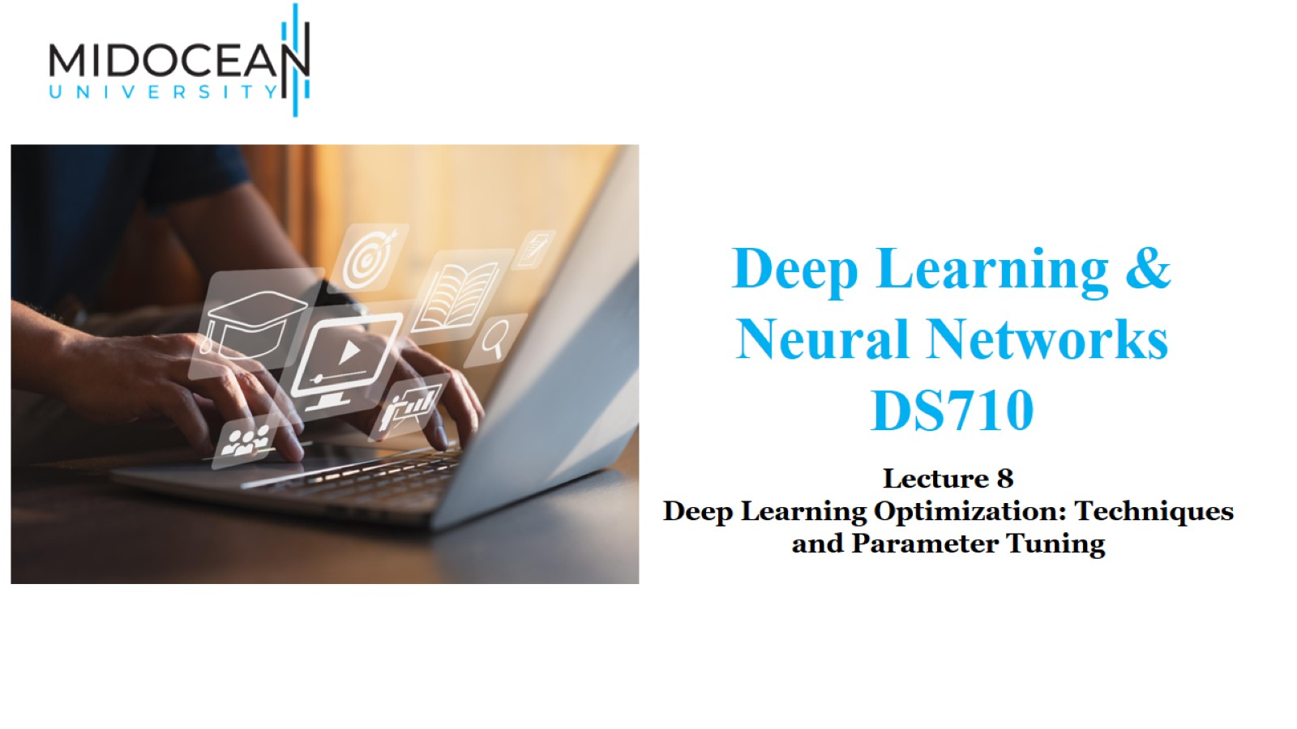

Slide 3
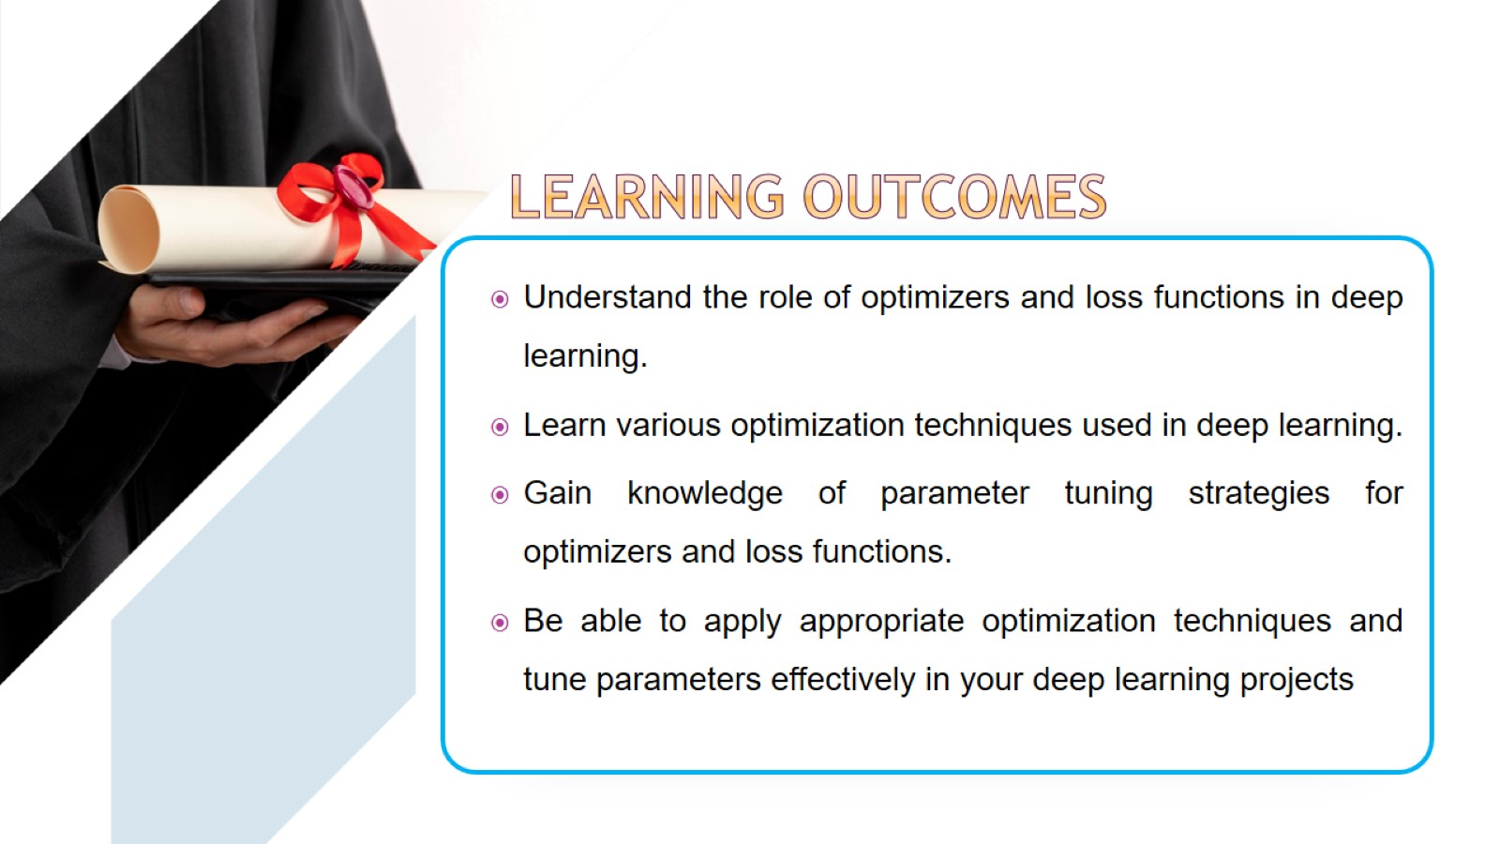

Slide 4
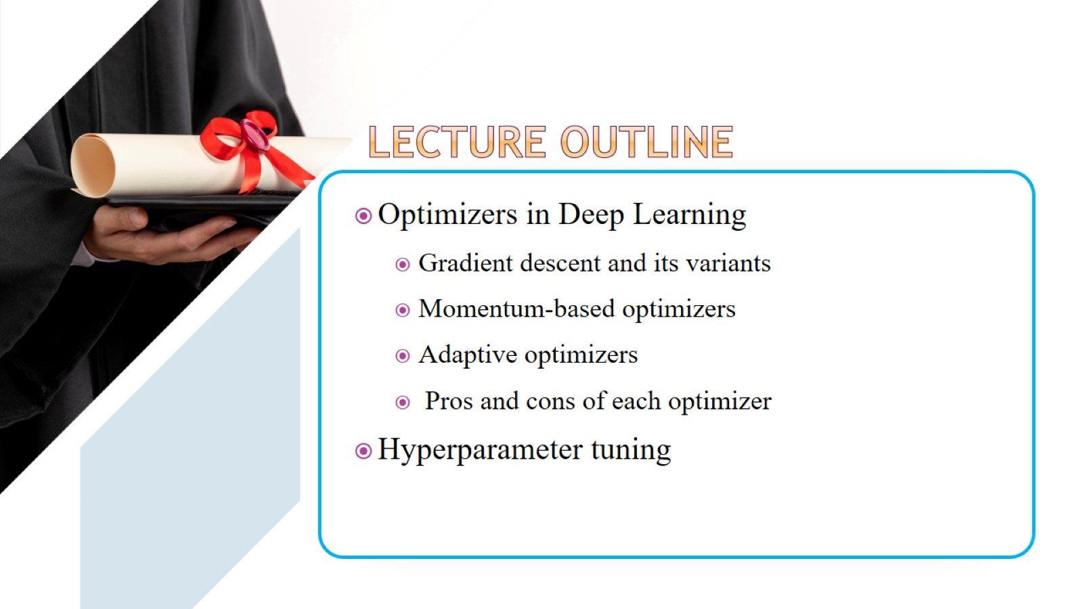

Slide 5
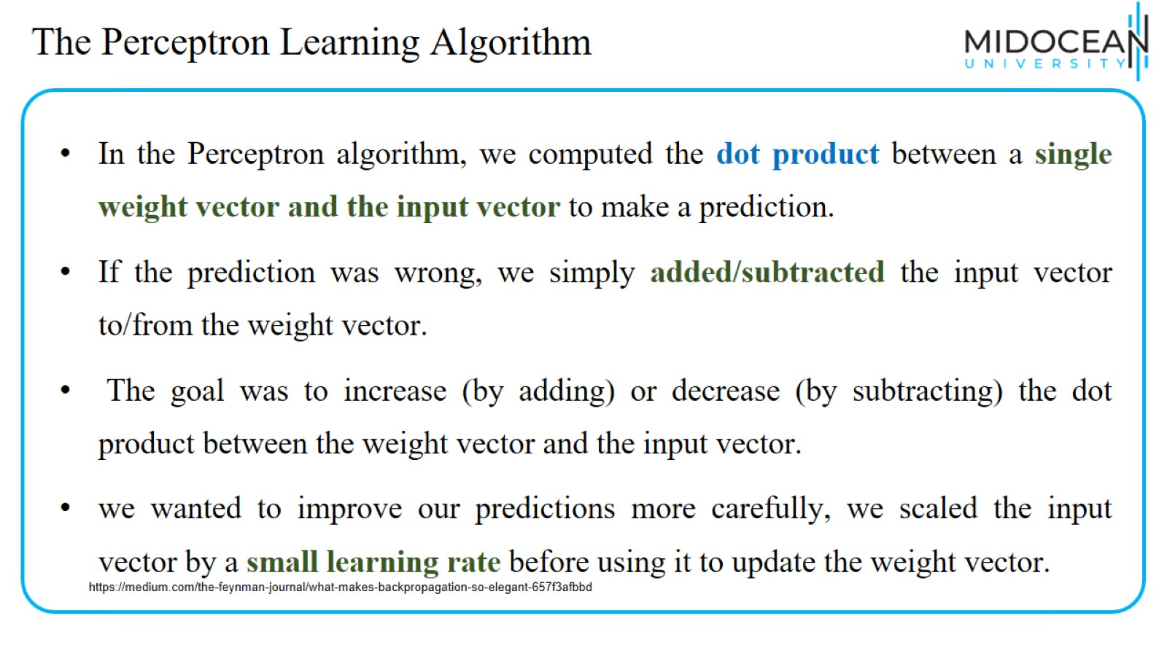
The Perceptron Learning Algorithm

Slide 6
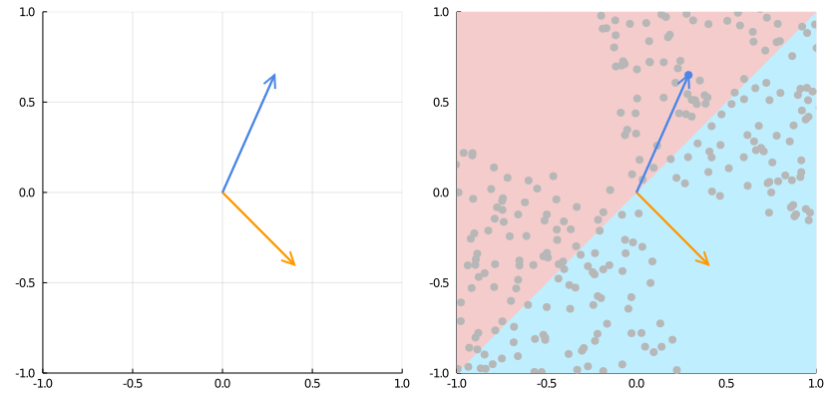
The Perceptron Learning Algorithm
https://medium.com/the-feynman-journal/what-makes-backpropagation-so-elegant-657f3afbbd

Slide 7
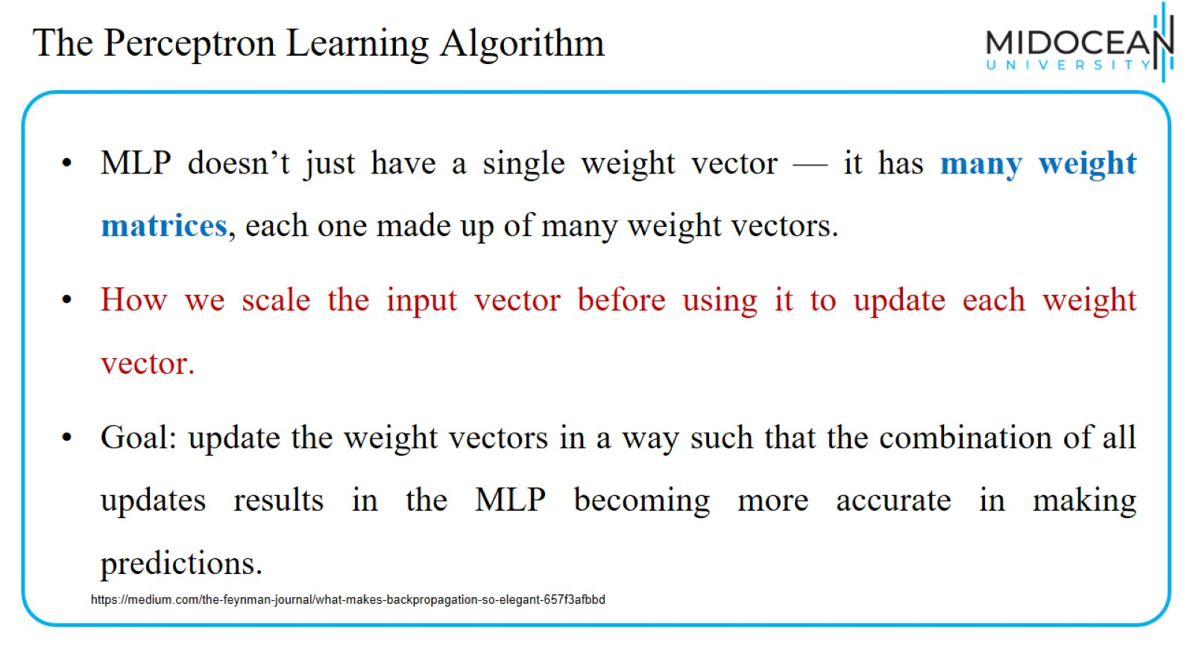
The Perceptron Learning Algorithm

Slide 8
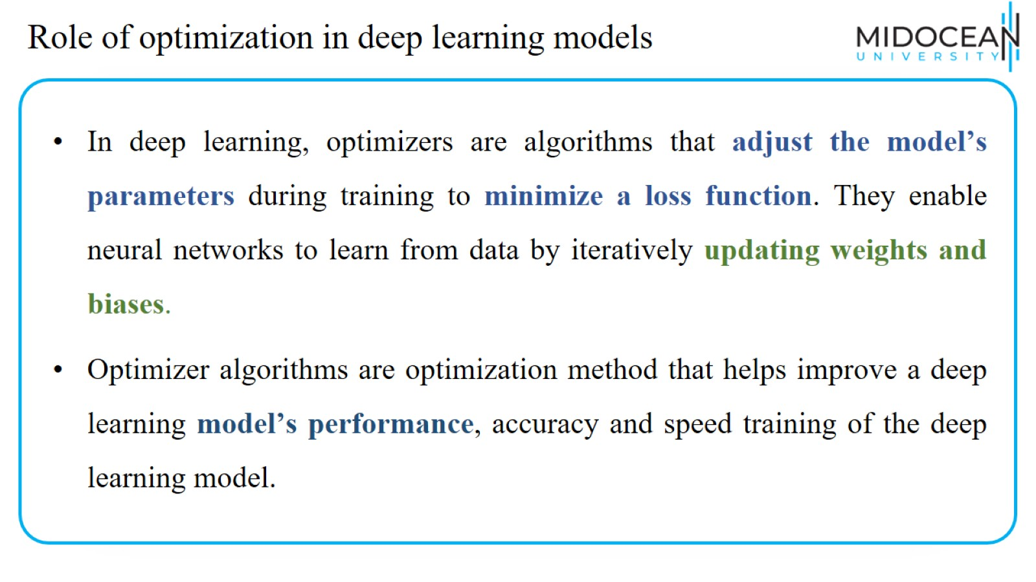
Role of optimization in deep learning models

Slide 9
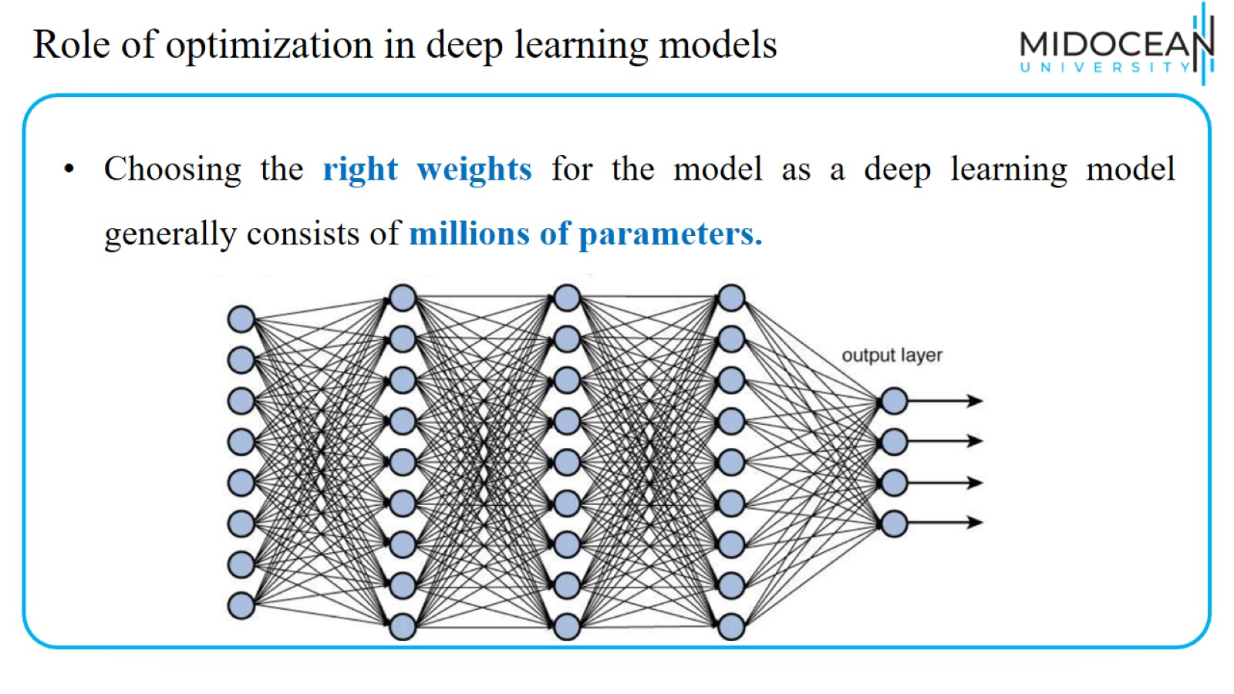
Role of optimization in deep learning models

Slide 10
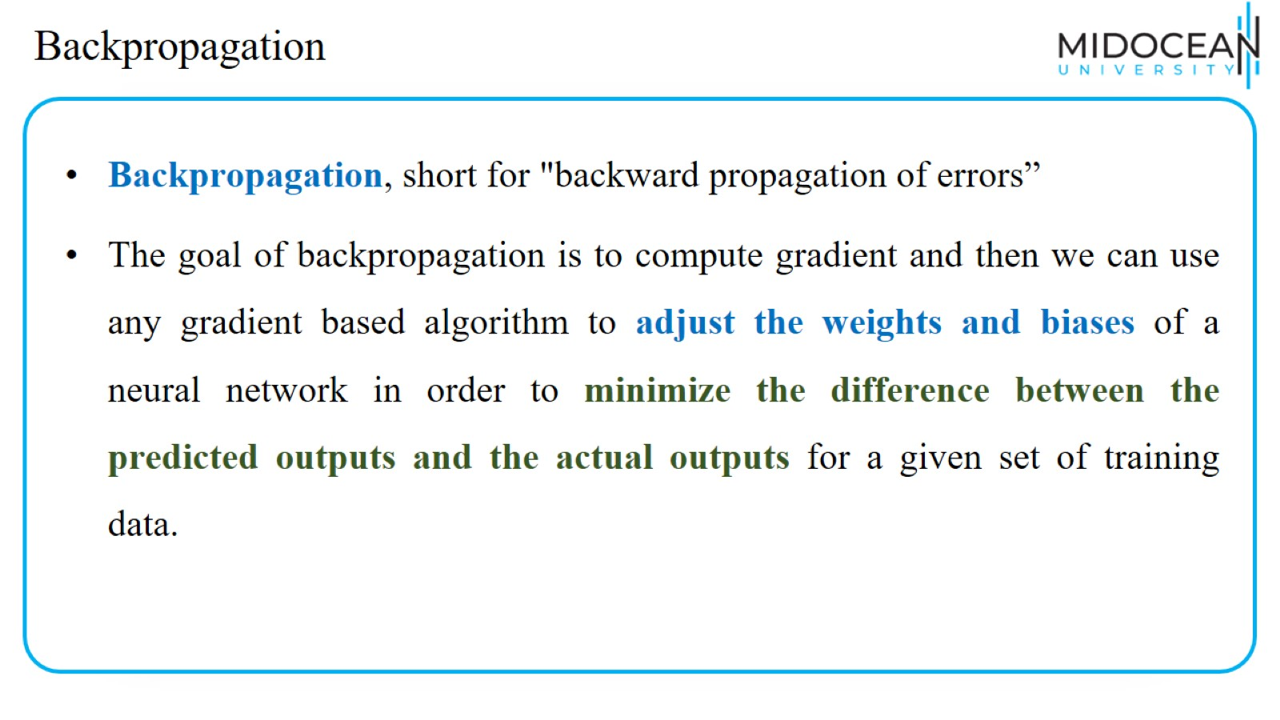
Backpropagation

Slide 11
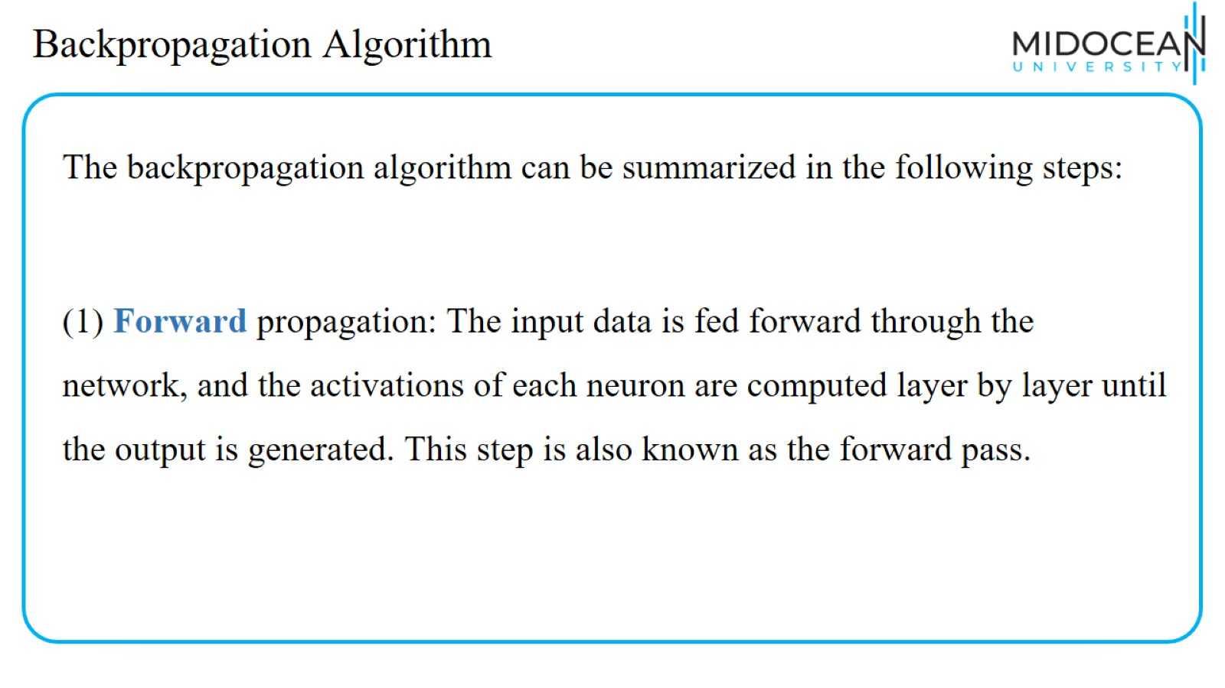
Backpropagation Algorithm

Slide 12
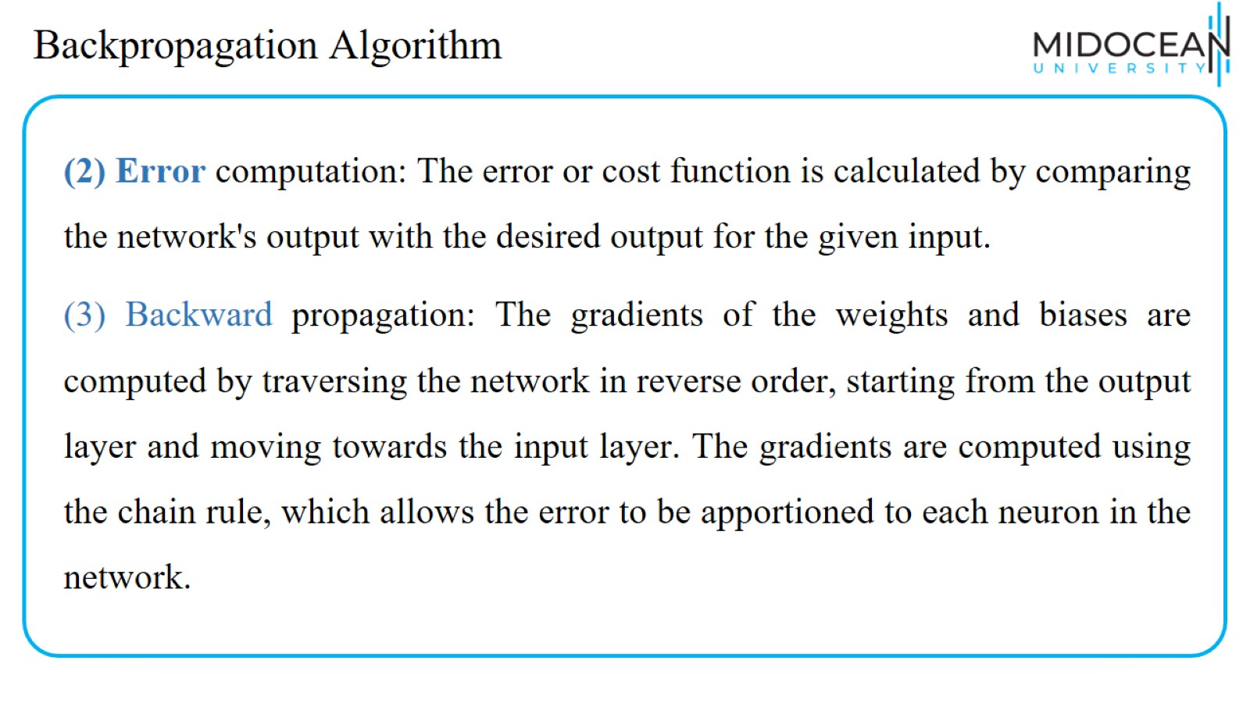
Backpropagation Algorithm

Slide 13
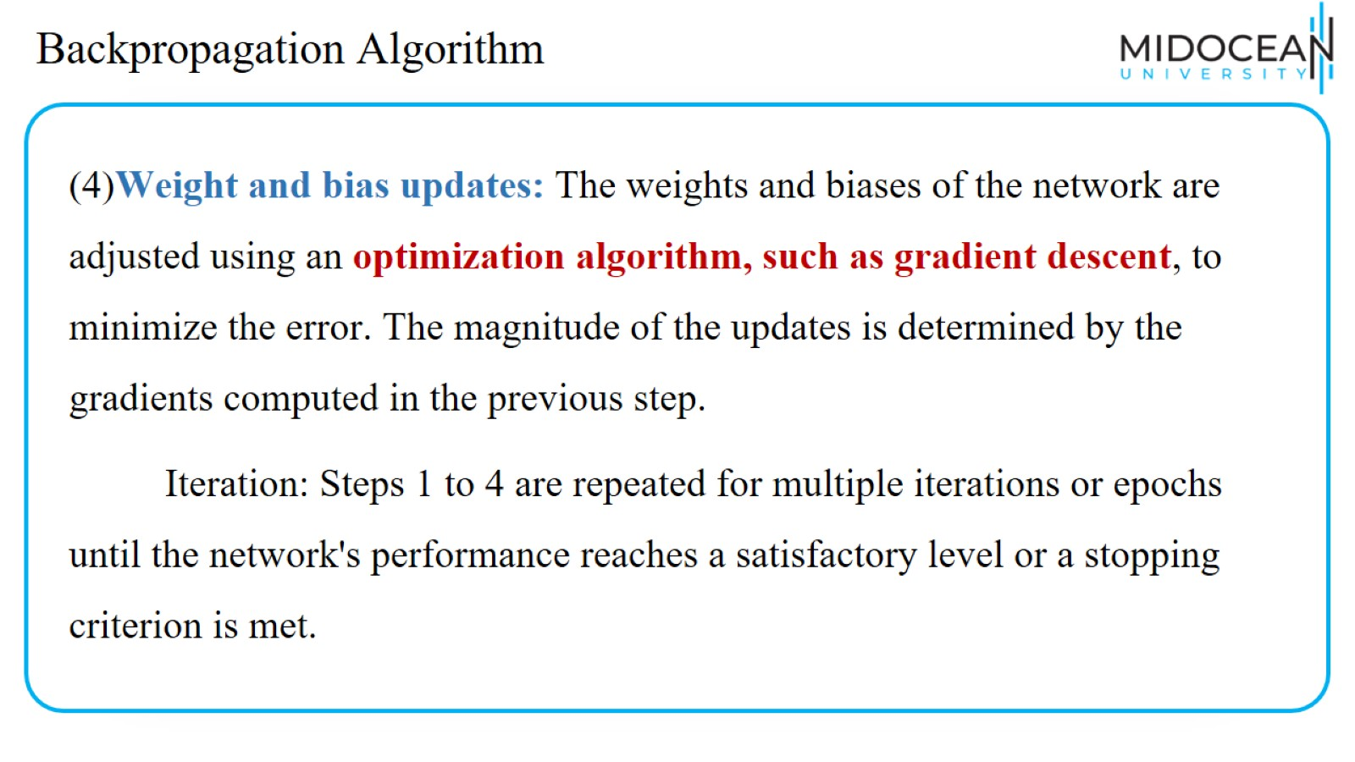
Backpropagation Algorithm

Slide 14
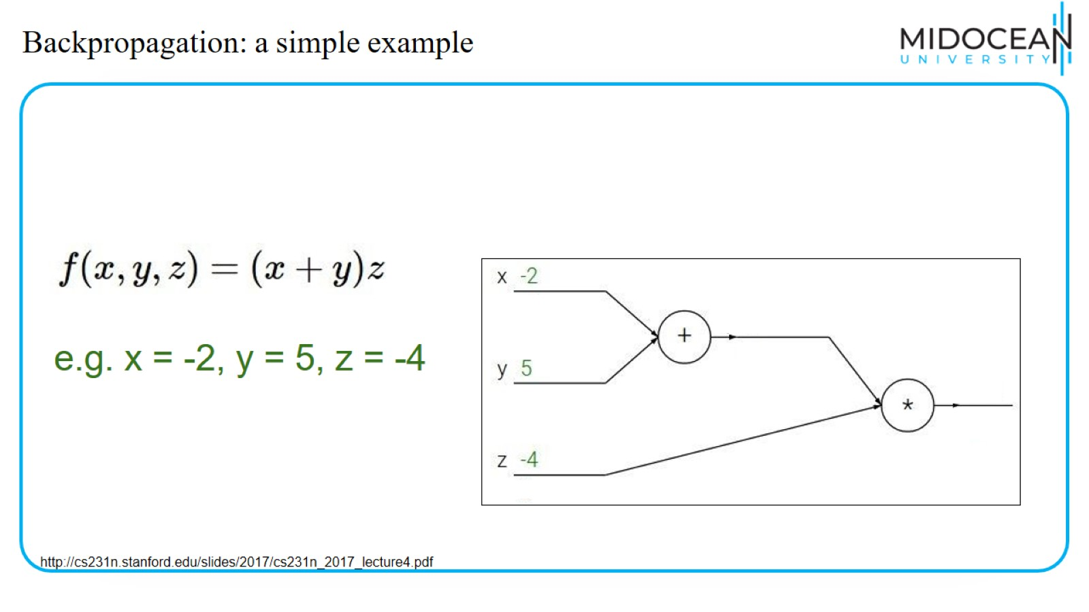
Backpropagation: a simple example

Slide 15
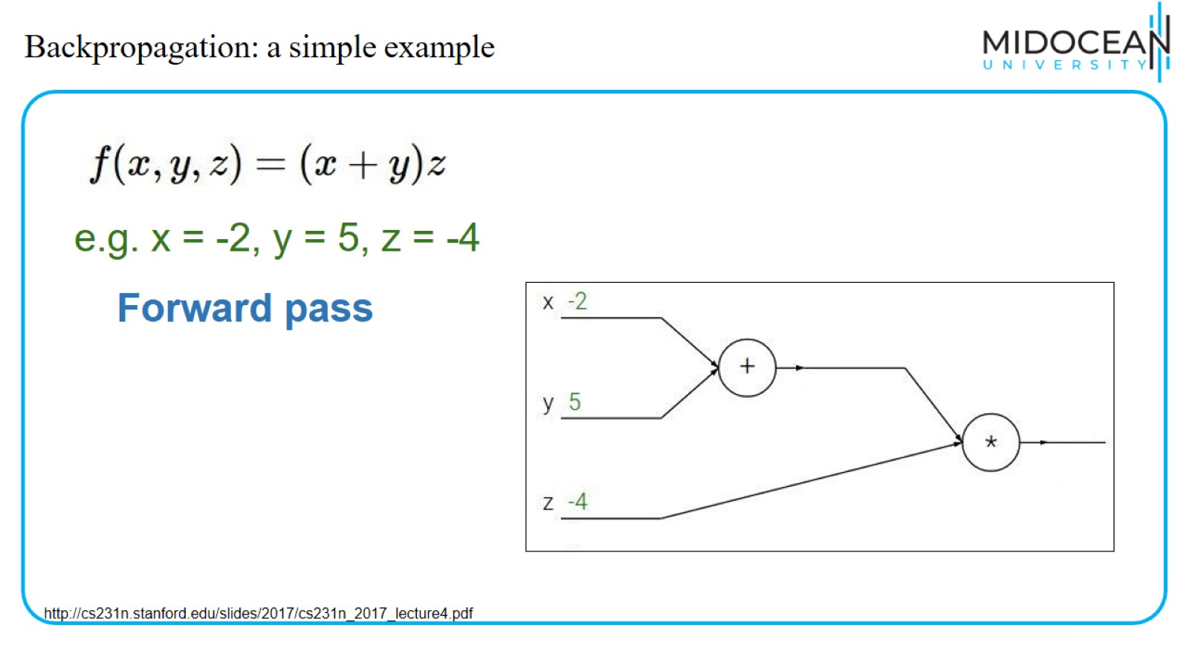
Backpropagation: a simple example

Slide 16
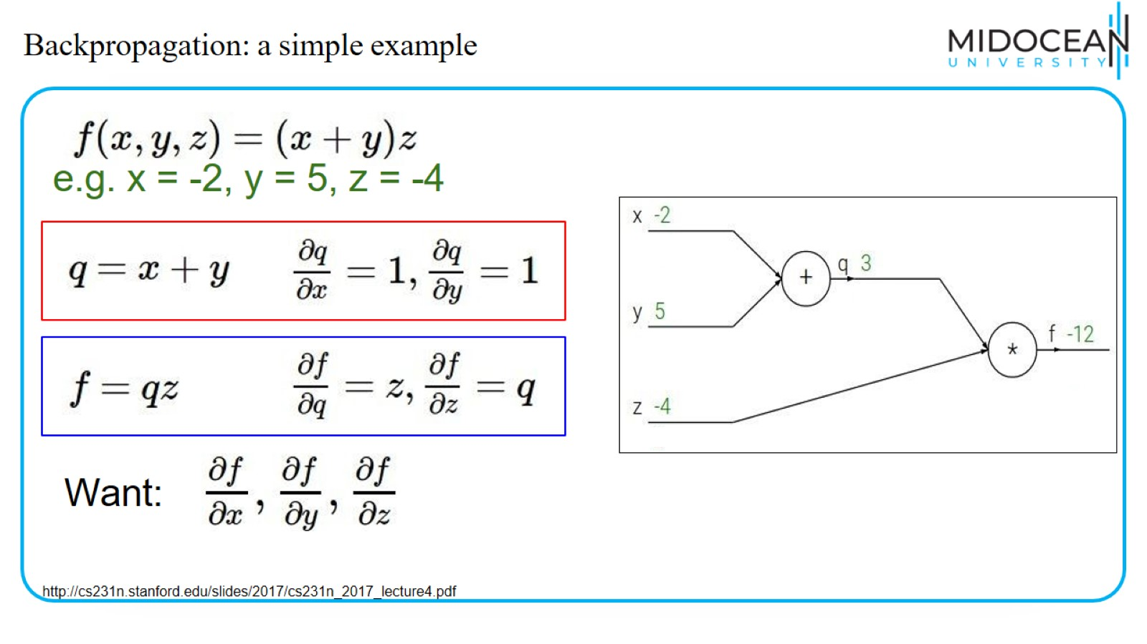
Backpropagation: a simple example

Slide 17
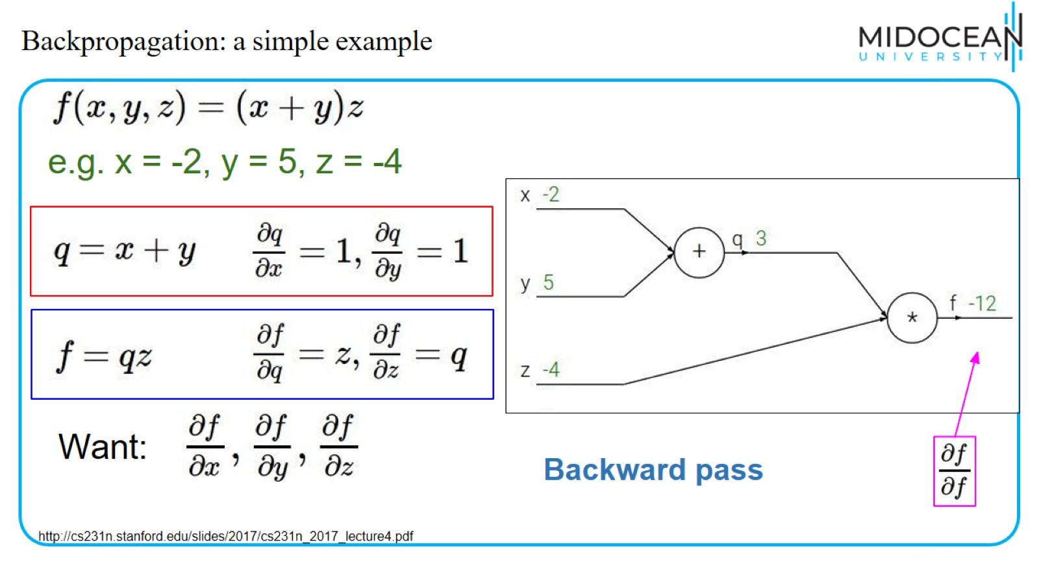
Backpropagation: a simple example

Slide 18
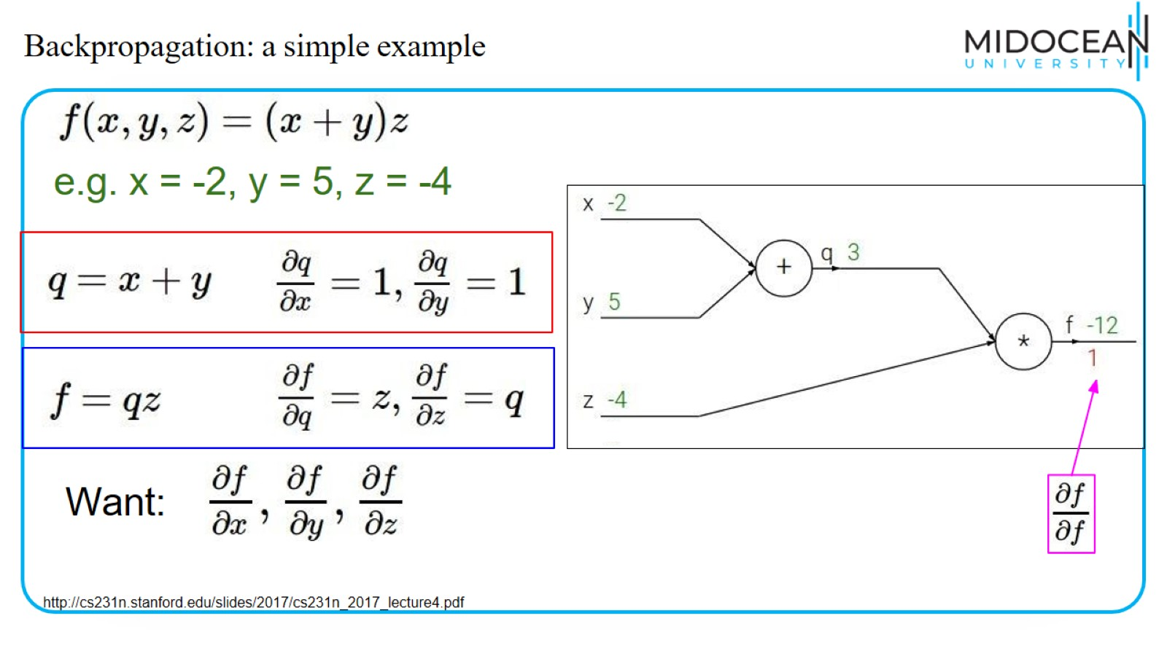
Backpropagation: a simple example

Slide 19
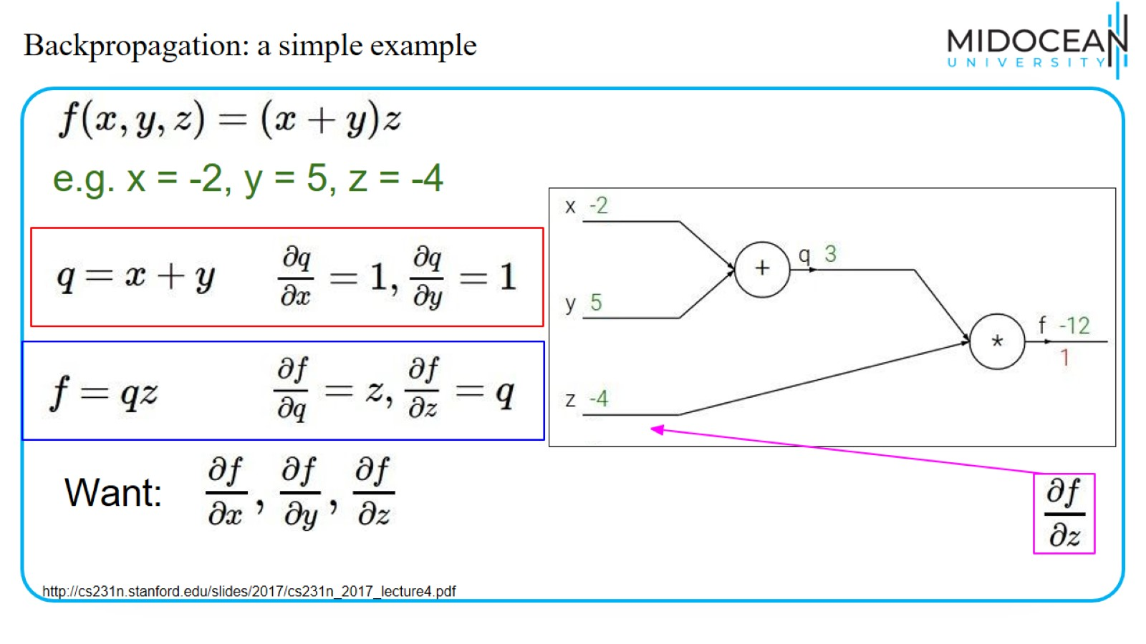
Backpropagation: a simple example

Slide 20
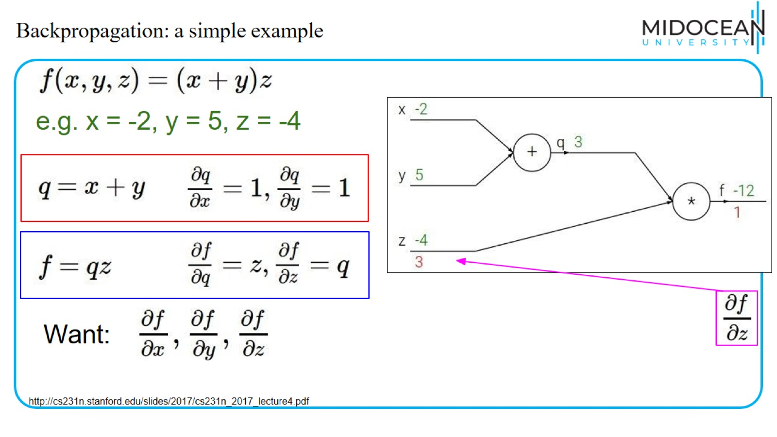
Backpropagation: a simple example

Slide 21
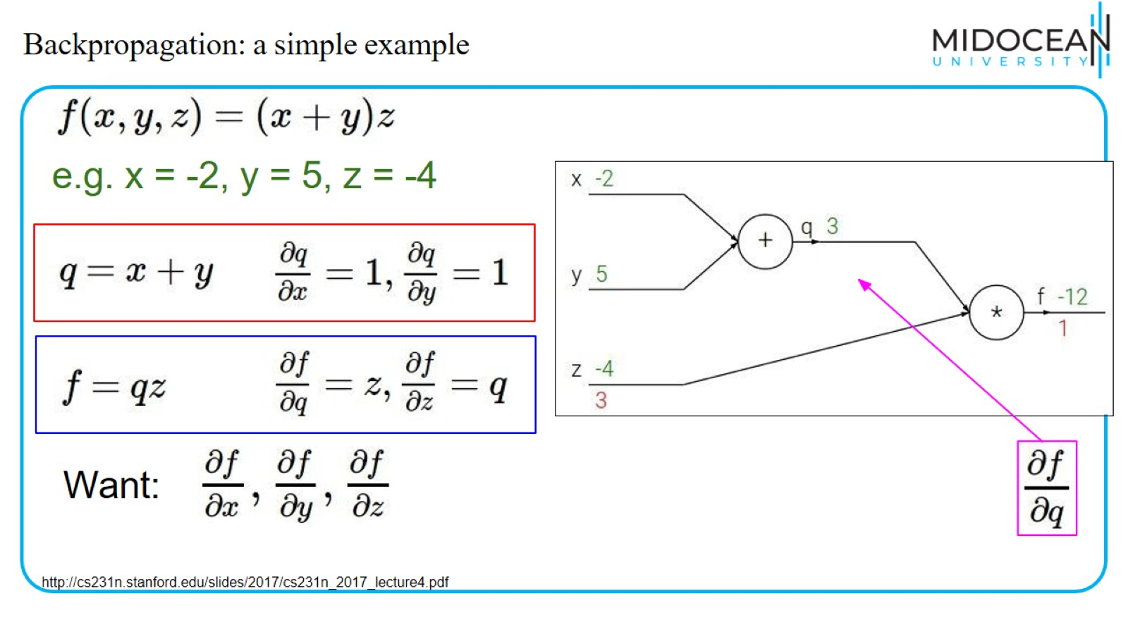
Backpropagation: a simple example

Slide 22
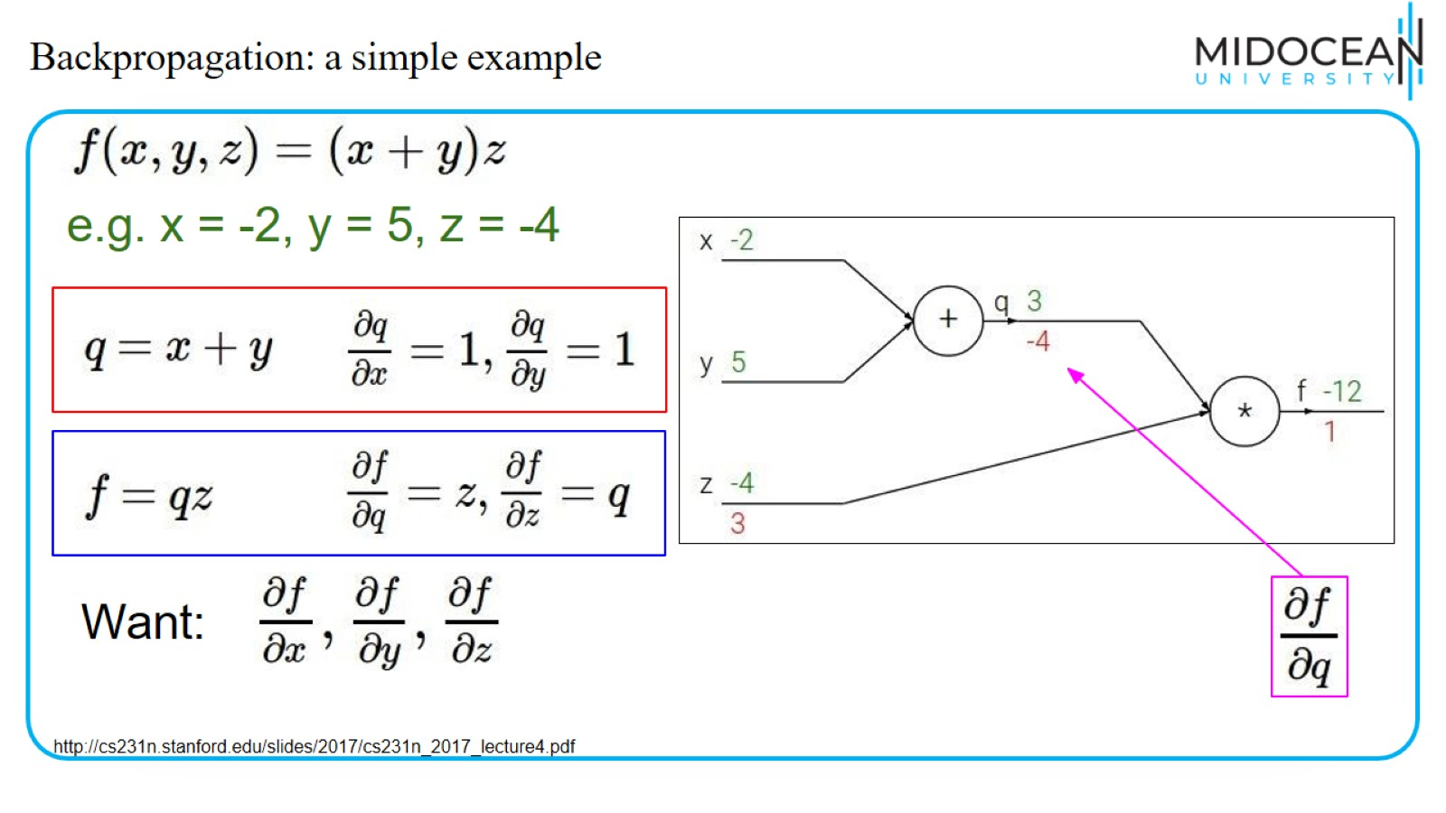
Backpropagation: a simple example

Slide 23
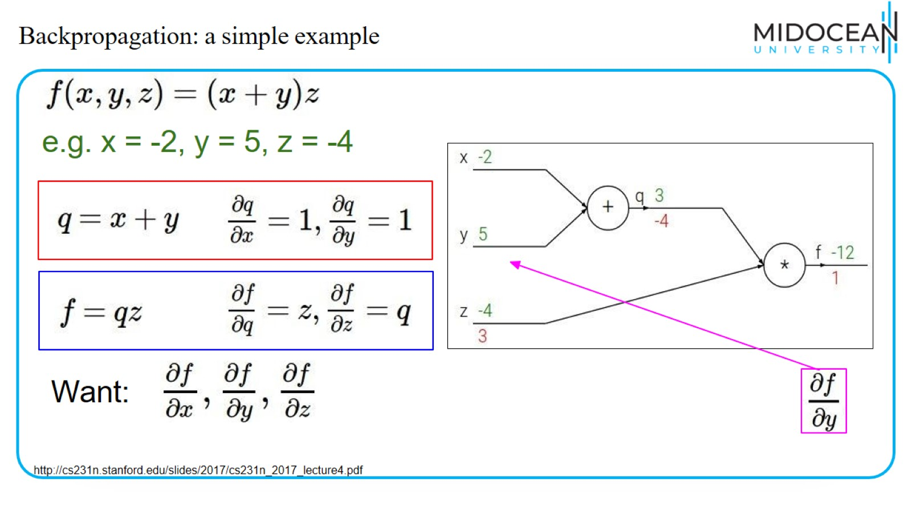
Backpropagation: a simple example

Slide 24
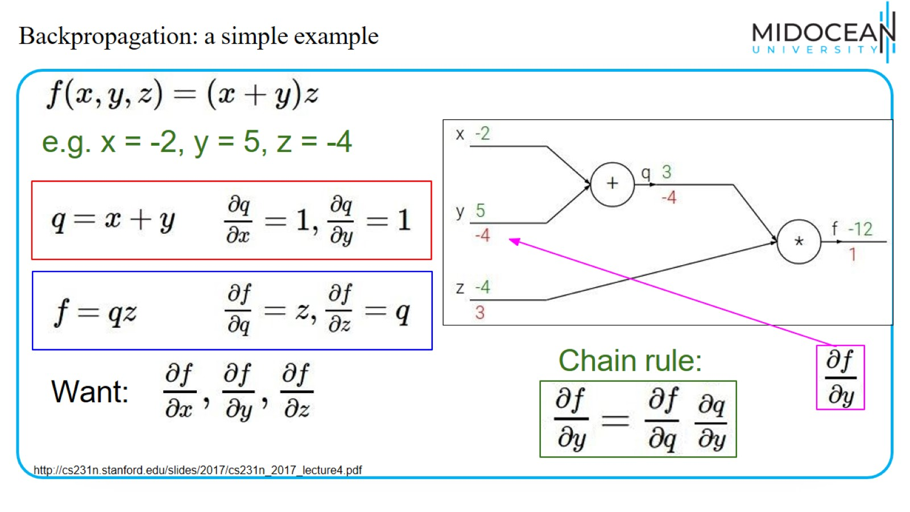
Backpropagation: a simple example

Slide 25
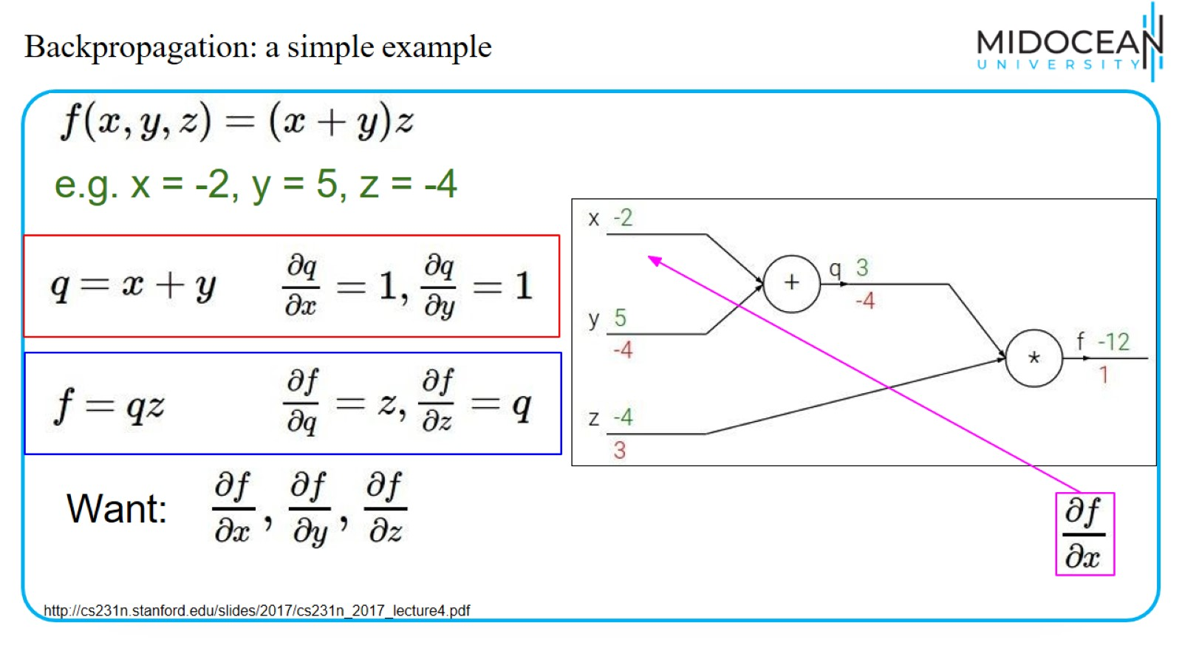
Backpropagation: a simple example

Slide 26
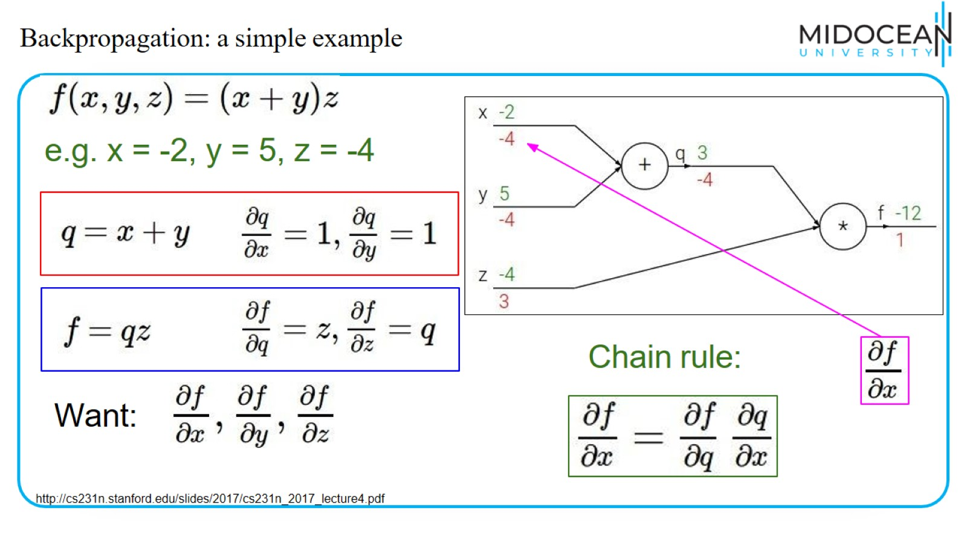
Backpropagation: a simple example

Slide 27
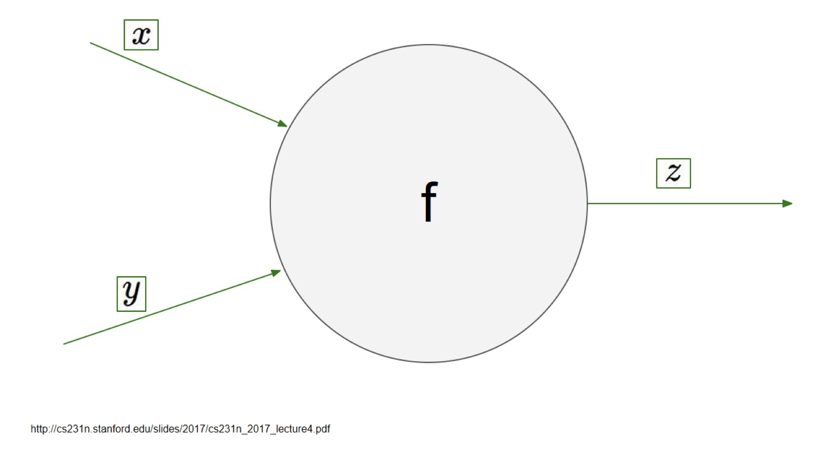

Slide 28
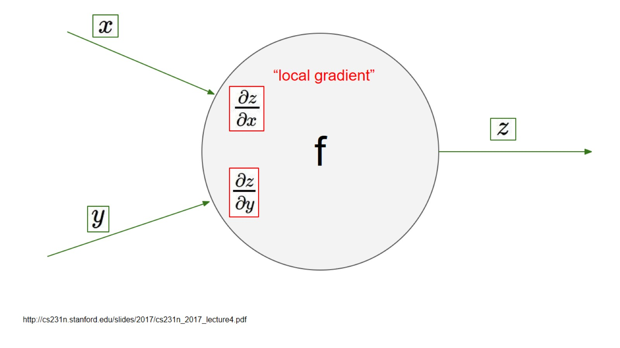
f

Slide 29
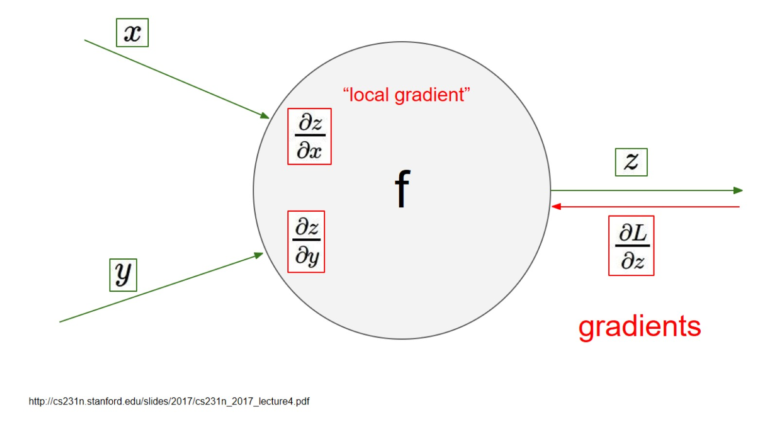

Slide 30
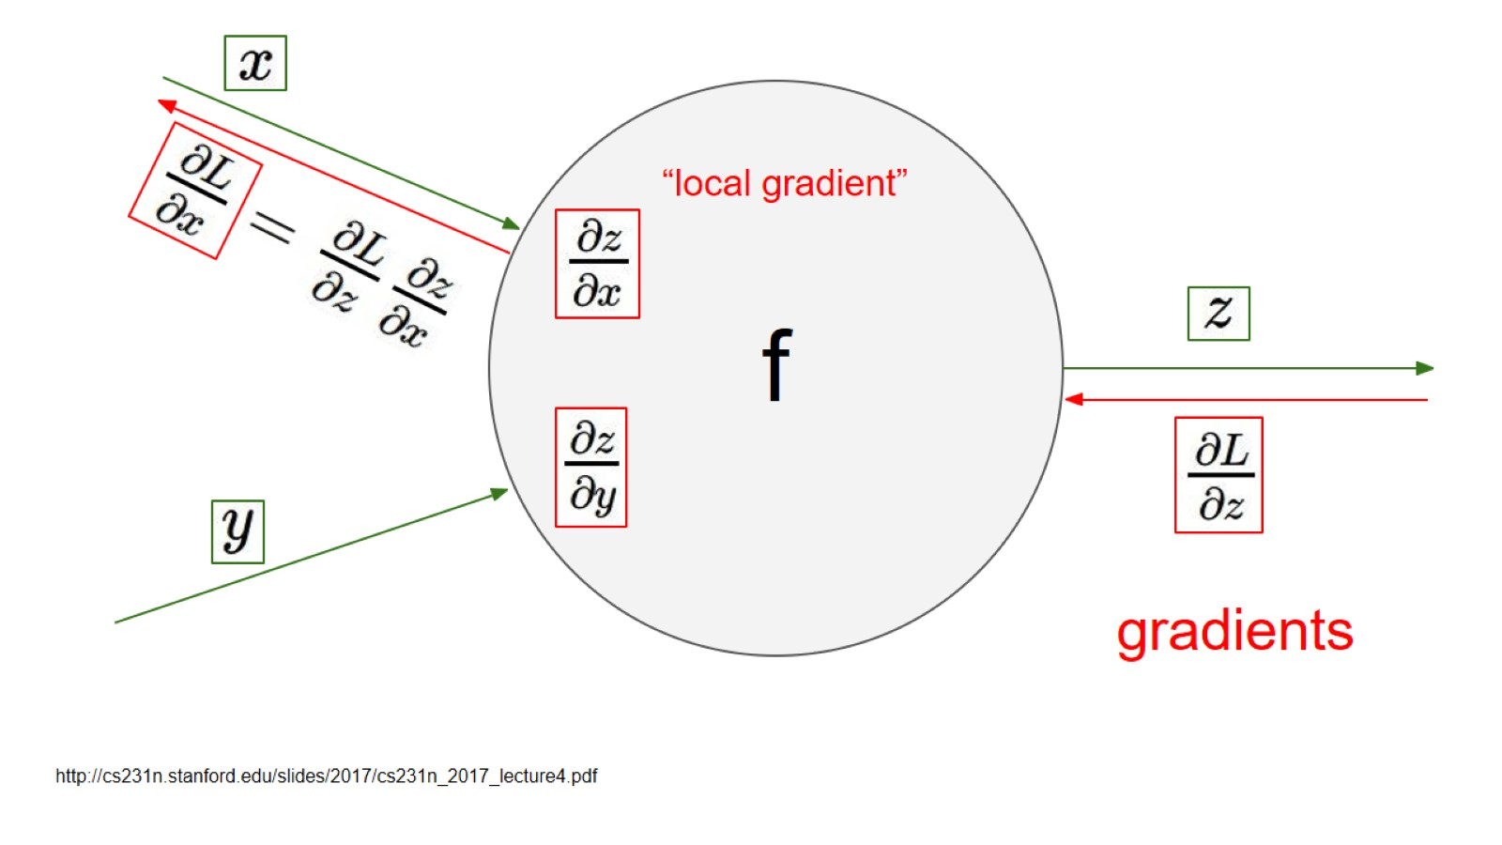

Slide 31
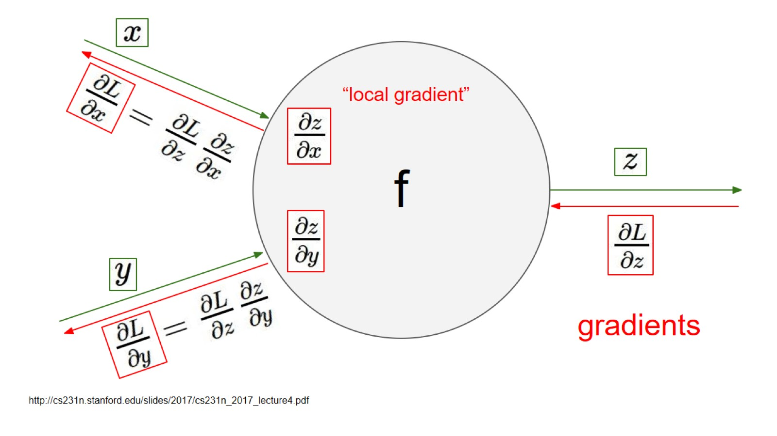

Slide 32
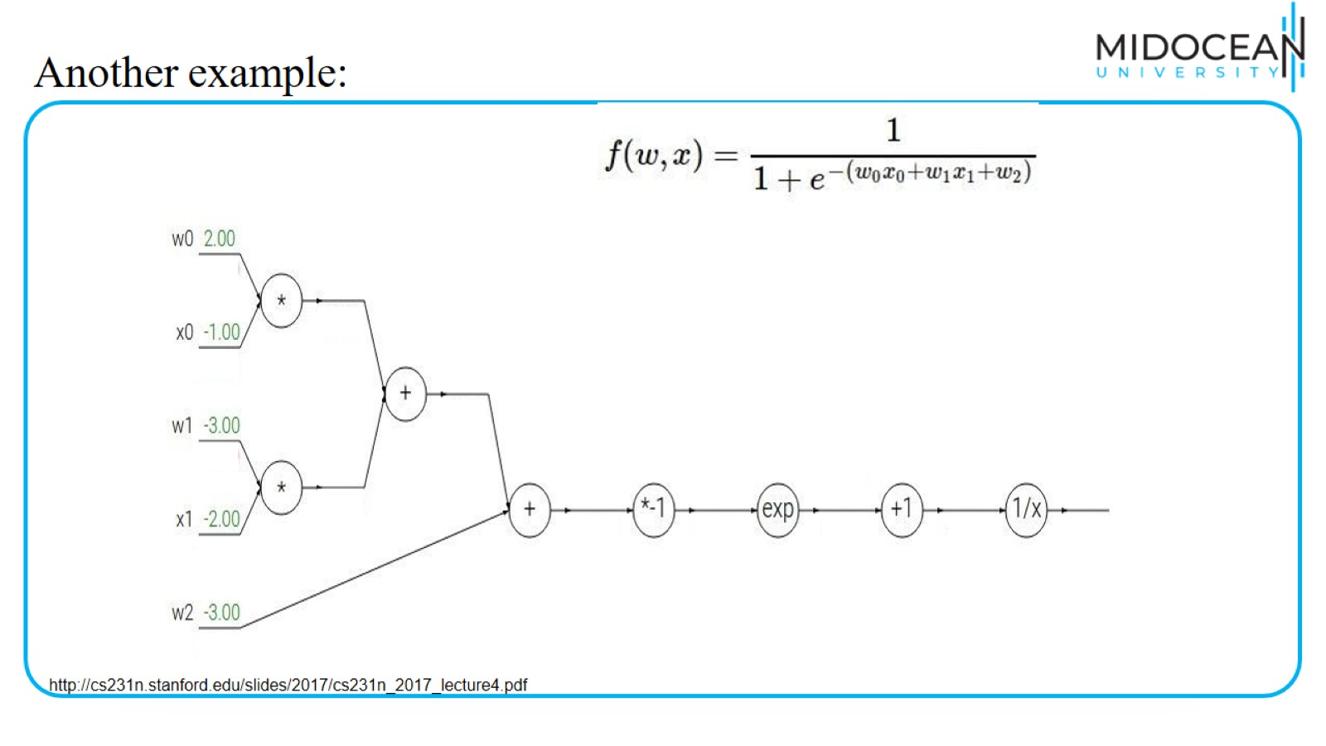
Another example:

Slide 33
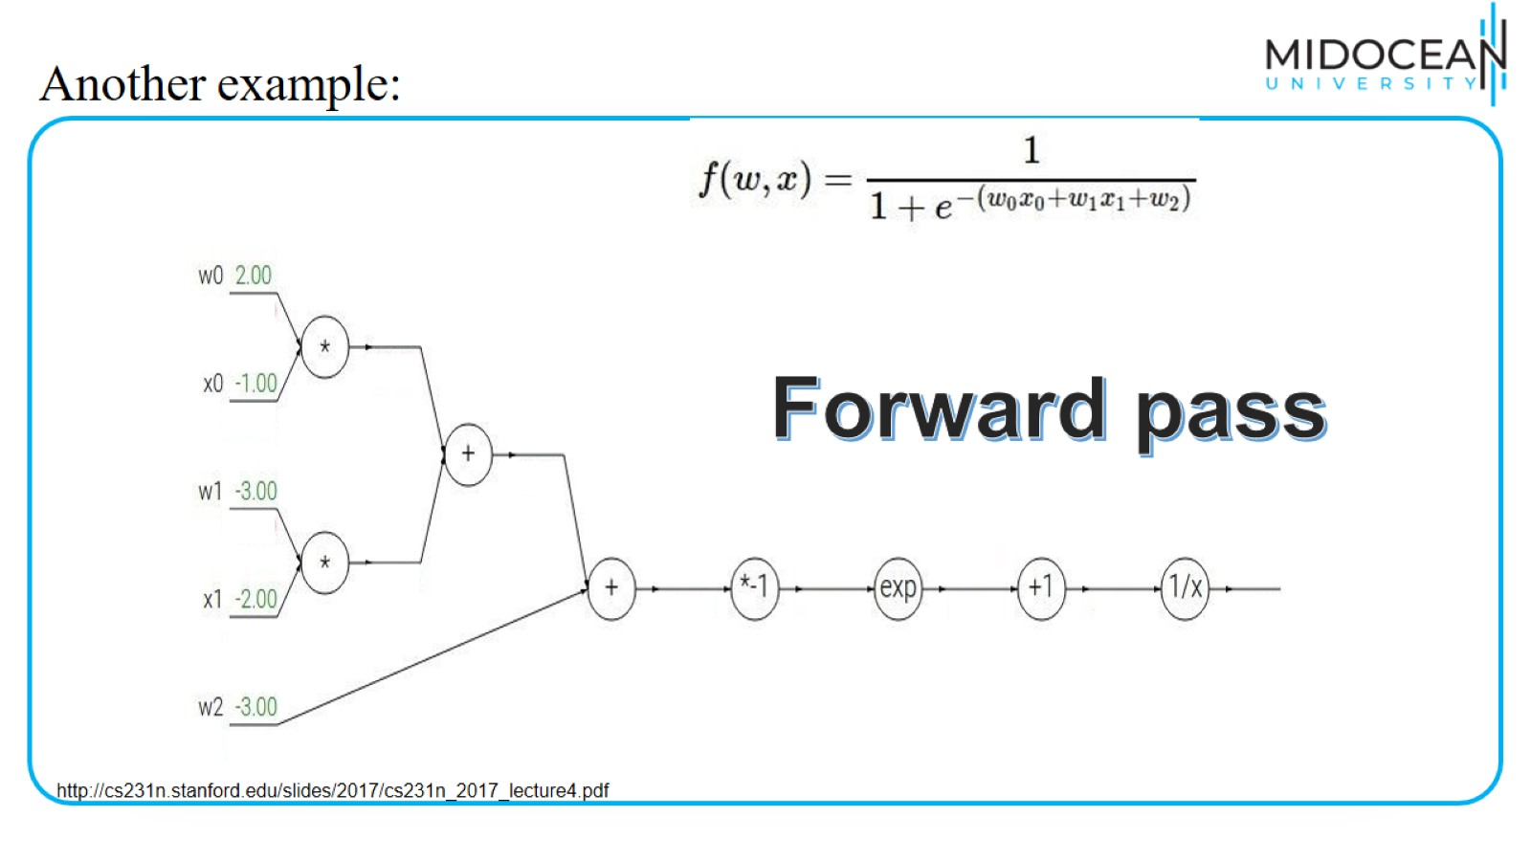
Another example:

Slide 34
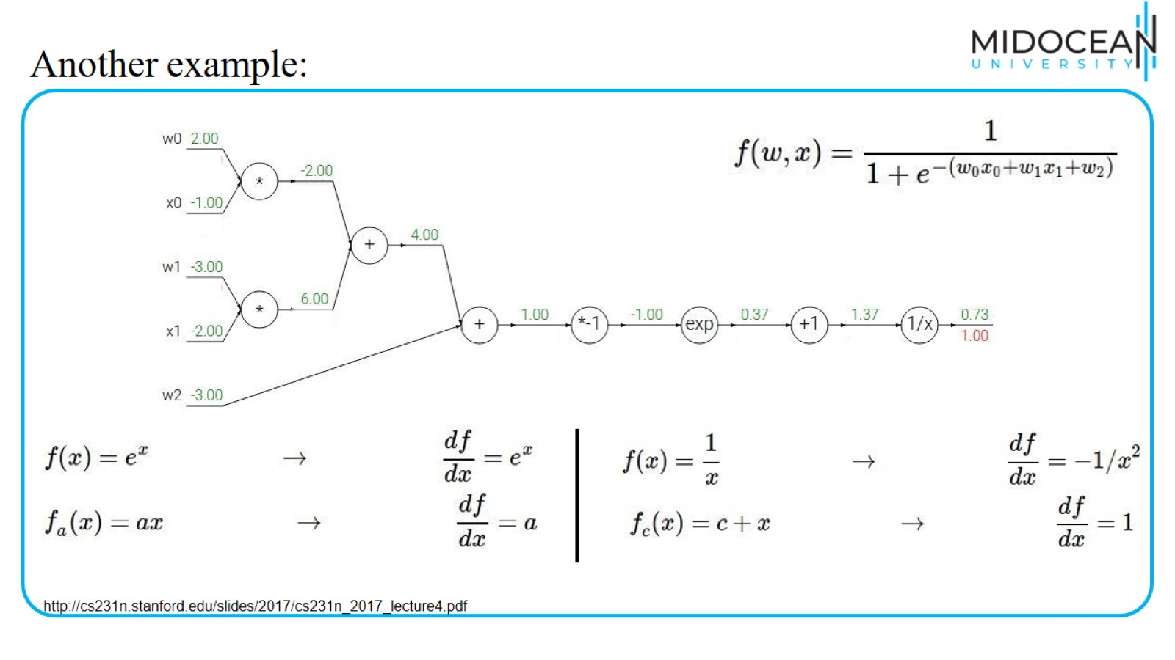
Another example:

Slide 35
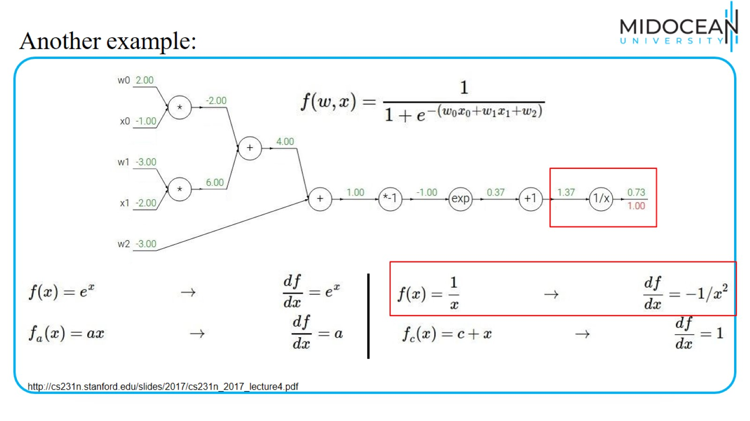
Another example:

Slide 36
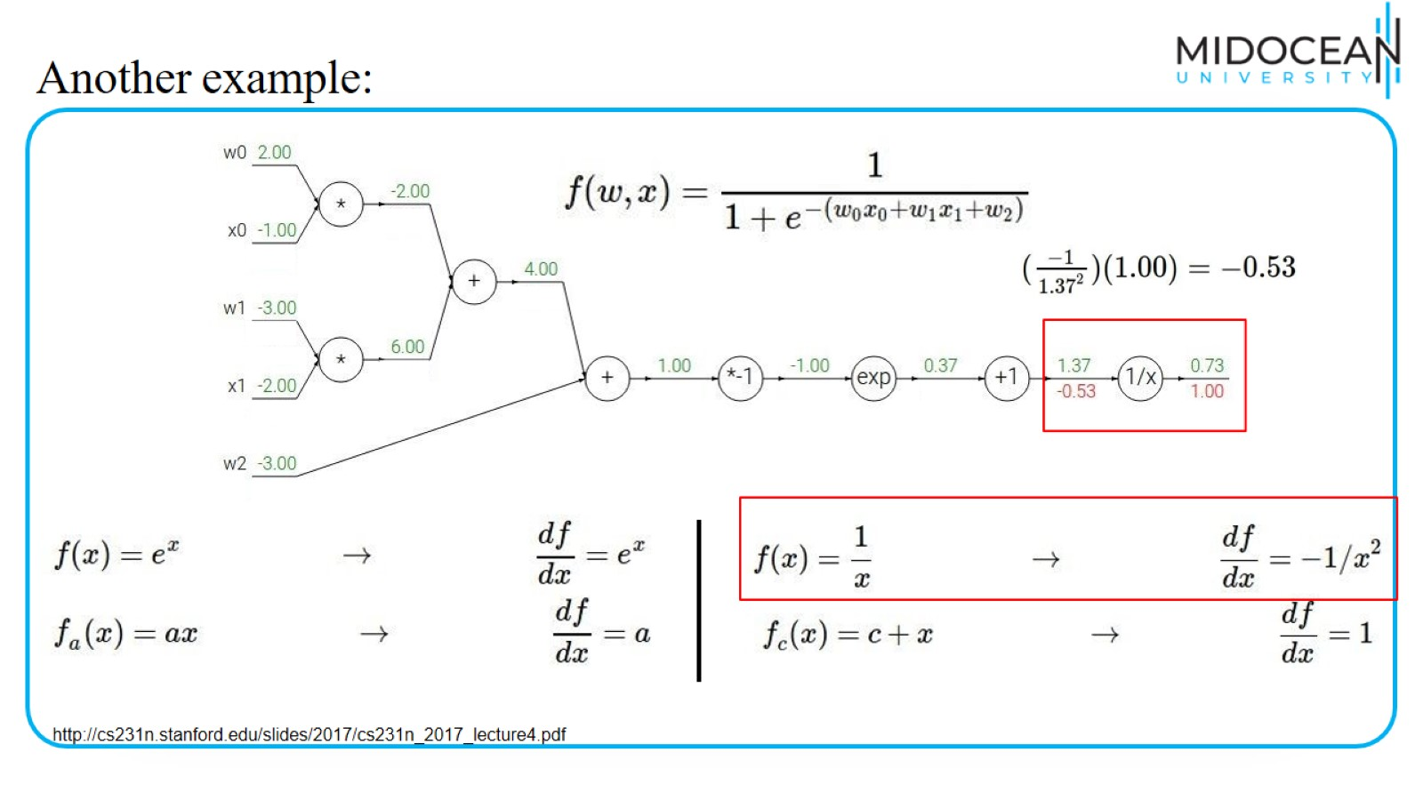
Another example:

Slide 37
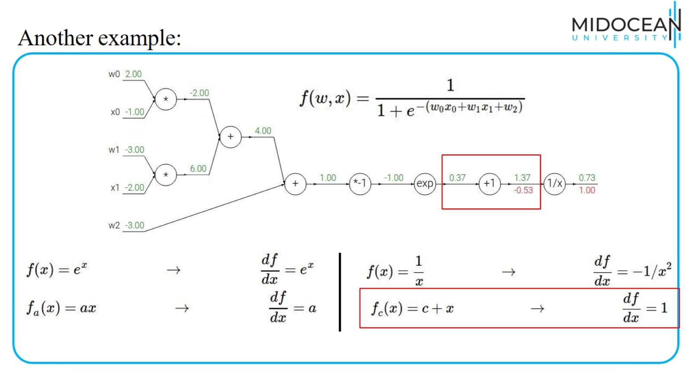
Another example:

Slide 38
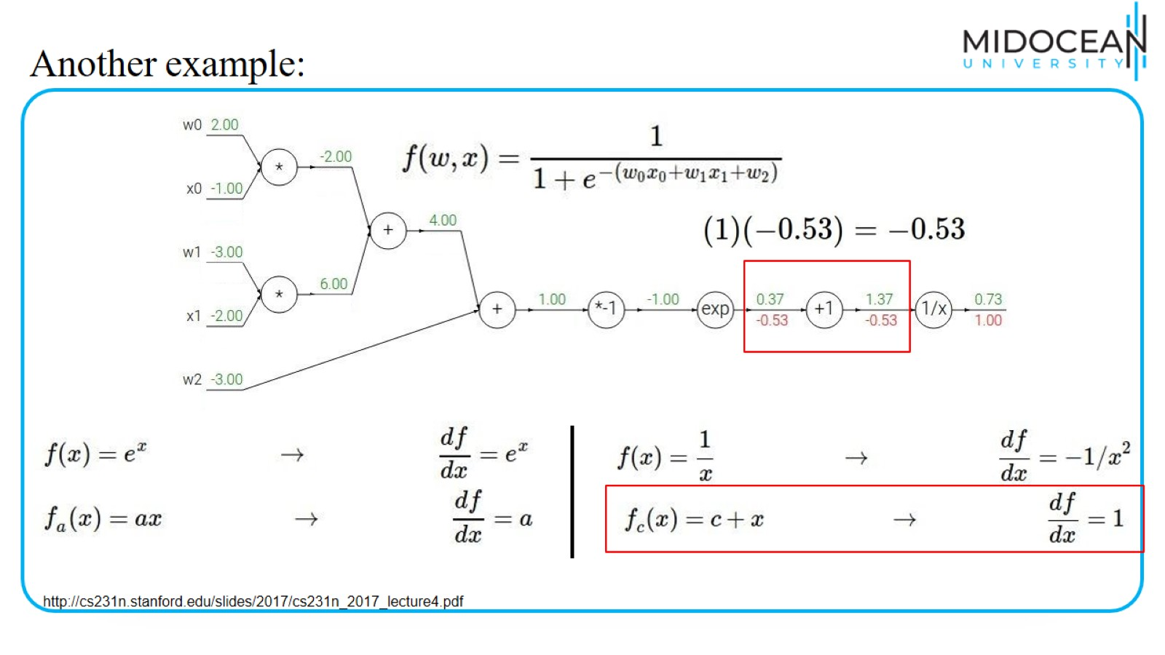
Another example:

Slide 39
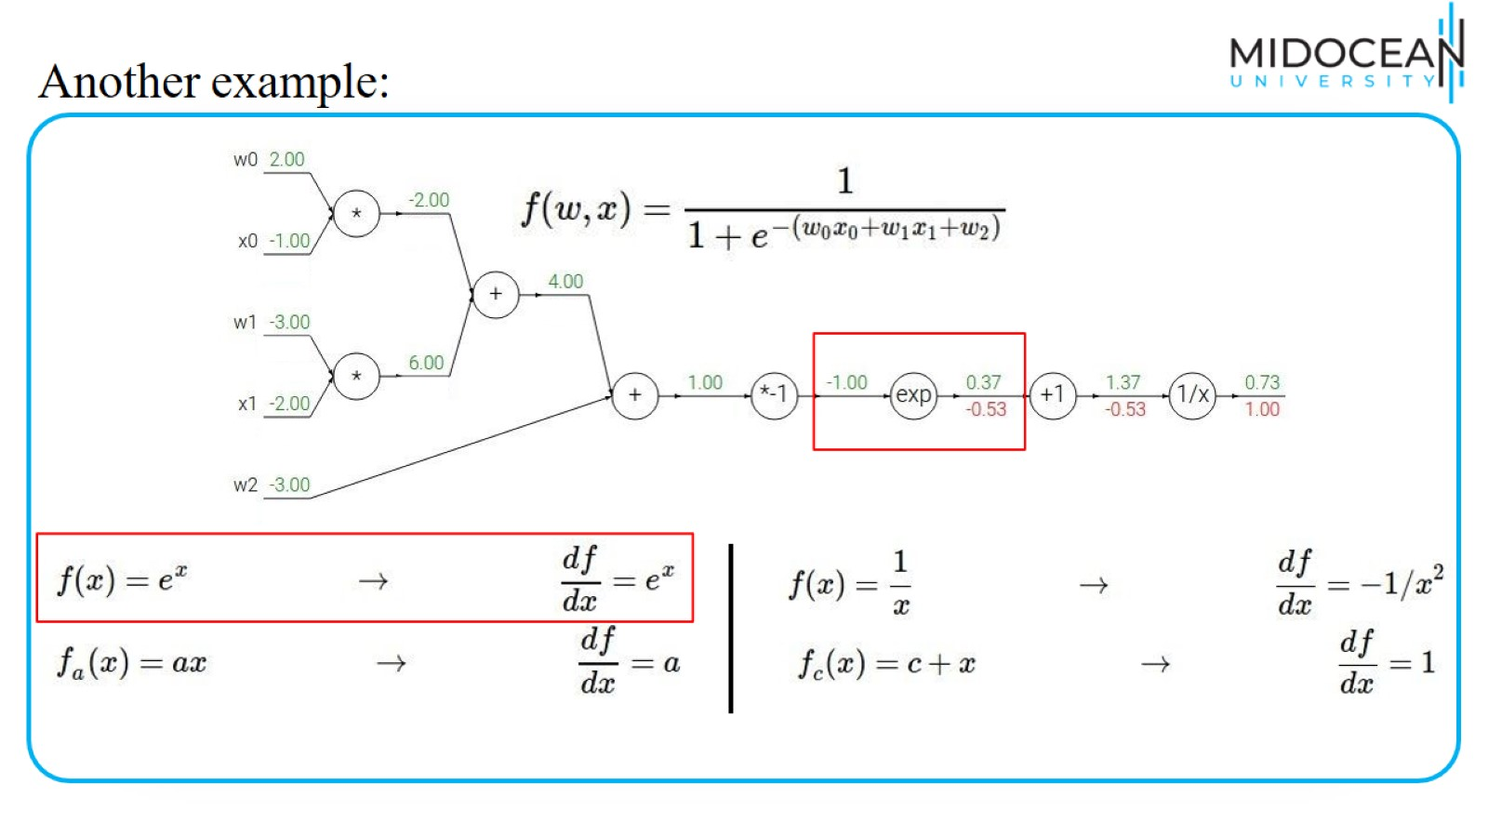
Another example:

Slide 40
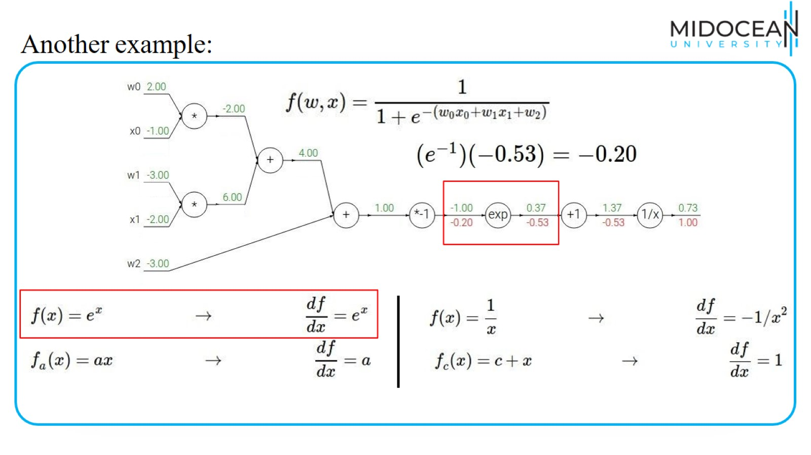
Another example:

Slide 41
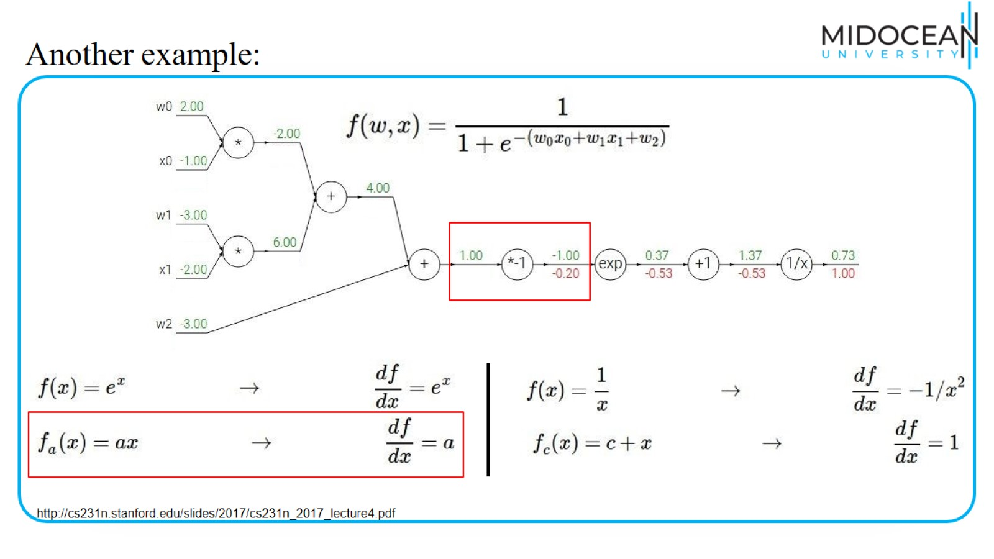
Another example:

Slide 42
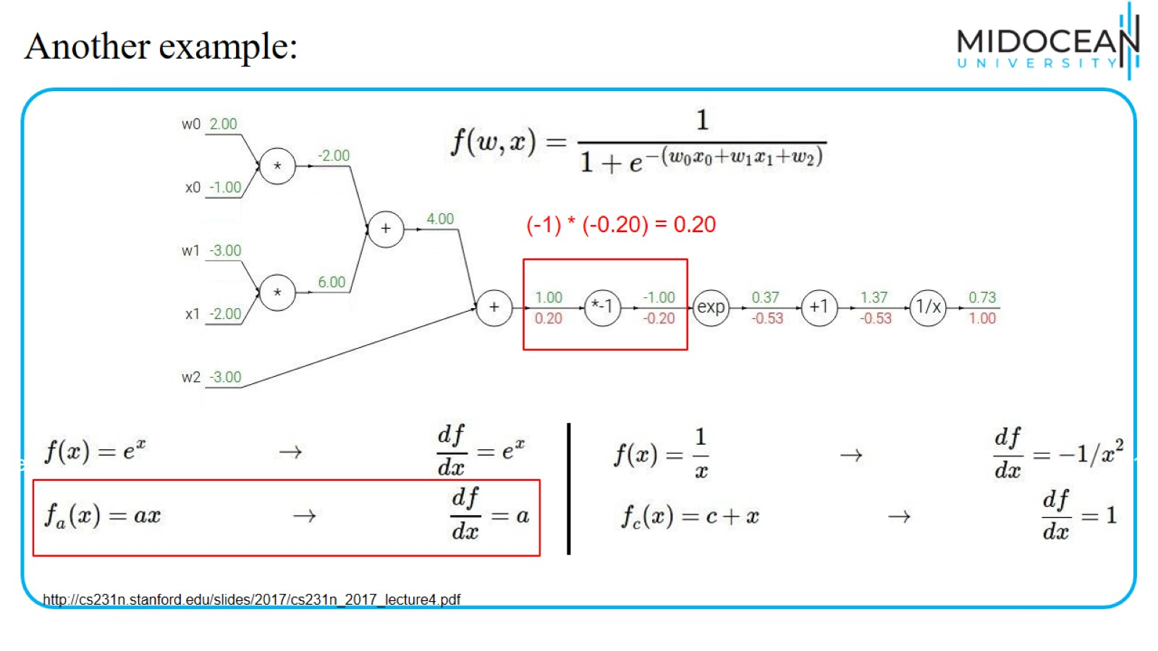
Another example:

Slide 43
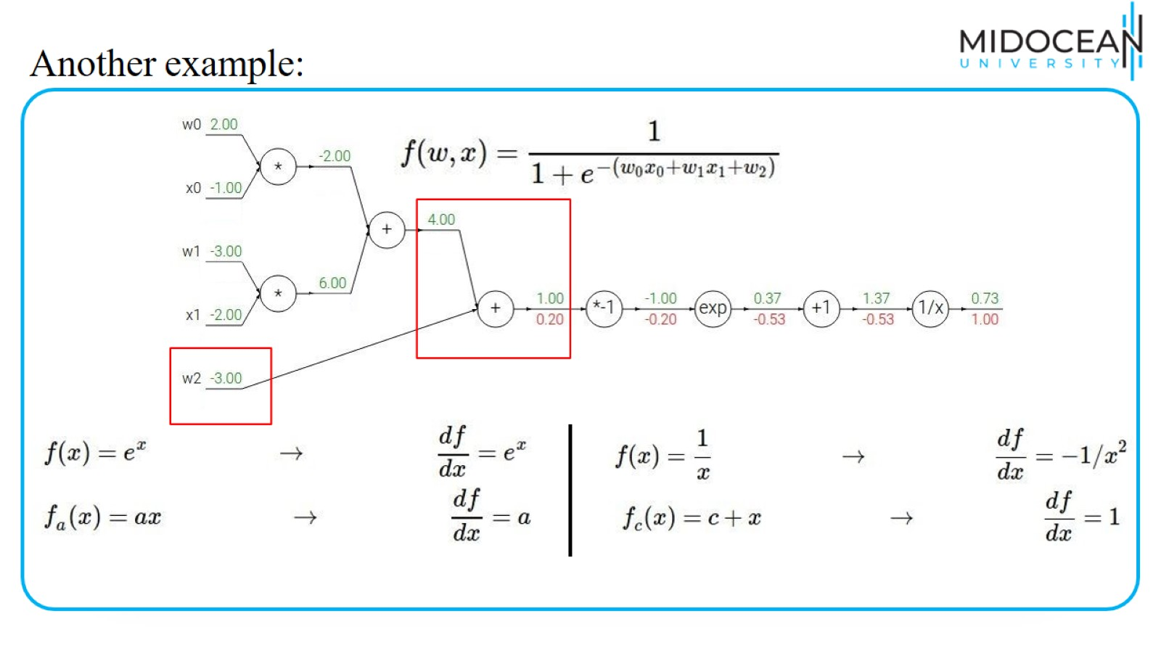
Another example:

Slide 44
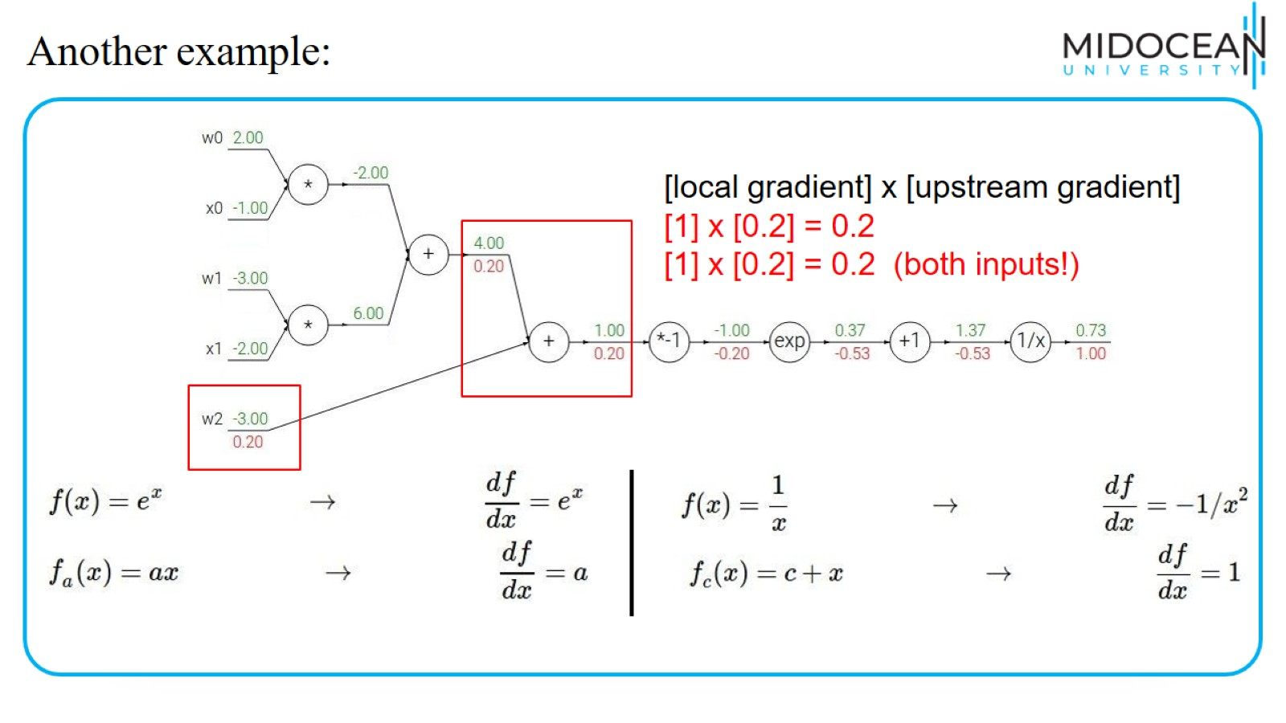
Another example:

Slide 45
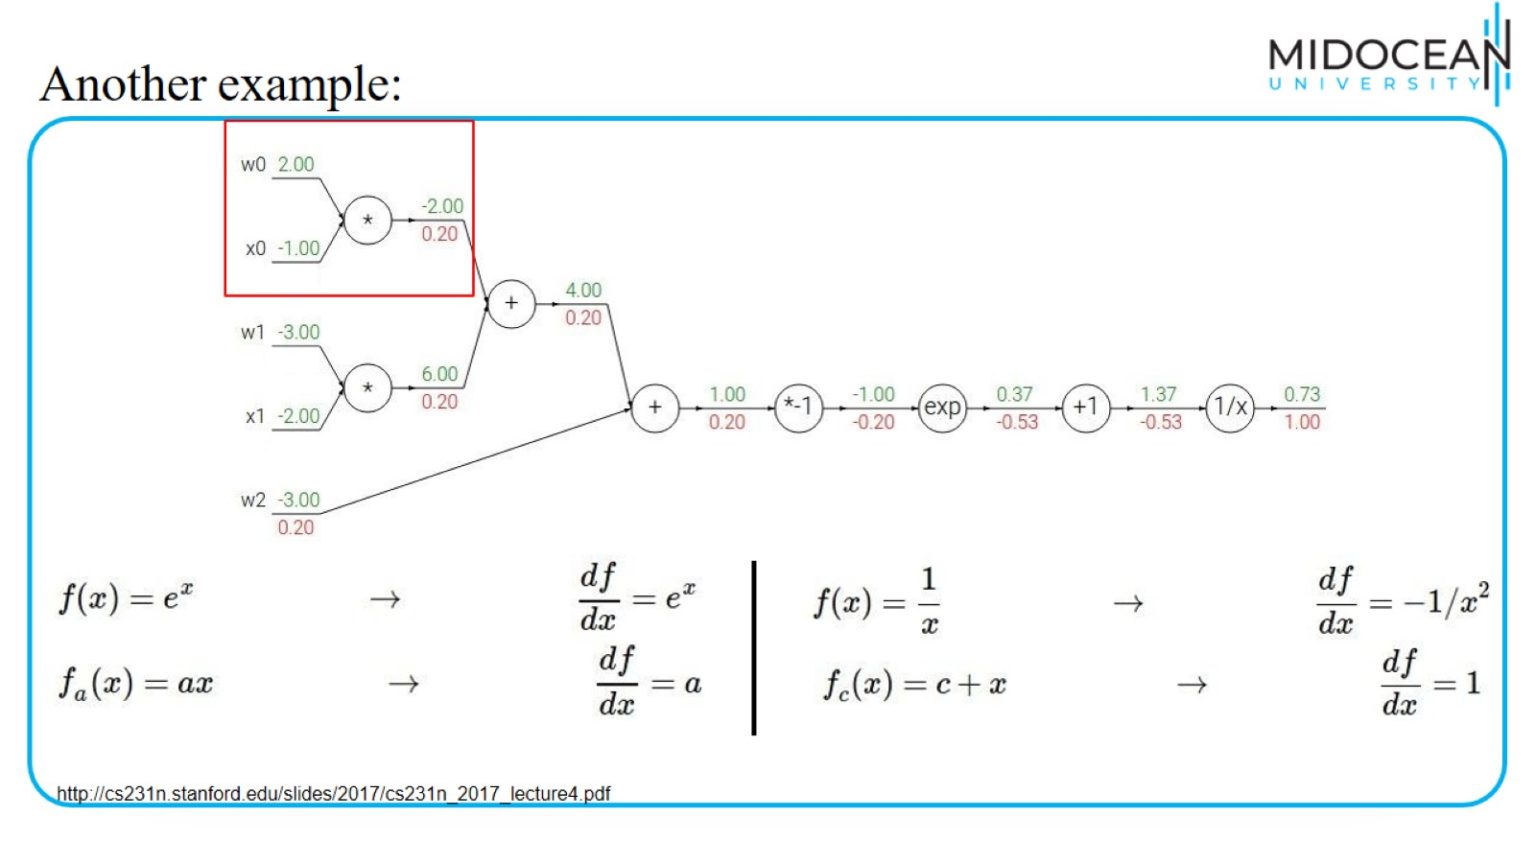
Another example:

Slide 46
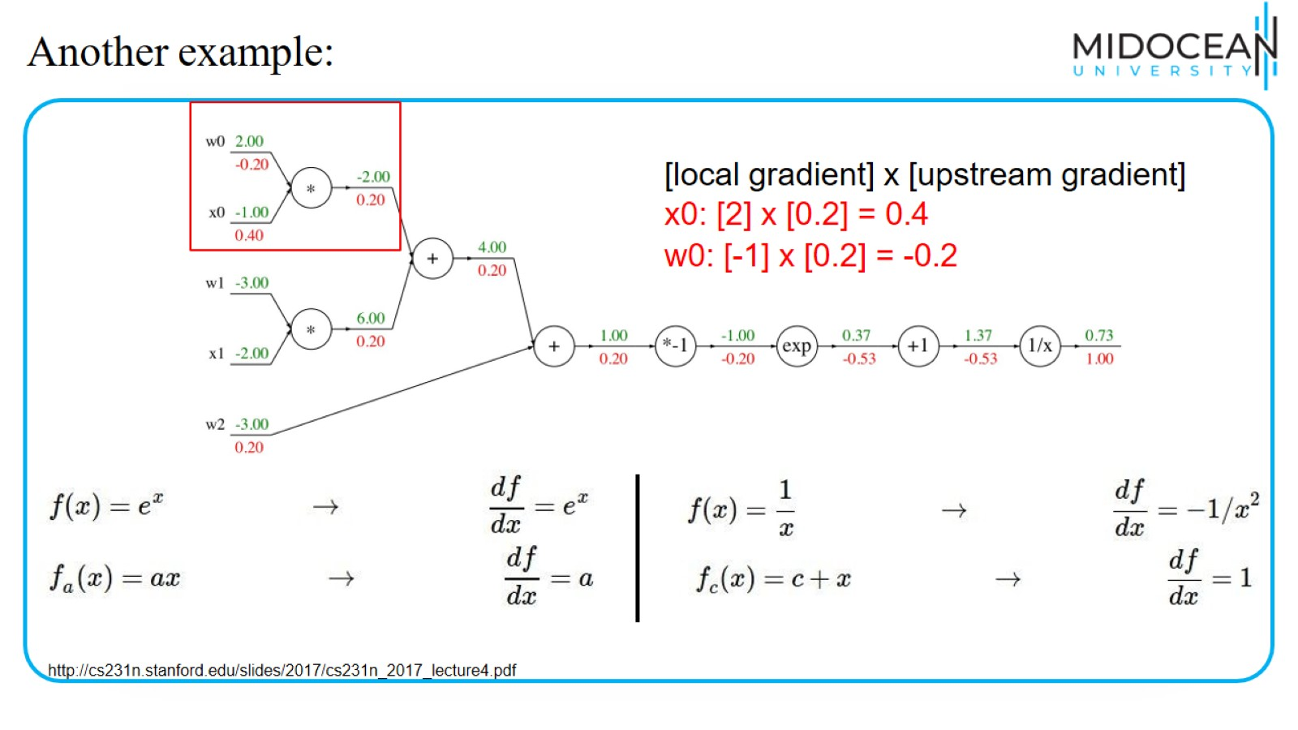
Another example:

Slide 47
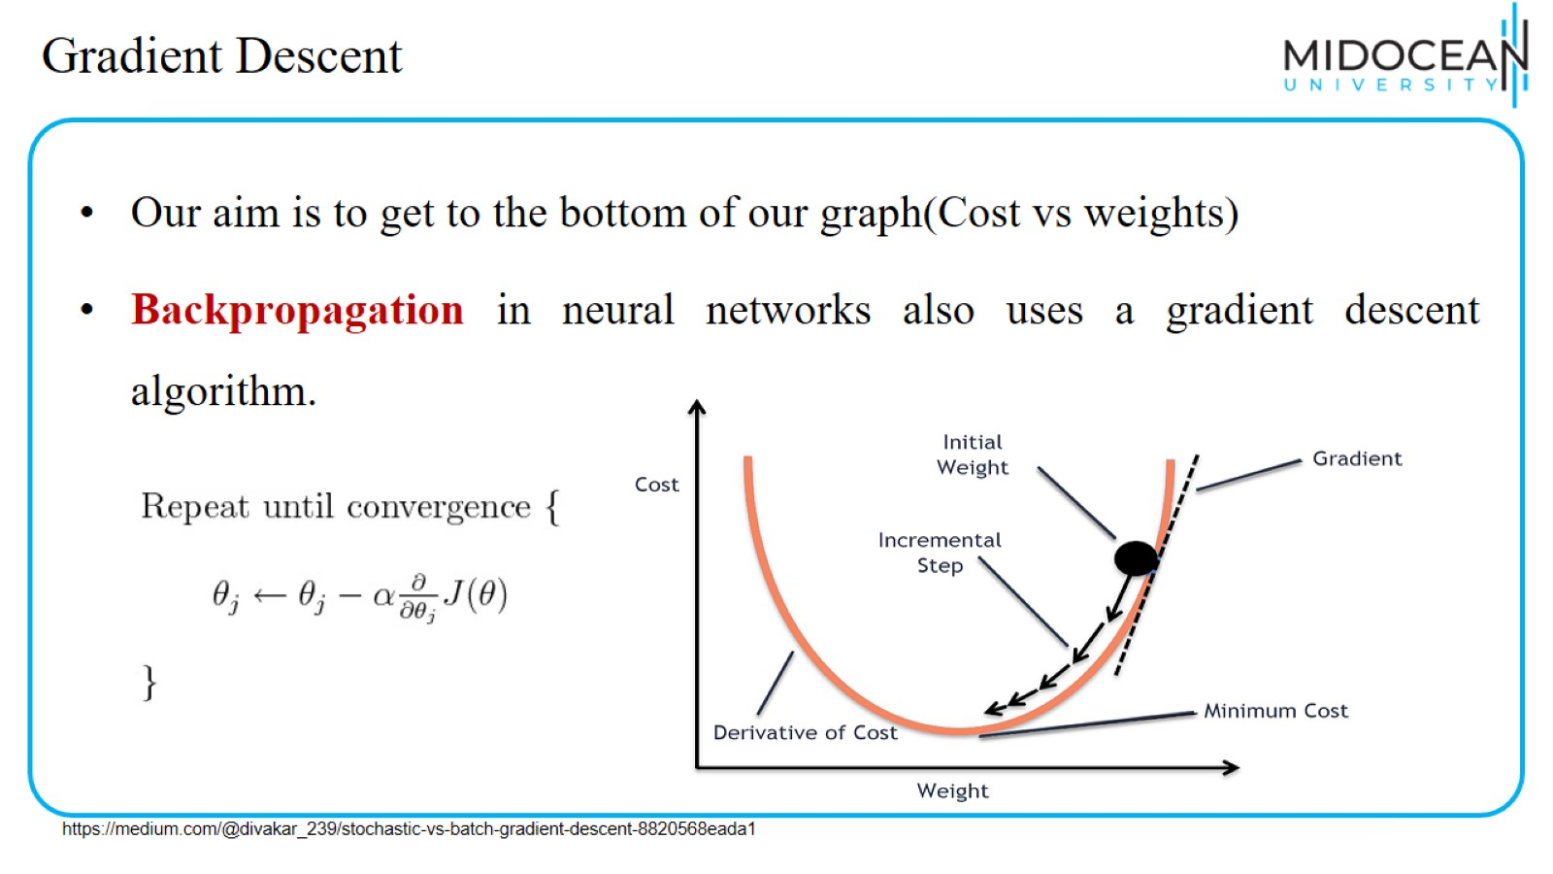
Gradient Descent

Slide 48
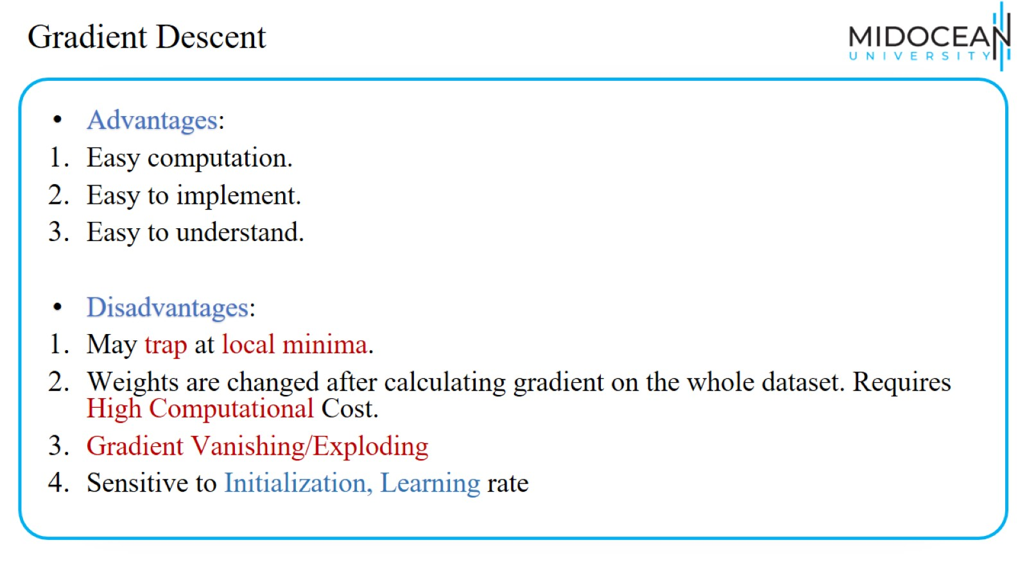
Gradient Descent

Slide 49
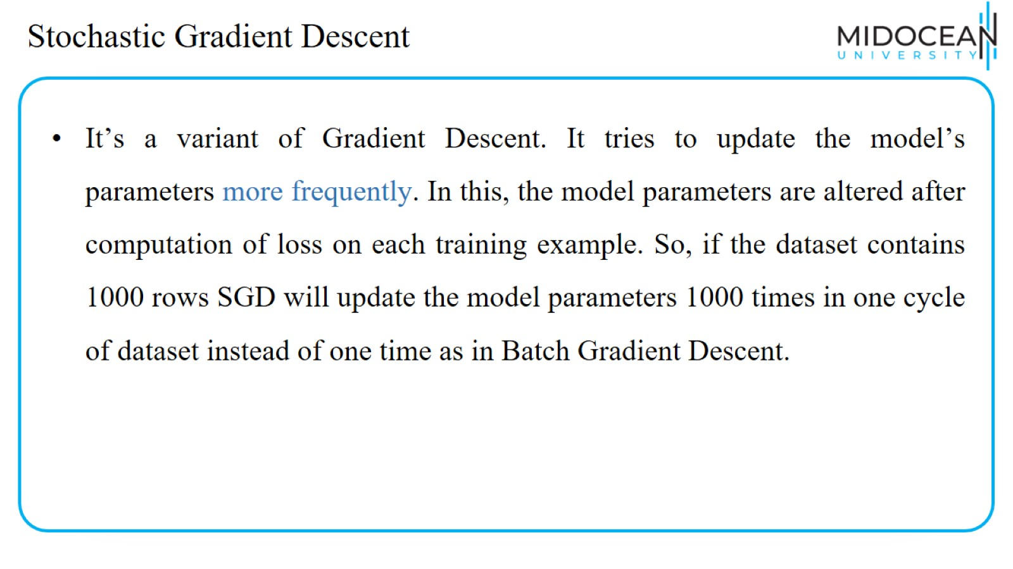
Stochastic Gradient Descent

Slide 50
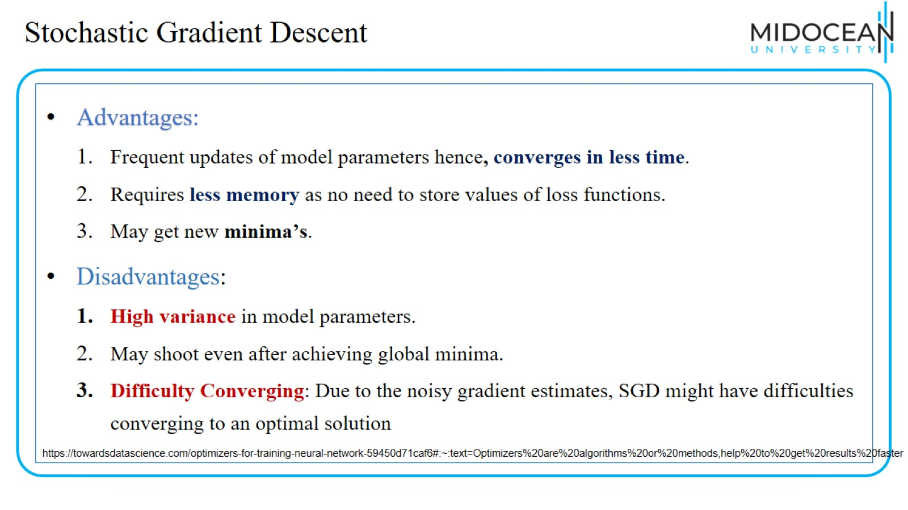
Stochastic Gradient Descent

Slide 51
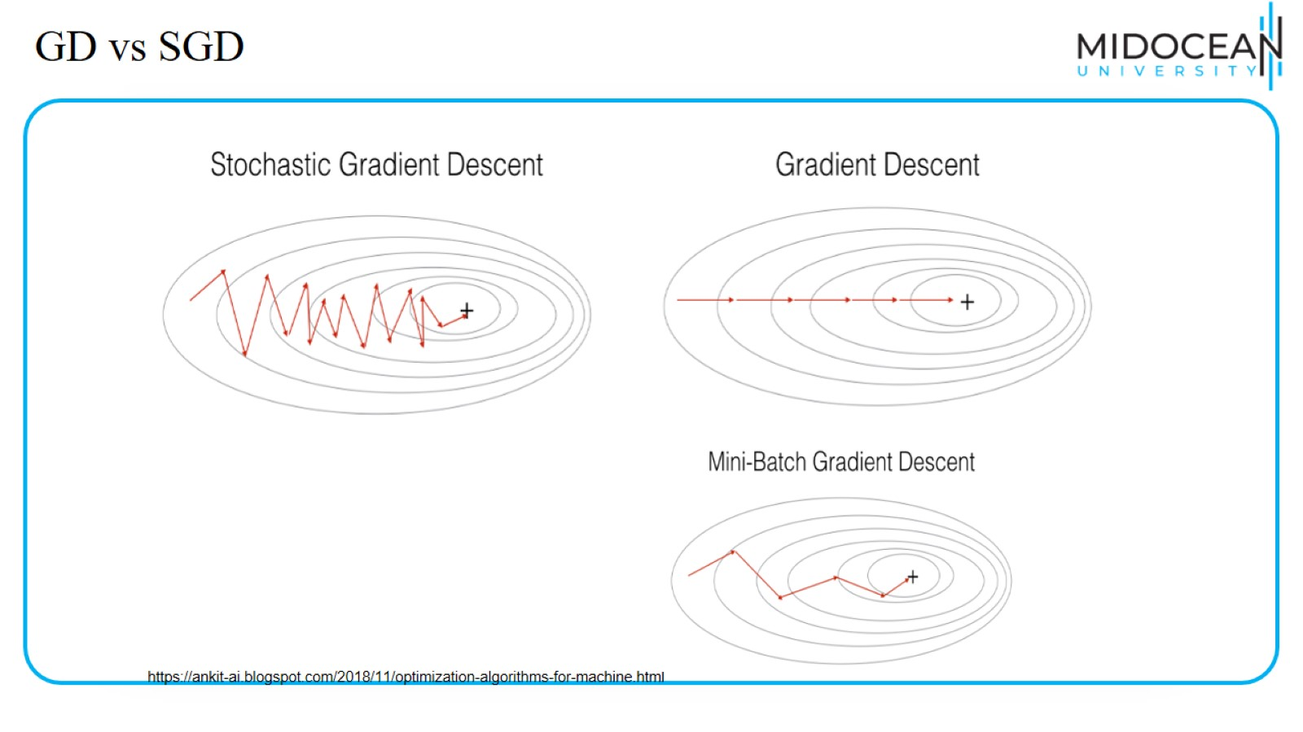
GD vs SGD

Slide 52

Mini-Batch Gradient Descent

Slide 53

Mini-Batch Gradient Descent

Slide 54

Vanilla Gradient Descent
https://towardsdatascience.com/a-visual-explanation-of-gradient-descent-methods-momentum-adagrad-rmsprop-adam-f898b102325c

Slide 55

Momentum
Momentum do some additional processing of the gradients to be faster and better.
https://towardsdatascience.com/a-visual-explanation-of-gradient-descent-methods-momentum-adagrad-rmsprop-adam-f898b102325c

Slide 56

Momentum
https://towardsdatascience.com/a-visual-explanation-of-gradient-descent-methods-momentum-adagrad-rmsprop-adam-f898b102325c

Slide 57

Momentum

Slide 58

Momentum

Slide 59

Momentum

Slide 60

Momentum

Slide 61

Nesterov Accelerated Gradient

Slide 62

SGD vs Momentum vs NAG
https://gbhat.com/machine_learning/gradient_descent_nesterov.html

Slide 63
SGD vs Momentum vs NAG
https://gbhat.com/machine_learning/gradient_descent_nesterov.html

Slide 64

Nesterov Accelerated Gradient

Slide 65

Nesterov Accelerated Gradient

Slide 66

Adagrad (Adaptive Gradient Descent)

Slide 67

RMSProp

Slide 68

Adam(Adaptive Moment Estimation)

Slide 69

LAB 1:
Optimizers in Keras

Slide 70


Slide 71

LAB 2:
Hyperparameters tunning in Keras

Slide 72


Slide 73


Slide 74


