Slide 1


College of Humanities
Master of Financial
Technology-
FinTech
Business Analysis
FNT613
Lecture 7
Prepared By:
Dr. Abeir Moussa

Slide 2

Modelling Business Process
7th Lecture
FNT613
Prepared By:
Dr. Abeir Moussa

Slide 3

Modelling Business Process
Week8
Chapter7

Slide 4

Lecture 7
Chapter outline
  Introduction
Organizational Context
An Alternative View of an Organization
The Organizational View of Business Processes
Value Propositions
Business Process Models
Analyzing the ‘as is’ Process
Improving Business Processes
Process Measurement
Business Process Model and Notation
Six Sigma

Slide 5
Lecture 7
INTRODUCTION
The business processes are the means by which an organization carries out the internal operations and delivers its products and services to its customers. This chapter will discuss the techniques for modelling business processes covering both the organizational view of process modelling and the more detailed business process models.
There are many reasons for creating business process models:
To understand how the existing process works. This can be particularly useful if the process has ‘grown’ organically (without any real planning) and no one is quite sure what happens currently in response to an event.

Slide 6
Lecture 7
INTRODUCTION
To explain to those working on the process what they do and how their task relates to the others working on the process. Here, the process model can be a training aid for new staff and an aide-memoire or reminder for more experienced personnel.
To help ensure consistency of approach, so that everyone follows the same process and customers’ experiences are not wholly dependent on who is dealing with them, in other words the ‘luck of the draw’.
To identify the problems and weaknesses of an existing business process with a view to developing and implementing an improved one. A model of an existing business process is often called an ‘as is’ model and the improved one is known as a ‘to be’ model.

Slide 7
Lecture 7
1. Organizational Context
A typical organization has many processes, many of which could be improved in some way or other. The costs and benefits of such improvement projects will vary enormously and, before embarking on a business process improvement project, it is useful to examine the organizational context in which the business processes take place. The traditional view of a business is based on the specialist functional areas such as sales, accounts and operations (Figure 7.1).

Slide 8
Lecture 7
1. Organizational Context
Typically, this is documented on an organization chart which shows the departments and how they are further subdivided, the reporting lines and the staff that work in the various areas. Individual employees tend to identify with a particular function – ‘I work in IT’ – because that defines not just the job that they do but also their social group, attitudes and culture.

Slide 9
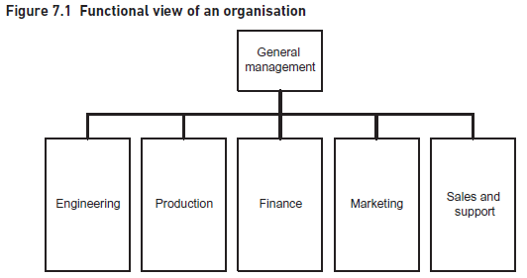
Lecture 7
1. Organizational Context

Slide 10
Lecture 7
2. An Alternative View of an Organization
Paul Harmon (2007) developed the organization model that provides an alternative view of an organization, providing a representation of both the internal processes and the external world with which the organization operates (Figure 7.2). The model is often developed in two stages: firstly, the external factors that influence the organization are considered and then the internal business process is analyzed.

Slide 11
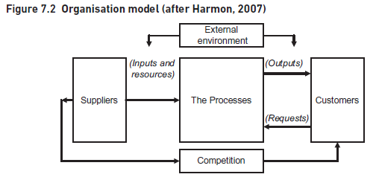
Lecture 7
2. An Alternative View of an Organization

Slide 12
Lecture 7
2. An Alternative View of an Organization
The four areas shown outside the organization in Figure 7.2 highlight those aspects of the external environment that need to be considered; they define the context in which the organization operates. These four areas are:
The suppliers of the resources required by the business processes. This covers not only the supply of physical materials but also external suppliers of finance, people and ideas.
The beneficiaries from the organization. While we always include the customers who purchase the products and services within this group, it is also important to take a broader view and include other types of customer. For each group of beneficiaries, we need to know the outcomes that they would like the organization to deliver. These outcomes are often in conflict with each other; where customers would like prices to be as low as possible, shareholders would like to have high dividends which they may see resulting from higher prices.

Slide 13
Lecture 7
2. An Alternative View of an Organization
The competitors operating within the same industry or business domain. Traditionally, this is interpreted to mean other organizations with whom we are competing in specific markets. In the organizational model, we extend the concept further by including those organizations that we are competing with for the supply of finance, services, skilled staff and ideas, as well as those who compete with us for customers.
The generic factors that may affect the organization such as changing regulation, economics or green issues. These are the type of factors covered by a PESTLE (political, economic, socio-cultural, technological, legal and environmental) analysis.

Slide 14
Lecture 7
3. The Organizational View of Business Processes
Now that we have understood the circumstances in which the business operates, we can turn our attention to what the business does when reacting to the external environment. Bearing in mind that the organization model is a high-level view of the processes that operate across the entire business, we need to show the end-to-end set of processes that convert the inputs from the suppliers to the outputs for the customers. However, it is helpful to think about an overview framework such as that shown in Figure 7.3 or Porter’s value chain (Figure 7.6).

Slide 15
Lecture 7
3. The Organizational View of Business Processes
An organizational business process map is formed from a high-level set of activities carried out in order to deliver benefit or value to the customers. When building business process models, we can begin by producing a business process map that reflects the structure shown in Figure 7.3.

Slide 16
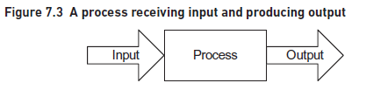
Lecture 7
3. The Organizational View of Business Processes
It is useful to distinguish between process maps and business process models. Process maps show sets of related processes, and their interactions, in a single diagram. Each process set is shown as a box and the arrows between them show their interdependencies. Business process models show a more detailed view of each of the processes within a higher level set.

Slide 17
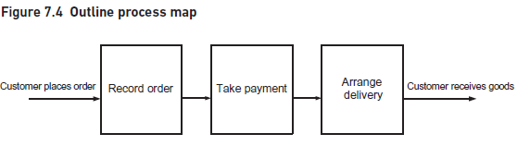
Lecture 7
3. The Organizational View of Business Processes
It is useful to begin by considering:
the core operation at the heart of the entire process, for example, taking bookings or selling goods;
the processes that provide input to the core process, for example, scheduling events or making goods;
the processes concerned with delivering products or services to the customer, for example, issuing event confirmation or delivering goods;
any sales, marketing or customer service processes.

Slide 18
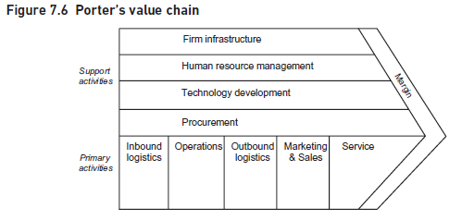
Lecture 7
3. The Organizational View of Business Processes

Slide 19
Lecture 7
3. The Organizational View of Business Processes
The value chain provides a means of Analyzing the activities performed by an organization. It identifies key areas of primary and support activity that will be required to deliver value to the organization’s customers and potentially differentiate the organization from its competitors. We can use the concept of a value chain to develop high-level process maps for the organization.

Slide 20
Lecture 7
4. Value Propositions
The definition of the value chain assumes that we understand the customers who purchase our goods and know what products or services they want. Unfortunately, many organizations produce poor value propositions which are bland descriptions of their products rather than being closely aligned with the needs of their customers.

Slide 21
Lecture 7
4. Value Propositions
In order to overcome the problem of inappropriate value propositions, Kaplan and Norton (1992), the architects of the Balanced Scorecard, have identified the main attributes that make up successful value propositions. These are the drivers that lead to increased customer satisfaction, acquisition and retention. The proposition attributes cover three areas:
product/service attributes that define the product itself;
customer relationship aspects;
image and reputation aspects.
The elements of a value proposition are illustrated in Figure 7.8.

Slide 22
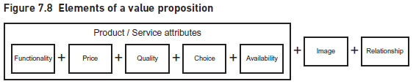
Lecture 7
4. Value Propositions
The product attributes are:
Functionality – or what the product does.
Price – what we charge for the product.
Quality – or how well the product performs.
Choice – do we simply provide a standard product or can it be tailored to the specific needs of the customer?
Availability or timing – for example how quickly can we respond to customer requests and do we introduce new products at the most appropriate time?

Slide 23
Lecture 7
5. Business Process Models
A business process is triggered by a business event and includes five key components:
the tasks that make up the process,
the process flow,
the decision points,
the actors that carry out the tasks,
and the outcome of the business process.
Unfortunately, there is no universally agreed set of terms in business process modelling and the terms ‘process’, ‘activity’, ‘task’ and ‘step’ are often used interchangeably.

Slide 24
Lecture 7
5. Business Process Models
For the sake of simplicity, we have adopted the following convention here:
‘Process’ refers to an entire set of activities that start with a triggering event and end with some output being delivered.
‘Task’ refers to an individual activity within the overall process; these are usually carried out by an actor at a single point in time.
‘Step’ refers to the activities carried out within an individual task. It is useful to show just the tasks on the process model rather than each individual step as this helps with the readability and clarity of the model. Task descriptions can then be produced where the steps within each task can be defined.

Slide 25

Business events
Developing the business process model
Analyzing tasks
Hierarchy of process models
beginning and ending the process
Lecture 7
5. Business Process Models

Slide 26
Lecture 7
5. Business Process Models
Business events
There are three types of business event:
External – these business events originate from outside the organization or the business system under consideration. For example, a customer makes a hotel booking or orders some goods.
Internal – these business events originate within the business system and typically involve business managers making decisions. For example, the marketing manager makes a decision to reduce prices on a product line or the finance manager decides to review fees charged by suppliers.
Time-based – these business events occur at a regular point in time. For example, a process to make salary payments to staff is initiated when it is the last working day of the month.

Slide 27
Lecture 7
5. Business Process Models
Developing the business process model
Business process models may be developed for many reasons, as we noted in the Introduction.
During a process improvement project, it is common for the business analyst to produce an ‘as is’ model to show how the process works at the moment. Analysis of this ‘as is’ model will help to identify problems and weaknesses, leading to an improved version documented in the ‘to be’ process model.
Two of the most popular are the Unified Modeling Language (UML) activity diagram technique and the Business Process Model and Notation (BPMN). Business process models are often called ‘swimlane diagrams’ because the ‘swimlanes’ showing all of the tasks performed by a defined ‘actor’, form a key element of the models.

Slide 28
Lecture 7
5. Business Process Models
To build a business process model, we first identify who takes part in the process. This enables us to identify the business ‘actors’ or ‘roles’. Actors may be individual people, a group of people or an organization, or may be an IT system. The tasks carried out by each actor are shown in a separate band or ‘swimlane’ and arrows are used to show the flow of the work between the different swimlanes. Swimlanes usually appear on the diagram in the same sequence as the actors’ involvement in the process, although it is an informal convention that the customer swimlane is placed at the top. As a result, the action on the model goes from left to right on a horizontal layout, following the ‘time axis’ and top to bottom as the different actors get involved. These left to right and top to bottom flows mirror the way that many people read text, at least in the western world, and tends to be intuitive. To reinforce this representation of time, it is useful to show a process flow from Task A to Task B as follows:
the process flow arrow originating from the right-hand edge of Task A;
and ending at the left-hand edge of the Task B symbol.

Slide 29
Lecture 7
5. Business Process Models
Once we have documented the overall flow of the process, then we can go back and fill in the details for each task. A major advantage of a business process model is that each actor can easily see their contribution to the overall process. A rule of thumb is to show a separate task for a piece of work done by an actor at a particular point in time. Each task should be shown as a single action, receiving an input from the preceding actor and handing over to the succeeding actor; this flow of work from one actor to another is known as a ‘hand-off’.

Slide 30
Lecture 7
5. Business Process Models
Analyzing tasks
The swimlane diagram shows the work carried out within the business process including actors and the flow of the work. This may be sufficient to identify problems with the ‘as is’ process but often we have to go into more detail in order to really understand how the process works and what is going wrong. A more detailed approach is to analyze each task (or box) shown on the business process model. We might consider the following aspects for each task:
The trigger or business event that initiates the task.
Inputs to the task. This may include the trigger but there is also likely to be additional information required to carry out the task.
Outputs from the task.
Costs relevant to this particular task.
Measures and standards applicable to the task.
Detailed breakdown of steps within the task.
Business rules to be followed in performing the task.

Slide 31
Lecture 7
5. Business Process Models
Documenting these aspects will help in the analysis of the task and in the identification of any problem areas or opportunities for improvement. A textual description may suffice for many tasks but where the steps and business rules are more complex a diagram, such as a flowchart or UML activity diagram (without swimlanes), will be much more useful.

Slide 32
Lecture 7
5. Business Process Models
Hierarchy of process models
The set of process models – from organization-level to swimlane diagram to task analysis – provides an organized, clear definition of the business processes and procedures. Figure 7.12 shows this hierarchy. This multileveled approach to business process modelling will necessitate an iterative approach to the analysis. As the lower level task analyzes reveal more detail, it is inevitable that the higher level business process models will have to be updated.

Slide 33
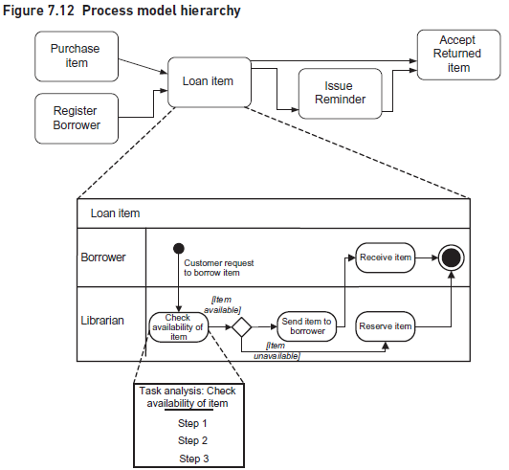
Lecture 7
5. Business Process Models

Slide 34
Lecture 7
5. Business Process Models
Beginning and ending the process
The start of a process can be represented in various ways.
It is usual for the swimlane of the process initiator, such as the customer, to be at the top of the model.
The variations between the different approaches determine how much detail is shown in that particular swimlane. The simplest way, as shown in Figures 7.10 and 7.11, shows the initiator, this time the borrower, providing the event or trigger that starts off the rest of the processing.
It knows nothing about how the borrower creates that initiating request but simply reacts as soon as it receives the input. Imagine, for example, a customer ringing up a call center to place an order.
The customer and the call center sales person are working together to record the order details.
This could be represented as a single task involving both actors and thus shown on the boundary between the customer and sales person swimlanes. This situation is shown in Figure 7.13.

Slide 35
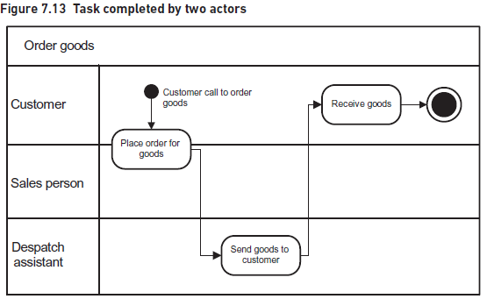
Lecture 7
5. Business Process Models

Slide 36
Lecture 7
6. Analyzing the ‘as is’ Process
Businesses evolve over time. The internal organization and people within the business change. The customers and the products we sell them change. As a result, processes are constantly changing to reflect the different environment in which they operate. Unfortunately, many of these changes occur in an ad hoc and uncontrolled way. When we formally model a process, we start to see how messy and incoherent they have become. Many people are surprised when they first see the swimlane diagram of the process on which they work. Whilst they are familiar with their own part of the process, they may have little idea of what the whole process does, how it works and where their work fits within it.

Slide 37
Identifying problems
Analyzing the hand-offs
Analyzing the processing
Other Factors causing inadequate performance of process
Lecture 7
6. Analyzing the ‘as is’ Process

Slide 38
Lecture 7
6. Analyzing the ‘as is’ Process
Identifying problems
In order to identify problems with an as is process, we need to find out how well it supports the business. Once we have determined the required performance levels, the next step is to compare them with the actual performance of the existing process. Information about the required and actual performance levels may not be easily available which can suggest several problems. A gap between the actual and required performance levels indicates the need for improvements.
There are two key aspects of the model we need to examine, the hand-offs between the tasks and the tasks themselves.

Slide 39
Lecture 7
6. Analyzing the ‘as is’ Process
Analyzing the hand-offs
One of the frequent problems found with business processes involve ‘hand-offs’, where one actor passes the work to another actor. Figure 7.14 shows two hand-offs, one from the Manager to the Clerk, and the other from the Clerk to the Manager. The task ‘Calculate results’ has two hand-offs in this diagram, one preceding and one succeeding.
Clear representation of hand-offs is a major advantage of this diagramming technique and is particularly beneficial when we are trying to improve processes. Hand-offs account for many of the problems experienced by traditional processes as they can cause delays, communication errors and bottlenecks to occur. For example, once a piece of work arrives at its destination it may have to wait in a queue until an actor is free to deal with it.

Slide 40
Lecture 7
6. Analyzing the ‘as is’ Process
Analyzing the processing
The ‘as is’ processes may have been in use for some considerable time and during this period they may have changed in a piecemeal fashion, reacting to changing business needs. As a result, they may contain significant inefficiencies and inconsistencies.
When Analyzing business processes it is important to look for the following possibilities:
Duplication of work. Some tasks may be carried out despite the fact that they duplicate other actors’ tasks or record the same information.
Redundancy. Work and/or data that was necessary when the process was first designed may no longer be required.

Slide 41
Lecture 7
6. Analyzing the ‘as is’ Process
Lack of standardization. Previously, organizations were less aware of the need for effective processes and hence there was less emphasis on carrying out processes in a standard way. Remote locations such as branch offices and depots were allowed flexibility in the way that they interpreted and implemented their processes. This may have worked in a decentralized business but now that there is greater control and centralization, all the different parts of the business are expected to operate in an integrated fashion.
Incompleteness. New requirements may have been identified of the process since its original design. These may have been ignored because they were too difficult or costly to incorporate in the existing process or they may have been handled by a work-around.
Inconsistent measurement or control. The business process approach has increased the emphasis on measuring the standard of work and the service provided to customers. Where a process has developed over time the measures may not be relevant or may be inconsistent with other measures.
If any of these situations are encountered, the analyst needs to apply business process modelling and improvement approaches in order to rectify the situation.

Slide 42
Lecture 7
7. Improving Business Processes
Improving the business process is about removing the problems that have been identified in the ‘as is’ process. Before we accept the initial definition of a problem, it may be worthwhile stepping back and asking whether this is the real problem that we should be solving or possibly a symptom of a more fundamental problem. Our initial analysis, for example, might have identified that our invoice production is taking too long and we are missing deadlines for billing our customers. Further analysis, however, might reveal that the real cause of the delay is excessive rework. A more appropriate solution to this situation would be to implement tighter controls, reduce the rework and eliminate the delays without incurring the cost of increased resources.

Slide 43
  business rules
        Constrains
        Operational guidance
  Simplify the process
  Extend the processing
  Remove bottlenecks
  Change the sequence of tasks
  Redefine process boundary
  Automate the processing
  Redesign the Process
Lecture 7
7. Improving Business Processes

Slide 44
Lecture 7
7. Improving Business Processes
business rules
Business process improvement is also about challenging the assumptions and business rules upon which the current process is built and which, in some circumstances, may limit the process.
Business rules are categorized in two ways:
Constraints – these are the business rules that have to be applied and restrict how a process or task is performed. The constraints may be enforced upon the organization, for example they may be legal or regulatory constraints. Alternatively, they may result from internal policies or strategies.
Operational guidance – these are the business rules that determine how procedures are conducted within the organization. For example, there may be rules governing cancellation fees for hotel bookings or postage charges for delivering orders.

Slide 45
Lecture 7
8. Process Measurement
When we are designing an improved business process, we must define not only what the process does but also how well that processing is to be carried out. The importance of measurement is illustrated by the oft-quoted statement ‘You can only manage what you can measure.’ If we want the actors carrying out tasks to achieve the required levels of performance, we need to define the performance measures and ensure the actors carrying out the work are advised of them. When defining performance measures, one of the fundamental points to recognize is that there are two perspectives on performance measurement: measurement for internal management purposes and measurement by our external customers.

Slide 46
  Internal measures
  External measures
  Process and task measures
  Performance issues
Lecture 7
8. Process Measurement

Slide 47
Lecture 7
8. Process Measurement
Internal measures
Internal measures are often derived from organizational objectives, critical success factors and key performance indicators. These measures are usually defined at an organizational level, cascaded down to departmental level and then further to the operational level. For example, the organization may set ‘low cost of operation’ as a critical success factor for the organization, defining key performance indicators that specify which aspects of low cost should be measured. However, when related performance measures are defined for the business processes, it is possible that the focus on costs can create problems for the successful delivery of the services to the customer.

Slide 48
Lecture 7
8. Process Measurement
External measures
The other aspect to performance measurement is concerned with what the customer expects to have delivered. One way of thinking about this is to consider what it is that each customer group will value about the deliverables it receives from the organization. Having identified this, we can then think about the performance measures that we need to apply internally in order to achieve what our customers require.
There are three major areas to think about:
the time it takes to complete a process or task;
the financial measures such as costs or prices;
the quality measures that are concerned with accuracy and effectiveness.

Slide 49
Lecture 7
8. Process Measurement
Process and task measures
One of the key issues for performance measures is to understand customers’ value expectations. The customer has an expectation of the organization’s performance in delivering the product or service. Internally, the process may be made up of several individual tasks, each of which will need to be allocated performance measures.
The task-level performance measures should be aggregated such that the product or service is delivered within the overall performance measures for the process.
Figure 7.15 demonstrates this principle by showing our loan item example with a timeline added in.
This timeline shows that the first task, ‘Check availability of item’, must take place within two working days of receiving the request from the customer. The second task, ‘Send item to borrower’, must take place within a further two working days. The customer must receive the item within a further one working day.

Slide 50
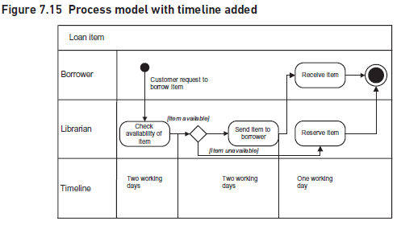
Lecture 7
8. Process Measurement

Slide 51
Lecture 7
8. Process Measurement
Performance issues
Measures and targets need to be chosen with care especially when managers are given incentives to achieve those targets. Targets will change the way that people behave – that is what they are designed to do. It is possible that the behavior could be inappropriate if we have not thought through the implications of the targets. For example, sales staff are often set sales targets on the assumption that more sales are good for the business as a whole. However, this may not be true if the increased sales are achieved by lowering prices too much. This is an example of sub-optimization where seemingly better performance in one part of the business can result in poorer performance for the business as a whole.

Slide 52
Lecture 7
9. Business Process Model and Notation
Business Process Model and Notation (BPMN) provides a standardized way of drawing business process models that is comprehensive and unambiguous. It is based on work that first appeared in 2004 as the Business Process Modelling Language. The Object Management Group (OMG), who look after UML as well as other software standards, took over responsibility for BPMN, issuing Version 1.0 in 2006 and Version 2.0 in 2010.

Slide 53
Lecture 7
9. Business Process Model and Notation
There is a lot of interest in BPMN and many software organizations use and support it. There are two main reasons for this. First, BPMN allows users to represent process models in an industry-standard way so that they are portable across a range of modelling tools. Second, users of BPMN can specify very precise process logic that can be understood and executed by workflow or process engines that control many business processes. The notation used in BPMN is extensive and very powerful.

Slide 54
Lecture 7
9. Business Process Model and Notation
Process modelling using BPMN is useful in two different, but related, aspects. The first concerns business analysts when working with the business to understand the problems with the current processes and consider how they may be improved. However, once the new processes have been agreed, the second aspect concerns the technical details of how the processes will be implemented. Some symbols are appropriate for process modelling as carried out by the business analyst, while others have more relevance for the technical staff.
The basics of BPMN look similar to UML activity diagrams with tasks shown in swimlanes, and connected by process flows that also link with initiating events and outcomes. There is a great deal of additional notation that could be used by the business analyst, including pools, gateways and messages.

Slide 55
Lecture 7
10. Six Sigma
An alternative approach to process improvement is embodied in the Six Sigma approach developed by Motorola in the 1970s and based on ideas from statistical process control. First used in manufacturing industries in the reduction of product defects, it is now used in a range of organizations including those in the pharmaceutical industry, local authorities, food processing, hospitals, the military, logistics, NASA and financial services. Its purpose is to eradicate performance deficiencies in processes that are critical to achieving customer satisfaction. These processes might include complaint handling, order fulfilment or delivering a package to a customer’s house. To achieve process improvement, Six Sigma follows a five step approach known as DMAIC:

Slide 56
Lecture 7
10. Six Sigma
Six Sigma follows a five step approach known as DMAIC:
Define the problem. What is going wrong? Is it one problem or many? What is the visible evidence? Where is it and where does it come from? How serious is it? Is it organization wide or localized? What will be done about it? What is the objective of this investigation?
Measure the data. This means obtaining the data to identify the symptoms; do they occur all the time or from time to time? Produce a map of the process that is producing the problem. Concentrate on the symptoms doing the most damage.
Analyze the results so far. Be creative and prepare theories about the causes of the problems. Document the theories and test them. Identify the root causes.
Improve the process. Assess alternative improvement methods. Design and test the chosen method. Implement the chosen method.
Control the new process and monitor its effectiveness.

Slide 57
CONCLUSION
Lecture 7
An organized, structured approach to business process improvement will be beneficial for both the organization and the business analysts carrying out the work. We have described an approach using an organizational view of processes that is then developed further into more detailed business process models. Business process models can be used for many purposes, including business improvement and staff training, but if they are to be useful it is important to produce clear, easily understood diagrams and well-structured supporting documentation.

Slide 58
REFERENCES
Required Reference:
Debra Paul and James Cadle, et al, (2020). “Business Analysis”. BCS, 4th Edition. ISBN:978-1-78017-5102
Recommended Reading
James Cadle, Debra Paul, Jonathan Hunsley, Adrian Reed, David Beckham, Paul Turner (2021). “Business Analysis Techniques” 3rd Edition, BCS. ISBN: 978-1-78017-5690

Slide 59



The End of Lecture
Thank You
Dr. Abeir Moussa
www.midocean.km

