Slide 1



Classification: Advanced Methods
Prepared by Dr. Amjad Qtaish
DS601
Data Mining
Lecture 08

Slide 2




Lecture: #08
Classification: Advanced Methods
Dr. Amjad Qtaish
Faculty of Informatics
Midocean University
Data Mining (DS601)

Slide 3
Chapter
Outline
08
    Classification: Advanced Methods
Classification: A Mathematical Mapping
Support Vector Machines
Lazy Learners (or Learning from Your Neighbors)
Other Classification Methods
Additional Topics Regarding Classification
Summary
Data Mining, Dr. Amjad Qtaish
3

Slide 4
Chapter
Classification: A Mathematical Mapping
08
Classification: predicts categorical class labels
  E.g., Personal homepage classification
    x_{i} = (x₁, x₂, x₃, …), y_{i} = +1 or –1
    x₁ : # of word “homepage”
    x₂ : # of word “welcome”
Mathematically, x ∈ X = ℜ^{n}, y ∈ Y = {+1, –1},
  We want to derive a function f: X → Y
Linear Classification
  Binary Classification problem
  Data above the red line belongs to class ‘x’
  Data below red line belongs to class ‘o’
  Examples: SVM, Perceptron, Probabilistic Classifiers
x
x
x
x
x
x
x
o
x
x
o
x
o
o
o
o
o
o
o
o
o
o
o
Data Mining, Dr. Amjad Qtaish
4

Slide 5
Chapter
Discriminative Classifiers
08
Advantages
  Prediction accuracy is generally high
    As compared to Bayesian methods – in general
  Robust, works when training examples contain errors
  Fast evaluation of the learned target function
    Bayesian networks are normally slow
Criticism
  Long training time
  Difficult to understand the learned function (weights)
    Bayesian networks can be used easily for pattern discovery
  Not easy to incorporate domain knowledge
    Easy in the form of priors on the data or distributions
Data Mining, Dr. Amjad Qtaish
5

Slide 6
Chapter
Outline
08
    Classification: Advanced Methods
Classification: A Mathematical Mapping
Support Vector Machines
Lazy Learners (or Learning from Your Neighbors)
Other Classification Methods
Additional Topics Regarding Classification
Summary
Data Mining, Dr. Amjad Qtaish
6

Slide 7
Chapter
SVM—Support Vector Machines
08
A relatively new classification method for both linear and nonlinear data
It uses a nonlinear mapping to transform the original training data into a higher dimension
With the new dimension, it searches for the linear optimal separating hyperplane (i.e., “decision boundary”)
With an appropriate nonlinear mapping to a sufficiently high dimension, data from two classes can always be separated by a hyperplane
SVM finds this hyperplane using support vectors (“essential” training tuples) and margins (defined by the support vectors)
Data Mining, Dr. Amjad Qtaish
7

Slide 8
Chapter
SVM—History and Applications
08
Vapnik and colleagues (1992)—groundwork from Vapnik & Chervonenkis’ statistical learning theory in 1960s
Features: training can be slow but accuracy is high owing to their ability to model complex nonlinear decision boundaries (margin maximization)
Used for: classification and numeric prediction
Applications:
  handwritten digit recognition, object recognition, speaker identification, benchmarking time-series prediction tests
Data Mining, Dr. Amjad Qtaish
8

Slide 9
Chapter
SVM—General Philosophy
08
Small Margin
Large Margin
Support Vectors
Data Mining, Dr. Amjad Qtaish
9

Slide 10
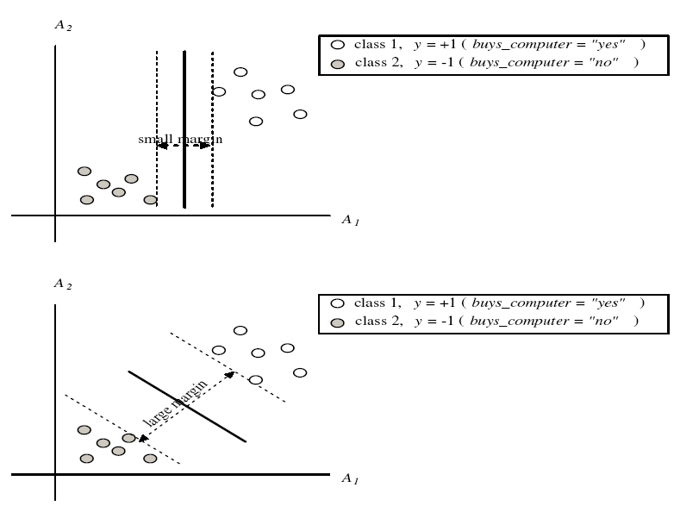
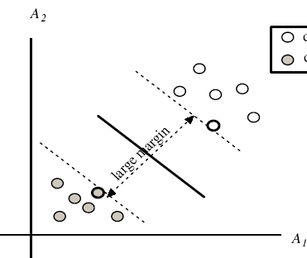
Chapter
SVM—Margins and Support Vectors
08
Data Mining, Dr. Amjad Qtaish
10

Slide 11
Chapter
SVM—When Data Is Linearly Separable
08
Let data D be (X₁, y₁), …, (X_{|D|}, y_{|D|}), where X_{i} is the set of training tuples associated with the class labels y_{i}
There are infinite lines (hyperplanes) separating the two classes but we want to find the best one (the one that minimizes classification error on unseen data)
SVM searches for the hyperplane with the largest margin, i.e., maximum marginal hyperplane (MMH)
Data Mining, Dr. Amjad Qtaish
11

Slide 12
Chapter
SVM—Linearly Separable
08
A separating hyperplane can be written as
    W ● X + b = 0
  where W={w₁, w₂, …, w_{n}} is a weight vector and b a scalar (bias)
For 2-D it can be written as
    w₀ + w₁ x₁ + w₂ x₂ = 0
The hyperplane defining the sides of the margin:
    H₁: w₀ + w₁ x₁ + w₂ x₂ ≥ 1 for y_{i} = +1, and
    H₂: w₀ + w₁ x₁ + w₂ x₂ ≤ – 1 for y_{i} = –1
Any training tuples that fall on hyperplanes H₁ or H₂ (i.e., the
sides defining the margin) are support vectors
This becomes a constrained (convex) quadratic optimization problem: Quadratic objective function and linear constraints → Quadratic Programming (QP) → Lagrangian multipliers
Data Mining, Dr. Amjad Qtaish
12

Slide 13
Why Is SVM Effective on High Dimensional Data?
Chapter
08
The complexity of trained classifier is characterized by the # of support vectors rather than the dimensionality of the data
The support vectors are the essential or critical training examples —they lie closest to the decision boundary (MMH)
If all other training examples are removed and the training is repeated, the same separating hyperplane would be found
The number of support vectors found can be used to compute an (upper) bound on the expected error rate of the SVM classifier, which is independent of the data dimensionality
Thus, an SVM with a small number of support vectors can have good generalization, even when the dimensionality of the data is high
Data Mining, Dr. Amjad Qtaish
13

Slide 14
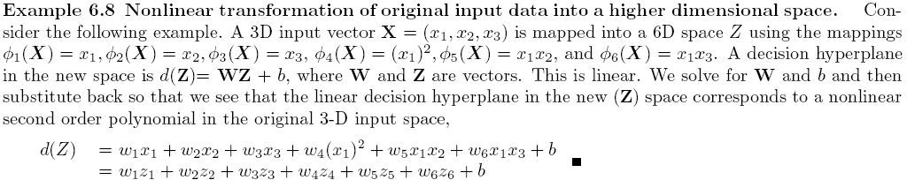
Chapter
SVM—Linearly Inseparable
08
Transform the original input data into a higher dimensional space
Search for a linear separating hyperplane in the new space
Data Mining, Dr. Amjad Qtaish
14

Slide 15
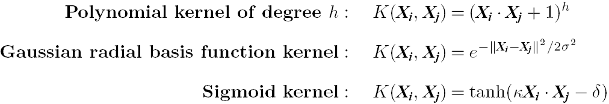
Chapter
SVM: Different Kernel functions
08
Instead of computing the dot product on the transformed data, it is math. equivalent to applying a kernel function K(X_{i}, X_{j}) to the original data, i.e., K(X_{i}, X_{j}) = Φ(X_{i}) Φ(X_{j})
Typical Kernel Functions
SVM can also be used for classifying multiple (> 2) classes and for regression analysis (with additional parameters)
Data Mining, Dr. Amjad Qtaish
15

Slide 16
Chapter
SVM vs. Neural Network
08
SVM
  Deterministic algorithm
  Nice generalization properties
  Hard to learn – learned in batch mode using quadratic programming techniques
  Using kernels can learn very complex functions
Neural Network
  Nondeterministic algorithm
  Generalizes well but doesn’t have strong mathematical foundation
  Can easily be learned in incremental fashion
  To learn complex functions—use multilayer perceptron (nontrivial)
Data Mining, Dr. Amjad Qtaish
16

Slide 17
Chapter
Outline
08
    Classification: Advanced Methods
Classification: A Mathematical Mapping
Support Vector Machines
Lazy Learners (or Learning from Your Neighbors)
Other Classification Methods
Additional Topics Regarding Classification
Summary
Data Mining, Dr. Amjad Qtaish
17

Slide 18
Chapter
Lazy vs. Eager Learning
08
Lazy vs. eager learning
  Lazy learning (e.g., instance-based learning): Simply stores training data (or only minor processing) and waits until it is given a test tuple
  Eager learning (the above discussed methods): Given a set of training tuples, constructs a classification model before receiving new (e.g., test) data to classify
Lazy: less time in training but more time in predicting
Accuracy
  Lazy method effectively uses a richer hypothesis space since it uses many local linear functions to form an implicit global approximation to the target function
  Eager: must commit to a single hypothesis that covers the entire instance space
Data Mining, Dr. Amjad Qtaish
18

Slide 19
Chapter
Lazy Learner: Instance-Based Methods
08
Instance-based learning:
  Store training examples and delay the processing (“lazy evaluation”) until a new instance must be classified
Typical approaches
  k-nearest neighbor approach
    Instances represented as points in a Euclidean space.
  Locally weighted regression
    Constructs local approximation
  Case-based reasoning
    Uses symbolic representations and knowledge-based inference
Data Mining, Dr. Amjad Qtaish
19

Slide 20
Chapter
The k-Nearest Neighbor Algorithm
08
All instances correspond to points in the n-D space
The nearest neighbor are defined in terms of Euclidean distance, dist(X₁, X₂)
Target function could be discrete- or real- valued
For discrete-valued, k-NN returns the most common value among the k training examples nearest to x_{q}
Vonoroi diagram: the decision surface induced by 1-NN for a typical set of training examples
_
.
.
_
_
+
_
.
.
+
.
_
x_{q}
+
_
.
+
Data Mining, Dr. Amjad Qtaish
20

Slide 21
Chapter
Discussion on the k-NN Algorithm
08
k-NN for real-valued prediction for a given unknown tuple
  Returns the mean values of the k nearest neighbors
Distance-weighted nearest neighbor algorithm
  Weight the contribution of each of the k neighbors according to their distance to the query x_{q}
    Give greater weight to closer neighbors
Robust to noisy data by averaging k-nearest neighbors
Curse of dimensionality: distance between neighbors could be dominated by irrelevant attributes
  To overcome it, axes stretch or elimination of the least relevant attributes
Data Mining, Dr. Amjad Qtaish
21

Slide 22
Chapter
Outline
08
    Classification: Advanced Methods
Classification: A Mathematical Mapping
Support Vector Machines
Lazy Learners (or Learning from Your Neighbors)
Other Classification Methods
Additional Topics Regarding Classification
Summary
Data Mining, Dr. Amjad Qtaish
22

Slide 23
Chapter
Genetic Algorithms (GA)
08
Genetic Algorithm: based on an analogy to biological evolution
An initial population is created consisting of randomly generated rules
  Each rule is represented by a string of bits
  E.g., if A₁ and ¬A₂ then C₂ can be encoded as 100
  If an attribute has k > 2 values, k bits can be used
Based on the notion of survival of the fittest, a new population is formed to consist of the fittest rules and their offspring
The fitness of a rule is represented by its classification accuracy on a set of training examples
Offspring are generated by crossover and mutation
The process continues until a population P evolves when each rule in P satisfies a prespecified threshold
Slow but easily parallelizable
Data Mining, Dr. Amjad Qtaish
23

Slide 24
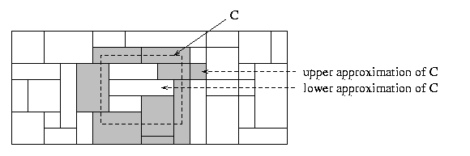
Chapter
Rough Set Approach
08
Rough sets are used to approximately or “roughly” define equivalent classes
A rough set for a given class C is approximated by two sets: a lower approximation (certain to be in C) and an upper approximation (cannot be described as not belonging to C)
Finding the minimal subsets (reducts) of attributes for feature reduction is NP-hard but a discernibility matrix (which stores the differences between attribute values for each pair of data tuples) is used to reduce the computation intensity
Data Mining, Dr. Amjad Qtaish
24

Slide 25
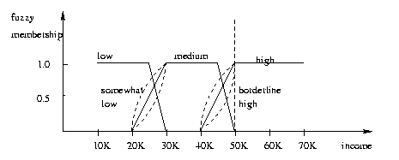
Chapter
Fuzzy Set Approaches
08
Fuzzy logic uses truth values between 0.0 and 1.0 to represent the degree of membership (such as in a fuzzy membership graph)
Attribute values are converted to fuzzy values. Ex.:
  Income, x, is assigned a fuzzy membership value to each of the discrete categories {low, medium, high}, e.g. $49K belongs to “medium income” with fuzzy value 0.15 but belongs to “high income” with fuzzy value 0.96
  Fuzzy membership values do not have to sum to 1.
Each applicable rule contributes a vote for membership in the categories
Typically, the truth values for each predicted category are summed, and these sums are combined
Data Mining, Dr. Amjad Qtaish
25

Slide 26
Chapter
Outline
08
    Classification: Advanced Methods
Classification: A Mathematical Mapping
Support Vector Machines
Lazy Learners (or Learning from Your Neighbors)
Other Classification Methods
Additional Topics Regarding Classification
Summary
Data Mining, Dr. Amjad Qtaish
26

Slide 27
Chapter
Multiclass Classification
08
Classification involving more than two classes (i.e., > 2 Classes)
Method 1. One-vs.-all (OVA): Learn a classifier one at a time
  Given m classes, train m classifiers: one for each class
  Classifier j: treat tuples in class j as positive & all others as negative
  To classify a tuple X, the set of classifiers vote as an ensemble
Method 2. All-vs.-all (AVA): Learn a classifier for each pair of classes
  Given m classes, construct m(m-1)/2 binary classifiers
  A classifier is trained using tuples of the two classes
  To classify a tuple X, each classifier votes. X is assigned to the class with maximal vote
Comparison
  All-vs.-all tends to be superior to one-vs.-all
  Problem: Binary classifier is sensitive to errors, and errors affect vote count
Data Mining, Dr. Amjad Qtaish
27

Slide 28
Error-Correcting Codes for Multiclass Classification
Chapter
08
Originally designed to correct errors during data transmission for communication tasks by exploring data redundancy
Example
  A 7-bit codeword associated with classes 1-4
Class | Error-Corr. Codeword
C₁ | 1 | 1 | 1 | 1 | 1 | 1 | 1
C₂ | 0 | 0 | 0 | 0 | 1 | 1 | 1
C₃ | 0 | 0 | 1 | 1 | 0 | 0 | 1
C₄ | 0 | 1 | 0 | 1 | 0 | 1 | 0
  Given a unknown tuple X, the 7-trained classifiers output: 0001010
  Hamming distance: # of different bits between two codewords
  H(X, C₁) = 5, by checking # of bits between [1111111] & [0001010]
  H(X, C₂) = 3, H(X, C₃) = 3, H(X, C₄) = 1, thus C₄ as the label for X
Error-correcting codes can correct up to (h-1)/h 1-bit error, where h is the minimum Hamming distance between any two codewords
If we use 1-bit per class, it is equiv. to one-vs.-all approach, the code are insufficient to self-correct
When selecting error-correcting codes, there should be good row-wise and col.-wise separation between the codewords
Data Mining, Dr. Amjad Qtaish
28

Slide 29
Chapter
Semi-Supervised Classification
08
Semi-supervised: Uses labeled and unlabeled data to build a classifier
Self-training:
  Build a classifier using the labeled data
  Use it to label the unlabeled data, and those with the most confident label prediction are added to the set of labeled data
  Repeat the above process
  Adv: easy to understand; disadv: may reinforce errors
Co-training: Use two or more classifiers to teach each other
  Each learner uses a mutually independent set of features of each tuple to train a good classifier, say f₁
  Then f₁ and f₂ are used to predict the class label for unlabeled data X
  Teach each other: The tuple having the most confident prediction from f₁ is added to the set of labeled data for f₂, & vice versa
Other methods, e.g., joint probability distribution of features and labels
Data Mining, Dr. Amjad Qtaish
29

Slide 30
Chapter
Active Learning
08
Class labels are expensive to obtain
Active learner: query human (oracle) for labels
Pool-based approach: Uses a pool of unlabeled data
  L: a small subset of D is labeled, U: a pool of unlabeled data in D
  Use a query function to carefully select one or more tuples from U and request labels from an oracle (a human annotator)
  The newly labeled samples are added to L, and learn a model
  Goal: Achieve high accuracy using as few labeled data as possible
Evaluated using learning curves: Accuracy as a function of the number of instances queried (# of tuples to be queried should be small)
Research issue: How to choose the data tuples to be queried?
  Uncertainty sampling: choose the least certain ones
  Reduce version space, the subset of hypotheses consistent w. the training data
  Reduce expected entropy over U: Find the greatest reduction in the total number of incorrect predictions
Data Mining, Dr. Amjad Qtaish
30

Slide 31
Chapter
Transfer Learning: Conceptual Framework
08
Transfer learning: Extract knowledge from one or more source tasks and apply the knowledge to a target task
Traditional learning: Build a new classifier for each new task
Transfer learning: Build new classifier by applying existing knowledge learned from source tasks
Traditional Learning Framework
Transfer Learning Framework
Data Mining, Dr. Amjad Qtaish
31

Slide 32
Chapter
Transfer Learning: Methods and Applications
08
Applications: Especially useful when data is outdated or distribution changes, e.g., Web document classification, e-mail spam filtering
Instance-based transfer learning: Reweight some of the data from source tasks and use it to learn the target task
TrAdaBoost (Transfer AdaBoost)
  Assume source and target data each described by the same set of attributes (features) & class labels, but rather diff. distributions
  Require only labeling a small amount of target data
  Use source data in training: When a source tuple is misclassified, reduce the weight of such tupels so that they will have less effect on the subsequent classifier
Research issues
  Negative transfer: When it performs worse than no transfer at all
  Heterogeneous transfer learning: Transfer knowledge from different feature space or multiple source domains
  Large-scale transfer learning
Data Mining, Dr. Amjad Qtaish
32

Slide 33
Chapter
Outline
08
    Classification: Advanced Methods
Classification: A Mathematical Mapping
Support Vector Machines
Lazy Learners (or Learning from Your Neighbors)
Other Classification Methods
Additional Topics Regarding Classification
Summary
Data Mining, Dr. Amjad Qtaish
33

Slide 34
Chapter
Summary
08
Effective and advanced classification methods
  Support Vector Machine (SVM)
  Other classification methods: lazy learners (KNN, case-based reasoning), genetic algorithms, rough set and fuzzy set approaches
Additional Topics on Classification
  Multiclass classification
  Semi-supervised classification
  Active learning
  Transfer learning
Data Mining, Dr. Amjad Qtaish
34

Slide 35



Thank You

Slide 36
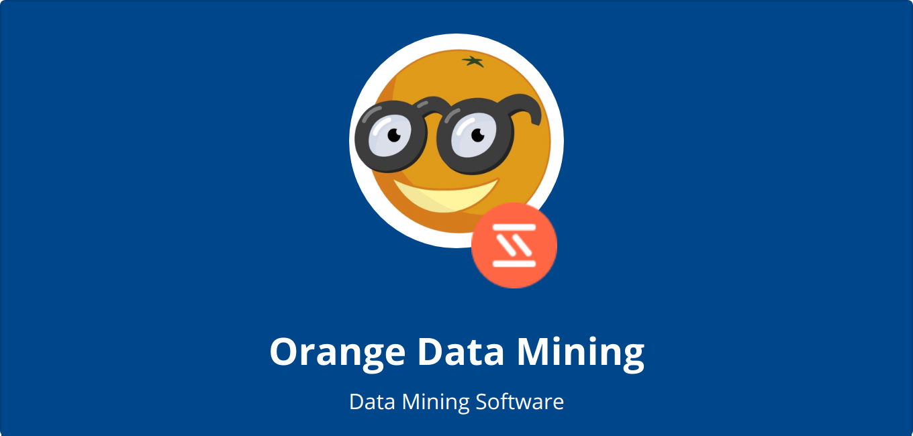
Classification

Slide 37
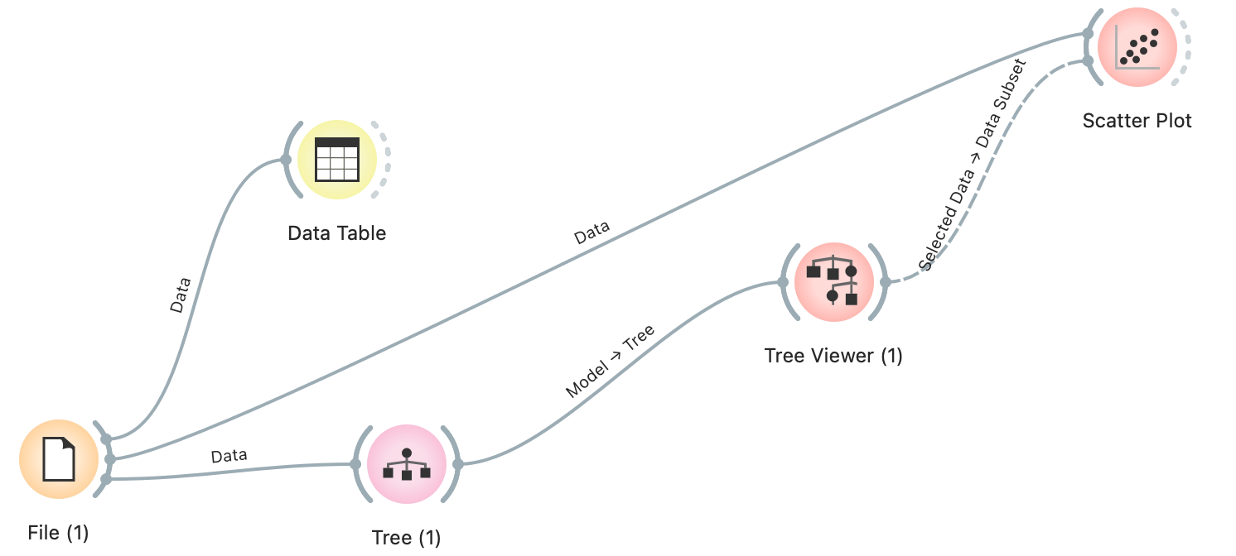
Iris Classification – Example 1

Slide 38
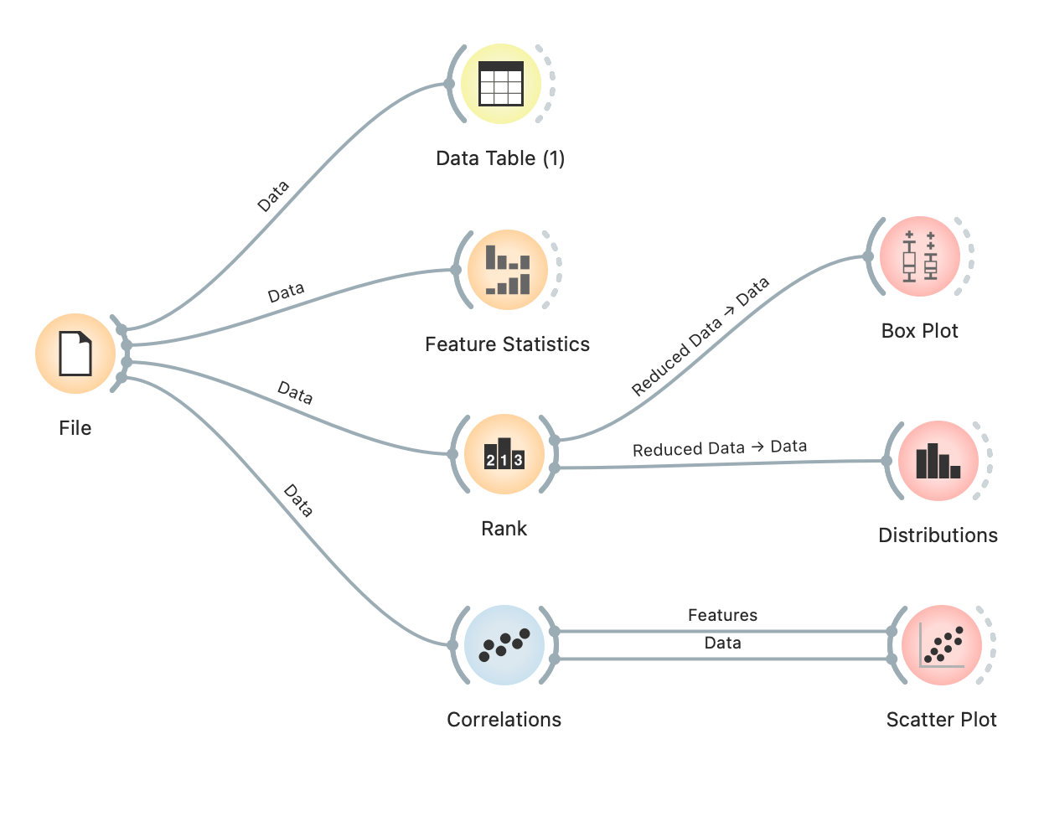
Iris Classification – Example 2

Slide 39
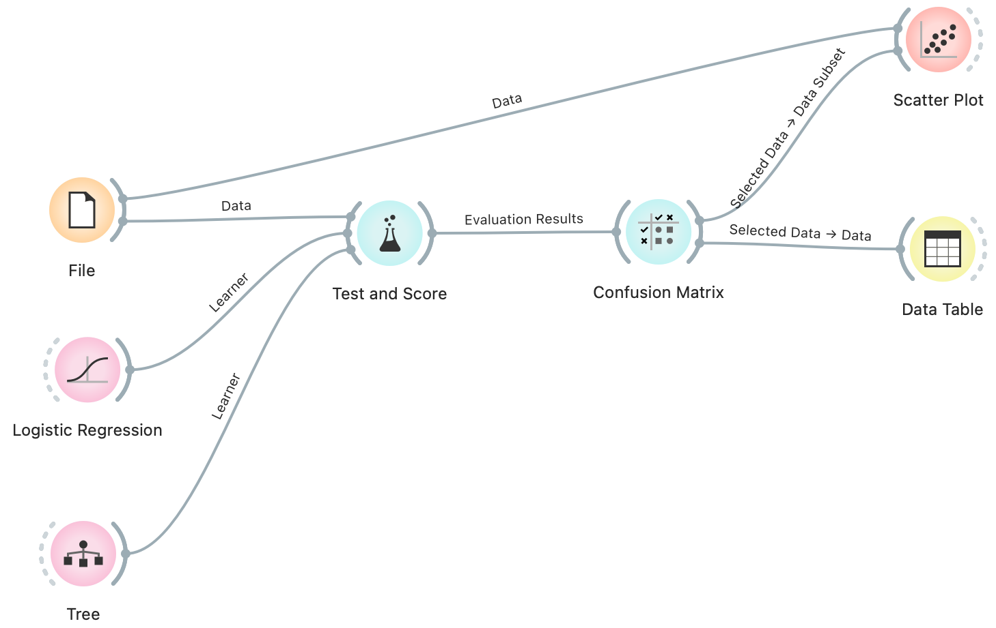
Iris Classification – Example 3

Slide 40
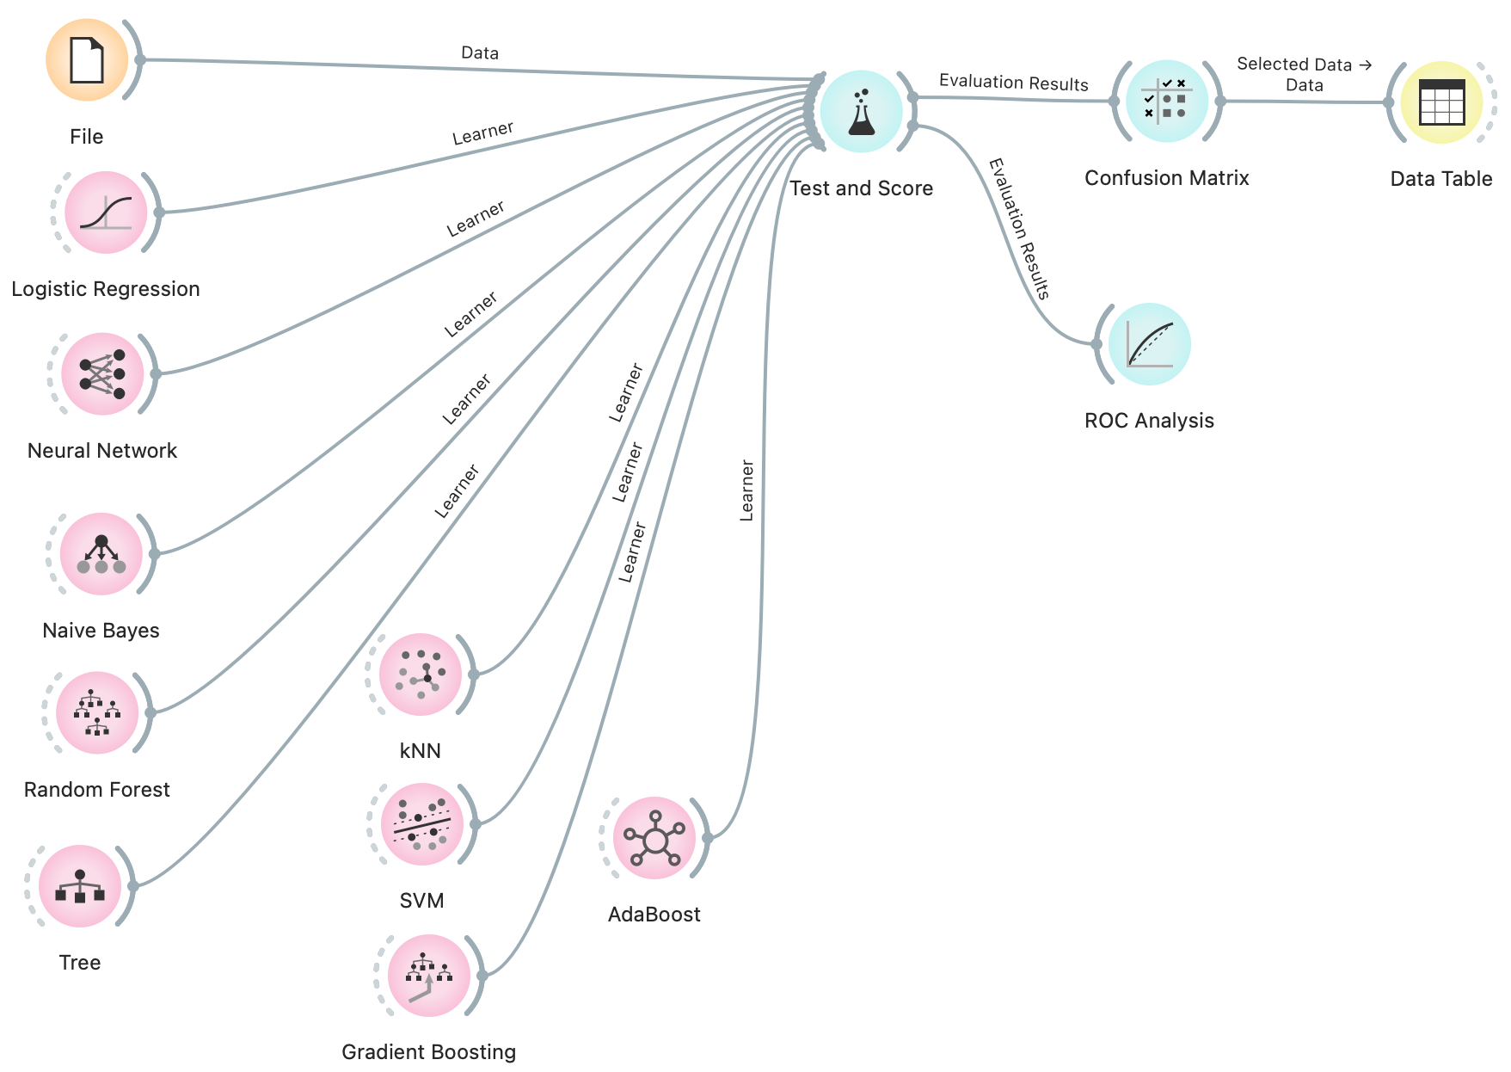
Iris Classification – Example 4

