Slide 1


DIGITAL MEDIA ETHICS
DGM 723
Prepared by:
Dr. Sherihan Mohamed
Lecture 3

Slide 2



DMG 723
DIGITAL MEDIA ETHICS
Chapter 2
Privacy in the (Post-)Digital Era
Prepared by:
Dr. Sherihan Mohamed

Slide 3

Lecture 2
Remember:
** Digital Media Ethics: How to proceed?
** Is Digital Media Ethics Possible? Grounds for hope
** How to do ethics in the new mediascape:
Dialogical approaches, difference, and Pluralism.
** Further considerations: Ethical judgments.

Slide 4
Lecture 3
Outlines:
** Information and privacy in the global digital Age.
** “Privacy” and private life: Changing attitudes in the age of social media and mobile devices
** “Privacy” and private life: Cultural and philosophical considerations
** “Privacy” and private life: Cultural differences and ethical pluralism

Slide 5

Information and privacy
in the global digital Age
Lecture 3
Privacy in the
(Post-) Digital Era

Slide 6
Information and privacy in the global digital Age
Lecture 3
“Privacy” and anonymity online – is there any?
These days, most of us are so accustomed to being TRACKED one way or another – including by our smartphones, health-tracking devices, GPS-equipped, digital cameras, etc. – that we may not give any of this a second thought.

Slide 7
Whether for managing our health, finding our way in a new place via Google maps, or keeping track of our children or partners having our rather precise physical location constantly monitored and known to at least selected apps makes contemporary life more convenient, healthier, and safer.

Slide 8

Information and privacy in the global digital Age
Lecture 3
Many of these apps can also be used for DARKER PURPOSES, starting with various forms of stalking, harassment, and worse. And there are times and circumstances in which we very much want to protect our identity and locational privacy.

Slide 9
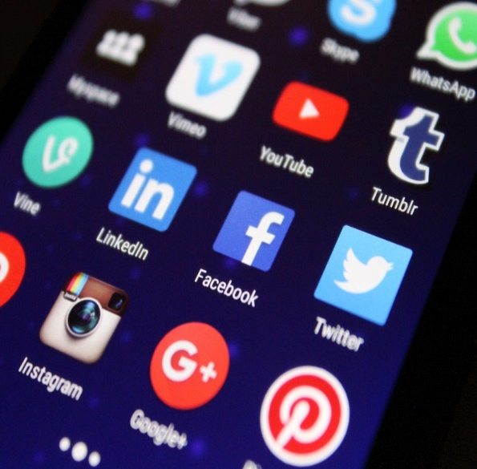
The dark side of using Digital Apps, especially in today’s Digital Age, revolves around significant threats to Privacy, Security, and overall well-being.
While Apps offer many benefits, they also come with Several Risks that can harm users in various ways, such as:

Slide 10
Information and privacy in the global digital Age
Lecture 3
Data Collection and Exploitation:
Most apps collect a vast amount of DATA about their users, from basic information like name and location to More Sensitive Data like browsing habits, health information, and even personal preferences. This data is often used for targeted advertising or Sold to third-party companies, sometimes without the user’s full awareness or consent. Over time, this data can accumulate, creating a detailed profile of the user that could be exploited.

Slide 11
Invasive Tracking:
Many apps, particularly those in social media, advertising, and even seemingly harmless utility apps, Track User Behavior across different platforms.
Even if you aren't using a particular app, it might track you through cookies, location tracking, or other means. This practice compromises privacy by continuously monitoring your actions and making it possible to link personal behaviors to a specific identity.

Slide 12
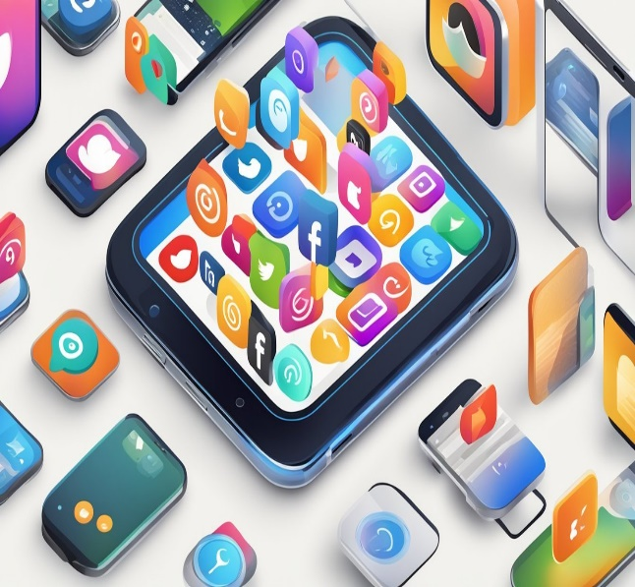
Information and privacy in the global digital Age
Lecture 3
Lack of Transparency and Control:
Some apps DO NOT clearly explain how they collect, store, and share data, leaving users in the dark about how their information is being used. Even when apps do offer privacy settings, they may be confusing, misleading, or buried deep within the app, making it difficult for users to control the extent of their data sharing.

Slide 13

Security Vulnerabilities:
Apps, particularly those that aren’t regularly updated or well-maintained, can have security flaws that expose user data to hackers. Even large, reputable companies have been the victims of data breaches that affect millions of users. Insecure apps can expose sensitive information like personal details, financial data, or login credentials, putting users at risk of identity theft or fraud.

Slide 14
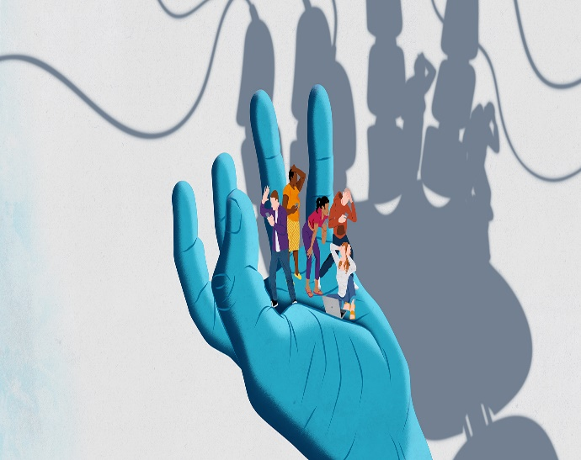
Information and privacy in the global digital Age
Lecture 3
Surveillance and Government Overreach:
Some apps, particularly messaging or social media platforms, are used by governments or organizations to spy on users.
Governments may request ACCESS to private data from app developers, or hackers may exploit app vulnerabilities to gain access to sensitive information. This can lead to violations of personal privacy, particularly in countries with oppressive regimes that use digital surveillance to track and control citizens.

Slide 15
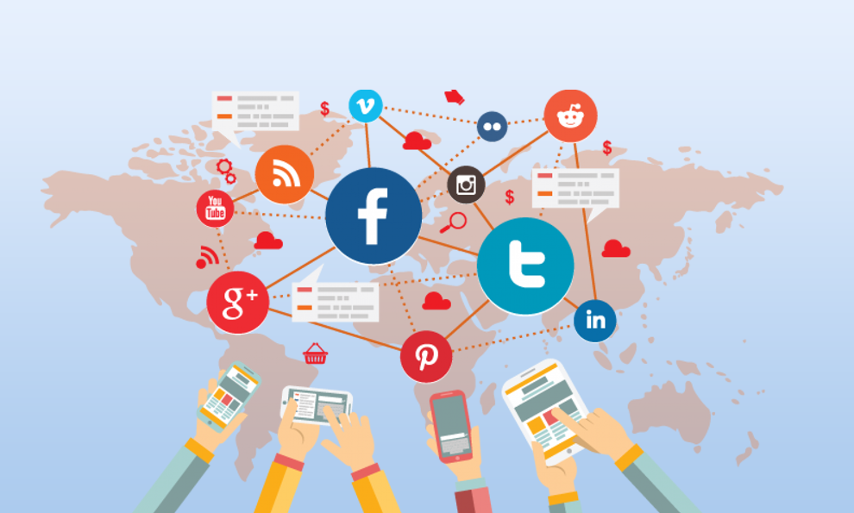
Psychological Manipulation:
Certain apps, especially social media platforms and games, are designed to manipulate users' emotions and behaviors. Through algorithms that exploit personal data, apps may encourage addiction, increase anxiety, or promote unhealthy comparison to others. This psychological manipulation may not only affect privacy but also mental health, especially among vulnerable users.

Slide 16
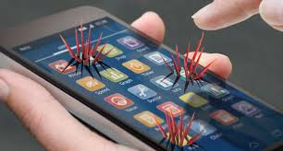
Information and privacy in the global digital Age
Lecture 3
Lack of Accountability:
Many apps are created by private companies that might not have the best interests of users in mind. IF privacy violations occur, these companies Might Not Be Held Accountable. Moreover, legal frameworks to protect privacy can be weak or outdated, leaving users with little recourse if their information is misused.

Slide 17
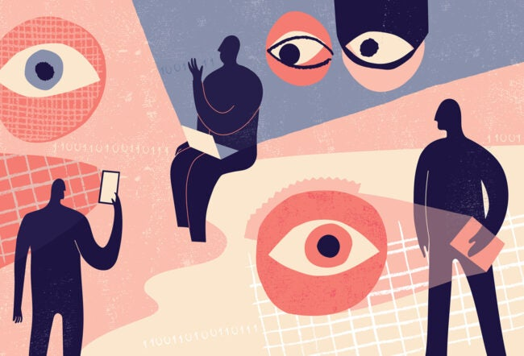
Long-Term Consequences of Data Storage:
Data collected by apps doesn't just disappear when you stop using them. In many cases, this data is stored indefinitely, creating a digital footprint that could follow you for years, affecting your reputation, security, and even employment prospects.

Slide 18
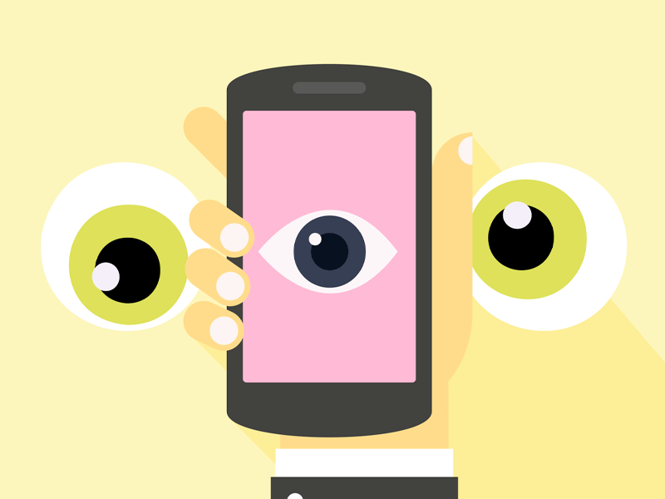
Information and privacy in the global digital Age
Lecture 3
Manipulation of Consent:
Often, apps ask for "consent" to access personal information, BUT the consent is not always fully informed. Users may feel pressured to grant access to data in order to use the app or continue enjoying its features, which can result in a false sense of consent that doesn’t fully protect their privacy.

Slide 19
“Privacy” and private life: Changing attitudes in the age of social media and mobile devices
Lecture 3

Slide 20
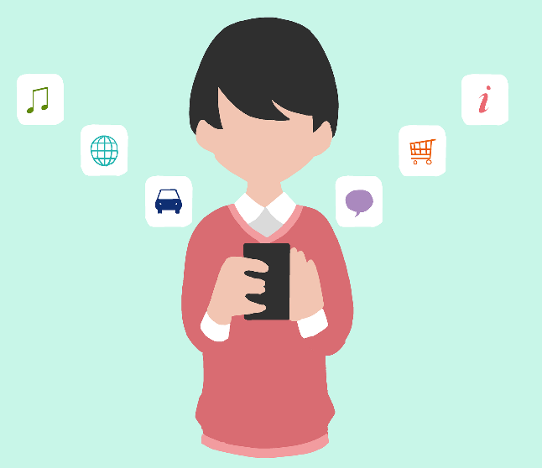
These manifest threats to personal privacy and private life are further accompanied by changing attitudes toward privacy in both “Western” and “Eastern” societies – perhaps as an artifact of our growing use of digital media.

Slide 21
“Privacy” and private life: Changing attitudes in the age of social media and mobile devices
Lecture 3
For example, in sharp tension with worries about hierarchical forms of surveillance by states and corporations, the terms first introduced by Albrechtslund (2008) – “voluntary” and “participatory surveillance” – are now commonplace understandings of our always-on behaviors. Lateral surveillance of one another is apparent on any given social media site (Facebook, Instagram, Twitter, etc.) as well as on video sharing sites such as YouTube.

Slide 22
Still more recently, our efforts to sustain some version of privacy are increasingly shared: we want to share what was once seen as primarily individually private information – but now within specific groups. “Group privacy” or “collective privacy” are terms that further refine and describe these changing privacy sensibilities – especially in an era increasingly dominated by “Big Data” approaches.

Slide 23

“Privacy” and private life: Changing attitudes in the age of social media and mobile devices
Lecture 3
The mobile phone and then tablets invert our earlier contexts as well: being “On The Grid” is now the norm – and so these devices have turned traditional notions of “public” and “private” upside down. Earlier, privacy in the form of being “off the grid” of a public communications network was commonplace.

Slide 24
Being “always on” inverts or turns upside down earlier understandings of who we are and of our relationships with others. We will now see how this inversion and transformation means.
First of all, that we have to rethink our conceptions of privacy in dramatic ways. It may also well mean that we will likewise need to revisit and perhaps revise our earlier ethical and political philosophies.

Slide 25
“Privacy” and private life:
Cultural and philosophical considerations
Lecture 3

Slide 26
Lecture 3
“Privacy” and private life: Cultural and philosophical considerations
What do we mean by “privacy?
Privacy enables us to create barriers and manage boundaries to protect ourselves from unwarranted interference in our lives, which allows us to negotiate who we are and how we want to interact with the world around us.
Privacy helps us establish boundaries to limit who has access to our bodies, places and things, as well as our communications and our information.

Slide 27
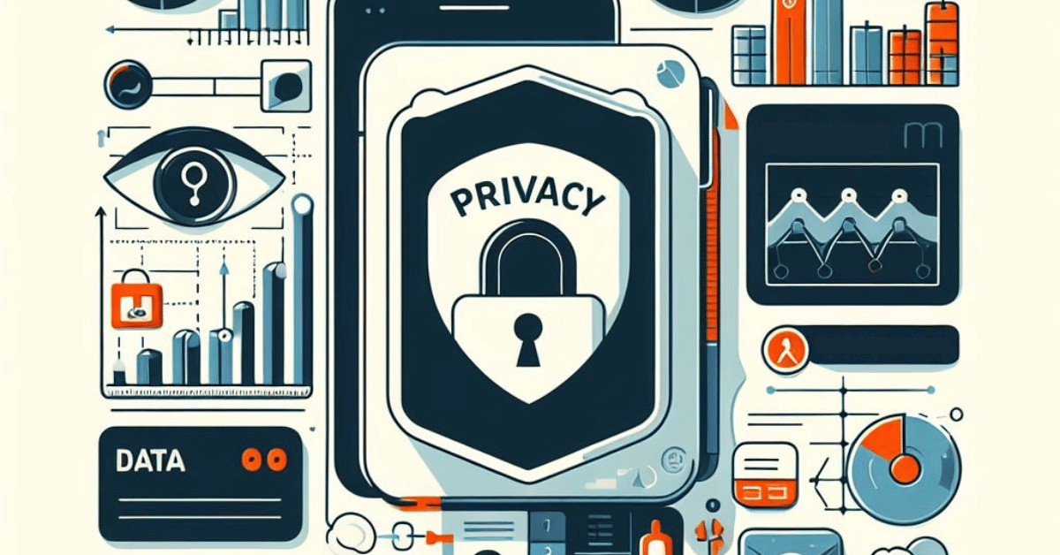
In the US context and tradition, the conception of privacy begins with primarily physical notions, what we initially wanted to protect was the privacy of spaces, first of all our homes.

Slide 28
Lecture 3
“Privacy” and private life: Cultural and philosophical considerations
“Privacy” is not simply a matter of protecting specific spaces. what we want protected in an information age is precisely our information – information that, in digital form, is that much easier to access, copy, and distribute.
But why would we worry? “The expectation of privacy is grounded in the fear concerning how the information might be used or appropriated to pressure or embarrass one, to damage one’s credibility or economic status, and so on”.

Slide 29
There is a variation in the meaning of “privacy” that varies from culture to culture, and what is clear is that these concepts most closely associated with “privacy” are not only aligned with the emerging practices of collective and group privacy, in addition, they are expressed in the increasingly influential account of privacy as “context integration.”

Slide 30

Lecture 3
“Privacy” and private life: Cultural and philosophical considerations
Is privacy a right?
Privacy is a qualified, fundamental human right. The right to privacy is articulated in all of the major international and regional human rights instruments, including:

Slide 31
* United Nations Declaration of Human Rights (UDHR) 1948, Article 12:
* International Covenant on Civil and Political Rights (ICCPR) 1966, Article 17
* Article 14 of the United Nations Convention on Migrant Workers;
* Article 16 of the UN Convention on the Rights of the Child;
* Article 10 of the African Charter on the Rights and Welfare of the Child;

Slide 32
Lecture 3
“Privacy” and private life: Cultural and philosophical considerations
What is the relationship between information privacy and data security?
Privacy and security are two interrelated but separate concepts.
Information security is concerned with unauthorized activity that causes a loss of confidentiality, integrity, or availability of information or systems (including systems that don't involve personal information).

Slide 33

Privacy concerns may arise from unauthorized access, but they can also arise from planned and permissible activity.
So, even if information is handled securely, privacy concerns may exist where the use or disclosure of that data impacts individuals.

Slide 34
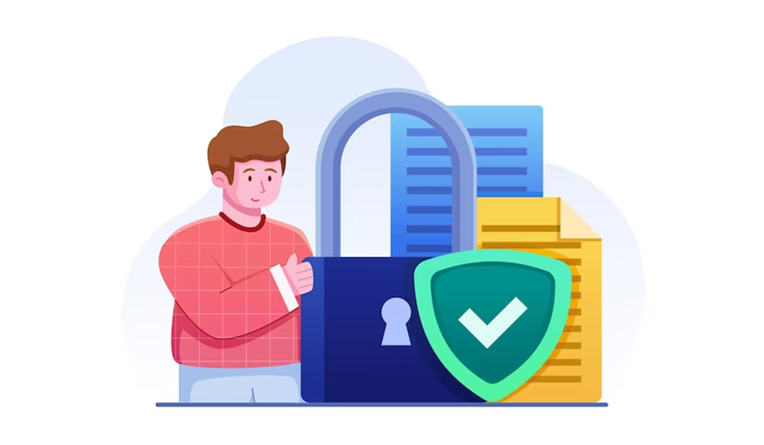
Lecture 3
“Privacy” and private life: Cultural and philosophical considerations
For example, a social website may handle all information it collects securely, But then use that information to profile individuals, make decisions about the content users will see, and share their information (securely!) with advertising firms.

Slide 35
“Privacy” and private life: Cultural
differences and ethical pluralism
Lecture 3

Slide 36
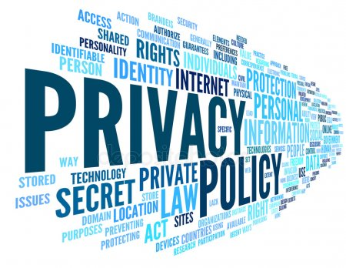
Lecture 3
“Privacy” and private life: Cultural differences and ethical pluralism
In the case of “privacy,” these cross-cultural comparisons can thus be understood to constitute an example of such an ethical pluralism.
This is to say: US-style conceptions of “privacy” as strongly individual and Thai notions of “privacy” as primarily familial privacy thus present us with strongly different ideas of “privacy.”

Slide 37

For the ethical relativist, these differences would be one more example arguing that there are no universal values or norms: the validity of ethical norms and values is solely relative to a given culture and time.

Slide 38
Lecture 3
“Privacy” and private life: Cultural differences and ethical pluralism
In this instance, the US notion of individual privacy as a positive good is legitimate – but only if you’re a member of the US culture; and the Thai emphasis on familial privacy alone as ethically acceptable is also legitimate. if you were born and raised in Thai culture in those days. This is fine – at least as long as people from both cultures have nothing to do with one another and thus require no shared norms or values.

Slide 39
For the ethical monist, we can establish a shared norm or value rather simply: one of these values or norms must be true – absolutely, finally, and universally – and hence any different value or norm can only be false.
Again, if we had nothing to do with one another, this might be a workable solution: but in today’s world, it is more or less impossible to live in such splendid isolation.

Slide 40
Lecture 3
“Privacy” and private life: Cultural differences and ethical pluralism
And so, if the ethical monist has his way, we must choose which norm or value is right and which is thereby wrong.
This approach seems to condemn us to intolerance and conflict – not very useful either for genuine understanding of the Other as Other 5 or for efforts to avoid cultural imperialism, much less warfare.

Slide 41
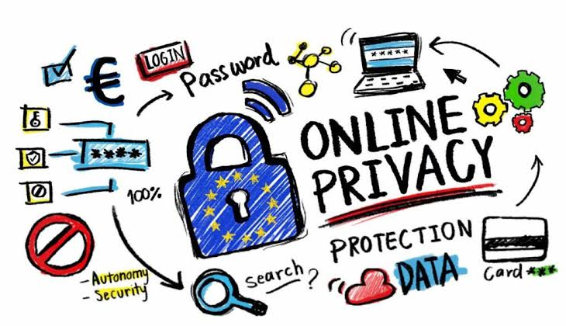
The ethical pluralist, finally, hopes to avoid such intolerance and conflict by way of arguing that both cultures share a notion of “privacy,” but this notion is understood and practiced in different ways – ways that are directly shaped by each culture’s distinctive traditions and assumptions. Ethical pluralism thus argues for a middle ground between relativism and monism.

Slide 42
Lecture 3
“Privacy” and private life: Cultural differences and ethical pluralism
Yes, norms and values vary from culture to culture – but, contra monism, this does not necessarily mean that only one cultural norm can be right and the other wrong: both can be correct as instances of different interpretations of a shared norm. Contra relativism, because varying cultural norms may thus instantiate a shared norm, cultural variations of this sort do not necessarily mean that there are no universally legitimate values or norms.

Slide 43
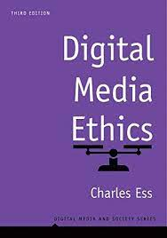

Digital Media Ethics (Digital Media and Society Series), 3rd Edition, by Charles Ess
Intro
Recommended Reference

Slide 44
Lecture 3
Outlines:
** Information and privacy in the global digital Age.
** “Privacy” and private life: Changing attitudes in the age of social media and mobile devices
** “Privacy” and private life: Cultural and philosophical considerations
** “Privacy” and private life: Cultural differences and ethical pluralism

Slide 45



Thank You

Slide 46
DIGITAL MEDIA ETHICS
Lecture 3
DMG 723
Prepared by:
Dr. Sherihan Mohamed

