Slide 1


Secure Operating systems
by Dr. Hesham Abou Elfetouh
Lecture 10

Slide 2

Introduction
In Previous Lecture you learned:
The Web Security
Browser Attack Types
Email Spam
Denial of Service Attacks
Classes of Attacks
Detection Methods

Slide 3
Lecture
10
Lecture 10 TOPICS
Network Security Tools
Network security tools
5.2.1. Firewalls

Slide 4
10 Lecture 10 GOALS
When you complete this Lecture, you will be able to:
Describe what is the fire wall
Illustrate Types of firewalls
Compare between firewall types
  Explain the firewall configurations
  Define What firewalls can—and can’t—block

Slide 5
Firewalls
Outline
  Introduction
  What is a firewall
  Firewall design
  Types of firewalls
    Packet filters
    (i-1) Simple packet filters
    (i-2) Stateful packet filters
    Application proxies
      (ii-1) Guards
    iii. Personal firewalls
  Comparison of firewall types
  Example firewall configurations
  What firewalls can—and can’t—block

Slide 6
What is a Firewall?
It is a device (h/w), or software, or combination of both designed as a:
Wall between protected local (sub)net & outside global net
Choke point of control and monitoring
It Interconnects networks with differing trust
It Imposes restrictions on network services
  only authorized traffic is allowed prevent unauthorized outside users from accessing network and/or single workstation
Auditing and controlling access
  can implement alarms for abnormal behavior prevent inside users from omitting sensitive information or accessing insecure resources
Itself immune to penetration
Provides perimeter defence

Slide 7
What is a Firewall?
Most firewalls run as dedicated devices
  Easier to design correctly and inspect each individual inbound or outbound packet of data sent to / from protected system
  Easier to optimize for performance
Firewalls implement security policies, or set of rules that determine what traffic can or cannot pass through
A firewall is an example of a reference monitor, which means it should have three characteristics:
  Always invoked (cannot be circumvented)
  Tamperproof
  Small and simple enough for rigorous analysis

Slide 8
What is a firewall
Examples of security policy requirements w.r.t. firewalls:
  Block any access from the outside, allow all accesses to the outside
  Allow” from” accesses only for certain activities OR only to/from certain subnets/hosts/apps/users
    E.g., prevent outside access to subnet hosts except for mail server accesses
Choice of default firewall behavior
  1) Default permit
    „That which is not expressly forbidden is allowed”
  2) Default deny
    „That which is not expressly allowed is forbidden”
  Users prefer default permit, security experts prefer default deny
  Sysadmin must make the choice

Slide 9
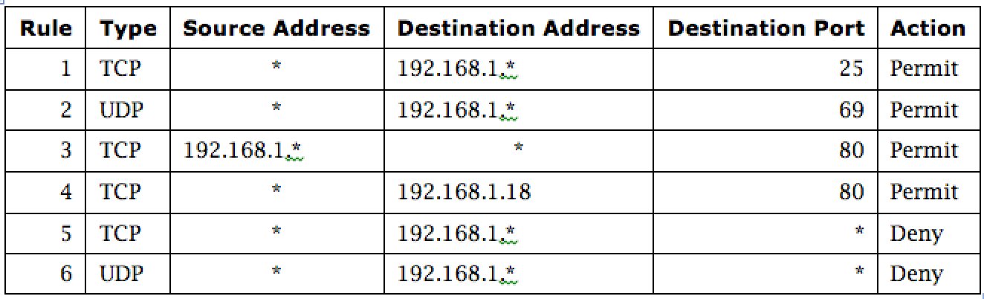
Firewall Security Policy
In this example firewall configuration,
External traffic can reach the entire internal network on TCP/25 and UDP/69 (1 &2).
Internal traffic can go out to port 80 on the external network.
External traffic can reach TCP/80 on one internal server.
All other traffic from external to internal is disallowed.
Notes:
In this example firewall configuration,
External traffic can reach the entire internal network on TCP/25 and UDP/69 (1 &2).
Internal traffic can go out to port 80 on the external network.
External traffic can reach TCP/80 on one internal server.
All other traffic from external to internal is disallowed.

Slide 10
Types of Firewalls
Packet filtering gateways or screening routers
Stateful inspection firewalls
Application-level gateways, also known as proxies
Circuit-level gateways
Guards
Personal or host-based firewalls
Combination of above is dynamic packet filter

Slide 11
Packet-Filtering Gateways
A packet-filtering gateway controls access on the basis of packet address and specific transport protocol type (e.g., HTTP traffic). The example firewall configuration table on a previous slide was in relation to a packet-filtering gateway. In the image on this slide, the firewall is filtering out Telnet traffic but allowing HTTP traffic in.
Notes:
A packet-filtering gateway controls access on the basis of packet address and specific transport protocol type (e.g., HTTP traffic). The example firewall configuration table on a previous slide was in relation to a packet-filtering gateway. In the image on this slide, the firewall is filtering out Telnet traffic but allowing HTTP traffic in. There is a second packet-filtering gateway image on the next slide.

Slide 12
Firewalls – Packet Filters
Simplest of components
Uses transport-layer information only
  IP Source Address, Destination Address
  Protocol/Next Header (TCP, UDP, ICMP, etc)
  TCP or UDP source & destination ports
  TCP Flags (SYN, ACK, FIN, RST, PSH, etc)
  ICMP message type
Examples
  DNS uses port 53
    No incoming port 53 packets except known trusted servers

Slide 13
Usage of Packet Filters
Filtering with incoming or outgoing interfaces
  E.g., Ingress filtering of spoofed IP addresses
  Egress filtering
Permits or denies certain services
  Requires intimate knowledge of TCP and UDP port utilization on several of operating systems

Slide 14
How to Configure a Packet Filter
Start with a security policy
Specify allowable packets in terms of logical expressions on packet fields
Rewrite expressions in syntax supported by your vendor
General rules - least privilege
  All that is not expressly permitted is prohibited
  If you do not need it, eliminate it

Slide 15

Every ruleset is followed by an implicit rule reading like this.
Example 1:
Suppose we want to allow inbound mail (SMTP, port 25) but only to our gateway machine. Also suppose that mail from particular site SPIGOT is to be blocked.

Slide 16

Solution 1:
Example 2:
Now suppose that we want to implement the policy “any inside host can send mail to the outside”.

Slide 17

Solution 2:
This solution allows calls to come from any port on an inside machine, and will direct them to port 25 on the outside. Simple enough…
So why is it wrong?

Slide 18
Our defined restriction is based solely on the outside host’s port number, which we have no way of controlling.
Now an enemy can access any internal machines and port by originating his call from port 25 on the outside machine.
What can be a better solution ?

Slide 19

The ACK signifies that the packet is part of an ongoing conversation
Packets without the ACK are connection establishment messages, which we are only permitting from internal hosts

Slide 20
Security & Performance of Packet Filters
IP address spoofing
  Fake source address to be trusted
  Add filters on router to block
Tiny fragment attacks
  Split TCP header info over several tiny packets
  Either discard or reassemble before check
Degradation depends on the number of rules applied at any point
Order rules so that most common traffic is dealt with first
Correctness is more important than speed

Slide 21
Port Numbering
TCP connection
  Server port is number less than 1024
  Client port is number between 1024 and 16383
Permanent assignment
  Ports <1024 assigned permanently
    20,21 for FTP 23 for Telnet
    25 for server SMTP 80 for HTTP
Variable use
  Ports >1024 must be available for client to make any connection
  This presents a limitation for stateless packet filtering
    If client wants to use port 2048, firewall must allow incoming traffic on this port
  Better: stateful filtering knows outgoing requests

Slide 22
Firewalls – Stateful Packet Filters
Traditional packet filters do not examine higher layer context
  i.e. matching return packets with outgoing flow
Stateful packet filters address this need
They examine each IP packet in context
  Keep track of client-server sessions
  Check each packet validly belongs to one
Hence are better able to detect bogus packets out of context
Notes:
A traditional packet filter makes filtering decisions on an individual packet basis and does not take into consideration any higher layer context. A stateful inspection packet filter tightens up the rules for TCP traffic by creating a directory of outbound TCP connections, and will allow incoming traffic to high-numbered ports only for those packets that fit the profile of one of the entries in this directory. Hence they are better able to detect bogus packets sent out of context.

Slide 23
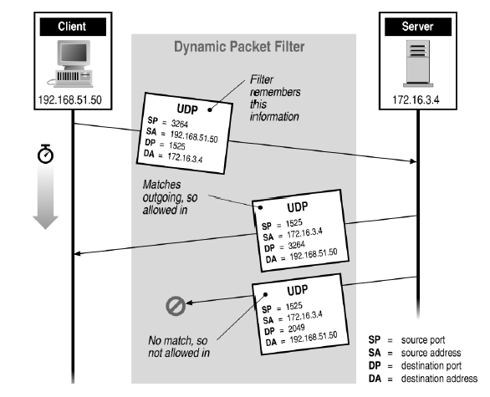
Stateful Filtering

Slide 24
Stateful Inspection Firewall
Packet-filtering gateways maintain no state from one packet to the next. They simply look at each packet’s IP addresses and ports and compare them to the configured policies.
Stateful inspection firewalls, on the other hand, maintain state information from one packet to the next. In the example in the image, the firewall is counting the number of systems coming from external IP 10.1.3.1; after the external system reaches out to a fourth computer, the firewall hits a configured threshold and begins filtering packets from that address. In real life, it can be difficult to define rules that require state/context and that attackers cannot circumvent.
Notes:
Packet-filtering gateways maintain no state from one packet to the next. They simply look at each packet’s IP addresses and ports and compare them to the configured policies. Stateful inspection firewalls, on the other hand, maintain state information from one packet to the next. In the example in the image, the firewall is counting the number of systems coming from external IP 10.1.3.1; after the external system reaches out to a fourth computer, the firewall hits a configured threshold and begins filtering packets from that address. In real life, it can be difficult to define rules that require state/context and that attackers cannot circumvent.

Slide 25
Firewall Outlines
Packet filtering
Application gateways
Circuit gateways
Combination of above is dynamic packet filter

Slide 26
Application Proxy
An application proxy simulates the behavior of an application at OSI layer 7 , so that the real application receives only requests to act properly. Application proxies can serve a number of purposes:
Filtering potentially dangerous application-layer requests
Log requests/accesses
Cache results to save bandwidth
Perhaps the most common form of application proxies in the real world is a web proxy, which companies often use to monitor and filter employee Internet use.
Notes:
An application proxy simulates the behavior of an application at OSI layer 7 so that the real application receives only requests to act properly. Application proxies can serve a number of purposes:
Filtering potentially dangerous application-layer requests
Log requests/accesses
Cache results to save bandwidth
Perhaps the most common form of application proxies in the real world is a web proxy, which companies often use to monitor and filter employee Internet use.

Slide 27
Firewall Gateways
Firewall runs set of proxy programs
  Proxies filter incoming, outgoing packets
  All incoming traffic directed to firewall
  All outgoing traffic appears to come from firewall
Policy embedded in proxy programs
Two kinds of proxies
  Application-level gateways/proxies
    Tailored to http, ftp, smtp, etc.
  Circuit-level gateways/proxies
    Working on TCP level
    Gateway is like a home router.
Notes:
Gateway is like a NAT box, ie, a home router.

Slide 28
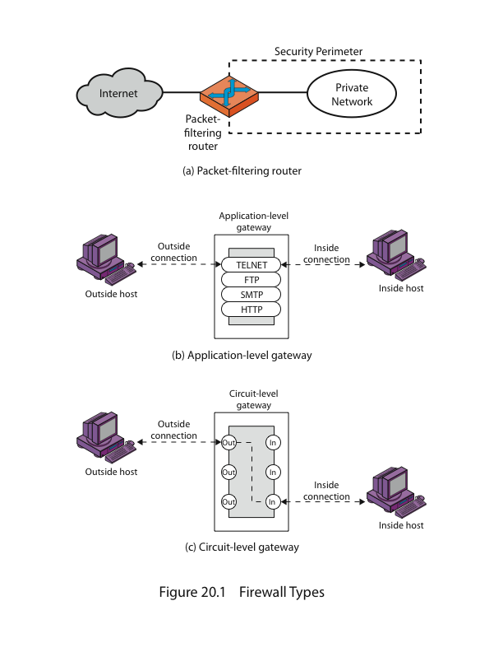
Firewalls - Application Level Gateway (or Proxy)

Slide 29
Application-Level Filtering
Has full access to protocol
  user requests service from proxy
  proxy validates request as legal
  then actions request and returns result to user
Need separate proxies for each service
  E.g., SMTP (E-Mail)
  NNTP (Net news)
  DNS (Domain Name System)
  NTP (Network Time Protocol)
  custom services generally not supported

Slide 30
Firewall Outlines
Packet filtering
Application gateways
Circuit gateways
Combination of above is dynamic packet filter

Slide 31
Circuit-Level Gateway
A circuit-level gateway is a firewall that essentially allows one network to be an extension of another. It operates at OSI layer 5, the session layer, and it functions as a virtual gateway between two networks. One use of a circuit-level gateway is to implement a VPN.
Notes:
A circuit-level gateway is a firewall that essentially allows one network to be an extension of another. It operates at OSI layer 5, the session layer, and it functions as a virtual gateway between two networks. One use of a circuit-level gateway is to implement a VPN.

Slide 32
Firewalls - Circuit Level Gateway
Relays two TCP connections
Imposes security by limiting which such connections are allowed
Once created usually relays traffic without examining contents
Typically used when trust internal users by allowing general outbound connections
SOCKS (Socket Secure protocol) commonly used for this.
Notes:
One advantage over normal packet filters: the IP addr is changed. So no internal IP addr is leaked out.
A circuit-level gateway relays two TCP connections, one between itself and an inside TCP user, and the other between itself and a TCP user on an outside host. Once the two connections are established, it relays TCP data from one connection to the other without examining its contents. The security function consists of determining which connections will be allowed. It is typically used when internal users are trusted to decide what external services to access.
One of the most common circuit-level gateways is SOCKS, defined in RFC 1928. It consists of a SOCKS server on the firewall, and a SOCKS library & SOCKS-aware applications on internal clients.
SOCKS, which stands for Socket Secure, is a network protocol that facilitates communication with servers through a firewall by routing network traffic to the actual server on behalf of a client. SOCKS is designed to route any type of traffic generated by any protocol or program.

Slide 33
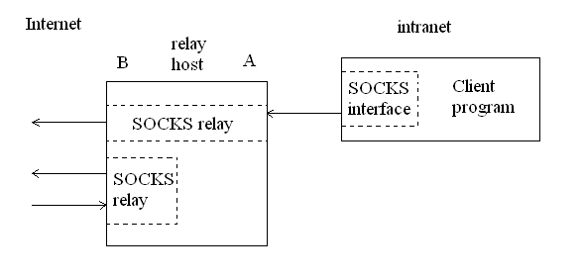
A typical SOCKS connection through interface A, and rogue connection through the external interface, B.

Slide 34
Bastion Host
A highly secure host system
Potentially exposed to "hostile" elements
Hence is secured to withstand this
  Disable all non-required services; keep it simple
Trusted to enforce trusted separation between network connections
Runs circuit / application level gateways
  Install/modify services you want
Or provides externally accessible services

Slide 35
Guard
A sophisticated firewall that, like an application proxy, can interpret data at the protocol level and respond
The distinction between a guard and an application proxy can be fuzzy; the more protection features an application proxy implements, the more it becomes like a guard
Guards may implement any programmable set of rules; for example:
  Limit the number of email messages a user can receive
  Limit users’ web bandwidth
  Filter documents containing the word “Secret”
  Pass downloaded files through a virus scanner

Slide 36
Personal Firewalls
A personal firewall runs on a workstation or server and can enforce security policy like other firewalls. In addition to restricting traffic by source IP and destination port, personal firewalls can restrict which applications are allowed to use the network. In this example Windows firewall configuration dialog, an administrator can select which protocols and applications should be allowed to communicate to and from the host.
Notes:
A personal firewall runs on a workstation or server and can enforce security policy like other firewalls. In addition to restricting traffic by source IP and destination port, personal firewalls can restrict which applications are allowed to use the network. In this example Windows firewall configuration dialog, an administrator can select which protocols and applications should be allowed to communicate to and from the host.

Slide 37
Firewall Outlines
Packet filtering
Application gateways
Circuit gateways
Combination of above is dynamic packet filter

Slide 38
Dynamic Packet Filters
Most common
Provide good administrators protection and full transparency
Network given full control over traffic
Captures semantics of a connection

Slide 39
5.6.7.8
1.2.3.4
5.6.7.8
1.2.3.4
Firewall
Intended connection from 1.2.3.4 to 5.6.7.8
Redialing on a dynamic packet filter. The dashed arrow shows the intended connection; the solid arrows show the actual connections, to and from the relay in the firewall box. The Firewall impersonates each endpoint to the other.

Slide 40
Application
Proxy
5.6.7.8
10.11.12.13
5.6.7.8
1.2.3.4
Firewall
Intended connection from 1.2.3.4 to 5.6.7.8
A dynamic packet filter with an application proxy. Note the change in source address

Slide 41
Firewalls Aren’t Perfect?
Useless against attacks from the inside
  Evildoer exists inside
  Malicious code is executed on an internal machine
Organizations with greater insider threat
  Banks and Military
Protection must exist at each layer
  Assess risks of threats at every layer
Cannot protect against the transfer of all virus infected programs or files
  because of a huge range of O/S & file types

Slide 42
Are Dynamic Packet Filters Safe?
Comparable to that of circuit gateways, as long as the implementation strategy is simple
If administrative interfaces use physical network ports as the highest-level construct
Not if evildoers exist on the inside
  Circuit or application gateways demand user authentication for outbound traffic and are therefore more resistant to this threat

Slide 43
Distributed Firewalls
A central management node sets the security policy enforced by individual hosts
Combination of high-level policy specification a with file distribution mechanism
Advantages:
  Lack of central point of failure
  Ability to protect machines outside topologically isolated space
  Great for laptops
Disadvantage:
  Harder to allow in certain services, whereas it’s easy to block

Slide 44
Distributed Firewalls Drawback
Allowing in certain services works if and only if you’re sure the address can’t be spoofed
  Requires anti-spoofing protection
  Must maintain the ability to roam safely
Solution: IPsec
  A machine is trusted if and only if it can perform proper cryptographic authentication

Slide 45
Where to Filter?
Balance between risk and costs
Always a higher layer that is hard to filter
  Humans

Slide 46
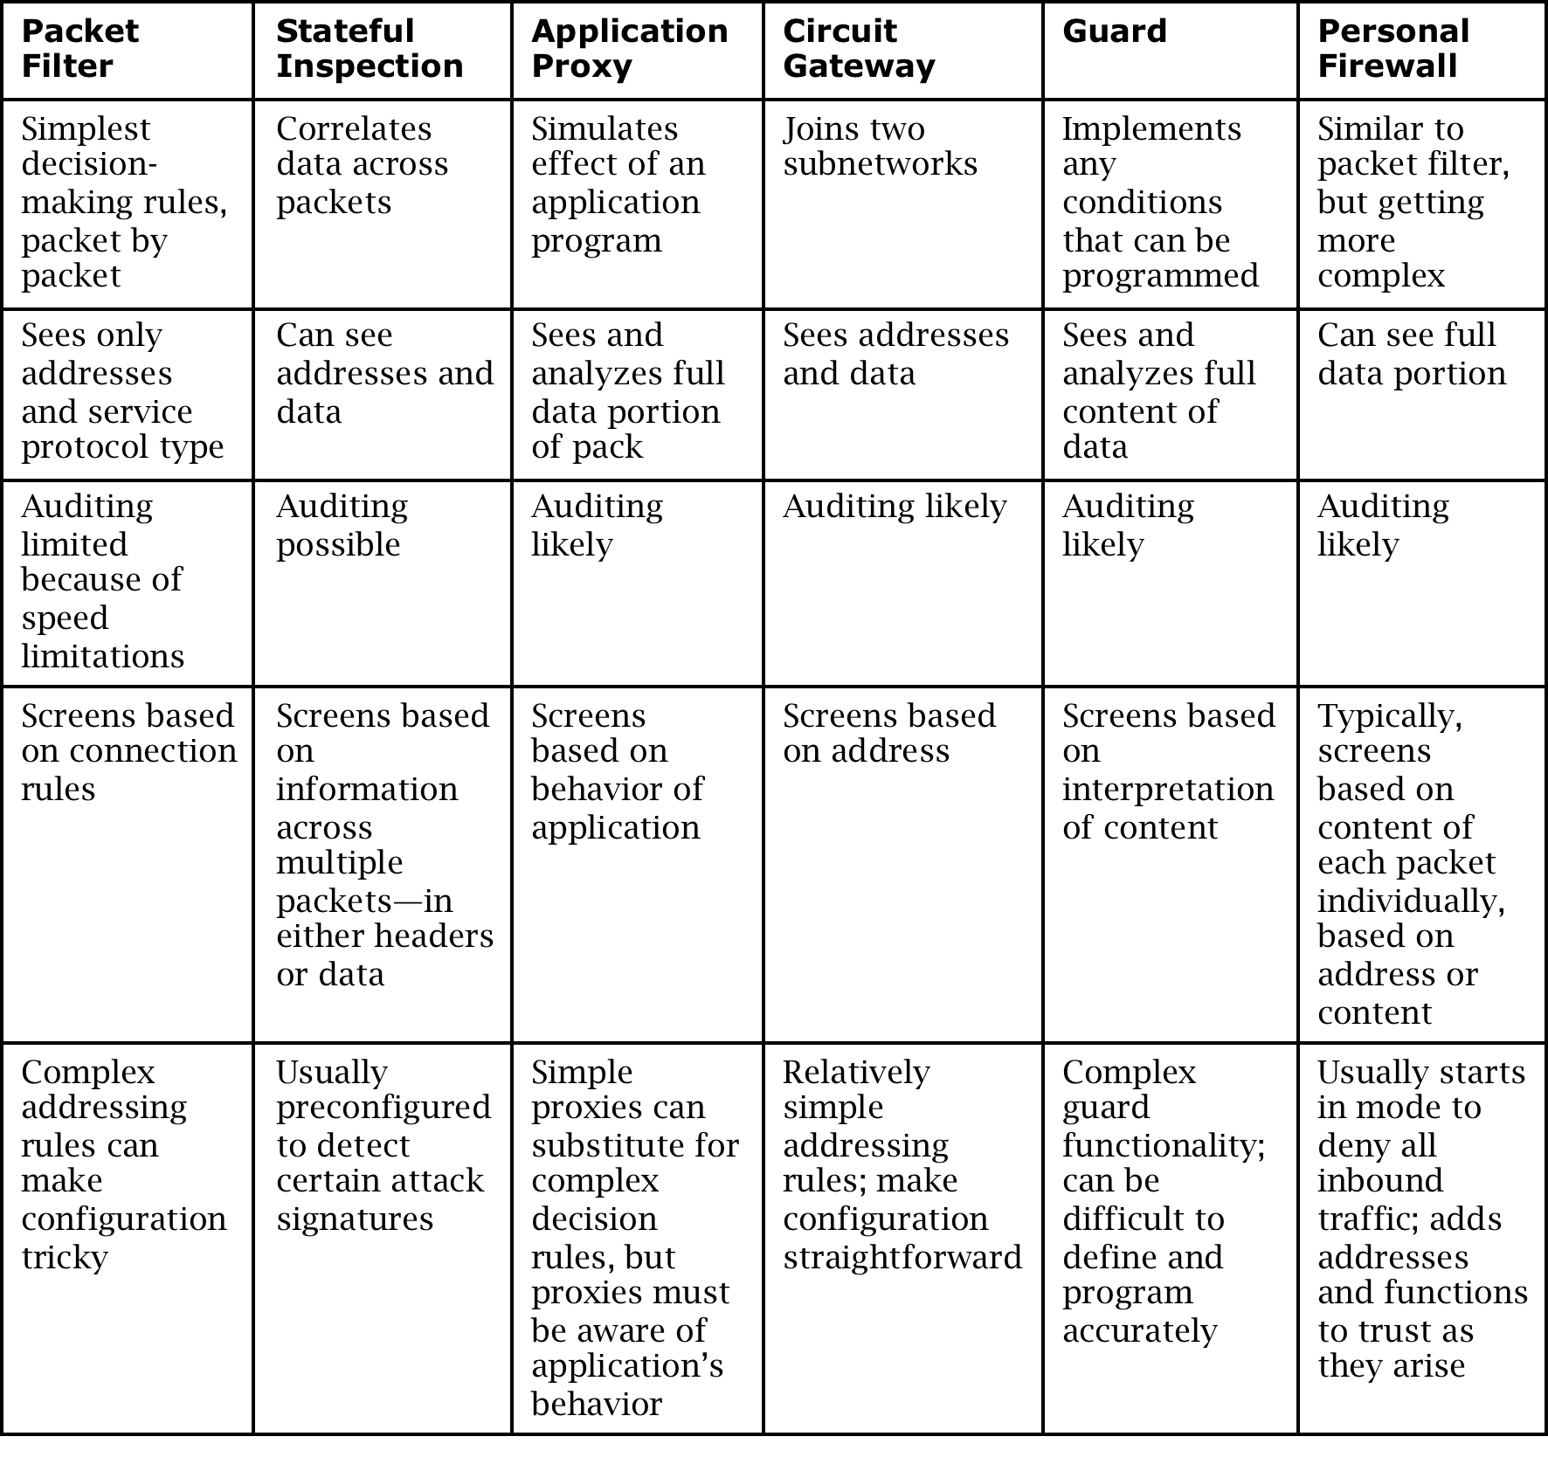
Comparison of Firewall Types

Slide 47
Demilitarized Zone (DMZ)
Notes:
A DMZ is a form of network architecture in which a network enclave is dedicated to services that should be somewhat accessible from the outside. In this example, a firewall protects a DMZ that contains web, email, and FTP servers, and a second firewall protects an internal network—that should not be reachable from the Internet—from the DMZ in case a DMZ host becomes compromised. The benefit of such a configuration is that the hosts that need to be accessible from the Internet—and are therefore most at risk from outside attack—can only do limited damage to the internal hosts that do not need to be reachable from the Internet. An even more careful option would separate the web, email, and FTP servers from one another with further firewalls.

Slide 48
What Firewalls Can and Cannot Do
Firewalls can protect an environment only if they control the entire perimeter
Firewalls do not protect data outside the perimeter
Firewalls are the most visible part of an installation to the outside, so they are an attractive target for attack
Firewalls must be correctly configured, that configuration must be updated as the environment changes, and firewall activity reports must be reviewed periodically for evidence of attempted or successful intrusion
Firewalls exercise only minor control over the content admitted to the inside, meaning that inaccurate or malicious code must be controlled by means inside the perimeter

Slide 49
Summary
  What is a firewall
  Firewall design
  Types of firewalls
  Comparison of firewall types
  Example firewall configurations
  What firewalls can—and can’t—block

