Slide 1


IELTS Preparation
Mini-Course
Lecture 6
Prepared by
Ahmed Soliman

Slide 2
Mastering the IELTS Writing Test
Task 2 (Academic)

Slide 3
🎯 Objectives
By the end of the lesson, students will be able to:
Understand the requirements of Writing Task 2.
Identify the five main question types and their structures.
Organize an essay into Introduction – Body 1 – Body 2 – Conclusion.
Write a clear thesis statement and topic sentences.
Use linking devices to improve coherence.

Slide 4
Task 1 Revision

Slide 5
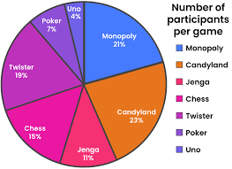
Types of diagrams
Pie chart

Slide 6
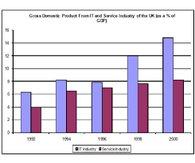
bar chart

Slide 7
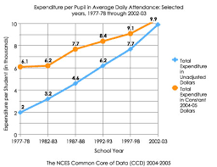
Line chart

Slide 8
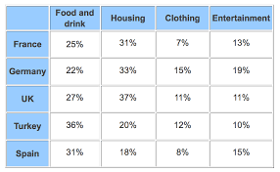
Table

Slide 9
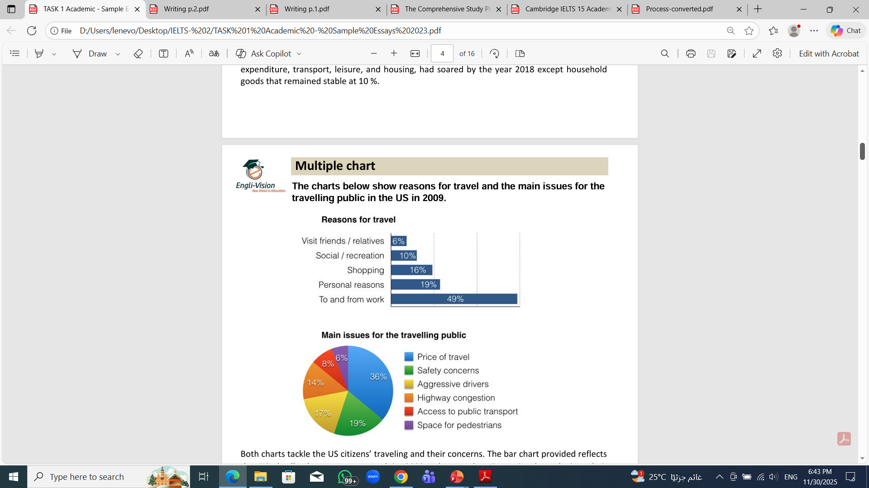
Multiple Charts

Slide 10
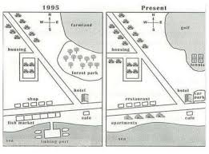
Map

Slide 11
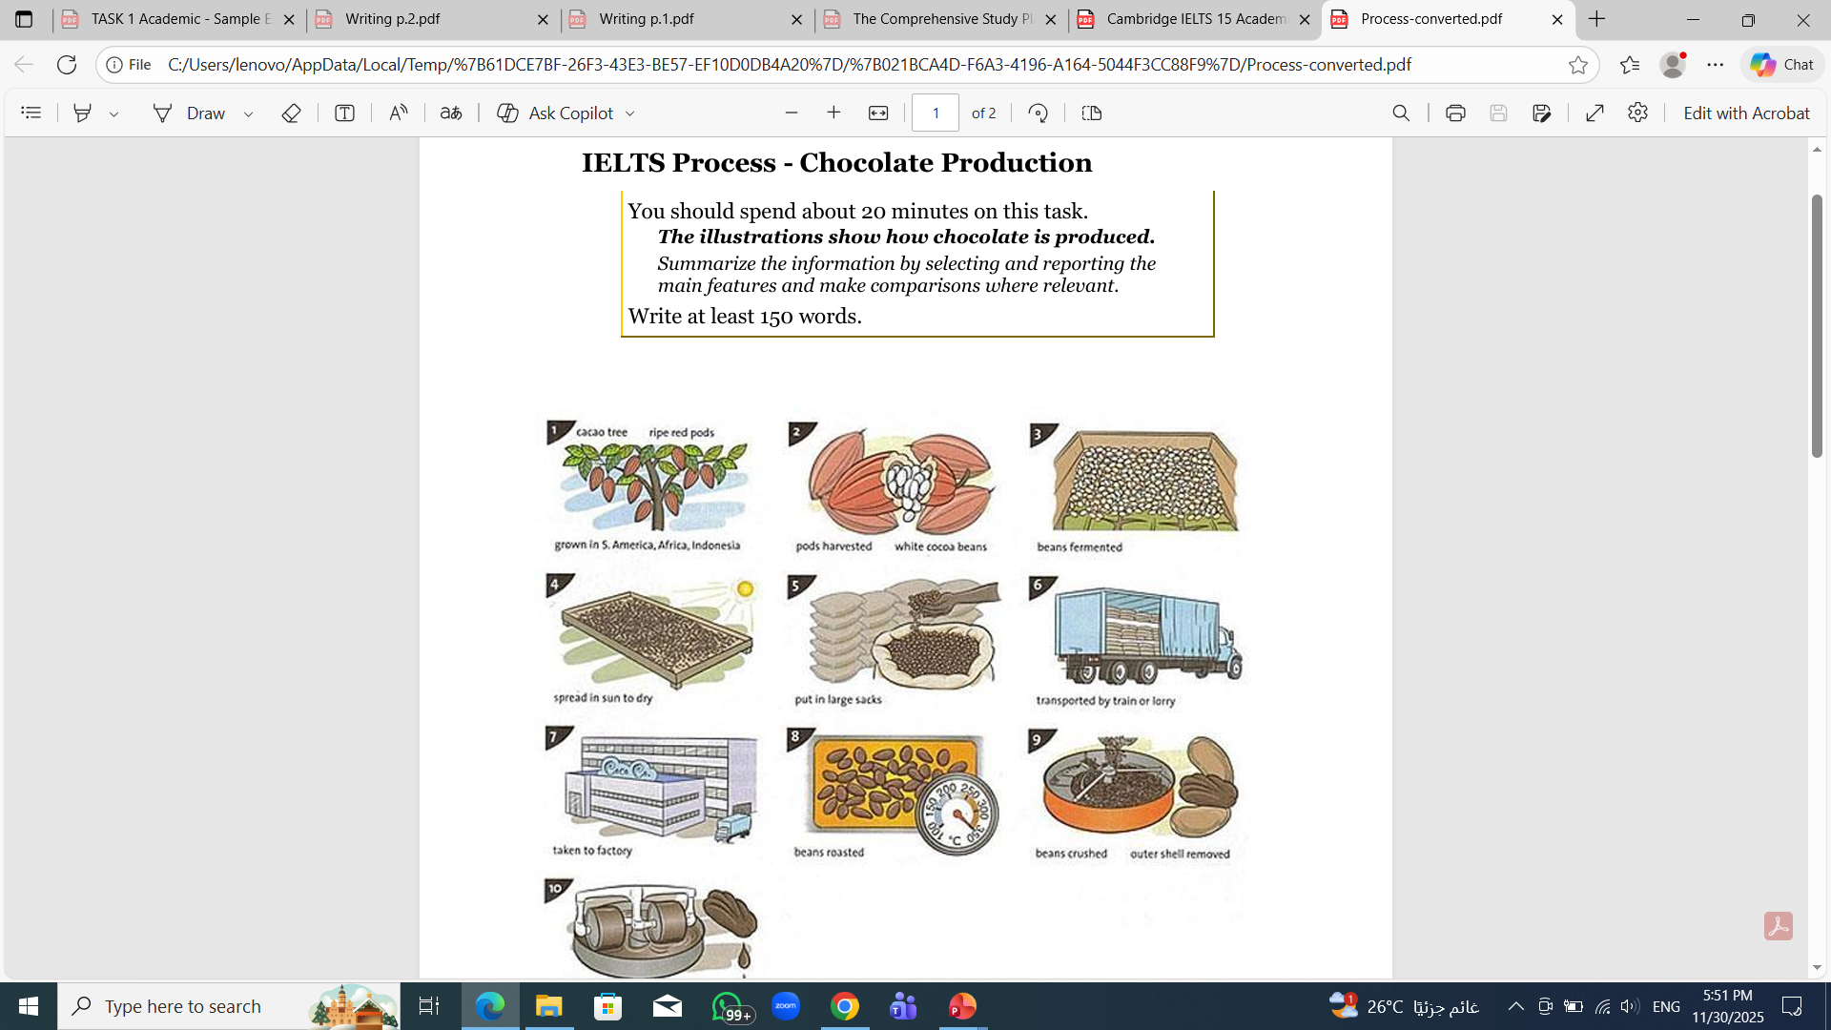
Process

Slide 12
Structure of a Band 7+ Answer
1. Introduction
Rewrite the question using synonyms.
Template:
The chart illustrates…
The table compares…
The graph provides information about…
2. Overview (MOST IMPORTANT)
Write 1–2 sentences summarizing the main trends.
Templates:
Overall, it is clear that…
It can be seen that…
In general,…
3. Body Paragraph 1 & 2 (Details / Analysis)
Group data logically:
highest vs lowest
similarities
time periods
categories
Use comparisons and trend language.

Slide 13
Match the word/ words to the right line:
1
3
remained steady
2
increased
rose
grew
4
decreased
fell
dropped
fluctuated

Slide 14
Lead-in
What do you find difficult in Writing Task 2?
What do you think the examiners look for?

Slide 15
Task 2 Requirements
✔ Length: Minimum 250 words
✔ Time: 40 minutes
✔ Style: Formal academic writing

Slide 16
Essay Structure
A. Introduction
Paraphrase the question
Give your thesis statement
Optional: outline sentence
Example:
Many people argue that students should take a gap year before university. This essay agrees that a gap year can be beneficial because it helps students gain experience and develop maturity.

Slide 17
B. Body Paragraph 1
Topic sentence
Explanation
Example
Mini-conclusion

Slide 18
C. Body Paragraph 2
Same structure as Body 1.

Slide 19
D. Conclusion
Restate main idea
No new information

Slide 20
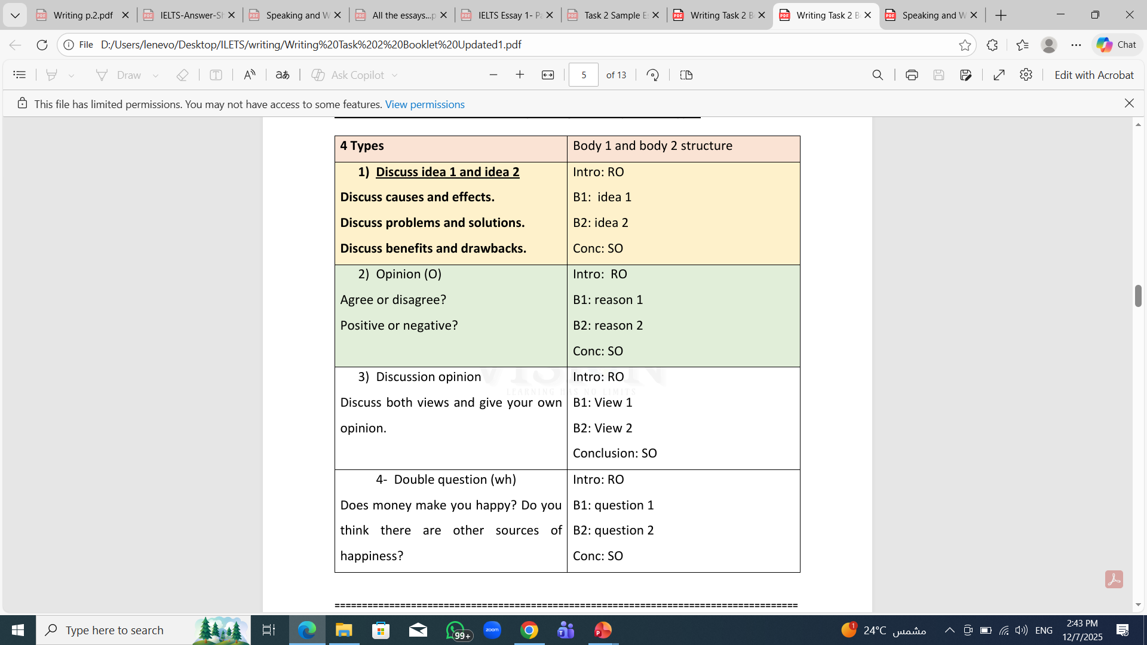
Types

Slide 21
Some people believe that celebrities have a positive effect on society, while others think that their effect is harmful and negative. Discuss both views and give your opinion.
Introduction: (R) Rephrase – (O) Opinion
(R) At present, whilst opponents hold the view that some influencers (entertainers) have detrimental (negative) effects on the community, proponents have a diverse perspective (points of view). (O) However, I am a staunch believer that some entertainers positively affect the youth because their deeds (doings/actions) are inspiring and appropriate.
(T) On the one hand, a category of individuals believes that singers, actors, or football players have detrimental effects on the community and they do not have a prominent (salient/major) role in society compared to other vocations. (E) In other words, if teachers who educate (prepare/groom) a myriad of (a plethora of) generations or doctors who put at least ten years of their lives in hectic study and saving people's lives are followed and imitated (mimicked) by juveniles (adolescents), they will help their society more than famous figures who spread violence, erroneous (wrong) thoughts and immoral behaviors. (X) For instance, the superstar "Mohamed Ramadan" receives millions of pounds for presenting violent content that diffuses (spread) atrocities (awfulness/crimes), promotes smoking, or even encourages drinking alcoholic beverages (intoxicating drinks). (S) Thus, what can be said is that these enormous earnings received by errant (misbehaving) entertainers provoke (affect) workers in other hard-working professions.

Slide 22
(T) On the other hand, some celebrities are worthy of being praised because they have an indispensable (essential/important) role. (E) To illustrate, when some glamorous characters generously contribute to philanthropic (humanitarian) associations by making monetary (financial) donations towards health facilities and launch awareness campaigns, they constructively influence adolescents. (X) This can be exemplified by the Egyptian footballer "Mohamed Salah" who encouraged a plethora of young people to combat (fight/battle) addiction by the anti-drug campaign that he initiated. (S) Therefore, not only do these luminaries deserve massive funds, but also, they should be honored by appreciation awards as it becomes lucid (clear) that some megastars can rebuild morals in the world.
(S) In conclusion, by highlighting the above-mentioned points, it can be reiterated that some influencers inspire and admonish (advise) the youth and caution them against crooked (wicked) practices/activities. (O) Certainly, the exemplary (excellent) public figures who are of high reputation are worthy of being well paid.

Slide 23
Useful Academic Language
A. Linking Words
Adding: moreover, in addition, furthermore
Contrasting: however, on the other hand, although
Results: therefore, as a result
Examples: for instance, for example

Slide 24
B. Academic Vocabulary
significant, controversial, generate, impact, trend, maintain

Slide 25
Practice
Essay Prompt:
"Some people think that children should learn financial management at school. To what extent do you agree or disagree?"

Slide 26
Task A: Identify Essay Type
→ Opinion (Agree/Disagree)

Slide 27
Task B: Students Write a Thesis Statement
I strongly believe that financial education should be taught at school because it helps students make better financial decisions in adulthood.

Slide 28
Practice
Prompt:
Some people believe that social networking sites have a negative impact on individuals and society. To what extent do you agree or disagree?

Slide 29
Introduction
Social networking platforms have become an essential part of modern life, yet many people argue that they have harmful effects on both individuals and society. I strongly agree with this view because these platforms can damage mental health and weaken real-life relationships.

Slide 30
Body Paragraph 1
Topic Sentence:
One major negative effect of social networking sites is their impact on mental well-being.
Explanation:
Because these platforms encourage constant comparison with others, users often feel inadequate, stressed, or dissatisfied with their own lives. The pressure to maintain a perfect online image increases anxiety, especially among young people who are more sensitive to social approval.
Example:
For instance, a recent study by the University of Michigan found that heavy Instagram users reported significantly higher levels of depression due to comparing themselves with influencers.
Mini-Conclusion:
Therefore, the psychological harm caused by social media can seriously affect individuals’ self-esteem and emotional stability.

Slide 31
Body Paragraph 2
Topic Sentence:
In addition to harming individuals, social networking sites can also weaken social bonds within communities.
Explanation:
People often spend hours interacting online instead of engaging in meaningful face-to-face conversations. This reduces the quality of real relationships and leads to shallow online connections that do not provide emotional support. Over time, this shift can create a society where people feel more isolated despite being constantly connected.
Example:
For example, research from the UK’s National Centre for Social Research showed that families who spent more than three hours a day on social media reported less communication at home and lower levels of life satisfaction.
Mini-Conclusion:
Thus, the overuse of social media can damage community relationships and increase feelings of loneliness.

Slide 32
Conclusion
In conclusion, I firmly agree that social networking sites have a negative impact on both individuals and society. They contribute to mental health problems and reduce the quality of real-life interactions. It is important for people to manage their social media use to protect their well-being and strengthen their relationships.

Slide 33
Assessment Criteria (Band Descriptors Summary)
Task Response
Coherence and Cohesion
Lexical Resource
Grammatical Range and Accuracy

Slide 34


Thank You

