Slide 1



IPv4 Addressing
Lecture 6
CCNA – Introduction to Networks V7.0 (ITN)
Prepared by
Dr. Abdelrhman Ahmed

Slide 2
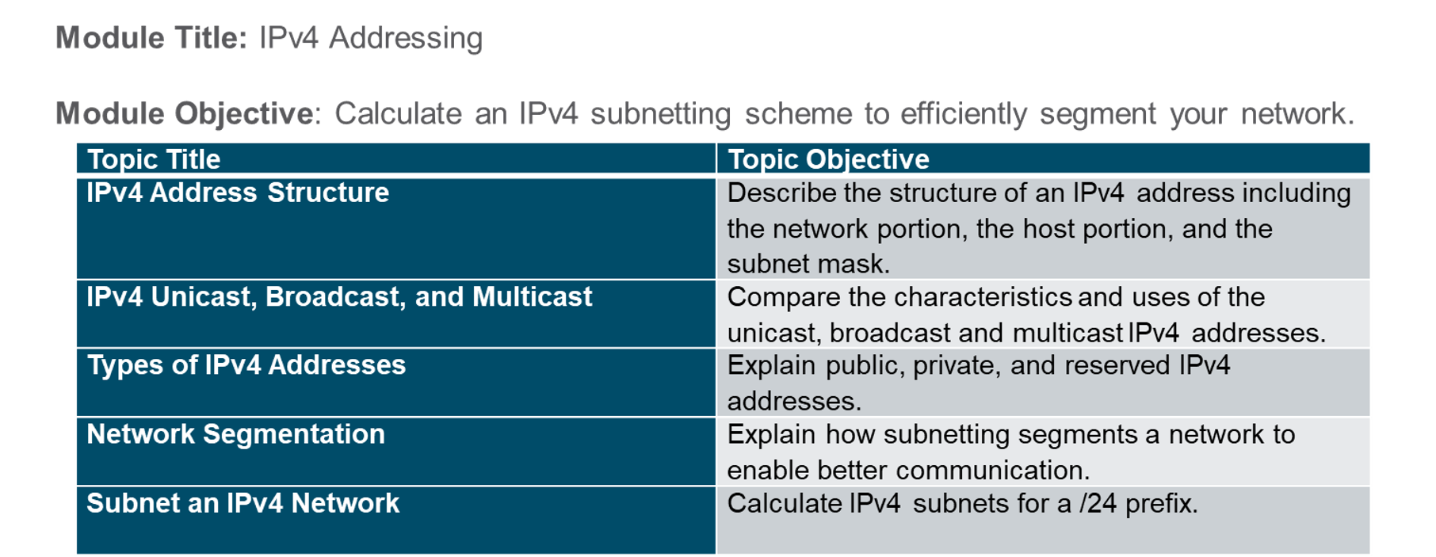
Chapter
Module Objectives
06

Slide 3
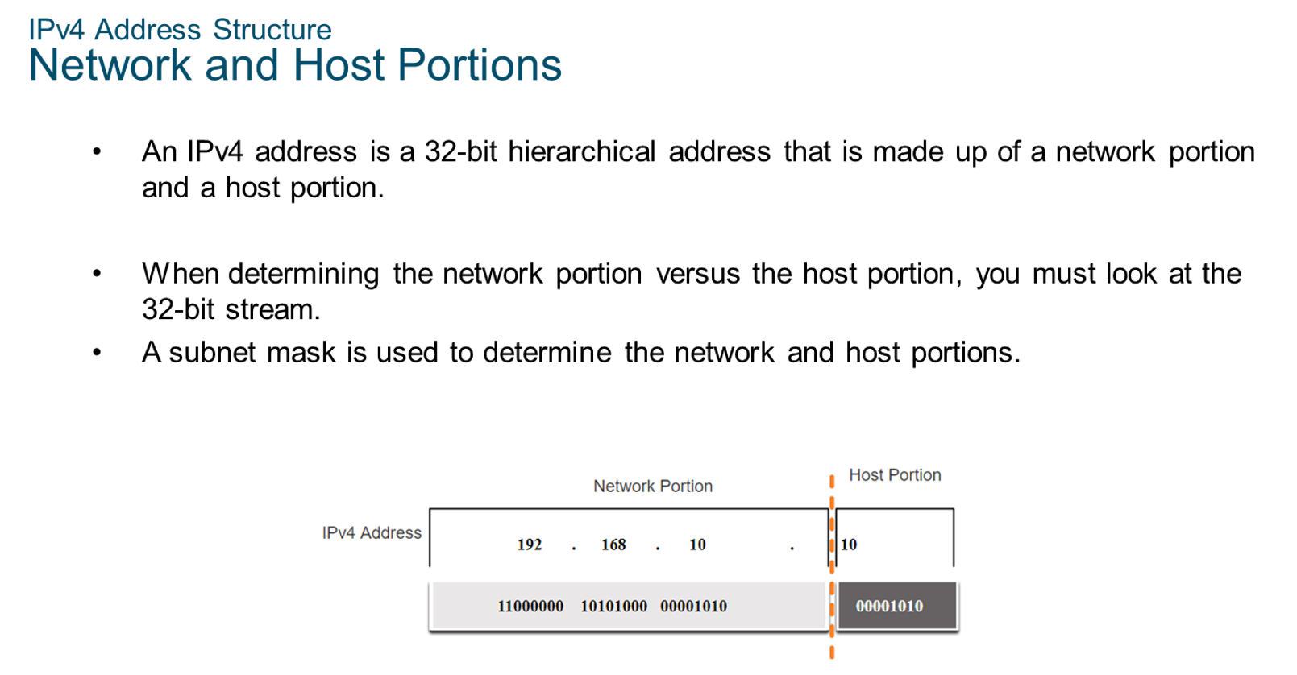
Chapter
IPv4 Address Structure
06

Slide 4
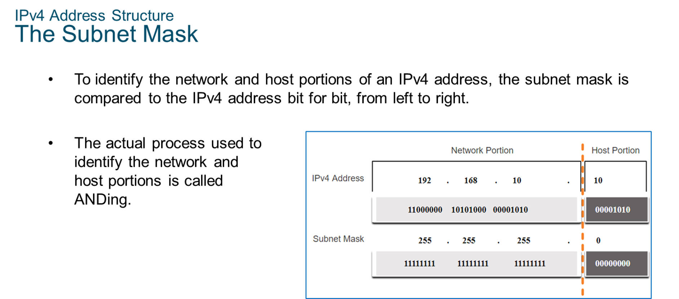
Chapter
IPv4 Address Structure
06

Slide 5
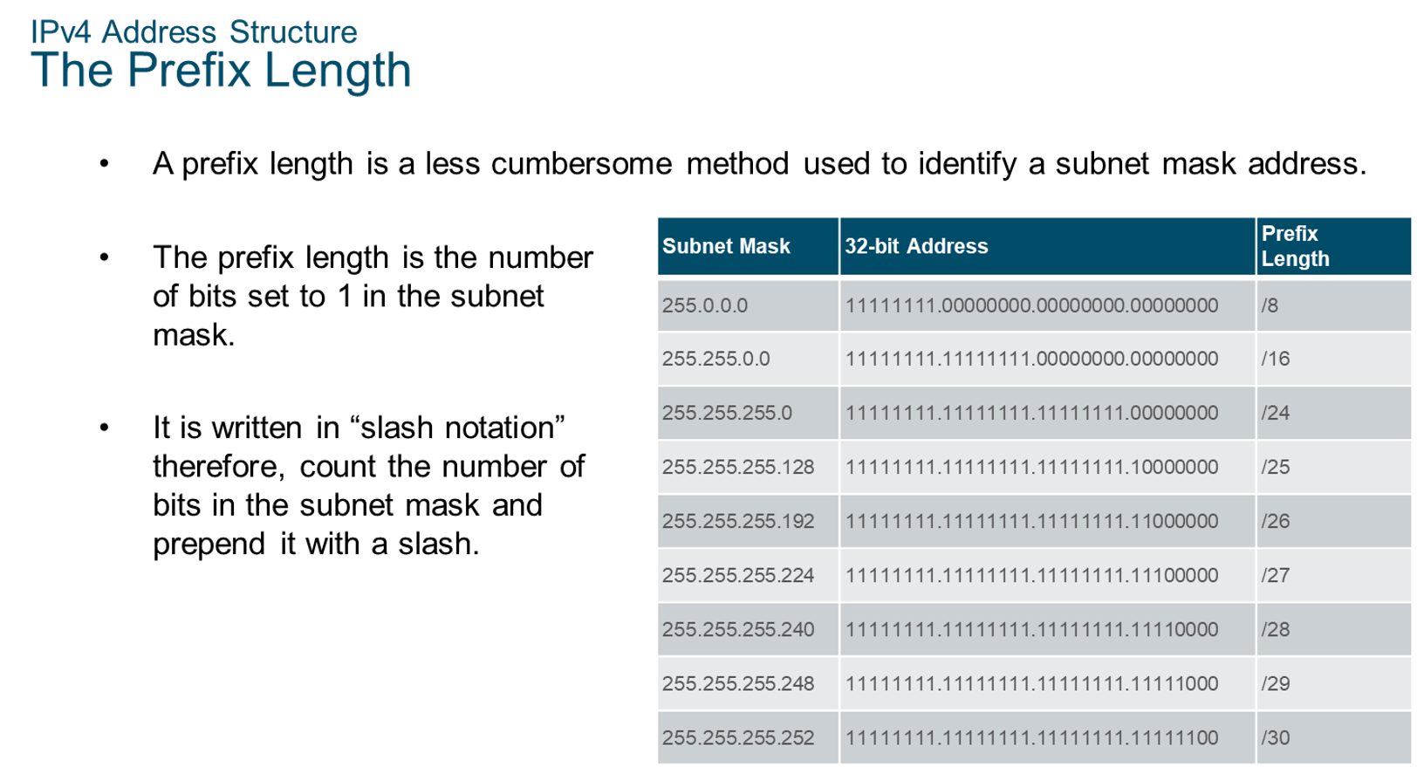
Chapter
IPv4 Address Structure
06

Slide 6
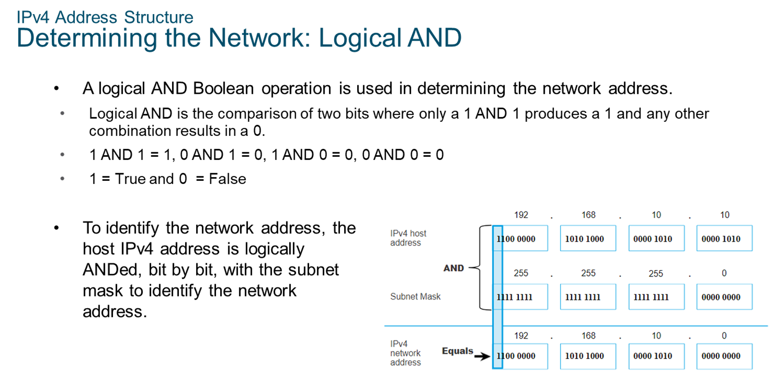
Chapter
IPv4 Address Structure
06

Slide 7
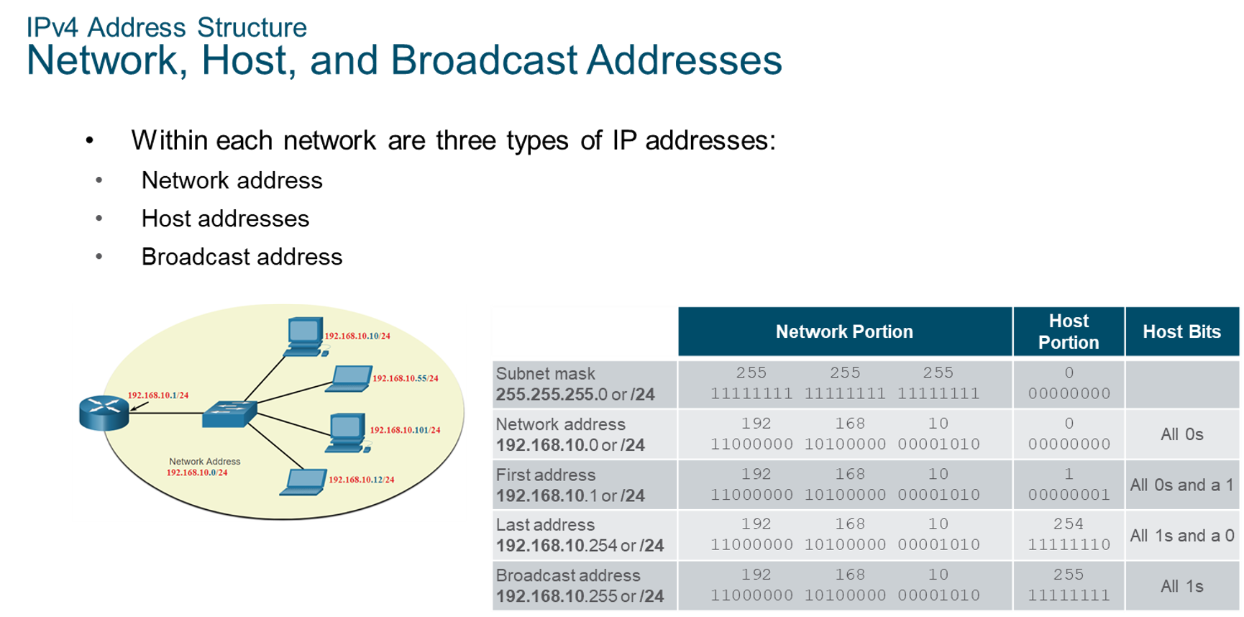
Chapter
IPv4 Address Structure
06

Slide 8
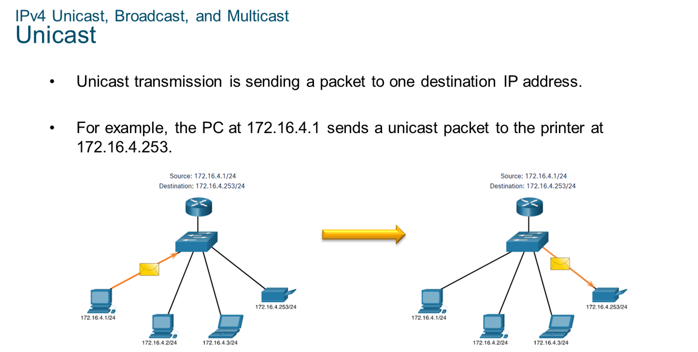
Chapter
IPv4 Unicast, Broadcast, Multicast
06

Slide 9
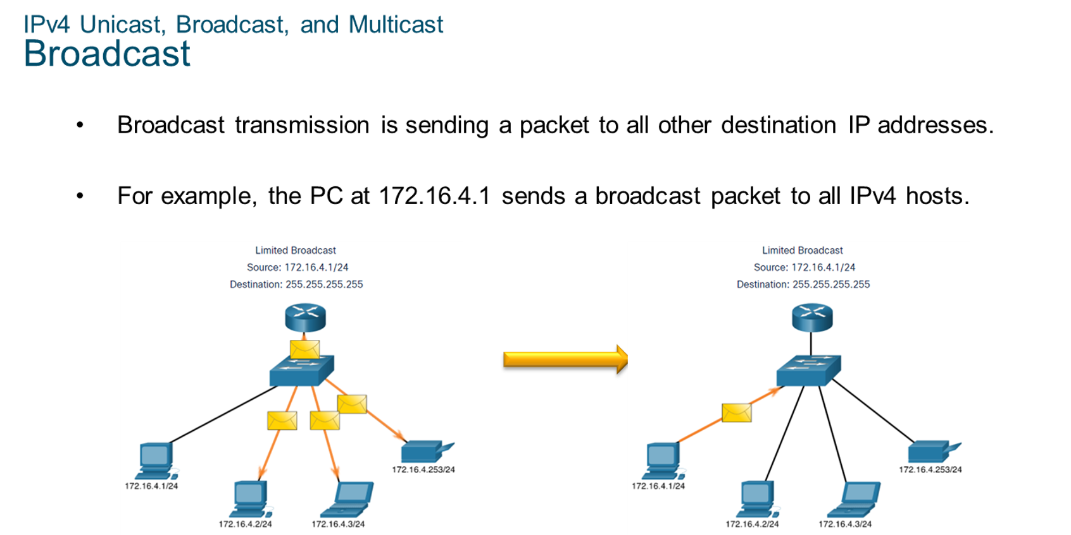
Chapter
06
IPv4 Unicast, Broadcast, and Multicast

Slide 10
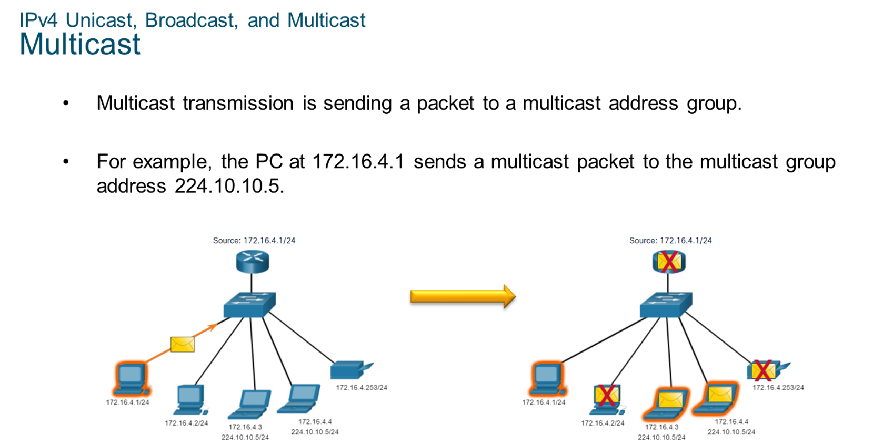
Chapter
IPv4 Unicast, Broadcast, and Multicast
06

Slide 11
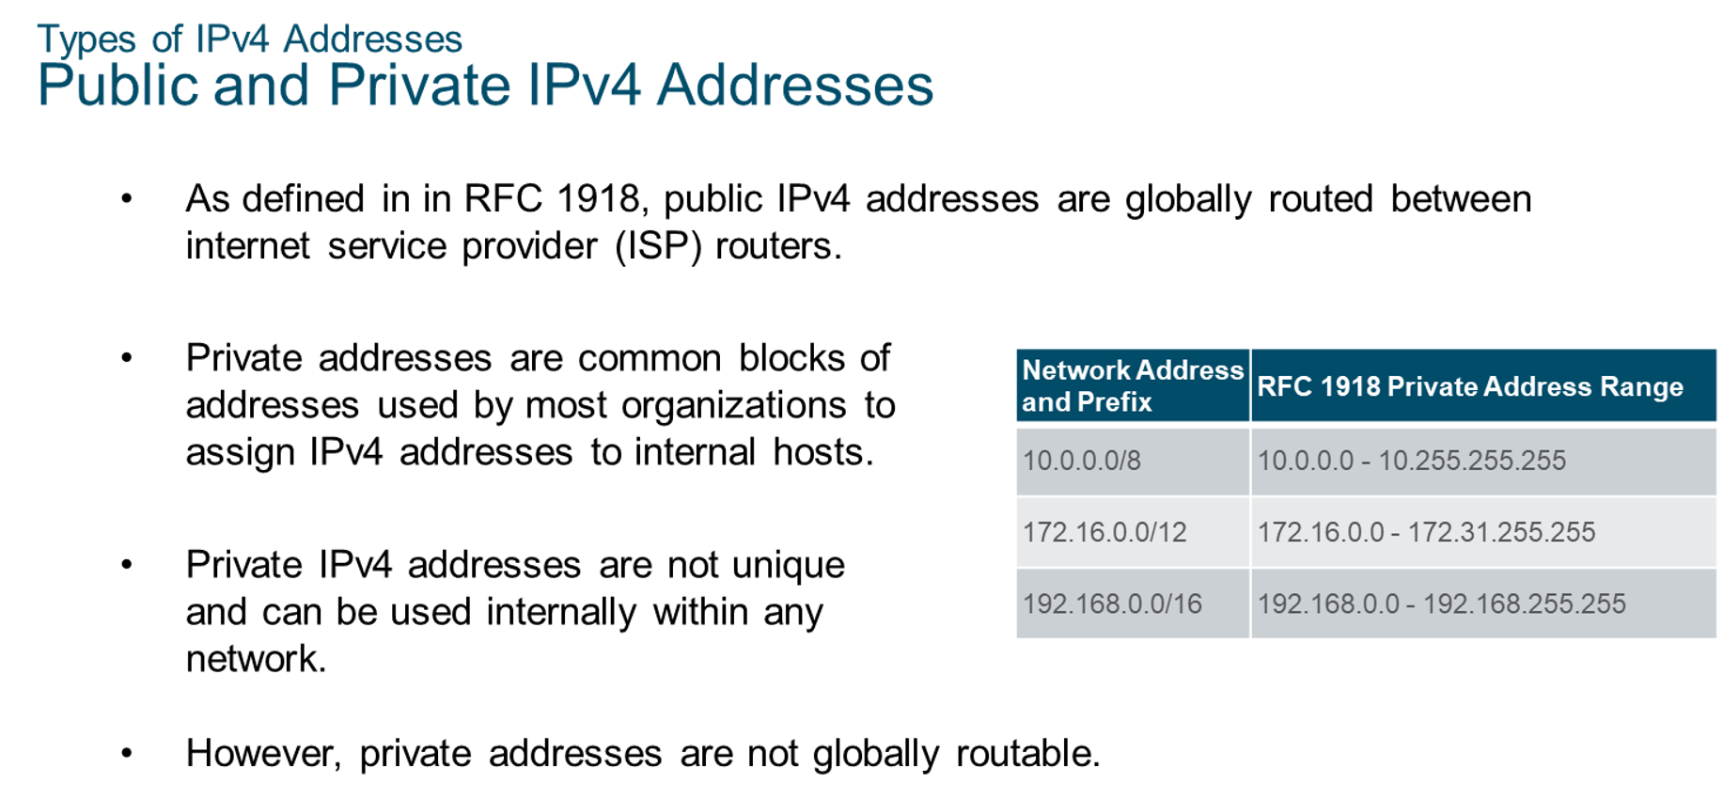
Chapter
06
Types of IPv4 Addresses

Slide 12
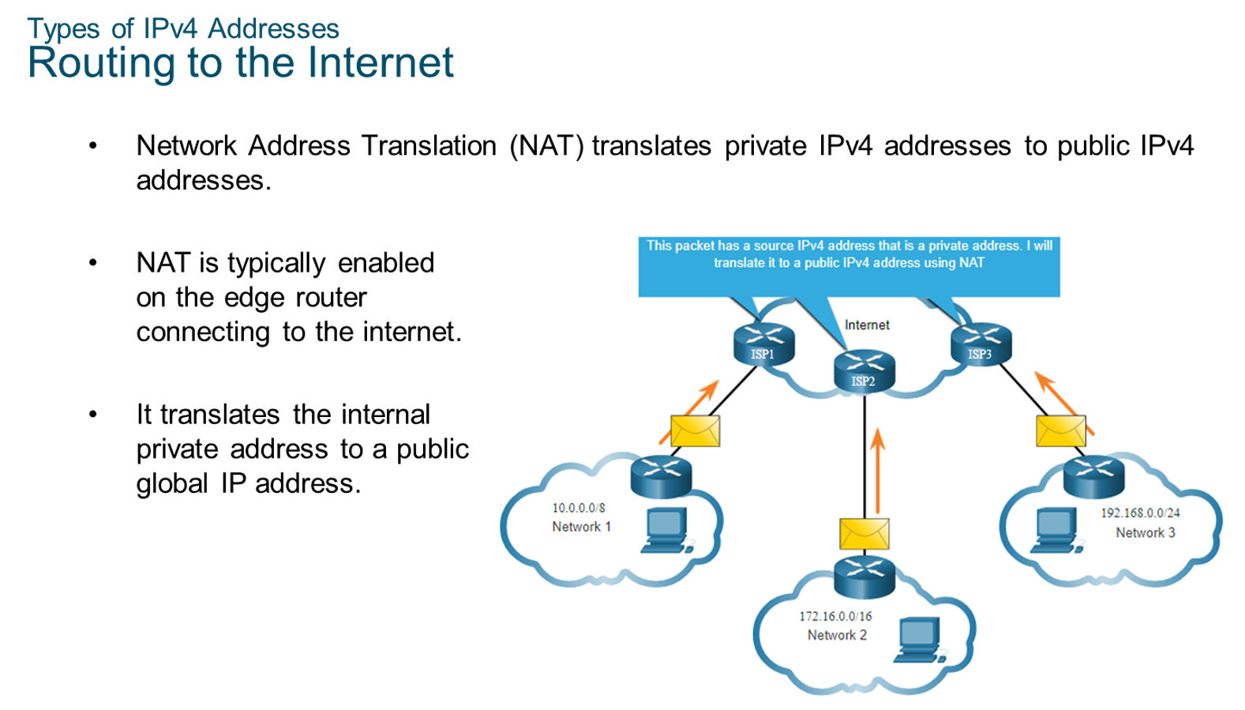
Chapter
Types of IPv4 Addresses
06

Slide 13
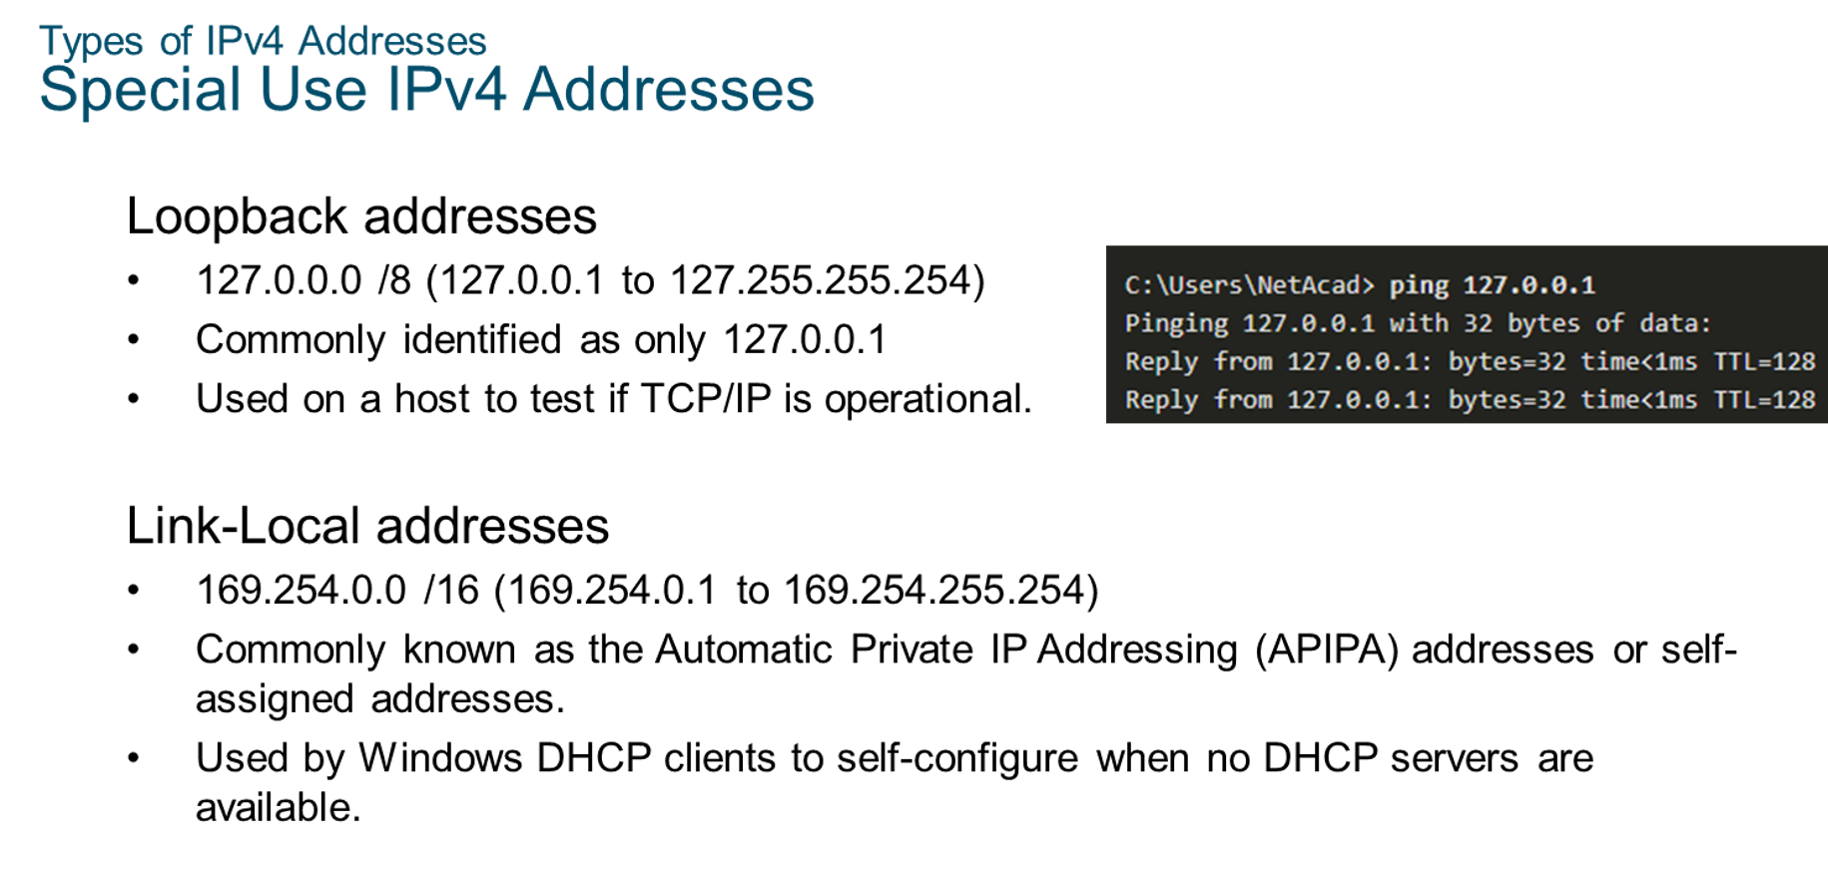
Chapter
Types of IPv4 Addresses
06

Slide 14
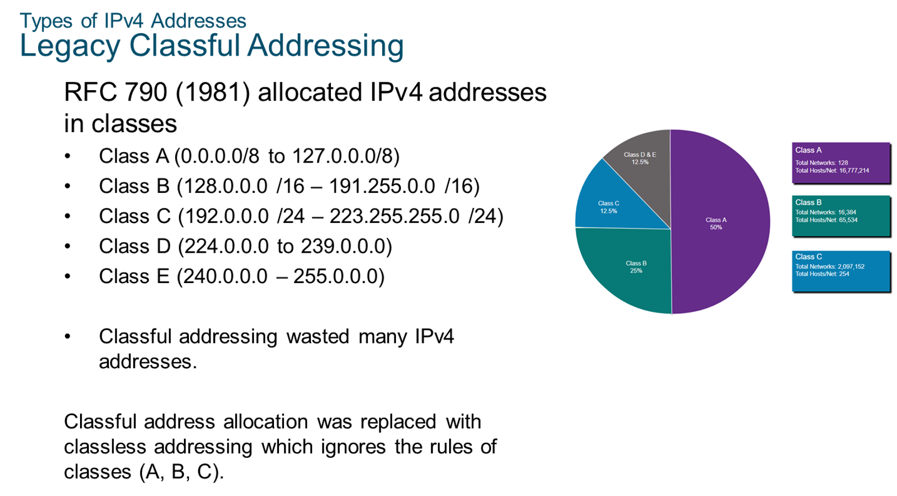
Chapter
Types of IPv4 Addresses
06

Slide 15
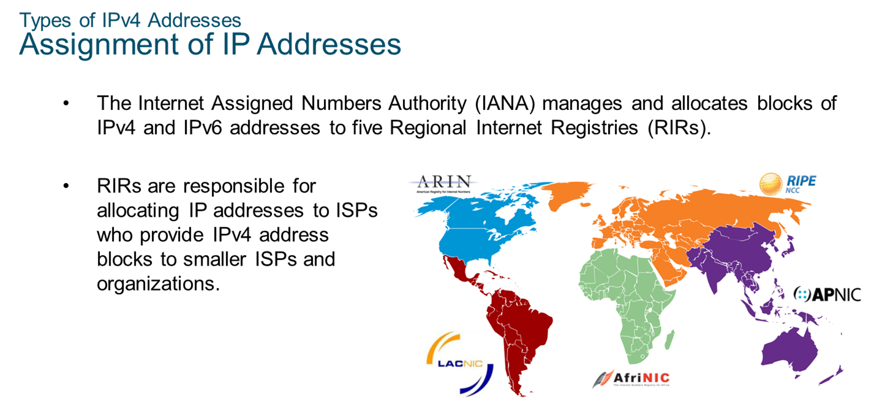
Chapter
Types of IPv4 Addresses
06

Slide 16
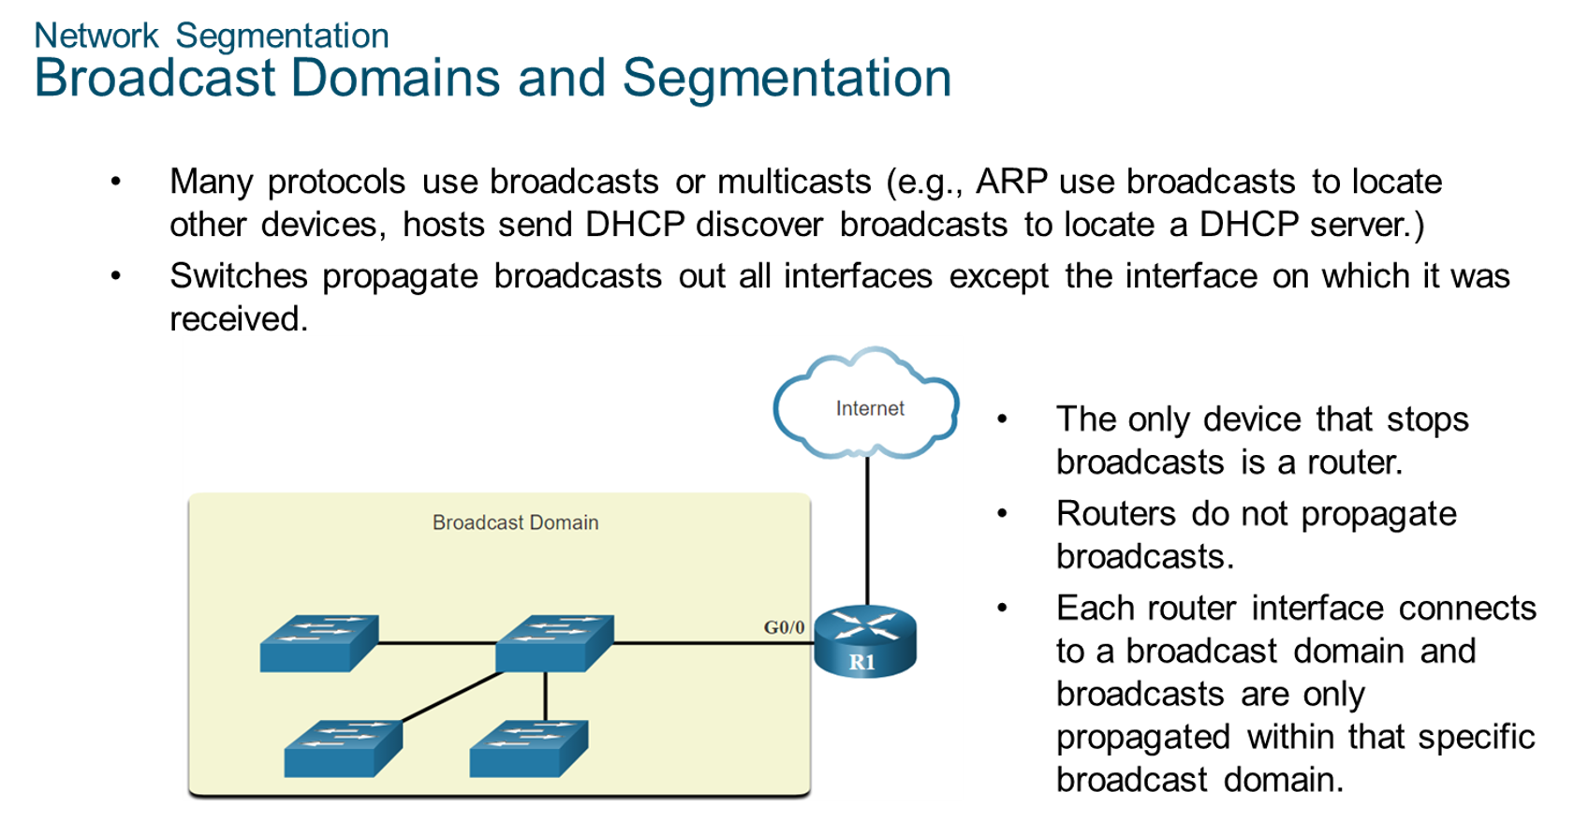
Chapter
Network Segmentation
06

Slide 17
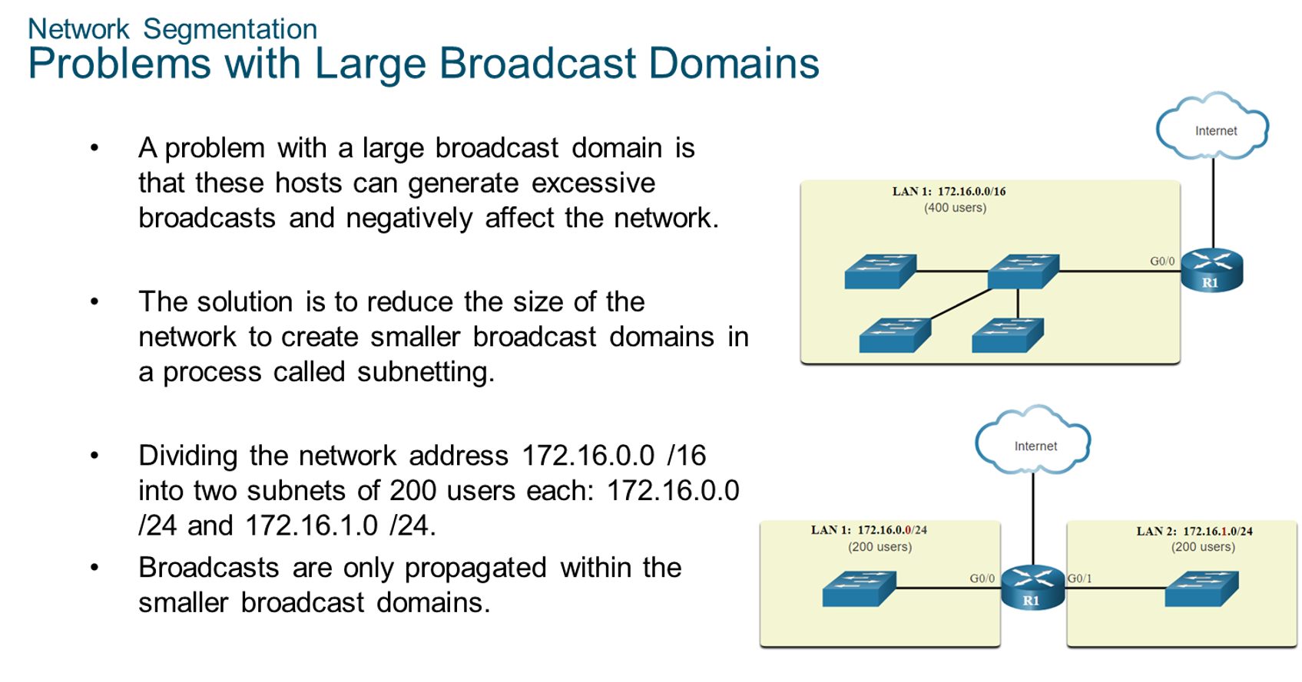
Chapter
Network Segmentation
06

Slide 18
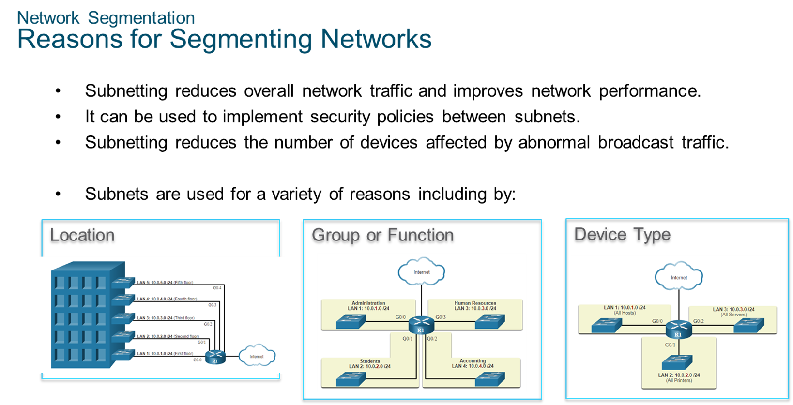
Chapter
Network Segmentation
06

Slide 19
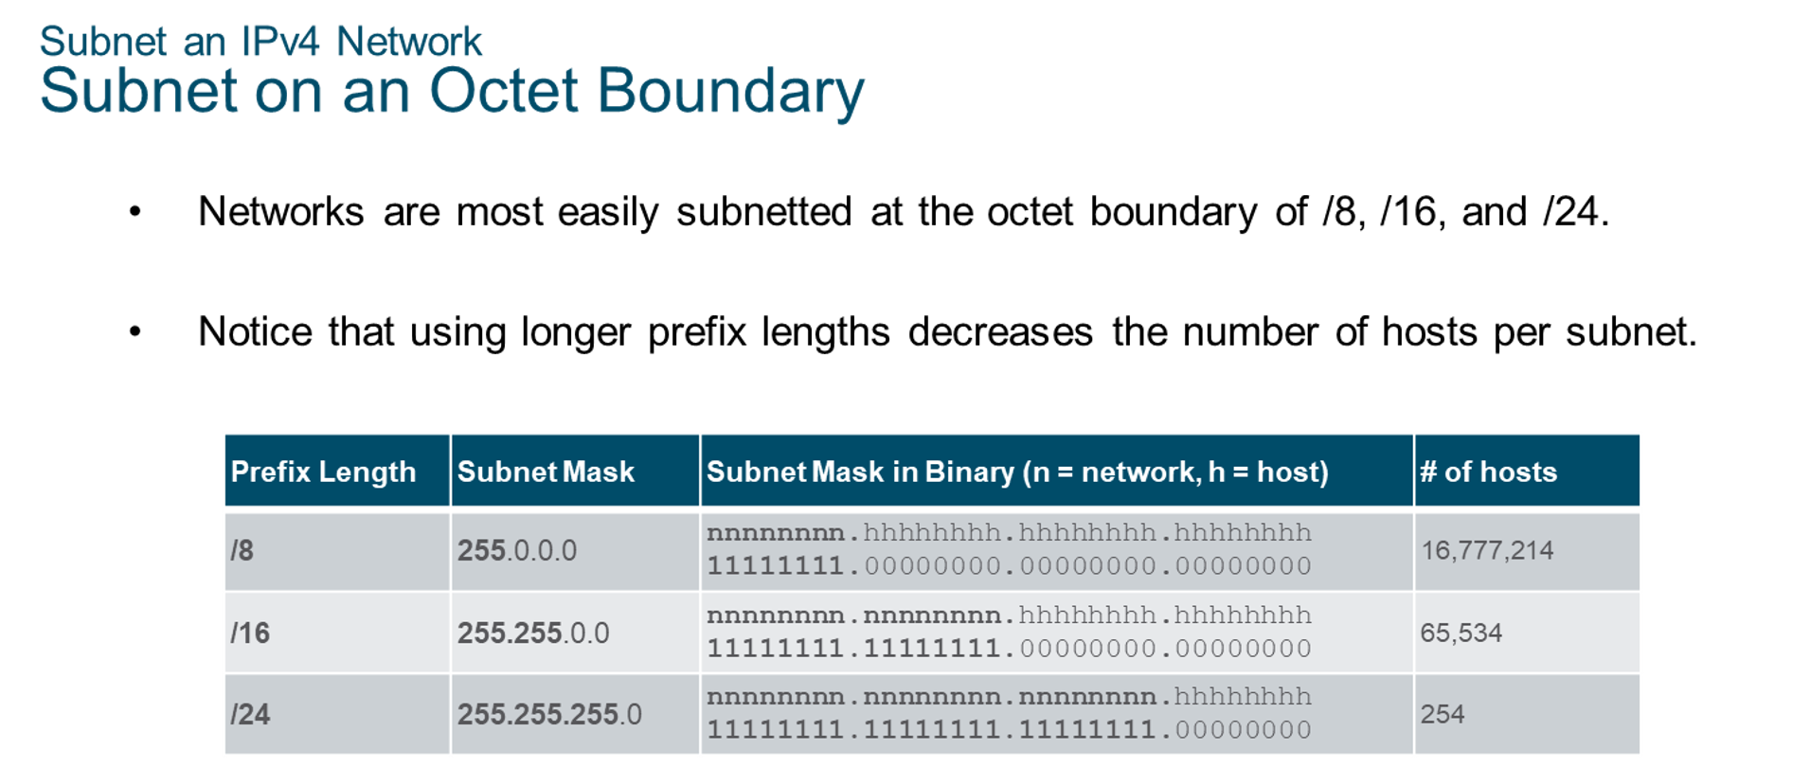
Chapter
Subnet an IPv4 Network
06

Slide 20
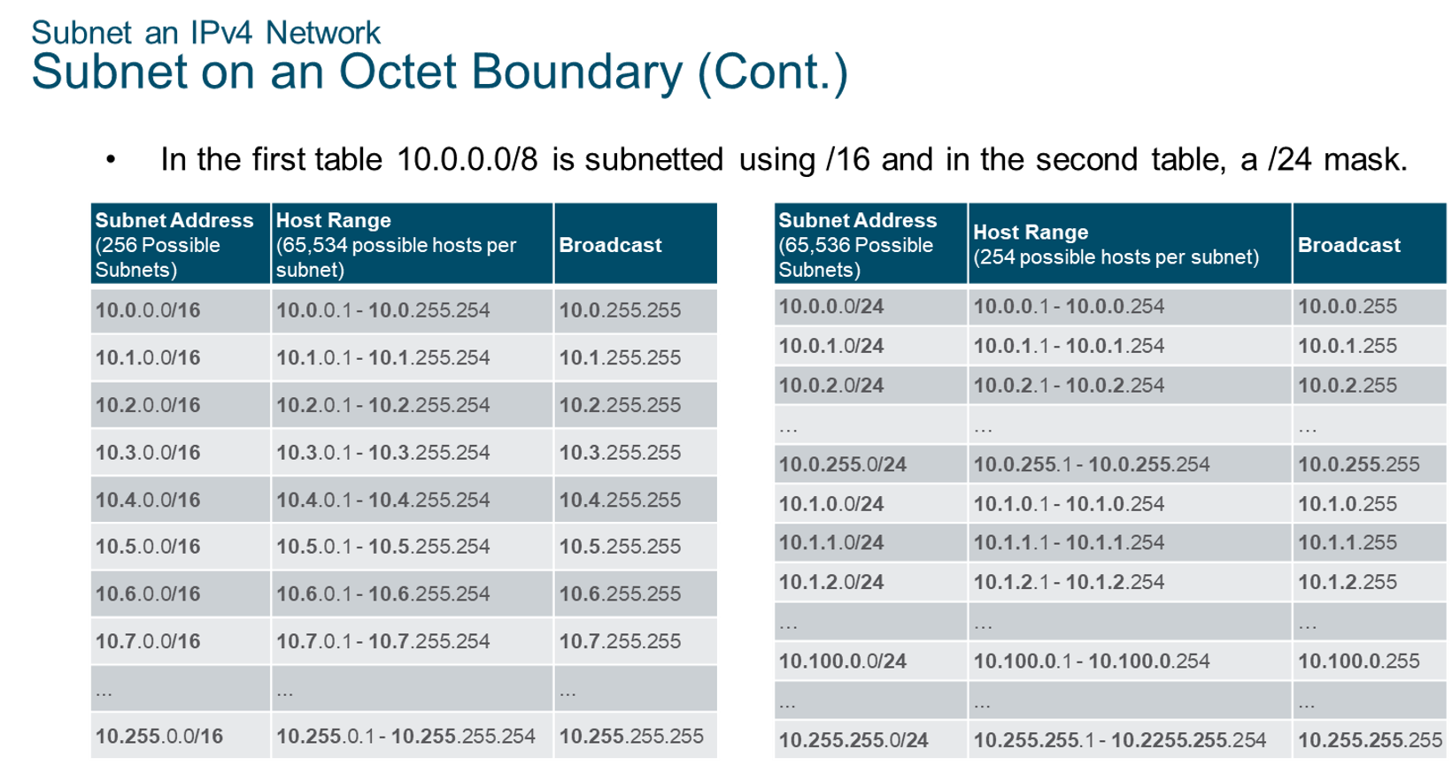
Chapter
Subnet an IPv4 Network
06

Slide 21
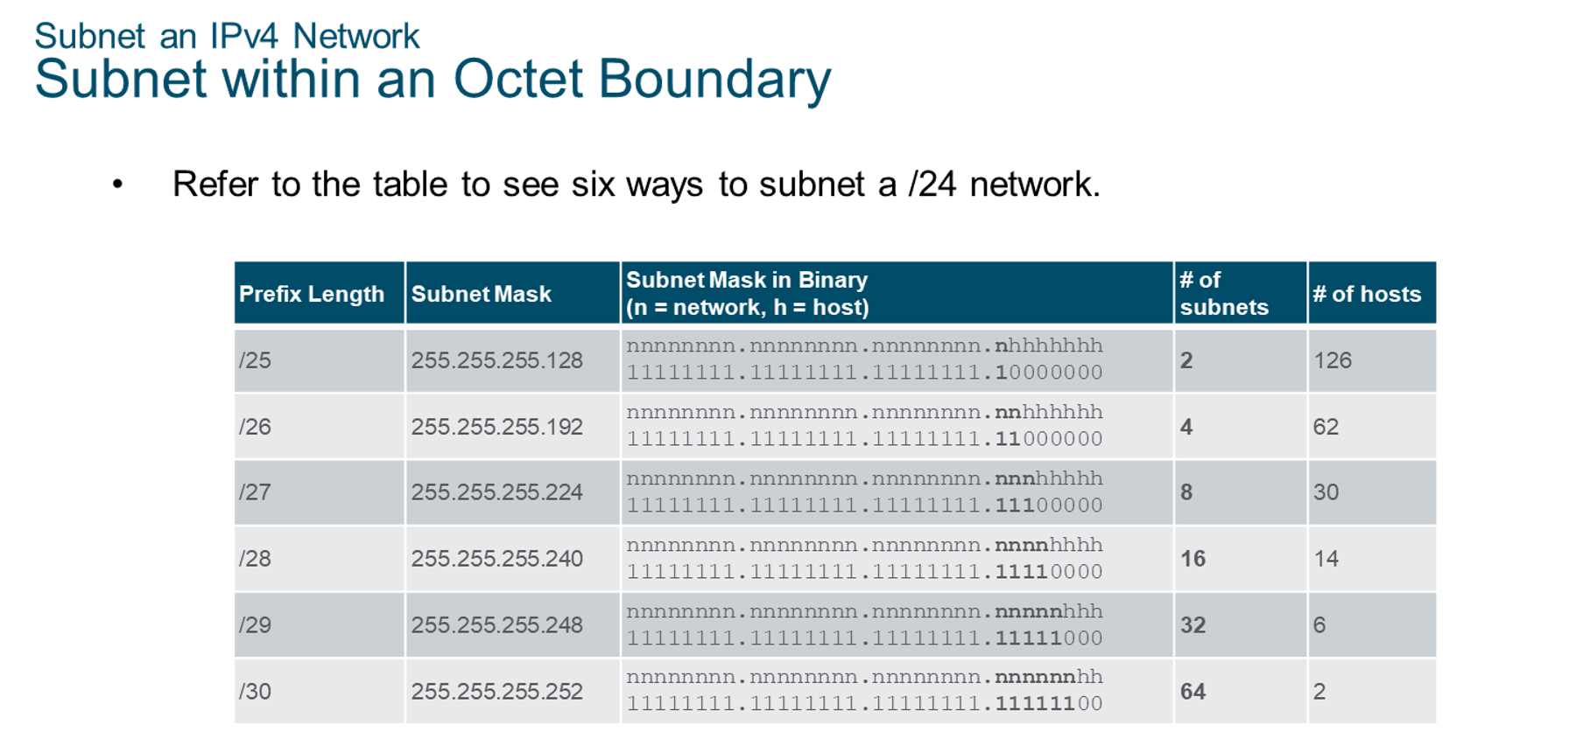
Chapter
Subnet an IPv4 Network
06

Slide 22
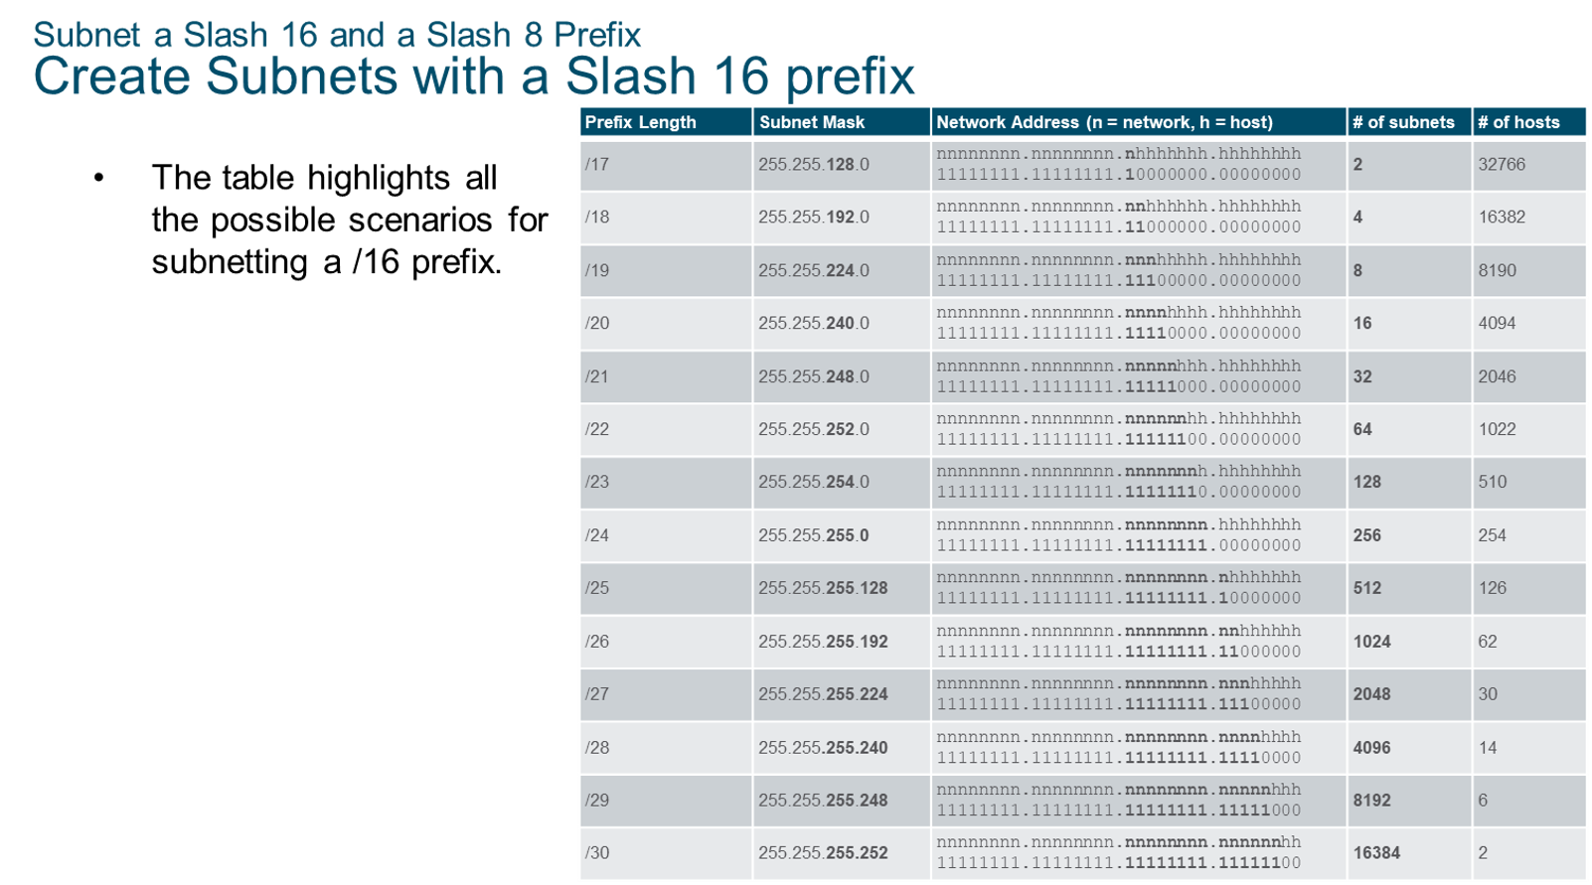
Chapter
Subnet a Slash 16 and a Slash 8 Prefix
06

Slide 23
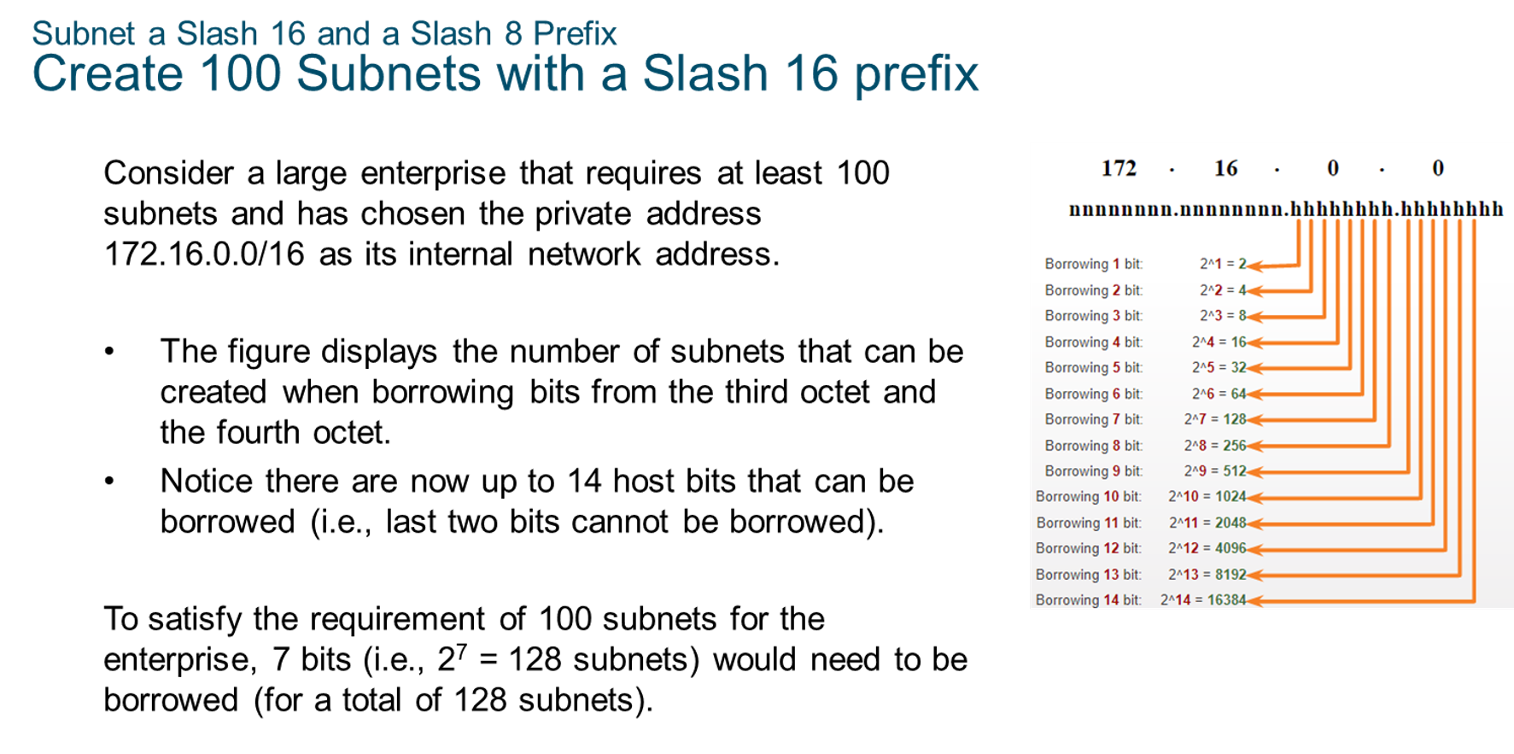
Chapter
Subnet a Slash 16 and a Slash 8 Prefix
06

Slide 24
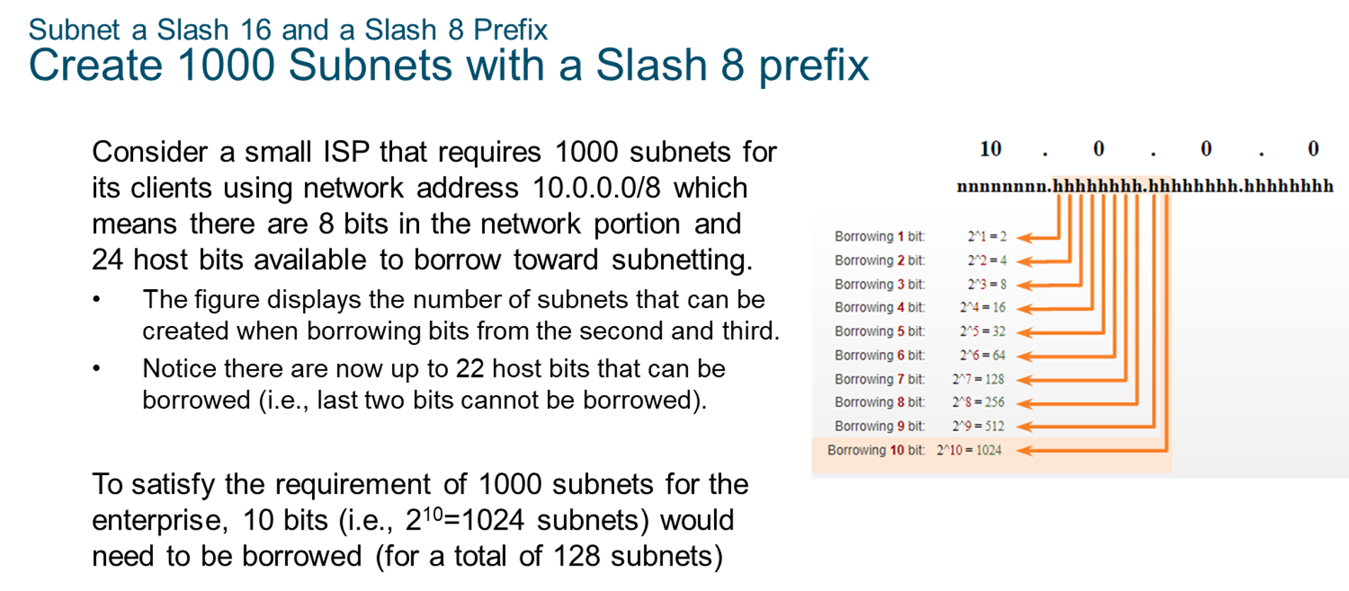
Chapter
Subnet a Slash 16 and a Slash 8 Prefix
06

Slide 25
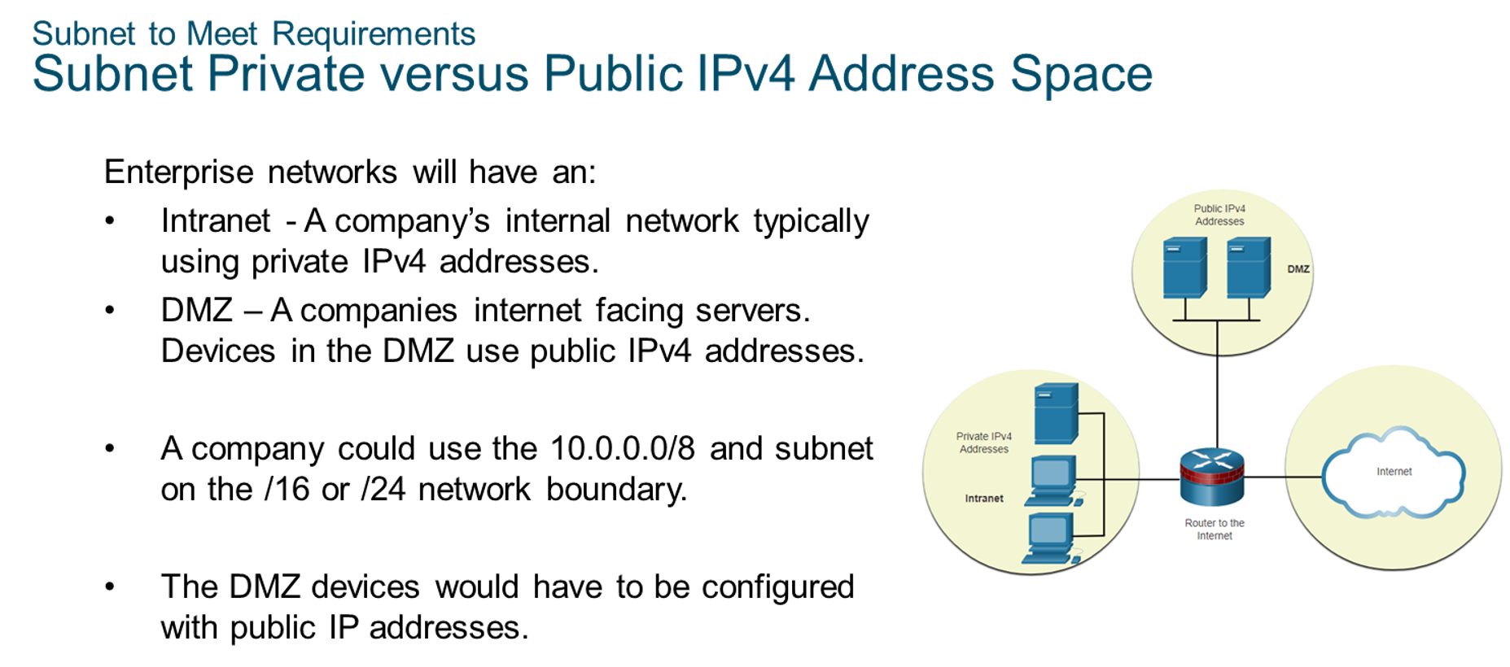
Chapter
Subnet to Meet Requirements
06

Slide 26
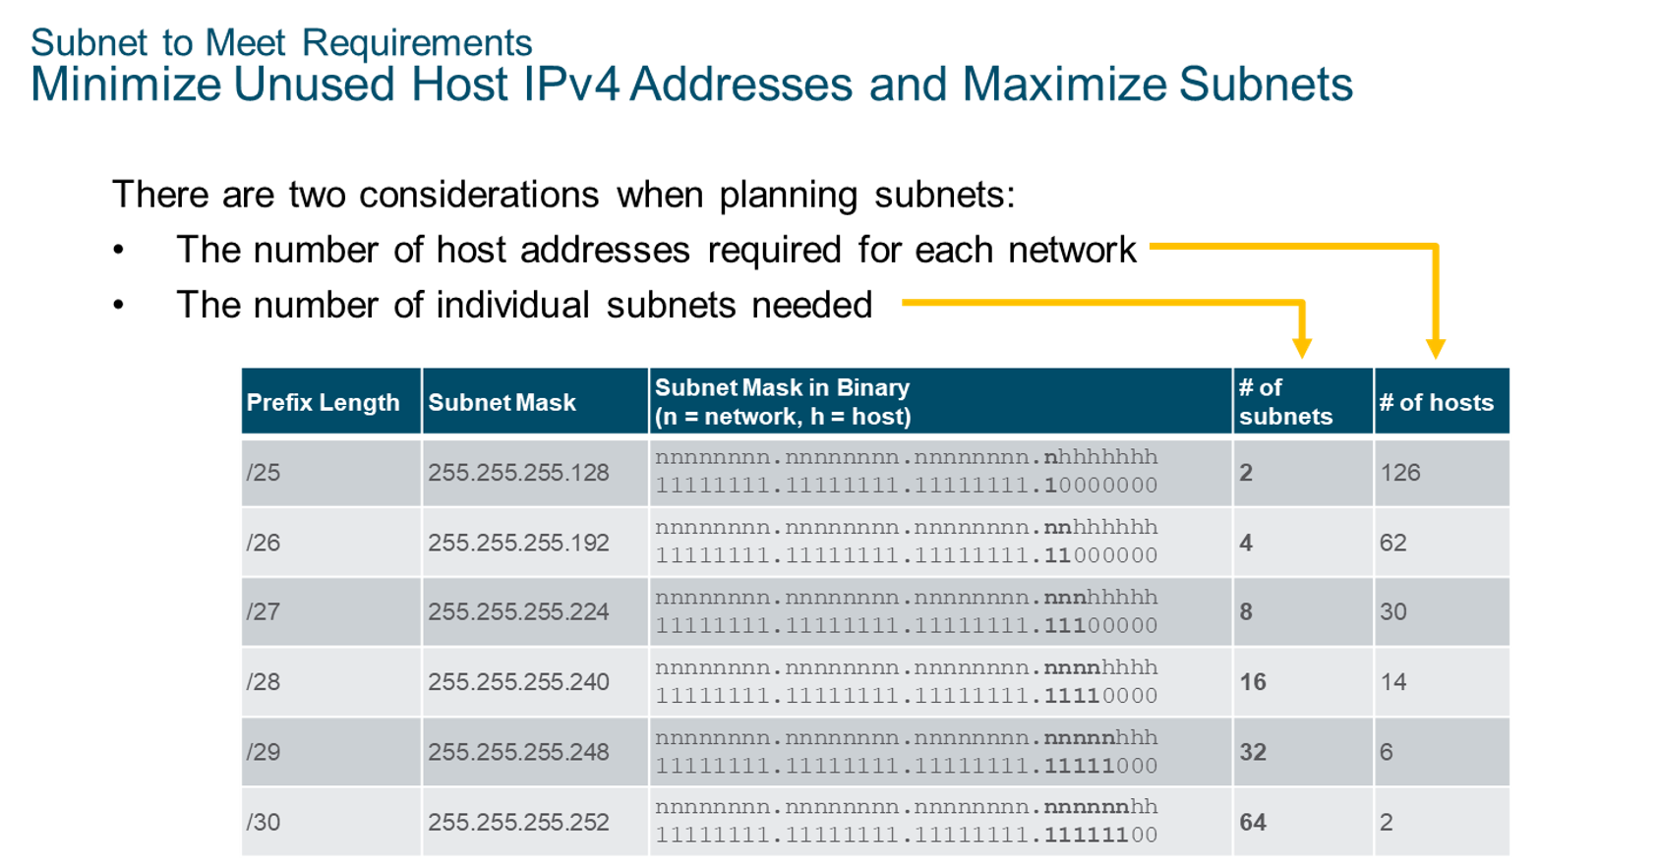
Chapter
Subnet to Meet Requirements
06

Slide 27
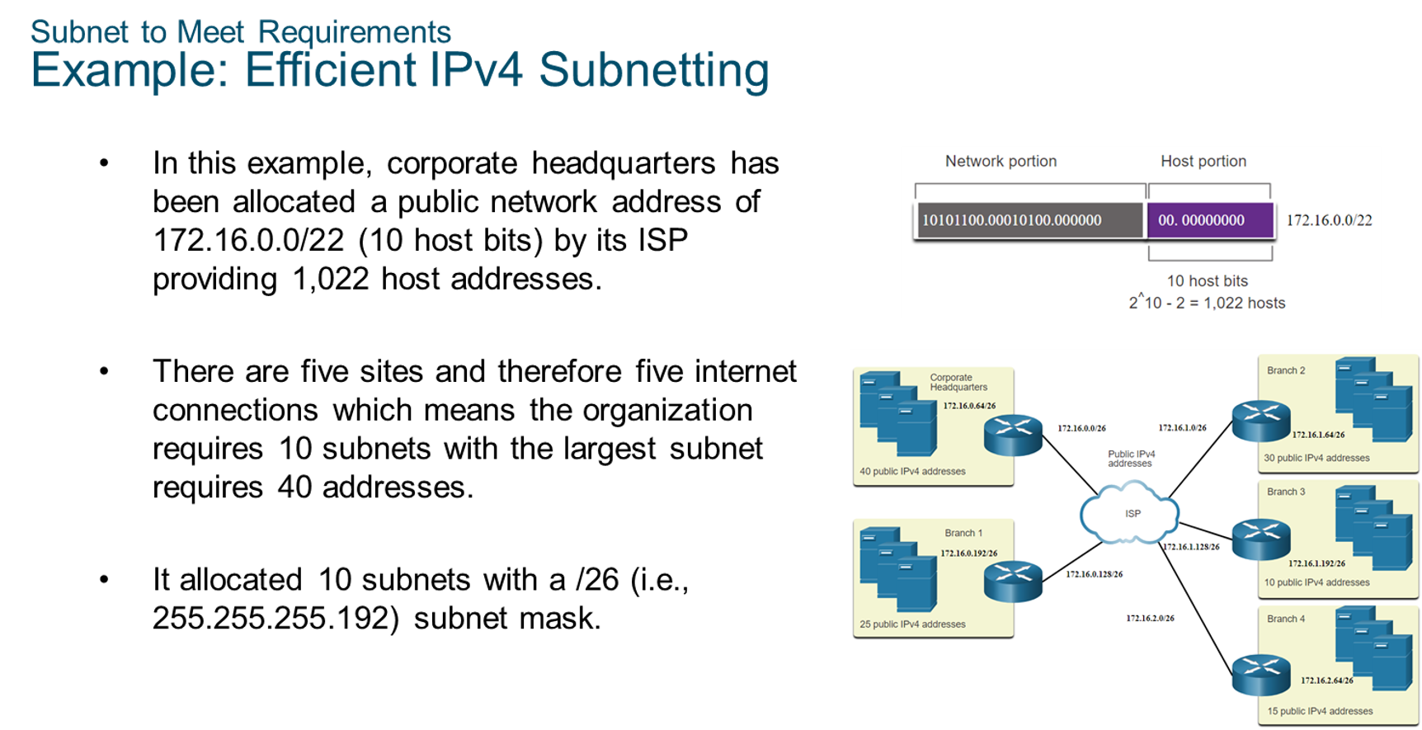
Chapter
Subnet to Meet Requirements
06

Slide 28
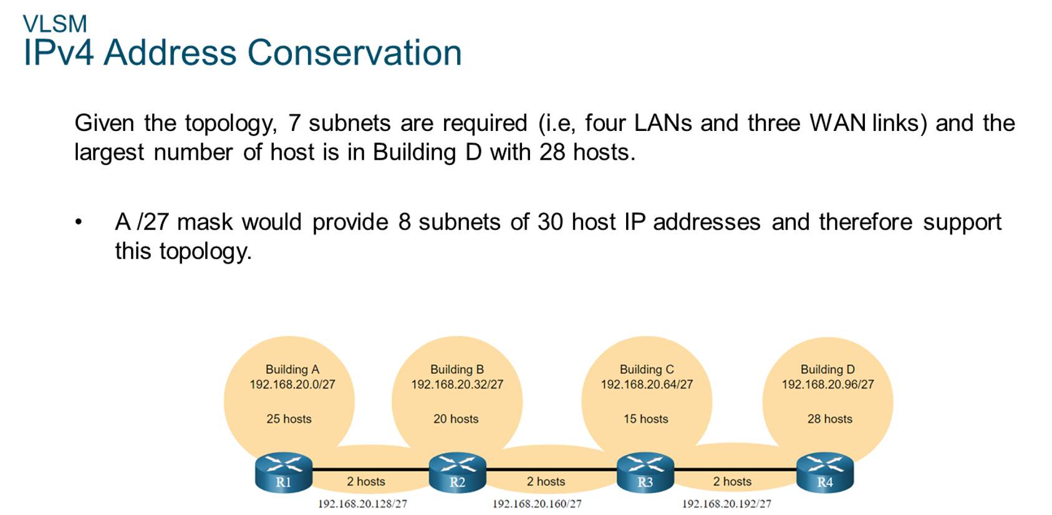
Chapter
VLSM
06

Slide 29
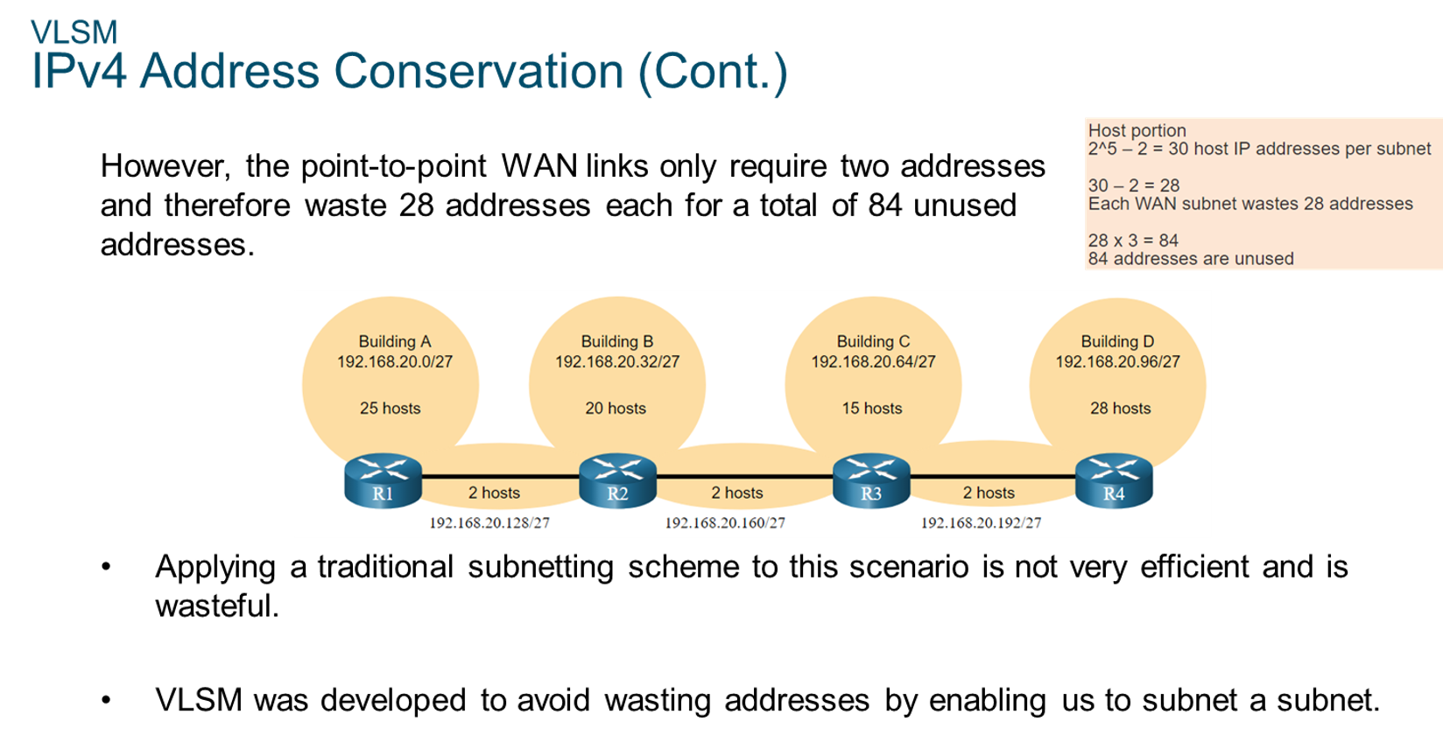
Chapter
VLSM
06

Slide 30
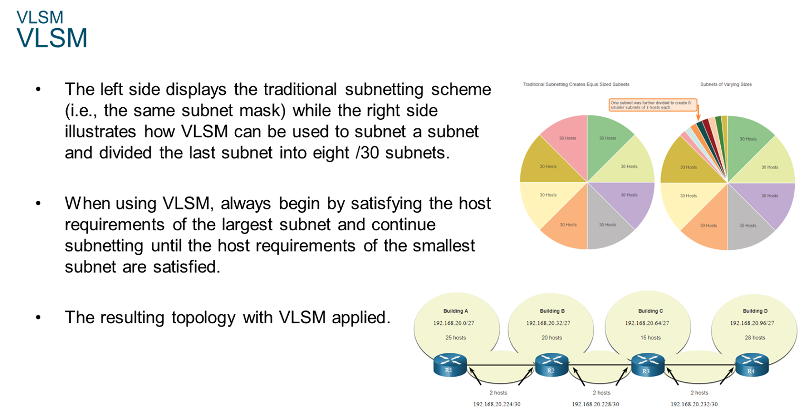
Chapter
VLSM
06

Slide 31
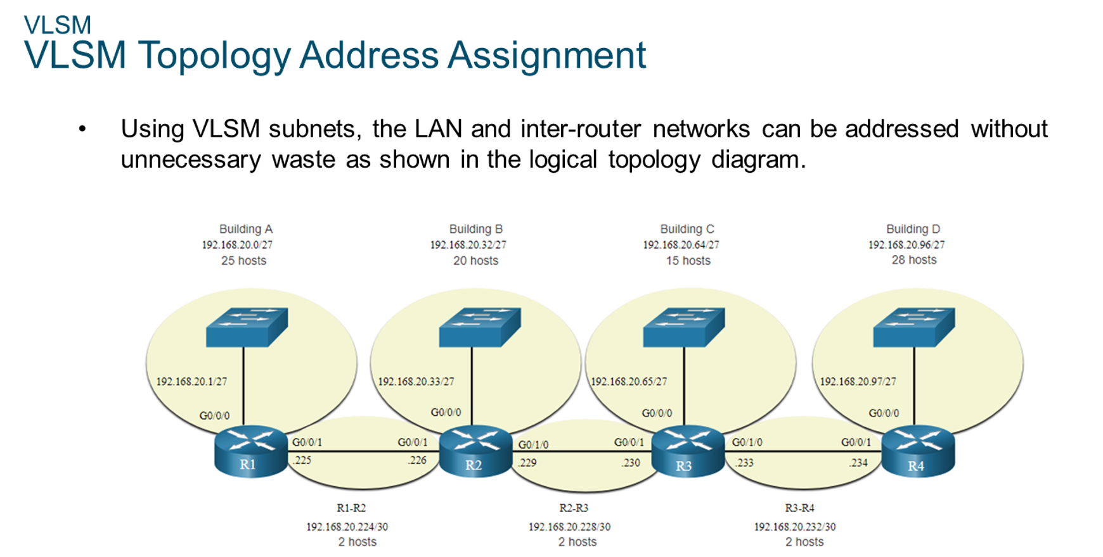
Chapter
VLSM
06

Slide 32
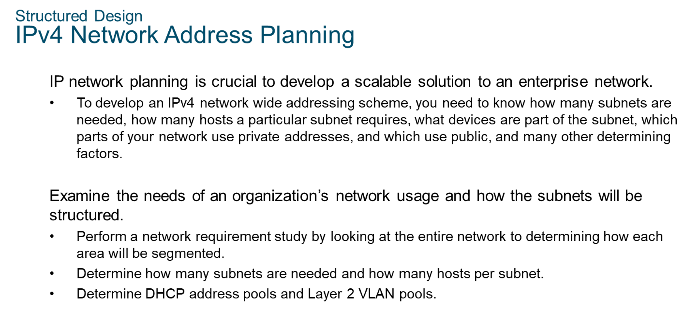
Chapter
Structured Design
06

Slide 33
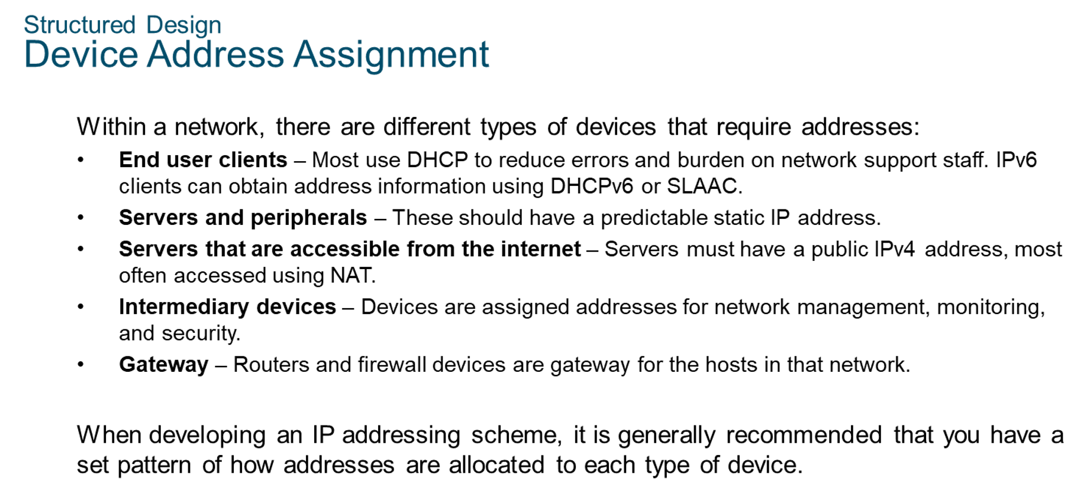
Chapter
Structured Design
06

Slide 34



Thank You

