Slide 1


Project Monitoring
Lecture 2
PMG 333
Defining the Project
Prepared by
Dr. Mohammed Mustafa

Slide 2


Learning objectives
Identify key elements of a project scope statement and understand why a complete scope statement is critical to project success.
Understand why it is important to establish project priorities in terms of cost, time, and performance.
Demonstrate the importance of a work breakdown structure (WBS) to the management of projects and how it serves as a data base for planning and control.
Demonstrate how the organization breakdown structure (OBS) establishes accountability to organizational units.
Describe a process breakdown structure (PBS) and when to use it.
Create responsibility matrices for small projects.
Create a communication plan for a project.

Slide 3
Lecture
Outlines
02
Step 1: Defining the Project Scope
Step 2: Establishing Project Priorities
Step 3: Creating the Work Breakdown Structure
Step 4: Integrating the WBS with the Organization
Step 5: Coding the WBS for the Information System
Process Breakdown Structure
Responsibility Matrices
Project Communication Plan
www.midocean.ae

Slide 4
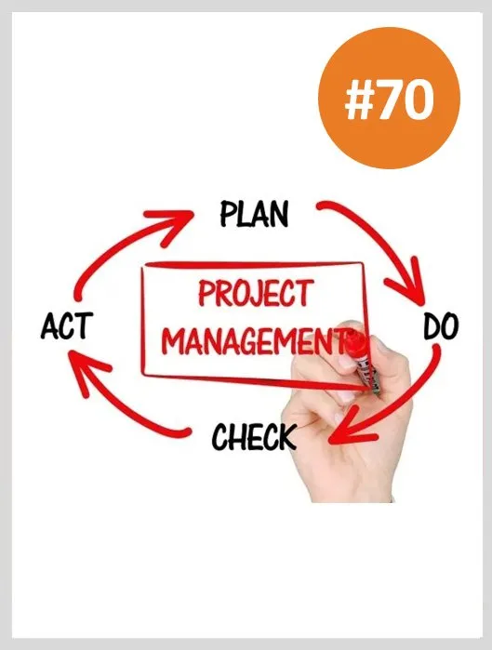
Define the Project Scope
Defining the project scope sets the stage for developing a project plan.
Project scope is a definition of the end result or mission of your project—a product or service for your client/customer.
The primary purpose is to define as clearly as possible the deliverable(s) for the end user and to focus project plans.
Research clearly shows that a poorly defined scope or mission is the most frequently mentioned barrier to project success.

Slide 5
Define the Project – cont..
In a study involving more than 1,400 project managers in the United States and Canada, Gobeli and Larson (1990) found that approximately 50 percent of the planning problems relate to unclear definition of scope and goals.
This and other studies suggest a strong correlation between project success and clear scope definition (Ashley et al., 1987; Pinto and Slevin, 1988; Standish Group, 2009).
The scope document directs focus on the project purpose throughout the life of the project for the customer and project participants.

Slide 6
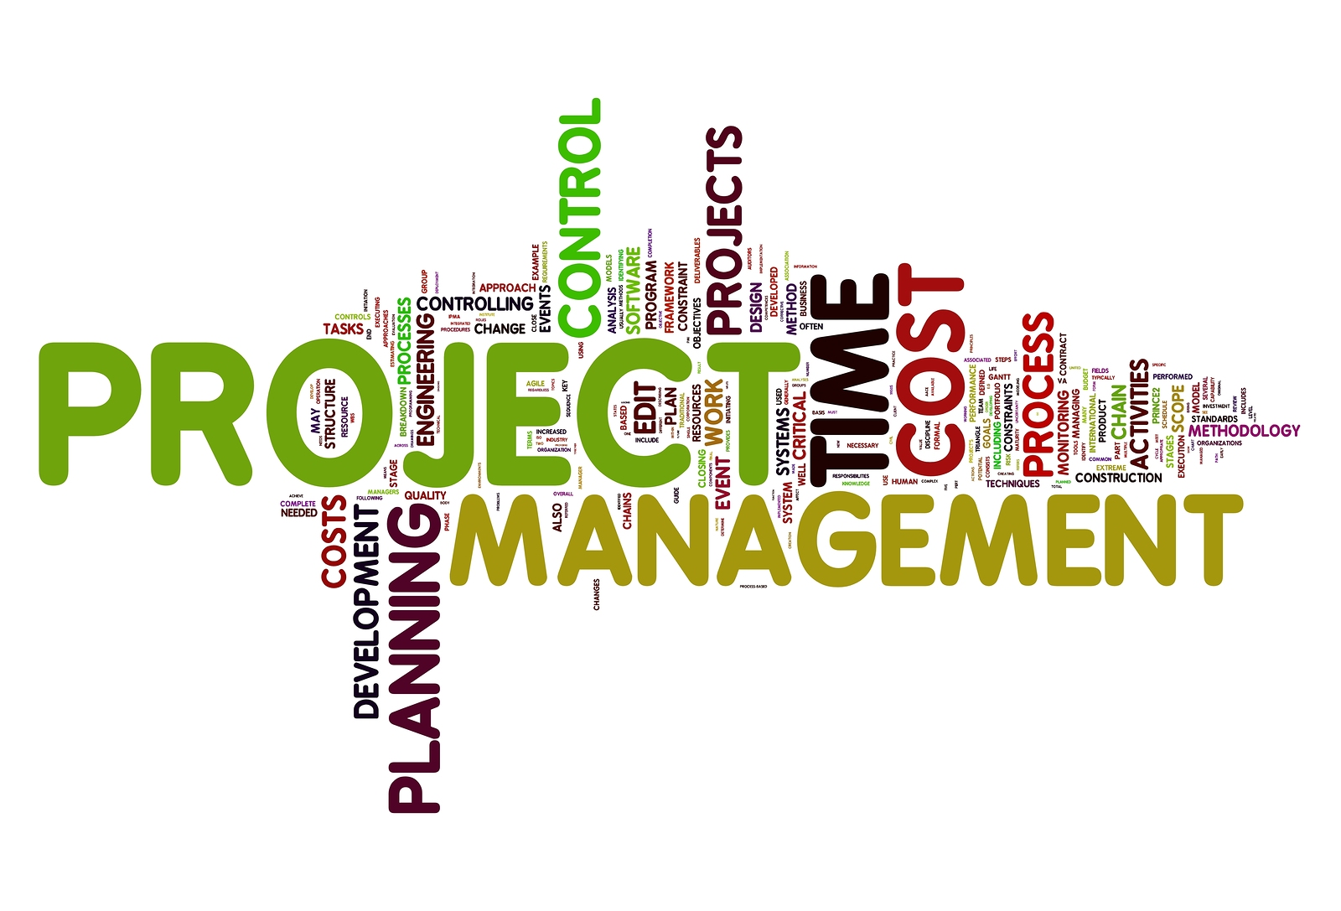
Define the Project – cont..
Your project scope definition is a document that will be published and used by the project owner and project participants for planning and measuring project success.
Scope describes what you expect to deliver to your customer when the project is complete.
Your project scope should define the results to be achieved in specific, tangible, and measurable terms.

Slide 7


Understanding the Project - Continued
Employing a Project Scope Checklist
Clearly, project scope is the keystone interlocking all elements of a project plan.
To ensure that scope definition is complete, you may wish to use the following checklist:

Slide 8
(1) Project Objective
The first step of project scope definition is to define the overall objective to meet your customer’s need(s).
For example, as a result of extensive market research a computer software company decides to develop a program that automatically translates verbal sentences in English to Russian.
The project should be completed within three years at a cost not to exceed $1.5 million.
Another example is to design and construct a portable, hazardous-waste thermal treatment system in 13 months at a cost not to exceed $13 million.
The project objective answers the questions of what, when, how much, and at times, where.

Slide 9
(2) Deliverables
The next step is to define major deliverables—the expected, measurable outputs over the life of the project.
For example, deliverables in the early design phase of a project might be a list of specifications.
In the second phase deliverables could be software coding and a technical manual.
The next phase could be the prototype.
The final phase could be final tests and approved software.
Note: Deliverables and requirements are often used interchangeably.

Slide 10

(3) Milestones
A milestone is a significant event in a project that occurs at a point in time.
The milestone schedule shows only major segments of work; it represents first, rough-cut estimates of time, cost, and resources for the project.
The milestone schedule is built using the deliverables as a platform to identify major segments of work and an end date—for example, testing complete and finished by July 1 of the same year.
Milestones should be natural, important control points in the project.
Milestones should be easy for all project participants to recognize.

Slide 11

(4) Technical requirements
More frequently than not, a product or service will have technical requirements to ensure proper performance.
Technical requirements typically clarify either the deliverables or define the performance specifications.
For example, a technical requirement for a personal computer might be the ability to accept 120-volt alternating current or 240-volt direct current without any adapters or user switches. Another well-known example is the ability of 911 emergency systems to identify the caller’s phone number and location of the phone.
Examples from information systems projects include speed and capacity of database systems and connectivity with alternative systems. For understanding the importance of key requirements.

Slide 12

(5) Limits and exclusions
The limits of scope should be defined. Failure to do so can lead to false expectations and to expending resources and time on the wrong problem.
Examples of limits are: work on site is allowed only between the hours of 8:00 pm - 5:00 am; system maintenance and repair will be done only up to one month after final inspection; client will be billed for additional training beyond that prescribed in the contract.
Exclusions further define the boundary of the project by stating what is not included.
Examples include: data will be collected by the client, not the contractor; a house will be built, but no landscaping or security devices added; software will be installed, but no training given.

Slide 13

(6) Reviews with customer
Completion of the scope checklist ends with a review with your customer—internal or external.
The main concern here is the understanding of and agreement to expectations.
Is the customer getting what he or she desires in deliverables? Does the project definition identify key accomplishments, budgets, timing, and performance requirements? Are questions of limits and exclusions covered?
Clear communication in all these issues is imperative to avoid claims or misunderstanding.

Slide 14

The term project charter has emerged to have a special meaning in the world of project management.
A project charter refers to a document that authorizes the project manager to initiate and lead the project.
This document is issued by upper management and provides the project manager with written authority to use organizational resources for project activities.
Often the charter will include a brief scope description as well as such items as risk limits, business case, spending limits, and even team composition.

Slide 15

Establishing Project Priorities
Quality and the ultimate success of a project are traditionally defined as meeting and/ or exceeding the expectations of the customer and/or upper management in terms of cost (budget), time (schedule), and performance (scope) of the project (See Figure under).
The interrelationship among these criteria varies.
For example, sometimes it is necessary to compromise the performance and scope of the project to get the project done quickly or less expensively.

Slide 16
Establishing Project Priorities – Cont..
Often the longer a project takes, the more expensive it becomes.
However, a positive correlation between cost and schedule may not always be true.
Other times project costs can be reduced by using cheaper, less efficient labor or equipment that extends the duration of the project.
Project managers are often forced to expedite or “crash” certain key activities by adding additional labor, thereby raising the original cost of the project.

Slide 17
Establishing Project Priorities – Cont..
One of the primary jobs of a project manager is to manage the trade-offs among time, cost, and performance.
To do so, project managers must define and understand the nature of the priorities of the project.
They need to have a candid discussion with the project customer and upper management to establish the relative importance of each criterion.
For example, what happens when the customer keeps adding requirements?

Slide 18
Project management –
Trade-offs

Slide 19
Priority matrix
One technique found in practice that is useful for this purpose is completing a priority matrix for the project to identify which criterion is constrained, which should be enhanced, and which can be accepted:

Slide 20
Priority matrix – Cont..
Constrain. The original parameter is fixed. The project must meet the completion date, specifications and scope of the project, or budget.
Enhance. Given the scope of the project, which criterion should be optimized? In the case of time and cost, this usually means taking advantage of opportunities to either reduce costs or shorten the schedule. Conversely, with regard to performance, enhancing means adding value to the project.
Accept. For which criterion is it tolerable not to meet the original parameters? When trade-offs have to be made, is it permissible for the schedule to slip, to reduce the scope and performance of the project, or to go over budget?

Slide 21
Project Priority Matrix

Slide 22
Creating the Work Breakdown Structure (WBS)
Major Groupings Found in a WBS
Once the scope and deliverables have been identified, the work of the project can be successively subdivided into smaller and smaller work elements.
The outcome of this hierarchical process is called the work breakdown structure (WBS).
Use of a WBS helps to assure project managers that all products and work elements are identified, to integrate the project with the current organization, and to establish a basis for control.
Basically, the WBS is an outline of the project with different levels of detail.

Slide 23
WBS – Cont..
Figure below, shows the major groupings commonly used in the field to develop a hierarchical WBS.
The WBS begins with the project as the final deliverable. Major project work deliverables/systems are identified first; then the subdeliverables necessary to accomplish the larger deliverables are defined.
The process is repeated until the subdeliverable detail is small enough to be manageable and where one person can be responsible.
This subdeliverable is further divided into work packages.
Because the lowest subdeliverable usually includes several work packages, the work packages are grouped by type of work—for example, design and testing.
These groupings within a subdeliverable are called cost accounts.
This grouping facilitates a system for monitoring project progress by work, cost, and responsibility.

Slide 24
How WBS Helps the Project Manager
The WBS defines all the elements of the project in a hierarchical framework and establishes their relationships to the project end item(s).
Think of the project as a large work package that is successively broken down into smaller work packages; the total project is the summation of all the smaller work packages. This hierarchical structure facilitates evaluation of cost, time, and technical performance at all levels in the organization over the life of the project.
The WBS also provides management with information appropriate to each level. For example, top management deals primarily with major deliverables, while first-line supervisors deal with smaller subdeliverables and work packages.

Slide 25
Work Breakdown Structure

Slide 26
Work Breakdown Structure

Slide 27
Work Package
The lowest level of the WBS is called a work package. Work packages are short-duration tasks that have a definite start and stop point, consume resources, and represent cost.
Each work package is a control point.
A work package manager is responsible for seeing that the package is completed on time, within budget, and according to technical specifications.
Practice suggests a work package should not exceed 10 workdays or one reporting period.

Slide 28
Work Package – Cont..
If a work package has a duration exceeding 10 days, check or monitoring points should be established within the duration, say, every three to five days, so progress and problems can be identified before too much time has passed.
Each work package of the WBS should be as independent of other packages of the project as possible.

Slide 29
Work Package – Cont..
To review, each work package in the WBS;
Defines work (what).
Identifies time to complete a work package (how long).
Identifies a time-phased budget to complete a work package (cost).
Identifies resources needed to complete a work package (how much).
Identifies a single person responsible for units of work (who).
Identifies monitoring points for measuring progress (how well).

Slide 30
Creating a WBS – Cont..
WBSs are products of group efforts.
If the project is small, the entire project team may be involved breaking down the project into its components.
For large, complex projects, the people responsible for the major deliverables are likely to meet to establish the first two levels of deliverables.
In turn, further detail would be delegated to the people responsible for the specific work.
Collectively this information would be gathered and integrated into a formal WBS by a project support person.
The final version would be reviewed by the inner echelon of the project team. Relevant stakeholders (most notably customers) would be consulted to confirm agreement and revise when appropriate.

Slide 31
Creating a WBS – Cont..
Project teams developing their first WBS frequently forget that the structure should be end-item, output oriented.
First attempts often result in a WBS that follows the organization structure—design, marketing, production, finance.
If a WBS follows the organization structure, the focus will be on the organization function and processes rather than the project output or deliverables.
In addition, a WBS with a process focus will become an accounting tool that records costs by function rather than a tool for “output” management.
Every effort should be made to develop a WBS that is output
oriented in order to concentrate on concrete deliverables.

Slide 32
Step 4: Integrating the WBS with the Organization
The WBS is used to link the organizational units responsible for performing the work.
In practice, the outcome of this process is the organization breakdown structure (OBS).
The OBS depicts how the firm has organized to discharge work responsibility.
The purposes of the OBS are to provide a framework to summarize organization unit work performance, identify organization units responsible for work packages, and tie the organizational unit to cost control accounts.

Slide 33
Integrating the WBS with the Organization – Cont.
Recall, cost accounts group similar work packages (usually under the purview of a department).
The OBS defines the organization subdeliverables in a hierarchical pattern in successively smaller and smaller units.
Frequently, the traditional organization structure can be used.
Even if the project is completely performed by a team, it is necessary to break down the team structure for assigning responsibility for budgets, time, and technical performance.

Slide 34
Step 5: Coding the WBS for the Information System
Gaining the maximum usefulness of a breakdown structure depends on a coding system.
The codes are used to define levels and elements in the WBS, organization elements, work packages, and budget and cost information.
The codes allow reports to be consolidated at any level in the structure.
The most commonly used scheme in practice is numeric indention.
A portion of the E-Slim Tablet x-13 Prototype project is presented in Exhibit below.

Slide 35
Step 5: Coding the WBS for the Information System

Slide 36
Coding – Cont..
Note the project identification is 1.0. Each successive indention represents a lower element or work package.
Ultimately the numeric scheme reaches down to the work package level, and all tasks and elements in the structure have an identification code.
The “cost account” is the focal point because all budgets, work assignments, time, cost, and technical performance come together at this point.

Slide 37
Example for Coding
the WBS

Slide 38
Process Breakdown Structure – Cont..
Process projects are driven by performance requirements, not by plans/blueprints.
Some practitioners choose to utilize what we refer to as a process breakdown structure (PBS) instead of the classic WBS.

Slide 39
Process Breakdown Structure

Slide 40

Project Communication Plan
Once the project deliverables and work are clearly identified, following up with an internal communication plan is vital.
Stories abound of poor communication as a major contributor to project failure.
Having a robust communications plan can go a long way toward mitigating project problems and can ensure that customers, team members, and other stakeholders have the information to do their jobs.
The communication plan is usually created by the project manager and/or the project team in the early stage of project planning.

Slide 41
Communication – Cont..
Project communication plans address the following core questions:
What information needs to be collected and when?
Who will receive the information?
What methods will be used to gather and store information?
What are the limits, if any, on who has access to certain kinds of information?
When will the information be communicated?
How will it be communicated?
Developing a communication plan has relationship with:
(1) Stakeholder analysis:
Identify the target groups.
Typical groups could be the customer, sponsor, project team, project office, or anyone who needs project information to make decisions and/or contribute to project progress.

Slide 42
Communication – Cont..
(2) Information needs:
What information is pertinent to stakeholders who contribute to the project’s progress?
The simplest answer to this question can be obtained by asking the different people what information they need and when they need it.
For example, top management needs to know how the project is progressing, whether it is encountering critical problems, and the extent to which project goals are being realized.
Frequent information needs found in communication plans are:
Project status reports, Deliverable issues, Changes in scope, Team status meetings, Gating decisions, Accepted request changes, Action items, Milestone reports.

Slide 43
Communication – Cont..
(3) Sources of information:
When the information needs are identified, the next step is to determine the sources of information.
That is, where does the information reside?
How will it be collected?
For example, information relating to the milestone report, team meetings, and project status meetings would be found in the minutes and reports of various groups.

Slide 44

Communication – Cont..
(4) Dissemination modes:
In today’s world, traditional status report meetings are being supplemented by e-mail, teleconferencing, SharePoint, and a variety of database sharing programs to circulate information.
In particular, many companies are using the Web to create a “virtual project office” to store project information.
Project management software feeds information directly to the website so that different people have immediate access to relevant project information.
In some cases, appropriate information is routed automatically to key stakeholders.
Backup paper hardcopy to specific stakeholders is still critical for many project changes and action items.

Slide 45
Communication – Cont..
(5) Responsibility and timing:
Determine who will send out the information.
For example, a common practice is to have secretaries of meetings forward the minutes or specific information to the appropriate stakeholders.
In some cases the responsibility lies with the project manager or project office.
Timing and frequency of distribution appropriate to the information need to be established.

Slide 46
Communication – Cont..
The advantage of establishing a communication plan is that instead of responding to information requests, you are controlling the flow of information.
This reduces confusion and unnecessary interruptions, and it can provide project managers greater autonomy.
Why? By reporting on a regular basis how things are going and what is happening, you allow senior management to feel more comfortable about letting the team complete the project without interference.

Slide 47



Thank You

