Slide 1

DIGITAL MEDIA ETHICS
Prepared by Dr. Sherihan Mohamed
Lecture 2
DIGITAL MEDIA ETHICS

Slide 2
DIGITAL MEDIA ETHICS
CHABTER 01
Central Issues in the Ethics of Digital Media

Slide 3

Chapter
02
Remember
**(Ethical) life in the (post-)digital age:
1. Digital media, analog media: convergence and Ubiquity.
2. Digital media and “greased information”.
3. Digital media as communication media: fluidity, ubiquity, global scope, and selfhood/identity.

Slide 4

Chapter
02
Outline
** Digital media ethics: How to proceed?
** Is digital media ethics possible? Grounds for hope
** How to do ethics in the new mediascape:
Dialogical approaches, difference, and
Pluralism.
** Further considerations: Ethical judgments
** Conclusion

Slide 5
DIGITAL MEDIA ETHICS
CHABTER 02
Digital media ethics: How to proceed?

Slide 6

Chapter
02
Digital media ethics: How to proceed?
At first glance, developing such an ethics would seem to be an impossible task.
First of all, digital media often present us with strikingly new sorts of interactions with one another.

Slide 7

Chapter
02
Digital media ethics: How to proceed?
So, it is not always clear whether – and, if so, then how– ethical guidelines and approaches already in place (and comparatively well established) for traditional media would apply.

Slide 8

Chapter
02
Digital media ethics: How to proceed?
But again, as emphasized in the term “post-digital,” digital media remain analogue media in essential ways – the music arriving at our ears remains analogue, etc.
And so, the life worlds of human experience that digital media now increasingly define remain connected with the analogue life worlds of earlier generations and cultures.

Slide 9

Chapter
02
Digital media ethics: How to proceed?
* In addition, digital media as global media thus force us to confront culturally variable views, regarding not simply basic ethical norms and practices but, more fundamentally, how ethics is to be done.

Slide 10

Chapter
02
Digital media ethics: How to proceed?
In particular, non-Western views challenge traditional Western notions of the primary importance of the individual, and thereby Western understandings of ethical responsibility as primarily individual responsibility.

Slide 11
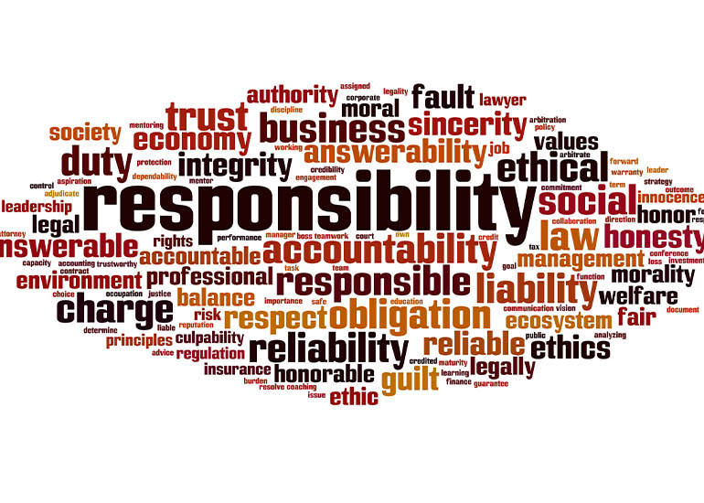
Chapter
02
Digital media ethics: How to proceed?
This means, more specifically, that multiple actors and agents must work together to make specific acts (both beneficent and harmful) possible.
Hence, in parallel with the distribution of information via networks, our ethical responsibility may be more accurately understood in terms of a distributed responsibility.

Slide 12

Chapter
02
Digital media ethics: How to proceed?
This understanding of “Distributed Responsibility“ is, in fact, not an entirely new idea.
Rather, it is one shared with both pre-modern Western philosophies and religions and multiple philosophies and religions around the globe.

Slide 13

Chapter
02
Digital media ethics: How to proceed?
Certainly, this is a Very Good Thing: it suggests important ethical norms and practices that can be shared among the multiple cultures and peoples now brought into digital communication with one another.
But it represents a major challenge, especially, to Western thinkers used to understanding ethical responsibility in primarily individualistic terms.

Slide 14
DIGITAL MEDIA ETHICS
CHAPTER 02
Is digital media ethics possible? Grounds for hope

Slide 15

Chapter
02
Is digital media ethics possible? Grounds for hope
When we first begin to grapple with digital media ethics, the tasks before us may seem to be overwhelming and perhaps simply futile.
But both our collective experience with earlier technological developments and more recent experience in the domain of information and computing ethics (ICE) suggest that, despite the considerable challenges of Developing new ethical frameworks for new technologies, we are nonetheless able to do so.

Slide 16

Chapter
02
Is digital media ethics possible? Grounds for hope
Indeed, this experience provides us with a number of examples of ethical resolutions that “work” both globally (as they involve discerning shared norms and understandings) and locally (as they further involve developing ways of interpreting and applying shared norms in specific cultural contexts).

Slide 17

Chapter
02
Is digital media ethics possible? Grounds for hope
As a primary example: the European Union has drawn up and now implemented more rigorous privacy protections than were defined under previous data regulations.

Slide 18

Chapter
02
Is digital media ethics possible? Grounds for hope
In 2015, the European Data Protection Supervisor (EDPS) established an Ethics Advisory Group, assigned to develop a “new digital ethics” to help guide the specific implementations of the GDPR, including sustaining the rigorous EU privacy protections vis the emerging Internet of Things and growing uses of Artificial Intelligence (AI).

Slide 19
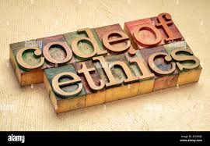
Chapter
02
Is digital media ethics possible? Grounds for hope
This new digital ethics, however, turns squarely on two ethical frameworks we have begun to explore here.
Namely, Deontology (roughly, an insistence on human autonomy and thereby basic rights, including the right to privacy) and Virtue ethics (briefly, a focus on achieving good lives of flourishing through the development of our best capacities).

Slide 20
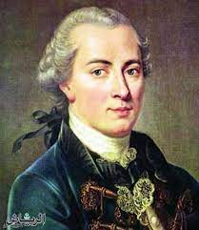
Chapter
02
Is digital media ethics possible? Grounds for hope
For example, the EDPS Ethics Advisory Group (EAG) foregrounds the central importance of autonomy and freedom, including as these are grounded in the philosophical work of Immanuel Kant.
Similarly, both the EAG report and the more philosophical account of the key ethical pillars of a “Good AI Society“ foreground the central aims of virtue ethics – namely, flourishing, well-being, and good lives.

Slide 21
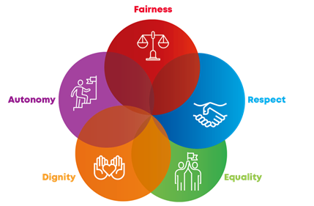
Chapter
02
Is digital media ethics possible? Grounds for hope
At the same time, these ethical frameworks are (also) applied in a pluralistic fashion.
So, the EAG asserts that basic norms and values – such as autonomy, dignity, equality, and so on – are both central “to the European project”.

Slide 22

Chapter
02
Is digital media ethics possible? Grounds for hope
These examples suggest that digital media ethics – as likewise requiring us to address the ethical dimensions evoked by developing new technologies, including how these implicate diverse cultural norms and traditions – is nonetheless a doable project.
Moreover: extensive evidence argues that with few exceptions, as enculturated human beings, we are already deeply ethical.

Slide 23
DIGITAL MEDIA ETHICS
CHAPTER 02
How to do ethics in the new mediascape

Slide 24

Chapter
02
How to do ethics in the new mediascape
These examples of the AoIR guidelines and recent EU law and ethics further offer important suggestions for how to proceed – specifically, as both examples share two elements in common.

Slide 25

Chapter
02
How to do ethics in the new mediascape
To begin with, they each incorporate what we can think of as dialogical approaches – approaches that emphasize the importance of listening for and respecting differences between our diverse ethical views.

Slide 26
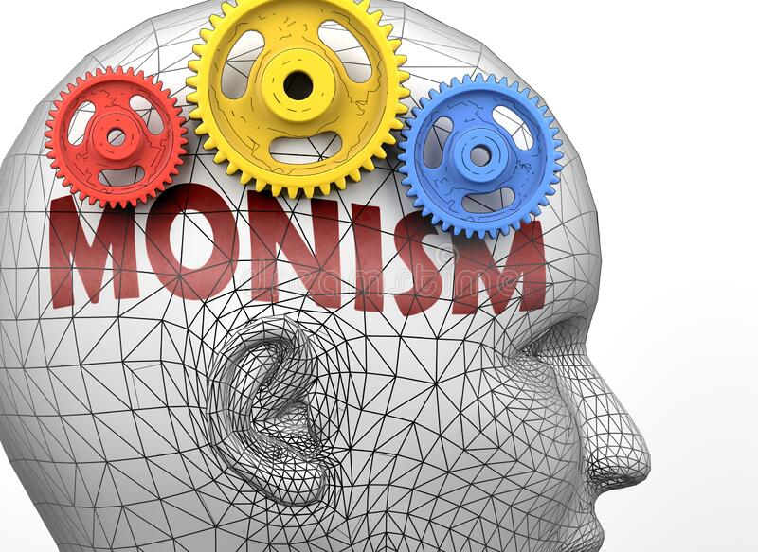
Chapter
02
How to do ethics in the new mediascape
Such approaches are called Ethical absolutism or ethical monism. These may work well in certain contexts and with regard to some ethical matters.
But, especially in a global context, a severe consequence of such ethical monism is to force us into thinking that one – and only one – particular ethical framework and set of norms and values are right, and those that are different can only be wrong.

Slide 27
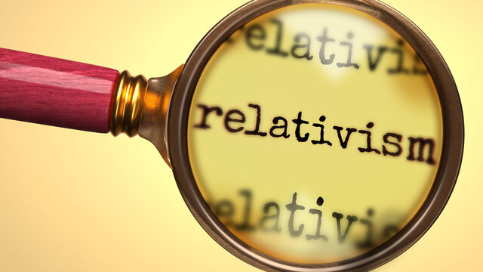
Chapter
02
How to do ethics in the new mediascape
Ethical relativism argues that beliefs, norms, practices, frameworks, etc., are legitimate solely in relation to a specific culture, time, and place. In this way.
Ethical relativism allows us to avoid the intolerance of ethical monism and to accept all views as legitimate.

Slide 28

Chapter
02
How to do ethics in the new mediascape
Such an approach is especially attractive as it prevents us from having to judge among diverse views and cultures: we can endorse all of them as legitimate in at least a relative way.

Slide 29

Chapter
02
How to do ethics in the new mediascape
Ethical pluralism in both internet research ethics and EU law and ethics surrounding privacy and data privacy protection shows how such pluralism stands as a third possibility – one that is something of a middle ground between absolutism and relativism.

Slide 30
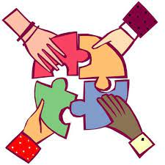
Chapter
02
How to do ethics in the new mediascape
That is, to begin with, such pluralism avoids the either/or of ethical monism – an either/or that forces us to choose between two different views, endorsing one as right and the other as wrong.

Slide 31

Chapter
02
How to do ethics in the new mediascape
Rather, we can thereby see that many (but not necessarily all) different views may be right, insofar as they function as diverse interpretations and applications of shared norms and values.

Slide 32
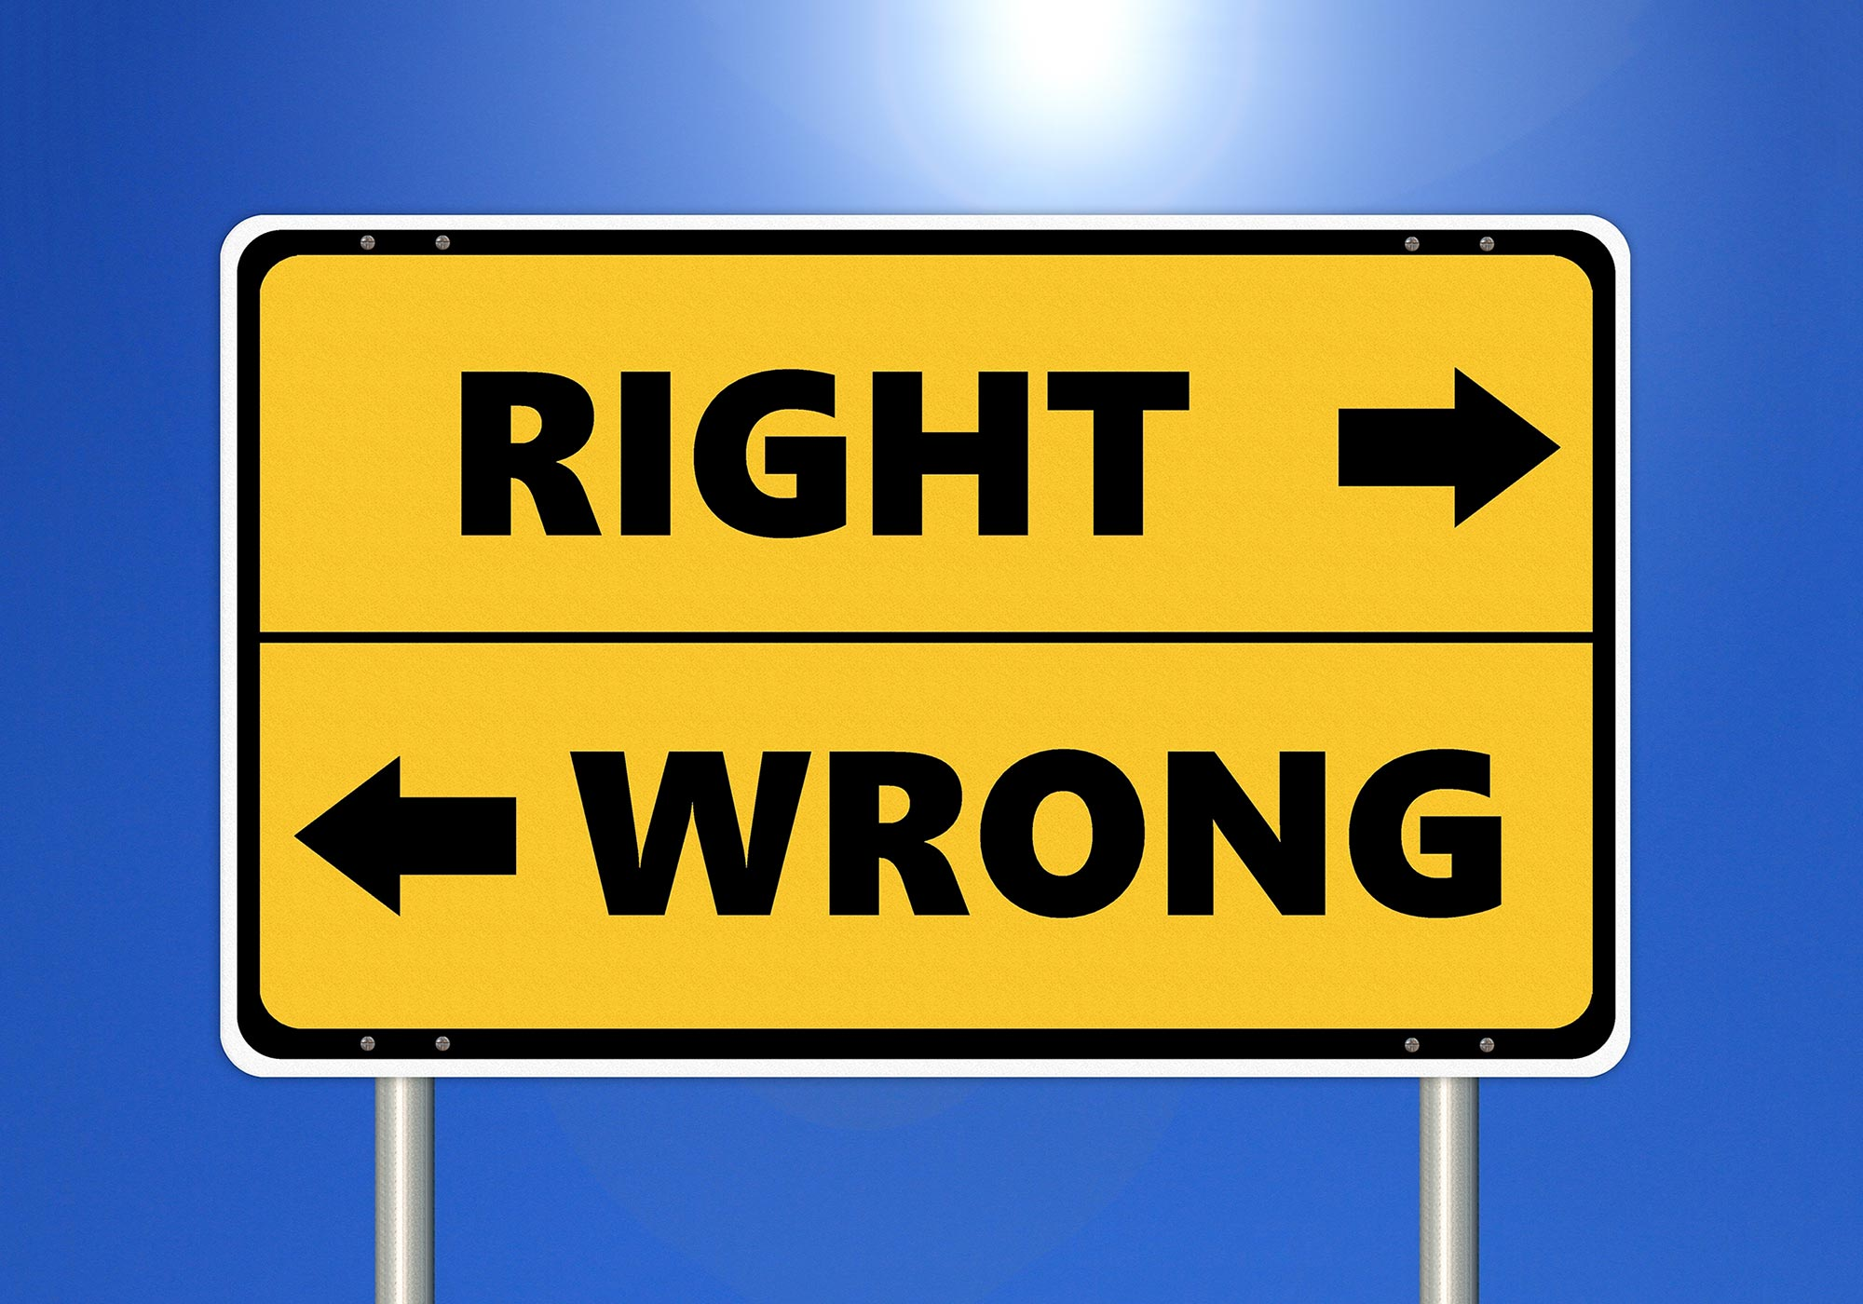
Chapter
02
How to do ethics in the new mediascape
But if the only way we are able to think about ethical matters is in terms of the either/or of ethical monism, then we literally cannot conceive of how to move beyond the right/wrong dualisms with which it often confronts us.

Slide 33
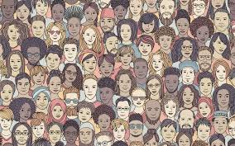
Chapter
02
How to do ethics in the new mediascape
We will find it difficult conceptually to move toward pluralism and other forms of middle grounds, because our either/or thinking insists that we can only have either unity (shared norms) or difference (in interpretation/application), but not both.

Slide 34
DIGITAL MEDIA ETHICS
CHAPTER 02
Further considerations: Ethical judgments

Slide 35

Chapter
02
Further considerations: Ethical judgments
Another difficulty with the “moral panics” approach to ethical issues in the new mediascape is that it suggests that “ethics” works like this:

Slide 36

Chapter
02
Further considerations: Ethical judgments
1. There are clear, universally valid norms of right and wrong that we can take as our ethical starting points – as premises in an ethical argument.

Slide 37

Chapter
02
Further considerations: Ethical judgments
2. All that “ethics” really involves is applying these initial premises to the particulars of the current case in front of us – in a straightforward deduction that concludes the right thing to do, as based on our first premises.

Slide 38

Chapter
02
Further considerations: Ethical judgments
3. Once we have our ethical answers in this way, we can be confident that our answers are right; those who disagree with us must be wrong.

Slide 39

Chapter
02
Further considerations: Ethical judgments
This approach to ethics is not necessarily mistaken; on the contrary, it seems that much of the time, most of us in fact do not perceive an ethical problem or difficulty in the situation we’re facing – because our ethical frameworks already provide us with reasonably clear and straightforward answers along just these lines.

Slide 40

Chapter
02
Further considerations: Ethical judgments
At the same time, however, this initial understanding of ethics obscures a number of important dimensions of ethical reflection.
There is no general rule for discerning which values, principles, norms, approaches apply before we can proceed to any inferences/conclusions about what to do.

Slide 41

Chapter
02
Further considerations: Ethical judgments
That is, we will find it difficult conceptually to move toward pluralism and other forms of middle grounds, because our either/or thinking insists that we can only have either unity (shared norms) or difference (in interpretation/application), but not both.

Slide 42

Chapter
02
Further considerations: Ethical judgments
Aristotle referred to this kind of judgment as “practical judgment”.
For Aristotle, the development of this sort of practical judgment is an ongoing project that continues throughout one’s entire life.

Slide 43

Chapter
02
Further considerations: Ethical judgments
Analogously, our first efforts to grapple with difficult ethical issues that require practical judgment do not always go well:
We are caught in the ethical “bootstrapping” problem of needing precisely the ability to judge that will be robust enough to help only after it has been developed and honed through many years of (sometimes hard) experience.

Slide 44
Chapter
02
Remember, Today We Talk About ..
** Digital media ethics: How to proceed?
** Is digital media ethics possible? Grounds for hope
** How to do ethics in the new mediascape:
Dialogical approaches, difference, and
Pluralism.
** Further considerations: Ethical judgments

Slide 45

Chapter
02
Thanks

Slide 46
DIGITAL MEDIA ETHICS
Prepared by Dr. Sherihan Mohamed
Introduction
DIGITAL MEDIA ETHICS

