Slide 1



Strategic and Operational Management
Prepared by
Dr. Ahmad AL-Naimi
MGM 630 (part one)
Lecture 3

Slide 2




LECTURE OUTLINE
Lecture
03
  The PESTEL Framework (- Political Factors - Economic Factors-Sociocultural Factors -Technological Factors - Ecological Factors-Legal Factors).
  Industry Structure and Firm Strategy: The Five Forces Model; (- Competition in the Five Forces Model -The Threat of Entry -The Power of Suppliers -The Power of Buyers -The Threat of Substitutes -Rivalry among Existing Competitors -A Sixth Force: The Strategic Role of Complements).
  Changes over Time: Industry Dynamics.
  Performance Differences within the Same Industry: Strategic Groups; (-The Strategic Group Model -Mobility Barriers).

Slide 3

LEARNING OBJECTIVES
Lecture
03
Generate a PESTEL analysis to evaluate the impact of external factors on the firm.
Apply Porter’s five competitive forces to explain the profit potential of different industries.
Explain how competitive industry structure shapes rivalry among
competitors.
Describe the strategic role of complements in creating positive-sum co-opetition.
Appraise the role of industry dynamics and industry convergence in shaping the firm’s external environment.
Generate a strategic group model to reveal performance differences
between clusters of firms in the same industry.

Slide 4
Looking Outside: Understanding the Industry and Competition
Lecture
03
3.1. The PESTEL Framework
A firm's external environment includes every factor that can affect its ability to gain and sustain a competitive advantage. By analyzing these factors, managers can mitigate threats and seize opportunities. A common way to make sense of them is to consider their source or proximity to the firm. For example, factors in the firm's general environment are ones managers have little direct control over, such as macroeconomic conditions like interest or currency exchange rates. The PESTEL framework organizes this general environment into six segments—Political, Economic, Sociocultural, Technological, Ecological, and Legal. Together these capture the broad external forces that shape the conditions in which every firm in an industry competes.

Slide 5
Looking Outside: Understanding the Industry and Competition
Lecture
03
In contrast, factors in the firm's task environment are ones managers can influence, such as the composition of their strategic groups (a set of close rivals) or the structure of the industry, as captured by Porter's five competitive forces. The task environment sits closer to the firm than the general environment, so its factors bear more directly on day-to-day strategy and are more responsive to a firm's own actions. We will now examine each layer in detail, moving from the firm's general environment inward to its task environment. Following Exhibit 3.1, we work from the outer ring to the inner ring.

Slide 6


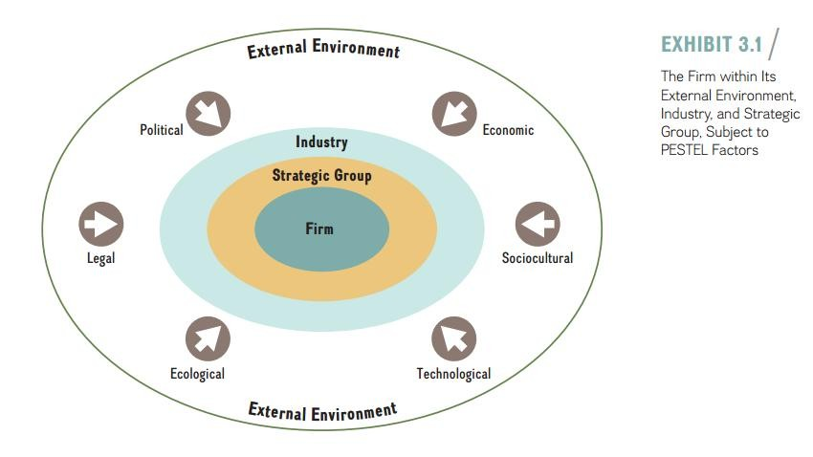
3–6

Slide 7
Lecture
03
Looking Outside: Understanding the Industry and Competition
The PESTEL model groups the factors in the firm’s general environment into six segments:
Political
Economic
Sociocultural
Technological
Ecological
Legal

Slide 8
Looking Outside: Understanding the Industry and Competition
Lecture
03
- Political Factors:
Political factors stem from the processes and actions of government bodies that can shape firms' decisions and behavior. They include tax policy, tariffs and trade restrictions, regulation and deregulation, labor and environmental laws, and overall political stability. Although these factors sit in the general environment—where firms traditionally have little sway—companies increasingly try to influence this realm through nonmarket strategies such as lobbying, public relations, political contributions, and litigation aimed at outcomes favorable to the firm. Firms that monitor and engage these forces early can reduce regulatory risk and turn shifting policy into a source of competitive advantage.

Slide 9
Lecture
03
Looking Outside: Understanding the Industry and Competition
- Economic Factors:
Economic factors in a firm’s external environment are largely macroeconomic,
affecting economy-wide phenomena. Managers need to consider how the
following five macro-economic factors can affect firm strategy:
Growth rates.
Levels of employment.
Interest rates.
Price stability (inflation and deflation).
Currency exchange rates.

Slide 10
Lecture
03
Looking Outside: Understanding the Industry and Competition
Growth rates. The overall economic growth rate is a measure of the change in the amount of goods and services produced by a nation’s economy. Strategists look to the real growth rate, which adjusts for inflation. This real growth rate indicates the current business cycle of the economy—that is, whether business activity is expanding or contracting.

Slide 11
Lecture
03
Looking Outside: Understanding the Industry and Competition
levels of Employment. Growth rates directly affect the level of employment. In boom times, unemployment tends to be low, and skilled human capital becomes a scarce and more expensive resource. In economic downturns, unemployment rises. As more people search for employment, skilled human capital is more abundant and wages usually fall.

Slide 12
Lecture
03
Looking Outside: Understanding the Industry and Competition
Interest rates. Another key macroeconomic variable for managers to track is real interest rates—the amount that creditors are paid for use of their money and the amount that debtors pay for that use, adjusted for inflation.
price Stability. Price stability—the lack of change in price levels of goods and services—is rare. Therefore, companies will often have to deal with changing price levels, which is a direct function of the amount of money in any economy.
Currency Exchange rates. The currency exchange rate determines how many dollars one must pay for a unit of foreign currency. It is a critical variable for any company that buys or sells products and services across national borders.

Slide 13
Lecture
03
Looking Outside: Understanding the Industry and Competition
- Sociocultural Factors:
Sociocultural factors capture a society’s cultures, norms, and values. Because sociocultural factors not only are constantly in flux but also differ across groups, managers need to closely monitor such trends and consider the implications for firm strategy. In recent years, for example, a growing number of U.S. consumers have become more health conscious about what they eat. This trend led to a boom for businesses such as Chipotle, Subway, and Whole Foods. At the same time, traditional fast-food companies McDonald’s and Burger King, along with grocery chains such as Albertsons and Kroger, have all had to scramble to provide healthier choices in their product offerings.

Slide 14
Lecture
03
Looking Outside: Understanding the Industry and Competition
- Technological Factors:
Technological factors capture the application of knowledge to create new processes and products. Major innovations in process technology include lean manufacturing, Six Sigma quality, and biotechnology. The nanotechnology revolution, which is just beginning, promises significant upheaval for a vast array of industries ranging from tiny medical devices to new-age materials for earthquake-resistant buildings. Recent product innovations include the smartphone, computer tablets, and high-performing electric cars such as the Tesla Model S. Recent service innovations include social media and online search engines that respond to voice commands.

Slide 15
Lecture
03
Looking Outside: Understanding the Industry and Competition
- Ecological Factors:
Ecological factors involve broad environmental issues such as the natural environment, global warming, and sustainable economic growth. Organizations and the natural environment coexist in an interdependent relationship. Managing these relationships in a responsible and sustainable way directly influences the continued existence of human societies and the organizations we create. Managers can no longer separate the natural and the business worlds; they are inextricably linked.

Slide 16
Lecture
03
Looking Outside: Understanding the Industry and Competition
- Legal Factors:
Legal factors include the official outcomes of political processes as manifested in laws, mandates, regulations, and court decisions—all of which can have a direct bearing on a firm’s profit potential. In fact, regulatory changes tend to affect entire industries at once. Many industries in the United States have been deregulated over the last few decades, including airlines, telecom, energy, and trucking, among others.

Slide 17
Lecture
03
Looking Outside: Understanding the Industry and Competition
3.2. Industry Structure and Firm Strategy: The Five Forces Model
Michael Porter developed the highly influential five forces model to help managers understand the profit potential of different industries and how they can position their respective firms to gain and sustain competitive advantage. By combining theory from industrial organization economics with hundreds of detailed case studies, Porter derived two key insights that form the basis of his seminal five forces model:

Slide 18
Looking Outside: Understanding the Industry and Competition
Lecture
03
Rather than defining competition narrowly as the firm’s closest competitors to explain and predict a firm’s performance, competition must be viewed more broadly, to also encompass the other forces in an industry: buyers, suppliers, potential new entry of other firms, and the threat of substitutes.
The profit potential of an industry is neither random nor entirely determined by industry-specific factors. Rather, it is a function of the five forces that shape competition: threat of entry, power of suppliers, power of buyers, threat of substitutes, and rivalry among existing firms.

Slide 19
Lecture
03
Looking Outside: Understanding the Industry and Competition
Competition In The Five Forces Model
Because the five forces model has especially powerful implications for strategy and competitive advantage, we will explore it in some detail. We start with the concept of competition. The first major insight this model provides is that competition involves more than just creating economic value; firms must also capture a significant share of it or they will see the economic value they create lost to suppliers, customers, or competitors. Firms create economic value by expanding as much as possible the gap between the value (V) the firm’s product or service generates and the cost (C) to produce it. Economic value thus equals V minus C. To succeed, creating value is not enough. Firms must also be able to capture a significant share of the value created to gain and sustain a competitive advantage.

Slide 20
Lecture
03
Looking Outside: Understanding the Industry and Competition
As Exhibit 3.2 shows, Porter’s model identifies five key competitive forces that managers need to consider when analyzing the industry environment and formulating competitive strategy:
Threat of entry.
Power of suppliers.
Power of buyers.
Threat of substitutes.
Rivalry among existing competitors.

Slide 21
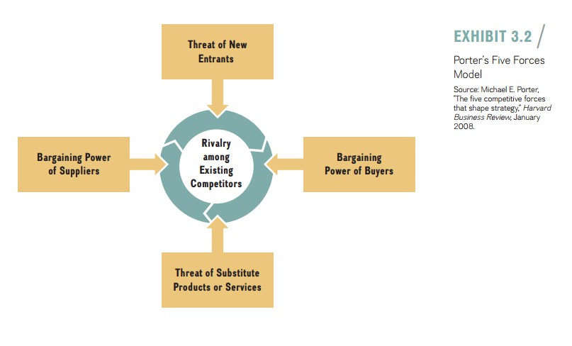
3–21

Slide 22
Lecture
03
Looking Outside: Understanding the Industry and Competition
The Threat of Entry:
The threat of entry describes the risk that potential competitors will enter the industry. Potential new entry depresses industry profit potential in two major ways:
  With the threat of additional capacity coming into an industry, incumbent firms may lower prices to make entry appear less attractive to the potential new competitors, which would in turn reduce the overall industry’s profit potential, especially in industries with slow or no overall growth in demand. 2. The threat of entry by additional competitors may force incumbent firms to spend more to satisfy their existing customers. This spending reduces an industry’s profit potential, especially if firms can’t raise prices.

Slide 23
Lecture
03
Looking Outside: Understanding the Industry and Competition
Of course, the more profitable an industry, the more attractive it is for new competitors to enter. There are, however, a number of important barriers to entry that raise the costs for potential competitors and reduce the threat of entry. Entry barriers, which are advantageous for incumbent firms, are obstacles that determine how easily a firm can enter an industry. Incumbent firms can benefit from several important sources of entry barriers:

Slide 24
Lecture
03
Looking Outside: Understanding the Industry and Competition
Economies of scale.
Network effects.
Customer switching costs.
Capital requirements.
Advantages independent of size.
Government policy.
Credible threat of retaliation.

Slide 25
Looking Outside: Understanding the Industry and Competition
Lecture
03
2. The power of Suppliers
The bargaining power of suppliers captures pressures that industry suppliers can exert on an industry’s profit potential. This force reduces a firm’s ability to obtain superior performance for two reasons: Powerful suppliers can raise the cost of production by demanding higher prices for their inputs or by reducing the quality of the input factor or service level delivered. Powerful suppliers are a threat to firms because they reduce the industry’s profit potential by capturing part of the economic value created.

Slide 26
Lecture
03
Looking Outside: Understanding the Industry and Competition
To compete effectively, companies generally need a wide variety of inputs into the production process, including raw materials and components, labor (via individuals or labor unions, when the industry faces collective bargaining), and services. The relative bargaining power of suppliers is high when
The suppliers’ industry is more concentrated than the industry it sells to.
Suppliers do not depend heavily on the industry for a large portion of their revenues.

Slide 27
Lecture
03
Looking Outside: Understanding the Industry and Competition
Incumbent firms face significant switching costs when changing suppliers.
Suppliers offer products that are differentiated.
There are no readily available substitutes for the products or services that the suppliers offer.
Suppliers can credibly threaten to forward-integrate into the industry.

Slide 28

Looking Outside: Understanding the Industry and Competition
Lecture
03
3. The Power of Buyers
The bargaining power of buyers is the mirror image of supplier power. Buyers are an industry's customers, and their power reflects the pressure they can place on producers' margins by pushing for lower prices or higher quality. Discounts squeeze revenue, while demands for better quality and service raise costs. Powerful buyers therefore capture part of the value created and reduce the industry's profit potential.
Buyers are strongest when they purchase in large volumes, when the product is undifferentiated, when switching costs are low, or when they could credibly produce the product themselves (backward integration).

Slide 29
Lecture
03
Looking Outside: Understanding the Industry and Competition
The power of buyers is high when
There are a few buyers and each buyer purchases large quantities relative to the size of a single seller.
The industry’s products are standardized or undifferentiated commodities.
Buyers face low or no switching costs.
Buyers can credibly threaten to backwardly integrate into the industry.

Slide 30
Lecture
03
Looking Outside: Understanding the Industry and Competition
In addition, companies need to be aware especially price sensitive. This is the case when:
of situations when buyers are
The buyer’s purchase represents a significant fraction of its cost structure or procurement budget.
Buyers earn low profits or are strapped for cash.
The quality (cost) of the buyers’ products and services is not affected much by the quality (cost) of their inputs.

Slide 31
Lecture
03
Looking Outside: Understanding the Industry and Competition
The Threat of substitutes
Substitutes meet the same basic customer needs as the industry’s product but in a different way. The threat of substitutes is the idea that products or services available from outside the given industry will come close to meeting the needs of current customers.
A high threat of substitutes reduces industry profit potential by limiting the price the industry’s competitors can charge for their products and services. The threat of substitutes is high when:
  The substitute offers an attractive price-performance trade-off.
  The buyer’s cost of switching to the substitute is low.

Slide 32
Looking Outside: Understanding the Industry and Competition
Lecture
03
5. Rivalry Among Existing Competitors
This force captures how intensely firms in the same industry compete for market share and profit, ranging from genteel to cut-throat. The other four forces—threat of entry, buyer and supplier power, and the threat of substitutes—all feed into this rivalry, as shown by the arrows pointing toward the center in Exhibit 3.2. The stronger those forces, the more intense the competition, and the lower the industry's profit potential.
Rivalry tends to intensify when there are many competitors of roughly equal size, when industry
growth is slow, when products are undifferentiated, when fixed costs or exit barriers are high,
and when firms compete mainly on price rather than on brand, quality, or service.

Slide 33
Lecture
03
Looking Outside: Understanding the Industry and Competition
The intensity of rivalry among existing competitors is determined largely by the
following factors:
Competitive industry structure.
Industry growth.
Strategic commitments.
Exit barriers.

Slide 34
Lecture
03
Looking Outside: Understanding the Industry and Competition
Competitive Industry Structure. The competitive industry structure refers to elements and features common to all industries. The structure of an industry is largely captured by
The number and size of its competitors.
The firms’ degree of pricing power.
The type of product or service (commodity or differentiated product).
The height of entry barriers.

Slide 35
Looking Outside: Understanding the Industry and Competition
Lecture
03
Industry Growth. The pace of industry growth shapes how intensely rivals compete. When demand is rising quickly, price competition tends to ease: because the pie is expanding, firms focus on capturing a share of new growth rather than fighting one another for existing customers and profits. Knee replacements, for instance, are a fast-growing segment of the medical products industry.
The reverse holds in slow-growing or declining markets. When the pie is no longer expanding, the only way to grow is to take share from rivals, which fuels price wars, heavier marketing spend, and shrinking margins. This is why rivalry is typically fiercest in mature industries—such as commercial airlines or packaged foods—where firms fight over a relatively fixed pool of demand.

Slide 36
Lecture
03
Looking Outside: Understanding the Industry and Competition
Strategic Commitments. If firms make strategic commitments to compete in an industry, rivalry among competitors is likely to be more intense. We defined strategic commitments(in Chapter 2) as firm actions that are costly, long-term oriented, and difficult to reverse. Strategic commitments to a specific industry can stem from large, fixed cost requirements, but also from non-economic considerations.

Slide 37
Lecture
03
Looking Outside: Understanding the Industry and Competition
Exit Barriers. The rivalry among existing competitors is also a function of an industry’s exit barriers, the obstacles that determine how easily a firm can leave that industry. Exit barriers comprise both economic and social factors. They include fixed costs that must be paid regardless of whether the company is operating in the industry or not.

Slide 38
Looking Outside: Understanding the Industry and Competition
Lecture
03
A Sixth Force: The Strategic Role of Complements
As valuable as the five forces model is for explaining the profit potential and attractiveness of industries, it can be enhanced by also considering the availability of complements. A complement is a product, service, or competency that adds value to the original offering when the two are used together. Complementors are companies that provide these goods or services.
For example, apps make a smartphone more valuable, and a strong app ecosystem can determine a platform's success. When complements are plentiful, demand for the core product rises and the whole industry's profit potential grows; when they are scarce, that potential is constrained.

Slide 39
Looking Outside: Understanding the Industry and Competition
Lecture
03
A complement is a product, service, or competency that adds value to the original product offering when the two are used in tandem. Complements increase demand for the primary product, thereby enhancing the profit potential for the industry and the firm. A company is a complement or to your company if customers value your product or service offering more when they are able to combine it with the other company’s product or service. Firms may choose to provide the complements themselves or work with another company to accomplish this.

Slide 40
Looking Outside: Understanding the Industry and Competition
Lecture
03
For example, in the smartphone industry, Google complements Samsung. The Korean high-tech company’s smartphones are more valuable when they come with Google’s Android system installed. At the same time, Google and Samsung are increasingly becoming competitors. With Google’s acquisition of Motorola Mobility, the online search company is planning to launch its own line of smartphones and Chromebooks. This development illustrates the process of co-opetition, which is cooperation by competitors to achieve a strategic objective. Samsung and Google cooperate as complementary to compete against Apple’s strong position in the mobile device industry, while at the same time Samsung and Google are increasingly becoming competitive with one another.

Slide 41
Looking Outside: Understanding the Industry and Competition
Lecture
03
3.3 Changes over Time: Industry Dynamics
Although the five-forces-plus-complements model is useful in understanding an industry’s profit potential, it provides only a point-in-time snapshot of a moving target. With this model (as with other static models), one cannot determine the changing speed of an industry or the rate of innovation. This drawback implies that managers must repeat their analysis over time in order to create a more accurate picture of their industry. It is therefore important that managers consider industry dynamics.

Slide 42
Looking Outside: Understanding the Industry and Competition
Lecture
03
Industry structures are not stable over time. Rather, they are dynamic. Since a consolidated industry tends to be more profitable than a fragmented one firms have a tendency to change the industry structure in their favor, making it more consolidated through horizontal mergers and acquisitions. Having fewer competitors generally equates to higher industry profitability. Industry incumbents, therefore, have an incentive to reduce the number of competitors in the industry. With fewer but larger competitors, incumbent firms can mitigate the threat of strong competitive forces such as supplier or buyer power more effectively.

Slide 43
Looking Outside: Understanding the Industry and Competition
Lecture
03
3.4 Performance Differences within the Same Industry: Strategic Groups
In further analyzing the firm’s external environment to explain performance differences, we now move to firms within the same industry. As noted earlier in the chapter, a firm occupies a place within a strategic group, a set of companies that pursue a similar strategy within a specific industry in their quest for competitive advantage. Strategic groups differ from one another along important dimensions such as expenditures on research and development, technology, product differentiation, product and service offerings, pricing, market segments, distribution channels, and customer service.

Slide 44
Lecture
03
Looking Outside: Understanding the Industry and Competition
To explain differences in firm performance within the same industry, the strategic group model clusters different firms into groups based on a few key strategic dimensions. Even within the same industry, firm performances differ depending on strategic group membership. Some strategic groups tend to be more profitable than others. This difference implies that firm performance is determined not only by the industry to which the firm belongs, but also by its strategic group membership.

Slide 45
Lecture
03
Looking Outside: Understanding the Industry and Competition
- The Strategic Group Model
To understand competitive behavior and performance within an industry, we can
map the industry competitors into strategic groups. We do this as shown:
Identify the most important strategic dimensions such as expenditures on research and development, technology, product differentiation, product and service offerings, pricing, market segments, distribution channels, and customer service.

Slide 46
Lecture
03
Looking Outside: Understanding the Industry and Competition
Choose two key dimensions for the horizontal and vertical axes, which expose important differences among the competitors. The dimensions chosen for the axes should not be highly correlated.
Graph the firms in the strategic group, indicating each firm’s market share by the size of the bubble with which it is represented.
The strategic group mapping in Exhibit 3.5 provides some additional insights:

Slide 47
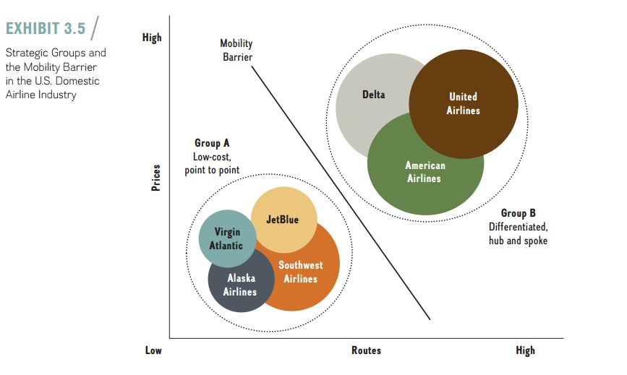
3–47

Slide 48
Looking Outside: Understanding the Industry and Competition
Lecture
03
- Mobility Barriers
Some strategic groups are more profitable, and therefore more attractive, than others—but mobility barriers limit movement between them. These are industry-specific factors that separate one group from another. In Exhibit 3.5, the two groups are divided by the fact that international routes require a hub-and-spoke model. Such routes are often the most profitable ones left to legacy carriers, though Persian Gulf airlines—notably Emirates, Etihad, and Qatar Airways—increasingly threaten that profit sanctuary.
Typical mobility barriers include heavy capital requirements, established brand reputation, proprietary technology, control of distribution channels, and economies of scale. The higher these barriers, the harder
it is for a firm in a less attractive group to migrate to a more profitable one—and the more durable the advantage of the firms already there.

Slide 49

References
Strategic management, third edition, 2017 By Frank t. Rothaermel
Georgia Institute of Technology.

Slide 50




Thank You

