Slide 1

5G Communications Technologies & Solutions
Lecture 3
IoT Security
Prepared by
Dr. Abdelrhman Ahmed

Slide 2
Foreword
Chapter
03
During the World Radiocommunication Conference 2015 held in Geneva, Switzerland from October 26 to 30, ITU Radiocommunication Sector (ITU- R) officially approved the resolution on promoting future 5G research and formally decided on "IMT-2020" as the official name of 5G.
5G is a new-generation communications technology. Its standards
evolution and industry development have attracted much attention and will be promoted by multiple parties. In addition, for mobile Internet and IoT scenarios, 5G brings new technologies and transformations.

Slide 3
Objectives
Chapter
03
Upon completion of this course, you will be able to:
Understand 5G standards evolution and industry development.
Master key technologies and points for 5G communications.
Distinguish between three 5G scenarios and their supported applications.
Be familiar with 5G business solutions and know the key to the success of operators'

Slide 4
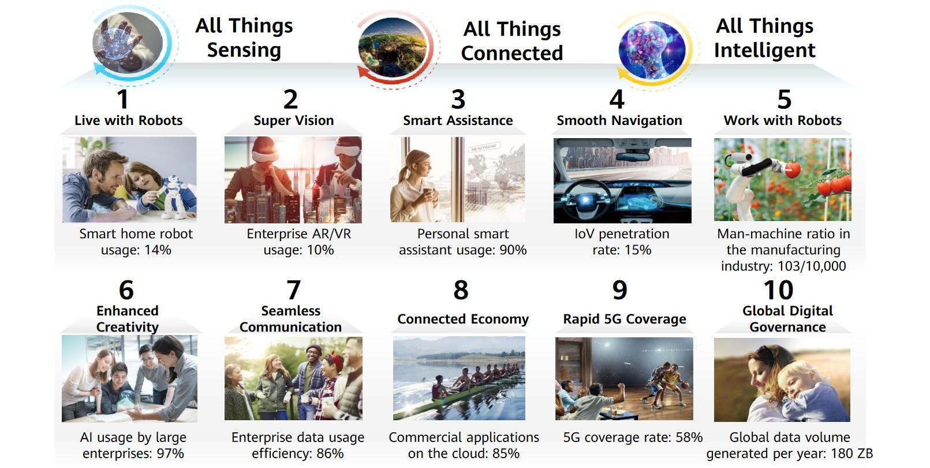
Vision 2025: Towards an Intelligent World
Chapter
03

Slide 5
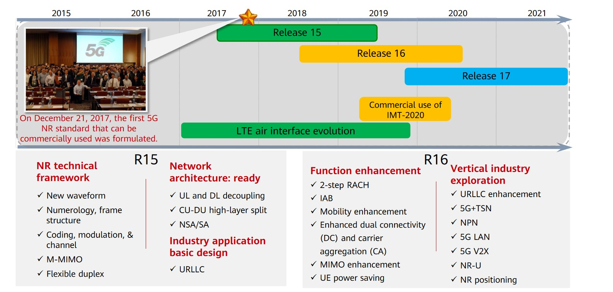
Evolution of 5G Communications Technical Standards
Chapter
03

Slide 6
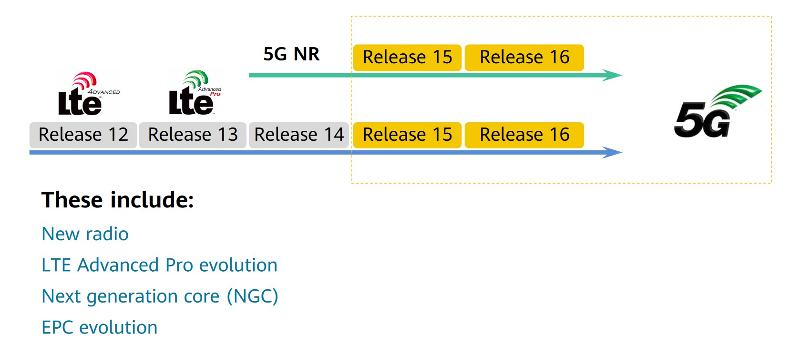
3GPP Release 15: New 5G Technology Standards
Chapter
03

Slide 7
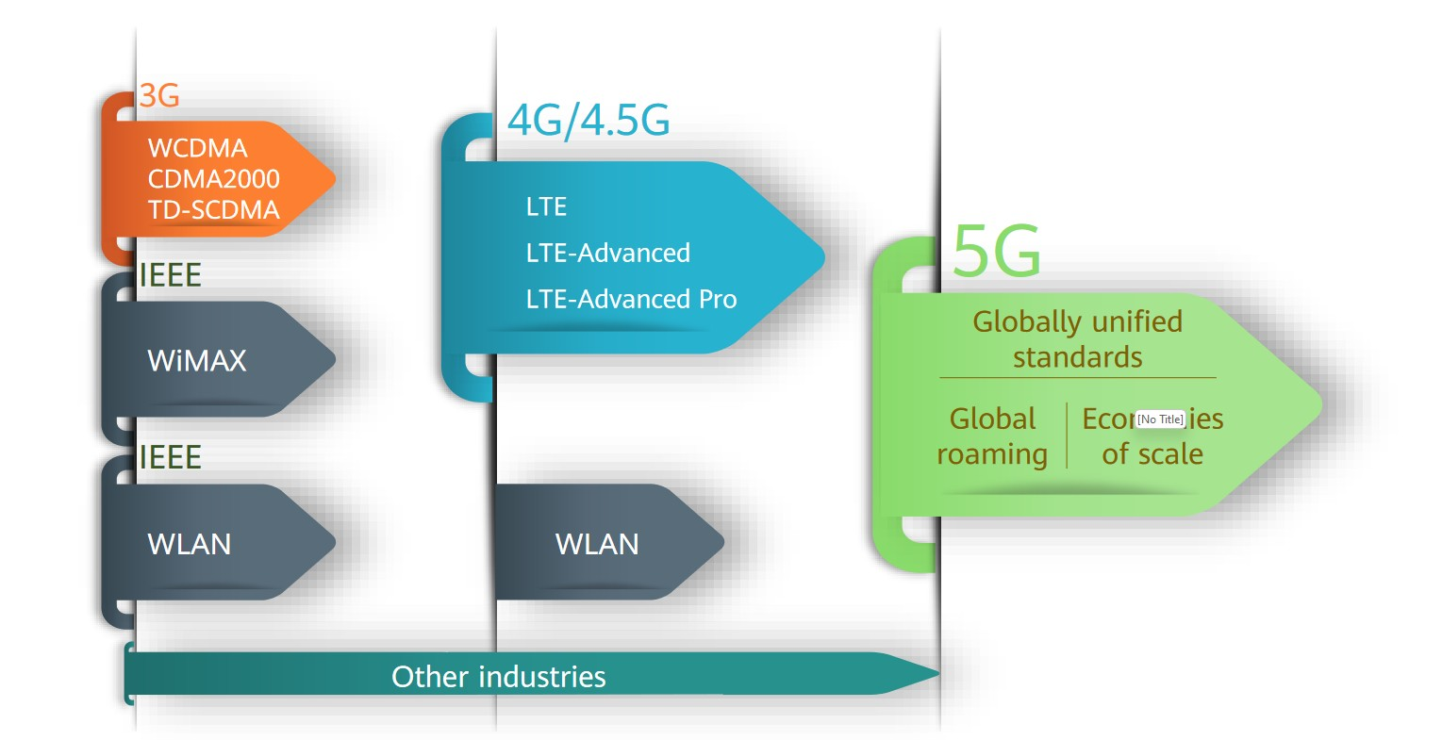
5G Unified Standards
Chapter
03

Slide 8
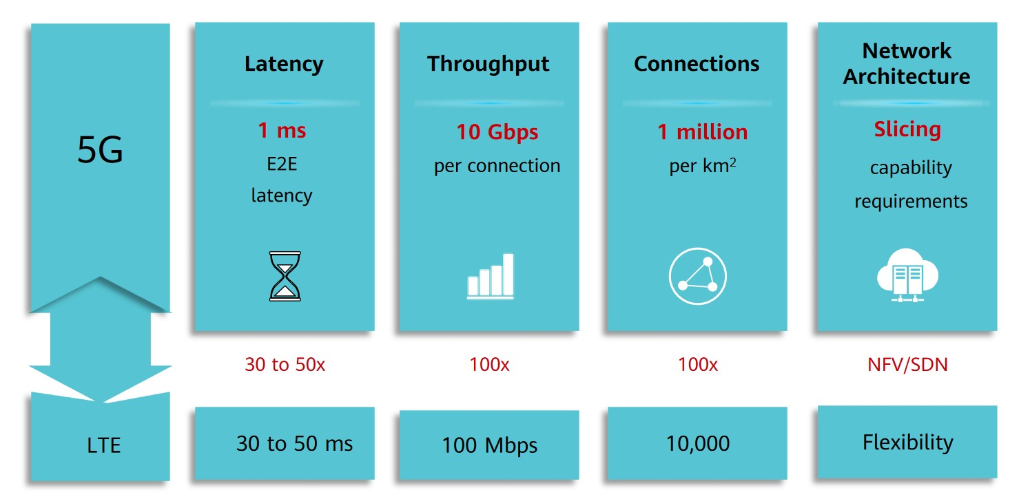
5G Key Performance Indicators
Chapter
03

Slide 9
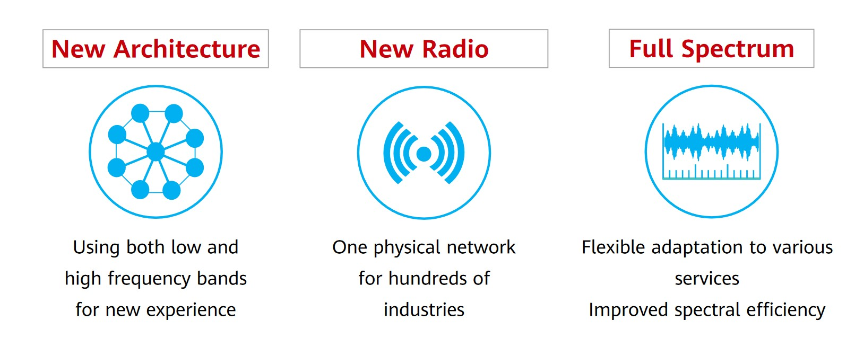
Three Key 5G Innovations
Chapter
03

Slide 10
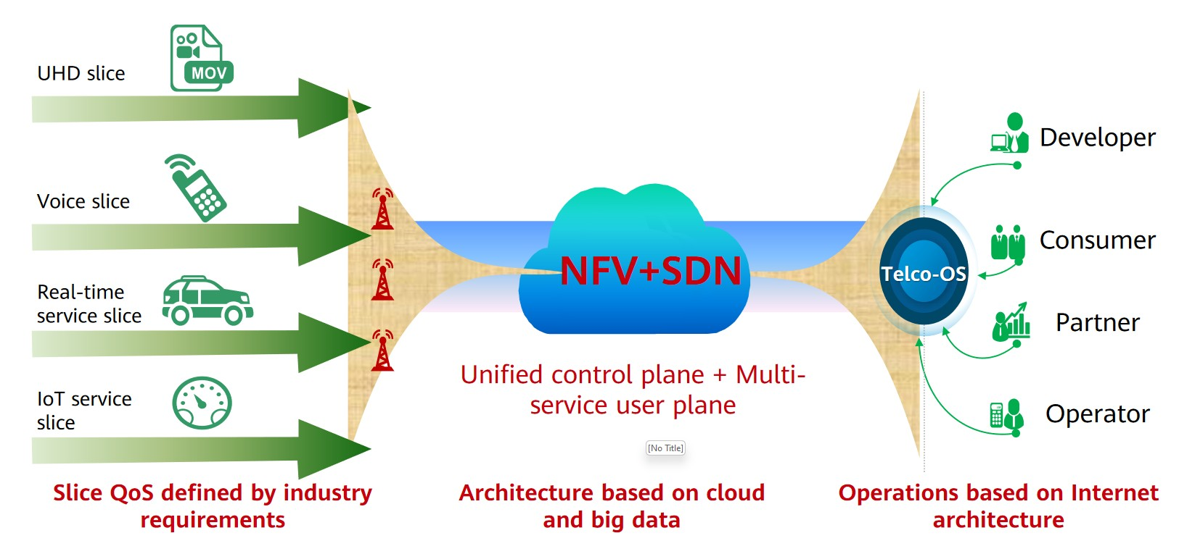
5G New Architecture – One Network for Hundreds of Industries
Chapter
03

Slide 11
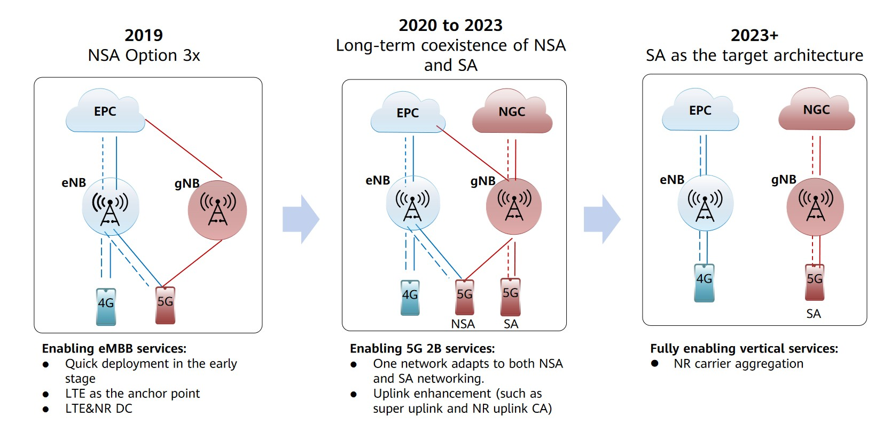
5G Networking Mode
Chapter
03

Slide 12
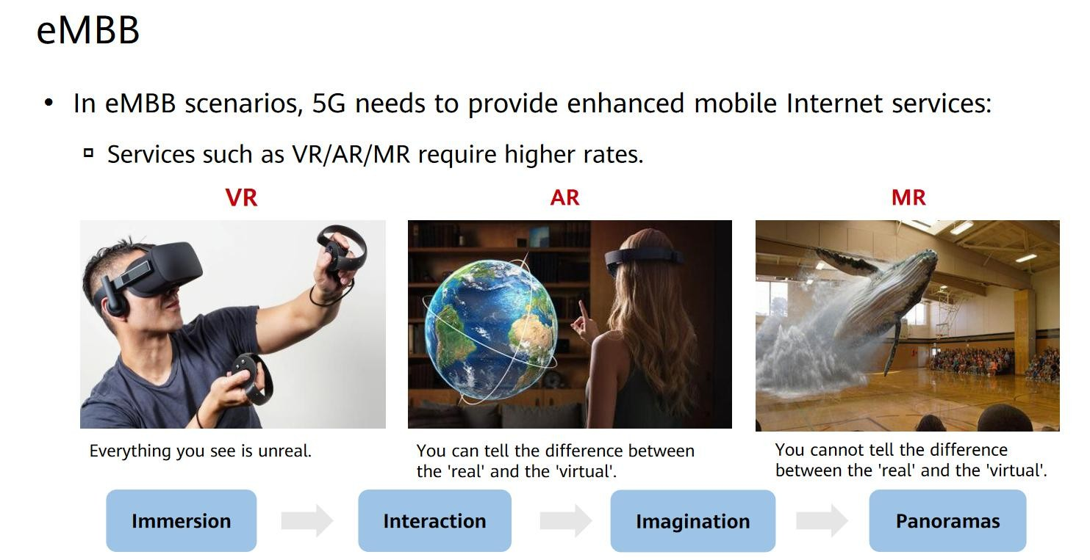
Three 5G Application Scenarios
Chapter
03

Slide 13
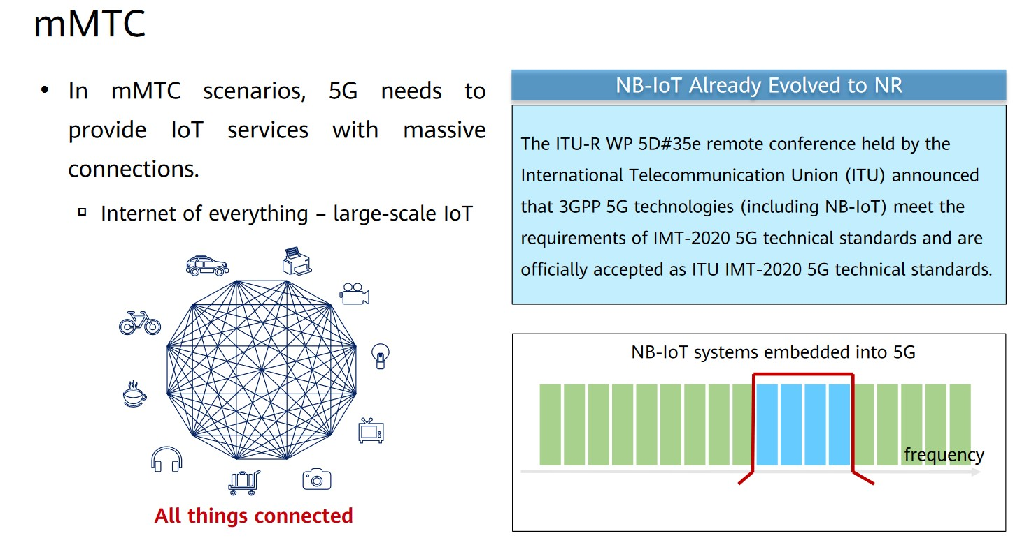
Three 5G Application Scenarios
Chapter
03

Slide 14
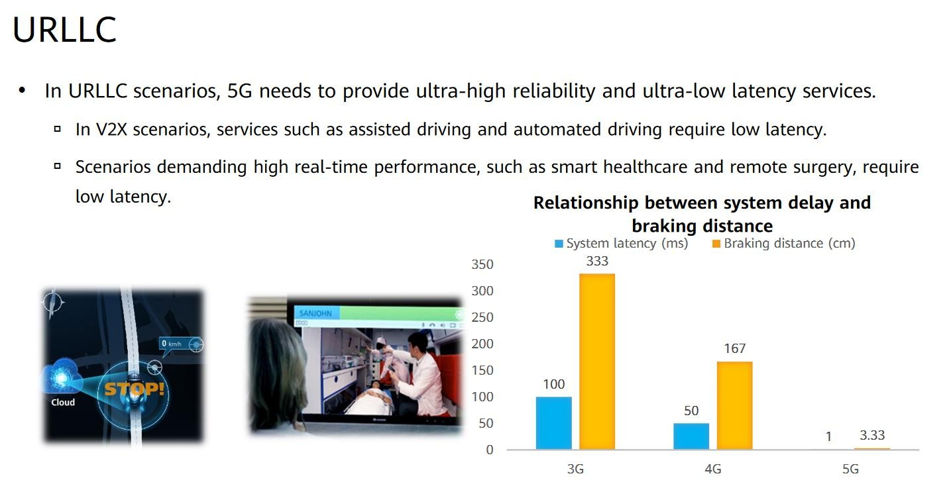
Three 5G Application Scenarios
Chapter
03

Slide 15
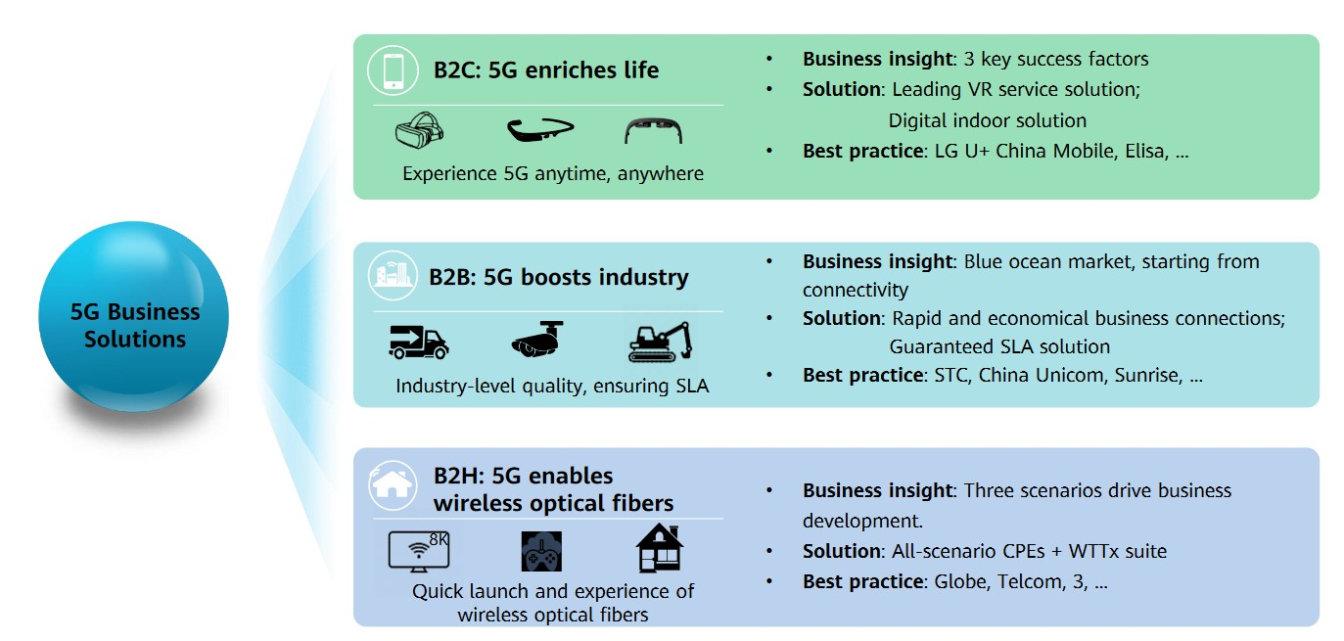
Three 5G Business Solutions Driving Business Success
Chapter
03

Slide 16
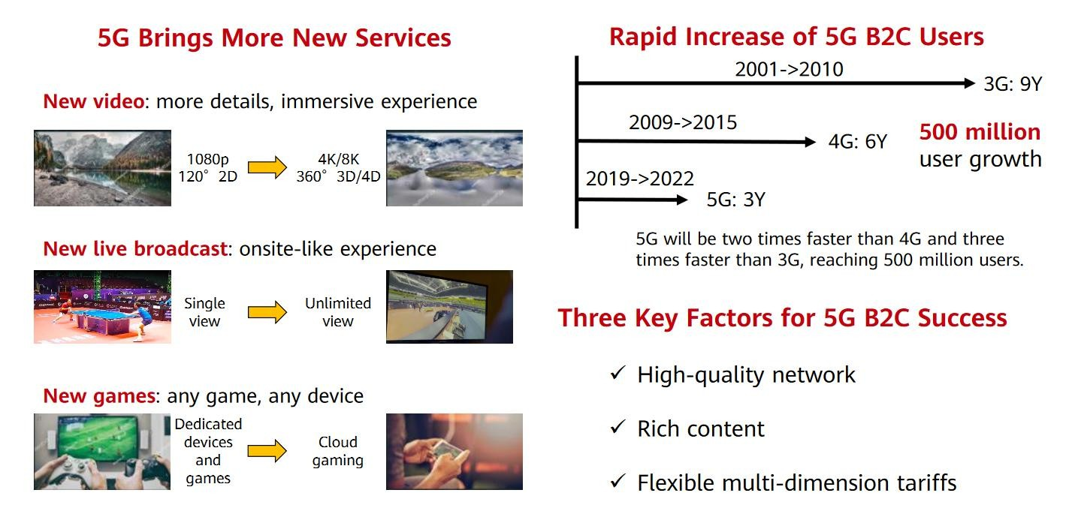
B2C Industry Insight: Three Key Success Factors
Chapter
03

Slide 17
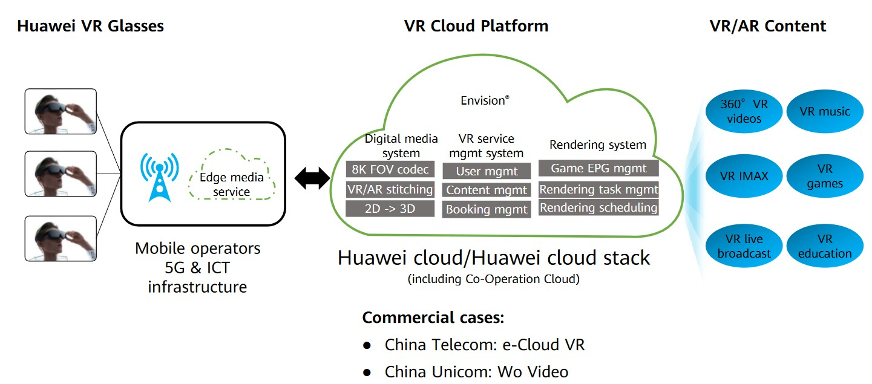
Solution: Driving VR/AR Business Success
Chapter
03

Slide 18



Thank You

