Slide 1




Mathematics 3 – MAT132
Mathematics 3
Lecture 10
MAT 132
Mathematical Operations by MATLAB
Prepared by
Dr. Israa Lewaa

Slide 2
Lecture Objectives
Lecture
05
Chapter Objectives
1- Learn the Importance of MATLAB.
2- Explain more about Elementary Functions.
3- Give a full illustration for Vectors and Matrices.
4- Understand how to conduct Matrix Multiplication.
5- Perform many Practical Examples on MATLAB

Slide 3
Lecture Outline
Lecture
09
Lecture Outline
1- Importance of MATLAB.
2- Elementary Functions.
3- Vectors and Matrices.
4- Matrix Multiplication.
5- Practical Examples on MATLAB

Slide 4

Importance of MATLAB
Lecture
08
Example

Slide 5
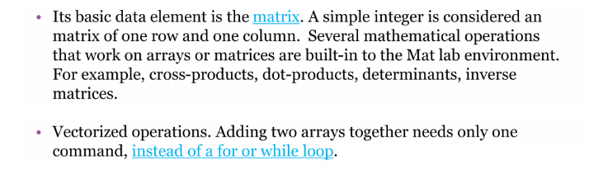
Lecture
08
Importance of MATLAB
Example

Slide 6
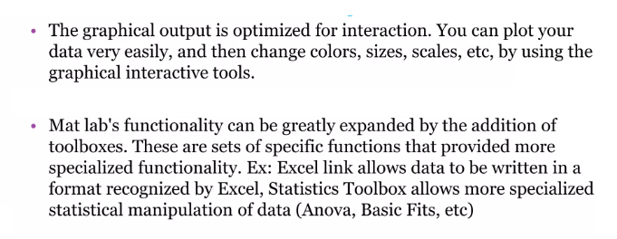
Importance of MATLAB
Lecture
08
Example

Slide 7
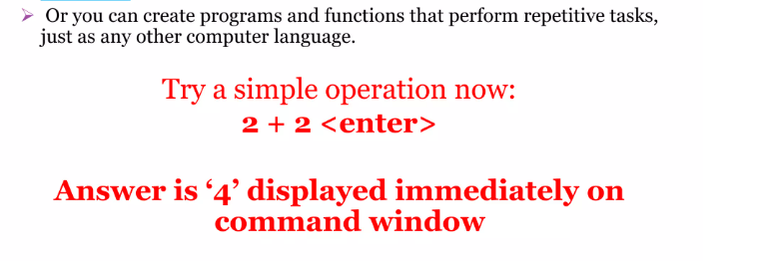
Importance of MATLAB
Lecture
08
Example

Slide 8
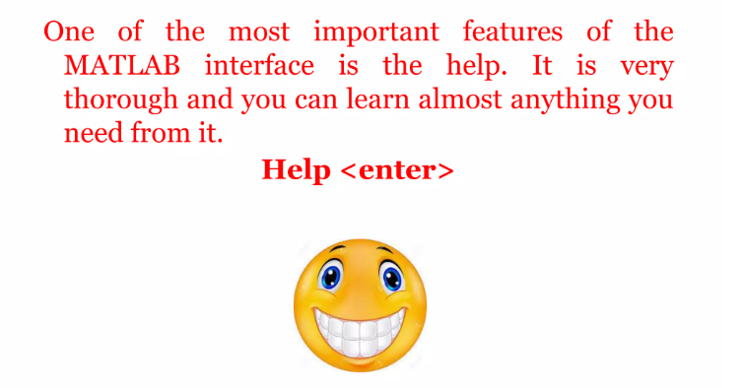
Importance of MATLAB
Lecture
08
Example

Slide 9
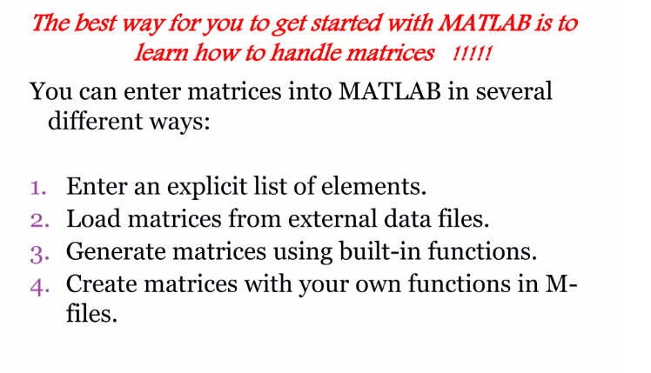
Importance of MATLAB
Lecture
08
Example

Slide 10
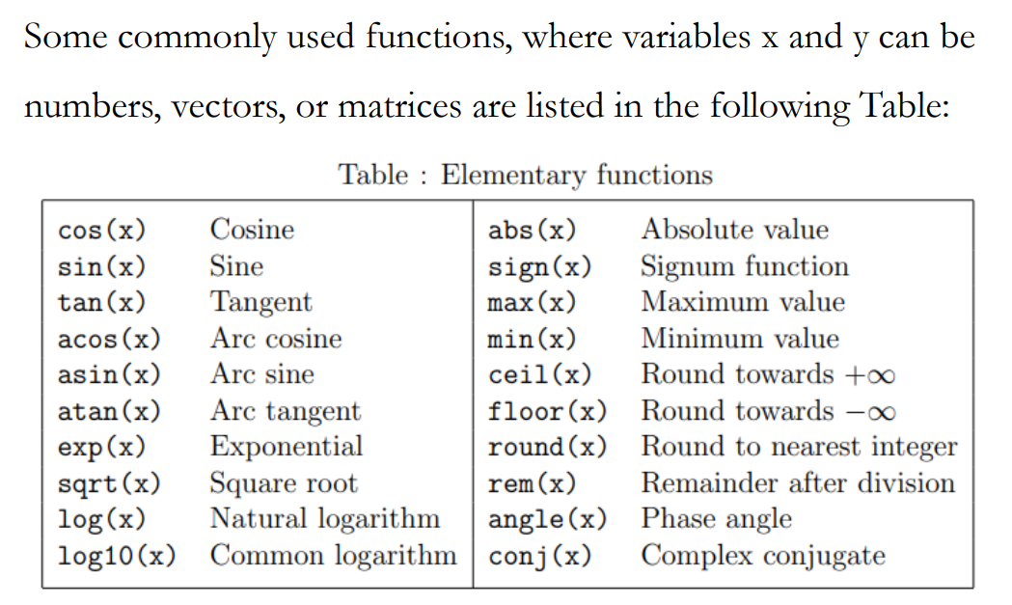
2- Elementary Functions
Lecture
08
1- Integration by parts

Slide 11
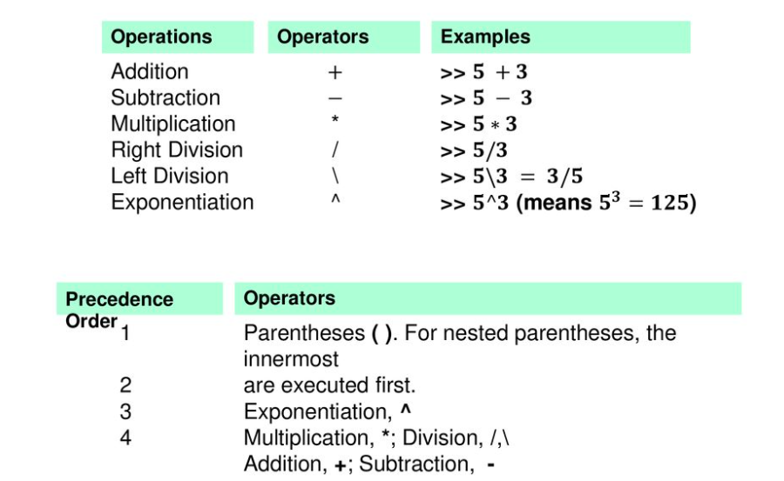
Creating MATLAB variables
Lecture
08
The Definite Integral

Slide 12
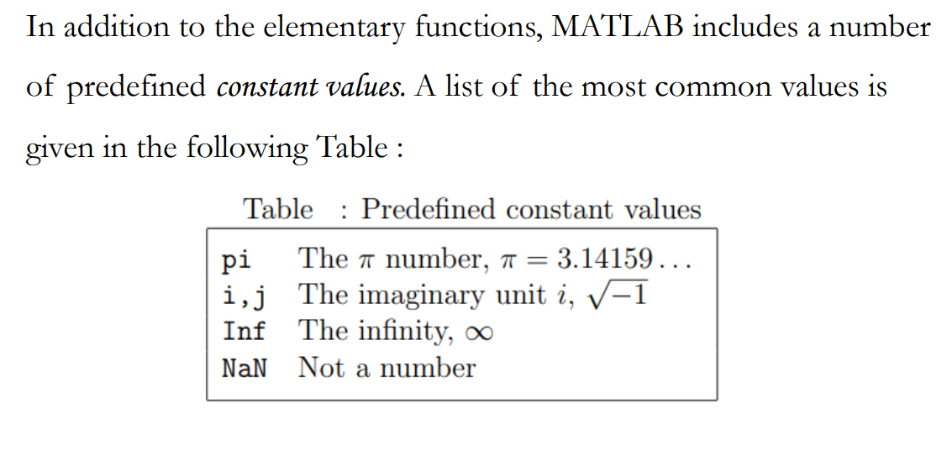
Elementary Functions
Lecture
08
Example

Slide 13
3- Matrices on MATLAB
Lecture
08
Example
Matrices on MATLAB

Slide 14
Matrices and Vectors
Lecture
08
Example
Input matrix
  A = [ 1 2 5; 3 9 0]
Use semicolon ";" to suppress output
Use … for line continuation

Slide 15
Matrices and Vectors
Lecture
08
The Definite Integral
Vector is a special case of matrix
Scalar is considered 1x1 matrix
  g = 9.81 (no [ … ] needed)
X = [ ] creates a null matrix

Slide 16
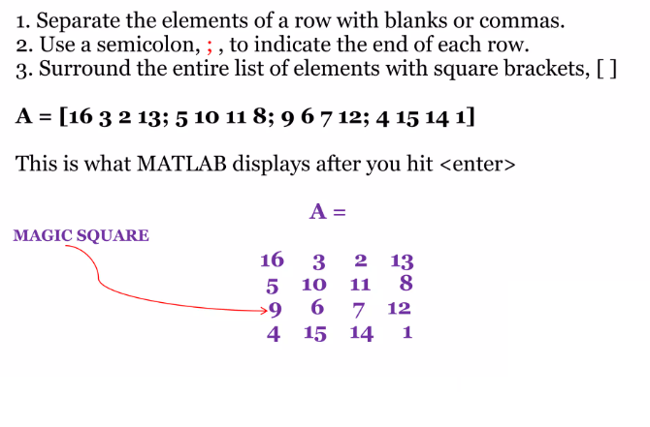
Matrices and Vectors
Lecture
08
Example

Slide 17
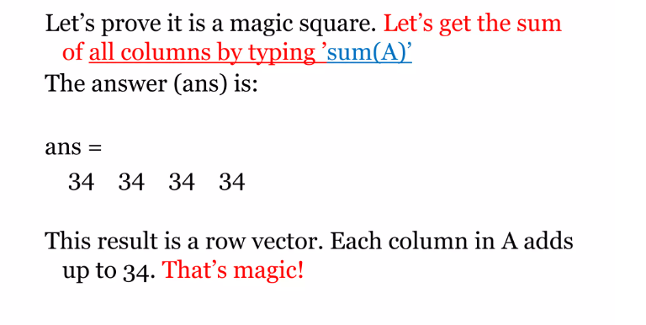
Magic Square
Lecture
08
Example

Slide 18
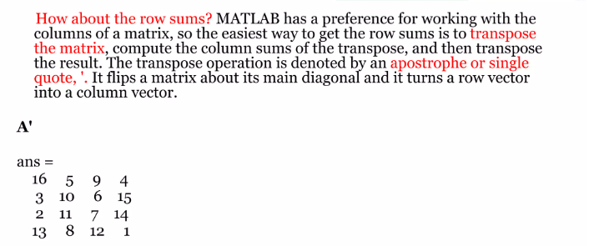
Transpose the Matrix
Lecture
08
Example

Slide 19
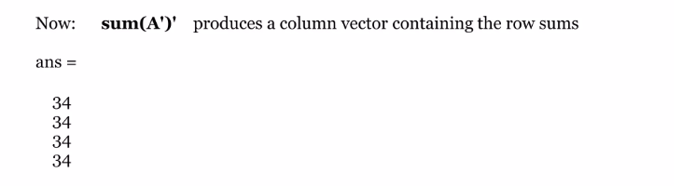
Row Sums
Lecture
08
Example

Slide 20
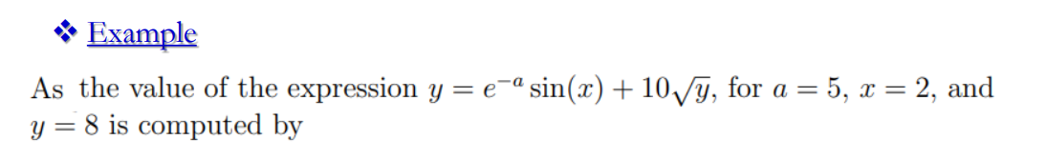
Extra Practice – Example 1
Lecture
08
Example

Slide 21
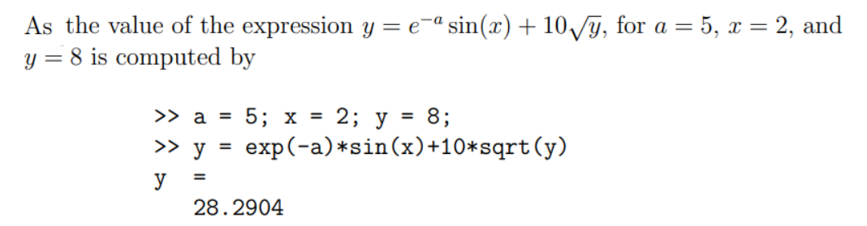
Extra Practice – Example 1 Solution
Lecture
08
Lecture
08
** Revision – Fundamentals

Slide 22
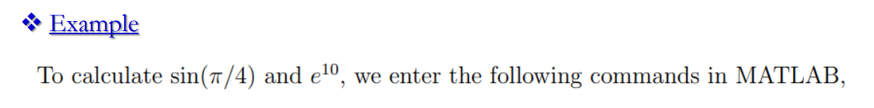
Extra Practice – Example 2
Lecture
08
Lecture
08
Example

Slide 23
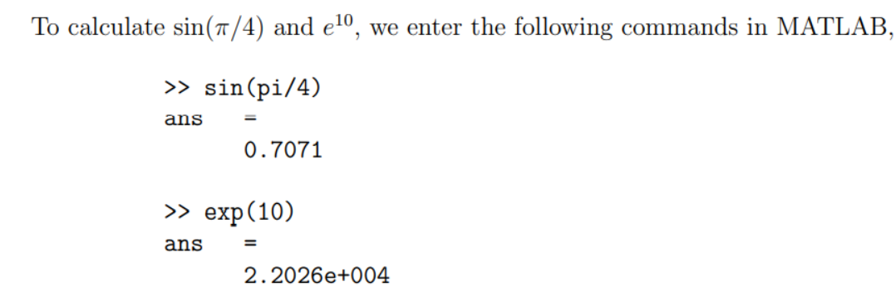
Extra Practice – Example 2 Solution
Lecture
08
Lecture
08
** Revision – Fundamentals

Slide 24
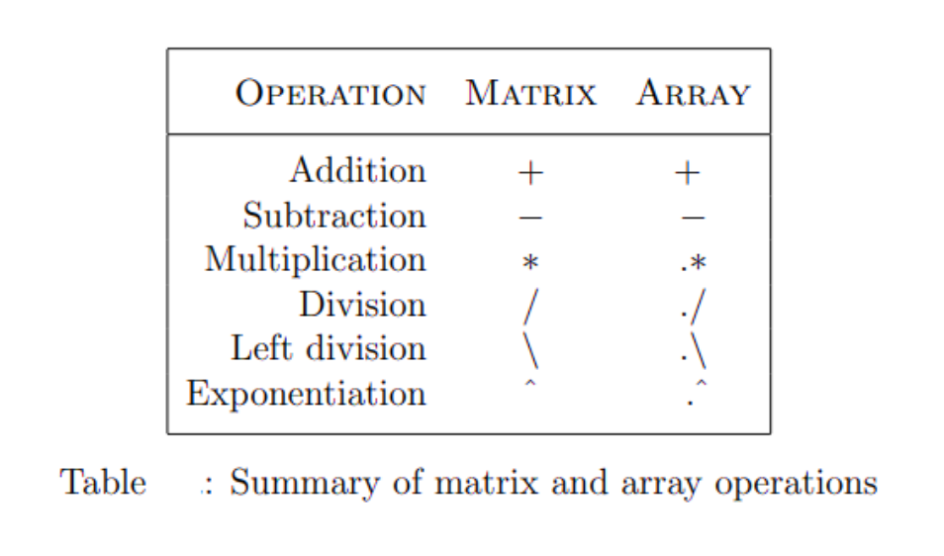
Summary of matrix and array Operations
Lecture
07
Lecture
08
** EXTRA PRACTISE

Slide 25
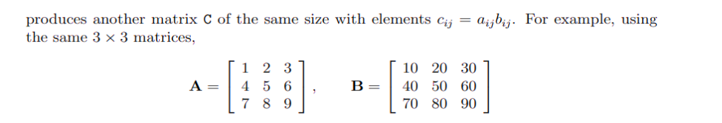
Extra Practice – Example 3
Lecture
08
Lecture
08
Example

Slide 26
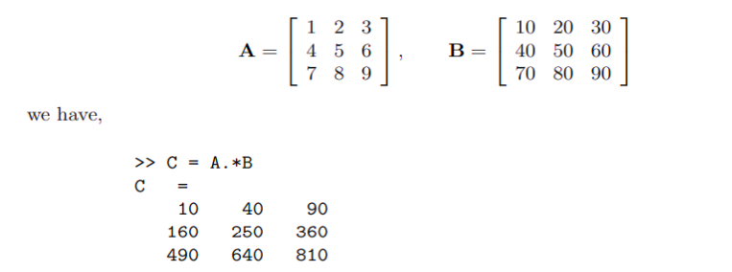
Extra Practice – Example 3 Solution
Lecture
08
Lecture
08
Example

Slide 27
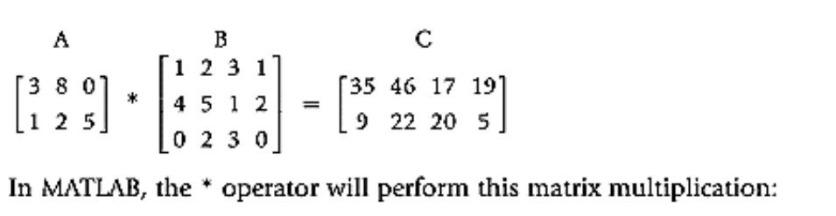
Extra Practice – Example 4
Lecture
08
Lecture
08
Example

Slide 28
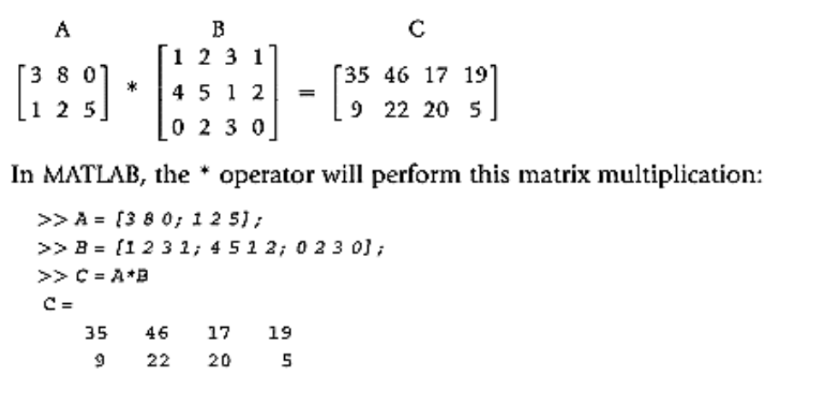
Extra Practice – Example 4 Solution
Lecture
08
Lecture
08
Example

Slide 29
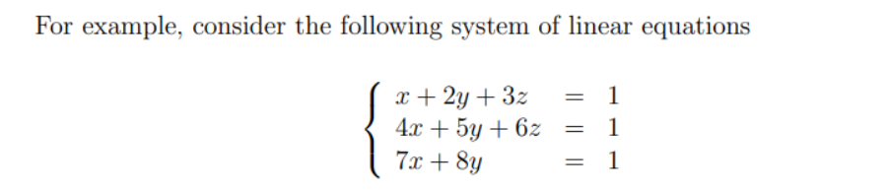
Extra Practice – Example 5
Lecture
07
Lecture
08
** EXTRA PRACTISE

Slide 30
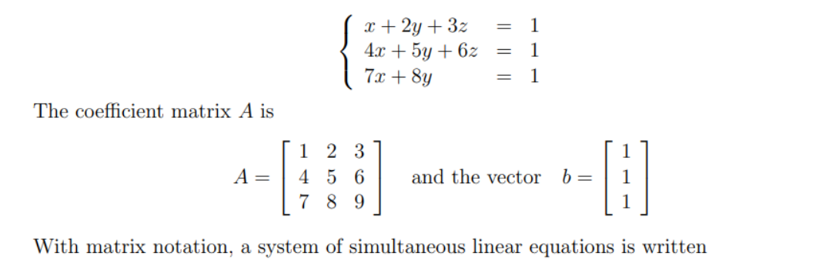
Extra Practice – Example 5 Solution
Lecture
07
Lecture
08
** EXTRA PRACTISE

Slide 31
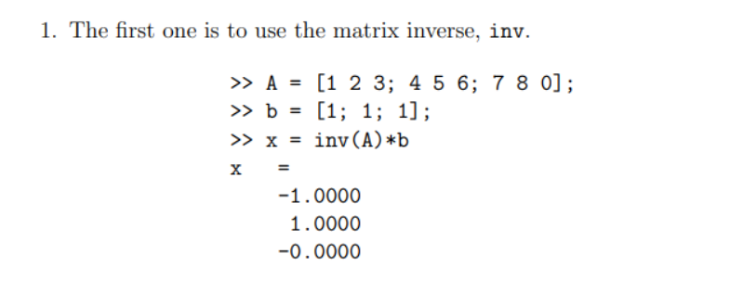
Extra Practice – Example 5 Solution
Lecture
08
Lecture
08
Examples for different Methods of Integration

Slide 32
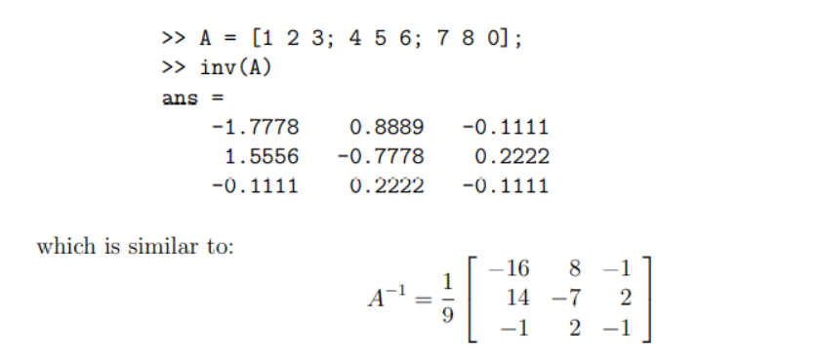
Extra Practice – Example 5 Solution
Lecture
08
Lecture
08
Example

Slide 33
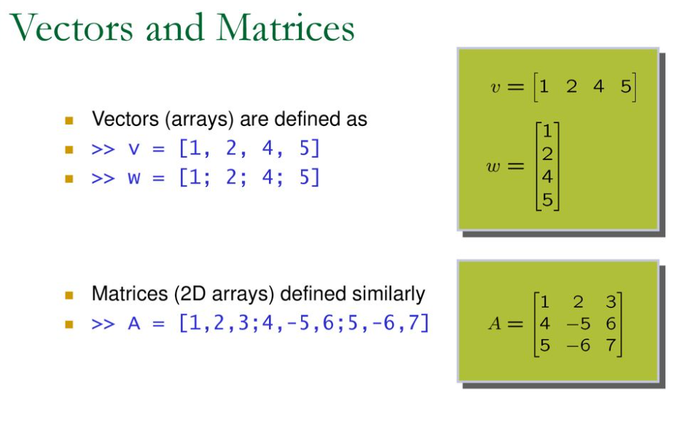
Vectors and Matrices
Lecture
08
Lecture
08
Example

Slide 34
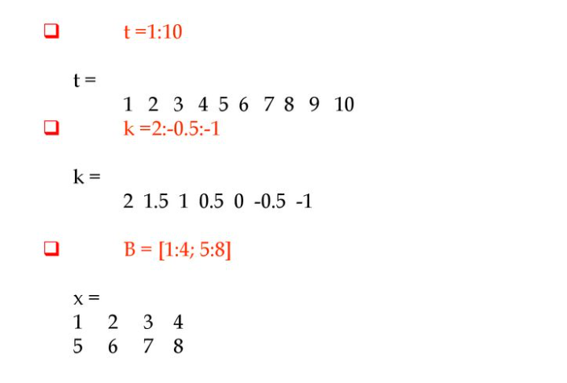
Vectors and Matrices
Lecture
08
Lecture
08
The Definite Integral

Slide 35
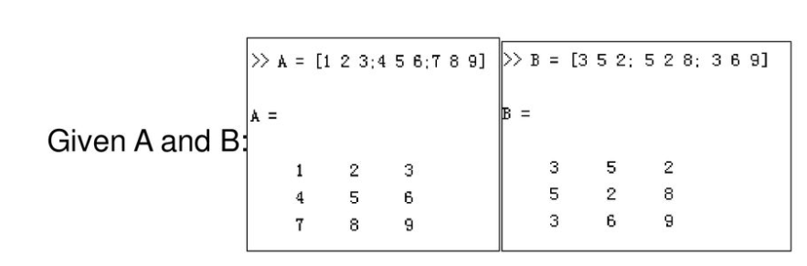
Extra Practice – Example 6
Lecture
08
Lecture
08
Example

Slide 36
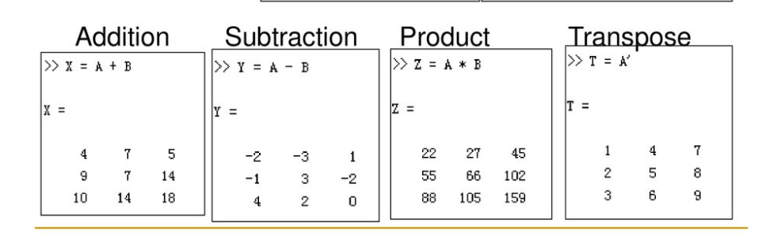
Extra Practice – Example 6 Solution
Lecture
08
Lecture
08
The Definite Integral

Slide 37
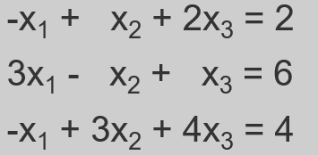
Extra Practice – Example 7
Lecture
08
Example

Slide 38
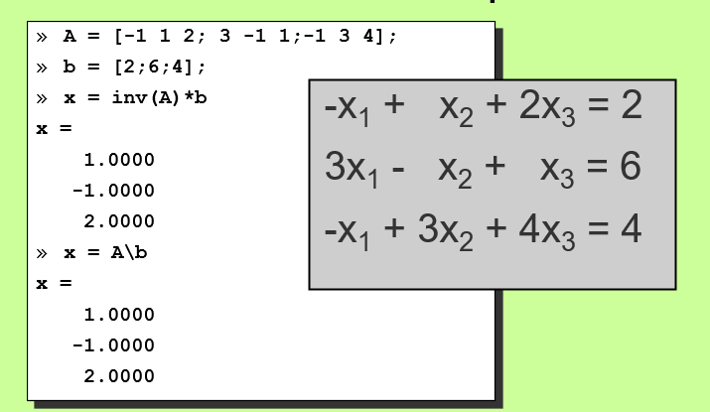
Extra Practice – Example 7 Solution
Lecture
08
The Definite Integral

Slide 39
Lecture Summary
Lecture
09
Lecture
08
Lecture Summary
1- Importance of MATLAB.
2- Elementary Functions.
3- Vectors and Matrices.
4- Matrix Multiplication.
5- Practical Examples on MATLAB

Slide 40
Success Tips for Math 3 Students
Lecture
10
Success Tips for Math 2 Students
1️⃣ Math is not about memorizing … Math is about understanding
Every rule in differentiation or integration has a geometric and practical meaning.
Understand why we differentiate and why we integrate.
Plot the function before solving — you will understand 50% of the problem before you even start.
2️⃣ Solve problems every day, even just one
Consistency matters more than quantity.
One problem a day is better than 30 problems the night before the exam.
Remember:
Math = Practice × Practice

Slide 41
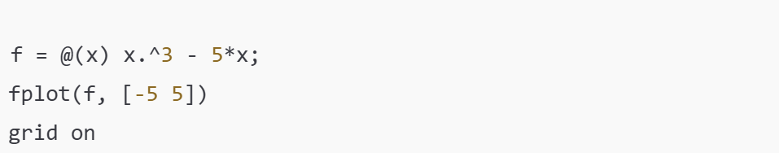
Success Tips for Math 3 Students
Lecture
10
Success Tips for Math 3 Students
3️⃣ Use MATLAB to Explore, Not to Replace Thinking
MATLAB is a powerful tool to help you understand complex concepts like:
Functions and plotting
Linear algebra operations
Numerical methods
Solving differential equations
Matrix computations
Use MATLAB to visualize, check your work, and experiment, not as a shortcut.
Example:

Slide 42
Success Tips for Math 3 Students
Lecture
10
Success Tips for Math 1 Students
4️⃣ Create a One-Page Summary After Each Lecture
Keep it short and useful.
Include:
Key formulas
Important examples
Common mistakes
Two practice questions
Your summary sheet will save you half the study time at the end of the semester.
5️⃣ Never Hesitate to Ask Questions
Most students get stuck in Chapter 2 or 3 simply because they don’t ask.
There is no such thing as a silly question — the real mistake is continuing without understanding.

Slide 43



Thank You

