Slide 1



Project Monitoring
Lecture 5
PMG 333
Managing Risk
Prepared by
Dr. Mohammed Mustafa

Slide 2


Learning objectives
Describe the risk management process.
Understand how to identify project risks.
Assess the significance of different project risks.
Describe the four different responses to man aging risks.
Understand the role contingency plans play in risk management process.
Understand opportunity management and describe the four different approaches to responding to opportunities in a project.
Understand how contingency funds and time buffers are used to manage risks on a project.

Slide 3
Lecture
Outlines
05
Risk Management Process​
Step 1: Risk Identification​
Step 2: Risk Assessment​
Step 3: Risk Response Development​
  Contingency Planning​
  Opportunity Management​
Step 4: Risk Response Control​
www.midocean.ae

Slide 4
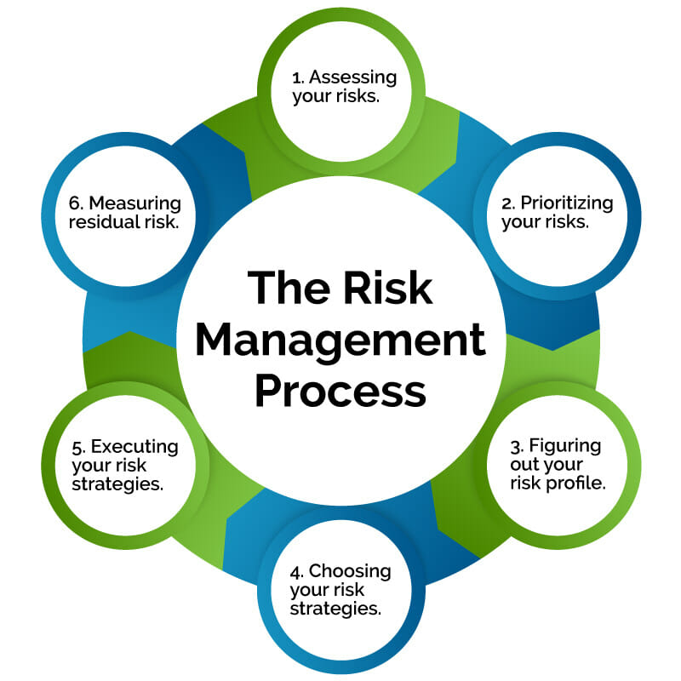
Introduction to Risk Management
Risk management attempts to recognize and manage potential and unforeseen trouble spots that may occur when the project is implemented.
Risk management identifies as many risk events as possible (what can go wrong), minimizes their impact (what can be done about the event before the project begins), manages responses to those events that do materialize (contingency plans), and provides contingency funds to cover risk events that actually materialize.
www.midocean.ae

Slide 5
Risk Management Process
We find that Figure 5.1 blow; presents a graphic model of the risk management challenge.
The chances of a risk event occurring (e.g., an error in time estimates, cost estimates, or design technology) are greatest during the early stages of a project.
This is when uncertainty is highest and many questions remain unanswered.
As the project progresses toward completion, risk declines as the answers to critical issues (Will the technology work? Is the timeline feasible?) are resolved.
The cost impact of a risk event, however, increases over the life of the project.

Slide 6
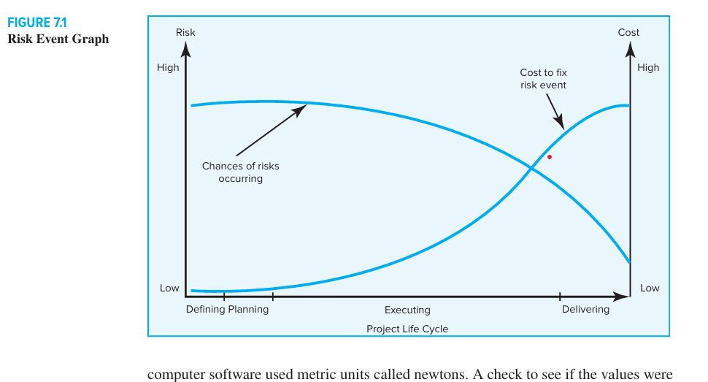
Figure 5.1: Showing the Risk Events

Slide 7
Risk Management Process – Cont.
For example, the risk event of a design flaw occurring after a prototype has been made has a greater cost or time impact than if the flaw were discovered during the planning phase of the project.
The cost of mismanaged risk control early on in the project is exemplified by the ill-fated 1999 NASA Mars Climate Orbiter.
Investigations revealed that Lockheed Martin botched the design of critical navigation software.
While flight computers on the ground did calculations based on pounds of thrust per second, the spacecraft’s computer software used metric units called newtons.
A check to see if the values were compatible was never done.

Slide 8
Risk Management Process – Cont.
Risk management is a proactive approach rather than reactive.
It is a preventive process designed to ensure that surprises are reduced and that negative consequences associated with undesirable events are minimized.
It also prepares the project manager to take action when a time, cost, and/or technical advantage is possible.
Successful management of project risk gives the project manager better control over the future and can significantly improve chances of reaching project objectives on time, within budget, and meeting required technical (functional) performance.

Slide 9
Risk Management Process – Cont.
The sources of project risks are unlimited.
There are external sources, such as inflation, market acceptance, exchange rates, and government regulations.
In practice, these risk events are often referred to as “threats” to differentiate them from those that are not within the project manager’s or team’s responsibility area.
(Later we will see bud gets for such risk events are placed in a “management reserve” contingency budget.)
Since such external risks are usually considered before the decision to go ahead with the project, they will be excluded from the discussion of project risks.
However, external risks are extremely important and must be addressed.
The major components of the risk management process are depicted in Figure 5.2 as presented in the next slide.

Slide 10
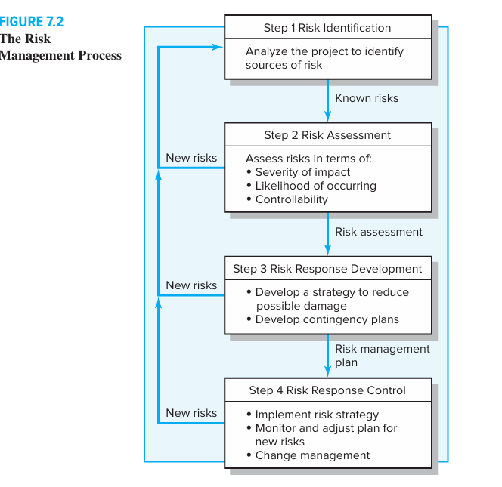
Figure 5.2: Showing the Risk Management Process

Slide 11
Step1: Risk Identification
The risk management process begins by trying to generate a list of all the possible risks that could affect the project.
Typically the project manager pulls together, during the planning phase, a risk management team consisting of core team members and other relevant stakeholders.
Research has demonstrated that groups make more accurate judgments about risks than individuals do (Snizek and Henry, 1989).
The team uses brainstorming and other problem identifying techniques to identify potential problems.
Participants are encouraged to keep an open mind and generate as many probable risks as possible.
More than one project has been bushwhacked by an event that members thought was preposterous in the beginning. Later during the assessment phase, participants will have a chance to analyze and filter out unreasonable risks.

Slide 12
Step1: Risk Identification - Cont.
One common mistake that is made early in the risk identification process is to focus on objectives and not on the events that could produce consequences.
For example, team members may identify failing to meet schedule as a major risk. What they need to focus on are the events that could cause this to happen (i.e., poor estimates, adverse weather, shipping delays, etc.).
Only by focusing on actual events can potential solutions be found. Organizations use risk breakdown structures (RBSs) in conjunction with work breakdown structures (WBSs) to help management teams identify and eventually analyze risks.

Slide 13
Step1: Risk Identification - Cont.
Figure 5.3 provides a generic example of a RBS. The focus at the beginning should be on risks that can affect the whole project as opposed to a specific section of the project or network.
For example, the discussion of funding may lead the team to identify the possibility of the project budget being cut after the project has started as a significant risk event.
Likewise, when discussing the market the team may identify responding to new product releases by competitors as a risk event.
After the macro risks have been identified, specific areas can be checked.
An effective tool for identifying specific risks is the work breakdown structure. Use of the RBS reduces the chance a risk event will be missed.
On large projects multiple risk teams are organized around specific deliverables and submit their risk management reports to the project manager.

Slide 14
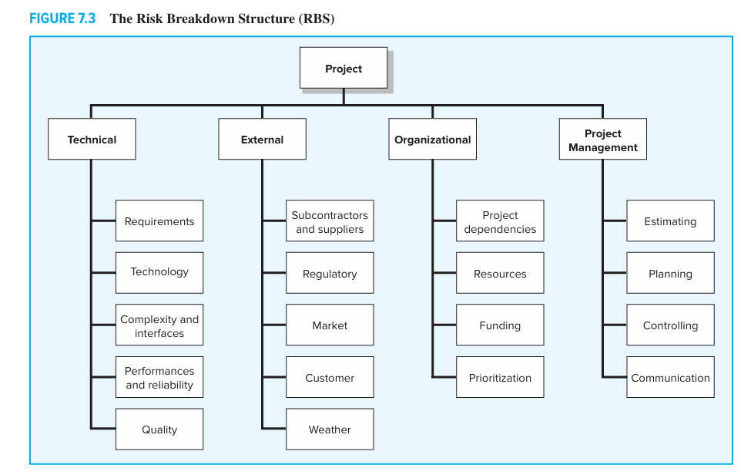
5.3 The Risk Breakdown Structure (RBS)

Slide 15
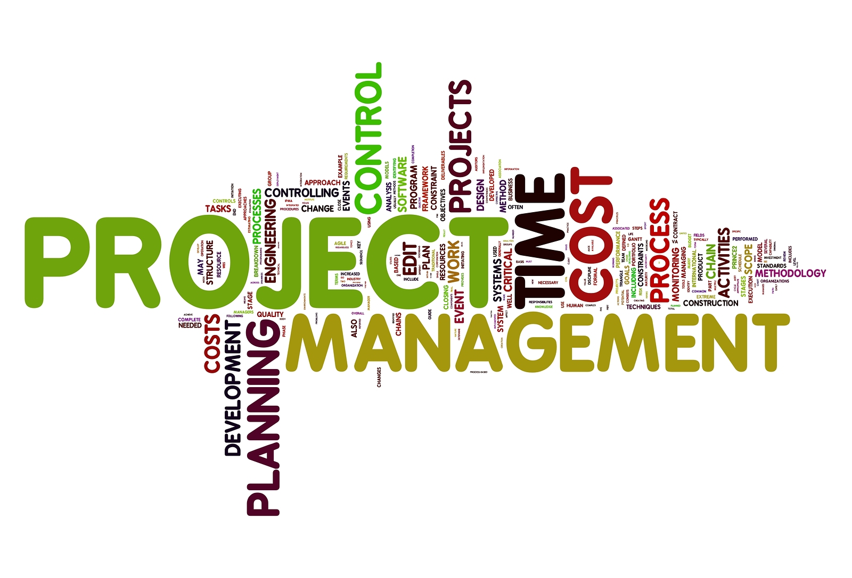
Risk Profile
A risk profile is a list of questions that address traditional areas of uncertainty on a project. These questions have been developed and refined from previous, similar projects.
Figure 5.4 provides a partial example of a risk profile.
Good risk profiles, like RBSs, are tailored to the type of project in question.
For example, building an information system is different from building a new car.

Slide 16
Risk Profile - Cont.
They are organization specific. Risk profiles recognize the unique strengths and weaknesses of the firm. Finally, risk profiles address both technical and management risks.
For example, the profile shown in Figure 5.4 asks questions about design such as, Does the design depend upon unrealistic assumptions? The questions may lead the team to identify that the technology will not work under extreme conditions as a risk.
Similarly, questions about work environment (Do people cooperate across functional boundaries?) may lead to the identification of potential communication breakdowns between marketing and R&D as a risk.

Slide 17
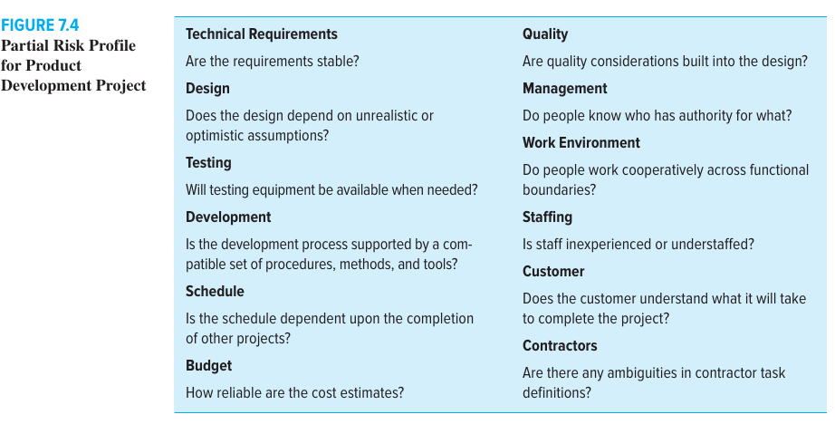
5.4 Partial Risk Profile for Product Development Project

Slide 18
Risk Profile - Cont.
The risk identification process should not be limited to just the core team.
Input from customers, sponsors, subcontractors, vendors, and other stakeholders should be solicited.
Relevant stakeholders can be formally interviewed or included on the risk management team.
Not only do these players have a valuable perspective, but by involving them in the risk management process they also become more committed to project success.
One of the keys to success in risk identification is attitude. While a “can do” attitude is essential during implementation, project managers have to encourage critical thinking when it comes to risk identification.
The goal is to find potential problems before they happen.

Slide 19
Step 2: Risk Assessment
Step 1 produces a list of potential risks.
Not all of these risks deserve attention.
Some are trivial and can be ignored, while others pose serious threats to the welfare of the project.
Managers have to develop methods for shifting through the list of risks, eliminating inconsequential or redundant ones and stratifying worthy ones in terms of importance and need for attention.
Scenario analysis is the easiest and most commonly used technique for analyzing risks.
Team members assess the significance of each risk event in terms of:
Probability of the event and/ or *Impact of the event.

Slide 20
Step 2: Risk Assessment – Cont.
imply stated, risks need to be evaluated in terms of the likelihood the event is going to occur and the impact or consequences of its occurrence.
The risk of a project manager being struck by lightning at a work site would have major negative impact on the project, but the likelihood is so low it is not worthy of consideration.
Conversely, people do change jobs, so an event like the loss of key project personnel would have not only an adverse impact but also a high likelihood of occurring in some organizations.
If so, then it would be wise for that organization to be proactive and mitigate this risk by developing incentive schemes for retaining specialists and/or engaging in cross-training to reduce the impact of turnover.

Slide 21
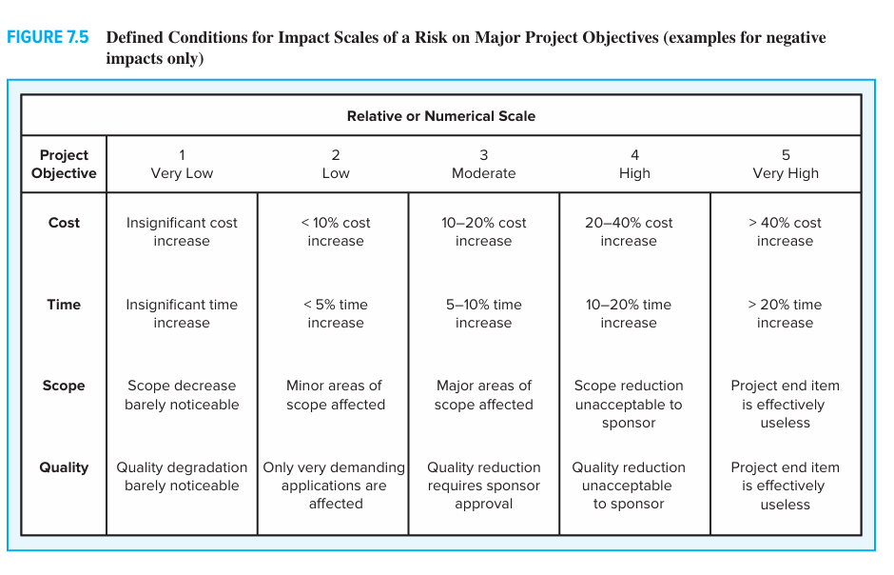
Risk Assessment – Cont.
Figure 5.5

Slide 22
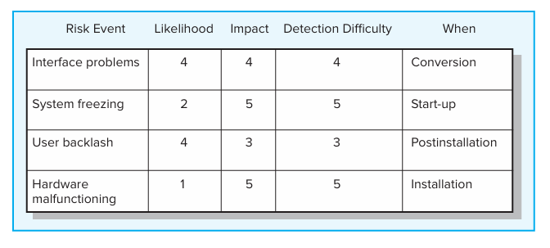
Risk Assessment Form

Slide 23
Risk Severity Matrix
The risk severity matrix provides a basis for prioritizing which risks to address.
Red zone risks receive first priority followed by yellow zone risks.
Green zone risks are typically considered inconsequential and ignored unless their status changes.
Failure Mode and Effects Analysis (FMEA) extends the risk severity matrix by including ease of detection in the equation:
Impact × Probability × Detection = Risk Value

Slide 24
Risk Severity Matrix
 |  | User backlash | Interface problems
 |  |  |  | System freezing
 |  |  |  | Hardware malfunctioning
5
Red zone
(major risk)
4
Likelihood
3
Yellow zone (moderate risk)
2
Green zone
(minor risk)
1
1
2
3
4
5
Impact

Slide 25
Risk Severity Matrix – Cont.
For example, a risk with an impact in the “1” zone with a very low probability and an easy detection score might score a 1 (1 × 1 × 1 = 1).
Conversely, a high-impact risk with a high probability and impossible to detect would score 125 (5 × 5 × 5 = 125).
This broad range of numerical scores allows for easy stratification of risk according to overall significance.
No assessment scheme is absolutely foolproof.
For example, the weakness of the FMEA approach is that a risk event rated Impact = 1, Probability = 5, and Detection = 5 would receive the same weighted score as an event rated Impact = 5, Probability = 5, and Detection = 1! This underscores the importance of not treating risk assessment as simply an exercise in mathematics. There is no substitute for thoughtful discussion of key risk events.

Slide 26
Step 3: Risk Response Development
When a risk event is identified and assessed, a decision must be made concerning which response is appropriate for the specific event.
Responses to risk can be classified as mitigating, avoiding, transferring, or retaining.

Slide 27
(1) Mitigating Risk
Mitigating Risk or Reducing risk is usually the first alternative considered. There are basically two strategies for mitigating risk:
(1) reduce the likelihood that the event will occur and/or
(2) reduce the impact that the adverse event would have on the project. Most risk teams focus first on reducing the likelihood of risk events since, if successful, this may eliminate the need to consider the potentially costly second strategy.

Slide 28
Mitigating Risk – Cont.
Often identifying the root causes of an event is useful.
For example, the fear that a vendor will be unable to supply customized components on time may be attributable to
(1) poor vendor relationships,
(2) design miscommunication, and
(3) lack of motivation
As a result of this analysis the project manager may decide to take his counterpart to lunch to clear the air, invite the vendor to attend design meetings, and restructure the contract to include incentives for on-time delivery.
Other examples of reducing the probability of risks occurring are scheduling out door work during the summer months, investing in up-front safety training, and choosing high-quality materials and equipment.

Slide 29
(2) Avoiding Risk
Risk avoidance is changing the project plan to eliminate the risk or condition.
Although it is impossible to eliminate all risk events, some specific risks may be avoided before you launch the project.
For example, adopting proven technology instead of experimental technology can eliminate technical failure.
Choosing an Australian supplier as opposed to an Indonesian supplier would virtually eliminate the chance that political unrest would disrupt the supply of critical materials.
Likewise, one could eliminate the risk of choosing the wrong software by developing web applications using both ASAP.NET and PHP. Choosing to move a concert indoors would eliminate the threat of inclement weather.

Slide 30
(3) Transferring Risk
Transferring risk or Passing risk to another party is common; this transfer does not change risk.
Passing risk to another party almost always results in paying a premium for this exemption.
Fixed price contracts are the classic example of transferring risk from an owner to a contractor.
The contractor understands his or her firm will pay for any risk event that materializes; therefore, a monetary risk factor is added to the contract bid price.
Before deciding to transfer risk, the owner should decide which party can best control activities that would lead to the risk occurring.

Slide 31
Transferring Risk – Cont.
Also, is the contractor capable of absorbing the risk? Clearly identifying and documenting responsibility for absorbing risk is imperative.
Another more obvious way to transfer risk is insurance.
However, in most cases this is impractical because defining the project risk event and conditions to an insurance broker who is unfamiliar with the project is difficult and usually expensive.
Of course, low-probability and high-consequence risk events such as acts of God are more easily defined and insured.
Performance bonds, warranties, and guarantees are other financial instruments used to transfer risk.

Slide 32
Transferring Risk – Cont.
On large, international construction projects like petrochemical plants and oil refineries, host countries are insisting on contracts that enforce Build-Own-Operate Transfer (BOOT) provisions.
Here the prime project organization is expected not only to build the facility, but also to take over ownership until its operation capacity has been proven and all the debugging has occurred before final transfer of ownership to the client.
In such cases, the host country has transferred financial risk of ownership until the project has been completed and capabilities proven.

Slide 33
(4) Accept Risk
Accept Risk In some cases a conscious decision is made to accept the risk of an event occurring.
Some risks are so large it is not feasible to consider transferring or reducing the event (e.g., an earthquake or flood).
The project owner assumes the risk because the chance of such an event occurring is slim.
In other cases risks identified in the budget reserve can simply be absorbed if they materialize.
The risk is retained by developing a contingency plan to implement if the risk materializes.
In a few cases a risk event can be ignored and a cost overrun accepted should the risk event occur

Slide 34
5.5 Contingency Planning
A contingency plan is an alternative plan that will be used if a possible foreseen risk event becomes a reality.
The contingency plan represents actions that will reduce or mitigate the negative impact of the risk event.
A key distinction between a risk response and a contingency plan is that a response is part of the actual implementation plan and action is taken before the risk can materialize,
while a contingency plan is not part of the initial implementation plan and only goes into effect after the risk is recognized.

Slide 35
5.6 Risk Management at the Top of the World.
Technical Risks:
Technical risks are problematic; they can often be the kind that cause the project to be shut down.
What if the system or process does not work? Contingency or backup plans are made for those possibilities that are foreseen.
For example, Carrier Transicold was involved in developing a new Phoenix refrigeration unit for truck-trailer applications.
This new unit was to use rounded panels made of bonded metals, which at the time was new technology for Transicold.

Slide 36
Risk Management at the Top of the World – Cont.
Schedule Risks:
Often organizations will defer the threat of a project coming in late until it surfaces.
Here contingency funds are set aside to expedite or “crash” the project to get it back on track.
Crashing, or reducing project duration, is accomplished by shortening (com pressing) one or more activities on the critical path.
This comes with additional costs and risk.
Some contingency plans can avoid costly procedures.
For example, schedules can be altered by working activities in parallel or using start-to-start lag relationships.
Also, using the best people for high-risk tasks can relieve or lessen the chance of some risk events occurring

Slide 37
Risk Management at the Top of the World – Cont.
Cost Risks:
Projects of long duration need some contingency for price changes—which are usually upward.
The important point to remember when reviewing price is to avoid the trap of using one lump sum to cover price risks.
For example, if inflation has been running about 3 percent, some managers add 3 percent for all resources used in the project.
This lump-sum approach does not address exactly where price protection is needed and fails to provide for tracking and control.
On cost sensitive projects, price risks should be evaluated item by item.
Some purchases and contracts will not change over the life of the project. Those that may change should be identified and estimates made of the magnitude of change.

Slide 38
Risk Management at the Top of the World – Cont.
Funding Risks:
What if the funding for the project is cut by 25 percent or completion projections indicate that costs will greatly exceed available funds?
What are the chances of the project being canceled before completion?
Seasoned project managers recognize that a complete risk assessment must include an evaluation of funding supply.
This is especially true for publicly funded projects.

Slide 39
5.6 Opportunity Management
For the sake of brevity, this chapter has focused on negative risks—what can go wrong on a project.
There is a flip side—what could go right on a project? This is commonly referred to as a positive risk or opportunity.
An opportunity is an event that can have a positive impact on project objectives.
For example, unusually favorable weather can accelerate construction work, or a drop in fuel prices may create savings that could be used to add value to a project.
Essentially the same process that is used to manage negative risks is applied to positive risks.

Slide 40
5.6 Opportunity Management – Cont.
Opportunities are identified, assessed in terms of likelihood and impact, responses are determined, and even contingency plans and funds can be established to take advantage of the opportunity if it occurs.
The major exception between managing negative risks and opportunity is in the responses.
The project management profession has identified four different types of response to an opportunity:

Slide 41
5.6 Opportunity Management – Cont.
Exploit. This tactic seeks to eliminate the uncertainty associated with an opportunity to ensure that it definitely happens.
Examples include assigning your best personnel to a critical burst activity to reduce the time to completion or revising a design to enable a component to be purchased rather than developed internally.
Share. This strategy involves allocating some or all of the ownership of an opportunity to another party who is best able to capture the opportunity for the benefit of the project.
Examples include establishing continuous improvement incentives for external contractors or joint ventures.

Slide 42
5.6 Opportunity Management – Cont.
Enhance. Enhance is the opposite of mitigation in that action is taken to increase the probability and/or the positive impact of an opportunity.
Examples include choosing site location based on favorable weather patterns or choosing raw materials that are likely to decline in price.
Accept. Accepting an opportunity is being willing to take advantage of it if it occurs, but not taking action to pursue it.
While it is only natural to focus on negative risks, it is sound practice to engage in active opportunity management as well.

Slide 43
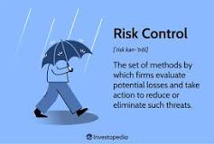
Step 4: Risk Response Control
Risk response control is the process of keeping track of the identified risks, monitoring residual risks and identifying new risks, ensuring the execution of risk plans, and evaluating the plans' effectiveness in reducing risk.
The core concepts of risk control include: Avoidance is the best method of loss control.
For example, after discovering that a chemical used in manufacturing a company's goods is dangerous for the workers, a factory owner finds a safe substitute chemical to protect the workers’ health

Slide 44



Thank You

