Slide 1


College of Management
Business Ethics
Lecturer: Dr. Raef Baraka
PMG 750
Lecture 09

Slide 2

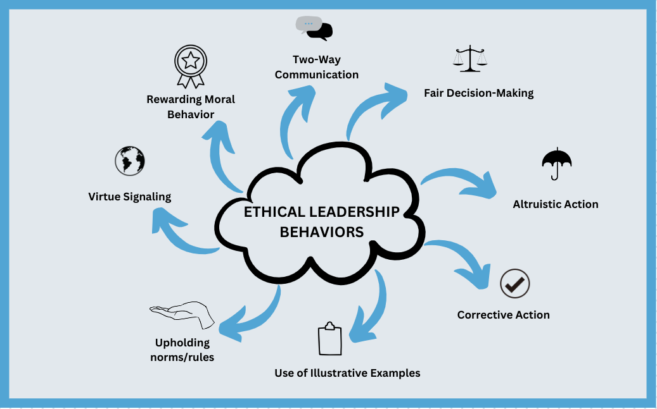
Chapter 11: ETHICAL LEADERSHIP
CHAPTER OBJECTIVES:
Define ethical leadership.
Examine requirements for ethical leadership.
Realize the benefits that come from effective ethical leadership.
Understand how ethical leadership impacts organizational culture.
Learn about the different styles of conflict management.

Slide 3
Chapter 11: ETHICAL LEADERSHIP
CHAPTER OBJECTIVES:
Understand how employees can be empowered to take on responsibilities in ethical leadership.
Examine leader–follower relationships.
Learn about leadership styles and how they influence ethical leadership.
Use the RADAR model to determine how ethical leaders handle misconduct situations.

Slide 4
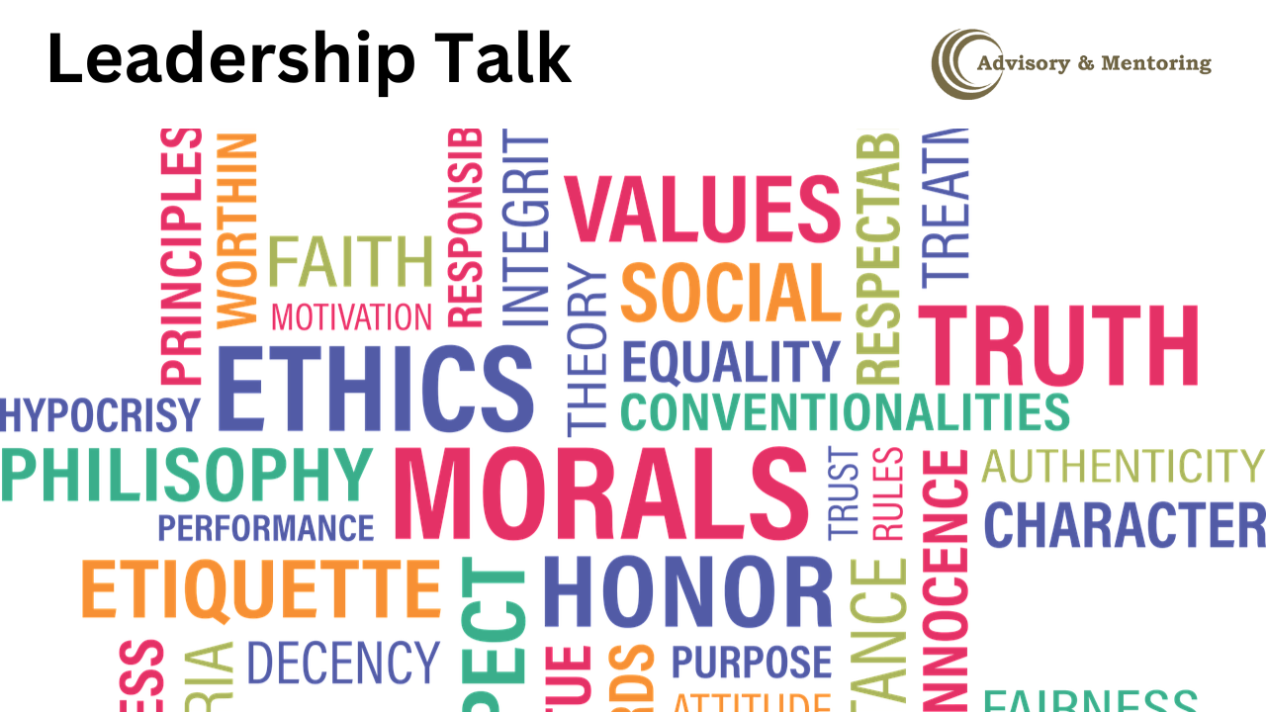
ETHICAL LEADERSHIP
DEFINING ETHICAL LEADERSHIP

Slide 5
ETHICAL LEADERSHIP
Defining Ethical Leadership
Leadership is the ability or authority to guide and direct others toward a goal.
Most people agree that effective leadership is essential for any organization.
Ethical decisions are one dimension of leadership.
Successful companies develop based upon the leadership and creative abilities of their founders.
Without the leadership capabilities of entrepreneurs such as Steve Jobs of Apple, Jeff Bezos of Amazon, Elon Musk of Tesla, and Mark Zuckerberg of Facebook, the most successful companies today would be greatly diminished, or nonexistent.
However, a strong founder is only one part of a company’s success.

Slide 6
ETHICAL LEADERSHIP
Defining Ethical Leadership
Strong ethical leadership must be demonstrated through successors, other managers, and employees to continue the firm’s success.
The ethical leadership skills of Tim Cook of Apple and Sheryl Sandberg, COO of Facebook, are as important as problem solving, planning, delegation, internal communications, and meeting management for the continued success of the company.
Ethical leadership creates an ethical culture.
If top managers fail to express desired ethical behaviors and goals, a corporate culture evolves on its own to reflect the values and norms of the company.

Slide 7
ETHICAL LEADERSHIP
Defining Ethical Leadership
Strong ethical leadership must be demonstrated through successors, other managers, and employees to continue the firm’s success.
The ethical leadership skills of Tim Cook of Apple and Sheryl Sandberg, COO of Facebook, are as important as problem solving, planning, delegation, internal communications, and meeting management for the continued success of the company.
Ethical leadership creates an ethical culture.
If top managers fail to express desired ethical behaviors and goals, a corporate culture evolves on its own to reflect the values and norms of the company.

Slide 8
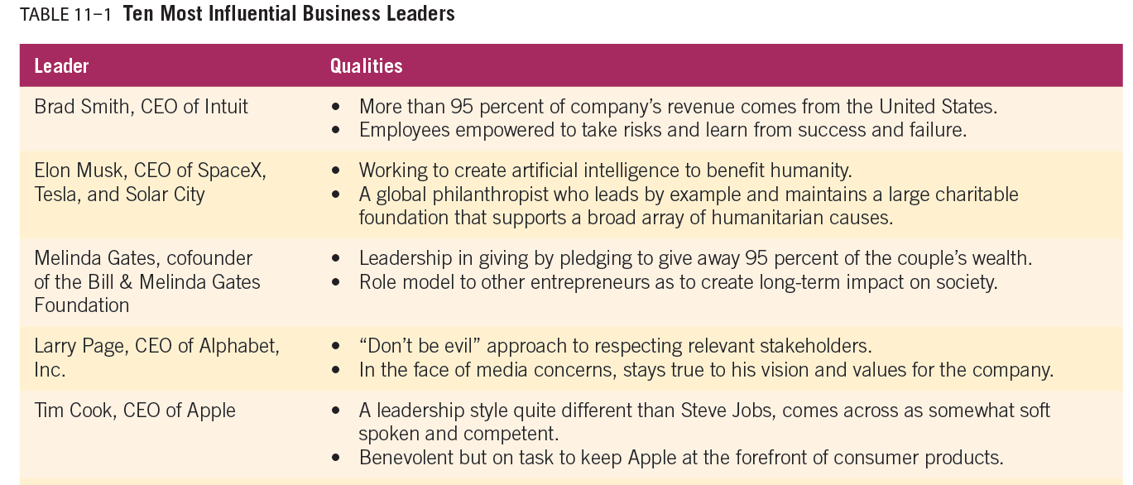
ETHICAL LEADERSHIP

Slide 9
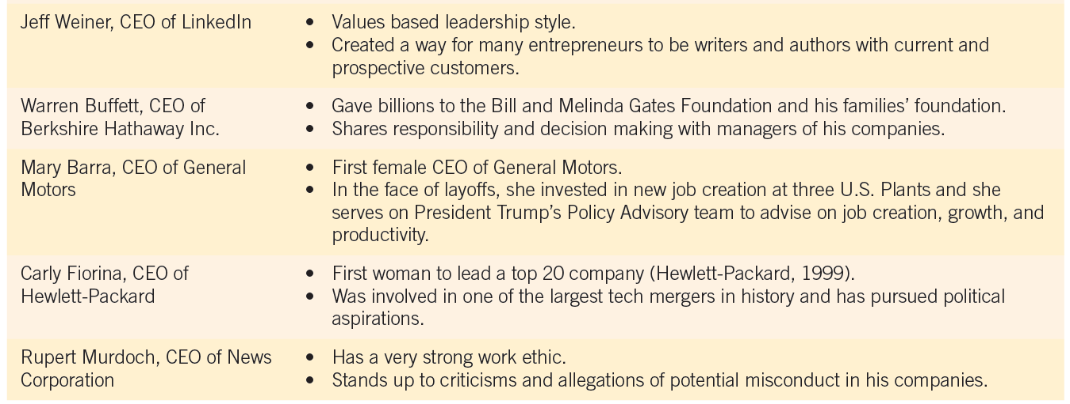
ETHICAL LEADERSHIP

Slide 10
ETHICAL LEADERSHIP
Defining Ethical Leadership
Leadership has a significant impact on ethical decision making because leaders have the power to motivate others and enforce the organization’s norms, policies, and viewpoints.
Ethical leaders ensure these goals are met in an ethical manner.
Leaders are central to influencing an organization’s corporate culture and ethical posture.
Ethical leadership is not simply allowing employees to follow their own moral codes. It is about helping to implement and reinforce shared ethical values to promote an ethical culture, as well as assume responsibility to model ethical conduct for employees.

Slide 11
ETHICAL LEADERSHIP
Defining Ethical Leadership
Ethical leadership has a positive relationship with the organizational citizenship of employees and a negative relationship with deviance, or misconduct.
In other words, ethical business leaders are more likely to have employees who follow their example and less likely to have deviants that create trouble in the company.

Slide 12
ETHICAL LEADERSHIP
Defining Ethical Leadership
Despite the importance of core values to an ethical organizational culture, there is a risk for managers to experience normative myopia, which occurs when managers overlook or stifle the importance of core values in their business decisions.
This tendency is thought to occur for three reasons:
(1) the belief that normative values do not apply to managerial decisions,
(2) the belief that facts and values can be separated in decision making, and
(3) the belief that normative values are outside the realm of business.
This can lead to ethical blindness, or the propensity to rationalize an unethical action or turn a blind eye to it.

Slide 13
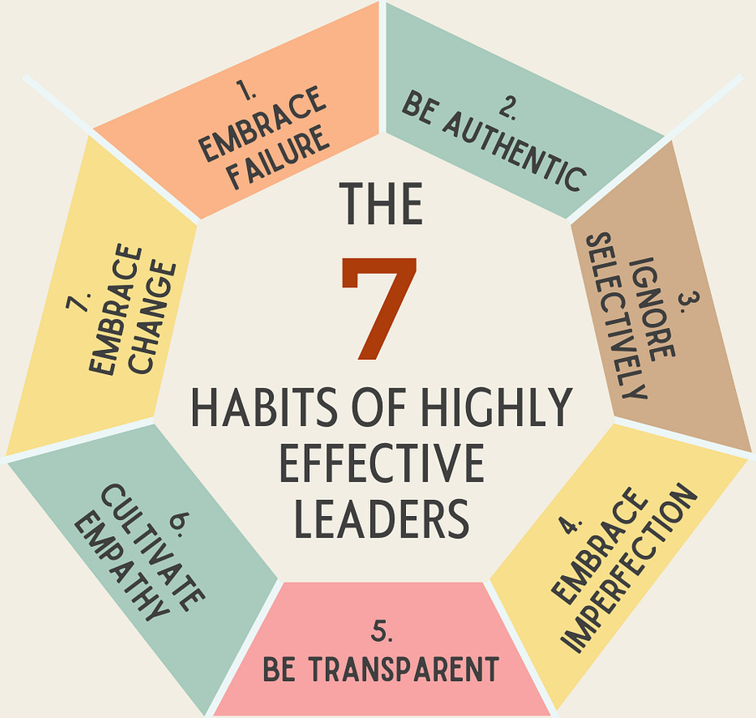
ETHICAL LEADERSHIP
REQUIREMENTS FOR ETHICAL LEADERSHIP

Slide 14
ETHICAL LEADERSHIP
Requirements For Ethical Leadership
While ethical leaders need good character and competence, they also require skills to lead and guide others.
Ethical leadership skills develop through years of training, experience, and learning other best practices of leadership.
In pinpointing what makes someone a “good” leader, experts remain divided; leadership qualities differ for each situation.
However, a number of requirements have been identified.
The strength of ethical leaders involves recognizing their own weaknesses and relying on others to help them.

Slide 15
ETHICAL LEADERSHIP
Requirements For Ethical Leadership
Ethical leaders encourage employees to reach their full potential and emphasize their role as helping to create value for key stakeholders.
Holistic reasoning allows leaders to relate decisions to the functions and activities that impact the entire organization.
They also try to develop policies and procedures that provide incentives to those who train new leaders.
Developing leaders should be a cyclical, or never-ending, process in the organization.
We adapted Carroll’s 7 Habits of Highly Moral Leaders to create Seven Habits of Strong Ethical Leaders (Table 11-2).

Slide 16
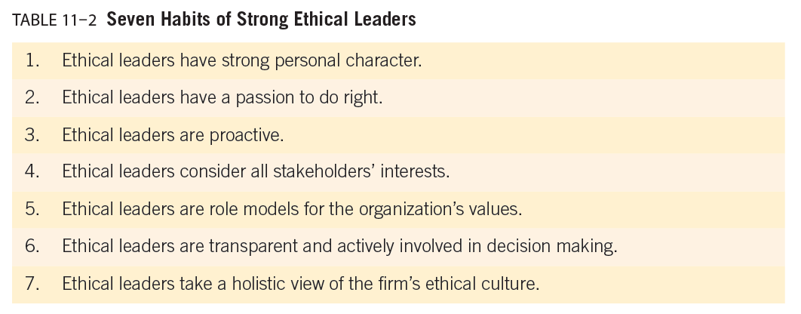
ETHICAL LEADERSHIP

Slide 17
ETHICAL LEADERSHIP
Requirements For Ethical Leadership
Finally, strong ethical leaders are those passionate about the organization and act in the organization’s best interests.
They develop a vision and ethical habits to lead their organization.
There is general agreement that ethical leadership is highly unlikely without a strong personal character.
The question is how to teach or develop a moral person in a corporate environment.

Slide 18
ETHICAL LEADERSHIP
Requirements For Ethical Leadership
Ethical leaders do not wait for ethical problems to arise.
They identify potential risks, emerging risks, and develop plans and processes to deal with them.
One way to be proactive is to take a leadership role in developing effective ethics and compliance programs that provide employees with guidance and support for making more ethical choices, even in the face of considerable pressure to do otherwise.
Ethical leaders who are proactive understand social needs and apply or develop the best practices of ethical leadership that exist in their industry.

Slide 19
ETHICAL LEADERSHIP
Requirements For Ethical Leadership
Ethical leaders do not wait for ethical problems to arise.
They identify potential risks, emerging risks, and develop plans and processes to deal with them.
Additionally, ethical leaders must model the organization’s values. If leaders do not actively serve as role models for the organization’s core values, then those values become nothing more than lip service.

Slide 20
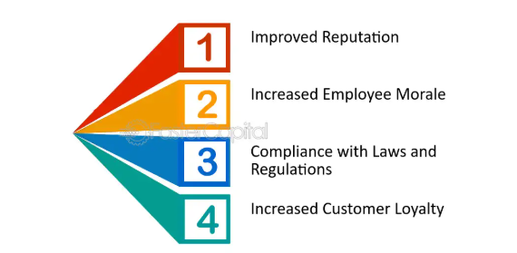
ETHICAL LEADERSHIP
BENEFITS OF ETHICAL LEADERSHIP

Slide 21
ETHICAL LEADERSHIP
Benefits of Ethical Leadership
Ethical leadership creates many benefits for an organization. Most importantly, ethical leadership has a direct impact on the corporate culture of the firm. For instance,
Ethical leaders communicate and monitor an organization’s values, ensuring that employees are familiar with the company’s purpose and beliefs.
They also provide cultural motivations for ethical behavior, such as reward systems for ethical conduct and decision making.
Ethical leadership can also lead to higher employee satisfaction and employee commitment.
While ethical leadership can create competitive advantages through employee satisfaction and productivity, it also creates strong relationships with external stakeholders.

Slide 22
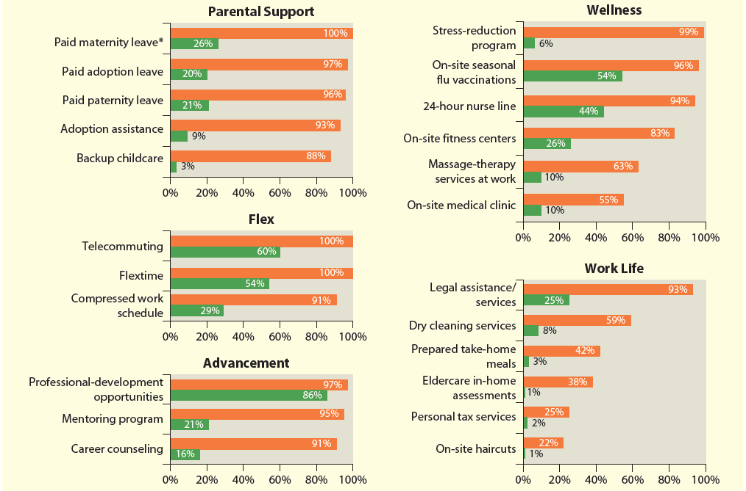

Slide 23
ETHICAL LEADERSHIP
Benefits of Ethical Leadership
Organizational culture emerges whether or not there is effective leadership.
The ethical dimension is dependent on how the company’s leaders influence the culture.
In organizations where leaders are tolerant or indifferent toward misconduct, a culture will likely develop in which employees cut corners and/or take excessive risks to advance their careers.
On the other hand, ethical leaders recognize that organizational culture will directly impact employee conduct and make a greater effort to promote a culture of ethics and compliance.
Leaders help set the tone for such a culture through shared values, attitudes, and ethical practices.

Slide 24
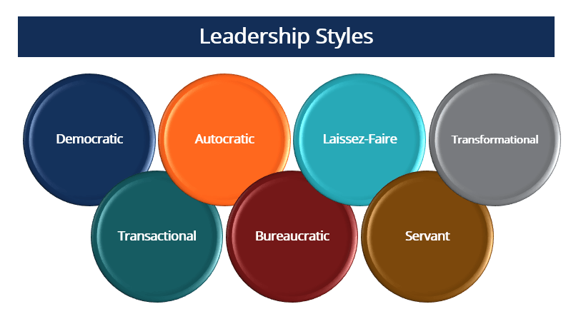
ETHICAL LEADERSHIP
LEADERSHIP STYLES AND ETHICAL DECISIONS

Slide 25
ETHICAL LEADERSHIP
Leadership Styles and Ethical Decisions
Leadership styles influence many aspects of organizational behavior, including employees’ acceptance of and adherence to organizational norms and values.
Styles that focus on building strong organizational values among employees contribute to shared standards of conduct.
They also influence the organization’s transmission and monitoring of values, norms, and codes of ethics.
In short, the leadership style of an organization influences how its employees act.

Slide 26
ETHICAL LEADERSHIP
Leadership Styles and Ethical Decisions
There is no one leadership style or an absolute list of attributes, values, or skills needed to be an effective leader.
However, three elemental ingredients for leadership include character, stewardship, and experience.
Strong ethical leaders must have the right kind of moral integrity or character.
Such integrity must be transparent; in other words, they must “do in private as if it were always public.”
Stewardship involves managing the responsibilities and duties of being a leader.
A leader must assume his or her responsibilities to lead effectively.

Slide 27
ETHICAL LEADERSHIP
Leadership Styles and Ethical Decisions
The most effective ethical leaders possess the ability to manage themselves and their relationships with others effectively, a skill known as emotional intelligence.
Emotionally intelligent leaders are skilled in 1. self-awareness, 2. self-control, and 2. relationship building.
They are outward directed and have a vision about achieving “something greater than themselves.

Slide 28
ETHICAL LEADERSHIP
Leadership Styles and Ethical Decisions
Six leadership styles that are based on emotional intelligence have been identified by Daniel Goleman:
The coercive leader demands instantaneous obedience and focuses on achievement, initiative, and self-control. Although this style can be very effective during times of crisis or during a turnaround, it otherwise creates a negative climate for organizational performance.
The authoritative leader—considered to be one of the most effective styles—inspires employees to follow a vision, facilitates change, and creates a strongly positive performance climate.
The affiliative leader values people, their emotions, and their needs and relies on friendship and trust to promote flexibility, innovation, and risk taking.

Slide 29
ETHICAL LEADERSHIP
Leadership Styles and Ethical Decisions
Six leadership styles that are based on emotional intelligence have been identified by Daniel Goleman:
The democratic leader relies on participation and teamwork to reach collaborative decisions. This style focuses on communication and creates a positive climate for achieving results.
The pacesetting leader can create a negative climate because of the high standards that he or she sets. This style works best for attaining quick results from highly motivated individuals who value achievement and take the initiative.
The coaching leader builds a positive climate by developing skills to foster long-term success, delegating responsibility, and skillfully issuing challenging assignments.

Slide 30
ETHICAL LEADERSHIP
Leadership Styles and Ethical Decisions
The most successful leaders do not rely on one style, but alter their techniques based on the characteristics of the situation.
Different styles are effective in developing an ethical culture depending on the leader’s assessment of risks and the desire to achieve a positive climate for organizational performance.
Additionally, many emotional intelligence characteristics can be taught.

Slide 31
ETHICAL LEADERSHIP
Leadership Styles and Ethical Decisions
The most successful leaders do not rely on one style, but alter their techniques based on the characteristics of the situation.
Starbucks, for instance, has their new employees go through a training program called the “Latte Method.”
L stands for listen,
A stands for acknowledge their complaint,
T stands for take action to solve the problem,
T stands for thanking them, and
E stands for explaining why the problem occurred.
This gives employees a way to work through customer service concerns and diplomatically deal with customers.

Slide 32
ETHICAL LEADERSHIP
Leadership Styles and Ethical Decisions
Another way to consider leadership styles is to classify them as transactional or transformational.
Transactional leaders attempt to create employee satisfaction through negotiating, or “bartering,” for desired behaviors or levels of performance.
Transformational leaders strive to raise employees’ level of commitment and foster trust and motivation.
Both transformational and transactional leaders can positively influence the corporate culture.

Slide 33
ETHICAL LEADERSHIP
Leadership Styles and Ethical Decisions
Transactional leaders communicate a sense of mission, stimulate new ways of thinking, and enhance as well as generate new learning experiences.
These leaders consider employee needs and aspirations in conjunction with organizational needs.
They also build commitment and respect for values that promote effective responses to ethical issues.
Thus, transformational leaders strive to promote activities and behavior through a shared vision and common learning experience.
As a result, they have a stronger influence on coworker support for ethical decisions and for building an ethical culture than transactional leaders.

Slide 34
ETHICAL LEADERSHIP
Leadership Styles and Ethical Decisions
Transformational ethical leadership is best suited for organizations that have higher levels of ethical commitment among employees and strong stakeholder support for an ethical culture

Slide 35
ETHICAL LEADERSHIP
Leadership Styles and Ethical Decisions
Transactional leaders, in contrast, focus on ensuring required conduct and procedures are implemented.
Their negotiations to achieve desired outcomes result in a dynamic relationship with subordinates where reactions, conflict, and crisis influence the relationship more than ethical concerns.
Transactional leaders produce employees who achieve a negotiated level of performance, including compliance with ethical and legal standards.
As long as employees and leaders both find this exchange mutually rewarding, the relationship is likely to be successful.

Slide 36
ETHICAL LEADERSHIP
Leadership Styles and Ethical Decisions
Authentic leaders are passionate about the company, live out corporate values daily in their behavior in the workplace, and form long-term relationships with employees and other stakeholders.
Authentic leaders do not mimic other leaders, but they do learn by observing them.
Authentic leaders display principle-centered power, because they are able to effectively handle difficult situations and display a strong commitment to their organizations.

Slide 37
ETHICAL LEADERSHIP
Leadership Styles and Ethical Decisions
Notice the similarity between principle-centered power and the self-control exhibited by emotionally intelligent leaders.
Finally, authentic leaders demonstrate core values and integrate these values into the operation of the firm.
Authentic leadership should be a goal for any leader who wants to create a strong ethical company.

Slide 38
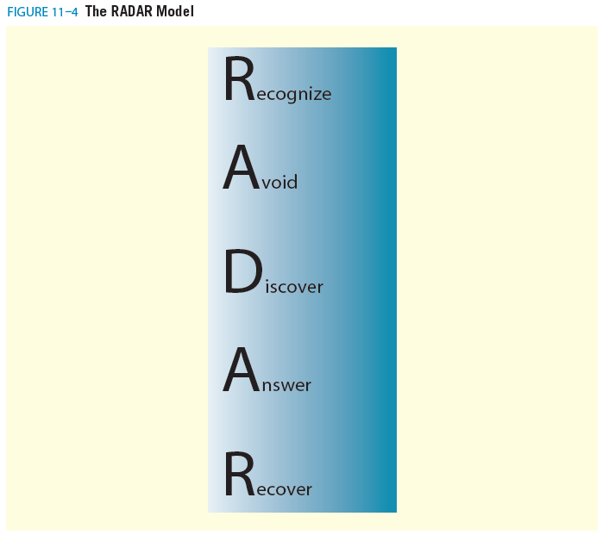
ETHICAL LEADERSHIP
THE RADAR MODEL

Slide 39
ETHICAL LEADERSHIP
The Radar Model
We mentioned earlier that ethical leaders must be proactive and cannot just wait for problems to arrive.
They must interact with employees and have systems in place to recognize or detect ethical issues before they arise.
The best way of handling misconduct is to avoid it completely. However, even the best organizations suffer from ethical risks.
However, even the best organizations suffer from ethical risks.
When ethical misconduct or issues arise, the leader should have plans in place to answer stakeholder concerns and recover from misconduct.

Slide 40
ETHICAL LEADERSHIP
The Radar Model
We adopted the acronym RADAR to describe an ethical leader’s duty to:
Recognize ethical issues,
The first step to prevent misconduct is recognizing the firm’s ethical risk areas. Ethical leaders must determine what issues the firm is most likely to face so controls can be implemented to limit the opportunity for misconduct
Avoid misconduct whenever possible,
After identifying ethical risk areas, ethical leaders should develop policies and procedures for detecting and avoiding misconduct.
This process is an important part of risk management.

Slide 41
ETHICAL LEADERSHIP
The Radar Model
We adopted the acronym RADAR to describe an ethical leader’s duty to:
Discover ethical risk areas,
Discovery involves proactively uncovering ethical risk areas that could lead to misconduct.
Many managers are reluctant to engage in this process because they fear doing so will uncover questionable conduct that could put the firm in an unfavorable light.
Instead, ethical leaders engage in an assessment process to evaluate the firm’s ethical weaknesses so the firm can address them.

Slide 42
ETHICAL LEADERSHIP
The Radar Model
We adopted the acronym RADAR to describe an ethical leader’s duty to:
Answer stakeholder concerns when an ethical issue comes to light,
Answering involves responding to the discovery of an ethical dilemma through communication both internally and externally.
When an ethical issue is detected, a leader should communicate with employees so everyone is aware of the issue, its importance, and the necessity for resolving it.

Slide 43
ETHICAL LEADERSHIP
The Radar Model
We adopted the acronym RADAR to describe an ethical leader’s duty to:
Recover from a misconduct disaster by improving upon weaknesses in the ethics program.
Recovery occurs when a firm begins to rebuild its reputation.
From an ethical standpoint, leaders should use this period to fix any weaknesses in the ethics program and develop improved ways of detecting misconduct.
Recovery involves a four-step process:
(1) take corrective action; (2) compensate stakeholders harmed by the misconduct; (3) express regret for the misconduct; and (4) reinforce the firm’s reputation with positive messages

Slide 44



Thank You

