Slide 1
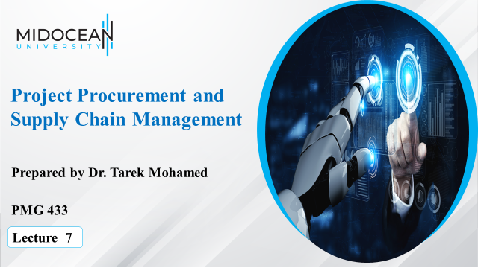

Slide 2
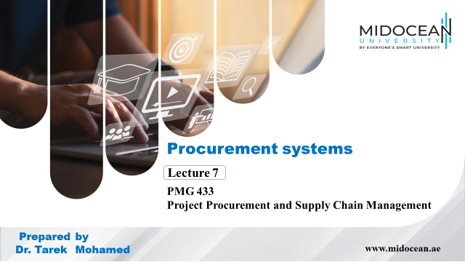

Slide 3


Learning Objectives
Understand the contents of a procurement management plan, contract statement of work, and calculations involved in a make-or-buy analysis.
Describe the work involved in planning purchases and acquisitions for projects.
Understand the process of requesting seller responses and the difference between proposals and bids.
Describe the seller selection process and recognize different approaches for evaluating proposals or selecting suppliers.
Discuss the importance of good contract administration.
Describe the contract closure process.
www.midocean.ae

Slide 4

Importance of Project Procurement Management
Procurement means acquiring goods and/or services from an outside source
Other terms include purchasing and outsourcing
Experts predict that global spending on computer software and services will continue to grow
People continue to debate whether offshore and outsourcing helps their own country or not
www.midocean.ae

Slide 5
Contracts
A contract is a mutually binding agreement that obligates the seller to provide the specified products or services and obligates the buyer to pay for them
Contracts can clarify responsibilities and sharpen focus on key deliverables of a project
Because contracts are legally binding, there is more accountability for delivering the work as stated in the contract
A recent trend in outsourcing is the increasing size of contracts
www.midocean.ae

Slide 6
What Went Wrong?
Companies often change their minds about procurement; For example, JPMorgan Chase announced a seven-year, $5 billion deal to outsource much of its data processing to IBM, but they revoked the contract less than two years into its existence because the procurement plan no longer fit their business strategy
The Australian Computer Society says sending work offshore may lower the number of students entering IT courses, deplete the number of skilled IT professionals, and diminish the nation’s strategic technology capability
Procurement can also cause security problems, including the protection of intellectual property, integrity of data, and the reliability of infrastructure in offshore locations
www.midocean.ae

Slide 7
Project Procurement Management Processes
Project procurement management: acquiring goods and services for a project from outside the performing organization
Processes include:
  Planning purchases and acquisitions: determining what to procure, when, and how
  Planning contracting: describing requirements for the products or services desired from the procurement and identifying potential sources or sellers (contractors, suppliers, or providers who provide goods and services to other organizations)
www.midocean.ae

Slide 8
Project Procurement Management Processes (continued)
Requesting seller responses: obtaining information, quotes, bids, offers, or proposals from sellers, as appropriate
Selecting sellers: choosing from among potential suppliers through a process of evaluating potential sellers and negotiating the contract
Administering the contract: managing the relationship with the selected seller
Closing the contract: completing and settling each contract, including resolving any open items
www.midocean.ae

Slide 9
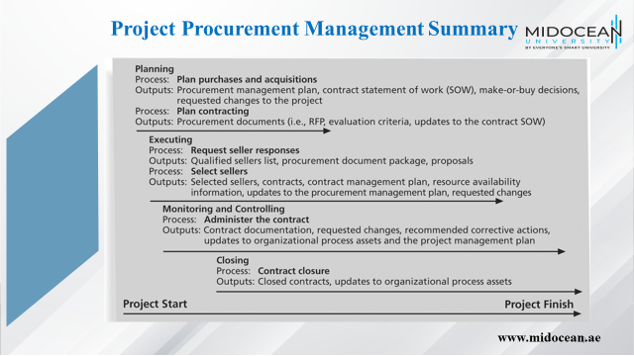

Slide 10
Solicitation Planning
Solicitation planning involves preparing of the documents needed for requesting bids (solicitation), and determining the evaluation criteria for the award of a contract. Common documents used in this process are:
Request for Proposals: used to solicit proposals from prospective sellers where there are several ways to meet the sellers’ needs.
Requests for Quotes: used to solicit quotes for well-defined procurements.
Invitations for bid or negotiation and initial contractor responses are also part of solicitation planning.
www.midocean.ae

Slide 11
Solicitation
Solicitation (or tendering) involves obtaining proposals, tenders or bids from prospective sellers. Prospective sellers do most the work in this process, usually at no cost to the buyer or the project. The buying organisation is responsible for advertising the “request to tender” (the solicitation).
Organizations can advertise to procure goods and services in several ways:
  Approaching the preferred vendor.
  Approaching several potential vendors.
  Advertising to anyone interested.
A bidders’ conference or similar meeting between the buyer and the prospective sellers can help clarify the buyer’s expectations.
www.midocean.ae

Slide 12
Planning Purchases and Acquisitions
Identifying which project needs can best be met by using products or services outside the organization
If there is no need to buy any products or services from outside the organization, then there is no need to perform any of the other procurement management processes
www.midocean.ae

Slide 13
What Went Right?
Several organizations, such as The Boots Company PLC in England, outsource their IT services to save money compared with the cost of running the systems themselves
Carefully planning procurement can also save millions of dollars, as the U.S. Air Force did by using a unit pricing strategy for a large office automation project
www.midocean.ae

Slide 14
Tools and Techniques for Planning Purchases and Acquisitions
Make-or-buy analysis: general management technique used to determine whether an organization should make or perform a particular product or service inside the organization or buy from someone else
Often involves financial analysis
Experts, both internal and external, can provide valuable inputs in procurement decisions
www.midocean.ae

Slide 15
Make-or-Buy Example
Assume you can lease an item you need for a project for $800/day; to purchase the item, the cost is $12,000 plus a daily operational cost of $400/day
How long will it take for the purchase cost to be the same as the lease cost?
www.midocean.ae

Slide 16
Make-or Buy Solution
Set up an equation so both options, purchase and lease, are equal
In this example, use the following equation; let d be the number of days to use the item:
  $12,000 + $400d = $800d
  Subtracting $400d from both sides, you get:
  $12,000 = $400d
  Dividing both sides by $400, you get:
  d = 30
If you need the item for more than 30 days, it is more economical to purchase it
www.midocean.ae

Slide 17
Types of Contracts
Different types of contracts can be used in different situations
  Fixed price or lump sum contracts: involve a fixed total price for a well-defined product or service
  Cost reimbursable contracts: involve payment to the seller for direct and indirect costs
  Time and material contracts: hybrid of both fixed price and cost reimbursable contracts, often used by consultants
  Unit price contracts: require the buyer to pay the seller a predetermined amount per unit of service
A single contract can actually include all four of these categories, if it makes sense for that particular procurement
www.midocean.ae

Slide 18
Point of Total Assumption
The Point of Total Assumption (PTA) is the cost at which the contractor assumes total responsibility for each additional dollar of contract cost
Contractors do not want to reach the point of total assumption because it hurts them financially, so they have an incentive to prevent cost overruns
The PTA is calculated with the following formula:
PTA = (ceiling price – target price)/government share + target cost
www.midocean.ae

Slide 19
Cost Reimbursable Contracts
Cost plus incentive fee (CPIF): the buyer pays the supplier for allowable performance costs plus a predetermined fee and an incentive bonus
Cost plus fixed fee (CPFF): the buyer pays the supplier for allowable performance costs plus a fixed fee payment usually based on a percentage of estimated costs
Cost plus percentage of costs (CPPC): the buyer pays the supplier for allowable performance costs plus a predetermined percentage based on total costs
www.midocean.ae

Slide 20
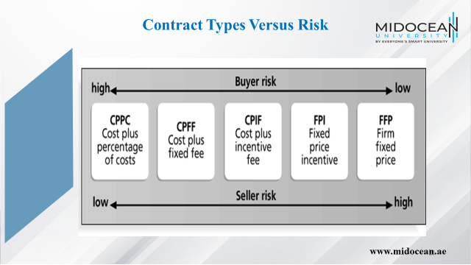

Slide 21
Contract Statement of Work (SOW)
A statement of work is a description of the work required for the procurement
If a SOW is used as part of a contract to describe only the work required for that particular contract, it is called a contract statement of work
A SOW is a type of scope statement
A good SOW gives bidders a better understanding of the buyer’s expectations
www.midocean.ae

Slide 22
Statement of Work (SOW) Template
www.midocean.ae

Slide 23
Planning Contracting
Involves preparing several documents needed for potential sellers to prepare their responses and determining the evaluation criteria for the contract award
  Request for Proposals: used to solicit proposals from prospective sellers
    A proposal is a document prepared by a seller when there are different approaches for meeting buyer needs
  Requests for Quotes: used to solicit quotes or bids from prospective suppliers
    A bid, also called a tender or quote (short for quotation), is a document prepared by sellers providing pricing for standard items that have been clearly defined by the buyer
www.midocean.ae

Slide 24
Outline for a Request for Proposal (RFP)
www.midocean.ae

Slide 25
Evaluation Criteria
It’s important to prepare some form of evaluation criteria, preferably before issuing a formal RFP or RFQ
Beware of proposals that look good on paper; be sure to evaluate factors, such as past performance and management approach
Can require a technical presentation as part of a proposal
www.midocean.ae

Slide 26
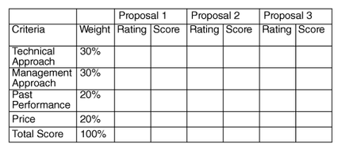
Sample Proposal Evaluation Sheet
The following template could be used by a project team to help create a short list of the best three proposals.
www.midocean.ae

Slide 27
Requesting Seller Responses
Deciding whom to ask to do the work, sending appropriate documentation to potential sellers, and obtaining proposals or bids
A bidders’ conference can help clarify the buyer’s expectations
www.midocean.ae

Slide 28
Source Selection
Once buyers receive proposals, they must select a vendor or decide to cancel the procurement. Source selection involves:
  Evaluating bidders’ proposals.
  Choosing the best one.
  Negotiating the contract.
  Awarding the contract.
It is highly recommended that buyers use formal evaluation procedures for selecting vendors.
Buyers often create a “short list”.
www.midocean.ae

Slide 29
Source Selection
After developing a short list of possible sellers, organisations will often undertake more detailed evaluation.
The following figure lists items that might be part of an evaluation of the top three vendors for a large information technology project.
All of the evaluation criteria are given a certain number of possible points (based on ranked importance), and the project team members and other stakeholders then evaluate each proposal by assigning points to each criteria.
www.midocean.ae

Slide 30
Seller Selection Process
Organizations often do an initial evaluation of all proposals and bids and then develop a short list of potential sellers for further evaluation
Sellers on the short list often prepare a best and final offer (BAFO)
Final output is a contract signed by the buyer and the selected seller
www.midocean.ae

Slide 31
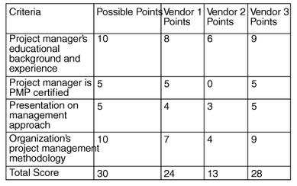
Detailed Criteria for Selecting Vendors
www.midocean.ae

Slide 32
Administering the Contract
Ensures that the seller’s performance meets contractual requirements
Contracts are legal relationships, so it is important that legal and contracting professionals be involved in writing and administering contracts
It is critical that project managers and team members watch for constructive change orders, which are oral or written acts or omissions by someone with actual or apparent authority that can be construed to have the same effect as a written change order
www.midocean.ae

Slide 33
Suggestions for Change Control in Contracts
Changes to any part of the project need to be reviewed, approved, and documented by the same people in the same way that the original part of the plan was approved
Evaluation of any change should include an impact analysis; how will the change affect the scope, time, cost, and quality of the goods or services being provided?
Changes must be documented in writing; project team members should also document all important meetings and telephone phone calls
www.midocean.ae

Slide 34
Suggestions for Change Control in Contracts
(continued)
Project managers and teams should stay closely involved to make sure the new system will meet business needs and work in an operational environment
Have backup plans
Use tools and techniques, such as a contract change control system, buyer-conducted performance reviews, inspections and audits, and so on
www.midocean.ae

Slide 35
Best Practice
A consultation company developed a list of best practices from experienced outsourcers throughout the world:
  Build in Broad Business Outcomes Early and Often
  Hire a Partner, Not Just a Provider
  It’s More Than a Contract, It’s a Business Relationship
  Leverage Gain-Sharing
  Use Active Governance
  Assign a Dedicated Executive
  Focus Relentlessly on Primary Objectives
www.midocean.ae

Slide 36
Contract Clauses
Contracts should include specific clauses to take into account issues unique to the project
Can require various educational or work experience for different pay rights
A termination clause is a contract clause that allows the buyer or supplier to end the contract
www.midocean.ae

Slide 37
Closing the Contract
Involves completing and settling contracts and resolving any open items
The project team should:
  Determine if all work was completed correctly and satisfactorily
  Update records to reflect final results
  Archive information for future use
The contract itself should include requirements for formal acceptance and closure
www.midocean.ae

Slide 38
Conclusion
It is essential that organisations obtain good contracts that minimise risk while ensuring optimum results through effective contract administration.
With the current competitive and demanding conditions found in information technology projects,
It is very important to prepare contracts with great care and expert assistance.
It is equally important to initiate and follow effective contract administration procedures.
www.midocean.ae

Slide 39
Conclusion
The following guidelines can help can assist in preparing proposals, contracts and administrative procedures:
  Use checklists and templates where appropriate.
  Evaluate risks by reference to suggested contract provisions where appropriate.
  All major proposals and contracts, and contracts with questionable provisions, should be reviewed by a contract law expert.
  Appropriate pricing and/or insuring of risk under the contract.
  Periodic review, improvement and updating of contract preparation and administration procedures.
www.midocean.ae

Slide 40
Summary of Learning Objectives
Understand the contents of a procurement management plan, contract statement of work, and calculations involved in a make-or-buy analysis.
Describe the work involved in planning purchases and acquisitions for projects.
Understand the process of requesting seller responses and the difference between proposals and bids.
Describe the seller selection process and recognize different approaches for evaluating proposals or selecting suppliers.
Discuss the importance of good contract administration.
Describe the contract closure process.
www.midocean.ae

Slide 41
Essential Reference
Morris, P. W., & Pinto, J. K. (Eds.). (2007). The Wiley guide to project technology, supply chain, and procurement management (Vol. 4). John Wiley & Sons.
Schwalbe, K. (2015). Information technology project management. Cengage Learning.
www.midocean.ae

Slide 42



Thank You

