Slide 1



Entrepreneurship
and Strategy
Prepared by Dr. Mohamed Soliman
ENT624
Entrepreneurial Strategy
Lecture 2

Slide 2



Learning Objectives
1. Understand the key role of strategy in the discovery and exploitation of opportunities as entrepreneurial firms form and grow.
2. Learn about contemporary trends and patterns in entrepreneurship, including its role in the global economy and the increase in social entrepreneurship.
3. Understand the significance of entrepreneurial firms to innovation in the Economy.

Slide 3
Entrepreneurship can be defined as the identification and utilization of previously unexploited opportunities.
- The identification of opportunities that lead to the creation of new business ventures is the heart of entrepreneurship today.

Slide 4
What is the relationship between entrepreneurship and strategy?
Both entrepreneurship and strategic management focus on the ways in which businesses create change by exploiting opportunities they discover within the uncertain environments in which they operate.
Entrepreneurs are able to create wealth by identifying opportunities and then developing competitive advantages to exploit them.

Slide 5
Strategic entrepreneurship is the integration of entrepreneurship and strategic management knowledge.
= entrepreneurship + strategic management
Successful entrepreneurs are able to notice the opportunities that many other people seem to miss, and, more important, they are then able to find the means to turn these possibilities into action: to bring to the market something novel and useful.

Slide 6
Increasingly, entrepreneurs are relying on the expertise and input of key stakeholders as they launch and develop their businesses.
Stakeholders are:
1) Outside the firm in the role of advisers.
2) Inside the firm in the roles of investors and employees.
The entrepreneur’s ability to create a powerful team capable of breakthrough thinking shapes the new venture’s potential success and growth.

Slide 7
Entrepreneurial Stages: Changing Patterns, Strategies, and Entrepreneurial Roles
 | Stage I: Entrepreneurial Strategies for the Emerging Venture | Stage II: Entrepreneurial Strategies for the Growing Venture | Stage III: Entrepreneurial Strategies for the Established Venture
Changing patterns of strategic needs of Entrepreneurial firms | -Strategic framework for new venture formation -Creativity and opportunity identification (the discovery process) -Evaluating and exploiting opportunities (the assessment process) -Market entry | - Financial resource capabilities - The evolving management team: capabilities for nurturing growth by building networks and strategic alliances | -Creativity and innovation strategies for breakthrough thinking: reinvention and change to sustain growth -Tapping new markets and opportunities: franchising, mergers & acquisitions
Strategic plan | The strategic plan: vision and values, the internal and external environment, and Organizational strategies for the entrepreneurial team | The strategic plan for the growing venture | Building an entrepreneurial model: Learning from failure and serial entrepreneurship
Strategic roles | Creativity, opportunity identification, and evaluation | Opportunity implementation and firm growth | Continual innovation and reinvention

Slide 8
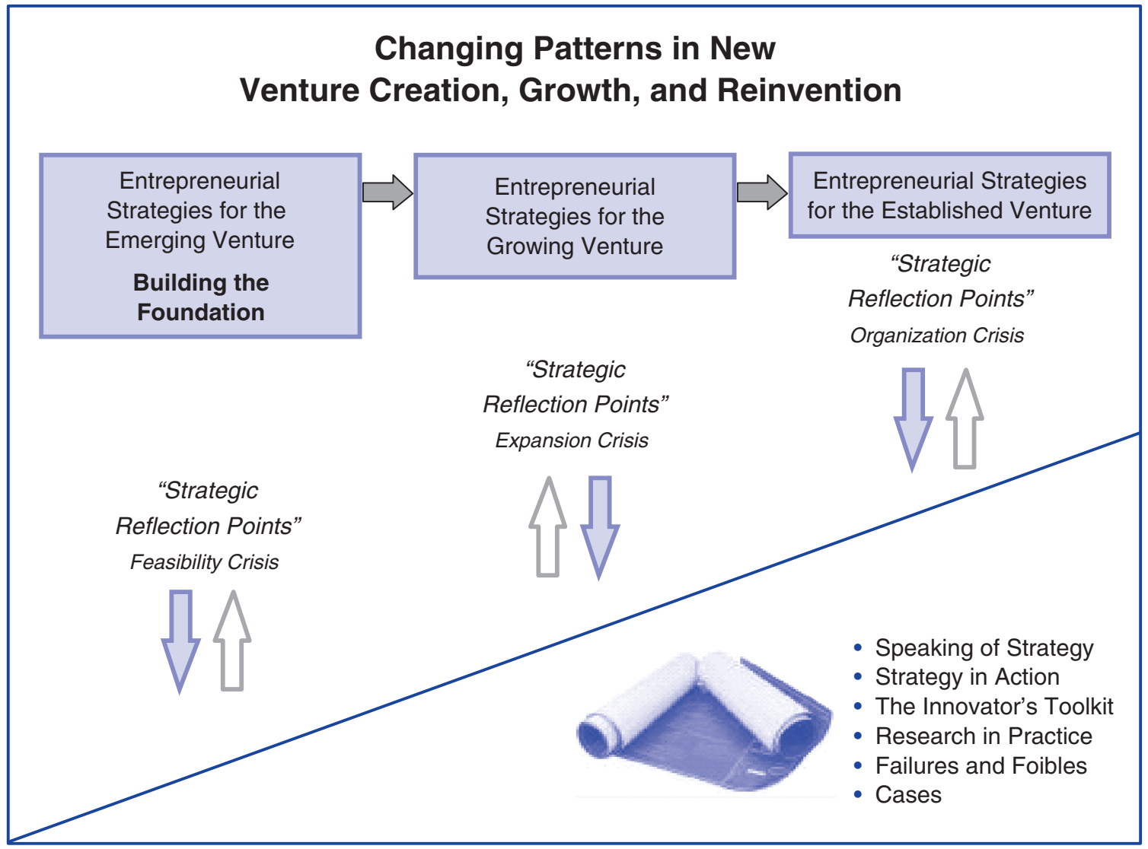
ENTREPRENEURSHIP STRATEGY

Slide 9
Stage I: Entrepreneurial Strategies for the Emerging Venture
Strategic needs of entrepreneurial firms :
Strategic framework for new venture formation
Creativity and opportunity identification (the discovery process)
Evaluating and exploiting opportunities (the assessment process)
Market entry
The strategic plan:
Vision and values, the internal and external environment, and
Organizational strategies for the entrepreneurial team.
Strategic roles:
Creativity, opportunity identification, and evaluation.

Slide 10
Strategic needs of entrepreneurial firms :
Financial resource capabilities.
The evolving management team.
capabilities for nurturing growth by building networks and strategic alliances.
The strategic plan:
A plan for the growing venture.
Strategic roles:
Opportunity implementation and firm growth.
Stage II: Entrepreneurial Strategies for the Growing Venture

Slide 11
Entrepreneurial Stages: Changing Patterns, Strategies, and Entrepreneurial Roles
Stage III: Entrepreneurial Strategies for the Established Venture
Strategic needs of entrepreneurial firms :
Creativity and innovation strategies for breakthrough thinking: reinvention and change to sustain growth
Tapping new markets and opportunities: franchising, mergers & acquisitions.
The strategic plan:
Building an entrepreneurial model
Learning from failure and serial entrepreneurship
Strategic roles: Continual innovation and reinvention

Slide 12

Test your knowledge
1. ………. = entrepreneurship + strategic management.
Entrepreneurship B) Strategic Management C) Strategic entrepreneurship
2. Entrepreneurial Strategies for the Emerging Venture require planning for Market Entry. ( )
3. Inside stakeholders have the role of advisers, while Outside ones have the role of investors and employees. ( )
4. …… the identification and utilization of previously unexploited opportunities.
Entrepreneurship B) Strategic Management C) Strategic entrepreneurship
5. Entrepreneurial Strategies for the Growing Venture focus on Financial resource and improving management team. ( )

Slide 13
Emerging businesses are significant players in the world’s economy today.
In the United States:
- they produce about half of the economy’s output,
- employ half of the private-sector workforce,
- fill niche markets, innovate, increase competition, and
- give people in all circumstances a chance to succeed.
Across industries, new ventures are confronted by a variety of business conditions, and they tackle them with unique solutions using diverse resources.

Slide 14
Entrepreneurial firms can be found in all sizes and in all stages of the life cycle.
Over the last decade, small firms have provided 60 to 80 percent of the net new jobs in the U.S. economy, and most of these net new jobs come from start-ups within the first two years of operation.
Most of the new employment in the economy continues to be an outgrowth of innovation, the engine that spurs job growth.

Slide 15
Creative destruction
Phenomenon in which new firms innovate to enter the market and compete with already established businesses, and
As a result, some of these older counterparts close due to lower productivity (competitive disadvantage).

Slide 16
Economists agree that entrepreneurship is responsible for much of the competition and innovation in the business world.
The innovations introduced by entrepreneurs make challenges and make obsolete the technologies, products, and services of existing industries.

Slide 17
Innovation is the primary driver of entrepreneurial behavior.
Social innovation, a mission of some entrepreneurs who are seeking not only to create new value in the form of products, but also to create change in the very communities in which they reside.

Slide 18
Entrepreneurship That Matters: Social Value Creation
This idea of social value creation is rooted within the social entrepreneurship literature and has more recently received attention among academic and clinical entrepreneurship researchers.
Underlying social entrepreneurship are the multiple benefits and rewards that are exhibited by a heightened sense of accountability to the populations served, as well as the outcomes that are created.

Slide 19
Social entrepreneurs seek to provide social improvements and enhancements to their communities, including attractive (both social and financial) return to their key stakeholders.
Social entrepreneurs assess their impact and influence in terms of the social outcomes, not simply in terms of size, growth, or processes.
However, much of the social entrepreneurship field is concerned with the creation of nonprofit ventures.

Slide 20
Social Entrepreneurship (cont.)
Although the creation of new and innovative nonprofits is critical, there is also a substantial need for educating future entrepreneurs about how for-profit venture creation can integrate both social and financial outcomes.
A critical starting point is to understand the diverse “for whom and for what” motives and beliefs of our future aspiring entrepreneurs, so that both women and men act as the change agents for themselves and their communities, thereby allowing them to invent new profitable and sustainable approaches that create solutions to change society for the better.

Slide 21
Social Entrepreneurs—Doing Business With a Conscience
There are many breeds of entrepreneurs:
- Some are out to revolutionize the software industry,
- Some to start a family restaurant, while
- another might set out to provide employment in poverty-stricken areas or
- to bring medicine to the sick.

Slide 22
Social Entrepreneurship (cont.)
It’s still a business, but with different objectives.
It is not to say that other entrepreneurs don’t have a social conscience, but some make a career out of it.

Slide 23
Social Entrepreneurship (cont.)
- For them, the motivation is the drive to create social change.
- They see problems around them that they feel need to be addressed, yet aren’t.
- They see kids with insufficient education, parents without jobs or the opportunity of employment, or sick countrymen without access to the proper health care.

Slide 24
Social entrepreneurship:
- To empower people to better lives by providing them with the means to get that life, whether it be education, employment or even simple entertainment.
- They go into these new ventures with a mission not based on profits, but on social change.

Slide 25
Social entrepreneurship (cont.)
- But at the same time, these organizations can be successful, self-sustaining businesses.
- Marketplace has a social goal and be involved in an economic venture.

Slide 26
The Role of Innovation in Entrepreneurship Strategy
There is the emphasis on the role of innovation in the entrepreneurship start-up and growth process.
Entrepreneurial firms are required to the development of new ideas, technologies, and actions across industries today.

Slide 27
While small entrepreneurial companies are not as common in capital-intensive industries such as auto manufacturing, aerospace, and oil research, they play major roles in the development of newer technology industries, including biotechnology, medical electronics, medical equipment, and telecommunications.
Large companies are often dependent on small firms’ discoveries and inventions.

Slide 28
• Small firms are having a powerful influence on technology. They represented 40 percent of the highly innovative firms.
• Large firms in biotechnology, medical electronics, semiconductor, and telecommunications industries have a higher than anticipated number of citations of small firm patents.

Slide 29
In conclusion, small firms are integral to the innovation process, even when they are not responsible for the final or breakthrough technology.

Slide 30
No successful entrepreneur would say it is easy or that no risk is involved.
If it were easy, if there was no risk, and if it did not take years of dedication and persistence, everyone might be an entrepreneur.
Unfortunately, the market does not have compassion or feelings.

Slide 31
Failures and Foibles
The Next Time I Start a New Venture . . .
Although many entrepreneurs make their share of mistakes, the Seasoned entrepreneur is able to turn those mistakes into ideas and plans of what NOT to do the second, third time around.

Slide 32
Consider the following statements from entrepreneurs who comment on the next time they start a new venture:
I will make sure I have sufficient start-up and back-up capital.
Nothing is as sure to kill a new venture as running out of money early in the game.
If your plan says you need a certain amount of capital, get it—and a little more, for back-up.

Slide 33
I will be certain there is a market for my “great idea” before I run with it.
I’ll never be caught with a “solution in search of a problem” again!

Slide 34
I will spend more time and care managing the business. I don’t like to deal with details, but somebody has to or the business will suffer.
Next time I’ll hire a manager to do right what I was doing ineffectively.

Slide 35
I’ll know something about the business I plan to start. Nothing is as sure a sign of impending trouble than an entrepreneur who asks, “how hard can it be?” when he or she has never before done whatever “it” is.
I’ll stick to a business I know, or I’ll make darn sure I learn about it before I start.

Slide 36
I’ll have “It’s the cash flow, Stupid!” tattooed on my forehead.
Cash-flow problems are easy to understand. If your suppliers give you 30 days to pay, and you give your customers 60 days to pay, the cash will flow out before it can flow in. Duh.
• I will have a lawyer draw up my partnership agreements. I will not let my partners become “former friends.”

Slide 37
I will know my competition as well as or better than my competition knows me, and I will look for competitors where I least expect to find them.
• I will stay on top of new developments. I will never stop learning about my business and my customers.

Slide 38
Recap
Entrepreneurship
Relationship between entrepreneurship and strategy
Strategic Entrepreneurship
Entrepreneurial Stages (stage 1, stage 2, stage 3 )
Creative Destruction
Social Entrepreneurship
The Role of Innovation in Entrepreneurship Strategy
Seasoned entrepreneur

Slide 39
Summary of Lecture Objectives
1. Understand the key role of strategy in the discovery and exploitation of opportunities as entrepreneurial firms form and grow.
• This chapter strongly emphasizes the key strategic roles of creativity, opportunity identification, opportunity evaluation, and innovation in the emergence and growth of entrepreneurial firms.
• This strategic approach examines three distinct stages of the entrepreneurship process, and provides you with strategies you can use to launch, grow, and revitalize the firm.

Slide 40
Summary of Lecture Objectives
2. Learn about contemporary trends and patterns in entrepreneurship, including its role in the global economy and the increase in social entrepreneurship.
• Entrepreneurships are formed by 1 out of every 11 adults around the world today. In the United States, entrepreneurships produce about half the economic output, employ half of the private sector workforce, and give people in all circumstances a chance to succeed.
• The number and percentage of people of color and women who start companies are increasing significantly.
• Entrepreneurships are continuing to benefit from the economic recovery.
Credit is more abundant, and while equity investment is still difficult to attract for early-stage financing, angel investments are available.
• Social entrepreneurs are driven to empower people by providing the means to better their lives; the mission of these self-sustaining firms is social change.

Slide 41
Summary of Lecture Objectives
3. Understand the significance of entrepreneurial firms to innovation in the economy.
• Entrepreneurial firms account for a significant percentage of patents and innovations.
• Large firms rely on smaller firms, especially in newer technologies such as biotechnology, medical electronics, and telecommunications.
As you will see throughout this book, innovation can be a highly successful competitive strategy for the survival and growth of firms.

Slide 42


Thank You

