Slide 1


Mathematics
Prepared by Dr. Israa Lewaa
Lecture 4
MAT 122
Operations of Matrices

Slide 2

Lecture
02
Lecture Outline
Matrix Addition
Matrix Subtraction
Matrix Multiplication
Practice
Lecture 4 Dr. Israa Lewaa Mathematics 2

Slide 3
Lecture
04
Matrix Addition
Sum A + B is the m × n matrix obtained by adding corresponding entries of A and B.
Lecture 4 Dr. Israa Lewaa Mathematics 2

Slide 4
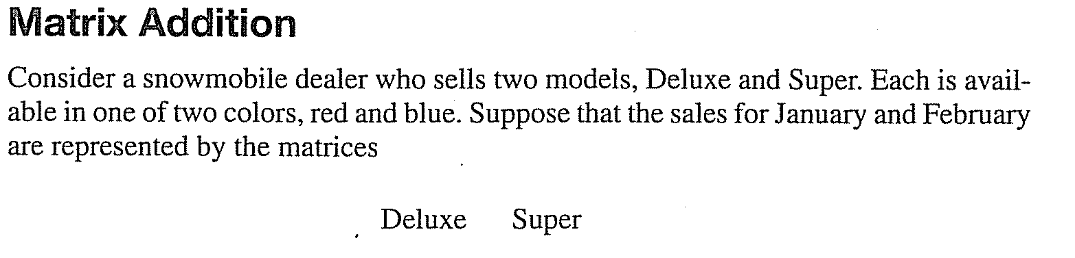
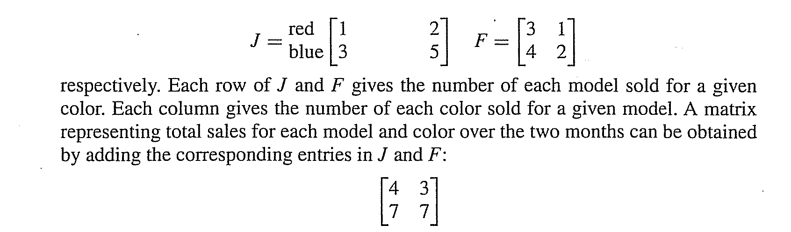
Lecture
04
Matrix Addition
Lecture 4 Dr. Israa Lewaa Mathematics 2

Slide 5
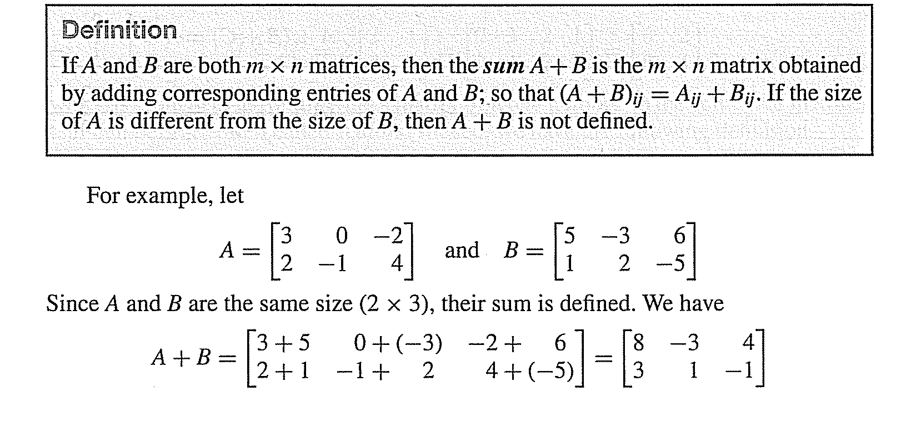
Lecture
04
Matrix Addition
Lecture 4 Dr. Israa Lewaa Mathematics 2

Slide 6
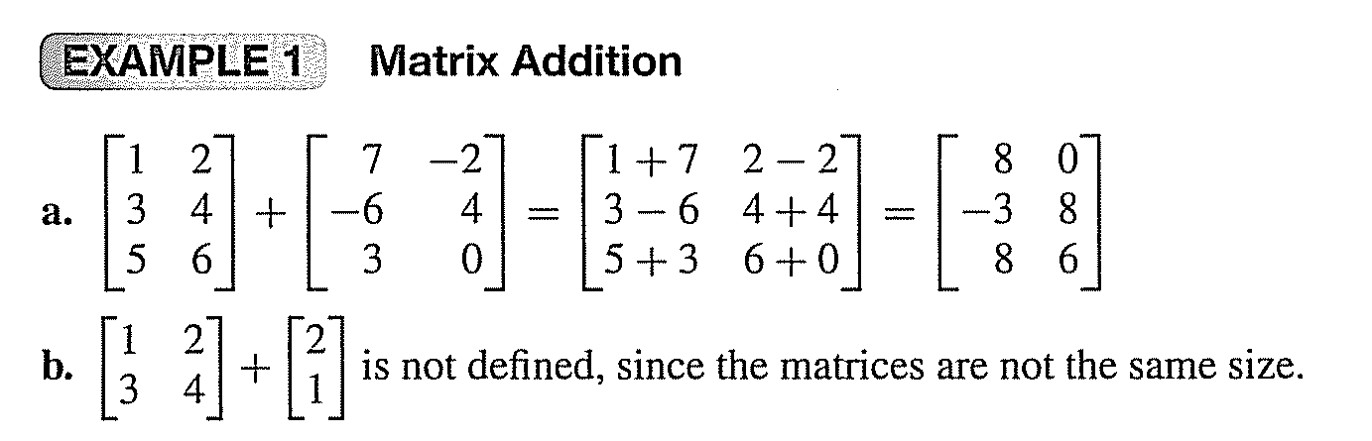
Lecture
04
Matrix Addition
Lecture 4 Dr. Israa Lewaa Mathematics 2

Slide 7
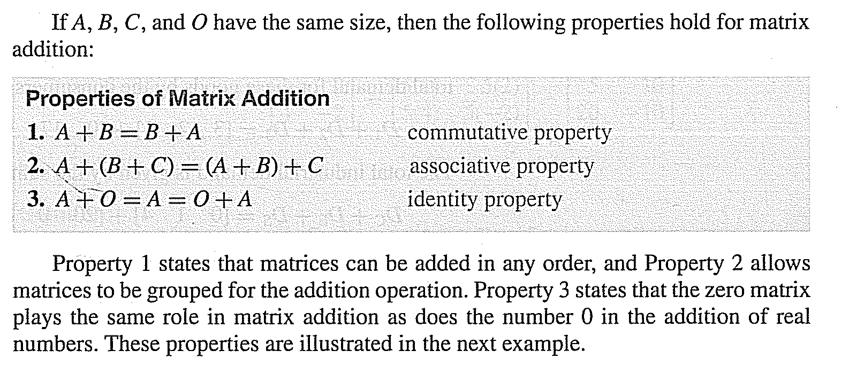
Lecture
04
Matrix Addition
Lecture 4 Dr. Israa Lewaa Mathematics 2

Slide 8
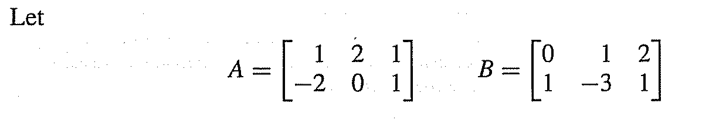
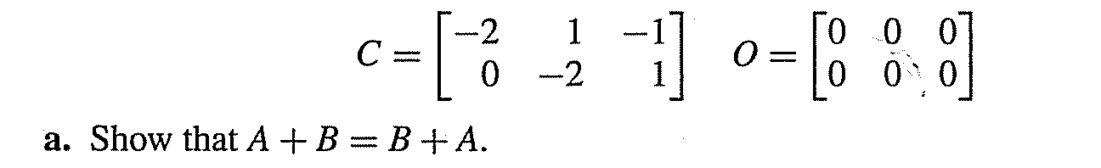


Lecture
04
Example

Slide 9
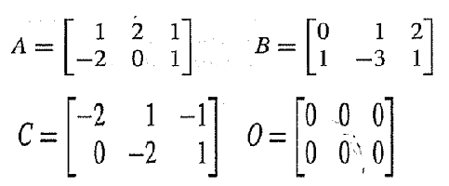
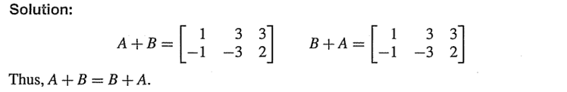
Lecture
04
Solution
Lecture 4 Dr. Israa Lewaa Mathematics 2

Slide 10
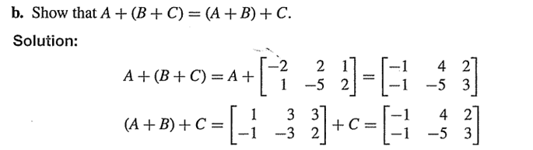
Lecture
04
Example
Lecture 4 Dr. Israa Lewaa Mathematics 2

Slide 11
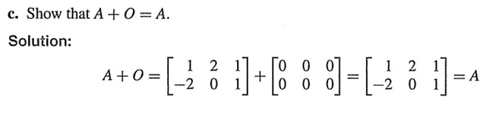
Lecture
04
Solution
Lecture 4 Dr. Israa Lewaa Mathematics 2

Slide 12
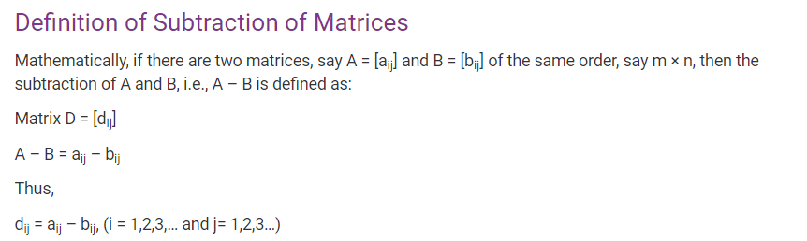
Lecture
04
Matrix Subtraction
Lecture 4 Dr. Israa Lewaa Mathematics 2

Slide 13
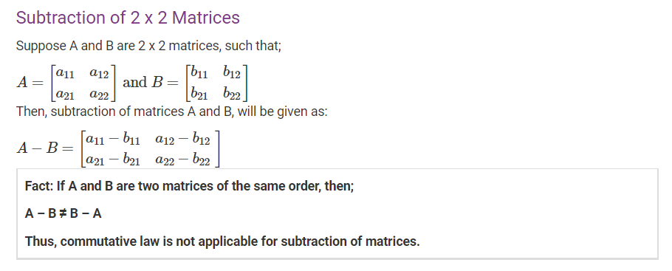
Lecture
04
Subtraction of 2*2 Matrices
Lecture 4 Dr. Israa Lewaa Mathematics 2

Slide 14
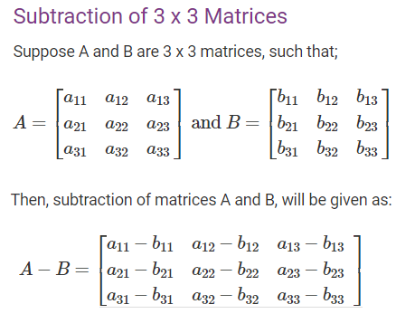
Lecture
04
Subtraction of 3*3 Matrices
Lecture 4 Dr. Israa Lewaa Mathematics 2

Slide 15
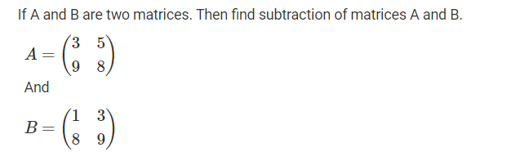
Lecture
04
Example
Lecture 4 Dr. Israa Lewaa Mathematics 2

Slide 16
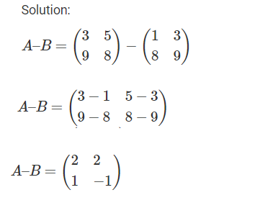
Lecture
04
Solution
Lecture 4 Dr. Israa Lewaa Mathematics 2

Slide 17
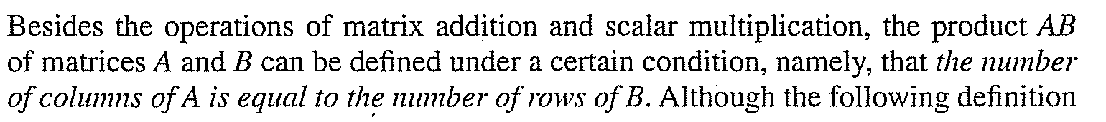
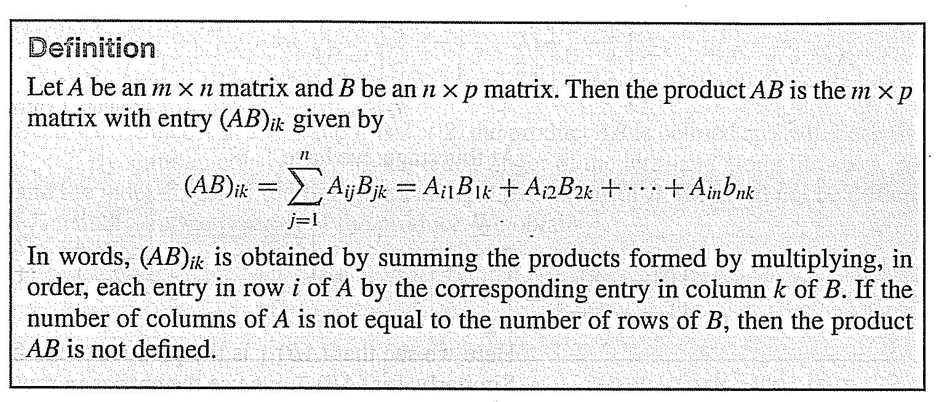
Lecture
04
Matrix Multiplication
Lecture 4 Dr. Israa Lewaa Mathematics 2

Slide 18
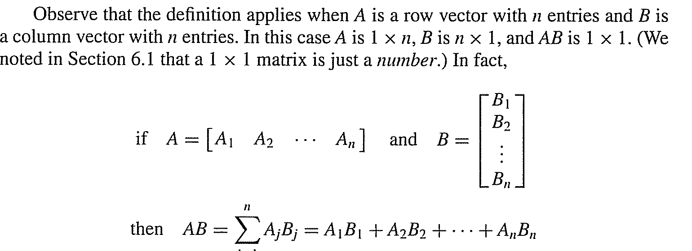
Lecture
04
Matrix Multiplication
Lecture 4 Dr. Israa Lewaa Mathematics 2

Slide 19
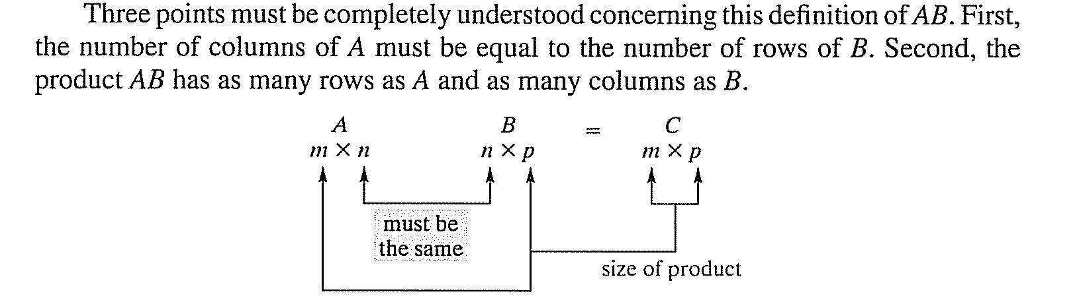
Lecture
04
Matrix Multiplication
Lecture 4 Dr. Israa Lewaa Mathematics 2

Slide 20
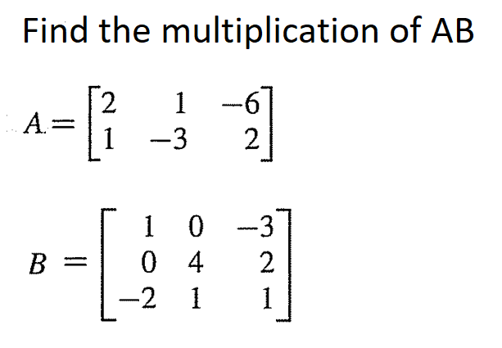
Lecture
04
Matrix Multiplication - Example
Lecture 4 Dr. Israa Lewaa Mathematics 2

Slide 21
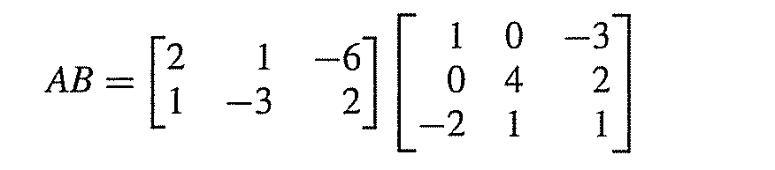
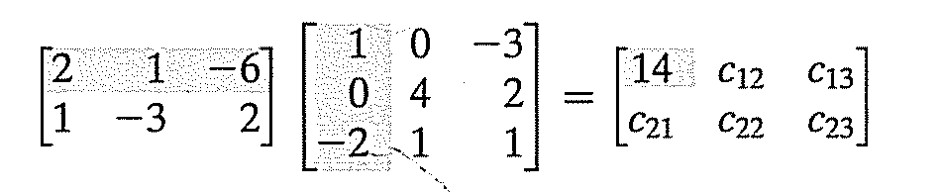
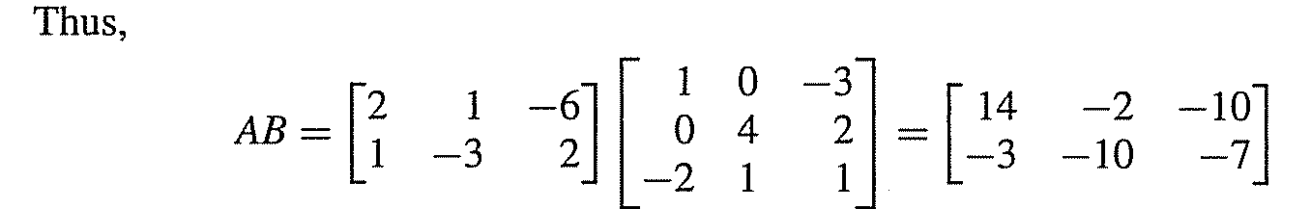
Lecture
04
Matrix Multiplication

Slide 22

Lecture
04
Matrix Multiplication

Slide 23
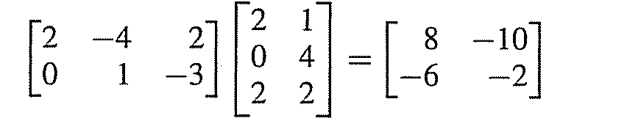
Lecture
04
Solution of Example
Lecture 4 Dr. Israa Lewaa Mathematics 2

Slide 24
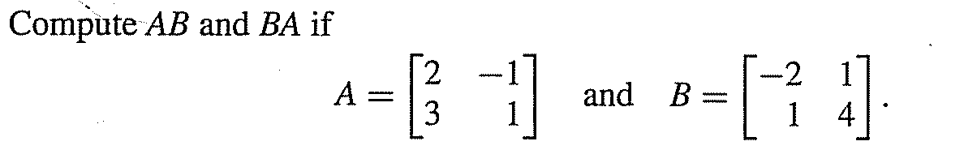
Lecture
04
Example
Lecture 4 Dr. Israa Lewaa Mathematics 2

Slide 25
Lecture
04
Example
Lecture 4 Dr. Israa Lewaa Mathematics 2

Slide 26
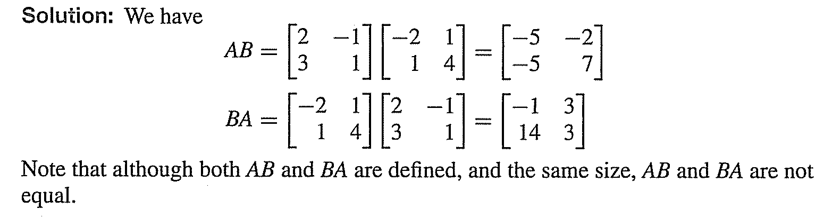
Lecture
04
Solution
Lecture 4 Dr. Israa Lewaa Mathematics 2

Slide 27
Lecture
04
Practice
Let’s Practice
Lecture 4 Dr. Israa Lewaa Mathematics 2

Slide 28
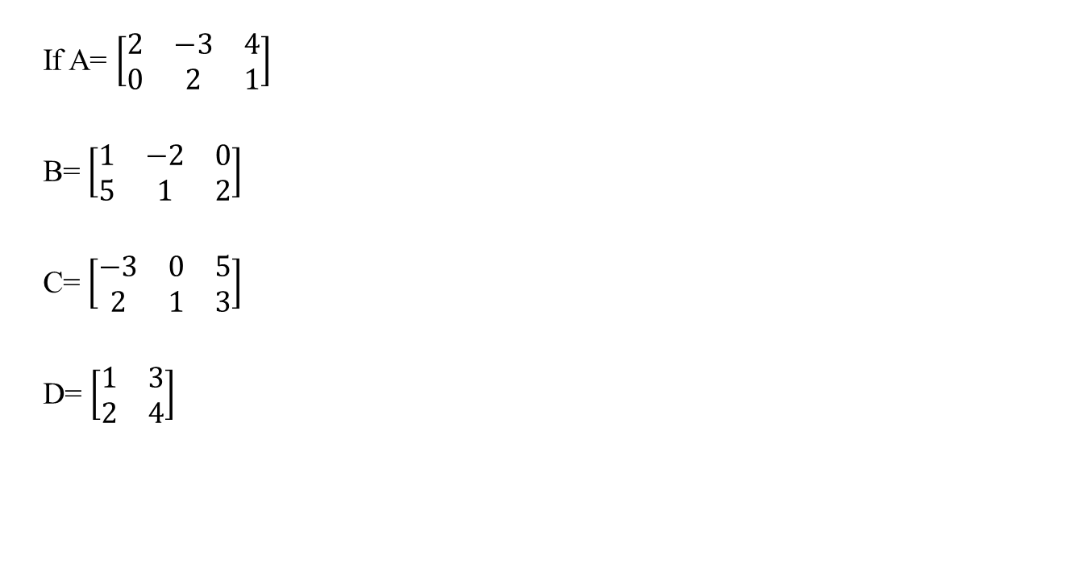
Lecture
04
Example 1
If A= $\left[\begin{matrix}2 & −3 & 4 \\ 0 & 2 & 1\end{matrix}\right]$
B= $\left[\begin{matrix}1 & −2 & 0 \\ 5 & 1 & 2\end{matrix}\right]$
C= $\left[\begin{matrix}−3 & 0 & 5 \\ 2 & 1 & 3\end{matrix}\right]$
D= $\left[\begin{matrix}1 & 3 \\ 2 & 4\end{matrix}\right]$
Lecture 4 Dr. Israa Lewaa Mathematics 2

Slide 29
Lecture
04
Example 1 Con’d
Find a) A + B
b) B + C d) A – B
c) A + C e) B – C
f) A – C h) A+D
Lecture 4 Dr. Israa Lewaa Mathematics 2

Slide 30
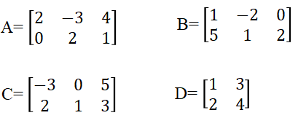
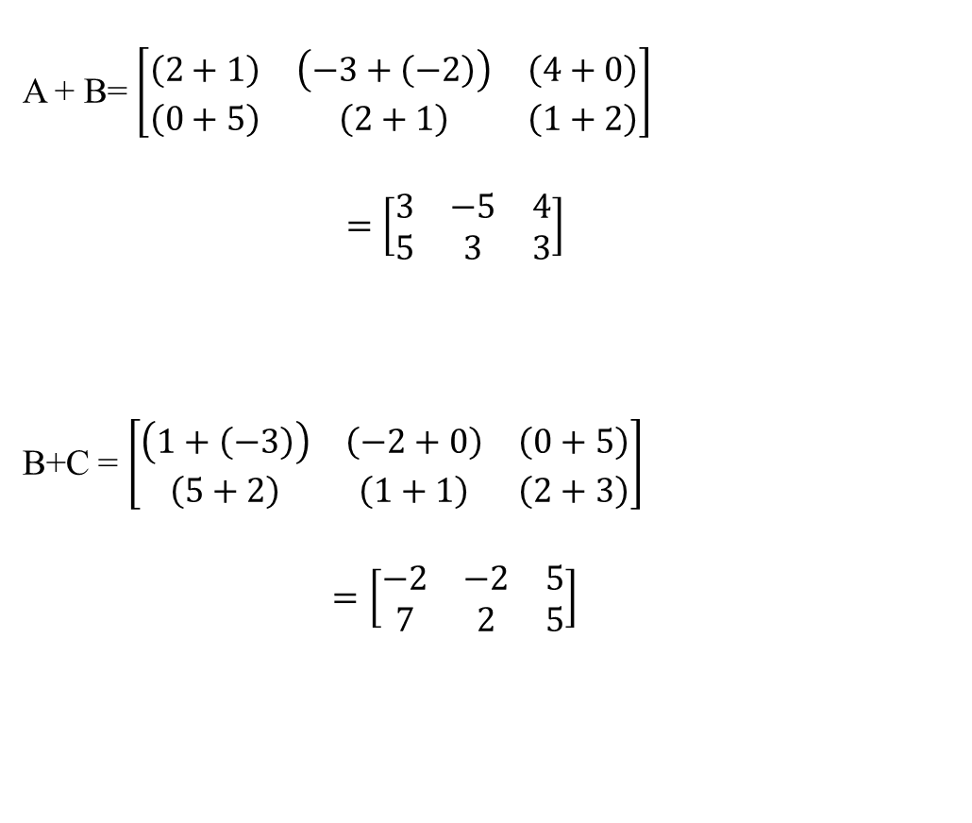
Lecture
04
Solution of Example 1
A + B= $\left[\begin{matrix}\left(2+1\right) & \left(−3+\left(−2\right)\right) & \left(4+0\right) \\ \left(0+5\right) & \left(2+1\right) & \left(1+2\right)\end{matrix}\right]$
$$=\left[\begin{matrix}3 & −5 & 4 \\ 5 & 3 & 3\end{matrix}\right]$$
B+C = $\left[\begin{matrix}\left(1+\left(−3\right)\right) & \left(−2+0\right) & \left(0+5\right) \\ \left(5+2\right) & \left(1+1\right) & \left(2+3\right)\end{matrix}\right]$
$$=\left[\begin{matrix}−2 & −2 & 5 \\ 7 & 2 & 5\end{matrix}\right]$$
Lecture 4 Dr. Israa Lewaa Mathematics 2

Slide 31
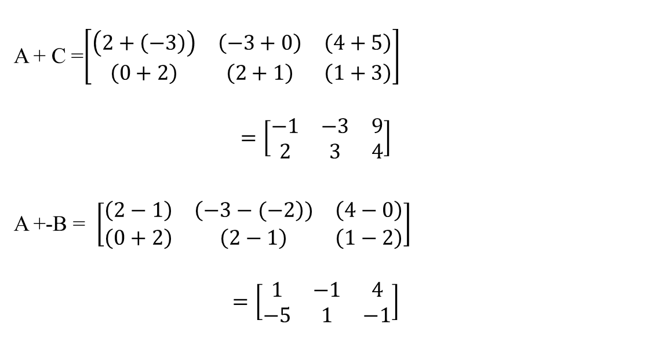
Lecture
04
Solution of Example 1
A + C =$\left[\begin{matrix}\left(2+\left(−3\right)\right) & \left(−3+0\right) & \left(4+5\right) \\ \left(0+2\right) & \left(2+1\right) & \left(1+3\right)\end{matrix}\right]$
$$=\left[\begin{matrix}−1 & −3 & 9 \\ 2 & 3 & 4\end{matrix}\right]$$
A +-B = $\left[\begin{matrix}\left(2−1\right) & \left(−3−(−2\right)) & \left(4−0\right) \\ \left(0+2\right) & \left(2−1\right) & \left(1−2\right)\end{matrix}\right]$
$$=\left[\begin{matrix}1 & −1 & 4 \\ −5 & 1 & −1\end{matrix}\right]$$
Lecture 4 Dr. Israa Lewaa Mathematics 2

Slide 32
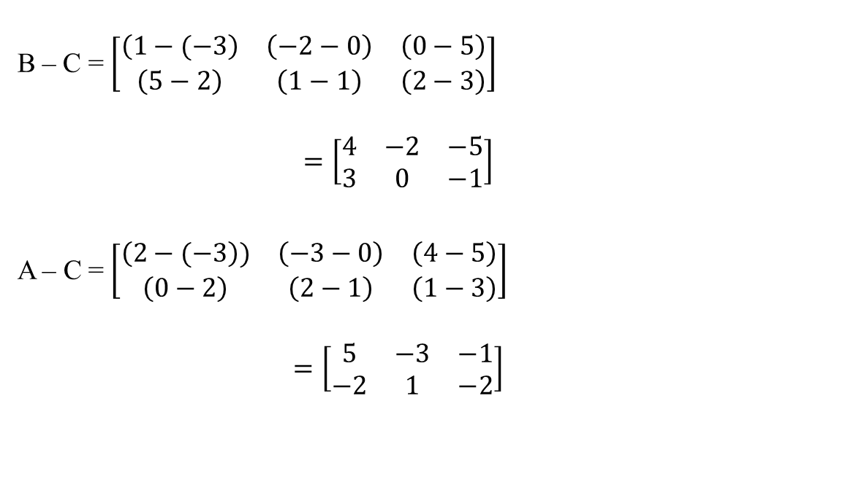
Lecture
04
Solution of Example 1
B – C = $\left[\begin{matrix}\left(1−(−3\right) & \left(−2−0\right) & \left(0−5\right) \\ \left(5−2\right) & \left(1−1\right) & \left(2−3\right)\end{matrix}\right]$
$$=\left[\begin{matrix}4 & −2 & −5 \\ 3 & 0 & −1\end{matrix}\right]$$
A – C = $\left[\begin{matrix}\left(2−(−3\right)) & \left(−3−0\right) & \left(4−5\right) \\ \left(0−2\right) & \left(2−1\right) & \left(1−3\right)\end{matrix}\right]$
$$=\left[\begin{matrix}5 & −3 & −1 \\ −2 & 1 & −2\end{matrix}\right]$$
Lecture 4 Dr. Israa Lewaa Mathematics 2

Slide 33
Lecture
04
Solution of Example 1
A + D
It is impossible to find the value of this addition because it should be in the same size
Lecture 4 Dr. Israa Lewaa Mathematics 2

Slide 34
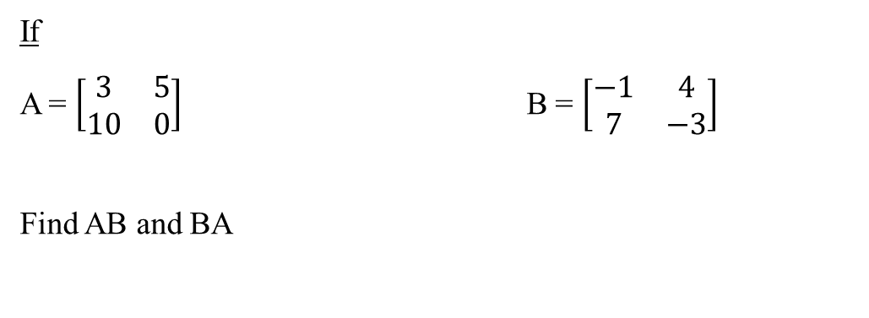
Lecture
04
Example 2
If
A = $\left[\begin{matrix}3 & 5 \\ 10 & 0\end{matrix}\right]$ B = $\left[\begin{matrix}−1 & 4 \\ 7 & −3\end{matrix}\right]$
Find AB and BA

Slide 35
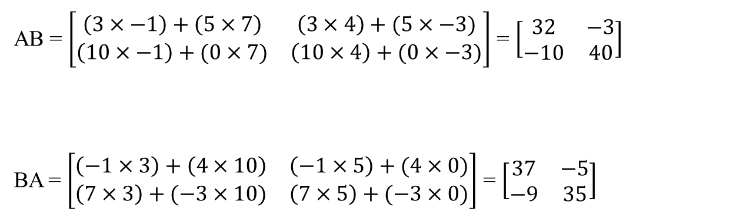
Lecture
04
Solution of Example 2
AB = $\left[\begin{matrix}\left(3×−1\right)+\left(5×7\right) & \left(3×4\right)+(5×−3) \\ \left(10×−1\right)+(0×7) & \left(10×4\right)+(0×−3)\end{matrix}\right]$ = $\left[\begin{matrix}32 & −3 \\ −10 & 40\end{matrix}\right]$
BA = $\left[\begin{matrix}\left(−1×3\right)+\left(4×10\right) & \left(−1×5\right)+(4×0) \\ \left(7×3\right)+(−3×10) & \left(7×5\right)+(−3×0)\end{matrix}\right]$ = $\left[\begin{matrix}37 & −5 \\ −9 & 35\end{matrix}\right]$
Lecture 4 Dr. Israa Lewaa Mathematics 2

Slide 36
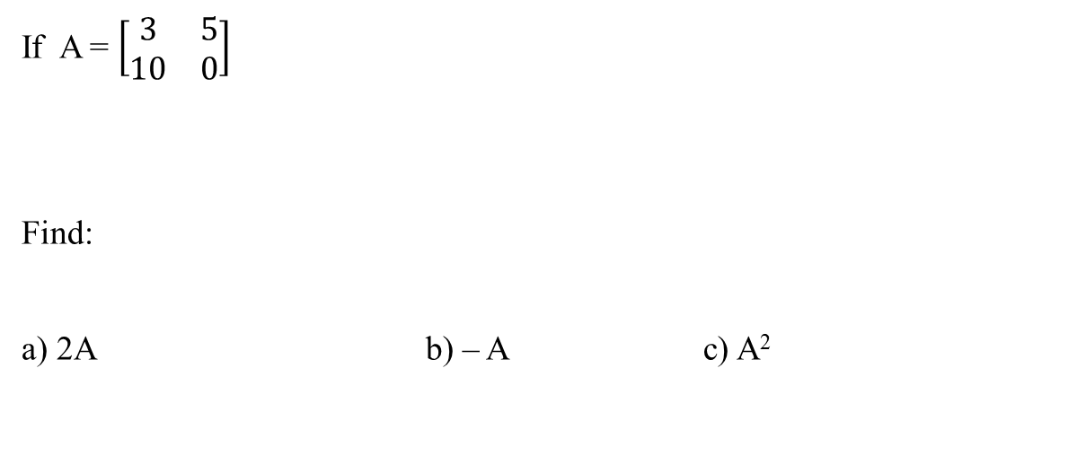
Lecture
04
Example 3
If A = $\left[\begin{matrix}3 & 5 \\ 10 & 0\end{matrix}\right]$
Find:
a) 2A b) – A c) A²
Lecture 4 Dr. Israa Lewaa Mathematics 2

Slide 37
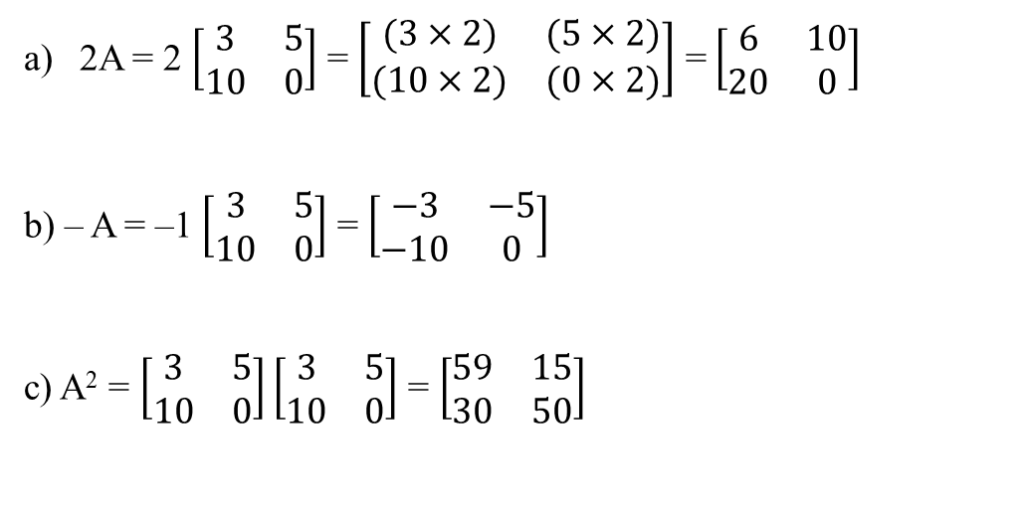
Lecture
04
Solution of Example 3
2A = 2 $\left[\begin{matrix}3 & 5 \\ 10 & 0\end{matrix}\right]$ = $\left[\begin{matrix}(3×2) & (5×2) \\ (10×2) & (0×2)\end{matrix}\right]$ = $\left[\begin{matrix}6 & 10 \\ 20 & 0\end{matrix}\right]$
b) – A = –1 $\left[\begin{matrix}3 & 5 \\ 10 & 0\end{matrix}\right]$ = $\left[\begin{matrix}−3 & −5 \\ −10 & 0\end{matrix}\right]$
c) A² = $\left[\begin{matrix}3 & 5 \\ 10 & 0\end{matrix}\right]\left[\begin{matrix}3 & 5 \\ 10 & 0\end{matrix}\right]$ = $\left[\begin{matrix}59 & 15 \\ 30 & 50\end{matrix}\right]$
Lecture 4 Dr. Israa Lewaa Mathematics 2

Slide 38
Lecture
04
Solution of Example 3
2A = 2 $\left[\begin{matrix}3 & 5 \\ 10 & 0\end{matrix}\right]$ = $\left[\begin{matrix}(3×2) & (5×2) \\ (10×2) & (0×2)\end{matrix}\right]$ = $\left[\begin{matrix}6 & 10 \\ 20 & 0\end{matrix}\right]$
b) – A = –1 $\left[\begin{matrix}3 & 5 \\ 10 & 0\end{matrix}\right]$ = $\left[\begin{matrix}−3 & −5 \\ −10 & 0\end{matrix}\right]$
c) A² = $\left[\begin{matrix}3 & 5 \\ 10 & 0\end{matrix}\right]\left[\begin{matrix}3 & 5 \\ 10 & 0\end{matrix}\right]$ = $\left[\begin{matrix}59 & 15 \\ 30 & 50\end{matrix}\right]$
Lecture 4 Dr. Israa Lewaa Mathematics 2

Slide 39
Lecture
04
Lecture Summary
Matrix Addition
Matrix Subtraction
Matrix Multiplication
Lecture 4 Dr. Israa Lewaa Mathematics 2

