Slide 1


Human Resources Management
Robert L. Mathis ⏐ John H. Jackson
Prepared by Dr. Samah Abdelfatah
MGM 243
Lecture 06

Slide 2



Part3:Developing HRM
Training Human Resources
Chapter
09
Lecture 06
MGM 243
Prepared by
Dr. Samah Abdelfatah
www.midocean.ae

Slide 3

Chapter
Learning Outcomes
09
After you have read this chapter, you should be able to:
Define training and discuss why a strategic approach is important.
Discuss the four phases of the training process.
Identify three types of analyses used to determine training needs.
Explain different means of internal and external training delivery.
Describe the importance of e-learning as part of current training efforts.
Give an example for each of the four levels of training evaluation.
www.midocean.ae

Slide 4
Chapter
NATURE OF TRAINING
09
Training is the process whereby people acquire capabilities to perform jobs.
Training provides employees with specific, identifiable knowledge and skills for use in their present jobs.
Organizational usage of training may include :
  “Hard” skills such as teaching sales representatives how to use intranet resources.
  “Soft” skills are critical in many instances and can be taught as well. They may include communicating, mentoring, managing a meeting, and working as part of a team.
www.midocean.ae

Slide 5
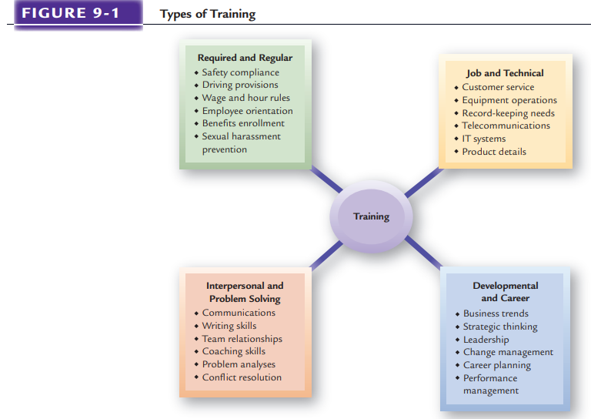
TRAINING CATEGORIES
www.midocean.ae

Slide 6
Chapter
TRAINING AND ORGANIZATIONAL STRATEGY
09
Training represents a significant HR expenditure for most employers. But it is too often viewed tactically rather than strategically, which means that training is seen as a short-term activity rather than one that has longer-term effects on organizational success.
Fortunately, more and more employers have recognized that training must be increased. One survey found that about half of the firms surveyed planned to increase their yearly training budgets.
www.midocean.ae

Slide 7

Chapter
Strategic Training
09
As a part of their training, individuals taking hotel reservations stay at a resort as guests in order to gain greater understanding of what they are selling and to experience the services themselves.
Strategic training is linked to how the organization accomplishes its organizational goals.
Strategic training enables HR and training professionals to get intimately involved with the business, partner with operating managers to help solve their problems, and make significant contributions to organizational results.
www.midocean.ae

Slide 8
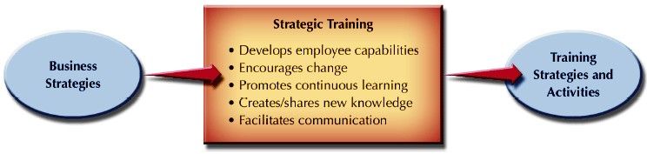
LINKING BUSINESS AND TRAINING STRATEGIES
Figure 9-2 shows how training may help accomplish certain organizational strategies. Ideally, the upper management group sees the training function as providing valuable intelligence about the necessary core skills.
Figure 9-2
Source: Based on ideas from Lisa A. Burke and Joseph V. Wilson III.
www.midocean.ae

Slide 9
Chapter
Organizational Competitiveness and Training
09
Knowledge management The way an organization identifies and leverages knowledge in order to be competitive
Knowledge management is a conscious effort to get the right knowledge to the right people at the right time so that it can be shared and put into action
Training as a Revenue Source Some organizations have identified that training can be a source of business revenue. For instance, Microsoft, Ceridian, Cisco, Hewlett-Packard, and other technology firms bundle training with products and services sold to customers.
www.midocean.ae

Slide 10
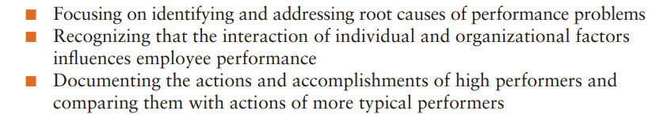
PERFORMANCE CONSULTING AND STRATEGIC TRAINING
Performance consulting Process in which a trainer and the organizational client work together to determine what needs to be done to improve organizational and individual results.
Performance consulting takes a broad approach by:
www.midocean.ae

Slide 11
PERFORMANCE CONSULTING AND STRATEGIC TRAINING
Integration of Performance and Training
Organizations are seeking more authentic (and hence more effective) training experiences for their employees by using real business problems to advance employee learning.
Chief Learning Officers
some organizations have created a position entitled chief learning officer (CLO) or chief knowledge officer (CKO). The CLO is a leader who designs knowledge through training for individual employees and the organization.
www.midocean.ae

Slide 12
Chapter
TRAINING AND GLOBAL STRATEGIES
09
For global firms the most brilliant strategies ever devised will not work unless they have well-trained employees throughout the world to carry them out.
Global Assignment Training: The orientation and training that expatriates and their families receive before departure significantly affect the success of an overseas assignment.
Intercultural Competence Training: Intercultural competence incorporates a wide range of human social skills and personality characteristics. As noted in Figure 9-3.
www.midocean.ae

Slide 13
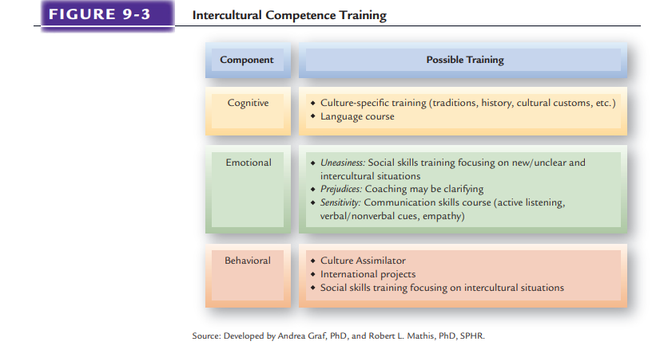
www.midocean.ae

Slide 14

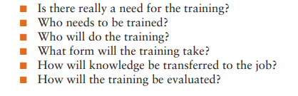
Chapter
TRAINING COMPONENTS
09
Training plans allow organizations to identify what is needed for employee performance before training begins. It is at this stage that fit with strategic issues is ensured.
Effective training efforts consider the following questions:
www.midocean.ae

Slide 15
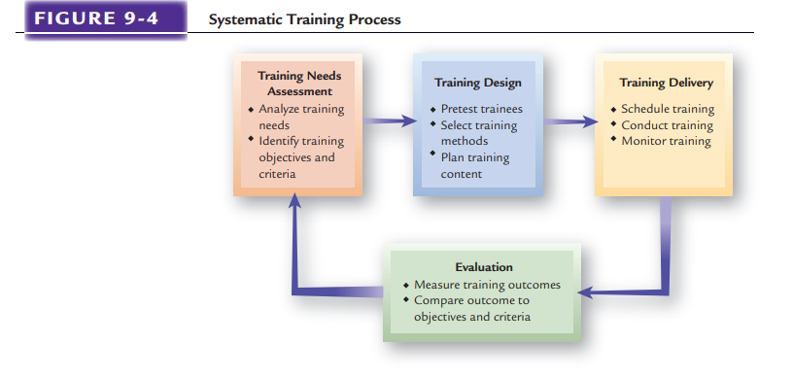
TRAINING NEEDS ASSESSMENT
Chapter
www.midocean.ae

Slide 16
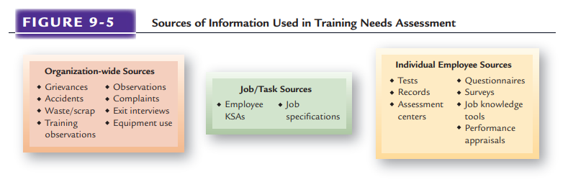
ANALYSIS OF TRAINING NEEDS
www.midocean.ae

Slide 17

Chapter
Establishing Training Objectives And Priorities
09
Once training requirements have been identified using appropriate needs analyses, then training objectives and priorities can be established by a “gap analysis,” which indicates the distance between where an organization is with its employee capabilities and where it needs to be.
Training objectives and priorities are then determined to close the gap.
Three types of training objectives can be set
www.midocean.ae

Slide 18
Chapter
TRAINING DESIGN
09
Once training objectives have been determined, training design can start. Whether job specific or broader in nature, training must be designed to address the assessed specific needs.
Effective training design considers learning concepts and a wide range of different approaches to training.
There are three primary considerations when designing training:
    Determining learner readiness,
    Understanding different learning styles, and
    Designing training for transfer. Each of these elements must be considered for the training design to mesh and produce effective learning.
www.midocean.ae

Slide 19
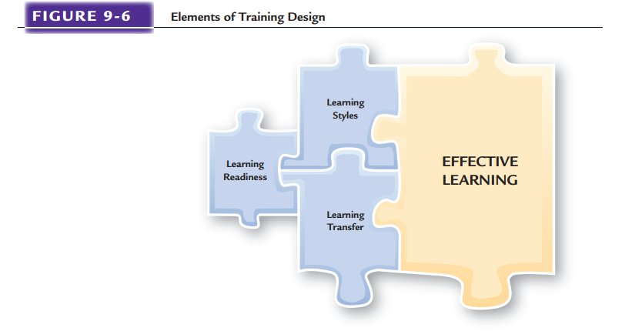
www.midocean.ae

Slide 20
Learner Readiness
1. Learning Readiness
Learner readiness means individuals having the ability to learn, which many people have. However, if effective learning is to occur, individuals must also have the motivation to learn and self-efficacy.
Ability to Learn
Learners must possess basic skills, such as fundamental reading and math proficiency, and sufficient cognitive abilities.
Motivation to Learn
A person’s desire to learn training content is referred to as “motivation to learn” and is influenced by multiple factors.
Self-Efficacy Person’s belief
Companies may discover that some workers lack the requisite skills to comprehend their training effectively.
Person’s belief that he or she can learn the training program content.
www.midocean.ae

Slide 21
Adult Learning
Adult Learning Malcolm Knowles’s classic work on adult learning suggests five principles for designing training for adults.
2. Learning Styles
Adult Learning Principles
Have need to know why they are learning something.
Have need to be self-directed.
Bring more work-related experiences into the process.
Employ a problem-solving approach in the experience.
Are motivated by both internal and external factors.
www.midocean.ae

Slide 22
Adult Learning
2. Learning Styles
Active practice
Performance of job related tasks and duties by trainees during training.
Spaced practice is performed in several sessions spaced over a period of hours or days.
Spaced practice
Massed practice
Massed practice is performed all at once.
www.midocean.ae

Slide 23
2. Learning Styles
Behavior modeling Copying someone else’s behavior
Reinforcement and Immediate Confirmation
Reinforcement Based on the idea that people tend to repeat responses that give them some type of positive reward and avoid actions associated with negative consequences.
Immediate confirmation Based on the idea that people learn best if reinforcement and feedback are given as soon as possible after training
www.midocean.ae

Slide 24
3. Learning Transfer
Transfer of Training
Finally, trainers should design training for the highest possible transfer from the class to the job.
Transfer occurs when trainees actually use on the job what knowledge and information they learned in training.
How much training effectively gets transferred to the job is estimated to be relatively low, given all of the time and money spent on training.
www.midocean.ae

Slide 25
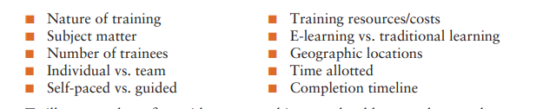
TRAINING DELIVERY
Once training has been designed, then the actual delivery of training can begin.
Whatever the approach used, a variety of considerations must be balanced when selecting training delivery methods.
The common variables considered are:
www.midocean.ae

Slide 26
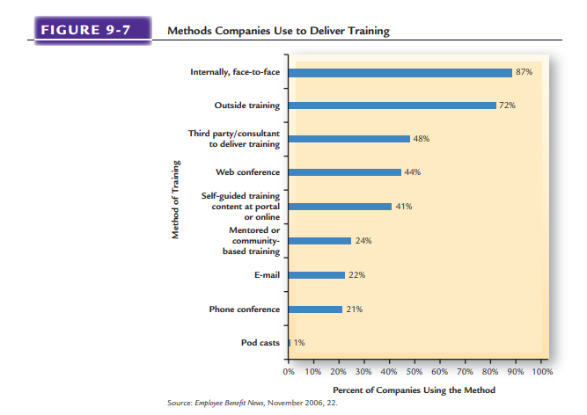
www.midocean.ae

Slide 27
Chapter
Internal Training
09
Informal training
Training that occurs through interactions and feedback among employees.
The most common type of training at all levels in an organization is on-the-job training (OJT) because it is flexible and relevant to what employees do
Cross Training
On-the-Job Training
Training people to do more than one job
www.midocean.ae

Slide 28
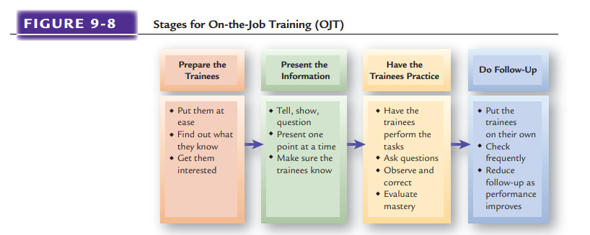
www.midocean.ae

Slide 29

Chapter
External Training
09
External training, or training that takes place outside the employing organization, is used extensively by organizations of all sizes.
Large organizations use external training if they lack the capability to train people internally or when many people need to be trained quickly.
www.midocean.ae

Slide 30
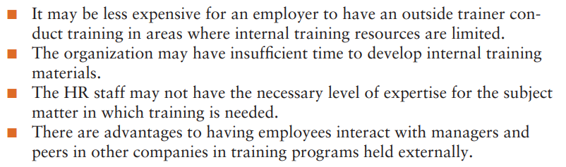
Chapter
External Training(Cont.)
09
Whatever the size of the organization, external training occurs for several reasons:
www.midocean.ae

Slide 31
External Training(Cont.)
Outsourcing of Training
Government-Supported Job Training
Educational Assistance Programs
www.midocean.ae

Slide 32
Chapter
Combination Training Approaches
09
Cooperative Training
Cooperative training approaches mix classroom form, generally referred to as school-to-work transition, helps individuals move into jobs while still in school or on completion of formal schooling. Such efforts may be arranged with high schools or with community colleges.
Instructor-Led Classroom and Conference Training
Is still the most prevalent approach to training. Employer-conducted short courses, lectures, and meetings usually consist of classroom training, whereas numerous employee development courses offered by professional organizations, trade associations, and educational institutions are examples of conference training.
www.midocean.ae

Slide 33

Orientation: Training for New Employees
Achievements of
Effective Orientation
Favorable
Impression
Provides
Information
Co-Worker
Acceptance
Socialization
and
Integration
Performance
and
Productivity
www.midocean.ae

Slide 34
Effective New Employee Orientation
Prepare New Employee
Consider “buddy” mentors
Use an orientation checklist
Cover needed information
Present information effectively
Avoid information overload
Evaluation and follow-up
www.midocean.ae

Slide 35
Chapter
E-LEARNING: ON-LINE TRAINING
09
The use of the Internet or an organizational intranet to conduct training online.
Distance Training/Learning
A growing number of college and university classes use some form of Internet-based course support.
Simulations and Training
Computer-supported simulations within organizational training can replicate the psychological and behavioral requirements of a task, often in addition to providing some amount of physical resemblance to the trainee’s work environment.
Blended Learning
Learning approach that combines short, fast-paced, interactive computer-based lessons and teleconferencing with traditional classroom instruction and simulation..
www.midocean.ae

Slide 36
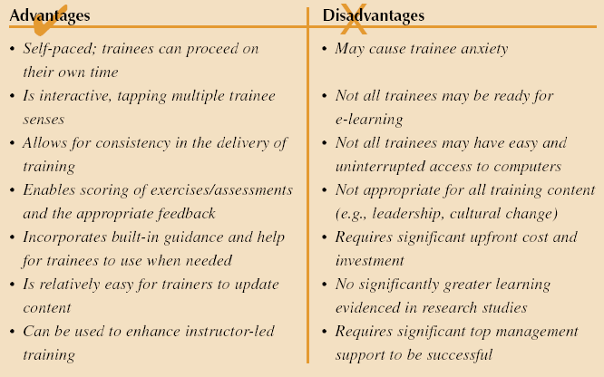
Advantages And Disadvantages Of E-learning
Figure 9-9
Source: Developed by Lisa A. Burke. May not be reproduced without permission.
www.midocean.ae

Slide 37
Developing E-Learning
Criteria for adopting e-learning:
Sufficient top management support and funding
Accepting the idea of decentralized and individualized training
Current training methods not meeting needs
Computer literacy and access to computers
Time and travel cost concerns for trainees
The number and self-motivation of trainees
www.midocean.ae

Slide 38
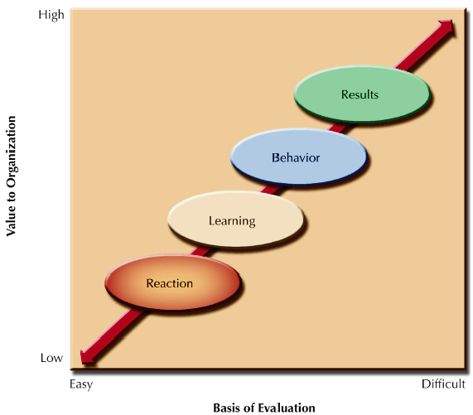
LEVELS OF TRAINING EVALUATION
Results Employers evaluate results by measuring the effect of training on the achievement of organizational objectives. Because results such as productivity, turnover, quality, time, sales, and costs are relatively concrete, this type of evaluation can be done by comparing records before and after training.
Behavior Evaluating training at the behavioral level means: (1) measuring the effect of training on job performance through interviews of trainees and their co-workers, and (2) observing job performance.
Learning levels can be evaluated by measuring how well trainees have learned facts, ideas, concepts, theories, and attitudes.
Reaction Organizations evaluate the reaction levels of trainees by conducting interviews with or administering questionnaires to the trainees.
Figure 9–10
www.midocean.ae

Slide 39
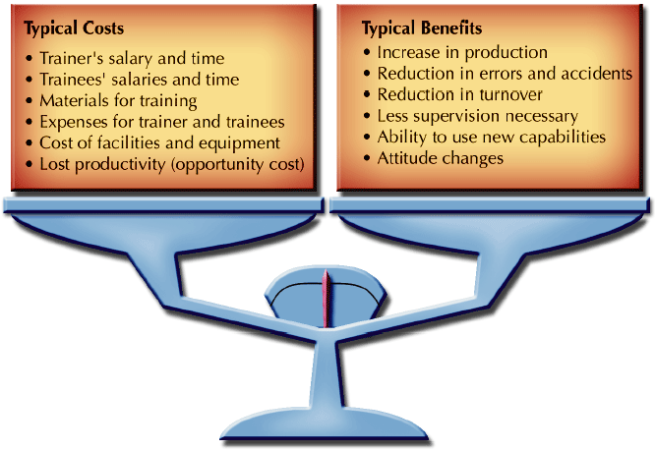
BALANCING COSTS AND BENEFITS OF TRAINING
www.midocean.ae
Figure 9-11

Slide 40
TRAINING EVALUATION
Chapter
09
Cost-Benefit Analyses
  Comparison of costs and benefits associated with training
Return on Investment
Benchmarking Training
Training Evaluation Designs
Pre-/Post-Measure
Post-Measure
Pre-/Post-Measure
Pre-/Post-Measure with a Control Group
www.midocean.ae

Slide 41
Chapter
SUMMARY
09
Nature Of Training
Training Categories
Training And Organizational Strategy
Performance Consulting And Strategic Training
Training Components
Training Needs Assessment & Analysis
Establishing Training Objectives And Priorities
Training Design
Training Delivery
E-learning: On-line Training
Balancing Costs And Benefits Of Training
Training Evaluation
www.midocean.ae

Slide 42



Thank You

