Slide 1

PMG 622
Agile Project Management
LECTURE 09: Agile planning
Everyone’s Smart
University
دكتور مهندس استشاري ادارة المشروعات
Eng. Dr. Akram Mustafa Suliman Ali,
PhD. AU, BEng. & MSc. AAST, CEng CMarEng MIMarEST, PE, PMP®,
ASQ CSSBB, ISO Lead Auditor, NDT Level II,

Slide 2
المنتدى المفتوح -The Open Forum
This is a Standard Forum displayed in a blog-like format
Students may start new topics in this format.
Allow multiple topics listed with the most recent topic at the top of the page and replies behind a link.
في هذا المنتدى يستطيع اي طالب بدء المناقشة ليرد عليه باقي الطلبة
و اشكركم على مشاركتكم
Forum Topic:
المنتدى المفتوح
-The Open Forum

Slide 3

Waste is a Crime
Notes:
Steps that definitely create value.
Steps that create no value, but are necessary given the current state of the system.
Steps that create no value and can be eliminated.

Slide 4
The wastes Categories and Actions
Waste | Actions | PDCA | Examples
Muri | Unreasonableness/ Overburden | P | Absurdity; unreasonable expectations; overburden; emotional waste
Mura | Inconsistency/ Unevenness | D | JIT + FIFO / 6 Sigma
Muda | Outcomes/ Waste | C
 | Will, motivation & determination to do that all | A
Notes:
Waste in inventory; Waste of not doings things right the first time; waste of working too hard; emotional waste of unreasonable expectations.
Overburden → unnecessary reporting etc.. Absurdity → unreasonable targets
Working Too Hard Only Makes More Work: Lexus 16.8 hrs 34 defects/ 100 cars. German 78.7 defects/ 100 cars.
Don’t Be Unreasonable: Challenging goals are motivators; goals that are impossible are just depressing
Don’t Be Heroic – If you need to be heroic to get things done, you have a problem. → Failure of planning
Strive For Flow: Choose the smoothest, most trouble free way to get things done. Scrum is about enabling the most flow possible
No assholes: Any one who causes emotional chaos, inspires fear or dread, or demeans or diminishes people need to be stopped cold. → Page 110
Enough With The Stupid Policies; Forms; Meetings; Approvals, etc.

Slide 5
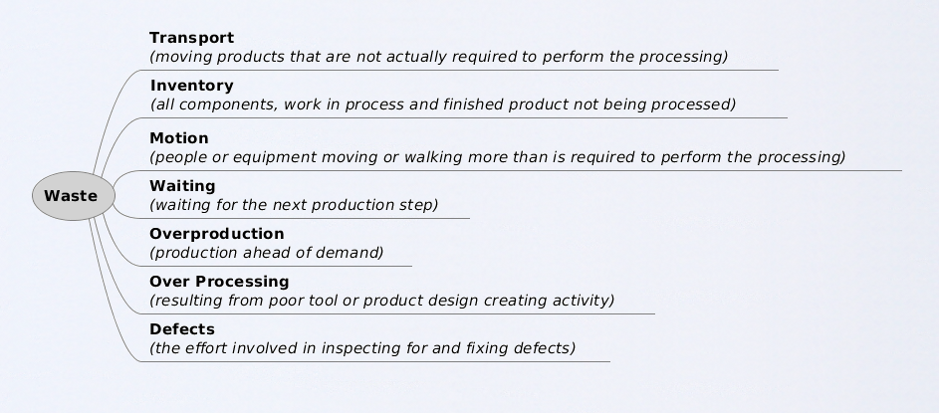
The 7 Wastes
Notes:
نصف الكوب الفارغ

Slide 6
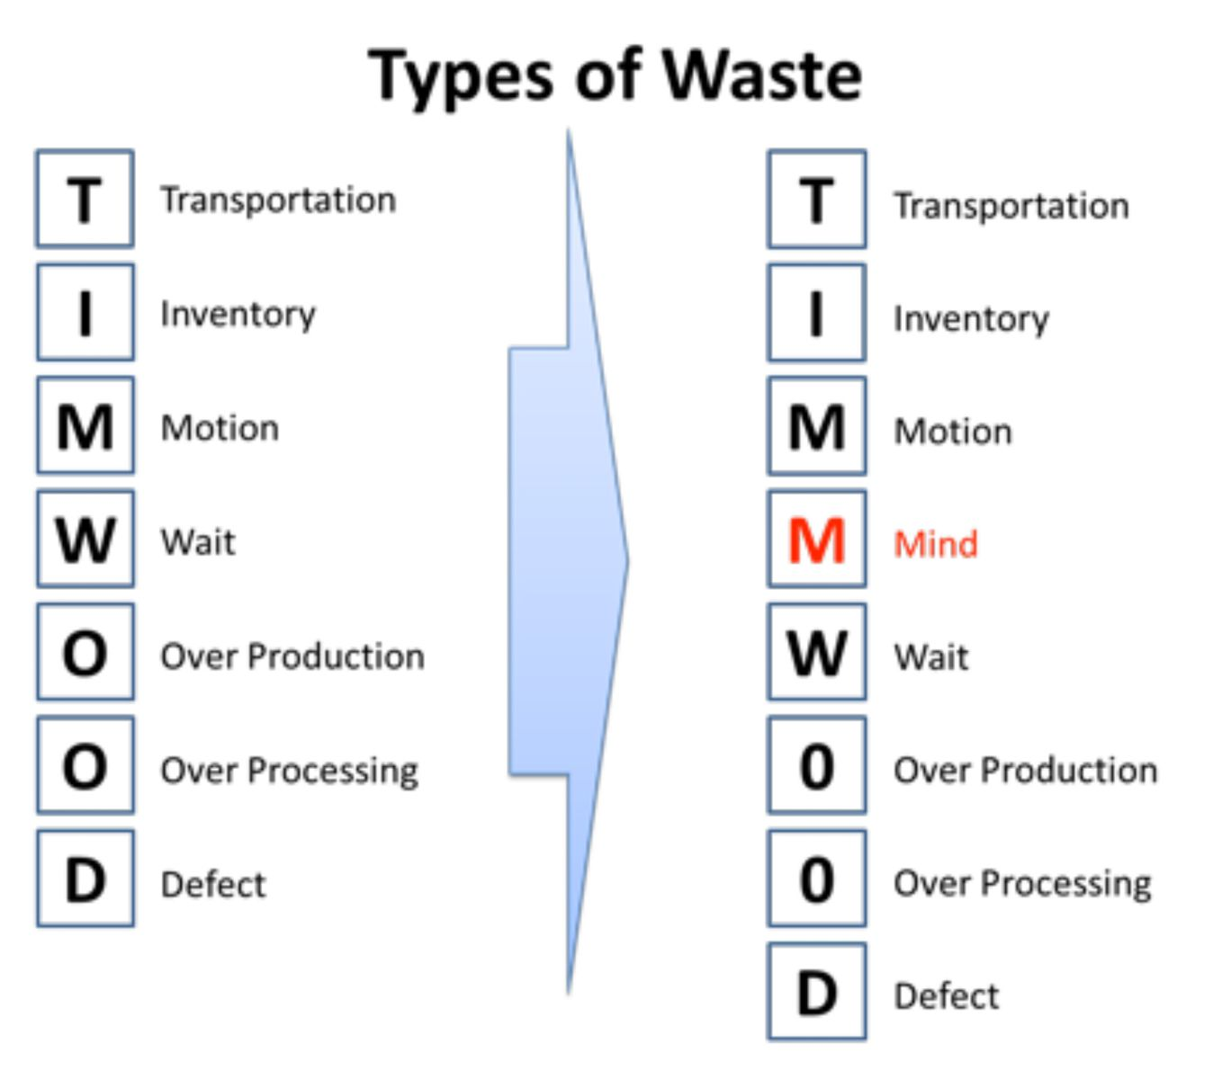
The 8th Waste

Slide 7
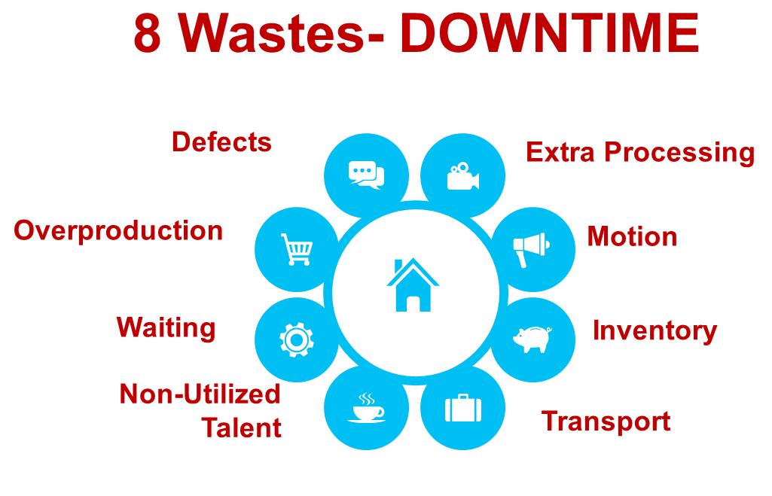
DOWNTIME

Slide 8
Unused Employee Creativity:
Losing
  time,
  ideas,
  skills,
  improvements, and learning opportunities
by not engaging or listening to your employees

Slide 9
Waste is a Crime
Everything that stands in the way is waste.
It is no exaggeration that in a low-growth period such waste is crime against society more than a business loss.
Eliminating waste must be a business’s first objective.
Senior Management needs to believe that impediments are nearly criminal.
Notes:
Lean and agile enterprises only.

Slide 10
Agile Planning
Notes:
Steps that definitely create value.
Steps that create no value, but are necessary given the current state of the system.
Steps that create no value and can be eliminated.

Slide 11
Planning and Time Boxing
Planning Is Useful. Blindly Following the Plans Is Stupid
Effectiveness = Planning
Efficiency = Time Boxing (Sprints)
Failing to plan is planning to fail
Notes:
SMARTER
Specific
Measureable
Attainable
Relevant
Time bound
Evaluate
Review

Slide 12
Scrum’ THREE BEST PRACTICES
Best Practice #1: User Stories
Best Practice #2: Planning Poker
Best Practice #3: Use of the Scrum Board
Notes:
Half-Done IS Not Done
Do It Right the First Time
Fixing a bug later took 24 times the effort if it is fixed on the same day it is created.
The story should include:
Customer
Object
Motivation → How is it going to satisfy the customer?
INVEST
Definition of done.
INVEST = READY STORY → Independent; Negotiable; Valuable; Estimable; Small; Testable (write the test before you do the story)
I want a car as ………………… (a) Urban Commuter, (b) South Dakota Farmer that I can use on daily basis

Slide 13
Best Practice #1: User Stories
Plain-english requirements, written on common 3X5 index cards
Form: As [a type of user] I want to [perform a specific action] such that [result]
Example: “As a web user, I want to make a reservation, such that I may secure my lodging”
Stories that are big are called EPICS
Acceptance criteria goes on card back
Notes:
Half-Done IS Not Done
Do It Right the First Time
Fixing a bug later took 24 times the effort if it is fixed on the same day it is created.
The story should include:
Customer
Object
Motivation → How is it going to satisfy the customer?
INVEST
Definition of done.
INVEST = READY STORY → Independent; Negotiable; Valuable; Estimable; Small; Testable (write the test before you do the story)
I want a car as ………………… (a) Urban Commuter, (b) South Dakota Farmer that I can use on daily basis

Slide 14

Best Practice #2: Planning
Poker
A way for the team to do estimates
Each participant has cards numbered 1,2,3,5,8,13,21
Values represent ‘story points’ of effort
Players discuss feature, then throw down a card together
Differences are noted and discussed, then process repeats till a consensus estimate is formed
Notes:
Scope and prioritize using DELPHI
Estimate using PLAN WITH POKER
Fibonacci Sequence
Halo Effect; Bandwagon Effect, and; Informational Cascade

Slide 15
Best Practice #3: Use of the Scrum Board
Scrum Board is a rows-and-columns depictions of work-in-progress
Items of work are rows, work status labels are columns
Work is addressed from top to bottom
Work migrates from left to right on the board

Slide 16
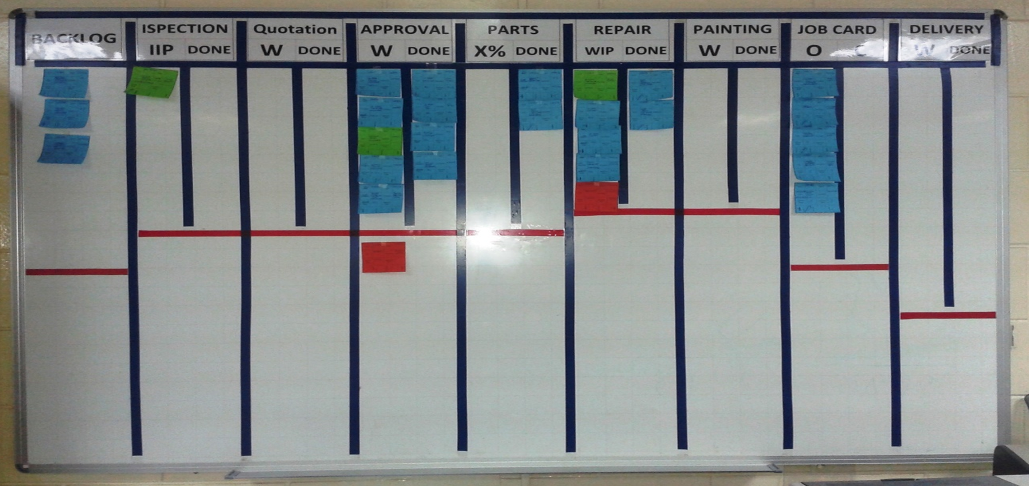
Sample Use of the Scrum Board
Notes:
There is no detailed reporting to management. Anyone in management or on another team can walk by and look at the scrum board and know where everything stands.

Slide 17
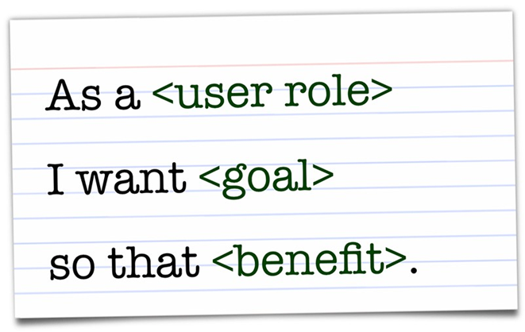
User Stories
I.N.V.E.S.T.
  Independent
  Negotiable
  Valuable
  Estimable
  Small
  Testable

Slide 18
Estimating User Stories [1/2]
Agile Estimating uses “Relative Sizing”
  Since effort is subjective, we use Relative Sizing to other User Stories
Fibonacci Sequence – 1, 2, 3, 5, 8, 13, 21+
  We try to keep it under 13 so we can better categorize Stories
T-Shirt Sizing is popular
  XS, S, M, L, XL, XXL

Slide 19
Estimating User Stories [2/2]
The number assigned to these are called “Story Points”
  Story Points can be thought of as “Effort Points” – more points = more effort
Breakdown of Estimating
  Epics = Large and Vague
  Features = A useable product
  User Story = One part of a feature
  Task = The smallest item a person could possibly do

Slide 20
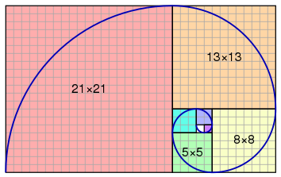
Fibonacci Spiral

Slide 21

Golden ratio
61.8% - also referred to as "the golden ratio" is found by dividing one number in the series by the number that follows it. For example: 8/13 = 0.6153, and 55/89 = 0.6179.

Slide 22
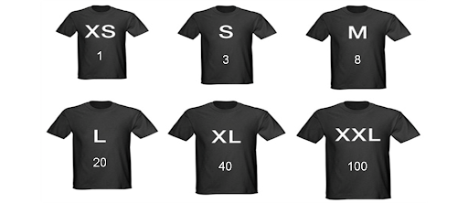
T-shirt size estimating

Slide 23
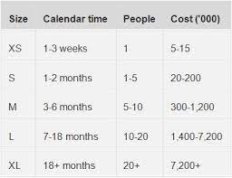
Story points quantification example

Slide 24
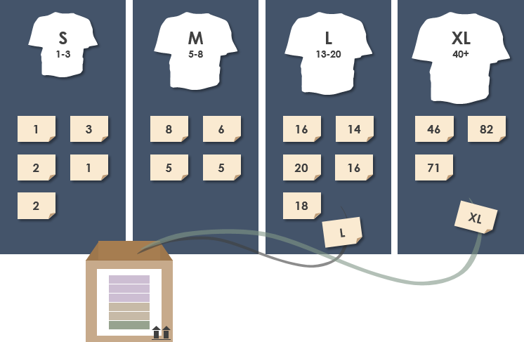
Sized stories planning

Slide 25
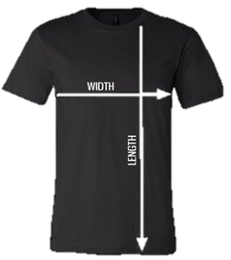
Further value of t-shirt size estimation

Slide 26
Agile Estimating
Velocity = The number of Story Points completed during an iteration (Sprint)
  Points are ONLY added if the User Story is 100% complete
  Cumulative Average
  It will take several iterations for Velocity to stabilize
  Tracked as a TEAM – not for individual performance
  Velocity will naturally fluctuate (a little) “reasonable amount”
  The more broken down a Feature can be, the better the estimates will be
  It can include ANY task so long as there are User Stories (placeholders)

Slide 27
Agile Math
Sprint 1, the team finished 20 story points.
  Sprint 2, the team finished 30 story points.
Sprint 3, the team estimates how many story points will be completed?
A) 20
B) 30
C) 50
D) 25

Slide 28
Agile Games

Slide 29
Features of Agile Games
Designed to promote collaboration
Have fun
Gamify the process
Spark innovation and creativity
Encourages participation
Generate organic conversations
Brings the team closer together
Promotes diversity

Slide 30
Examples Of Games
Planning Poker – Used to estimate the size of a User Story
Coin Game – Used to show workflow, pull, and batches
20/20 Vision – Used to prioritize User Stories on a board
Prune the Product Tree – Used to prioritize User Stories on a “tree”
Product Box – Used to have stakeholders show what they want and value
Buy a Feature – Used to “buy” features based on priority
Draw a House – Used to encourage reasoning and communication
Chair Game – Used to promote communication and have fun

Slide 31
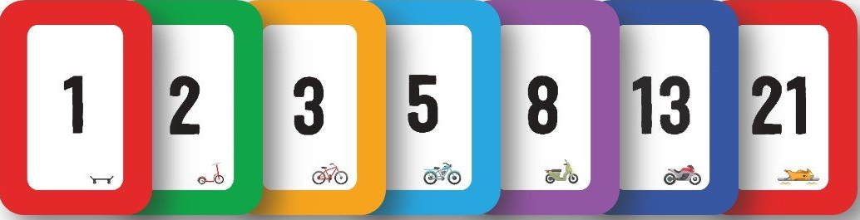
Planning Poker

Slide 32
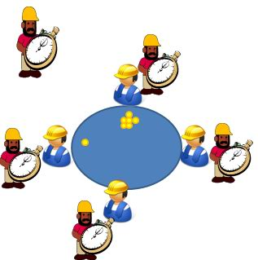
Coin Game

Slide 33
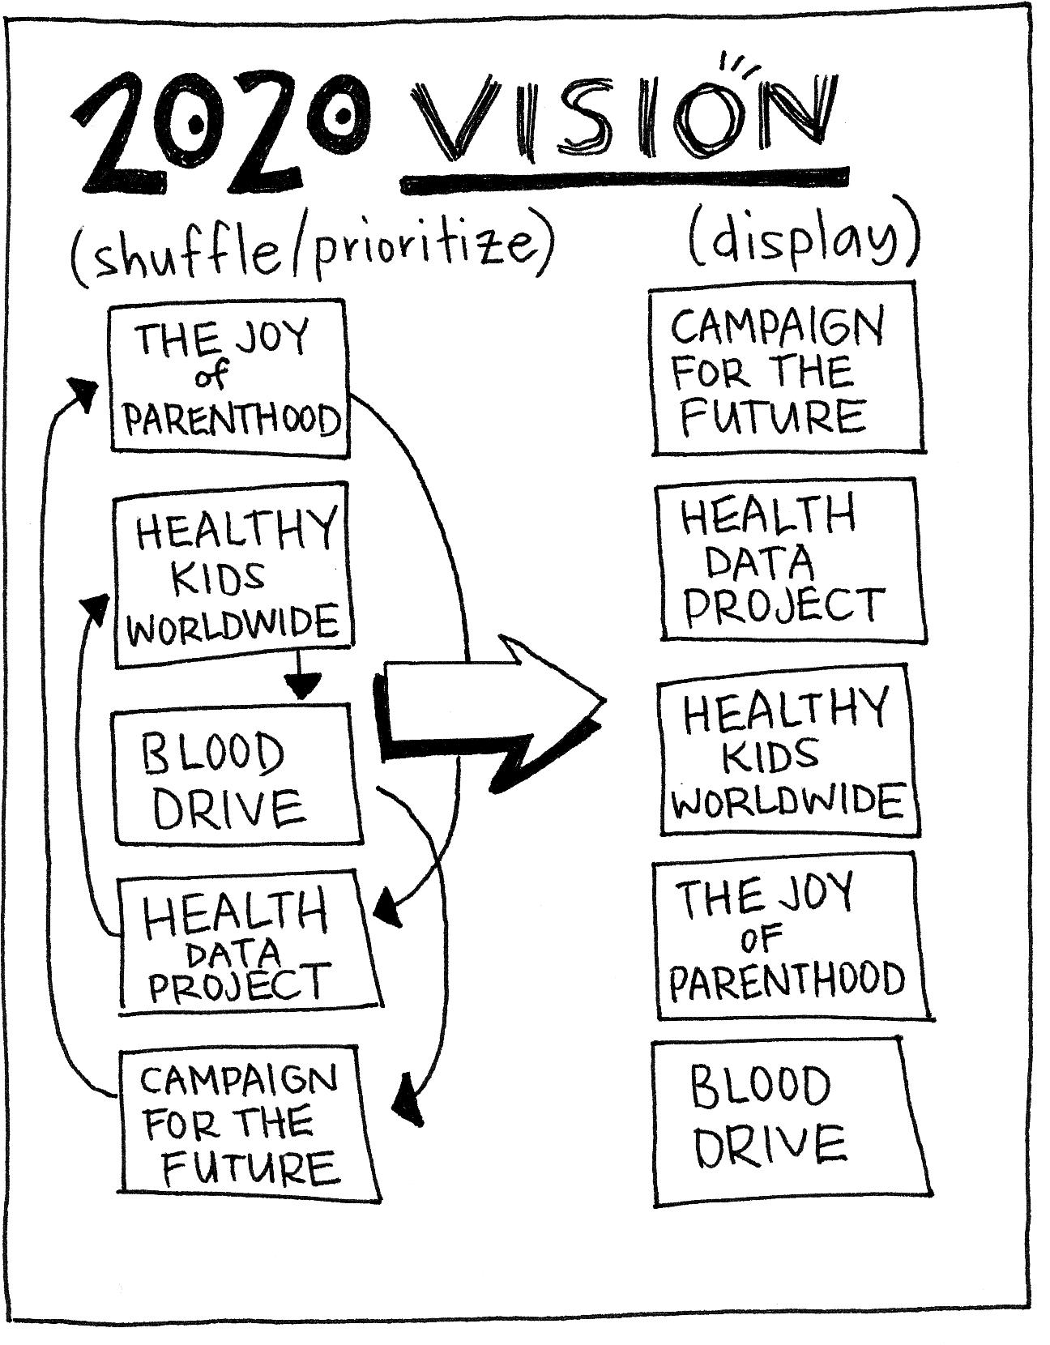
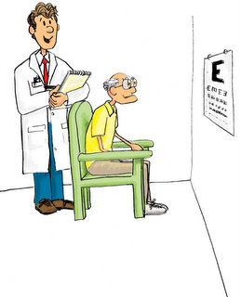
20/20 Vision

Slide 34
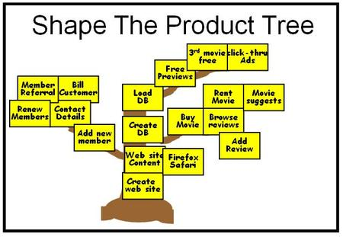
Prune the Product Tree

Slide 35
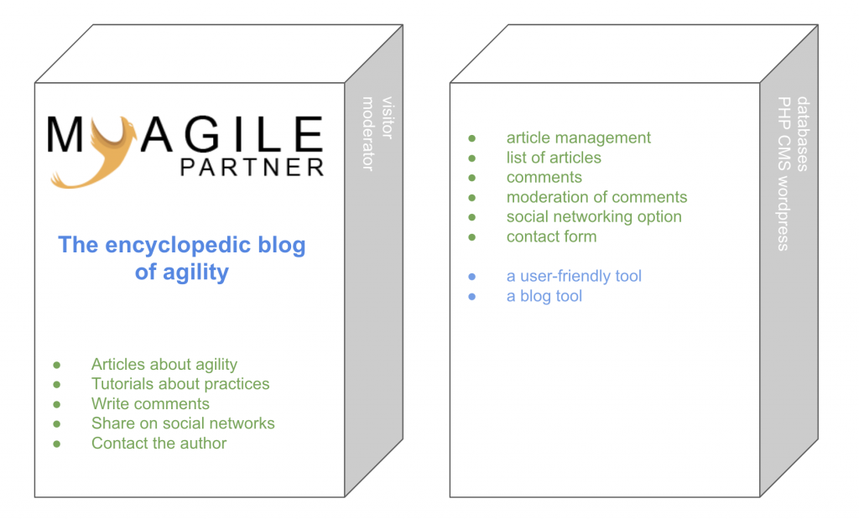
Product Box

Slide 36
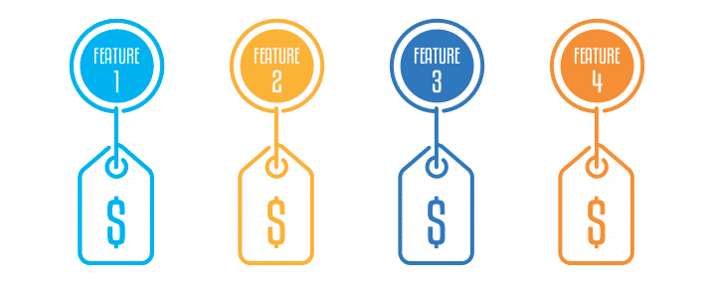
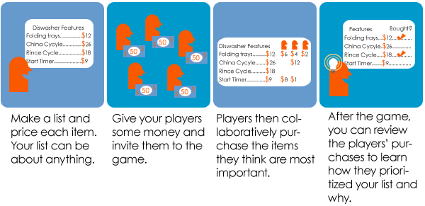
Buy a Feature
Notes:
Create a list of potential features and provide each with a price. Just like for a real product, the price can be based on development costs, customer value, or something else. Although the price can be the actual cost you intend to charge for the feature, this is usually not required. Customers buy features that they want in the next release of your product using play money you give them. Make certain that some features are priced high enough that no one customer can buy them. Encourage customers to pool their money to buy especially important and/or expensive features. This will help motivate negotiations between customers as to which features are most important.

Slide 37
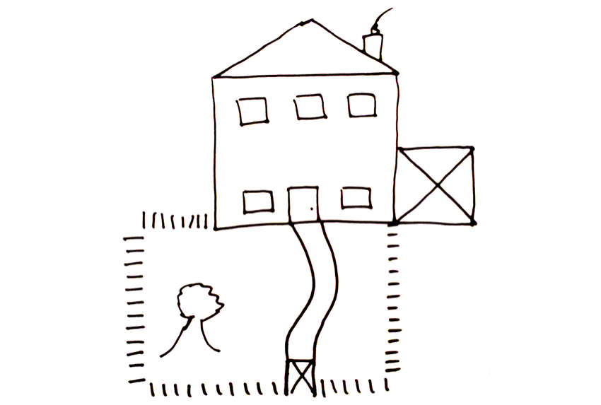
Draw a House
Notes:
If you want to explain acceptance criteria, then this activity gets across the concept very well in a simple, straightforward, and powerful way.
Once you have been around the room, tell everyone that you need them to write down what you are now about to say, and say the following:
There is a door on the lower floor in the middle of the house.
On each side of the door there is a window.
On the upper floor, there are three windows evenly spaced across the house.
The house has a pitched roof.
There is a chimney.
The house has a garage.
The house has a fence around a garden.
The fence has a gate.
There is a path from the door of the house to the gate.
The garden has a tree.

Slide 38
Chair Game
https://www.youtube.com/watch?v=drv-2D6g3Gw

