Slide 1



Object Oriented Programming
Prepared by Dr. Yasser Abdelhamid
IT223
Object Oriented Programming
Lecture 08

Slide 2

outline
Abstraction
Abstract classes
Interfaces
Multiple inheritance
Interfaces vs abstract classes

Slide 3
abstraction

Slide 4
Abstraction
Sometimes we may come across a situation where we cannot provide implementation to all the methods in a class.
We want to leave the implementation to a class that extends it.
In such case we declare a class as abstract.

Slide 5
Abstraction
Abstraction is a process of hiding the implementation details and showing only functionality to the user.
Abstraction lets you focus on what the object does instead of how it does it.
Abstraction can be implemented using
  Abstract classes
  Interfaces

Slide 6
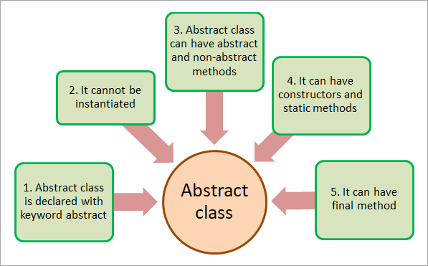
abstract classes

Slide 7
Abstract class
An abstract class is declared using abstract keyword.
Abstract classes may have
  abstract and
  non-abstract methods.
Abstract classes cannot be instantiated.

Slide 8
Abstract class
Any class which extends abstract class must override all its abstract methods.
An abstract class can contain 0 or more abstract methods.
Abstract class declaration
  Example :
    abstract class MyClass{}

Slide 9
abstract methods
Abstract methods are only declared in abstract classes.
Declaring abstract methods in non-abstract classes results in a compilation error.

Slide 10
example
// Example of abstract class
abstract class Bike{
abstract void run(); // must be overriden
}
class Honda4 extends Bike{
void run(){System.out.println(“Overriding abstract method");}
public static void main(String args[]){
Bike obj = new Honda4();
obj.run();
}
}

Slide 11
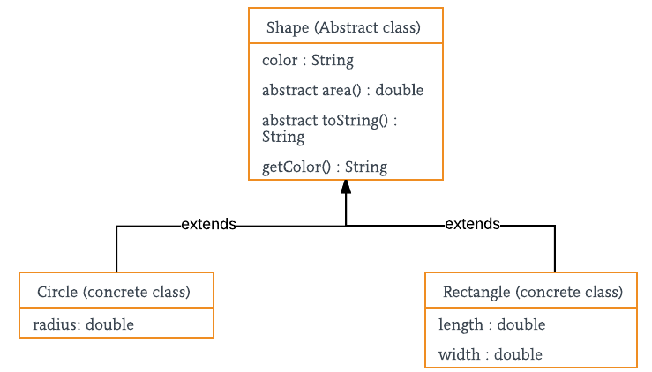
Example

Slide 12
Example shape class
public abstract class Shape {
private String name;
public Shape() {
this.name = "Unknown shape";
}
public Shape(String name) {
this.name = name;
}
public String getName() {
return this.name;
}
public void setName(String name) {
this.name = name;
}
// Abstract methods
public abstract void draw();
public abstract double getArea();
public abstract double getPerimeter();
}

Slide 13
example rectangle class
public class Rectangle extends Shape {
private double width;
private double height;
public Rectangle(double width, double height) {
// Set the shape name as "Rectangle"
super("Rectangle");
this.width = width;
this.height = height;
}
…

Slide 14
example rectangle class (cont.)
// Provide an implementation for inherited abstract draw() method
public void draw() {
System.out.println("Drawing a rectangle...");
}
// Provide an implementation for inherited abstract getArea() method
public double getArea() {
return width * height; }
// Provide an implementation for inherited abstract getPerimeter() method
public double getPerimeter() {
return 2.0 * (width + height); }
}

Slide 15
example circle class
public class Circle extends Shape {
private double radius;
public Circle(double radius) {
super("Circle");
this.radius = radius;
}
…

Slide 16
example circle class (cont.)
// Provide an implementation for inherited abstract draw() method
public void draw() {
System.out.println("Drawing a circle...");
}
// Provide an implementation for inherited abstract getArea() method
public double getArea() {
return Math.PI * radius * radius;
}
// Provide an implementation for inherited abstract getPerimeter() method
public double getPerimeter() {
return 2.0 * Math.PI * radius;
}
}

Slide 17
using shape abstract class
Shape s = new Rectangle(2.0, 5.0);
/* Late binding
s.getArea() will call the getArea() method
of the Rectangle class.
*/
double area = s.getArea();

Slide 18
example: handling Array of shapes
public class ShapeUtil {
public static void drawShapes(Shape[] list) {
for (int i = 0; i < list.length; i++) {
// Draw a shape, no matter what it is
list[i].draw(); // Late binding
}
}
…

Slide 19
example: handling Array of shapes(cont.)
public static void printShapeDetails(Shape[] list) {
for (int i = 0; i < list.length; i++) {
// Gather details about the shape
String name = list[i].getName(); // Late Binding
double area = list[i].getArea(); // Late binding
double perimeter = list[i].getPerimeter(); // Late binding
// Print details
System.out.println("Name: " + name);
System.out.println("Area: " + area);
System.out.println("Perimeter: " + perimeter);
}
}
}

Slide 20
Late binding
In Java, late binding, also known as dynamic binding or runtime polymorphism, refers to the process of determining the appropriate method or function to call at runtime, based on the actual type of the object rather than the reference type.
Late binding allows for more flexibility and extensibility in object-oriented programming.

Slide 21
Testing shapeutil class
public class ShapeUtilTest {
public static void main(String[] args) {
// Create some shapes, draw, and print their details
Shape[] shapeList = new Shape[2]; Array of two shapes
shapeList[0] = new Rectangle(2.0, 4.0); // Upcasting
shapeList[1] = new Circle(5.0); // Upcasting
// Draw all shapes
ShapeUtil.drawShapes(shapeList);
// Print details of all shapes
ShapeUtil.printShapeDetails(shapeList);
}
}

Slide 22
Exercise: Bank accounts application
A bank account has a name, interest rate, and interest interval.
Create an abstract class that implements bank accounts class.
Create concrete bank account classes for the following types of accounts:
  Savings account, interest rate 12%, monthly
  Platinum account, interest rate 17%, quarterly.
Create test class to use these classes.

Slide 23
interfaces

Slide 24
interfaces
Interfaces are another way to achieve abstraction in Java.
Interfaces cannot be used to create objects.
Classes implement interfaces.
On implementation of an interface, you must override all of its methods.
An interface cannot contain a constructor.

Slide 25
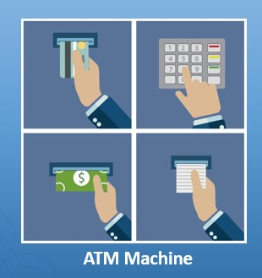


Interfaces implement abstraction

Slide 26
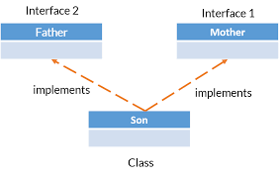
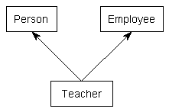
Multiple inheritance
Multiple inheritance can be achieved using interfaces.
A class can implement multiple interfaces.

Slide 27
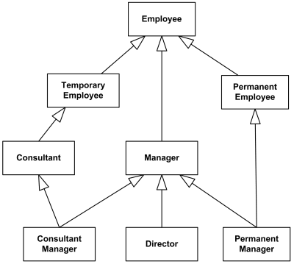
example

Slide 28
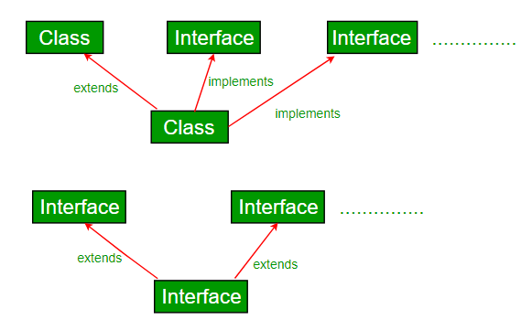
interfaces vs classes

Slide 29
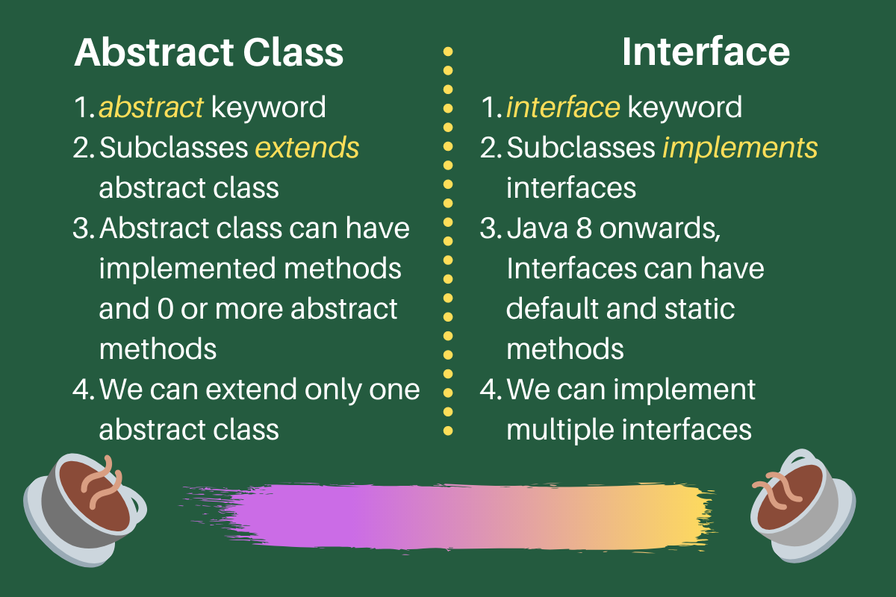
Interfaces vs abstract classes

Slide 30
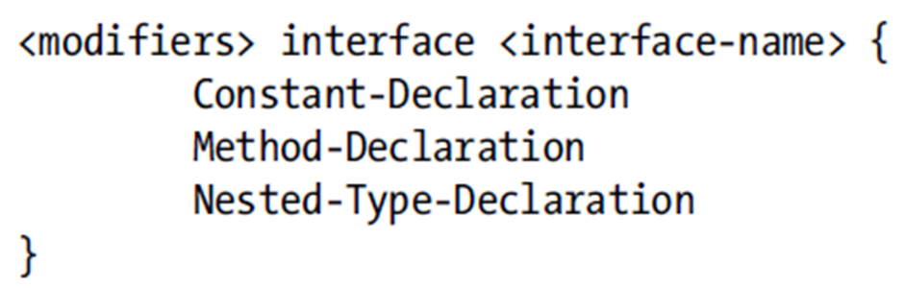
Declaring an Interface
Like a class, an interface can have a public or package-level (default) scope.
The keyword interface is used to declare an interface.
An interface declaration is implicitly abstract.

Slide 31
Declaring Interface Members
An interface can have three types of members:
  Constant fields
  Abstract, static, and default methods
  Static types (nested interfaces and classes)
interface cannot have mutable instances and class variables.

Slide 32
Constant Fields Declarations
All fields in an interface are implicitly public, static, and final.
You can access the fields in an interface using the dot notation in the form of:
  <interface-name>.<field-name>.
You must initialize fields at the time of declaration.

Slide 33
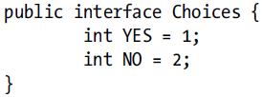
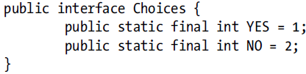
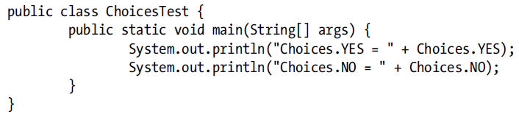
Constant Fields Declarations
=>

Slide 34
interface methods
Interface methods are by default abstract and public.
The absence of static and default modifiers makes a method abstract.

Slide 35
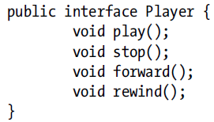
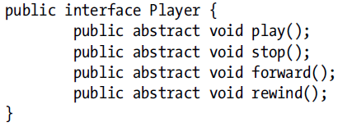
interface methods
=>

Slide 36
Static Methods Declarations
From Java 8, you can have static methods in interfaces.
A static method contains the static modifier.
They are implicitly public.

Slide 37
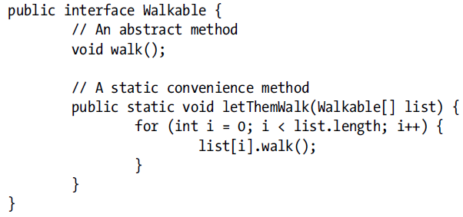
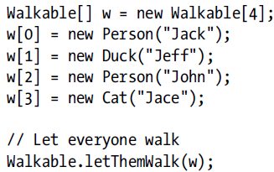
Static Methods Declarations
Static method definition
Using static methods of interfaces

Slide 38
Default Methods Declarations
A default method provides a default implementation for the classes that implements the interface, but does not override the default method.

Slide 39
Default Methods Declarations
interface SaySomething{
// Default method
default void defaultMsg(){
System.out.println(“Working…");
}
// Abstract method
void sayMsg(String msg);
}
public class Person implements SaySomething{
public void sayMsg(String msg){ // implementing abstract method
System.out.println(msg);
}
public static void main(String[] args) {
Person p = new Person();
p.defaultMsg(); // calling default method
p.sayMsg(“Working hard…"); // calling abstract method
}
}

Slide 40
multiple inheritance
class Person implements SaySomething, DoSomething {
// implementing first interface
public void sayMsg(String msg){ // implementing abstract method
System.out.println(msg);
}
// can we override interface default method?
public void defaultMsg(){
System.out.println("Working… Working… Working…");
}
// implementing second interface
public void doMsg(String msg){ // implementing abstract method
System.out.println(msg);
}
// can we override interface default method?
public void defaultAction(){
System.out.println("Jumping... Jumping... Jumping...");
}
public static void main(String[] args) {
Person p = new Person();
p.defaultMsg(); // calling default method from first interface
p.sayMsg("Working hard…"); // calling abstract method
p.defaultAction(); // calling default method from second interface
p.doMsg("Jumping hard...");
}
}
interface SaySomething{
// Default method
default void defaultMsg(){
System.out.println("Working…");
}
// Abstract method
void sayMsg(String msg);
}
// second interface
interface DoSomething{
// Default method
default void defaultAction(){
System.out.println("Jumping...");
}
// Abstract method
void doMsg(String msg);
}

Slide 41
SUmmary
Abstraction
Abstract classes
Interfaces
Multiple inheritance
Interfaces vs abstract classes

Slide 42


Thank You

