Slide 1


Business English
Lecture 1
Prepared by
Ahmed Soliman

Slide 2
Writing a CV and a Cover Letter

Slide 3
Warm-Up / Lead-in: Selling Yourself in 30 Seconds
• Imagine meeting a potential employer for the first time.
• You have 30 seconds to introduce yourself and explain why you'd be great for the job.
• Include: Name, Degree/Major, Key Skills, One Strength.
• Class discussion: What was easy? Difficult? Why is this important for a CV or cover letter?

Slide 4
Objectives
Understand the difference between a CV and a cover letter
Identify the main parts of a professional CV
Write a clear, well-structured cover letter
Use formal, polite, and professional language

Slide 5
What is a CV?
Curriculum Vitae
Formal document listing education, experience, skills
Used for jobs, internships, scholarships
1–2 pages for students

Slide 6
What is a Cover Letter?
Short letter sent with your CV
Explains why you want the job and why you're a good fit
Shows motivation and interest
Usually one page

Slide 7
Why Are They Important?
First impression on an employer
Show communication skills in writing
Tailor application to the job
Stand out from other candidates

Slide 8

Parts of a CV
Contact Information
Objective/Profile (optional)
Education
Experience
Skills
Achievements/Certifications

Slide 9
Tips for Writing a CV
Clear and easy to read
Relevant to the job
Concise, no unnecessary details
No grammar or spelling mistakes
Use strong action verbs

Slide 10
A Sample of a CV
Name: Mohamed Saleh
Address: 22 El-Tahrir Street, Cairo, Egypt
Phone: (+20) 112-345-6789
Email: mohamed.saleh@email.com
LinkedIn: linkedin.com/in/mohamedsaleh
Professional Profile
Detail-oriented and reliable Accountant with over 3 years of experience in financial reporting, budgeting, and tax preparation. Strong knowledge of Egyptian accounting standards and IFRS. Eager to contribute my expertise to a dynamic finance team.
Education
Bachelor of Commerce (Accounting Major)
Ain Shams University, Cairo
Graduated: June 2020 | GPA: 3.5 / 4.0
Key Courses: Financial Accounting, Cost Accounting, Auditing, Taxation

Slide 11
Professional Experience
Junior Accountant
Nile Group Trading Co. – Cairo | July 2021 – Present.
Prepared monthly financial statements and assisted with year-end closing
Managed accounts payable and receivable records in compliance with company policy
Assisted in preparation of VAT returns and tax filings
Supported internal and external audit processes with accurate documentation
Accounting Assistant
Al-Falak Consulting – Cairo | August 2020 – June 2021.
Recorded daily journal entries in accounting software (QuickBooks)
Helped prepare monthly management reports for senior accountants
Assisted in preparing payroll and calculating deductions
Maintained organized records of invoices and payments

Slide 12
Key Skills
• Financial Reporting & Analysis
• Accounts Payable & Receivable Management
• Tax Preparation & VAT Returns
• Accounting Software (QuickBooks, SAP, Excel)
• Attention to Detail & Problem Solving
• Strong Communication (Arabic & English)
Certifications
• Certified Management Accountant (CMA) Part 1 – Passed 2023
• QuickBooks Certified User – 2022
Languages
• Arabic (Native)
• English (Fluent)
Volunteer Experience
Event Organizer - University Career Fair 2023
Coordinated schedules for over 20 company booths
Welcomed guests and provided logistical support during workshops

Slide 13
Parts of a Cover Letter
Greeting
Introduction
Body Paragraph(s)
Closing

Slide 14

What is a Cover Letter? (and Why It’s Important)
A cover letter is a one-page document that you submit as part of your job application (alongside your CV or Resume).
Its purpose is to introduce you and briefly summarize your professional background. On average, your cover letter should be from 250 to 400 words long.
A good cover letter can spark the HR manager’s interest and get them to read your resume.
A bad cover letter, on the other hand, might mean that your application is going directly to the paper shredder. So, to make sure this doesn’t happen, it’s essential to know how to write a convincing cover letter.
www.midocean.ae

Slide 15
Cover letter format
Header with date and contact information
Salutation or greeting
Opening paragraph
Middle paragraph(s)
Closing paragraph
Letter ending and signature
www.midocean.ae

Slide 16
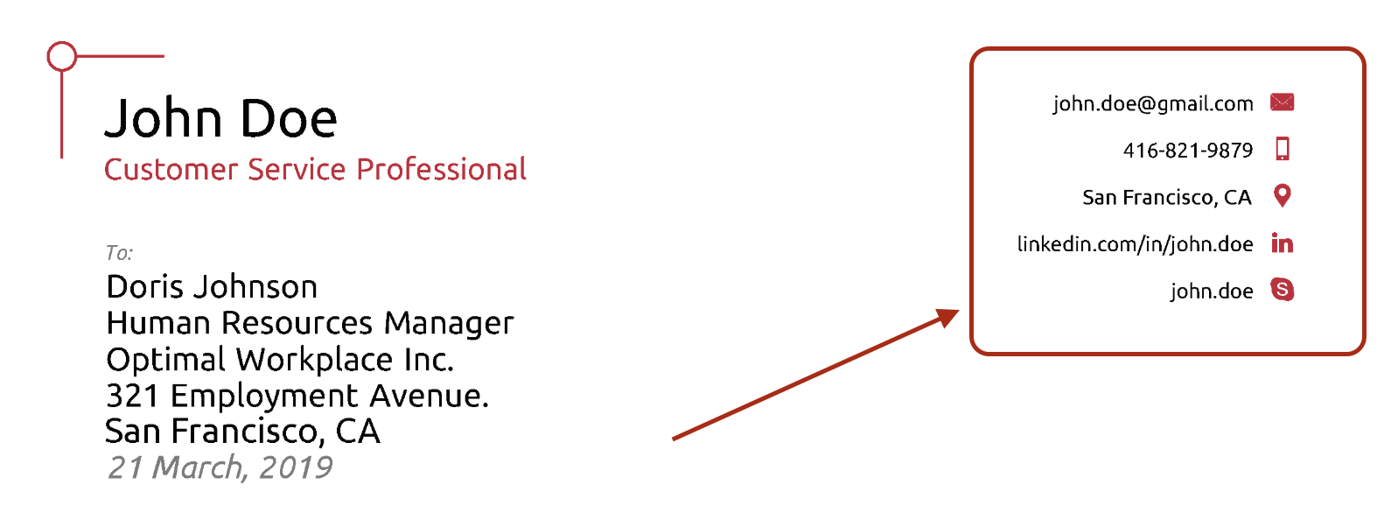
How to Write the Perfect Cover Letter (And Get Hired!)
1- Start the Cover Letter with a Header
www.midocean.ae

Slide 17
2. Include a greeting
Example greetings:
Dear Hiring Manager,
Dear Tyler Wallace,
www.midocean.ae

Slide 18
3- Write an Attention-Grabbing Introduction
So, it’s essential to catch their attention from the very first paragraph.
www.midocean.ae

Slide 19
4- Explain why you’re the perfect person for the job
This is where you show off your professional skills and convince the HR manager that you’re a better fit for the job than all the other applicants.
But first things first - before you even write anything, you need to learn what the most important requirements for the role are. So, open up the job ad and identify which of the responsibilities are the most critical.
www.midocean.ae

Slide 20
5- Explain why you’re a good fit for the company
Once you’ve written the last paragraph, you might be thinking - I’m a shoo-in for the job! What else do I need to write? I’ll just wrap up the cover letter and hit that sweet SEND button.
Well, no. You’re not quite there yet.
The HR manager doesn’t only look at whether you’ll be good at the job or not. They’re looking for someone that’s also a good fit for the company culture.
After all, employees that don’t fit in are bound to quit, sooner or later. This ends up costing the company a ton of money, up to 50% of the employee’s annual salary.
Meaning, you also need to convince the HR manager that you’re really passionate about working with them.
www.midocean.ae

Slide 21
6- Wrap up with a call to action
Finally, it’s time to finish up your cover letter and write the conclusion.
In the final paragraph, you want to:
Wrap up any points you couldn't in the previous paragraphs. Do you have anything left to say? Any other information that could help the hiring manager make their decision? Mention it here.
Thank the hiring manager for their time. It never hurts to be courteous, as long as you don’t come off as too needy.
Finish the cover letter with a call to action. The very last sentence in your cover letter should be a call to action. You should ask the hiring manager to take some sort of action.
www.midocean.ae

Slide 22
Good Example:
So to wrap it all up, thanks for looking into my application. I hope I can help Company X make the most out of their Facebook marketing initiatives. I'd love to further discuss how my previous success at XYZ Inc. can help you achieve your Facebook marketing goals.
www.midocean.ae

Slide 23
7- Use the right formal closing
Once you’re done with the final paragraph, all you have to do is write down a formal “goodbye” and you’re good to go.
Feel free to use one of the most popular conclusions to a cover letter:
Best Regards,
Kind Regards,
Sincerely,
Thank you,
www.midocean.ae

Slide 24
8- End with your signature at the bottom.
www.midocean.ae

Slide 25
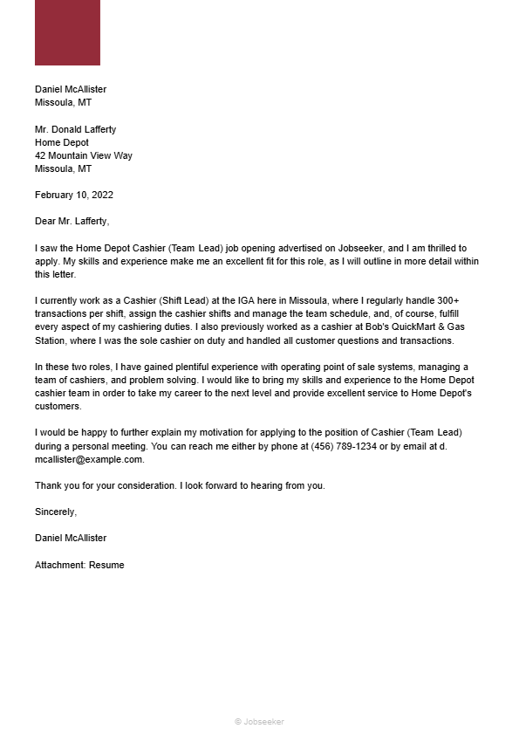

Slide 26


Thank You

