Slide 1
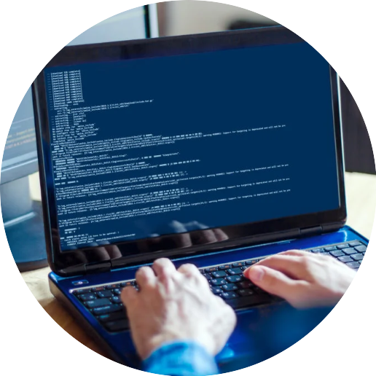


Programming
Foundations in
Python
Prepared by Dr. Hamada I. AbdulWakel
Lecture 3

Slide 2



Control and Iteration
Statements
Lecture 3
Prepared by
Dr. Hamada I. AbdulWakel
www.midocean.ae

Slide 3
Lecture
RECAP: LECTURE 2
03
The SDLC phases and models.
The input and output operations.
Data types in Pythons.
www.midocean.ae

Slide 4
Lecture
LECTURE MAIN POINTS
03
Controlling the program flow.
The relational operators and comparison expressions.
The selection statements.
The iteration statements.
www.midocean.ae

Slide 5
Lecture
03
PROGRAM EXAMPLES
Ex1: write a program that reads a three-digit number, separates this number into its individual digits and print them.
  Program scenario:
  Enter a number of three-digits: 234
  Your number is 234 and its digits are:
  First digit = 2
  Second digit = 3
  Third digit = 4
www.midocean.ae

Slide 6
Lecture
03
PROGRAM EXAMPLES
Cont'd
Ex1: python code.
Number = int( input("Enter a number of three-digits: "))
  D1 = Number // 100
  New_number1 = Number % 100
  D2 = New_number1 // 10
  New_number2 = New_number1 % 10
  print("Your number is", Number , " and its digits are: ")
  print("First digit = ", D1)
  print("Second digit = ", D2)
  print("Third digit = ", New_number2)
www.midocean.ae

Slide 7
Lecture
03
PROGRAM EXAMPLES
Cont'd
Ex2: write a program which inputs a temperature reading expressed in Fahrenheit and outputs its equivalent in Celsius, using the formula.
ºC = 5 / 9 * ( ºF – 32 )
  Program scenario:
  Enter a temperature in Fahrenheit: 85
  The equivalent Celsius temperature = 29.44
www.midocean.ae

Slide 8
Lecture
03
PROGRAM EXAMPLES
Cont'd
Ex2: python code.
temp_fah = float( input("Enter a temperature in Fahrenheit: ") )
  temp_cel = 5/9 * (temp_fah - 32)
  print("The equivalent Celsius temperature = ", temp_cel)
www.midocean.ae

Slide 9
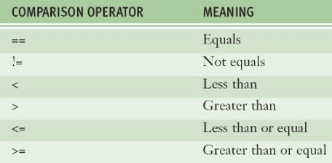
BOOLEAN DATA TYPE AND
COMPARISON OPERATORS
Lecture
03
Boolean data type consists of two values TRUE and FALSE.
The "is" operator is used to test if
two variables refer to the same
value.
The "is not" operator is used to
compare if the objects are pointing
to the same memory location or not.
www.midocean.ae

Slide 10
BOOLEAN DATA TYPE AND
COMPARISON OPERATORS
Lecture
03
Cont'd
Code examples:
print (15 > 3)
print(15 == 15)
x1 = 5
y1 = 5
print(x1 is not y1)
x2 = 'Hello'
y2 = 'Hello'
print(x2 is y2)
www.midocean.ae

Slide 11
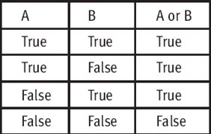
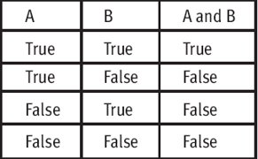

Lecture
03
COMPOUND BOOLEAN EXPRESSIONS
The logical operators:
  The not operator.
  The and operator.
  The or operator.
www.midocean.ae

Slide 12
Lecture
03
COMPOUND BOOLEAN EXPRESSIONS
Cont'd
Examples of compound Boolean expressions:
print( type(True) )
print( isinstance(True, int) )
print( True and True )
print( True and False )
print( 5 > 3 and 5 == 3 + 2 )
print( 5 < 3 and 5 == 3 and 5 != 3 )
print( True or False )
print( 5 > 3 or 5 == 3 + 2 )
www.midocean.ae

Slide 13
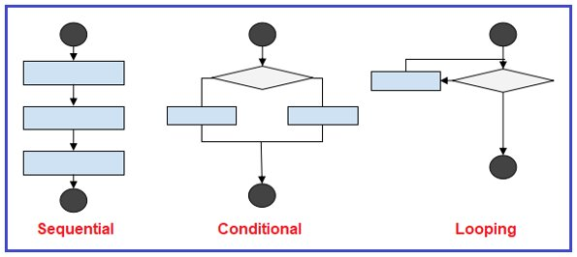
Lecture
03
PROGRAM FLOW
www.midocean.ae

Slide 14
Lecture
03
PROGRAM FLOW
Cont'd
A program’s flow is the order in which the program’s code executes.
The sequential flow: a set of statements whose execution process happens in a sequence.
The conditional flow: allows a program to test several conditions and execute instructions based on which condition is true.
The looping flow: used to repeat a group (block) of programming instructions.
www.midocean.ae

Slide 15
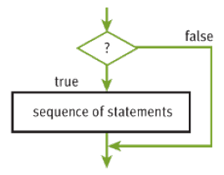
THE CONDITIONAL FLOW
STATEMENTS
Lecture
03
The basic-selection statement (If statement).
  Syntax:
  if <condition> :
  <statement(s)>
  Example:
  x = 5
  if x == 6 :
  print( "Yes")
www.midocean.ae

Slide 16
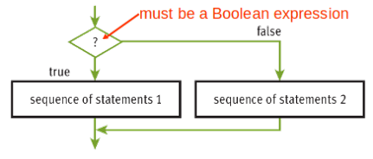
THE CONDITIONAL FLOW
STATEMENTS
Lecture
03
Cont'd
The two-way selection statement (If...else statement).
  Syntax:
  if <condition> :
  <true statement(s)>
  else:
  <false statement(s)>
  Example:
  x = 5
  if x == 6 :
  print( "Yes")
  else:
  print("No")
www.midocean.ae

Slide 17
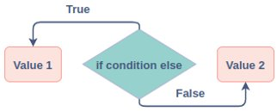
THE CONDITIONAL FLOW
STATEMENTS
Lecture
03
Cont'd
The ternary operator statement (If...else statement).
  Syntax:
  <variable> = <true statement> if <condition> else <false statement>
www.midocean.ae

Slide 18
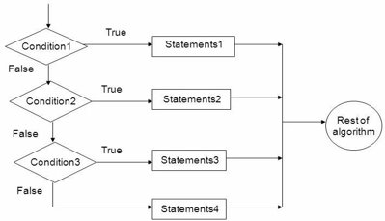
THE CONDITIONAL FLOW
STATEMENTS
Lecture
03
Cont'd
The multi-way selection statement (If...elif statement).
  Syntax:
  if <condition_1> :
  <true cond_1 statement(s)>
  elif <condition_2> :
  <true cond_2 statement(s)>
  else:
  <otherwise statement(s)>
www.midocean.ae

Slide 19
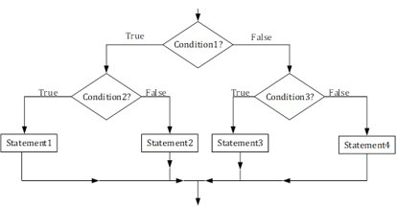
THE CONDITIONAL FLOW
STATEMENTS
Lecture
03
Cont'd
The nested selection statement (If...if statement).
  Syntax:
  if <condition1>:
  if <condition2>:
  <true cond2_statement(s)>
  else:
  <otherwise statement(s)>
  else:
  <otherwise statement(s)>
www.midocean.ae

Slide 20
THE CONDITIONAL FLOW
STATEMENTS: EXAMPLES
Lecture
03
Ex3: write a program which inputs a person's age and outputs one of the messages using the criteria specified.
  You are child: age between 0 and 9
  You are an adolescent: age between 9 and 18
  You are an adult: age between 18 and 65
  Golden ages: age above 65
www.midocean.ae

Slide 21
THE CONDITIONAL FLOW
STATEMENTS: EXAMPLES
Lecture
03
Cont'd
Ex3: python code.
age = int(input("Enter your age: "))
if age >= 0 and age <= 9:
print("You are a child!")
elif age > 9 and age <= 18:
print("You are an adolescent!")
elif age > 18 and age <= 65:
print("You are an adult!")
elif age > 65:
print("Golden ages!")
www.midocean.ae

Slide 22
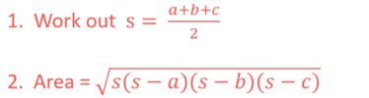
THE CONDITIONAL FLOW
STATEMENTS: EXAMPLES
Lecture
03
Cont'd
Ex4: write a program that accepts the sides (a, b, c) of a triangle and calculates and display its area.
www.midocean.ae

Slide 23
THE CONDITIONAL FLOW
STATEMENTS: EXAMPLES
Lecture
03
Cont'd
Ex4: python code.
a = float(input('Enter first side: '))
b = float(input('Enter second side: '))
c = float(input('Enter third side: '))
s = (a + b + c) / 2
area = (s*(s-a)*(s-b)*(s-c)) ** 0.5
print("The area of the triangle = ", area)
www.midocean.ae

Slide 24
THE CONDITIONAL FLOW
STATEMENTS: EXAMPLES
Lecture
03
Cont'd
Ex5: write a program that check of a given number is divided by 3 and 4.
  Python code:
  Num = int(input())
  if Num % 3 == 0 and Num % 4 == 0:
  print("The number is divided by both 3 and 4")
  elif Num % 3 == 0 or Num % 4 == 0:
  print("The number is divided by either 3 or 4")
else:
print("The number is not divided by any of 3 or 4")
www.midocean.ae

Slide 25
THE CONDITIONAL FLOW
STATEMENTS: EXAMPLES
Lecture
03
Cont'd
Ex6: write a program that check if a single digit integer is a positive or negative.
  Python code:
  x = int(input("Enter a single digit number: "))
  if x < 0 and x < 10:
  print("This number is a single digit positive number")
  elif x < 0 and x > -10:
  print("This number is a single digit negative number")
  else:
  print("Invalid integer")
www.midocean.ae

Slide 26
THE CONDITIONAL FLOW
STATEMENTS: EXAMPLES
Lecture
03
Cont'd
Ex7: Python code for nested if.
  var = 100
  if var < 200:
  print ("Expression value is less than 200")
  if var == 150:
  print ("Which is 150")
  elif var == 100:
  print ("Which is 100")
  elif var < 50:
  print ("Expression value is less than 50")
  else:
  print ("Could not find true expression")
www.midocean.ae

Slide 27
THE CONDITIONAL FLOW
STATEMENTS: EXAMPLES
Lecture
03
Cont'd
Ex8: Python code ternary operator.
a = 10
b = 20
  min = a if a < b else b
  print(min)
  print ("Both a and b are equal" if a == b else "a is greater than b" if a > b else "b is greater than a")
www.midocean.ae

Slide 28
Lecture
03
ITERATION/LOOPING STATEMENTS
An iteration statement, or loop, repeatedly executes a statement, known as the loop body, until the controlling expression is False.
The while statement evaluates the control expression before executing the loop body.
The for statement is used to repeat the execution of a set of statements for every element of a sequence.
www.midocean.ae

Slide 29
Lecture
03
ITERATION/LOOPING STATEMENTS
Cont'd
The range function returns a sequence of numbers between the given range.
  Examples:
range(10)
range(-10) #empty sequence
range(2, 10)
range(-2, 10)
range(10, 2) #empty sequence
range(1, 10, 2)
range(10, 1, -1)
www.midocean.ae

Slide 30
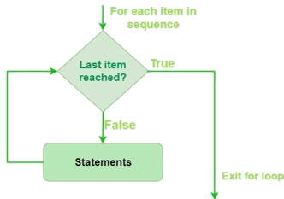
Lecture
03
ITERATION/LOOPING STATEMENTS
Cont'd
The for statement:
  Syntax:
  for <variable> in <sequence> :
  <statement 1>
  …..
  <statement n>
www.midocean.ae

Slide 31
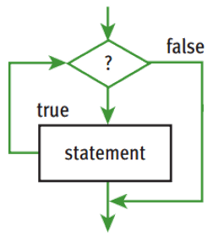
Lecture
03
ITERATION/LOOPING STATEMENTS
Cont'd
The while statement:
  Syntax:
  while <condition> :
  <statement 1>
  …..
  <statement n>
www.midocean.ae

Slide 32
ITERATION/LOOPING STATEMENTS:
EXAMPLES
Lecture
03
Ex9: write a program that reads the number of students in a class then reads their marks and finds and displays the average.
  stdCount = int(input("Enter number of students in a class"))
  sum = 0.0
  for i in range(stdCount):
  mark = float(input("Enter mark: "))
  sum += mark
  print("The marks average = ", sum / stdCount)
www.midocean.ae

Slide 33
ITERATION/LOOPING STATEMENTS:
EXAMPLES
Lecture
03
Cont'd
Ex10: write a program that calculates the total of the following series of numbers:
1/30 + 2/29 + 3/28 + ….....+ 30/1
  min = 1
  max = 6
  sum = 0.0
  for i in range(min, max):
  sum += min / (max-1)
  min += 1
  max -= 1
  print(sum)
www.midocean.ae

Slide 34
ITERATION/LOOPING STATEMENTS:
EXAMPLES
Lecture
03
Cont'd
Ex11: write a program that calculates the average of a set of temperature. Data is terminated by the value 999.
  sum = 0.0
  count = 0
  temp = float(input("enter a temperature "))
  while temp != 999:
  count += 1
  sum += temp
  temp = float(input("enter another temp"))
  print("temperature average = ", sum/count)
www.midocean.ae

Slide 35
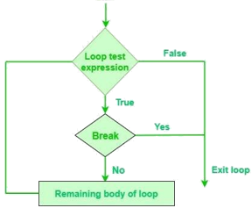
Lecture
03
BREAK AND CONTINUE STATEMENTS
Break statement: the loop with exits when a condition is met even if the loop condition or loop sequence does not finish.
  Syntax:
  while <condition>:
  <statement 1>
  …....
  if <condition>:
  break
  <statement n>
www.midocean.ae

Slide 36
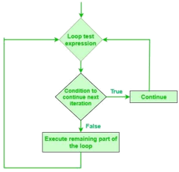
Lecture
BREAK AND CONTINUE STATEMENTS
03
Cont'd
Continue statement: the loop will scape an iteration when a condition is met. The statements under the continue will not execute.
  Syntax:
  while <condition>:
  <statement 1>
  …....
  if <condition>:
  continue
  <statement n>
www.midocean.ae

Slide 37
Lecture
03
ITERATION/LOOPING STATEMENTS
The do-while statement:
  Syntax:
  while True :
  <statement 1>
  …..
  if <condition>:
  break
  <statement n>
www.midocean.ae

Slide 38
BREAK AND CONTINUE STATEMENTS:
EXAMPLES
Lecture
03
Ex12: write a program to print numbers from 1 to 10. The program should stop and not printing the number 5.
count= 0
  while count < 10:
  count += 1
  if count == 5:
  break
  print(count)
www.midocean.ae

Slide 39
BREAK AND CONTINUE STATEMENTS:
EXAMPLES
Lecture
03
Cont'd
Ex13: write a program to print numbers from 1 to 10 except the number 5.
  count = 0
  while count < 10
  count += 1
  if count == 5:
  continue
  print(count)
www.midocean.ae

Slide 40
Lecture
03
QUESTIONS FOR ONLINE DISCUSSION
Write a program that calculates the occupancy rate for a hotel. The program should start by asking the user how many floors the hotel has. A loop should then iterate once for each floor. In each iteration, the loop should ask the user for the number of rooms on the floor and how many of them are occupied. After all the iterations, the program should display how many rooms the hotel has, how many of them are occupied, how many of them are unoccupied. The percentage may be calculated by dividing the number of rooms occupied by the number of rooms.
www.midocean.ae

Slide 41


Thank You

