Slide 1


DIGITAL MEDIA ETHICS
DGM 723
Prepared by:
Dr. Sherihan Mohamed
Lecture 6

Slide 2



DMG 723
DIGITAL MEDIA ETHICS
Chapter 4
Friendship, Slow/Fair Technology, and Democracy
Prepared by:
Dr. Sherihan Mohamed

Slide 3

Lecture 5
Remember:
** What do we mean with copyleft?
- Copyleft and open sources.
- What is the Public copyright?
** Other Copyleft Applications:
- Creative commons.
- Public domain.

Slide 4
Lecture 6
Outlines:
** Friendship online? Initial considerations
- Privacy Paradox and social media
- Ethics and social media.
- Ethical challenges with social media use.
** Slow/Fair Technology:
- Fairphone as a type of slow/fair Technology.

Slide 5

Lecture 6
Friendship online? Initial considerations

Slide 6
Friendship online? Initial considerations
Privacy Paradox & social media
Lecture 6
Today’s information/digital age offers widespread use of social media. The use of social media is ubiquitous and cuts across all age groups, social classes and cultures.
However, the increased use of these media is accompanied by privacy issues and ethical concerns. These privacy issues can have far-reaching professional, personal and security implications.

Slide 7
Ultimate privacy in the social media domain is very difficult because these media are designed for sharing information.
Participating in social media requires persons to ignore some personal, privacy constraints resulting in some vulnerability.
The weak individual privacy safeguards in this space have resulted in unethical and undesirable behaviors resulting in privacy and security breaches, especially for the most vulnerable group of users.

Slide 8
Friendship online? Initial considerations
Privacy Paradox & social media
Lecture 6
An exploratory study was conducted to examine social media usage and the implications for personal privacy. We investigated how some of the requirements for participating in social media and how unethical use of social media can impact users’ privacy.. What was the Results?

Slide 9
Results indicate that if users of these networks pay attention to privacy settings and the type of information shared and adhere to universal, fundamental, moral values such as mutual respect and kindness, many privacy and unethical issues can be avoided.

Slide 10
The unethical use of social media has resulted in the breach of individual privacy and impacts both physical and information security. Reports in 2019, reveal that persons between the ages 8 and 11 years spend an average 13.5 hours weekly online and 18% of this age group are actively engaged on social media. Those between ages 12 and 15 spend on average 20.5 hours online and 69% of this group are active social media users.

Slide 11
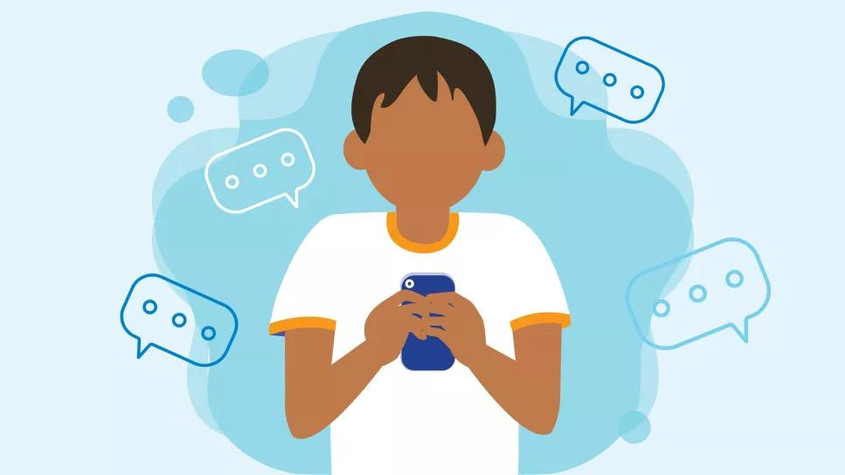
Friendship online? Initial considerations
Privacy Paradox & social media
Lecture 6
While children and teenagers represent the largest Internet user groups, for the most part they do not know how to protect their personal information on the Web and are the most vulnerable to cyber-crimes related to breaches of information privacy.

Slide 12

In today’s IT-configured society Data is one of -if not the most- valuable asset for most businesses/organizations. Organizations and governments collect information via several means including invisible data gathering, marketing platforms and search engines such as Google.

Slide 13
Friendship online? Initial considerations
Privacy Paradox & social media
Lecture 6
Information can be attained from several sources, which can be fused using technology to develop complete profiles of individuals.
The information on social media is very accessible and can be of great value to individuals and organizations for reasons such as marketing, etc.; hence, data is retained by most companies for future use.

Slide 14
Friendship online? Initial considerations
Ethics and social media
Lecture 6
Ethical values are intended to be guiding principles that if followed, could yield harmonious results and relationships. They seek to give answers to questions such as “How should I be living? How do I achieve the things that are deemed important such as knowledge and happiness or the acquisition of attractive things?” If one chooses happiness, the next question that needs to be answered is “Whose happiness should it be; my own happiness or the happiness of others?

Slide 15
In the domain of social media, some of the ethical questions that must be contemplated and ultimately answered are:
* Can this post be regarded as oversharing?
* Has the information in this post been distorted in anyway?
* What impact will this post have on others?

Slide 16

Friendship online? Initial considerations
Ethics and social media
Lecture 6
As previously mentioned, users within the ages 8–15 represent one of the largest social media user groups. These young persons within the 8–15 age range are still learning how to interact with the people around them and are deciding on the moral values that they will embrace. These moral values will help to dictate how they will interact with the world around them.

Slide 17
The ethical values that guide our interactions are usually formulated from some moral principle taught to us by someone or a group of individuals including parents, guardians, religious groups, and teachers.
just to name a few. Many of the Gen Y’s/“Digital Babies” are “newbies” yet are required to determine for themselves the level of responsibility they will display when using the varying social media platforms.

Slide 18
Friendship online? Initial considerations
Ethics and social media
Lecture 6
This includes considering the impact a post will have on their lives and/or the lives of other persons. They must also understand that when they join a social media network, they are joining a community in which certain behavior must be exhibited.
Such responsibility requires a much greater level of maturity than can be expected from them at that age.

Slide 19
It is common for individuals to post even the smallest details of their lives from the moment they wake up to when they go to bed. They will openly share their location, what they eat at every meal or details about activities typically considered private and personal.
They will also share likes and dislikes, thoughts and emotional states and for the most part this has become an accepted norm.

Slide 20
Friendship online? Initial considerations
Ethics and social media
Lecture 6
With this openness of sharing risks and challenges arise that are often not considered but can have serious impacts.
The speed and scale with which social media creates information and makes it available —almost instantaneously— on a global scale, added to the fact that once something is posted there is really no way of truly removing it, this should prompt individuals to think of the possible impact a post can have.

Slide 21

Unfortunately, more often than not, posts are made without any thought of the far-reaching impact they can have on the lives of the person posting or others that may be implicated by the post.

Slide 22
Friendship online? Initial considerations
Ethical challenges with social media use
Lecture 6
The use of modern-day technology has brought several benefits. Social media is no different and chief amongst its benefit is the ability to stay connected easily and quickly as well as build relationships with people with similar interests. As with all technology, there are several challenges that can make the use of social media off putting and unpleasant.

Slide 23
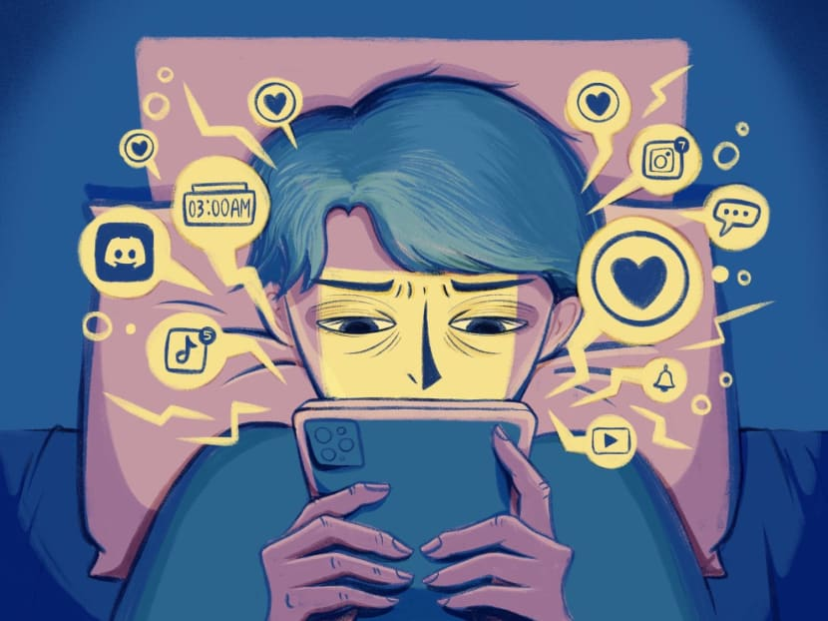
Some of these challenges appear to be minor but they can have far reaching effects into the lives of the users of social media, and it is therefore advised that care be taken to minimize the challenges associated with the use of social media.

Slide 24
Friendship online? Initial considerations
Ethical challenges with social media use
Lecture 6
A major challenge with the use of social media is Oversharing because when persons share on social media, they tend to share as much as is possible which is often times too much. When persons are out and about doing exciting things, it is natural to want to share this with the world as many users will post a few times a day when they head to lunch, visit a museum, go out to dinner or other places of interest.

Slide 25

While this all seems relatively harmless, by using location-based services which pinpoint users with surprising accuracy and in real time, users place themselves in danger of laying out a pattern of movement that can be easily traced.

Slide 26

Friendship online? Initial considerations
Ethical challenges with social media use
Lecture 6
While this seems more like a security or privacy issue it stems from an ethical dilemma—“Am I sharing too much?” Oversharing can also lead to damage of user’s reputation especially if the intent is to leverage the platform for business.

Slide 27
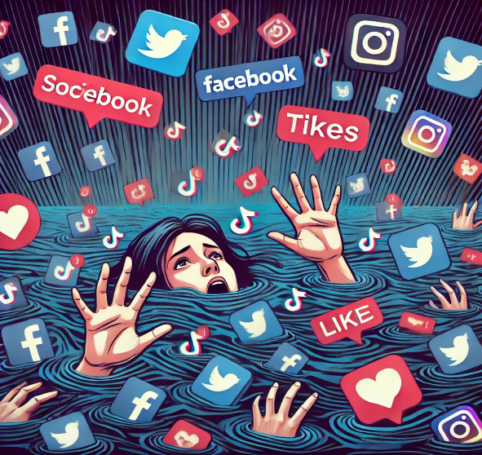
Another ethical challenge users of social media often encounter is that they have no way of authenticating content before sharing, which becomes problematic when the content paints people or establishments negatively. Often times content is shared with them by friends, family and colleagues.

Slide 28
Friendship online? Initial considerations
Ethical challenges with social media use
Lecture 6
The unauthenticated content is then reshared without any thought but sometimes this content may have been maliciously altered so the user unknowingly participates in maligning others.
Even if the content is not altered the fact that the content paints someone or something in a bad light should send off warning bells as to whether or not it is right to share the content which is the underlying principle of ethical behavior.

Slide 29
Online, the multiplicity of sources involved in the dissemination of contents, their possible anonymity, the absence of standards for information quality, the ease in manipulating and altering the information, the lack of clarity of the context, and the presence of many potential targets of credibility evaluation (i.e., the content, the source, and the medium), make urgent the need of developing systems for helping users in automatically assess credibility of information and information sources.

Slide 30

Friendship online? Initial considerations
Ethical challenges with social media use
Lecture 6
Since the Social Web is characterized by multiple social applications, which have been developed to address different aims and in different contexts, the solutions that have been proposed to address the credibility assessment issue in Social Media change depending on the considered scenario.

Slide 31
Lecture 5
Slow/Fair Technology

Slide 32
Slow/Fair Technology
Lecture 6
Why do we need Slow/Fair Technology?
Fairness is not usual, it is not spread around equally despite a kinship to the notion of equity, it is no more lasting than physical beauty, and it cannot be defined out of context: you know it only when you see it, and by then it is often gone.
Dynamic systems such as schoolyards, the Internet economy or human immunology are not conducive environments, and this means the technology sector has to work a little bit harder to do what is fair.

Slide 33

Add to that, the limits of the human body, and the need to take into account human wellbeing, the limits of the planet and stakeholders' interests in decision making, all suggest the need for a new paradigm, Slow Tech, in the design of ICT and ICT systems.

Slide 34
Slow/Fair Technology
Lecture 6
Slow/Fair Tech should not be seen as technology that is slow, but as a concept or message that enables people to reflect, stand back, and consider.
Thus, the opportunity that it provides for human reflection and intervention and action means that it has a growing importance in supporting this striving – or quest – for ethical ICT.

Slide 35
Fairphone is a Dutch electronics manufacturer and social enterprise that designs and produces smartphones with the goal of having a lower environmental footprint and better social impact than is common in the industry.
In particular, the company Aims to minimize the use of conflict minerals in its devices, maintain fair labor conditions for its workforce and suppliers, and allow users to maintain their own devices.

Slide 36
Slow/Fair Technology
Lecture 6
The company was founded in 2013 as a social enterprise with the support of the Waag Society, and is based in Amsterdam, the Netherlands.
As of 2022, the company's most recent model is the Fairphone 4, a modular smartphone which supports 5G connectivity, has dual 48MP cameras with optical image stabilization, an IP54 rating and MIL810G drop test certification. It is only sold in Europe.

Slide 37

The purpose of modularity is to make the phone easily repairable and customisable by the user, and therefore longer-lasting.
According to the company, increasing the lifespan of a phone by two years reduces CO₂ emissions by 30%.

Slide 38

Slow/Fair Technology
Lecture 6
Fairphone, Environmentally Friendly, and a major improvement on its last handset, the Fairphone 4 is a solid all-round pick for a mid-range handset. It is also the clear choice right now for anyone after a sustainable handset that will last through the falls, accidental drops and years of usage.

Slide 39


Digital Media Ethics (Digital Media and Society Series), 3rd Edition, by Charles Ess
Intro
Recommended Reference

Slide 40
Lecture 6
Outlines:
** Friendship online? Initial considerations
- Privacy Paradox and social media
- Ethics and social media.
- Ethical challenges with social media use.
** Slow/Fair Technology:
- Fairphone as a type of slow/fair Technology.

Slide 41



Thank You

Slide 42
DIGITAL MEDIA ETHICS
Lecture 6
DMG 723
Prepared by:
Dr. Sherihan Mohamed

