Slide 1

The Cultures of New Media (DGM 715)
Prepared by
Dr. Mohamed Owies
Intro- Lecture
The Cultures of New Media
(DGM 715)

Slide 2
Course Description
The Cultures of New Media
Dr. Mohamed Owies
The Cultures of New Media

Slide 3

Course Description
Course Description
This course examines the cultural implications of computer-mediated communication and related media, specifically social media technologies and new media innovations.

Slide 4
Course Description
Course Description
We will explore theories of digital media and how they relate to current research and debates about social media, virtual communities, mediated realities, and artificial intelligence. The course is an exploration of the ways in which various forms of new media shapes, guides, intersects, influences, and bounds today’s culture in a variety of contexts from organizations to social and political movements.

Slide 5
Course Description
Learning Objectives
By the end of the semester students in this course will be able to:
Explain ways in which new media intersects their personal cultural practices.
Describe and critique theories and research applicable to the study of new media and apply these theories to a variety of cultural contexts.

Slide 6
Course Description
Learning Objectives
By the end of the semester students in this course will be able to:
Prepare ethnographic field notes and preliminary analysis based on observation of a culture that incorporates digital technologies.
Produce and present a case study analysis of the use and implications of digital media.

Slide 7
Part One
Theories
Course Description
Digital Society .
Social Media.
Cyber Debates .
Interaction and Identity .
Communities and Networks.

Slide 8
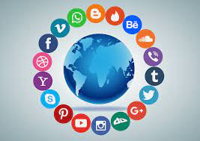
Part Two
Topics
Course Description
Digital Visuality and Visibility .
Feeling Digital.
Digital Citizenship.
Digital Power and Exploitation.
Digital Activism.
Mobile Culture.
Software, Algorithms and Data.

Slide 9
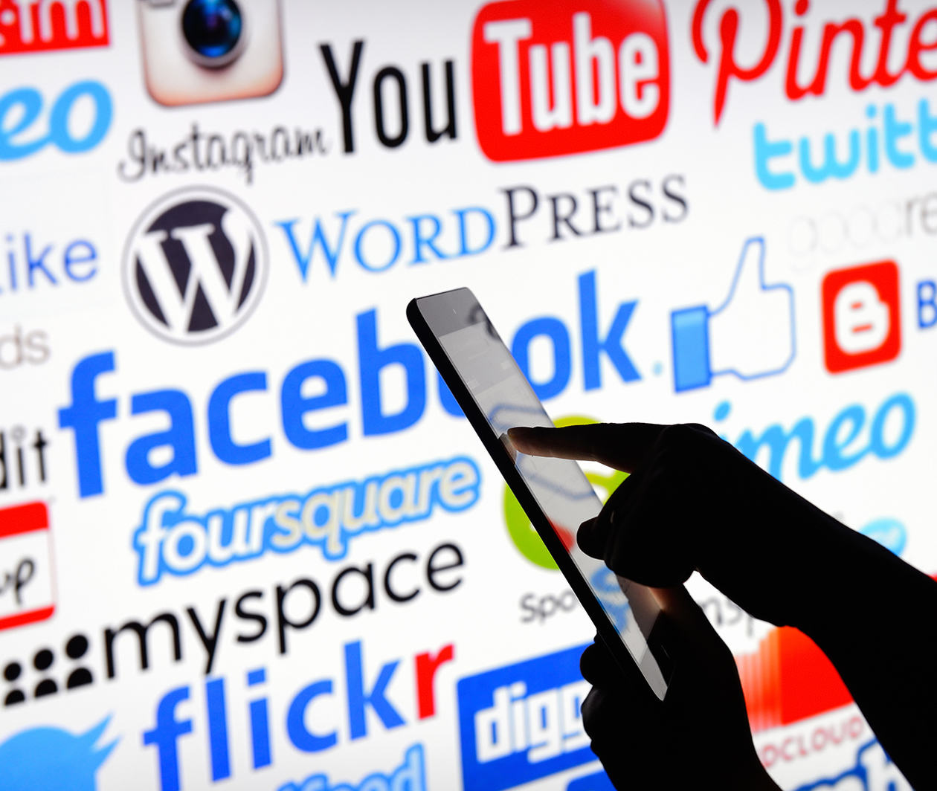
Part Three
Tools
Course Description
Digital Social Research
The Research Process
Digital Ethnography
Mapping and Mining Digital Society

Slide 10
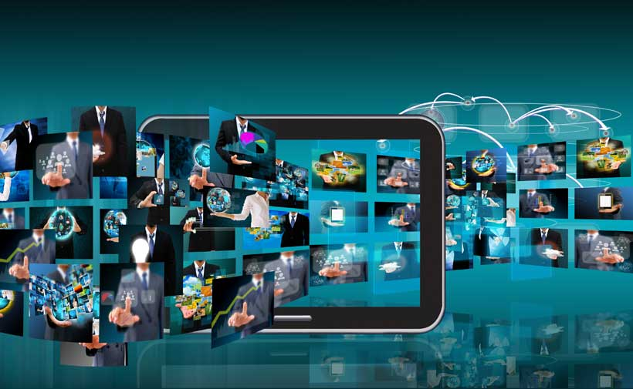
Part Four
Conclusion
Course Description
A Theory of Digital Media and Social Change.

Slide 11
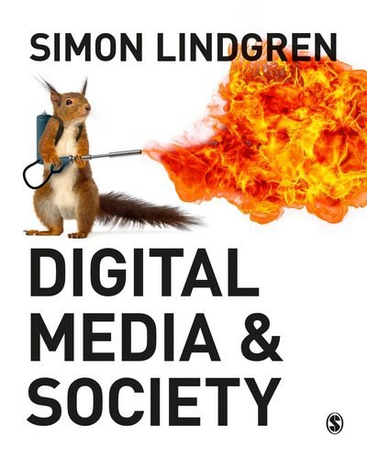
Recommended Reference
Recommended Reference
Digital Media & Society, by Simon Lindgren

Slide 12
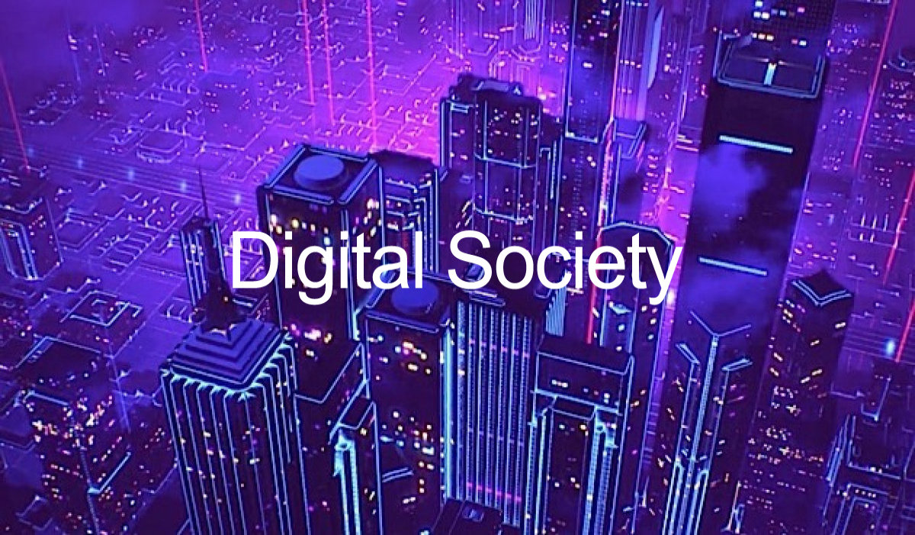
Intro
lecture
Digital Society
Definition of Digital Society:
For the time being, then, let’s call our present society digital society. I mean then, society as affected by digitally networked communication tools and platforms, such as the internet and social media.
Today we have the internet, smartphones, apps, social network services, blogs, and media sharing platforms. One stunning statistic after another tells us about the extreme amounts of information and knowledge — much of it created by ordinary people.

Slide 13
Intro lecture
Digital Society
Definition of digital society:
The World Wide Web was innovated by Tim Berners-Lee’s key which transformed the Internet from a relatively small network of computers used primarily for military and research purposes to a global network.
This technological revolution formed the material foundation for a new type of society. An entire generation have now come of age in the network society, the information age, or to use a term more recently popularised in the social sciences, the digital society.

Slide 14
Intro lecture
Definition of digital society
At the same time, people in society continuously contribute to shaping the new media through the ways in which they use, adapt, or resist them.
This is a society characterised by information flowing through global networks at unprecedented speeds. New undergraduate and postgraduate courses are appearing that specialise in understanding ‘digital society’, ‘digital culture’, or ‘digital media and society.
New fields of research have grown into the disciplines of ‘digital sociology’ and the ‘digital humanities.

Slide 15
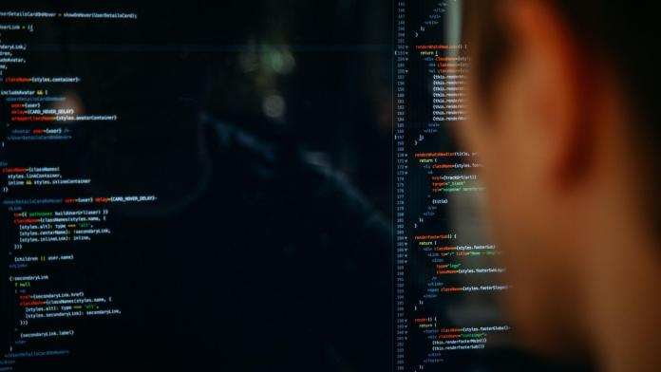
Intro lecture
Features of Digital Society
knowledge and information are now widely accessible through the Internet;
use of new technological devices such as computers, mobile phones, tablet computers, and other related tools;
use of the social networks within work or private life for informal learning;
and the need for all citizens to develop and master digital skills to adopt changes and to take advantage of them.

Slide 16

Intro lecture
Features of Digital Society
Reduced manual labor:
Actually, digitalizing would mean being involved less in manual labor and more in technical or machinery or computer-based labor.
This would, in the long run, make the human force less required because the tasks would be performed by Artificial intelligence.

Slide 17
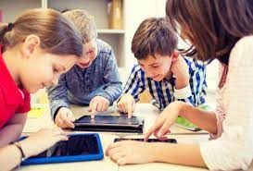
Intro lecture
Features of Digital Society
Improved life of citizens:
The definition of a machine reads, ‘anything which makes human life simple’. This is true in our lives too. We can imagine the shift and the turns our lives took after the coming of computers, the internet, and machinery of the like.
Everything human beings do is directed to make lives easier and for every person in the world.
The daily developments in the world of science with the coming of life-like robots. everything is possible because the human mind wants to make things go easier and more accessible to all. So, a digitalized society would be definitely a society that has to offer a better life to its citizens.

Slide 18
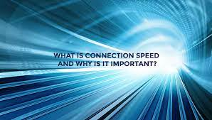
Intro lecture
Features of Digital Society
Increased communication speed:
With almost hundreds billions of texts sent daily worldwide, messages have simplified life and communication to a big extent. Now, fights and misunderstandings can be solved over the phone with fingers.
This has also improved communication at the organizational level.
A digital society would excel in developing and offering ease in communication

Slide 19
Intro lecture
Features of Digital Society
Increase in learning opportunities
Students nowadays think out of the box and are learning new skills every day through their tools.
Affiliate marketing, freelancing, digital marketing, and even online teaching or graphic designing are possible and available to children these days to try their hands on.
Life has grown so much and opportunities have increased and are available worldwide, all you need is a device to give you information and a heart and mind which is ready to dream.
A digital society is not traditional, it is not conventional but something that has a larger horizon for itself.

Slide 20
Intro lecture
Features of Digital Society
Changed education system
It would not be wrong to repeat ourselves because we cannot help but think that what would our children do if there was not any internet during Covid imposed lockdown?
This would have been a literal blow to the government, the teachers, and the students alike. The present times have taught us the need and importance of digitalization on a global level.
Our National Education Policy is also bent on giving the students an option of blended classes with both online and offline options.
Digitalization in education began with the introduction of projectors and whiteboards in private and government schools

Slide 21
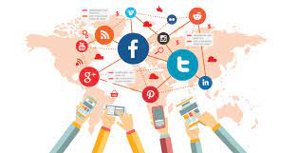
Intro lecture
Thank You

