Slide 1


Computer Organization and Architecture
Prepared by Dr. Eng. Gamal Selim
Lecture 06

Slide 2
Revision

Slide 3
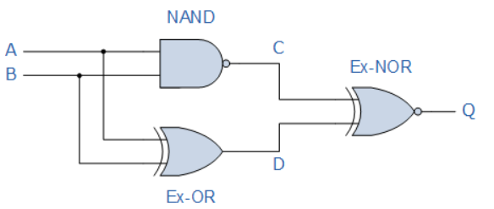
Boolean Algebra Examples No1
Construct a Truth Table for the logical functions at points C, D and Q in the following circuit and identify a single logic gate that can be used to replace the whole circuit.

Slide 4
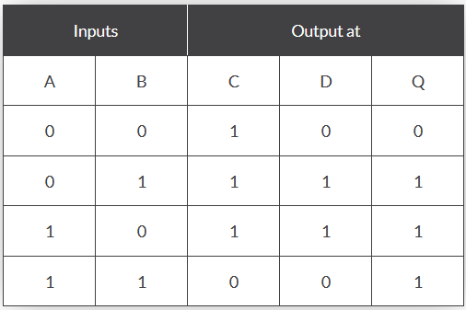
Boolean Algebra Examples No1
First observations tell us that the circuit consists of a 2-input NAND gate, a 2-input EX-OR gate and finally a 2-input EX-NOR gate at the output. As there are only 2 inputs to the circuit labelled A and B, there can only be 4 possible combinations of the input ( 2² ) and these are: 0-0, 0-1, 1-0 and finally 1-1. Plotting the logical functions from each gate in tabular form will give us the following truth table for the whole of the logic circuit below.

Slide 5
Boolean Algebra Examples No1
From the previous truth table, column C represents the output function generated by the NAND gate, while column D represents the output function from the Ex-OR gate. Both of these two output expressions then become the input condition for the Ex-NOR gate at the output.
It can be seen from the truth table that an output at Q is present when any of the two inputs A or B are at logic 1. The only truth table that satisfies this condition is that of an OR Gate. Therefore, the whole of the above circuit can be replaced by just one single 2-input OR Gate.

Slide 6
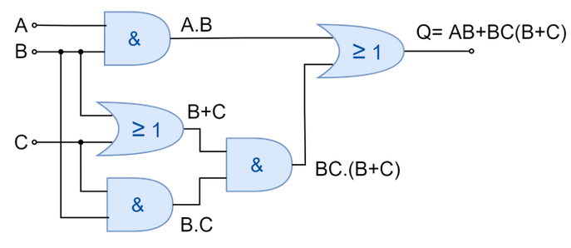
Boolean Algebra Examples No2
In this example, the desired logic function is reduced by applying Boolean Algebra Laws and Theorems.

Slide 7
Boolean Algebra Examples No2
The steps involved in the reduction of Boolean expression are as follow:
AB + BC(B+C)
Applying Distributive Law
AB + BBC + BCC
Applying Identity Law (AA=A) to 2nd and 3rd terms
AB + BC + BC
Applying Identity Law (A + A = A) to 2nd and 3rd terms
AB + BC
Taking out common B
B(A+C)

Slide 8
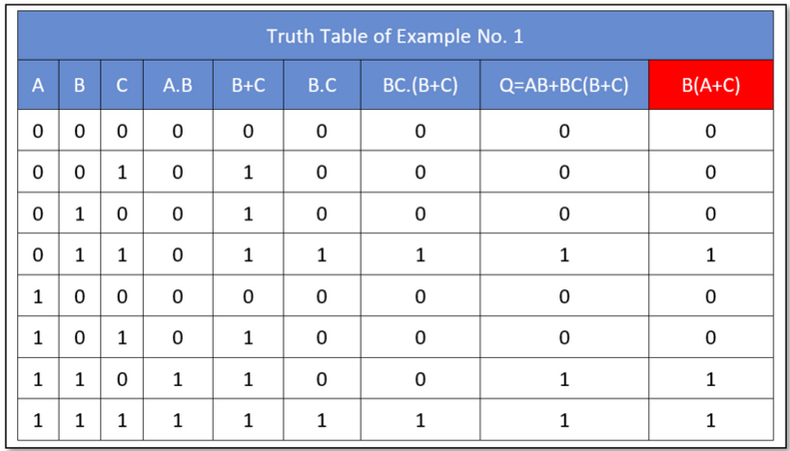
Boolean Algebra Examples No2
The reduced expression B(A+C) produces the same logical output as of original expression. The truth table of the original Boolean expression as well as of reduced expression (red) is shown below:

Slide 9
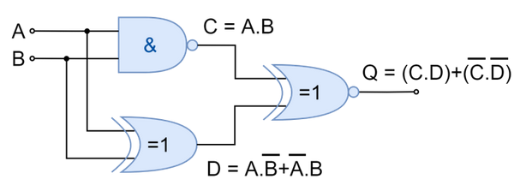
Boolean Algebra Examples No3
In this example, the desired logic function is reduced by applying Boolean Algebra Laws and Theorems.

Slide 10
Boolean Algebra Examples No3
The digital logic circuit comprises three logic gates i.e. AND, NOR, and OR. The output of the NOR is converted to the product of inversed individual input. The final output of the OR gate which is the function of the whole logic circuit comes to be equivalent to the function of XNOR logic. Hence, the given three gates digital logic circuit can be replaced by a single gate of Exclusive-NOR gate.
A | B | C | D | Q
0 | 0 | 1 | 0 | 0
0 | 1 | 1 | 1 | 1
1 | 0 | 1 | 1 | 1
1 | 1 | 0 | 0 | 1

Slide 11
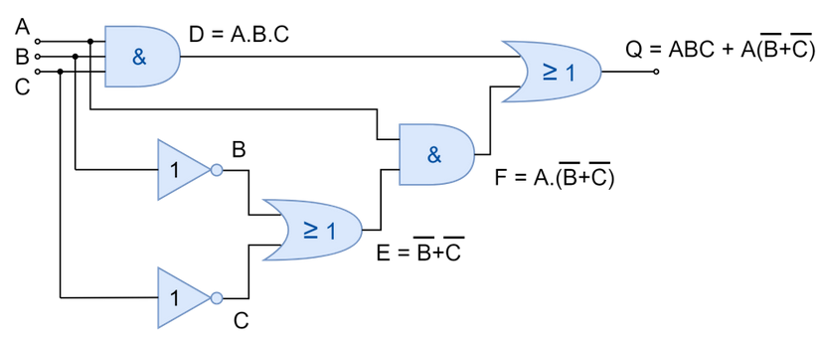
Boolean Algebra Examples No4
In the final example, a more complex digital logic circuit has simplified which consists of six logic gates. The logic circuit to be reduced has been shown below.

Slide 12
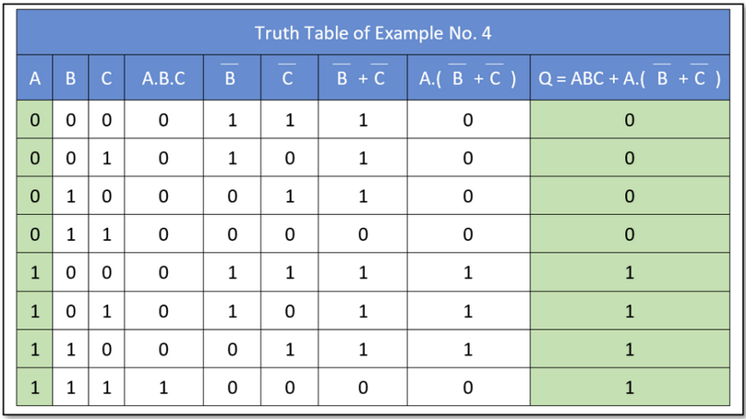
Boolean Algebra Examples No4

Slide 13
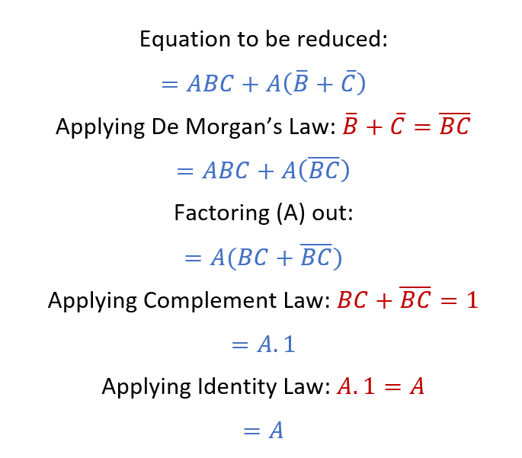
Boolean Algebra Examples No4
The Boolean expression of the given logic circuit has also been reduced below using Boolean algebra laws and theorems.

Slide 14
Combinational Circuits

Slide 15
Introduction
  Introduction to Combinational Circuits
  Adder
  Ripple Carry Adder
  Subtraction
  Adder/Subtractor

Slide 16
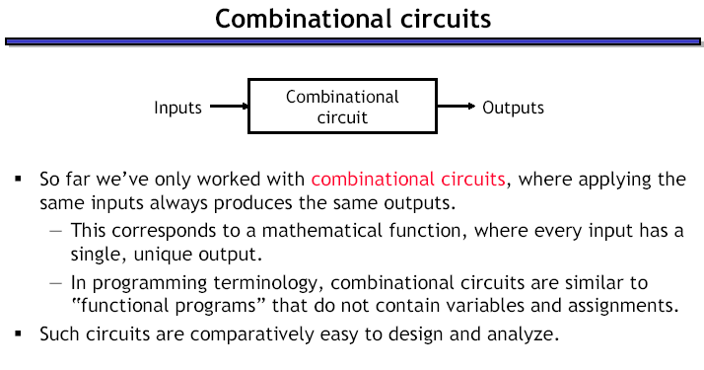

Slide 17
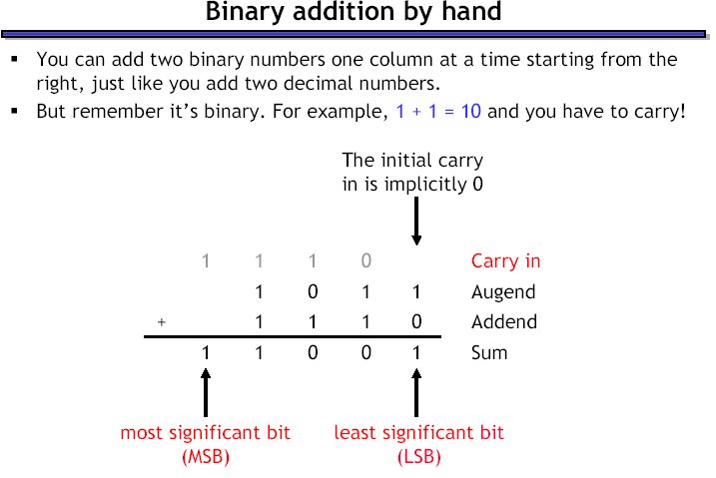

Slide 18
Adders

Slide 19
Adder
Design an Adder for 1-bit numbers?
  Specification:
  2 inputs (X,Y)
  2 outputs (C,S)

Slide 20
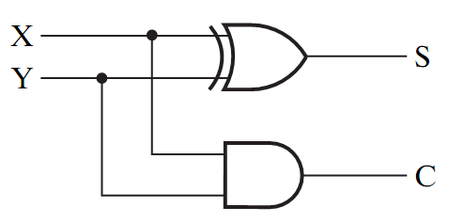
Adder
Design an Adder for 1-bit numbers?
1. Specification: 3. Optimization/Circuit
2 inputs (X,Y)
2 outputs (C,S)
2. Formulation:
X | Y | C | S
0 | 0 | 0 | 0
0 | 1 | 0 | 1
1 | 0 | 0 | 1
1 | 1 | 1 | 0

Slide 21
Half Adders

Slide 22
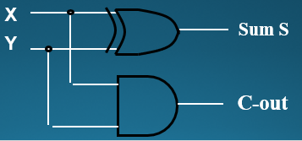
Half Adder
Adding two single-bit binary values, X, Y produces a sum S bit and a carry out C-out bit.
This operation is called half addition and the circuit to realize it is called a half adder.
Half Adder Truth Table
  S(X,Y) = Σ (1,2)
  S = X’Y + XY’
  S = X ⊕ Y
  C-out(x, y, C-in) = Σ (3)
  C-out = XY
Inputs
Outputs
X
0
0
1
1
Y
0
1
0
1
S
0
1
1
0
C-out
0
0
0
1
X
Half
Adder
S
Y
C-OUT

Slide 23
Full Adders

Slide 24
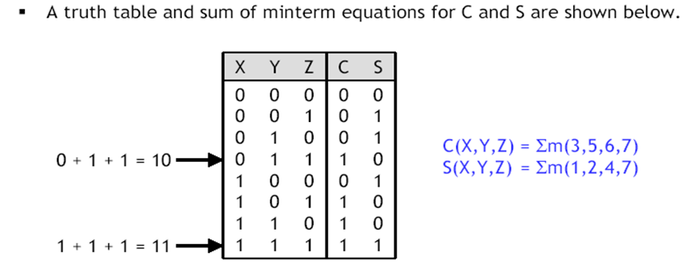
Full Adder
A combinational circuit that adds 3 input bits to generate a Sum bit and a Carry bit

Slide 25
Full Adder Circuit Using XOR
X
Y
Sum S
X
Y
C-in
Full
Adder
X
XY
C-out
C-in
Y
X
XC-in
C-out
S
C-in
Y
C-in
YC-in

Slide 26
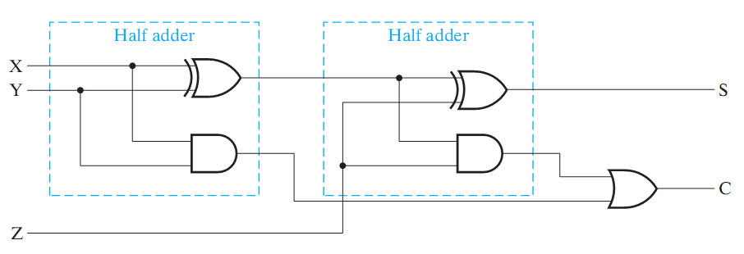
Full Adder = 2 Half Adders
Manipulating the Equations:
S = ( X ⊕ Y ) ⊕ Z
C = XY + XZ + YZ = XY + Z(X ⊕ Y )
Think of Z as a carry in
Src: Mano’s Book

Slide 27
Bigger Adders

Slide 28
Bigger Adders
How to build an adder for n-bit numbers?
  Example: 4-Bit Adder
    Inputs ?
    Outputs ?
    What is the size of the truth table?
    How many functions to optimize?

Slide 29
Bigger Adders
How to build an adder for n-bit numbers?
  Example: 4-Bit Adder
    Inputs ? 9 inputs
    Outputs ? 5 outputs
    What is the size of the truth table? 512 rows!
    How many functions to optimize? 5 functions

Slide 30
Ripple carry Adders

Slide 31
Ripple Carry Adder
To add n-bit numbers:
Use n Full-Adders in parallel
The carries propagates as in addition by hand
Use Z in the circuit as a C_{in}
1 0 0 0
0 1 0 1
0 1 1 0
1 0 1 1

Slide 32
4-bit Carry Ripple Adder
Inputs to be added
X3X2X1X0
Y3Y2Y1Y0
Adds two 4-bit numbers:
X = X3 X2 X1 X0
Y = Y3 Y2 Y1 Y0
producing the sum S = S3 S2 S1 S0 ,
C-out = C4 from the most significant
position j=3
4-bit
Adder
C4
C-out
C-in
C0 =0
S3 S2 S1 S0
Data inputs to be added
Sum Output
X3
Y3
X2
Y2
X1
Y1
X0
Y0
Full
Adder
C3
Full
Adder
C2
Full
Adder
C1
Full
Adder
C4
C-out
C-in
C-out
C-in
C-out
C-in
C-out
C-in
C0 =0
S3
S2
S1
S0
Sum output

Slide 33
Binary Parallel Adders

Slide 34
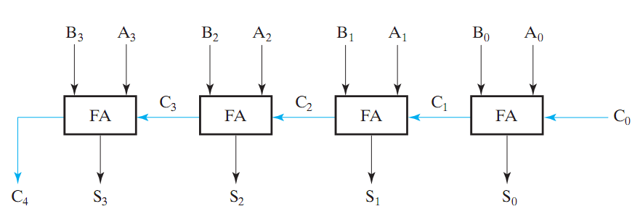
Binary Parallel Adder
To add n-bit numbers:
Use n Full-Adders in parallel
The carries propagates as in addition by hand
Src: Mano’s Book
This adder is called ripple carry adder

Slide 35
Subtractors

Slide 36
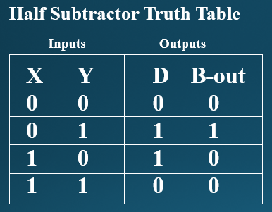
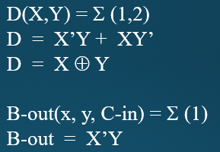
Half Subtractor
Subtracting a single-bit binary value Y from anther X (I.e. X -Y ) produces a difference bit D and a borrow out bit B-out.
This operation is called half subtraction and the circuit to realize it is called a half subtractor.
X
Y
Difference D
X
Half
Subtractor
D
Y
B-OUT
B-out

Slide 37
Subtraction (2’s Complement)
How to build a subtractor using 2’s complement?
1
Src: Mano’s Book
S = A + ( -B)

Slide 38
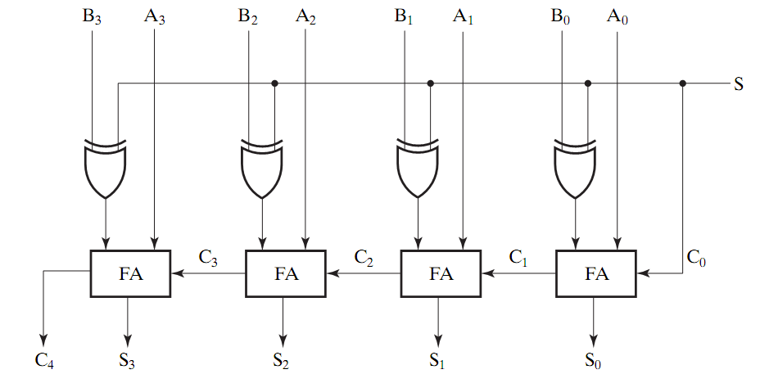
Adder/Subtractor
0 : Add
1: subtract
Src: Mano’s Book
Using full adders and XOR we can build an Adder/Subtractor!

Slide 39
Binary Parallel Adder (Again)
To add n-bit numbers:
Use n Full-Adders in parallel
The carries propagates as in addition by hand
Src: Mano’s Book
This adder is called ripple carry adder

Slide 40




  Thank You

