Slide 1


Computer Organization and Architecture
Prepared by Dr. Eng. Gamal Selim
Lecture 08

Slide 2
Revision

Slide 3
Decoders

Slide 4
Decoder
  Accepts a value and decodes it
    Output corresponds to value of n inputs
  Consists of:
    Inputs (n)
    Outputs (2^{n} , numbered from 0 → 2^{n} - 1)
    Selectors / Enable (active high or active low)

Slide 5
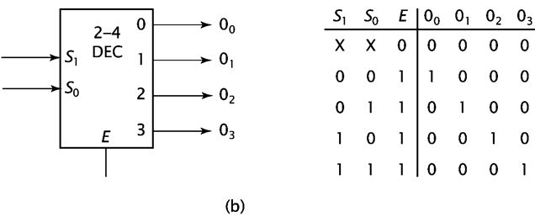
2-to-4 Decoder

Slide 6
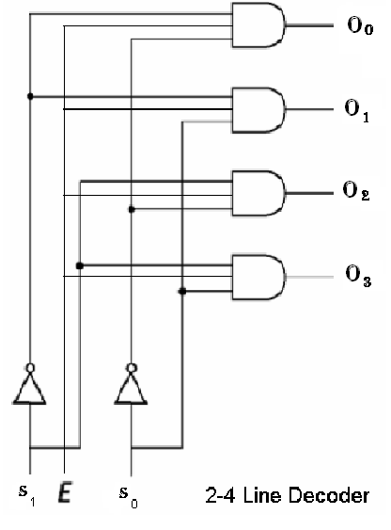
2-to-4 Decoder

Slide 7
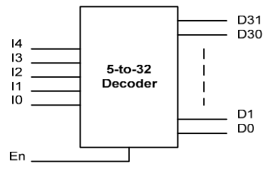
Example on expansion decoder
Construct a 5-to-32 decoder using only 2-to-4 decoders and 3-to-8 decoders (with enable).
We are going to make 5-to-32 decoder like the one shown below:

Slide 8
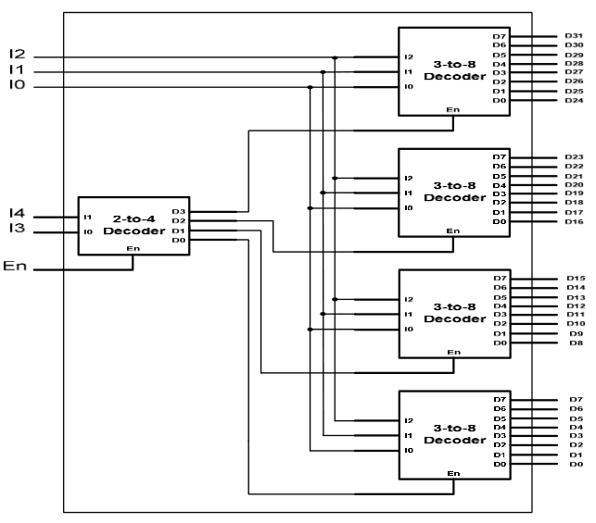
Example on expansion decoder
We need four 3-to-8 decoder for the last stage and one 2-to-4 decoder for selecting each of them at the first stage:

Slide 9
Encoders

Slide 10
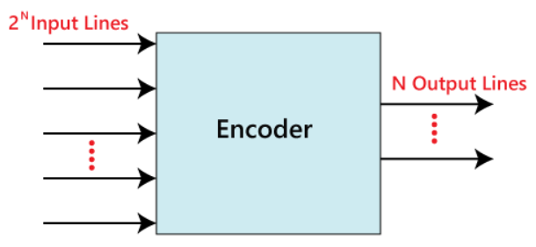
Encoders

Slide 11
4-to-2 line Encoder

Slide 12
4 to 2 line Encoder
In 4 to 2 line encoder, there are total of four inputs, i.e., Y₀, Y₁, Y₂, and Y₃, and two outputs, i.e., A₀ and A₁. In 4-input lines, one input-line is set to true at a time to get the respective binary code in the output side. Below are the block diagram and the truth table of the 4 to 2 line encoder.

Slide 13
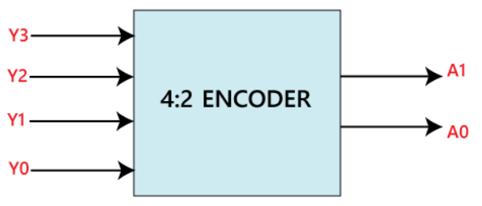
4 to 2 line Encoder

Slide 14
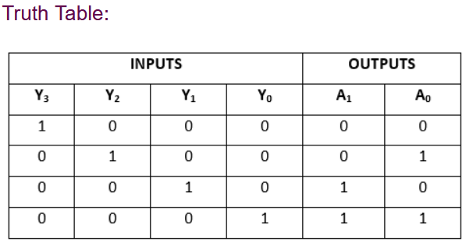
4 to 2 line Encoder

Slide 15
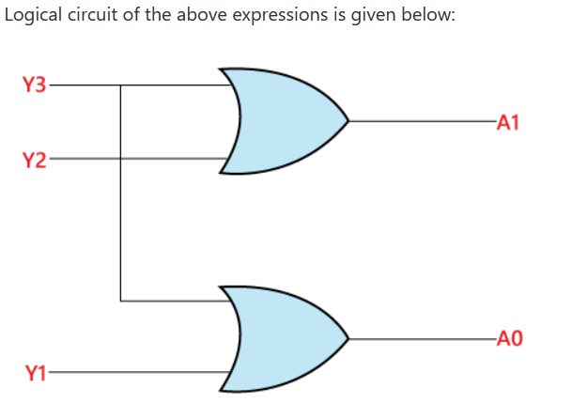
4 to 2 line Encoder
The logical expression of the term A0 and A1 is as follows:
A₁=Y₃+Y₂
A₀=Y₃+Y₁

Slide 16
Encoder vs Decoder

Slide 17
Encoder vs Decoder
ENCODER | DECODER
Encoder circuit basically converts the applied information signal into a coded digital bit stream. | Decoder performs reverse operation and recovers the original information signal from the coded bits.
In case of encoder, the applied signal is the active signal input. | Decoder accepts coded binary data as its input.
The number of inputs accepted by an encoder is 2n. | The number of input accepted by decoder is only n inputs.
The output lines for an encoder is n. | The output lines of an decoder is 2n.

Slide 18
Encoder vs Decoder
ENCODER | DECODER
The encoder generates coded data bits as its output. | The decoder generates an active output signal in response to the coded data bits.
The operation performed is simple. | The operation performed is complex.
The encoder circuit is installed at the transmitting end. | The decoder circuit is installed at the receiving side.
OR gate is the basic logic element used in it. | AND gate along with NOT gate is the basic logic element used in it.

Slide 19
Digital Circuits Cont.

Slide 20
Digital Circuits Cont.
Multiplexer
Demultiplexer

Slide 21
Multiplexer / Demultiplexer
The basic function of the Multiplexer (MUX).
The typical application of a MUX.
A 4-to-1 MUX designed with Small Scale Integration (SSI).
A 4-to-1, 8-to-1, & 16-to-1 Medium Scale Integration (MSI) MUX.
The basic function of the Demultiplexer (DEMUX).
The typical application of a DEMUX.
A 1-to-4 DEMUX design with Small Scale Integration (SSI).

Slide 22
Multiplexer (MUX)

Slide 23
What is a Multiplexer (MUX)?
The term Multiplexer means many into one.
Multiplexing is the process of transmitting a large number of information over a single line.
A Digital Multiplexer (MUX) is a combinational Circuit that select one digital information from several sources and transmits the selected information on a single output line.
A Multiplexer is also called a Data Selector.
The Multiplexer has several data input line and a single output line.

Slide 24
What is a Multiplexer (MUX)?
MUX directs one of the inputs to its output line by using a control bit word (selection line) to its select lines.
Multiplexer contains the followings:
  data inputs
  selection inputs
  a single output
Selection input determines the input that should be connected to the output.
The multiplexer acts like an electronic switch that selects one from different.

Slide 25
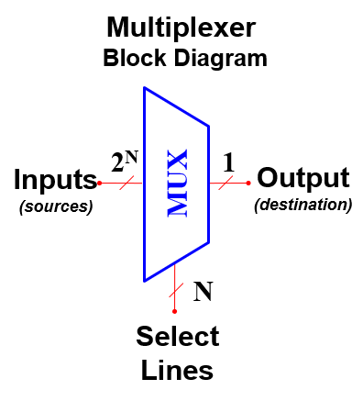
What is a Multiplexer (MUX)?
A MUX is a digital switch that has multiple inputs (sources) and a single output (destination).
The select lines determine which input
is connected to the output.
MUX Types
  → 2-to-1 (1 select line)
  → 4-to-1 (2 select lines)
  → 8-to-1 (3 select lines)
  → 16-to-1 (4 select lines)

Slide 26
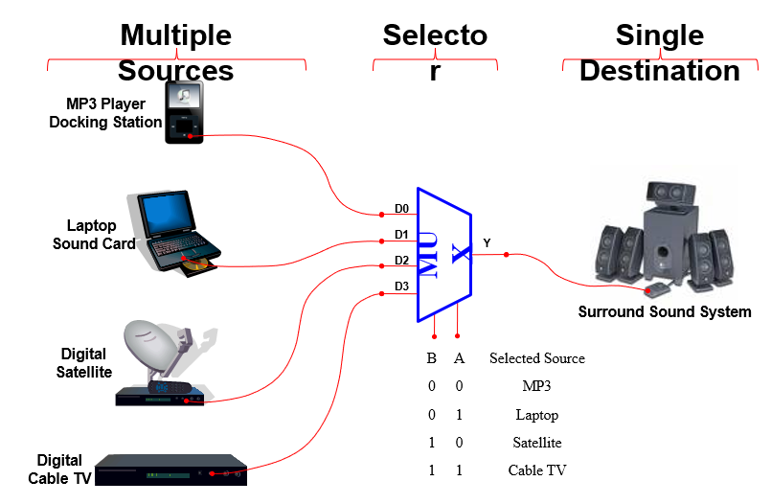
Typical Application of a MUX

Slide 27
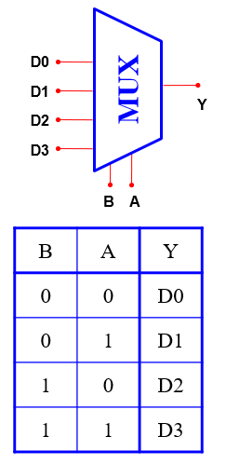
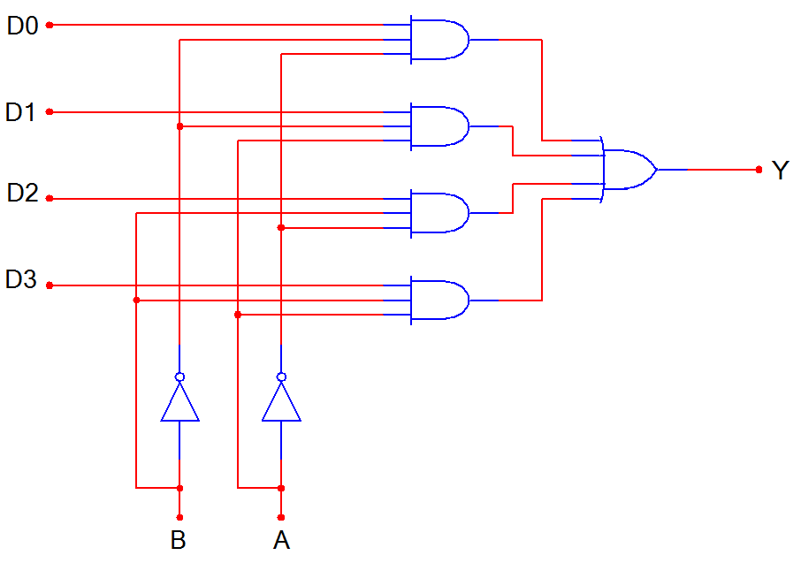
4-to-1 Multiplexer (MUX)

Slide 28
DeMultiplexer (DEMUX)

Slide 29
What is a Demultiplexer (DEMUX)?
The De-Multiplexer is a combinational logic circuit that performs the reverse operation of multiplexer (Several output lines, one input line).
De -Multiplexer means one to many. A De-Multiplexer is a circuit with one input and many output. By applying control signal, we can steer any input to the output. Few types of De -Multiplexer are 1-to 2, 1-to-4, 1-to-8 and 1-to 16 De -Multiplexer .
De-Multiplexer is the process of taking information from one input and transmitting the same over one of several outputs.

Slide 30
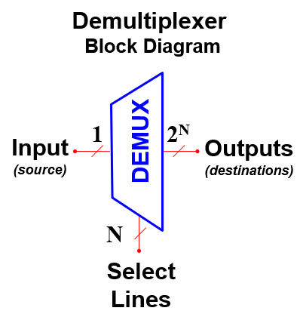
What is a Demultiplexer (DEMUX)?
A DEMUX is a digital switch with a single input (source) and a multiple outputs (destinations).
The select lines determine which output
the input is connected to.
DEMUX Types
  → 1-to-2 (1 select line)
  → 1-to-4 (2 select lines)
  → 1-to-8 (3 select lines)
  → 1-to-16 (4 select lines)

Slide 31
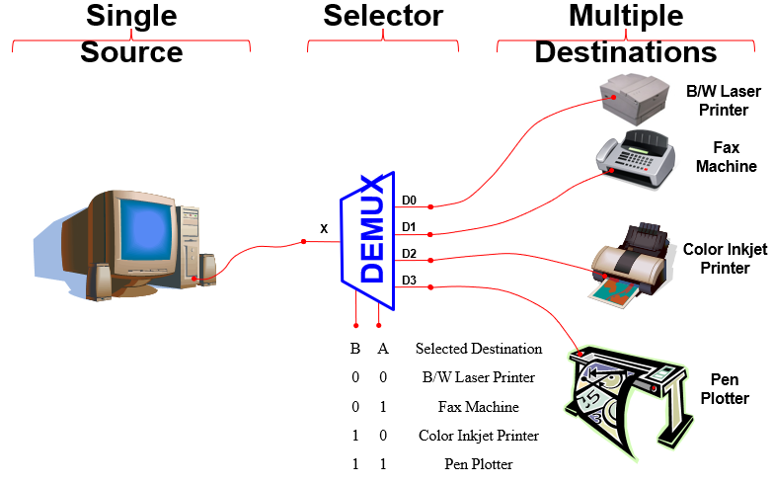
Typical Application of a DEMUX

Slide 32
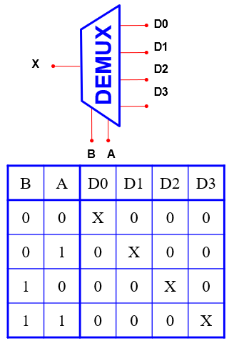
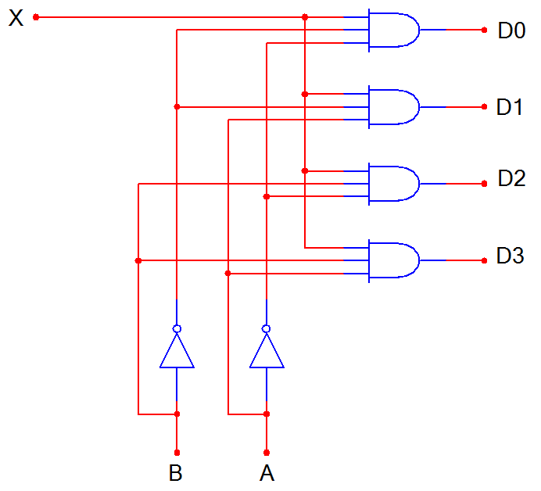
1-to-4 De-Multiplexer (DEMUX)

Slide 33
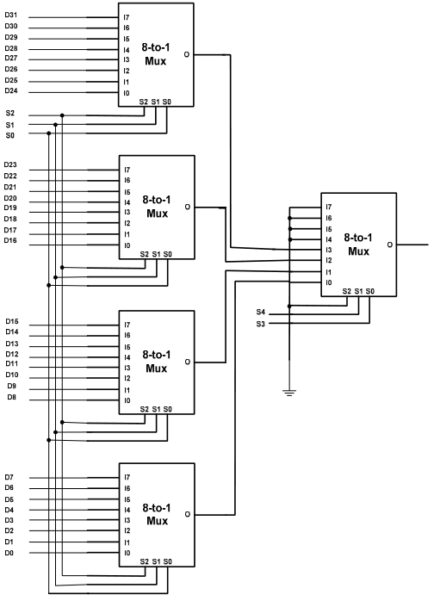
Example of expansion Multiplexer
  Design a 32-to-1 multiplexer using only 8-to-1 multiplexer
We use four 8-to-1 in the first stage and another
one to select between the output of the others:

Slide 34
MUX vs DeMUX

Slide 35
Difference between Multiplexer and Demultiplexer
  Both multiplexer and demultiplexer are types of combinational digital circuit that are used in several large-scale digital systems. However, there are many differences between a multiplexer and a demultiplexer, which are highlighted in the following table

Slide 36
Difference between Multiplexer and Demultiplexer
Basis of Difference | Multiplexer | Demultiplexer
Definition | A multiplexer is a combinational digital circuit that takes multiple data inputs and provides only single output. | A demultiplexer is a combinational digital circuit that takes single input and provides multiple outputs.
Abbreviated name | The abbreviation used to represent the multiplexer is MUX. | The abbreviation used to represent the demultiplexer is DEMUX.
Input and output lines | Multiplexer has 2^{n} input lines and 1 output line. Where, n is the number of select lines. | Demultiplexer has 1 input line and 2^{n} output lines. Where, n is the number of select lines.
Also known as | Multiplexer is also known as a "data selector". | Demultiplexer is also known as "data distributor".

Slide 37
Difference between Multiplexer and Demultiplexer
Basis of Difference | Multiplexer | Demultiplexer
Operating principle | The operating principle of the multiplexer is "many to one". | The operating principle of a demultiplexer is "ne to many".
Acts as | Multiplexer acts as a digital multi-position switch. | Demultiplexer acts as a digital circuit.
Conversion technique | A multiplexer performs parallel to serial conversion. | A demultiplexer performs serial to parallel conversion.
Function of control signal | In case of multiplexer, the function of control signal is to select a specific input that has to be transmitted at the output. | In demultiplexer, the function of control signal is to deliver the single input signal over the multiple output lines.

Slide 38
Difference between Multiplexer and Demultiplexer
Basis of Difference | Multiplexer | Demultiplexer
Examples | Examples of some common multiplexers are − 8:1 Multiplexer 16:1 Multiplexer 32:1 Multiplexer | Some common demultiplexers are − 1:2 Demultiplexer 1:4 Demultiplexer 1:8 Demultiplexer 1:16 Demultiplexer
Practical importance | In practice, the multiplexer increases the efficiency of the communication system by enabling the data transmission using a single line. | In practice, the demultiplexer takes the output of a multiplexer and convert in its original form at the receiver end.

Slide 39
Difference between Multiplexer and Demultiplexer
Basis of Difference | Multiplexer | Demultiplexer
Usage in time-division multiplexing | A multiplexer is used at the transmitter end in the time-division multiplexing (TDM). | The demultiplexer is used at the receiver end in the time-division multiplexing.
Applications | The multiplexers are commonly used in communication systems, telephone networks, computer memories, etc. | The demultiplexers are used in communication systems, reconstruction of parallel data, ALU, etc.

Slide 40




  Thank You

