Slide 2
Contents
Circuit Optimization
  The Map Method
  Two-Variable Map
  Three-Variable Map
  Four-Variable Map
  Don’t Care Conditions
  Product of Sums Simplification

Slide 3
Circuit Optimization
  Complexity of a logic circuit is directly related to the algebraic expression.
  Simplification using algebraic manipulation (in part1) has issues:
How to know succeeding steps in the manipulative process
Difficult to determine whether the simplest expression has been achieved.
  To obtain the simplest implementation for a given function, we can use a graphical technique using Karnaugh maps (K-maps)
Notes:
The complexity of a logic circuit that implements a Boolean function is directly related to the algebraic expression from which the function is implemented.
truth-table representation of a function is unique, when expressed algebraically, the function appears in many different forms.
Boolean expressions may be simplified by algebraic manipulation, as discussed in Section 2.
How ever, this procedure of simplification is awkward, because it lacks specific rules to predict each succeeding step in the manipulative process and it is difficult to determine whether the simplest expression has been achieved. By contrast, the map method provides a straightforward procedure for optimizing Boolean func- tions of up to four variables.

Slide 4
Karnaugh Maps (K-map)
  A K-map is a collection of squares
  Each square represents a minterm (or a row in the truth table)
  Adjacent squares differ in the value of one variable
  A K-map is a graphical representation of a Boolean function
Notes:
Alternative algebraic expressions for the same function are derived by recognizing patterns of squares

Slide 5
Karnaugh Maps (K-map)
  A K-map is a reorganized version of the truth table
  In K-map, the number of cells is similar to the total number of variable input combinations. For example, if the number of variables is two, the number of cells is 2² = 4. if the number of variables is three, the number of cells is 2³=8, and if the number of variables is four, the number of cells is 2⁴.
  K-map provide a means for finding optimum or near optimum
    SOP and POS standard forms, and

Slide 6
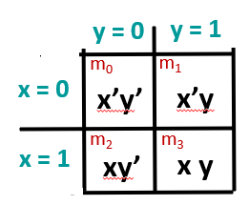
Two Variable K-Maps
Karnaugh Maps (K-map)
    Every 2 adjacent cells differ in the value of 1 variable only.
    m₀ and m₁ are adjacent and differ in the value of the y variable.
    m₀ and m₂ differ in the x variable.
    m₁ and m₃ differ in the x variable.
    m₂ and m₃ differ in the value of the variable y.
Notes:
A K-Map is a different form of the truth table.

Slide 7
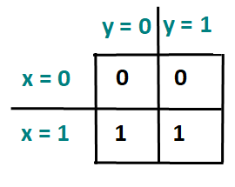
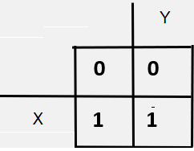
K-Map Function Representation
Example:
F(x,y) = ∑m2,m3
X | Y | F
0 | 0 | 0
0 | 1 | 0
1 | 0 | 1
1 | 1 | 1

Slide 8
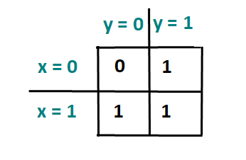
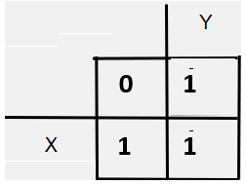
K-Map Function Representation
Example:
  G(x,y) = (x’y +xy’ +xy )
  G(x,y) =∑ m1,m2,m3
X | Y | G
0 | 0 | 0
0 | 1 | 1
1 | 0 | 1
1 | 1 | 1

Slide 9
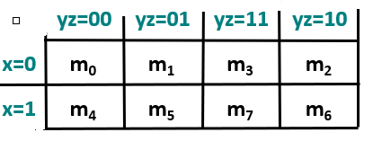
Karnaugh Maps (K-map)
A three-variable K-map:
Where each minterm corresponds
to the product terms:
Note that if the binary value for an index differs in one bit position, the minterms are
adjacent on the K-Map

Slide 10
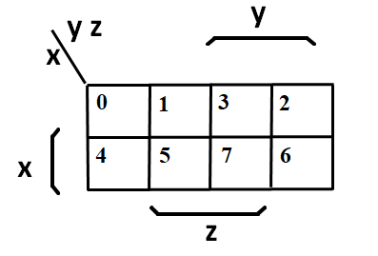
Alternative Map Labeling
Alternate labeling are useful:

Slide 11
Example Functions
By convention, we represent the minterms of F by a "1" in the map and leave the minterms of F’ blank
Example:
  F(x,y,z)=Ʃ(2,3,4,5)
Example:
  G(a,b,c)= Ʃ(3,4,6,7)
y
0
1
3
2
1
1
x
4
5
7
6
1
1
y
z
0
1
3
1
2
x
4
5
7
6
1
1
1
z
Notes:
Xy’+x’y
B c+ac’

Slide 12
Combining Squares
By combining squares, we reduce number of literals in a product term
On a 2-variable K-Map:
# of adjacent squares | Represents
1 | A minterm with two variables
2 | A product term with one variables
4 | The function of all ones (no variables) = 1

Slide 13
Combining Squares
By combining squares, we reduce number of literals in a product term
On a 3-variable K-Map:
# of adjacent squares | Represents
1 | A minterm with three variables
2 | A product term with two variables
4 | A product term with one variable
8 | The function of all ones (no variables) = 1

Slide 14
Combining Squares
Groupings to select product-terms must be:
  Rectangular in shape
  In powers of twos (1, 2, 4, 8, etc.)
  Always select largest possible groupings of minterms (i.e. prime implicants)
  Eliminate redundant groupings

Slide 15
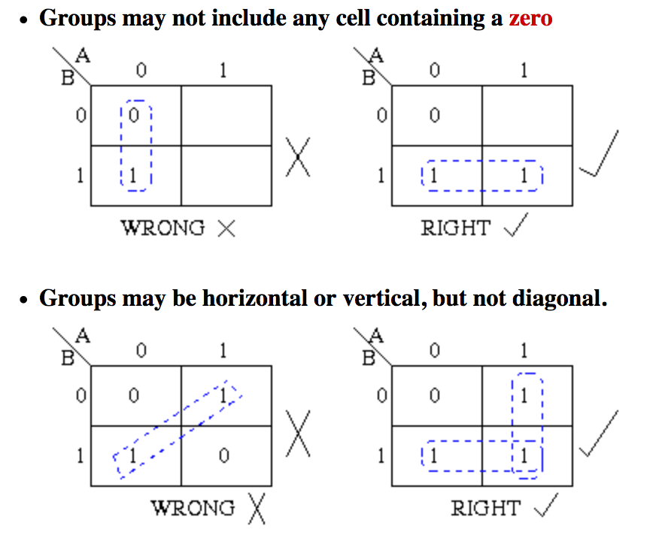
Combining Squares

Slide 16
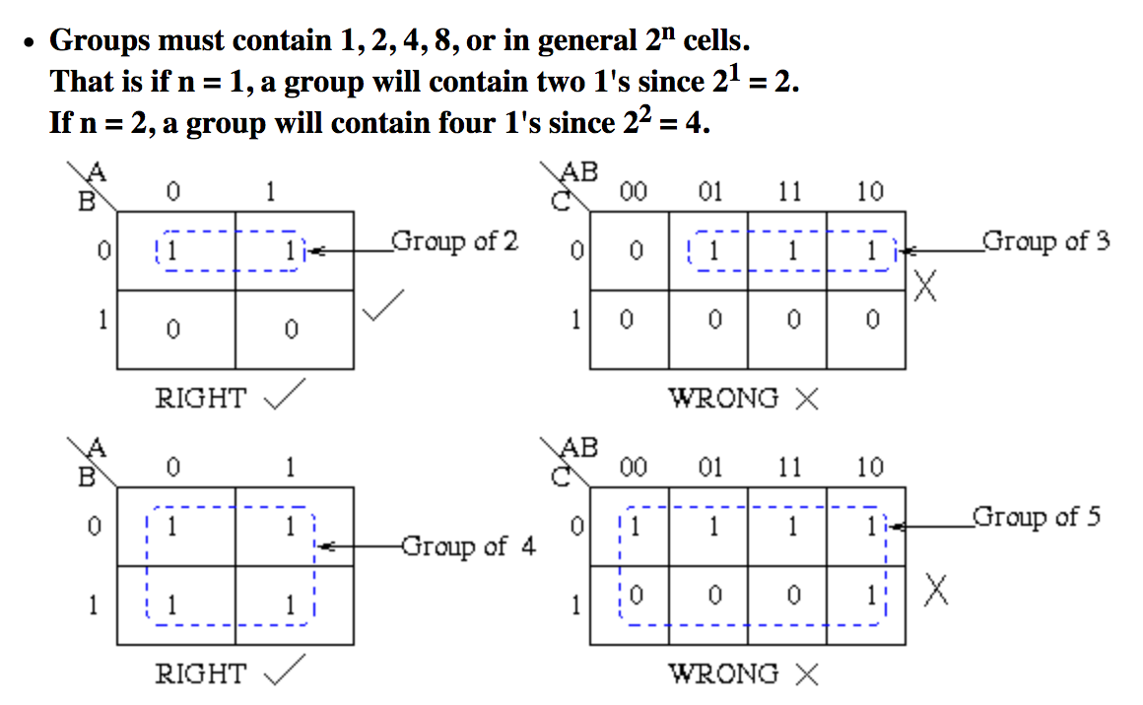
Combining Squares

Slide 17
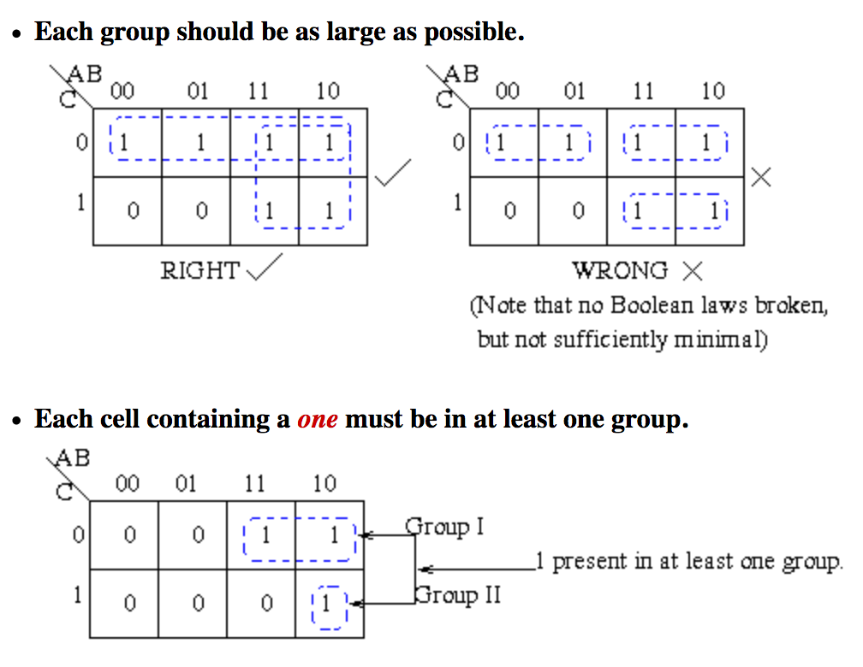
Combining Squares

Slide 18
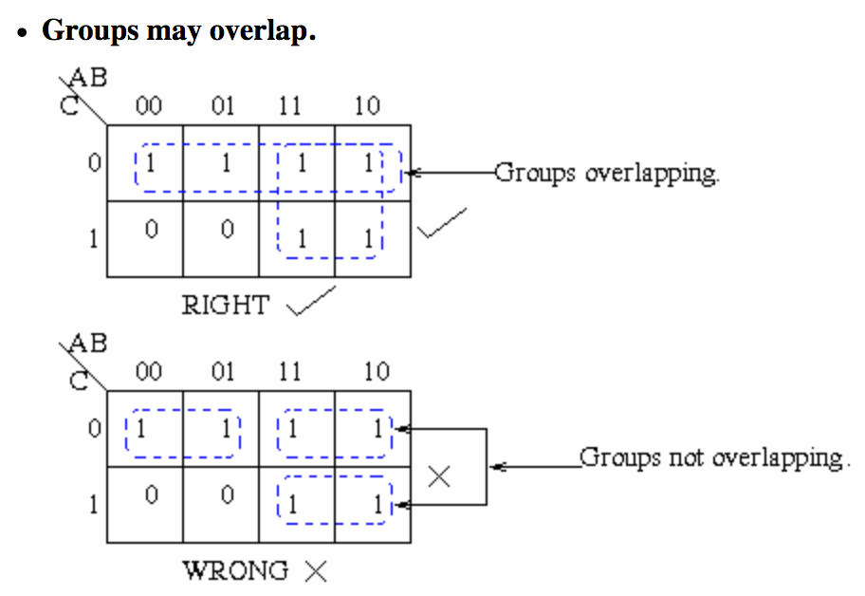
Combining Squares

Slide 19
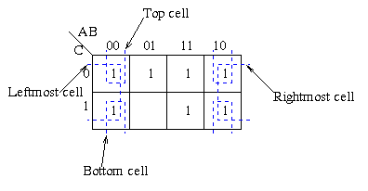
Combining Squares
Groups may wrap around the table. The leftmost cell in a row may be grouped with the rightmost cell and the top cell in a column may be grouped with the bottom cell.

Slide 20
Karnaugh Maps (K-map)
Four variable maps can have rectangles corresponding to:
  A single 1 = 4 variables, (i.e. Minterm)
  Two 1s = 3 variables,
  Four 1s = 2 variables
  Eight 1s = 1 variable,
  Sixteen 1s = zero variables (i.e. Constant "1")
Four-Variable Maps

Slide 21
Karnaugh Maps (K-map)
Four-Variable Maps
Possible valid groupings of a 4-variable K-map include:
Invalid groups examples:
1
1
1
1
1
1
1
1
1
1
1
1
1
1
1
1
1
1
1
1
1
1
1
1
1
1
1
1
1
1
1
1
1
1
1
1

Slide 22
Combining Squares
By combining squares, we reduce number of literals in a product term
On a 4-variable K-Map:
# of adjacent squares | Represents
1 | A minterm with four variables
2 | A product term with three variables
4 | A product term with two variable
8 | A product term with one variable
16 | The function of all ones (no variables) = 1

Slide 23
Simplest SOP Expressions
To find the simplest possible sum of products (SoP) expression from a K-map, you need to do the following:
  define the given expression in its canonical form
  create the K-map by entering 1 to each product-term into the K-map cell and fill the remaining cells with zeros

Slide 24
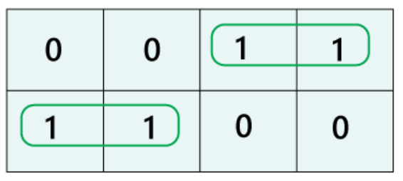
Form the groups by considering each one in the K-map.
Group the number of ones in the decreasing order. First, we have to try to make the group of eight, then for four, after that two and lastly for 1.
find the boolean expression for each group. By looking at the common variables in cell-labeling, we define the groups in terms of input variables.

Slide 25
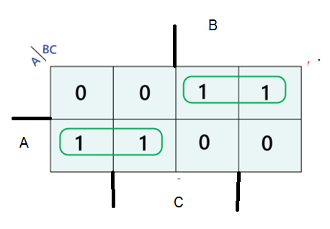
Before Simplification
F(A,B,C) = ∑ m2, m3,m4,m5
= A’.B.C’ + A’.B.C + A.B’.C’ +A.B’.C’
After simplification
F (A,B,C) = A’.B + A.B’

Slide 26
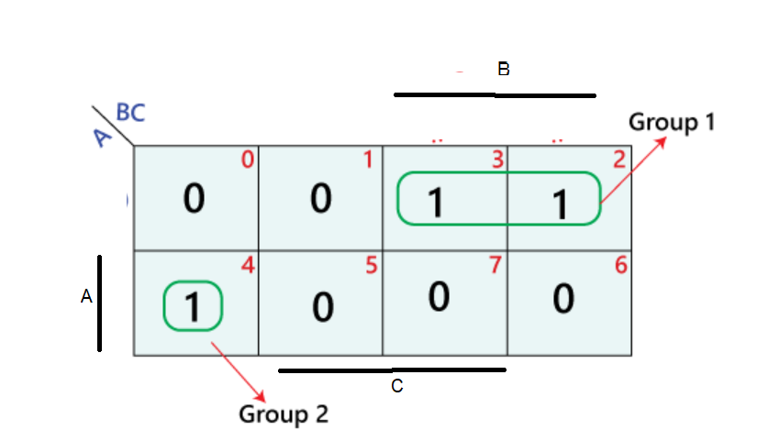
Before Simplification
F(A,B,C) = ∑ m2, m3,m4
= A’.B.C’ + A’.B.C + A.B’.C’
After simplification
F (A,B,C) = A.B’.C’ + A’.B

Slide 27
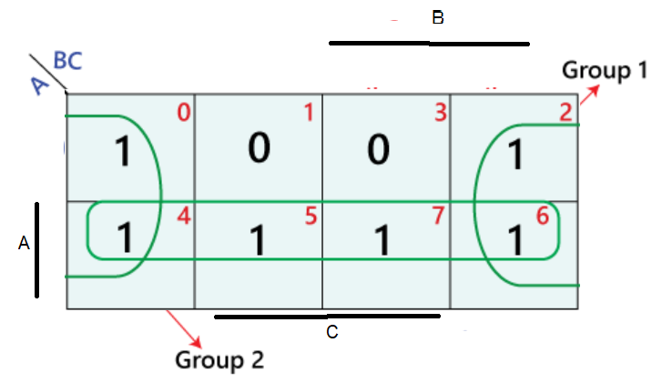
Before Simplification
F(A,B,C) = ∑ m0, m2,m4,m5, m6, m7
= A’.B’.C’ + A’.B.C’ + A.B’.C’ + AB’C
+A.B.C’+A.B.C
After simplification
F (A,B,C) = C’ + A

Slide 28
Karnaugh Maps (K-map)
Example:
Simplify F(x,y,z)=Ʃ(1,2,3,5,7)
z
x
y
y
1
1
1
x
1
1
z
F(x,y,z)=x’y+z

Slide 29
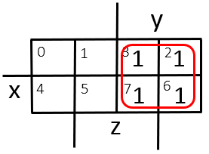
Karnaugh Maps (K-map)
Example:
Simplify F(x,y,z)= Ʃ(2,3,6,7)
    F=y
Thus the four terms that form a 2 × 2 square correspond to the term "y".

Slide 30
Product-of-Sums Optimization
The optimized Boolean functions derived from the maps in all of the previous examples were expressed in sum-of-products form.
With only minor modification, the product-of-sums form can be obtained.
STEPS:
Mark the empty squares with 0s
Combine them into valid rectangles
Read the product terms to obtain F’
Take the complement of F’ to obtain F as a product-of-sums.

Slide 31
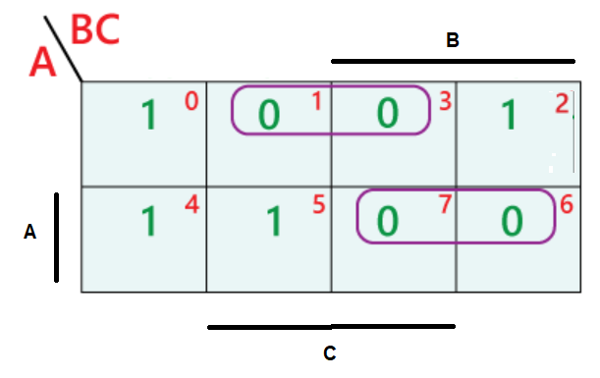
Simplify the following function using K.MAP
in the form of product of sum
F= ∑ 0,2,4,5
Solution:
F’ = A’.C + A.B
F = (A+C’) (A’ + B’)

Slide 32
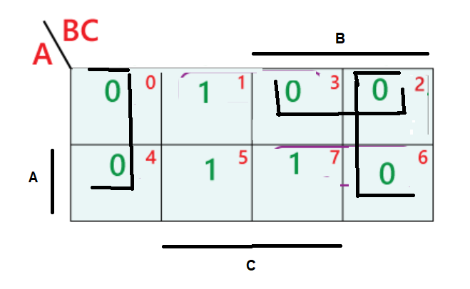
Simplify the following function using K.MAP
in the form of product of sum
F= ∑ 1,5,7
Solution:
F’ = C’ + A’.B
F = C . (A+B’)

Slide 33
Don't Cares in K-Maps
Sometimes a function table or map contains :
  Input values for the minterm will never occur,
  Output value for the minterm is not used
In these cases, the output value is defined as a “don't care” ( an “x” entry).
By doing that. the cost of the logic circuit of that function may be lowered.

Slide 34
Don't Cares in K-Maps
Example :
Assume A 3 variable logic function F is defined as follow:
The output is equal to one of its input is <3 and >=6
The output is not specified when the input = 3
The output is zero otherwise.
Since the output @ 3 never occurs, it is represented as don’t care..
x | y | z | F
0 | 0 | 0 | 1
0 | 0 | 1 | 1
0 | 1 | 0 | 1
0 | 1 | 1 | X
1 | 0 | 0 | 0
1 | 0 | 1 | 0
1 | 1 | 0 | 1
1 | 1 | 1 | 1
Notes:
What is BCD code?
Binary coded decimal (BCD) is a system of writing numerals that assigns a four-digit binary code to each digit 0 through 9 in a decimal (base-10) numeral. The four-bit BCD code for any particular single base-10 digit is its representation in binary notation, as follows: 0 = 0000. 1 = 0001. 2 = 0010.

Slide 35
Don't Cares in K-Maps
Ultimately, each “x” entry may take on either a 0 or 1 value in resulting solutions.
For example, an “x” may take on value “0” in an SOP solution and value “1” in a POS solution (If not covered), or vice-versa (If covered).
Any minterm with value “x” need not be covered by a prime implicant.

Slide 36
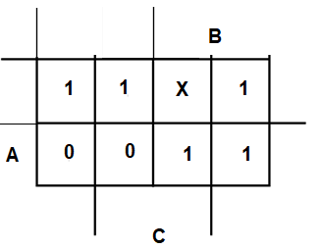
Product of Sums Example
Find the optimum SoP solution:
F(A,B,C)= Ʃ(m0, m1, m2,m6,m7) + Ʃ_{d}(m3)
  F = A’ + B
x | y | z | F
0 | 0 | 0 | 1
0 | 0 | 1 | 1
0 | 1 | 0 | 1
0 | 1 | 1 | X
1 | 0 | 0 | 0
1 | 0 | 1 | 0
1 | 1 | 0 | 1
1 | 1 | 1 | 1
Notes:
F' = B' D' + A' B
F = (B + D)(A + B')

Slide 37
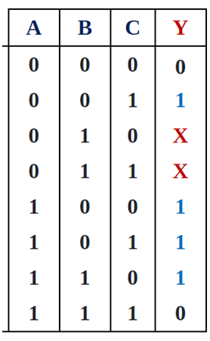
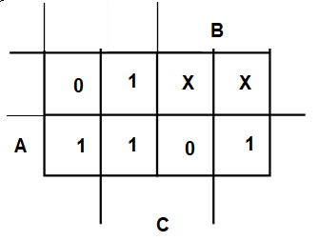
Example:
Find The simplified function in terms of PoS
F(A,B,C)= Ʃ(m1, m4,m5,m6) + Ʃ_{d}(m2,m3)
  F’ = B.C + A’.C’
  F = (B’+C’) . (A + C)

Slide 38
End of Chapter 5

