Slide 1



Corporate Entrepreneurship and Innovation
Prepared by Dr. Ibrahim Siam
ENT628
Entrepreneurship
Lecture 5

Slide 2



Chapter
Managing risk in the entrepreneurial organization
08
CONTENTS
Bias and risk-taking
'Known-un known'
A risk management framework
Assessing risks
Mitigating risks
Monitoring risks
Financing risk
ENT628
Entrepreneurship

Slide 3
Critically evaluate the structure of on organization.
Managing risk in the entrepreneurial organization
Chapter
08
LEARNING OUTCOMES
Understand that people are naturally risk-averse for gains and risk-seeking for losses and explain the consequences of this bios
Understand the difference between 'known-unknowns' and 'unknown-unknowns' and the risk management techniques appropriate to the different situations
Use the risk management framework outlined in this chapter to identify risk, evaluate the probability of it materializing, quantify its impact, and find ways to mitigate it
Understand and explain the nature of financing risk and how it might be mitigated or avoided.
ENT628
Entrepreneurship

Slide 4
Chapter
ENCOURAGING
Creativity and innovation
09
CONTENTS
  • Creativity, innovation, and commercia l opportunity
  • Measuring creativity
  • Blocks to creativity and innovation
  • Connectivity
  • Knowledge networks
  • Crowdsourcing and open innovation
  • Accelerators and incubators
ENT628
Entrepreneurship

Slide 5
Critically evaluate the structure of on organization.
Chapter
Culture in the entrepreneurial organization
09
LEARNING OUTCOMES
Critically assess the dimensions of your own creative potential
Understand and explain the importance of knowledge networks and the contribution that crowdsourcing can make to creativity and innovation
Critically analyze the factors that contribute to a creative environment
Develop creativity and discovery skills
ENT628
Entrepreneurship

Slide 6
Chapter
Bias And Risk-taking
08
This chapter looks at the challenges of managing risk. Because it operates in a changing, uncertain environment and/or is introducing frequent or radical innovation, the entrepreneurial organization probably faces greater risks than other organizations. The skill of risk management is therefore important.
This helps them make quick decisions and can lead to better decision­ making with good information flows. However, entrepreneurs are inherently confident in their ability to influence outcomes and this can lead to over-optimism, perhaps reflecting itself in an inherent bias towards riskier projects {or at least a willingness to accept risks that others might not). This underlines the need for simple, speedy risk management processes in an organization, based on open and accurate information flow.
ENT628
Entrepreneurship

Slide 7
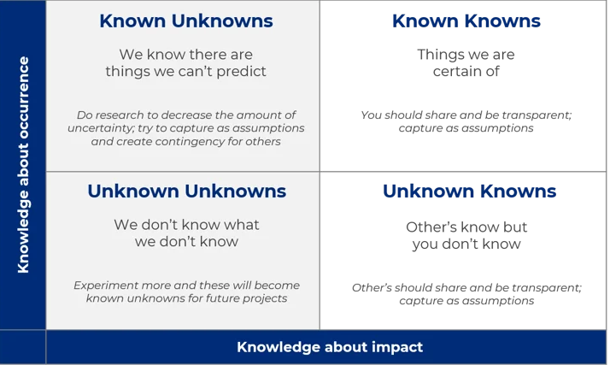
Chapter
08
'Known-unknowns' And 'Unknown-unknowns'
  they also need to be based upon as much information as possible - from both inside and outside the organization - perhaps phasing a project so as to allow more information about the risks associated with it to be collected and assessed as the project develops.
ENT628
Entrepreneurship

Slide 8
Chapter
'Known-unknowns' And 'Unknown-unknowns'
08
The risk management framework outlined in this chapter covers these 'known-unknowns: This approach works best for projects involving incremental innovations where there is infor­mation that can be applied to the decision.
The second situation is where the risks cannot be identified {the risks are unknown) -for example, some natural disaster that has never struck before. When a project involves many unknown factors, such as whether or not a new technology might work and whether or not there might be a market demand for it, these are unknown risks where the impact cannot be quantified and their likelihood of occurrence is equally unquantifiable - 'unknown­ unknowns: This is often the entrepreneurial context, where there is very little information available.
ENT628
Entrepreneurship

Slide 9
Chapter
A Risk Management Framework
08
Most organizational control systems are aimed at minimizing risk/uncertainty and promoting efficiency and effectiveness.
However, efficiency and effectiveness can be the enemy of entrepreneurship and innovation. By definition, a highly efficient organi­zation has no slack. Everything is tightly controlled, every penny accounted for, all jobs are defined and individuals are made to conform.
This environment might lead to high degrees of efficiency but it does not encourage entrepreneurship and innovation. On the other hand, entrepreneurship and innovation can be risky - and the more frequent and radical the innovations being introduced by an organization, the higher the risks it faces.
ENT628
Entrepreneurship

Slide 10
Chapter
A Risk Management Framework
08
The previous section highlighted the need to approach decision-making and risk assessment systematically.
Any form of general risk management involves a four-stage process:
1. Identify the risks that might be faced (the known-unknowns).
2. Assess the likelihood, impact and controllability of those risks.
3. Decide how the risks can be mitigated (reduced or avoided).
4. Deciding what early warning signs need to be monitored to identify when the risks start materializing.
ENT628
Entrepreneurship

Slide 11
Chapter
A Risk Management Framework
08
Identify the risks that might be faced (the known-unknowns).
The first step is to identify what the risks might be. Risks can either relate to a specific project - project risk -or to the business as a whole - corporate risk. Of course, you cannot hope to predict all eventualities, but the more you try to anticipate them, the more you are able to generate both plans to deal with these risks and strategic options about the changes in direction that might result. Risk can take a number of forms. The corporate risks an organization faces may come from:
External incidents | e.g., flood, fire and pandemic illness, etc.): These can be difficult to predict and the probability of occurrence might be low. However, the possible impact might be so great
Internal incidents | (e.g., loss of sources of supply, malfunction of a major machine and product contamination etc.): These can be many and varied, depending on the operations of the business
ENT628
Entrepreneurship

Slide 12
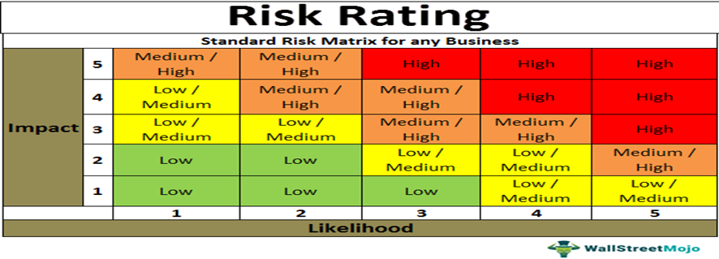
Chapter
Assessing Risks
08
Identifying risks is only the start of the process of risk management because not all risks are the same. Equally important is trying to estimate the probability and impact of the risk materializing. If the probability is very low, is there any point in preparing contingency plans? The answer may be 'yes' - if the impact on the business was large, but risk management is about prioritization. Ideally, the risks with the highest probability of occurrence and the greatest loss to the organization are handled first, and those with the lowest probability of occurrence and the smallest loss are dealt with last.
ENT628
Entrepreneurship

Slide 13
Chapter
Assessing Risks
08
Identifying risks is only the start of the process of risk management because not all risks are the same. Equally important is trying to estimate the probability and impact of the risk materializing. If the probability is very low, is there any point in preparing contingency plans? The answer may be 'yes' - if the impact on the business was large, but risk management is about prioritization.
Ideally, the risks with the highest probability of occurrence and the greatest loss to the organization are handled first, and those with the lowest probability of occurrence and the smallest loss are dealt with last.
ENT628
Entrepreneurship

Slide 14
Chapter
Mitigating Risks
08
Once an organization has a risk and/or danger index (for projects or for the business as a whole), it can decide what to do about the risks it faces and start to develop key activities - things it needs to do in order to mitigate the risks.
There are four options:
Attempt To Eliminate The Risk | It might withdraw completely from the area of activity that generates the risk - an unlikely course of action initially for an entrepreneurial organization. However, it needs to at least continue to monitor the risk because at some point in the future, it might change this decision. By their nature, entrepreneurial orga­nizations develop risky projects - all the more reason to accept this and attempt to reduce or share the risk.
ENT628
Entrepreneurship

Slide 15
Chapter
Mitigating Risks
08
Leading -This scale gauges the degree of respect and deference shown to authority figures (power distance}. (China, Russia)
Deciding -This scale measures how group decision-making is consensually compared to relying on one person (the boss). (Japanese)
Trusting -This scale balances task-based trust (from the head} with relationship ­based trust (from the heart). In task-based cultures (e.g., the USA, the UK, Germany) trust is built through work. In relationship -based societies (e.g., Brazil, China, India} trust is built by personal networks
Attempt to reduce the risk | It might attempt to reduce the risk of a project by selecting low-risk strategic alternatives within a business model, for example by using different distribution channels. It might also reduce risks by increasing internal controls, staff training or supervision, depending on the nature of the risk. Understanding the nature of the risk and putting in place the effective risk management processes outlined in this chapter will help.
ENT628
Entrepreneurship

Slide 16
Chapter
Mitigating Risks
08
Leading -This scale gauges the degree of respect and deference shown to authority figures (power distance}. (China, Russia)
Deciding -This scale measures how group decision-making is consensually compared to relying on one person (the boss). (Japanese)
Trusting -This scale balances task-based trust (from the head} with relationship ­based trust (from the heart). In task-based cultures (e.g., the USA, the UK, Germany) trust is built through work. In relationship -based societies (e.g., Brazil, China, India} trust is built by personal networks
Transfer and /or sharing the risk | There are many useful techniques that can be used to transfer both internal and external risks such as insurance, foreign exchange, or interest rate hedging. Partnering in all its forms {e.g., subcontracting, outsourcing, franchising, etc.) is an extremely effective way of transferring risk. Partnerships and strategic alli­ances can be used to share the risks of a project as well as leverage the strategic skills of the partnership. This helps a company to avoid over-commitment to any one project.
ENT628
Entrepreneurship

Slide 17
Chapter
Mitigating Risks
08
Leading -This scale gauges the degree of respect and deference shown to authority figures (power distance}. (China, Russia)
Deciding -This scale measures how group decision-making is consensually compared to relying on one person (the boss). (Japanese)
Trusting -This scale balances task-based trust (from the head} with relationship ­based trust (from the heart). In task-based cultures (e.g., the USA, the UK, Germany) trust is built through work. In relationship -based societies (e.g., Brazil, China, India} trust is built by personal networks
Accept the risk | The organization might simply accept all the risks in quadrant A. If it accepts the risk completely, it needs to manage the risk and put in place early warning indicators of it materializing, although this might be uneconomic if the impact on the organization is small. Many industries have inherent risks that need to be accepted if the firm decides to operate in that sector. Even when risk is accepted, entrepreneurs find ways of limiting the downside effects on the rest of the organization should the risk materialize. Entrepreneurs are experts at protecting themselves from downside risk whilst capturing a lot of the upside profit. Partnering is a simple example of this. Another simple strategy is to compartmentalize the commercial risks by setting up each project as a separate legal entity. Should one fail, it will not endanger the whole organization. Serial entrepreneurs do this as a matter of course, partly because they intend to sell off each business at some point in the future. However, riskier off-shoots (divisions, etc.).
ENT628
Entrepreneurship

Slide 18
Chapter
Monitoring Risks
08
All organizations have to accept some residual risk associated with their operations. However, each company will need to monitor those risks with the highest risk index numbers, particularly those that are least controllable. It needs to identify parameters or events that indicate an increased likelihood of the risk materializing - so-called key risk indicators.
And this is where the information gathered by networking with customers, suppliers, and other professionals is of vital importance. This can give it foreknowledge of risks materializing. These need to be monitored on a regular basis so the organization can then take remedial action.
ENT628
Entrepreneurship

Slide 19
Chapter
Monitoring Risks
08
To be effective, key risk indicators must be easy to monitor as part of the firm's regular activity, highlighting when corrective action is needed and providing guidance on what action is needed. Cash flow is an obvious example of a potential key risk indicator. The risk is bankruptcy - any organization needs cash to pay its bills - and cash flow measures its ability to do this.
If the reaction of competitors is a major risk to a business, it needs to develop a risk indicator that will measure this and put in place activities to ensure that it is monitored. For example, supermarkets regularly and routinely monitor the prices competitors charge for a typical basket of products. Without doing this they risk being uncompetitive and losing customers to rivals.
ENT628
Entrepreneurship

Slide 20
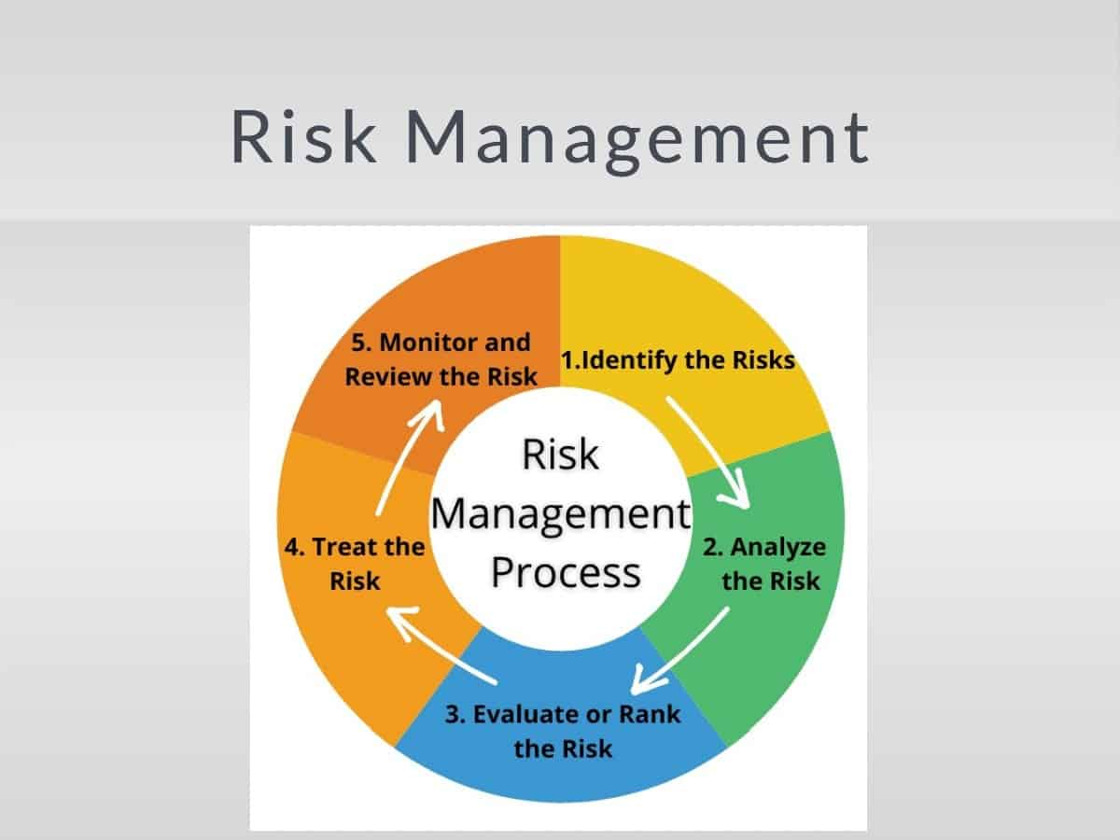
Chapter
Monitoring Risks
08
Accepting the existence of risk may be part of an entrepreneurial architecture, but that does not mean that risk should be ignored. Risks need to be understood, monitored, and managed, and decisions are made based upon a realistic assessment of their likelihood, impact, and controllability.
ENT628
Entrepreneurship

Slide 21
Chapter
Monitoring Risks
08
These processes could be key or even critical activities for an organiza­tion practicing innovation. The primary way that entrepreneurs mitigate the risks they face is through their ability to react quickly to the knowledge and information they obtain through their extensive network of contacts both inside and outside the organization. Open information flows within the organization are therefore essential. They help inform deci­sions and mitigate risks.
ENT628
Entrepreneurship

Slide 22
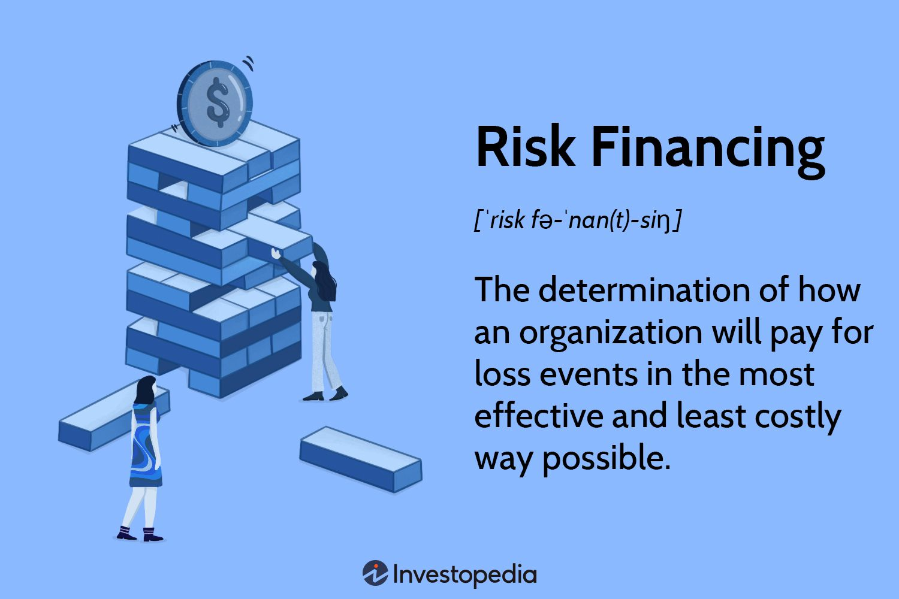
Chapter
Financing Risk
08
An organization faces both commercial risks -arising from the nature of the project and the commercial environment in which it operates - and financing risks - arising from how the activity is financed. Using external funds of any sort brings new risks and constraints. Entrepreneurs tend to keep the use of external funds - both loans and equity - to a mini­mum.
ENT628
Entrepreneurship

Slide 23
Chapter
Financing Risk
08
This may be because of their inability to borrow or unwillingness to give up control They may alter their business model so as to minimize the need for external funding. They keep capital investment and fixed costs as low as possible, sometimes renting or leasing assets, often subcontracting some activities. They might hire temporary, rather than part­ or full-time, staff.
Entrepreneurs prefer to commit costs to a project only after the opportu­nity has proved to be commercially viable - part of the approach called 'affordable loss' mentioned earlier. However, if the opportunity proves to be commercially viable they may then have to find external funds to finance the project.
ENT628
Entrepreneurship

Slide 24
Chapter
Financing Risk
08
The general rule of prudent financing is to match the term duration of the loan with the term duration of the use to which it is put. Hence long-term loans should be used to finance long-term projects or the purchase of fixed assets. However, lenders are usually unwilling to lend for the development of more innovative longer-term projects, where the return is uncertain and does not materialize until some way into the future. For these reasons, they see such projects as too risky.
However, whilst financiers may be unwilling to lend against a specific project, they may be willing to lend to an established business that has a track record of successful trading on the basis that its portfolio of products or services generates sufficient income to cover the interest and loan repayments.
ENT628
Entrepreneurship

Slide 25
Chapter
Financing Risk
08
An organization faces both commercial risks -arising from the nature of the project and the commercial environment in which it operates - and financing risks - arising from how the activity is financed. Using external funds of any sort brings new risks and constraints. Entrepreneurs tend to keep the use of external funds - both loans and equity - to a mini­mum.
This may be because of their inability to borrow or unwillingness to give up control They may alter their business model so as to minimize the need for external funding. They keep capital investment and fixed costs as low as possible, sometimes renting or leasing assets, often subcontracting some activities. They might hire temporary, rather than part­ or full-time, staff.
ENT628
Entrepreneurship

Slide 26
Chapter
Creativity, Innovation And Commercial Opportunity
09
Innovation is the prime tool entrepreneurs use to create opportunity. It is underpinned by creativity, which is the ability to find or create something new -ideas, rules, patterns, meth­odologies, etc.
But if creativity underpins innovation, then entrepreneurship and the ability to perceive opportunities is the context in which it will flourish. For the entrepreneur, creativity is an essential tool that is used to seek out a business opportunity, identify unmet needs in the marketplace and find innovative ways of meeting these needs.
ENT628
Entrepreneurship

Slide 27

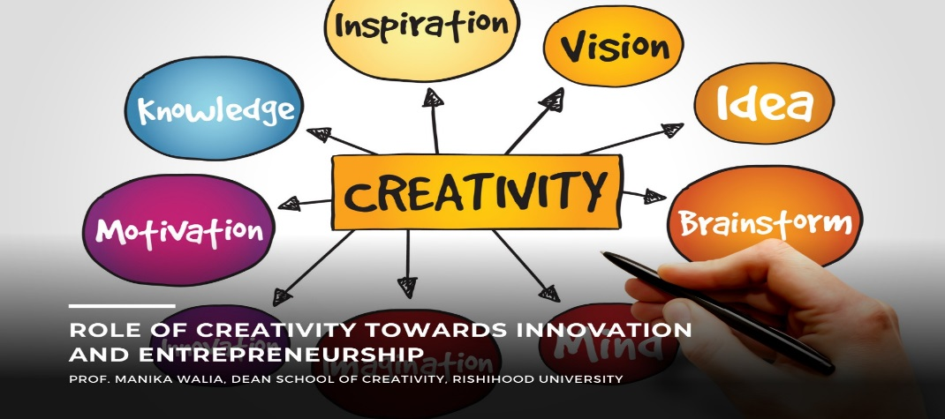
Chapter
Creativity, Innovation And Commercial Opportunity
09
In the words of Bolton and Thompson (2000): 'Creativity is the starting point whether it is associated with invention or opportunity spotting. This creativity is turned to practical reality (a product, for example) through innovation. Entrepreneurship then sets that innovation in the context of an enterprise (the actual business), which is something of recognized value
ENT628
Entrepreneurship

Slide 28
Chapter
MEASURING CREATIVITY
09
The point is that most people are not creative; this is not by nature, but because of their upbringing. Society has certain values and norms of behaviour. It encourages us to con­form, to follow these norms of behaviour. Not doing so brings the threat of sanction or penalty. It values logic, but particularly the dominant logic of the group and it has a tendency to reject non-conformist thinking - and thinkers. This is why creative types are often seen as rebels, disruptors or trouble-makers. They create change - and people and society gen­erally do not like change.
Creativity can be encouraged through an appro­priate culture within an entrepreneurial architecture. It involves overcoming some personal blocks or barriers and can be developed through training and by practicing the discovery skills
ENT628
Entrepreneurship

Slide 29
Chapter
MEASURING CREATIVITY
09
Majaro (1992) believed that, while stereotyping is to be avoided, creative types do exhibit some similar characteristics:
Conceptual fluency -They are able to produce many ideas.
Mental flexibility -They are adept at lateral thinking.
Originality -They produce atypical responses to problems.
Suspension of judgment -They do not analyze too quickly.
Impulsive -They act impulsively to an idea, expressing their 'gut-feeling:
Anti-authority - They are always willing to challenge authority.
Tolerance - They have a high tolerance threshold towards the ideas of others.
ENT628
Entrepreneurship

Slide 30
Chapter
Barriers To Creativity And Innovation
09
People may be inherently creative, but this is not something that all organizations or society generally encourages. Furthermore, most of us stifle it because we find creativity involves questioning the status quo, questioning might lead to change, and change can be threatening.
We all cre­ate rituals and routines that we feel comfortable with and these normally mitigate against questioning the status quo and it is these routines that help us through the day. Being creative often takes people outside their 'comfort zone; since it makes them feel uneasy. Here are some of these barriers to creativity:
ENT628
Entrepreneurship

Slide 31
Chapter
Barriers To Creativity And Innovation
09
The three greatest barriers to creativity are the fear of failure, the experience of failure, and the pain of uncertainty. They argue that simply managing the anxiety and actual pain people feel in connection with the prospect and experience of both failure and uncertainty should result in a measurable increase in innova­tion. Individual managers can sometimes actively block creativity and innovation within their sphere of influence, despite the policies and procedures of the organization designed to encourage it. Kanter {2004) suggested 5 ways that they could do this:
Regard new ideas with suspicion.
Enforce cumbersome approval mechanisms , rules and regulations.
Pit departments and individuals against each other.
Express criticism, without praise.
Treat problem identification as a sign of failure
ENT628
Entrepreneurship

Slide 32

Chapter
Connectivity
09
This diversity underpins much of modern, particularly technology-based, innovation. However, we are often constrained in our thinking not only by our dominant logic but also by our prior knowledge so we need to expand it. We need to actively seek out new knowledge, information, and perspectives in as many ways as possible: through reading, travel, meeting and talking to others, and even web browsing.
One prerequisite to all creative processes is the generation of knowledge and openness to different ideas. This helps create the cognitive diversity that, is needed to provide different perspectives on problems and situ­ations that enable recombining ideas from different walks of life.
ENT628
Entrepreneurship

Slide 33
Chapter
Knowledge Networks
09
Customers
Competitive intelligence
Supplier/vendors
Academic partners
Industry analysts
Employees
Many authors have found that a strategic focus on creating intellectual, social, and rela­tional assets increases innovation
ENT628
Entrepreneurship

Slide 34
Chapter
Crowdsourcing And Open Innovation
09
Technology helps organizations extend their knowledge networks beyond their organizational boundaries. The internet has led to an enormous boost in connectivity. It makes communication and the transfer of knowledge and ideas on a global basis so much easier and quicker. Common design file standards can be sent to web-based on-demand com­mercial manufacturing services at the press of a button. This sort of network is now used extensively for supply chain management. .
ENT628
Entrepreneurship

Slide 35
Chapter
Crowdsourcing And Open Innovation
09
crowdsourcing
It is a way of opening up collabora­tion to people connected on the internet to form a kind of online community.
open innovation
links external individuals and organizations with an organization that wishes to generate new ideas, knowledge or to solve problems associ­ated with an innovation
open source software (OSS) communities. OSS
The best-known example of this is Wikipedia
ENT628
Entrepreneurship

Slide 36
Chapter
Accelerators And Incubators
09
These are sponsored 'boot-camps' or training programmers for start-up teams, which offer training and support from mentors with different skills and investors with different back­ grounds. They are designed to facilitate rapid conceptualization, prototyping, and develop­ment of a business idea within a tight time frame - typically three months.
There are two types of accelerators:
• 'Start-up' or 'seed' accelerators, which are general programs open to all start-ups;
• 'Corporate accelerators; which have objectives set by the sponsoring company .
ENT628
Entrepreneurship

Slide 37
Chapter
Creative Environments
09
The lesson for organizations wishing to build a creative environ­ment is that they must work to develop this sort of physical and cultural environment. This involves bringing together people with different backgrounds and perspectives.
It means allowing them to hold different opinions and disagree with each other - questioning the dominant logic of their community. These communities will then attract similarly minded questioning but tolerant people, developing a virtuous circle of creativity.
people exhibited greater creativity if placed within an environment that matched their cognitive style.
ENT628
Entrepreneurship

Slide 38
Chapter
Knowledge And Learning
09
Knowledge creation is primarily an individual activity and the key role of the organization is to harness it for the production of goods or services. It is therefore logical that the orga­nization's main focus is to stimulate individual creativity and learning and to translate that into products and services that the market values.
However, just because an individual has knowledge it does not necessarily mean that it is embedded within an organization. It is often passed on in the form of information.
Connectivity generates information, but to be really useful that information needs to be turned into knowledge by other individuals and this only happens through the wheel of learning.
ENT628
Entrepreneurship

Slide 39
Chapter
Knowledge And Learning
09
Information comes into the organization from a range of sources. It is conceptualized by other individuals through the wheel of learning in a way that is consistent with the organization's norms, cognitive frameworks, context, and culture.
This is learning, which in turn leads either to
Tacit knowledge (embedded in individuals' minds and activities)
Explicit knowledge (stated in verbal communications or documents).
ENT628
Entrepreneurship

Slide 40
Chapter
Developing Discovery Skills
09
Knowledge, awareness and connectivity are combined into what are called 'discovery skills: These are skills that can be learned by individuals (tacit knowledge)
The skills are:
Networking These innovative entrepreneurs actively sought out new knowledge and information.
Observing Innovative entrepreneurs observe common phenomena and people's behavior - in par­ticular, that of potential customers
3. Questioning entrepreneurs have the curiosity to challenge conventional wisdom, asking 'Why?; 'Why not?' and 'What if?
ENT628
Entrepreneurship

Slide 41
Chapter
Developing Discovery Skills
09
ENT628
Entrepreneurship

Slide 42



Thank You

