Slide 1

Risk Management
Prepared by Dr. Dalia Hosni
Lecture 7
MGM 510
Risk Management

Slide 2

Lecture 7
قيمة للعميل
قيمة للعميل
EVOLUTION OF MANAGEMENT FOCUS
تطور اهتمام الإدارة
1990-2000
Customer Value
1991
- - - - - -
- - - - - -
1991
- - - - - -
- - - - - -
1980s
Quality
1990
- - - - - -
- - - - - -
1990
- - - - - -
- - - - - -
1981
- - - - - -
- - - - - -
1981
- - - - - -
- - - - - -
1980
- - - - - -
- - - - - -
1970s
Strategy
1980
- - - - - -
- - - - - -
1970s
Strategy
الجودة
1971
- - - - - -
- - - - - -
الجودة
1971
- - - - - -
- - - - - -
1960s
Marketing
1970
- - - - - -
- - - - - -
1970
- - - - - -
- - - - - -
1961
- - - - - -
- - - - - -
الاستراتيجية
1950s
Production
1960
- - - - - -
- - - - - -
1951
- - - - - -
- - - - - -
التسويق
1950
- - - - - -
- - - - - -
الإنتاج

Slide 3
Lecture 7
Supply chain management
Introduction
Recently, managing risk has become a crucial challenge for supply chain managers owing to several factors, such as growing global competition, rising cost pressures, increasing customer expectations, and ever-increasing complexity
Due to the increasing complexity and interrelation of modern supply chains, the type and nature of uncertain developments and the impact of an action have become difficult, or even impossible, to predict
Risks and uncertainties frequently interrupt the operational efficiency of the supply chain and hence adversely impact a firm’s profits

Slide 4
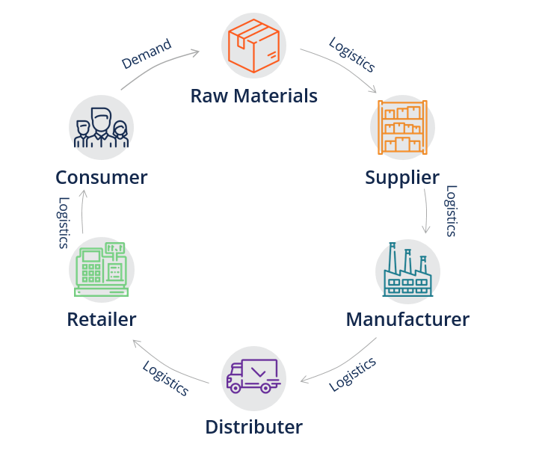
Lecture 7
Supply chain management
First appearing in 1982 :and used to describe connecting logistics with other functions.
The term was also used by Houlihan (1985, 1988) to describe the connections between logistics and internal functions and external
organizations
A supply chain consists of all activities associated with the flow and transformation of goods from raw materials to end users

Slide 5
Lecture 7
Supply chain management
What is a Supply Chain?
A supply chain is an entire system of producing and delivering a product or service, from the very beginning stage of sourcing the raw materials to the final delivery of the product or service to end-users.
The supply chain lays out all aspects of the production process, including the activities involved at each stage, information that is being communicated, natural resources that are transformed into useful materials, human resources, and other components that go into the finished product or service.

Slide 6




Lecture 7
Supply chain management
- A supply chain consists of
Supplier
Manufacturer
Distributor
Retailer
Customer
Upstream
Downstream
- aims to Match Supply and Demand, profitably for products and services
SUPPLY SIDE
DEMAND SIDE
- achieves
+
+
+
+
+
=
The right
Product
The right
Price
The right
Store
The right
Quantity
The right
Customer
The right
Time
Higher
Profits

Slide 7
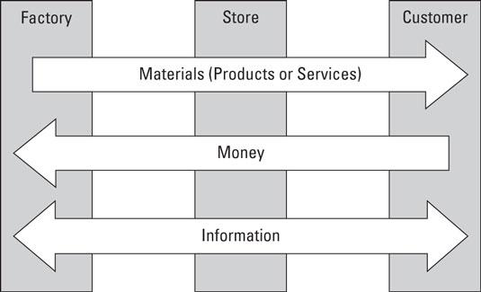
Lecture 7
Supply chain management

Slide 8
Lecture 7
Risk in the supply chain
Supply chain management is responsible for the movement of materials all the way from initial suppliers through to final customers. Supply chain risk appears as any event that might affect this movement and disrupt the planned flow of materials.
There are risks in the supply chain when unexpected events might disrupt the flow of materials on their journey from initial suppliers through to final customers.

Slide 9
Lecture 7
Risk in the supply chain
There are risks in the supply chain when unexpected events might disrupt the flow of materials on their journey from initial suppliers through to final customers.
These risks might prevent deliveries, cause delays, damage goods or somehow affect smooth operations. But these initial effects are only a beginning, and the consequences are generally much broader. A late delivery of raw materials might halt production; it might raise costs by forcing a move to alternative transport, materials or operations; it might raise stocks of work in progress; it might make partners reconsider their trading relationships. An interruption to the supply chain can have widespread effects,

Slide 10
Lecture 7
Supply Chain Risk Management (SCRM)
SCRM can be described as the intersection of supply chain management and risk management
A supply chain consists of all activities associated with the flow and transformation of goods from raw materials to end users.
a supply chain is a network of facilities and distribution options that performs the function of procurement of materials, transformation of these materials into intermediate and finished products, and the distribution of these finished products to customers.

Slide 11
Lecture 7
Supply Chain Risk Management (SCRM)
Supply chain risk management (SCRM) is the process of taking strategic steps
To identify
To assess
To mitigate
_ the risk in the end-to-end supply chain

Slide 12
Lecture 7
Risk Management
Ritchie and Brindley (2007) pointed out three dimensions of risk as follows:
Likelihood/probability of the occurrence of particular events/outcomes;
Consequences/severity of the occurrence of particular events;
Causal pathways leading to these events (detection).
      Risk = Likelihood X Severity X Detection

Slide 13
Lecture 7
What is risk management?
Risk Management in project is the identification, analysis and treatment of potential impacts to the project based on an assessment of likelihood and consequence

Slide 14
Lecture 7
Why is project risk management important?
?
        Risk management is inseparable from the cost, schedule and quality of the project. Consequently, it has to be a key component of the project management process.

Slide 15
Lecture 7
Definition of Supply Chain Risk Management
SCRM has been defined in a number of ways
    SCRM as the management of supply chain risk through coordination or collaboration among supply chain partners so as to ensure profitability and continuity.
    SCRM “The implementation of strategies to manage both everyday and exceptional risks along the supply chain based on continuous risk assessment with the objective of reducing vulnerability and ensuring continuity”.
Supply chain risk management refers to the process by which businesses take strategic steps to identify, assess, and mitigate risks within their end-to-end supply chain. There are both internal and external risks that can disrupt your supply chain, so it’s helpful to understand the difference between the two.

Slide 16
Lecture 7
External Supply Chain Risks
As the name implies, these global supply chain risks come from outside of your organization. Unfortunately, that means that they are harder to predict and typically require more resources to overcome. Some of the top external supply chain risks include:
      Demand Risks: Demand risks occur when you miscalculate product demand and are often the product of a lack of insight into year-over-year purchasing trends or unpredictable demand.
      Supply Risks: Supply risks occur when the raw materials your business relies on aren’t delivered on time or at all, thereby causing disruption to the flow of product, material, and/or parts.
      Environmental Risks: Environmental risk in the supply chain is the direct result of social-economic, political, governmental, or environmental issues that affect the timing of any aspect of the supply chain.
      Business Risks: Business risks occur whenever unexpected changes take place with one of the entities you depend on to keep your supply chain running smoothly — for example, the purchase or sale of a supplier company.

Slide 17
Lecture 7
Internal Supply Chain Risks
Manufacturing Risks: Manufacturing risks refer to the possibility that a key component or step of your workflow could be disrupted, causing operations to go off schedule.
Business Risks: Business risks are a product of disruptions to standard personnel, management, reporting, and other essential business processes.
Planning and Control Risks: Planning and control risks are caused by inaccurate forecasting and assessments and poorly planned production and management.
Mitigation and Contingency Risks: Mitigation and contingency risks can occur if your business doesn’t have a contingency plan for supply chain disruptions.

Slide 18
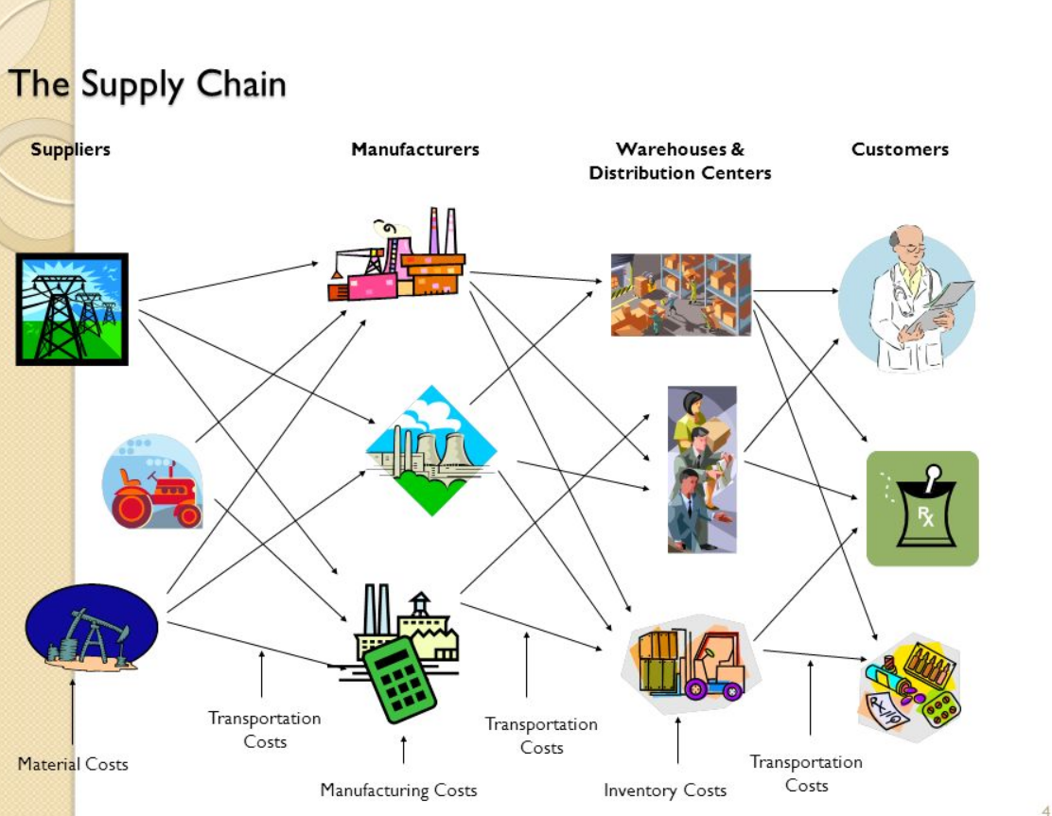
Lecture 7
Supply Chain Management

Slide 19
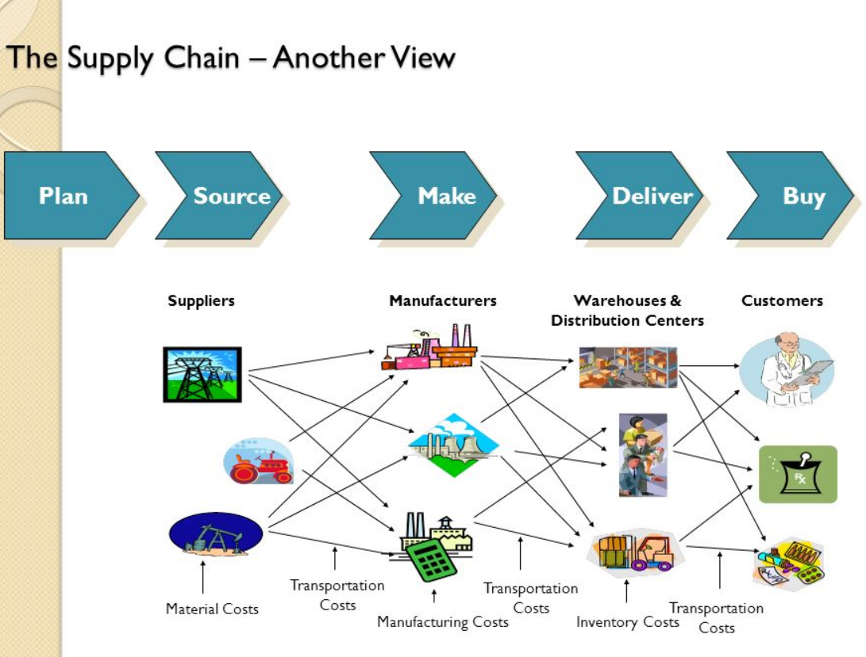
Lecture 7
Supply Chain Management

Slide 20
Lecture 7
Supply Chain for Service Providers
More difficult than manufacturing
Focuses on human resources and support services
More compact and less extended
Does not focus on the flow of physical goods

Slide 21
Lecture 7
Supply chain management
- A supply chain consists of
Supplier
Manufacturer
Distributor
Retailer
Customer
Upstream
Downstream
- aims to Match Supply and Demand, profitably for products and services
SUPPLY SIDE
DEMAND SIDE
- achieves
+
+
+
+
+
=
The right
Product
The right
Price
The right
Store
The right
Quantity
The right
Customer
The right
Time
Higher
Profits

Slide 22
Lecture 7
Supply chain management

Slide 23
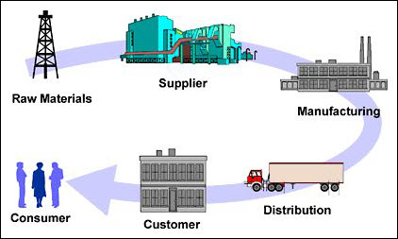
Lecture 7
Supply chain flow diagram

Slide 24
Lecture 7
Supply chain flow diagram
Supply chain management is control of supply chain as process from supplier to manufacture to wholesaler to retailer to consumer.
Supply chain management flow can be divided into three main flow
                The product flow
                The information flow
                The finance flow

Slide 25
Lecture 7
Supply chain management flow
Information flow
Reverse product flow
supplier
producer
customer
Primary product flow
Primary product flow
Primary cash flow

Slide 26
Lecture 7
Knowledge management in SC
Knowledge management is the process of capturing, developing, sharing and effectively using organizational knowledge
Knowledge management system refer to any kind of IT system that stores and retrieves knowledge, improves collaboration locates knowledge source

Slide 27
Lecture 7
Supply chain knowledge management
The KM adoption in supply chain makes the environment collaborative that enables the chain to be more adaptive and response.
This helps to organization to achieves an improvement strategic competitive position in the market.
More cost effective, efficient and competitively response and adaptive supply chain.

Slide 28
Lecture 7
Benefits of supply chain knowledge management
Improve project management
Customer participation
Reduced process cycle time
Supply chain

Slide 29
Lecture 7
Key Issue in supply chain management
Bullwhips effect- In supply chain increasing demand and supply variation from retailer, customer to manufacturing. Away from customer the always fluctuated demand like increase and suddenly decrease in supply chain such case is effected on production management and supply chain management, price of product. The effect is known as Bullwhip effect
  Cost/pricing issues
  Managing inventory and supplier
  Primary manufacturing process PUSH
  Maintaining safety and quality

Slide 30
Lecture 7
Key challenges in supply chain management
Customer service - Supply chain management is all about providing the right product in the right quantity to the right place and the right time. Seems simple, but can get complicated...quickly.
Cost control - Operating costs are under extreme pressure by rising energy/fuel and freight costs, greater number of global customers, technology, increasing labor rates and new regulations and rising commodity prices.

Slide 31
Lecture 7
Key challenges in supply chain management
Planning & risk management - In order to stay as efficient and effective as possible, periodic assessments and redesigns are needed. These adjustments are in response to changes in the market - changes such as new product launches, global sourcing, credit availability and the need to protect intellectual property. These risks must be identified and quantified in order to control and mitigate.
Supplier/partner relationship management - It is important to create, understand and follow mutually agreed upon standards to better understand current performance and opportunities for improvement. Having two different methods for measuring and communicating performance and results wastes time and effort. Trust the system that was put in place for consistent results and better supplier/partner relationships.

Slide 32
Lecture 7
Supply Chain Management (SCM)
Managing flow of information through supply chain in order to attain the level of synchronization that will make it more responsive to customer needs while lowering costs
Keys to effective SCM
Information
Communication
Cooperation
trust

Slide 33
Lecture 7
What Is Supply Chain Management (SCM)?
A set of approaches used to efficiently integrate
Suppliers
Manufacturers
Warehouses
Distribution centers

Slide 34
Lecture 7
What Is Supply Chain Management (SCM)?
So that the product is produced and distributed
In the right quantities
To the right locations
And at the right time
System-wide costs are minimized and
Service level requirements are satisfied

Slide 35
Lecture 7
WHAT IS SUPPLY CHAIN MANAGEMENT
Is the strategic management of activities involved in the acquisition and conversion of materials to finished products delivered to the customer"
Supplier Management
Customer Management
Material Flow
Information Flow
Schedule /Resources
Conversion
Stock Deployment
Delivery
Leads to Business Process Integration

Slide 36
Lecture 7
SUPPLY CHAIN MANAGEMENT
Supply chain is the system by which organizations source, make and deliver their products or services according to market demand.
Supply chain management operations and decisions are ultimately triggered by demand signals at the ultimate consumer level.
Supply chain as defined by experienced practitioners extends from suppliers’ suppliers to customers’ customers.

Slide 37
Lecture 7
Why is SCM Difficult
Uncertainty is inherent to every supply chain
Travel times
Breakdowns of machines and vehicles
Weather, natural catastrophe, war
Local politics, labor conditions, border issues
The complexity of the problem to globally optimize a supply chain is significant
Minimize internal costs
Minimize uncertainty
Deal with remaining uncertainty

