Slide 1

RHSA (Admin 1) Red Hat Enterprise Linux 8 Essentials
Prepared by Eng. Taghreed Elsayed
Lecture 3
Getting help in Red Hat Enterprise Linux

Slide 2

Chapter
03
Getting help in Red Hat Enterprise Linux

Slide 3
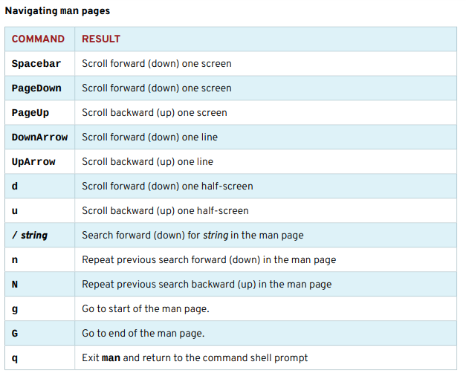
Chapter
03
Getting help in Red Hat Enterprise Linux
NAVIGATE AND SEARCH man PAGES The ability to efficiently search for topics and navigate man pages is a critical administration skill. The following table lists basic man navigation commands:

Slide 4
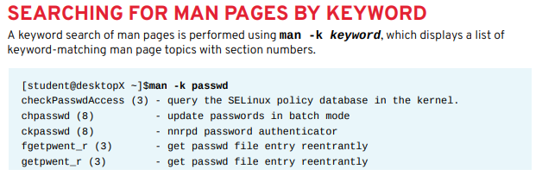
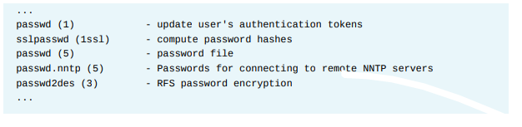
Chapter
03
Getting help in Red Hat Enterprise Linux

Slide 5
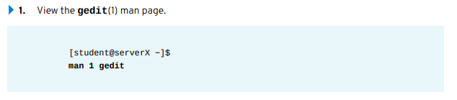
Chapter
03
Getting help in Red Hat Enterprise Linux
IMPORTANT The man command -K option performs a full-text page search, not just titles and descriptions like the -k. A full-text search can use greater systems resources and take more time.
Finding relevant information by using man options and arguments . Perform the following steps on server X unless directed otherwise:

Slide 6
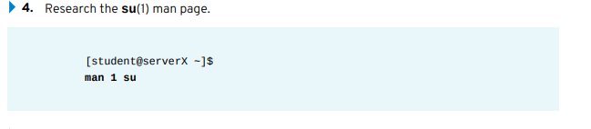
Chapter
03
Getting help in Red Hat Enterprise Linux
2. Research how to edit a specific file using gedit from the command line.
gedit filename
3. Research the gedit option used to begin an editing session with the cursor at the end of the file.
gedit + filename

Slide 7


Chapter
03
Getting help in Red Hat Enterprise Linux
5. Research what su does when the username argument is omitted.
su assumes a username of root.
6. Research how su behaves when a single dash option is used.
su starts a child login shell (creating login environment by sourcing login scripts). Without the single dash, a non-login child shell is created, matching the user's current environment.
7. Consult the passwd(1) man page. Determine the options that will lock and unlock a user account when this command is used by root.

Slide 8
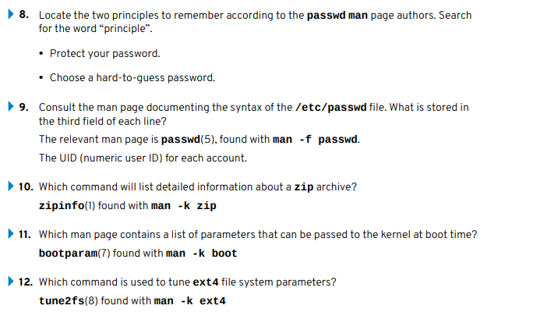
Chapter
03
Getting help in Red Hat Enterprise Linux

Slide 9
Chapter
03
READING DOCUMENTATION USING PINFO
Some commands and utilities have both man pages and info documentation; usually, the info documentation will be more in-depth. Compare the differences in tar documentation using man and pinfo:
The pinfo info reader is more advanced than the original info command. Designed to match the lynx text web browser keystrokes, it also adds color. Info nodes for a particular topic are browsed with pinfo topic. Enter only pinfo for the info topics directory. New documentation nodes become available in pinfo when their corresponding software packages are installed.

Slide 10
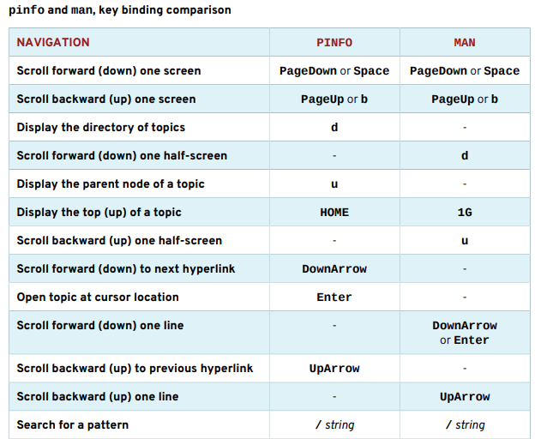
Chapter
03
READING DOCUMENTATION USING PINFO

Slide 11
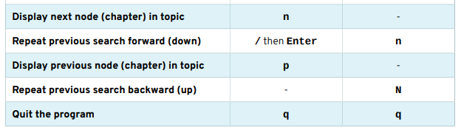
Chapter
03
READING DOCUMENTATION USING PINFO

Slide 12
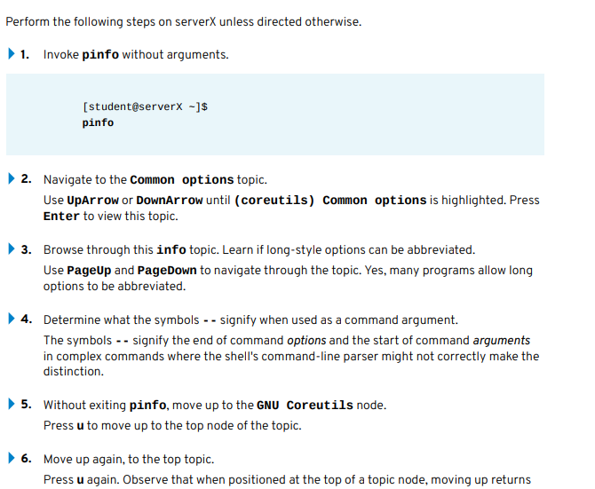
Chapter
03
USING THE PINFO COMMAND

Slide 13
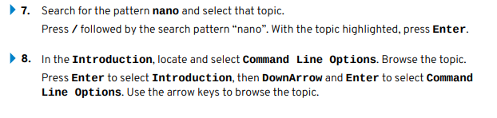
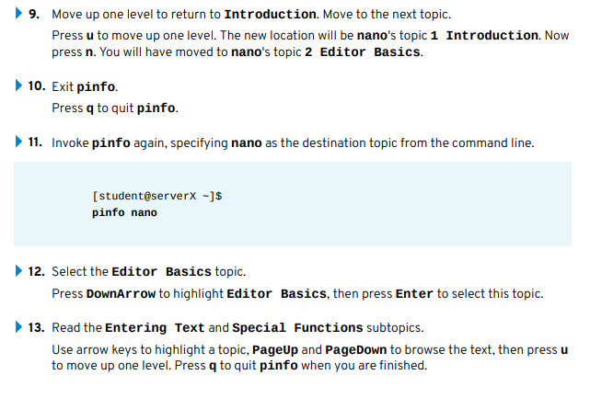
Chapter
03
Getting help in Red Hat Enterprise Linux

Slide 14
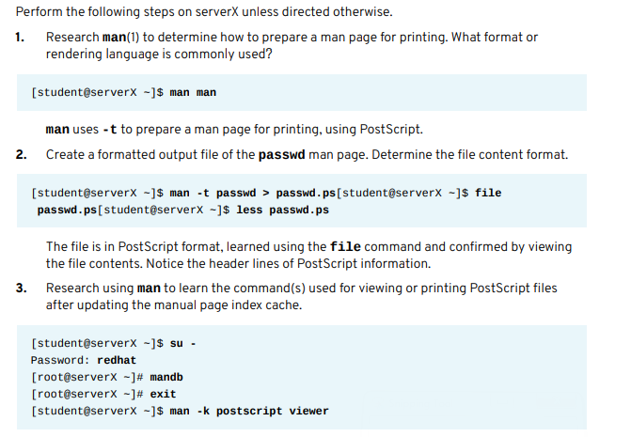
Chapter
03
VIEWING AND PRINTING HELP DOCUMENTATION

Slide 15
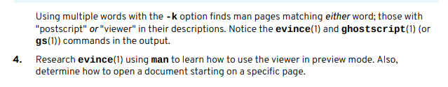
Chapter
03
VIEWING AND PRINTING HELP DOCUMENTATION

Slide 16
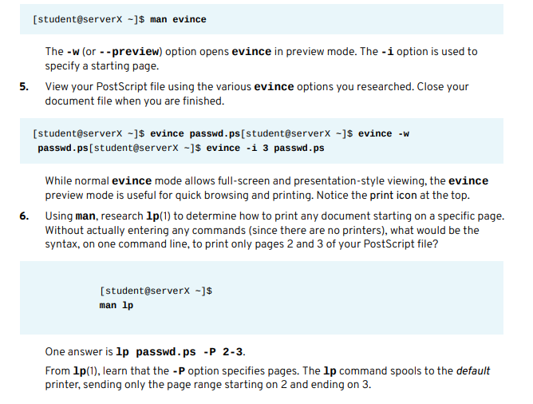
Chapter
03
VIEWING AND PRINTING HELP DOCUMENTATION

Slide 17
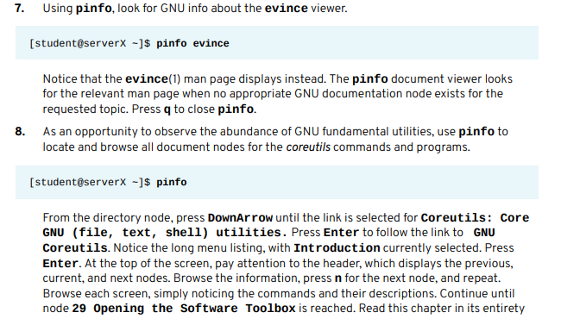
Chapter
03
VIEWING AND PRINTING HELP DOCUMENTATION

Slide 18
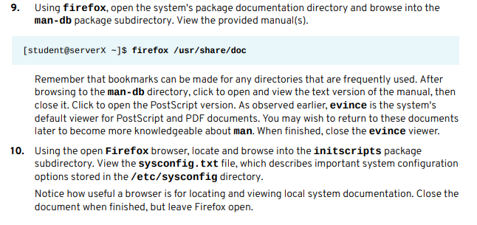
Chapter
03
Getting help in Red Hat Enterprise Linux

Slide 19
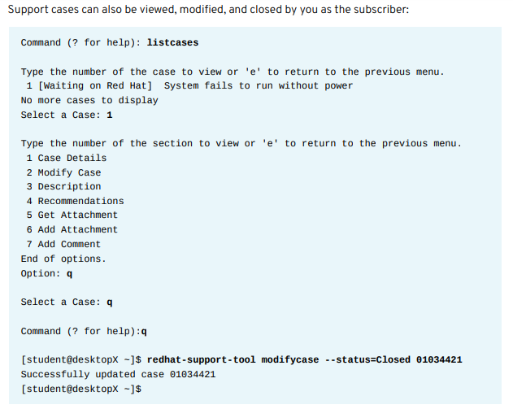
Chapter
03
Getting help in Red Hat Enterprise Linux

Slide 20
Chapter
03
Getting help in Red Hat Enterprise Linux
The Red Hat Support Tool has advanced application diagnostic and analytic capabilities. Using kernel crash dump core files, redhat-support-tool can create and extract a backtrace, a report of the active stack frames at the point of a crash dump, to provide onsite diagnostics and open a support case.
The tool also provides log file analysis. Using the tool's analyze command, log files of many types, including operating system, JBoss, Python, Tomcat, oVirt, and others, can be parsed to recognize problem symptoms, which can then be viewed and diagnosed individually. Providing preprocessed analysis, as opposed to raw data such as crash dump or log files, allows support cases to be opened and made available to engineers more quickly.

