Slide 1


DIGITAL MARKETING
APPLICATIONS
Prepared by Dr. HEBA AWAWDEH
COURSE CODE - MKT720
INTRO

Slide 2
DIGITAL MARKETING
APPLICATIONS
Course outline
Course description
Learning outcomes
Chapters
Parts of course
References
Assessment
COURSE CODE - MKT720
INTRO

Slide 3

Course Description
This course aims to introduce students to the basic concepts, role and importance OF applications that support digital marketing Implementation, this course also aims to Recognize Current and emerging technologies that support social media marketing applications
intro

Slide 4




THE 2 KEY QUESTIONS TO THIS COURSE IS NOT WHETHER TO DEPLOY & USE INTERNET TECHNOLOGY – COMPANIES HAVE NO CHOICE IF THEY WANT TO STAY COMPETITIVE – BUT HOW TO DEPLOY & USE IT ?
WHAT ARE THE MARKETING COMMUNICATIONS TECHNIQUES THAT BUSINESS NEED TO MASTER TO MAKE EFFECTIVE USE OF DIGITAL MARKETING?

Slide 5
Learning Outcomes
intro
At the end of this course, the student will be able to:
Developing digital marketing strategies
UNDERSTAND DIGITAL MARKETING FUNDAMENTALS
DEFINE What are the 8 Types of Digital Marketing?
Learn about the best applications you need in DIGITAL-marketing
Recognize Current and emerging technologies that SUPPORT SOCIAL MEDIA MARKETING APPLICATIONS
Understand the infrastructure of social media
REALISE DIGITAL MARKETING: IMPLEMENTATION AND PRACTICES

Slide 6
TOPICS
The main innovations included in the chapters are as follow
CHAPTER 1 - INTRODUCING DIGITAL MARKETING
CHAPTER 2 - ONLINE MARKETPLACE ANALYSIS MICRO-ENVIRONMENT
CHAPTER 3 - THE DIGITAL MACRO -ENVIRONMENT
CHAPTER 4 - DIGITAL MARKETING STRATEGY DEVELOPMENT
CHAPTER 5 - DIGITAL MEDIA AND THE MARKETING MIX
CHAPTER 6 - RELATIONSHIP MARKETING USING DIGITAL PLATFORMS
CHAPTER 7 - DELIVERING THE DIGITAL CUSTOMER EXPERIENCE
CHAPTER 8 - CAMPAIGN PLANNING FOR DIGITAL MEDIA
CHAPTER 9 - MARKETING COMMUNICATIONS USING DIGITAL MEDIA CHANNELS
CHAPTER 10 -EVALUATION AND IMPROVEMENT OF DIGITAL CHANNEL PERFORMANCE

Slide 7

PART 1 INTRODUCE THE OPPORTUNITIES AND CHALLENGES OF DIGITAL MARKETING AND EXPLAINS THE DIFFERENT TYPE OF DIGITAL MARKETING PLATFORMS AND MEDIA CHANNELS AVAILABLE TO ENGAGE AUDIENCE ONLINE.IT ALSO INTRODUCE A PLANNING FRAMEWORK THAT CAN BE USED TO STRUCTURE DIGITAL MARKETING STRATEGIES AND PROVIDE A FOUNDATION FOR DEVELOPING AN INTEGRATED DIGITAL MARKETING STRATEGY BY REVIEWING HOW THE ONLINE MARKETPLACE OF AN ORGANIZATION CAN BE ASSESSED AS A PART OF SITUATION ANALYSIS
INTRO
PART 1
DIGITAL MARKETING FUNDEMENTAL

Slide 8
IN PART 2 WE EXPLORE DIGITAL MARKETING STRATEGY DEVELOPMENT BY COMBINING TRADITIONAL APPROACHES TO STRATEGIC MARKETING PLANNING WITH DEPLOYING DIGITAL MEDIA ,DATA AND TECHNOLOGY .AND ALSO PRESENT A FRAMEWORK FOR DEVELOPING DIGITAL MARKETING STRATEGIES AND IN THIS PART WE WILL DISCUSS THE OPPORTUNITIES FOR VARYING THE MARKETING MIX ONLINE AND REVIEW STRATEGIES FOR DIGITAL CUSTOMER RELATIONSHIP MANAGEMENT.
INTRO
PART 2
DIGITAL MARKETING STRATEGY DEVELOPMENT

Slide 9
IN PART 3, PRACTICAL SUCCES FACTORS FOR IMPLEMENTING AND MANAGING DIGITAL MARKETING STRATEGY ARE DESCRIBED ,INCLUDING WEBSITE AND APPLICATIONS DEVELOPMENT TO ENSURE A QUALITY CUSTOMER EXPERIENCE
AND MARKETING COMMUNICATIONS TO PROMOTE A SITE AND THE EVALUATION OF COMPANY DIGITAL PRESENCES
INTRO
PART 3
DIGITAL MARKETING IMPLEMENTATION AND PRACTICE

Slide 10
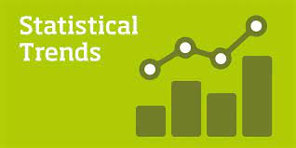
With new technologies emerging and consumer behavior (7ws) changing rapidly,
businesses were eager to stay ahead of the curve
and adopt the latest marketing trends.
Why are digital marketing statistics important?
INTRO

Slide 11
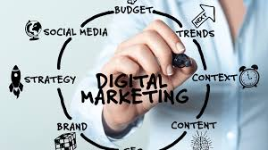
We need to prove the point of our work with digital marketing statistics, but here are a few other reasons why making data-backed decision in marketing is so important:
Statistics help you prioritize your efforts. If you’re implementing a multi- channel marketing strategy, you’ll want to know how certain platforms will perform compared to others. With statistics to back your choices, you’re able to know what channels might require more resources over others.
Digital marketing statistics help you stay competitive. With these data points, you’re able to know what others are doing—which can help you jump ahead of your competitors.
INTRO
Why are digital marketing statistics important?

Slide 12
Stay on top of trends. Data reveals patterns and digital marketing trends that can help you to identify strategies and platforms where it might make sense to be an early adopter.
Data can make room for other strategies. When you’re leveraging digital marketing statistics, you have full confidence in what’s going to work.
INTRO
Why are digital marketing statistics important?

Slide 13
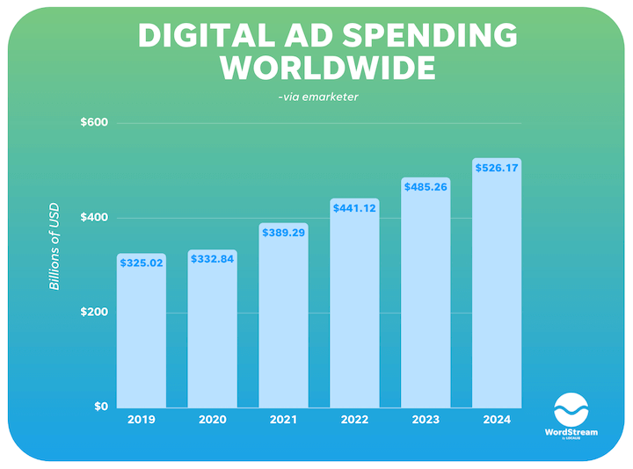
Digital Marketing Industry: Statistics Overview
How big is the online advertising industry?
Digital ad spend worldwide is estimated at $441 billion in 2022 ad projected to reach $485 billion in 2023.
The annual growth rate for digital media is higher than that of offline media.
INTRO

Slide 14
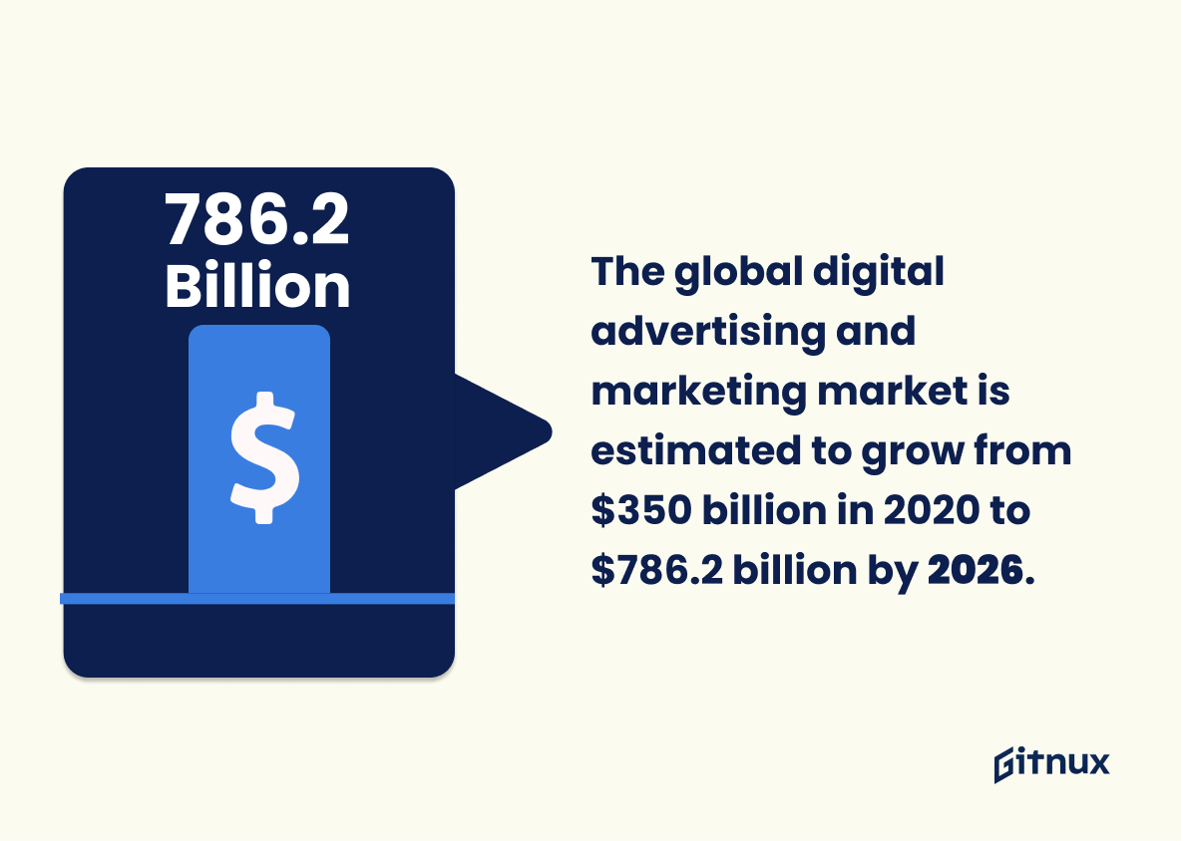
Digital Marketing Industry: Statistics Overview
This statistic shows the shift in ad spending from desktop to mobile phones, which is important for digital marketers to understand in order to optimize their campaigns for the most effective results.
The global digital advertising and marketing market is estimated to grow from $350 billion in 2020 to $786.2 billion by 2026, with a compound annual growth rate of 9%.
INTRO

Slide 15
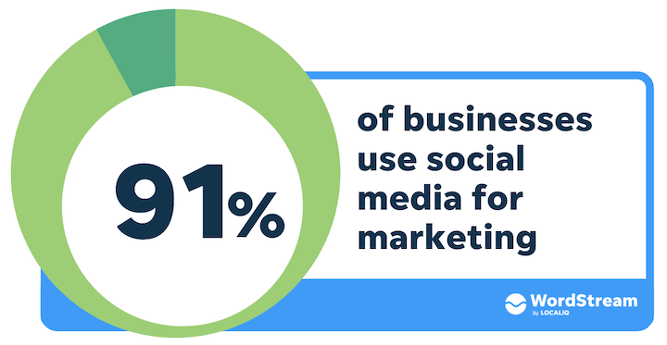
Digital Marketing Industry: Statistics Overview
2023 social media marketing statistics
Social media marketing statistics prove just how fast the space is growing,
How big is the social media market?
The social media market size is estimated to be worth $72.2 billion.
What percentage of marketing is done on social media?
How many businesses use social media for marketing?
INTRO

Slide 16
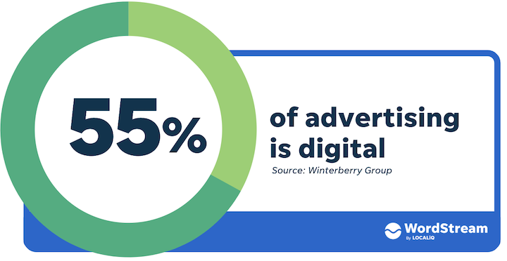
Digital Marketing Industry: Statistics Overview
2023 social media marketing statistics
Is digital marketing in demand in 2023?
INTRO

Slide 17
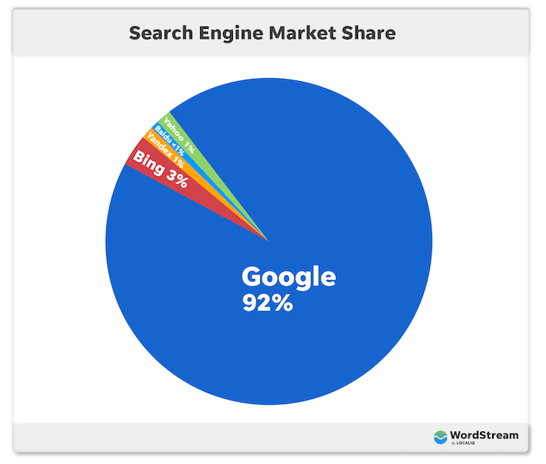
Digital Marketing Industry: Statistics Overview
Is digital marketing in demand in 2023?
Google holds 92% of the total worldwide search engine market share.
INTRO

Slide 18

Digital Marketing Industry: Statistics Overview
In conclusion, the world of digital marketing was evolving at a rapid pace, and businesses were embracing these new trends to stay ahead of the competition and meet the changing needs of consumers.
INTRO

Slide 19
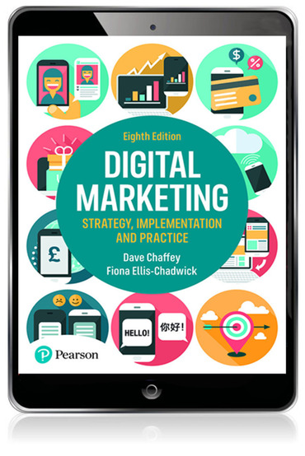

INTRO
REFERENCES
Insert Your Amazing Statement Here
A wonderful serenity has taken possession of my entire soul, like these sweet

Slide 20

Weekly Tests

Slide 21

Weekly Discussion session

Slide 22


Thank You

