Slide 1


Project Planning
Lecture 10
PMG202
Project Closure
Prepared by
Lec. Dina ElWakkad
www.midocean.ae

Slide 2


www.midocean.ae

Slide 3
1) The Project Closure definition
2) Why Is Project Closure Important?
3) The 3 Phases of the Project Closure Process
4) What Are Project Closure Deliverables?
5) Project Closure Best Practices
www.midocean.ae

Slide 4
1) The Project Closure
www.midocean.ae

Slide 5
Project Closure defines a Project’s success.
Project Closure is the critical last phase in the project management lifecycle.
During project closure:
  the team reviews the deliverables,
  then compares and tests its quality to the intended project outcome.
  Then they share the deliverables with the project’s client.
www.midocean.ae

Slide 6
Project Closing is the combination of the following when applied to a Project:
Assurance that all agreed upon project management processes have been executed, and
Reviewing whether or not all organizational governance processes have been executed.
Formal recognition of the completion of a project—everyone agrees that it is completed.
Obtaining approval by the project's sponsor and customer (whether internal or external) for the work completed.
Capturing of lessons learned: What was done well, and should be documented so it can be repeated in the future? What could have been done better? And if so, how can it have been done.
www.midocean.ae

Slide 7
A Project Manager will close a Project for many reasons.
Those include completing a Project on time and finishing it early.
Projects can also get canceled or fail completely.
www.midocean.ae

Slide 8
2) Why Is Project Closure Important?
www.midocean.ae

Slide 9
There are three big benefits to ending a project the right way.
A formal closure is also a clear closure, which means you can properly hand over the project and responsibility to the client.
It lets you disband the project team, so the project doesn’t incur further costs.
It ensures the project met all the original objectives.
It teaches lessons by identifying and addressing any objectives that weren’t achieved.
www.midocean.ae

Slide 10
Failure to conduct thorough Project Close out could potentially:
Put the Organization at a considerable amount of Risk.
Prevent the Organization from realizing the anticipated benefits from the Deliverables of the Project.
Result in significant losses to the Organization.
Undermine the Project Manager and Project Management Team's credibility.
www.midocean.ae

Slide 11
3) The 3 Phases of the Project Closure Process
www.midocean.ae

Slide 12
The 3 phases of Project Closure are Technical, Learning, and People.
During the Technical Phase, clean up loose ends.
For the Learning Phase, evaluate what did and didn’t work, as well as how to improve.
In the People Phase, appreciate Team Members.
www.midocean.ae

Slide 13
The technical phase
The technical phase creates a true sense of finality (and success) among the team and the organization.
A great project lifecycle enables you to do the following:
Tie-Up Loose Ends: Make sure everything is in order (e.g., all vendors and workers are properly paid) and the paperwork is complete.
Show Appreciation for Supporting Departments: Give hearty thanks to everyone who helped with the project.
Hold a Project Outcomes Meeting: Gather upper-level managers and supervisors and thank them for giving the project the green light. Use this time to report on the deliverables and summarize lessons learned, emphasizing the foundation laid for future successes for the organization as a result.
Create a Repository of Digital Project Resources: Make these materials available for future reference.
www.midocean.ae

Slide 14
The Learning Phase
The learning phase of project closure enables you to:
Dedicate Time for Team Reflection: Consider what you’ve done, how you’ve done it, and what you’ve learned now that the project is complete.
Document Lessons Learned: The learning phase brings lessons learned to the forefront and documents them for the benefit of your team today and for future reference when you or a colleague initiates a new project.
www.midocean.ae

Slide 15
The Learning Phase
The learning phase of project closure enables you to:
Respond to Questions about the Current Project: One way to ensure you’ve addressed all issues is to respond to questions about the current project, then make that information accessible to all relevant parties.
www.midocean.ae

Slide 16
People Phase
Take the time to commemorate what you’ve accomplished as a team
www.midocean.ae

Slide 17
4) What Are Project Closure Deliverables?
www.midocean.ae

Slide 18
Project closure deliverables are items identified as the outputs of the project. Deliverables may take many forms, depending on the project at hand, including the following:
Competitor market share analysis, including opportunities for growth
New, streamlined team or resource management processes
Processes for matching and maximizing talent and organizational needs
Software for tracking new leads and existing client contacts
System for analyzing values-driven investments relative to costs
www.midocean.ae

Slide 19
5) Project Closure Best Practices
www.midocean.ae

Slide 20
Focus on Interactivity: Take the time to show how much each person mattered to the project’s success. Whether you’re focused on technical, learning, or people phases of closing a project, involving each team member affirms their roles and ensures the project is meaningful from start to finish.
Be Open: Project closure requires professionalism, but that doesn’t mean rigidity. Make sure the team feels safe sharing and participating in each phase of project closure. Each team member brings their own skills, experience, and perspective to the project, so be sure to set the stage for an open conversation that encourages everyone to contribute in ways they feel comfortable.
www.midocean.ae

Slide 21
Create Space for Best Team Member Performance: If your team works best in the morning, schedule project closure phases on staggered mornings over the course of a week.
Realize Inclusivity Is Essential: If some team members work remotely, be sure they are fully acknowledged, engaged, and contributing as actively as team members who may be in the same physical space. Furthermore, over the course of the project, you’ve probably figured out that each team member’s style is different.
www.midocean.ae

Slide 22
Communicate in a Purposeful and Clearly Defined Manner: Set the stage for project closure and each of its phases through clear communication.
  During your last meeting before project closure begins, inform the team what project closure is, why it’s important, and how you’ll accomplish project closure as a team over each phase.
  Provide a review of project closure goals and your process for accomplishing them in writing.
www.midocean.ae

Slide 23
Assign Closing Tasks to Team Members:
  You’re the project manager, but that doesn’t mean you have to or should be doing all the project closure work.
  Keep the strongly collaborative nature of the project going throughout each phase of project closure:
    Assign roles, ask for volunteers to keep track of project closure outcomes
www.midocean.ae

Slide 24
  Embrace the Opportunity to Acknowledge and Promote Talent: You’ve also built in a morale boost that creates more enthusiasm for future project participation with high-quality outcomes.
www.midocean.ae

Slide 25



Slide 26
1) The Project Closure definition
2) Why Is Project Closure Important?
3) The 3 Phases of the Project Closure Process
4) What Are Project Closure Deliverables?
5) Project Closure Best Practices
www.midocean.ae

Slide 27
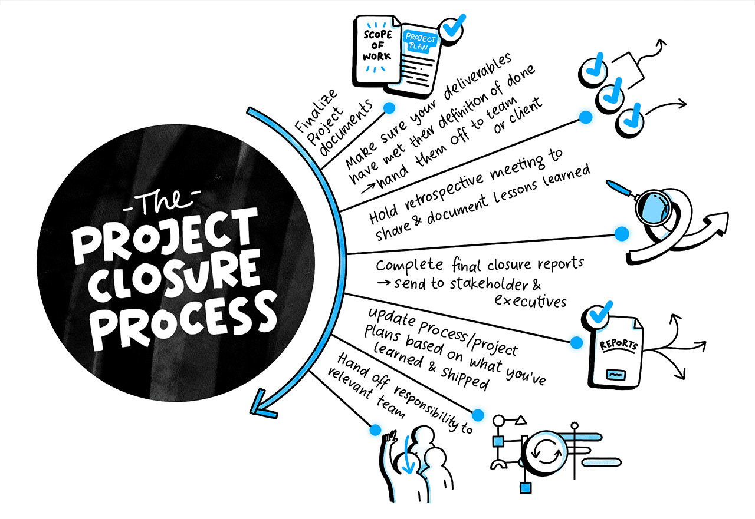

Slide 28
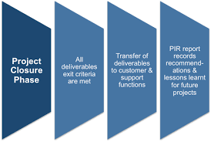

Slide 29
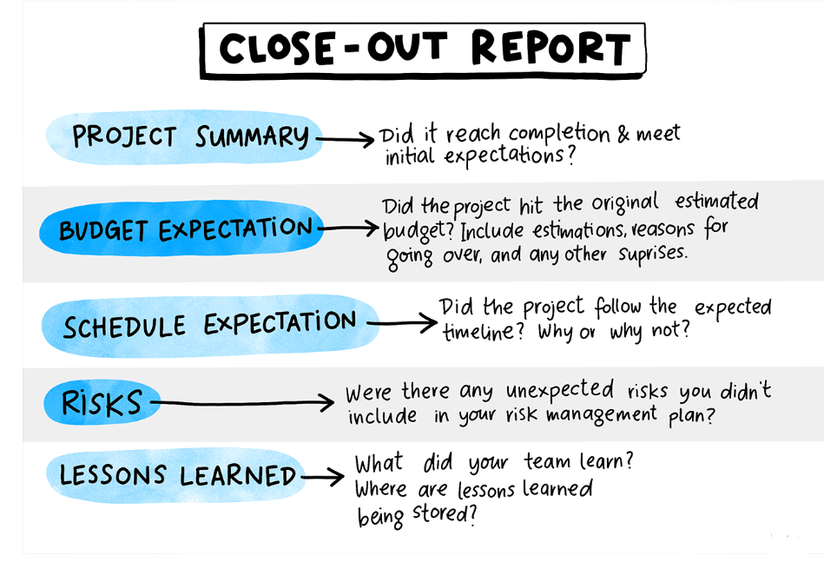

Slide 30

www.midocean.ae

Slide 31
Questions
During this phase, the team reviews the deliverables, then compares and tests their quality to the intended. project outcome: Closure Phase Initiating Phase Execution phase Planning Phase
It defines a team’s and an organization’s culture: Effective project closure Effective project planning Effective project execution Effective project monitoring
www.midocean.ae

Slide 32
Questions
The Phases of the Project Closure Process are: All answers are correct. Technical Phase Learning Phase People Phase
--------- creates a true sense of finality (and success) among the team and the organization Technical Phase Learning Phase People Phase All answers are correct.
www.midocean.ae

Slide 33
Questions
-------------- Consider what you’ve done, how you’ve done it, and what you’ve learned now that the project is complete Learning Phase Technical Phase People Phase All answers are correct
---------- Take the time to commemorate what you’ve accomplished as a team People Phase Learning Phase Technical Phase All answers are correct
www.midocean.ae

Slide 34
Questions
Which of the following part of the technical phase? All answers are correct. Tie-Up Loose Ends Show Appreciation for Supporting Departments Hold a Project Outcomes Meeting
The learning phase includes: All answers are correct. Dedicate Time for Team Reflection Document Lessons Learned Respond to Questions about the Current Project
www.midocean.ae

Slide 35
Questions
A Project Manager will close a Project for---- All answers are correct. Those include completing a Project on time and finishing it early. Projects canceled. Projects fail completely
The Project Closure Deliverables include: All answers are correct. Competitor market share analysis Software for tracking new leads and existing client contacts. System for analyzing values-driven investments relative to costs.
www.midocean.ae

Slide 36
Questions
Which of the following is not Project Closure Best Practices Miscommunication Focus on Interactivity Create Space for Best Team Member Performance Realize Inclusivity Is Essential
During project closure-------- All answers are correct. the team reviews the deliverables, compares and tests its quality to the intended project outcome. they share the deliverables with the project’s client.
www.midocean.ae

Slide 37
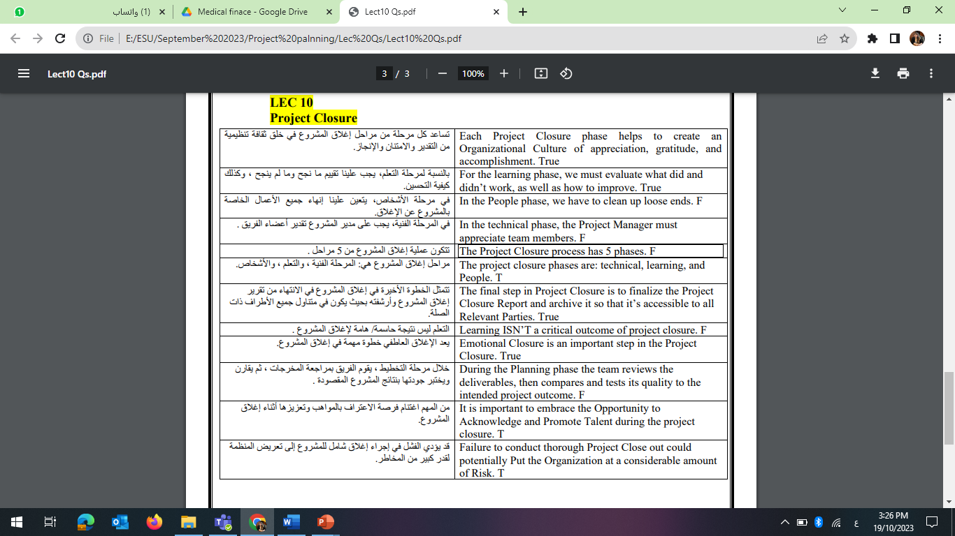
Questions
www.midocean.ae

Slide 38
Questions
www.midocean.ae

Slide 39


Slide 40


Thank You

